Slide 1

Status of SVT FPC Development at LBL
Zhengwei Xue
LBNL

Slide 2
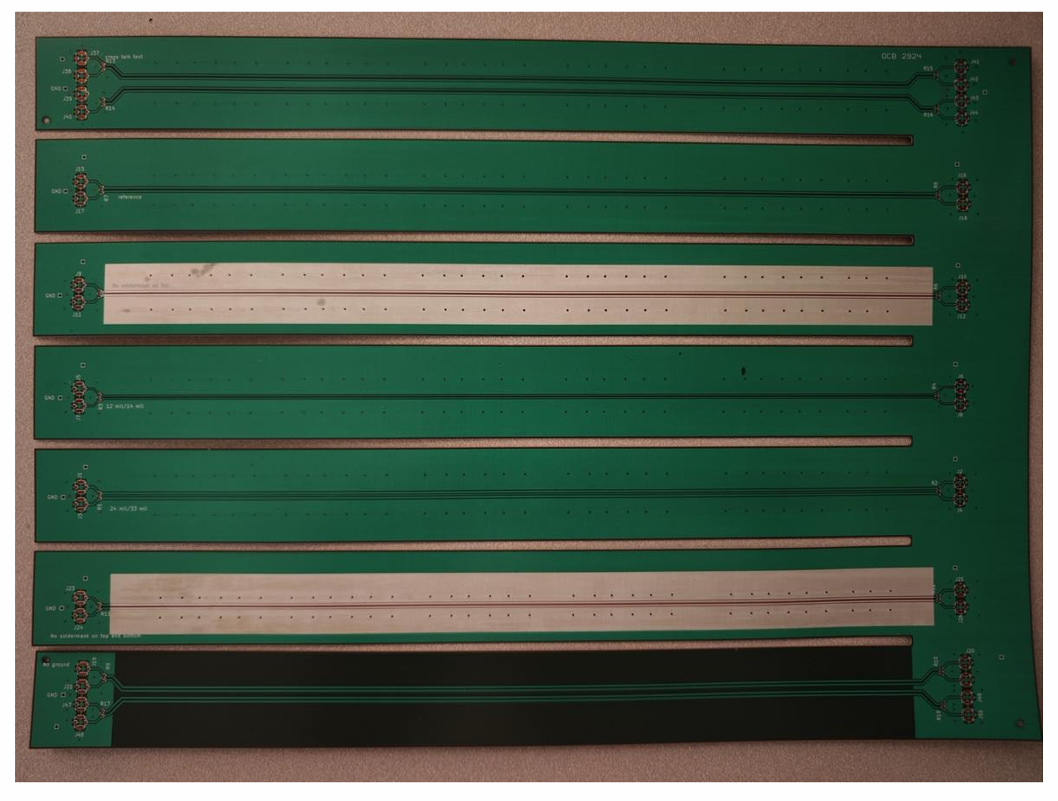
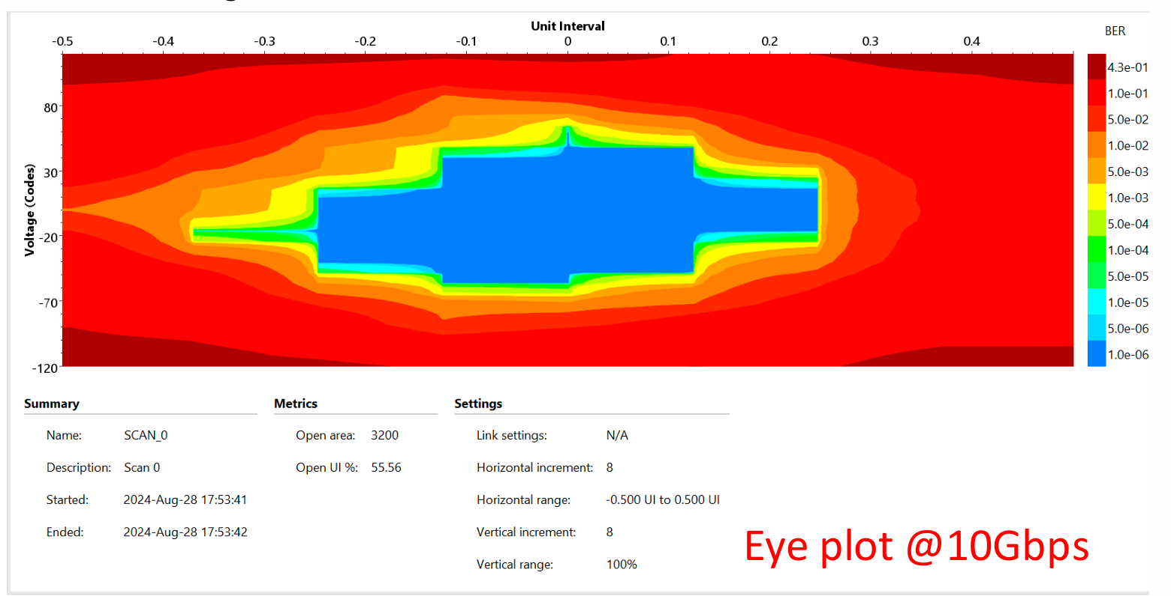
Summary and Outlook from Sep 12, 2024
Received a 2nd set of Al-based FPC prototypes from OMNI:
  Double metal layer with 25 cm long differential lines for high-speed data transmission;
  Soldering and vias facilitated by selective Cu plating;
  IBERT test done with FPGA suggests that these FPC support GTY communication @10Gbps;
  Improved high frequency signal transmission property based on S21 measured up to 4 GHz;
  Total material budget of the FPC is 0.136% X₀ (TBC).
Plan for the 3rd set
  Reduce total material budget;
  Manufacture FPC based on LTU/STFC design but modified to be consistent with vendor’s design rules if there is no objection.

Slide 3
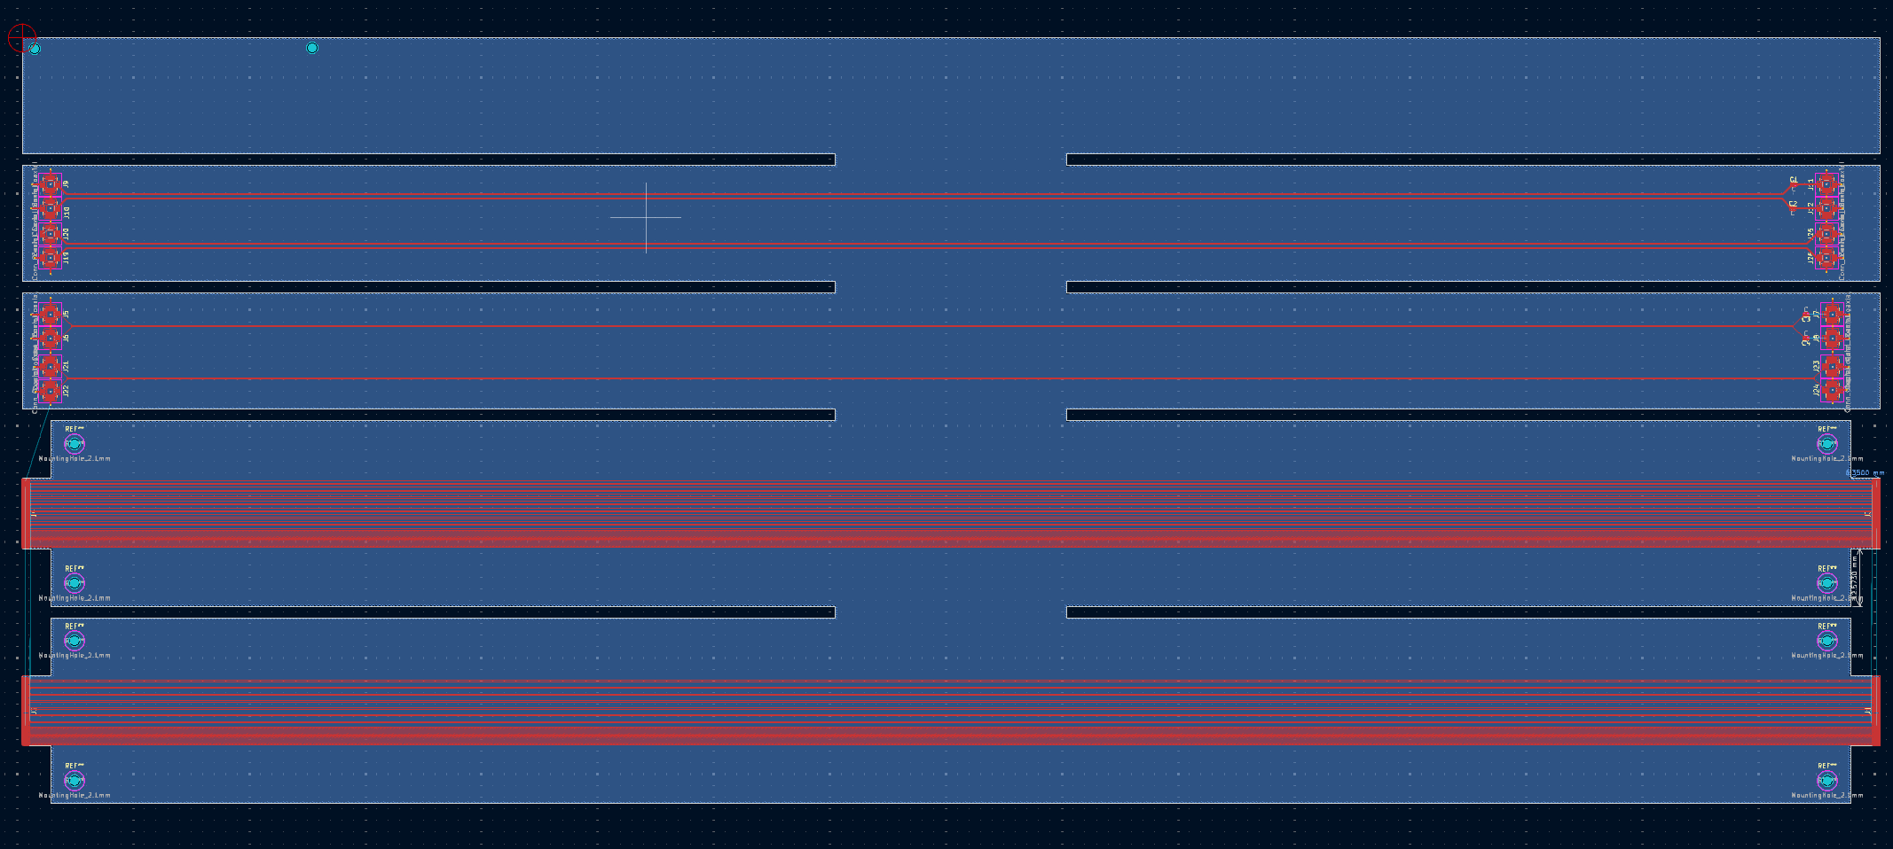
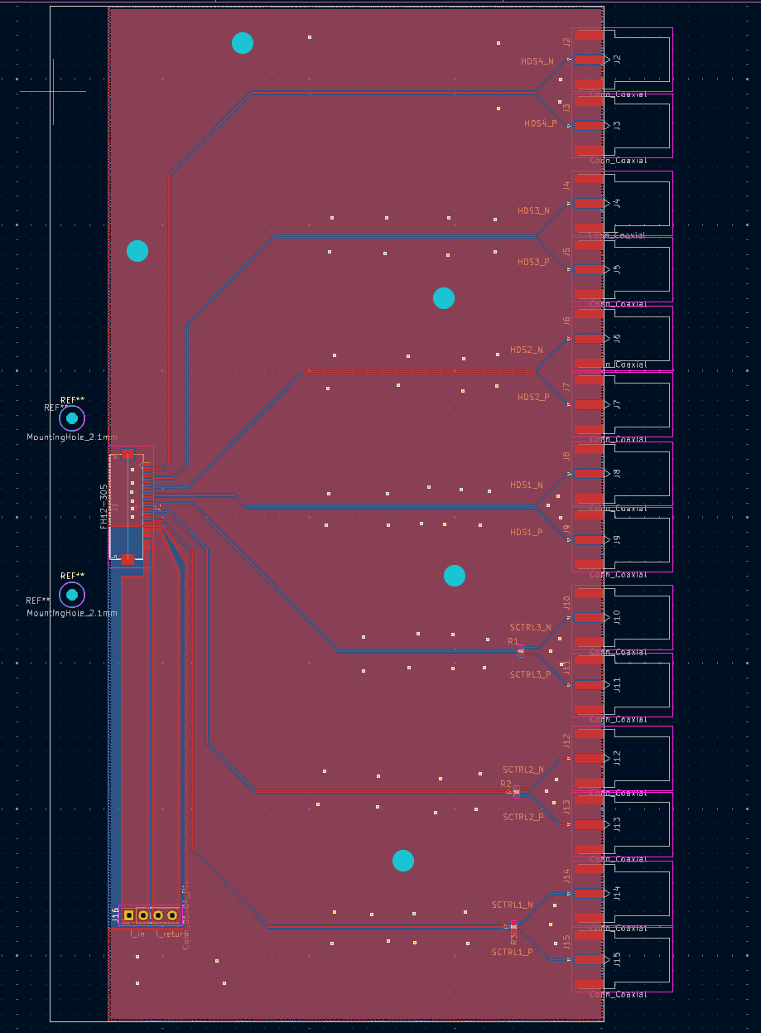
FPC and interface board prototype for 3rd set
The 3rd set of FPC prototype includes:
  Two strips have interface pins that share the same structure as the LTU/STFC design;
  Corresponding interface board;
  Two strips are used to test the effect of AC coupling on the signal;
  One strip for the physical property test;
  Minimum trace width/distance is 6/6 mil.
Plan:
  Manufacture the interface board;
  Skip this FPC prototype, design a more complete FPC with the same interfaces as LTU/STFC board;
FPC
Interface board

Slide 4
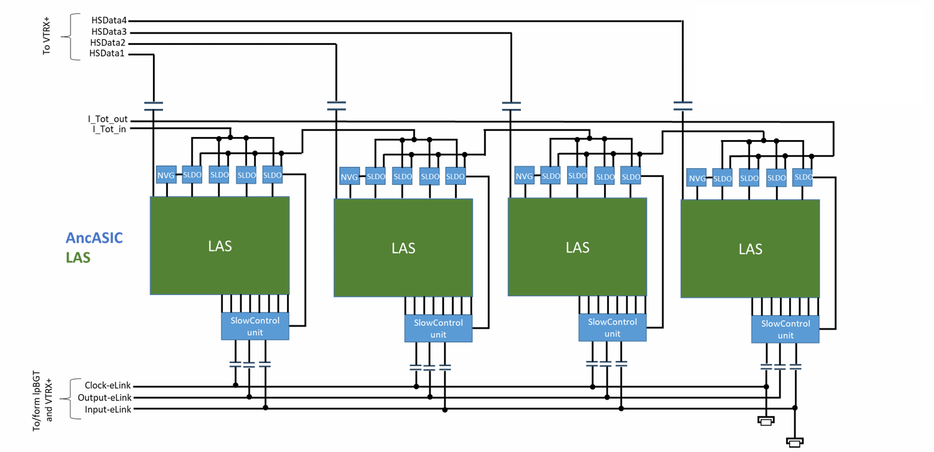
FPC connects for AncASIC
To power supply
FPC
Signal ratings:
High speed data: 5.12Gbps/10Gbps
Clock-eLink: 80Mbps
Output-eLink: 160Mbps
Input-eLink: 80Mbps

Slide 5
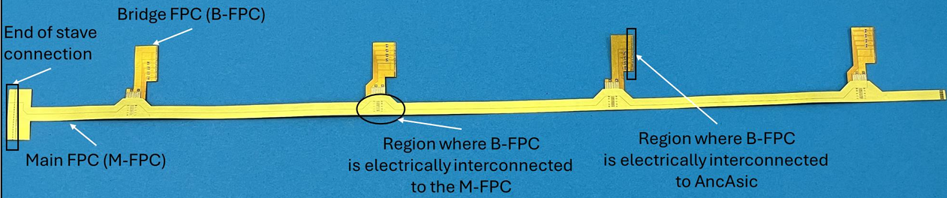
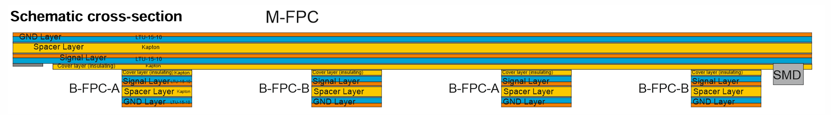
FPC from LTU/STFC
The entire design consists of one main FPC and four bridge FPCs (which include two types: A and B), and the main FPC is bonded to the bridge-FPC by single-point Tape Automated Bonding (spTAB).

Slide 6
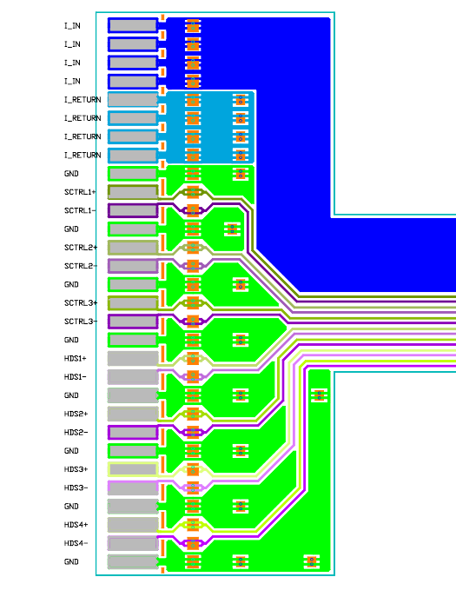
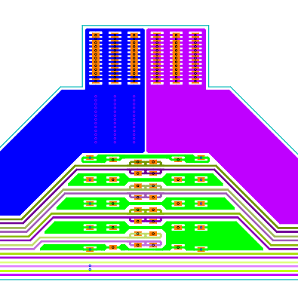
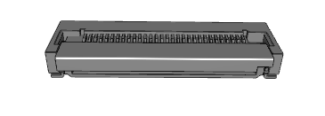
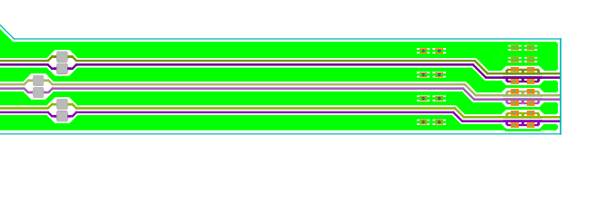
Top layer in main FPC
I_in
I_return
GND
Perforation
I_ return
(DC power)
I_ in
I_ in
I_ in(DC power)
SpTAB-M-FPC-to-B-FPC
SpTAB-Main-Top-to-GND
SpTAB-Main-FPC-to-PCBs
Fpc connector:
FH28D-30S
Differential signal:
Slow control (maximum 160 Mbps) *3
High Speed (maximum 10Gbps) Data*4
Width and space: 70um and 130um, For reference only.

Slide 7
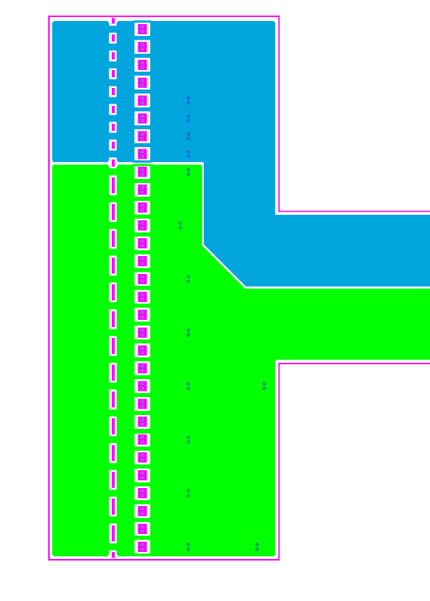
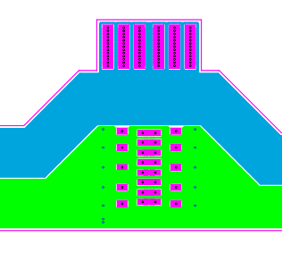
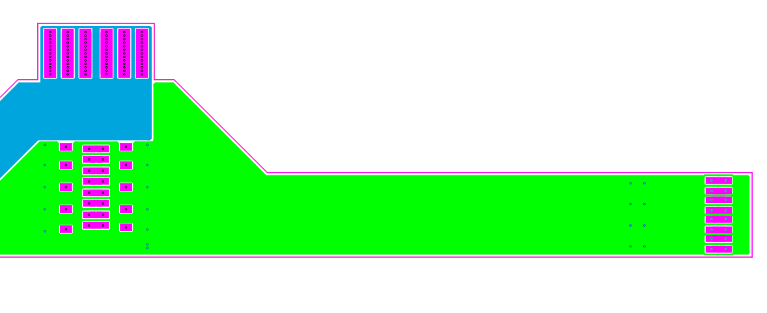
Bottom layer in main FPC
I_RETURN
GND
SpTAB-M-FPC-to-B-FPC
SpTAB-Main-Top-to-GND
SpTAB-Main-FPC-to-PCBs

Slide 8
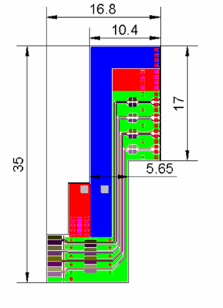
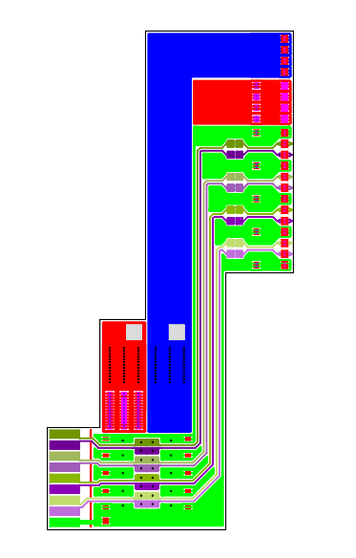
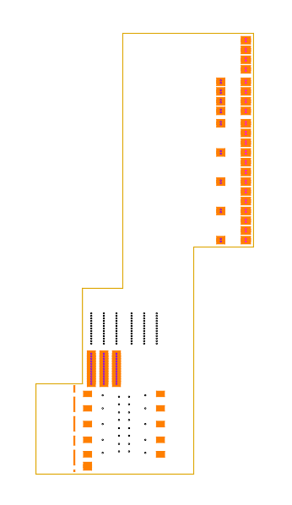
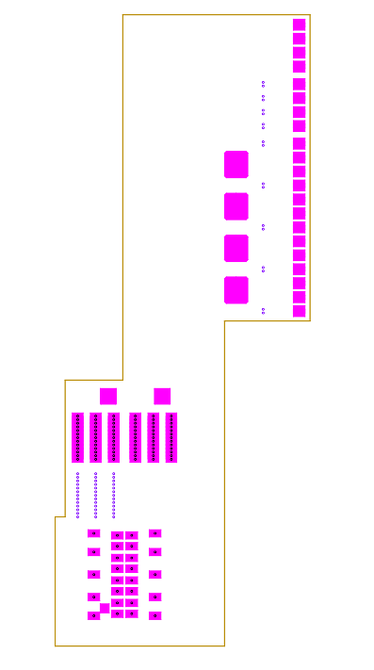
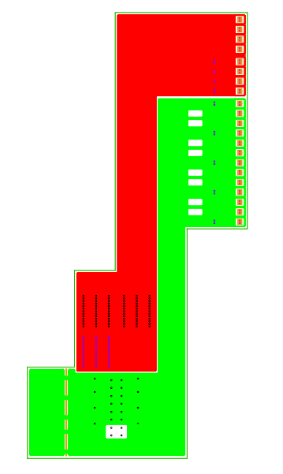
Layers in Bridge FPC TypeA
Unit: mm
Cover layer
Top layer
Spacer layer
Bottom layer
I_in SpTAB-M-FPC-to-B-FPC
I_OUT SpTAB-Bridge-Top-to-GND
GND SpTAB-Bridge-FPC-to-PCBs
Differential Trace width and space:
70um and 130um, For reference only.

Slide 9
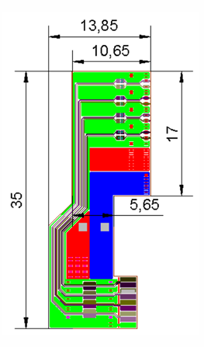
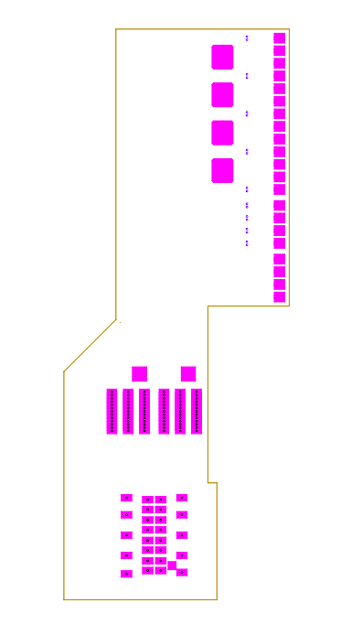
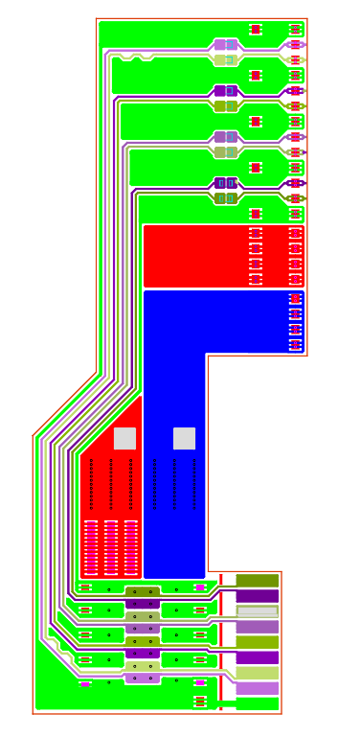
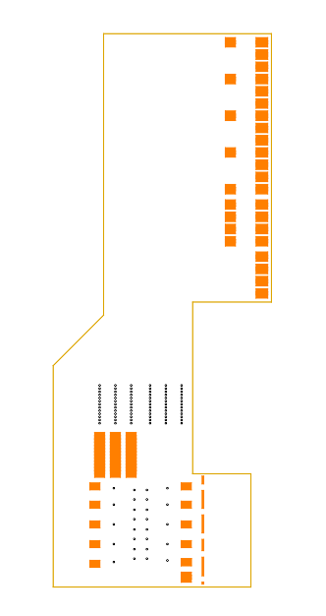
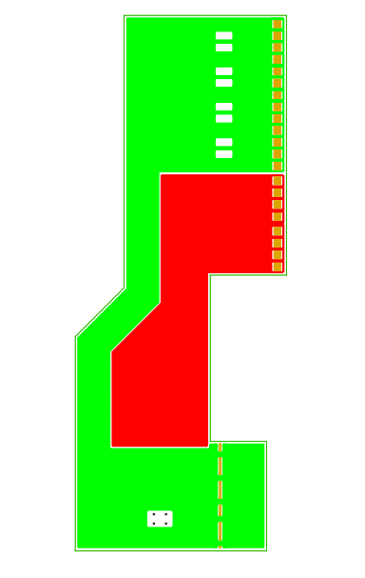
Layers in Bridge FPC TypeB
Unit: mm
Spacer layer
Bottom layer
Cover layer
Top layer
I_in SpTAB-M-FPC-to-B-FPC
I_OUT SpTAB-Bridge-Top-to-GND
GND SpTAB-Bridge-FPC-to-PCBs
Differential Trace width and space:
70um and 130um, For reference only.

Slide 10
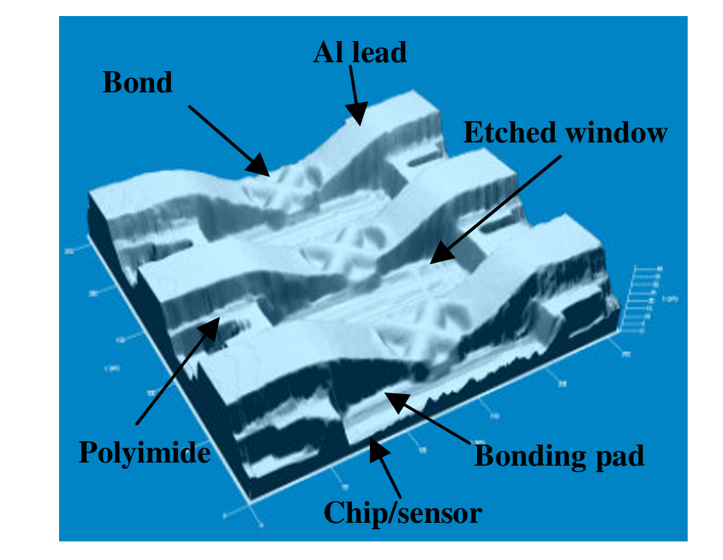
Advantage of LTU/STFC FPC: SpTAB
Main-Bottom-Pi
Main-Bottom-Al
Main-Spacer layer
Main FPC
Main-Bottom-Pi
Main-Top-Pi
Main-Bottom-Al
Main-Top-Al
Main-Spacer layer
Cover layer
Main-Top-Pi
Cover layer
Main-Top-Al
Bridge-Top-Al
Main-Cover layer
Bridge-Top-Pi
Bridge FPC
Intra-board bonding
plated through hole can achieve the same functionality
Bridge-Spacer layer
A 3D image of spTAB interconnections, From ALICE Silicon Strip Detector, Link is Here.
For reference only.
Bridge-Bottom-Al
Bridge-Bottom-Pi
Based on single-point Tape Automated Bonding (spTAB), LTU's FPC can achieve inter-layer connections.
inter-board bonding
Assembly bridge FPC to main FPC

Slide 11
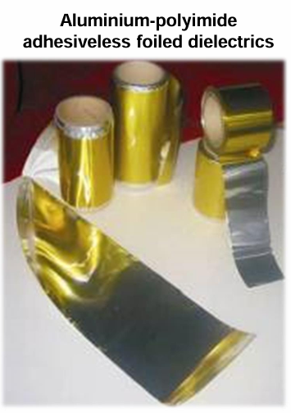
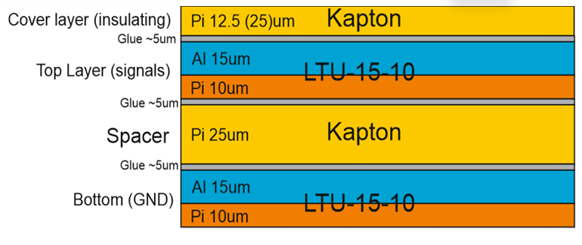

Advantage of LTU/STFC FPC: material budget
Soldermask (29 um)
Aluminum (25.4 um)
Dielectric (175 um)
Aluminum (25.4 um)
Soldermask (29 um)
Cross section of LTU FPC
Cross section of OMNI
 | LTU FPC |  |  |  | OMNI FPC in 2st set
Components | Thickness (um) | Material | X0(cm) | X0(%) | Thickness (um) | Material | X0(cm) | X0(%)
Metal layers | 30 | Aluminum | 8.897 | 0.034 | 51 | Aluminum | 8.897 | 0.057
Dielectric | 20+25+25 | Polyimide | 28.57 | 0.023 | 58+175 | Soldermask Ink + Arlon 528K | 28.57 | 0.081
glue | 15 | TBC | 39.07 | 0.004 | 0 |  | 0
Total |  |  |  | 0.061 |  |  |  | 0.138
Due to the use of Aluminium-polyimide adhesiveless material, LTU can produce FPCs with a very small material budget.

Slide 12
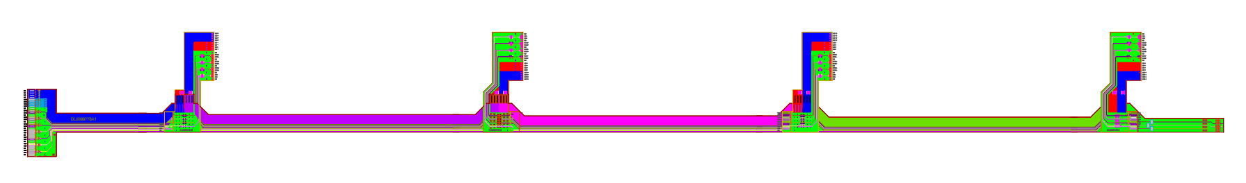

Advantage of LTU/STFC FPC: material budget
Widened area
The width and space for the differential trace in LTU/STFC FPC are 70 um and 130 um. However, the minimum width and space that OMNI can produce are both 6 mil (152 um).
So, OMNI FPC will be larger than LTU/STFC FPC. Roughly calculated, the area will increase by 6~10%. That will also increase the contribution of material budget.

Slide 13
Plan for our 3rd set
Reduce material budget of FPC:
  OMNI is seeking to collaborate with professional flexible PCB manufacturers, with the aim of significantly reducing the thickness of the dielectric layer in their FPC.
Manufacture FPC based on LTU design:
  Combine bridge FPC to main FPC:
  Seeking some technology to assembly one FPC to another (e.g. SpTAB).
  Using a higher integration interface;
  A prototype FPC and interface board share the same structure as the STCF/LTU FPC has been designed, but we may skip this if the costs are too high.
Data transmission tests:
  Signal integrity (interesting factors include: reflections, cross talk, skew, jitter and attenuation);
  Power integrity (interesting factors include: IR drop and noise pick up);

