Slide 1
Black History Month Events @ LBNL
Black Joy Parade
BHM Speaker Series - Olusola “Sol” Omolayo
BHM Speaker Series - Kiki Williams
February 19, 2025 @ 12pm
February 23, 2025 @ 12:30pm
February 26, 2025 @ 12pm
Join to hear Sol Omolayo, the Lead Vacuum Engineer and Deputy for Accelerator Mechanical Systems on the Advanced Light Source upgrade (ALS-U) project talk about his career.
For the second year in a row, Berkeley Lab will have a booth at the Black Joy Parade. Come to volunteer, celebrate, honor, commemorate, and experience Black joy!
Keasara "Kiki" Williams is the Director of the newly formed Office for the Prevention of Harassment and Discrimination (OPHD) at LBNL. Join to hear about her career and experiences.

Slide 2
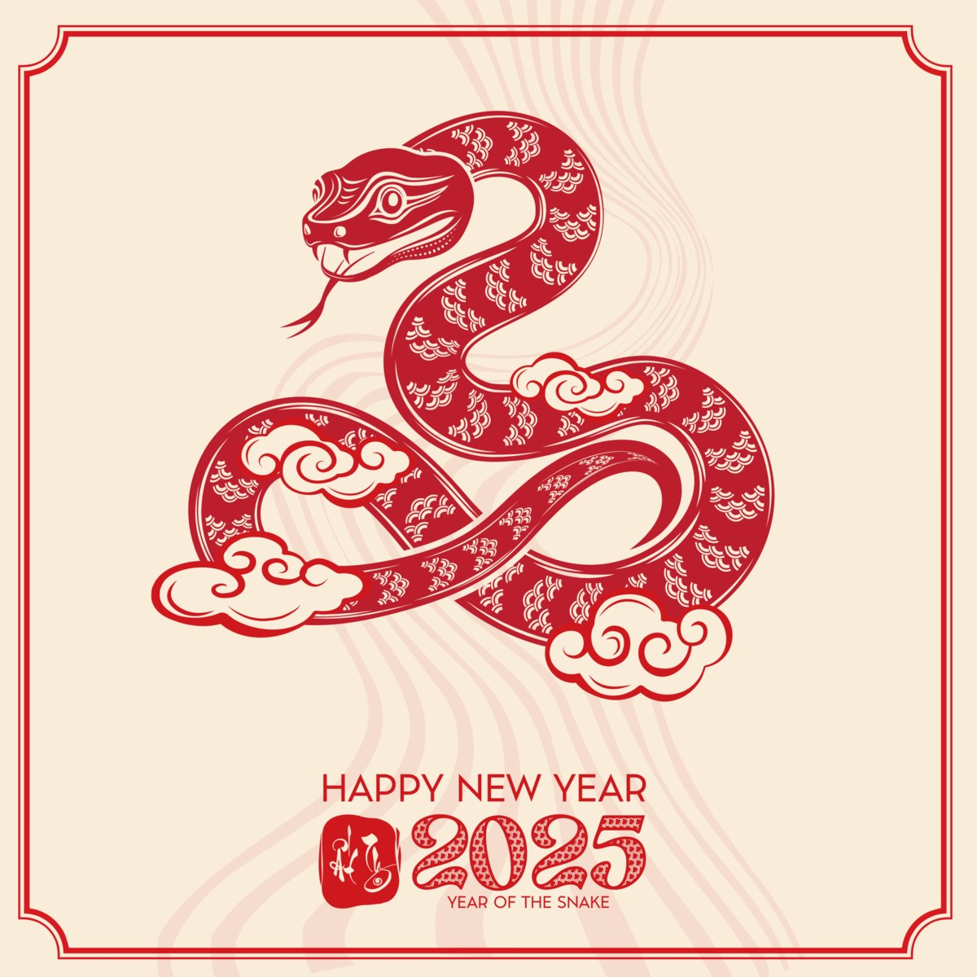
API ERG Event @ LBNL
Asian Art Museum Talk - Masterpieces of the Asian Art Museum
February 28, 2025 @ 1pm
What constitutes a “masterpiece?” Why are some objects considered masterworks while others are relegated to lesser positions? Explore some possible answers as illustrated by a selection of exceptional objects from the collection of the Asian Art Museum. Encounter fabulous statues, ancient bronzes, mystic jade, delicate ceramics, and evocative paintings that will dazzle you with their amazing beauty and expert technique.
Zoom

Slide 3
Recognition
The NSD Community Stewardship Council
Mark Bandstra
Heather Crawford
Tom Gallant
Reiner Kruecken
TD MacDonald
Hannah Parrilla
Ernst Sichtermann

Slide 4
Why Recognize?
Recognition has been shown to:
Improve self esteem
Increase motivation
Increase productivity
Enhance connectedness
Decrease stress/fear
Not only do these things benefit the individual, but they benefit groups at large!
Additionally, recognition can inspire career development, especially for those who may underestimate their own abilities, by providing the confidence needed to pursue their growth.
https://hbr.org/2016/05/recognizing-employees-is-the-simplest-way-to-improve-morale
https://www.gallup.com/workplace/236441/employee-recognition-low-cost-high-impact.aspx
https://bucketlistrewards.com/blog/benefits-rewarding-employees/
https://www.psychologytoday.com/us/blog/the-uncertainty-principal/202407/workplace-recognition-is-actually-reassurance-and-necessary
https://bucketlistrewards.com/blog/psychology-of-employee-recognition/

Slide 5
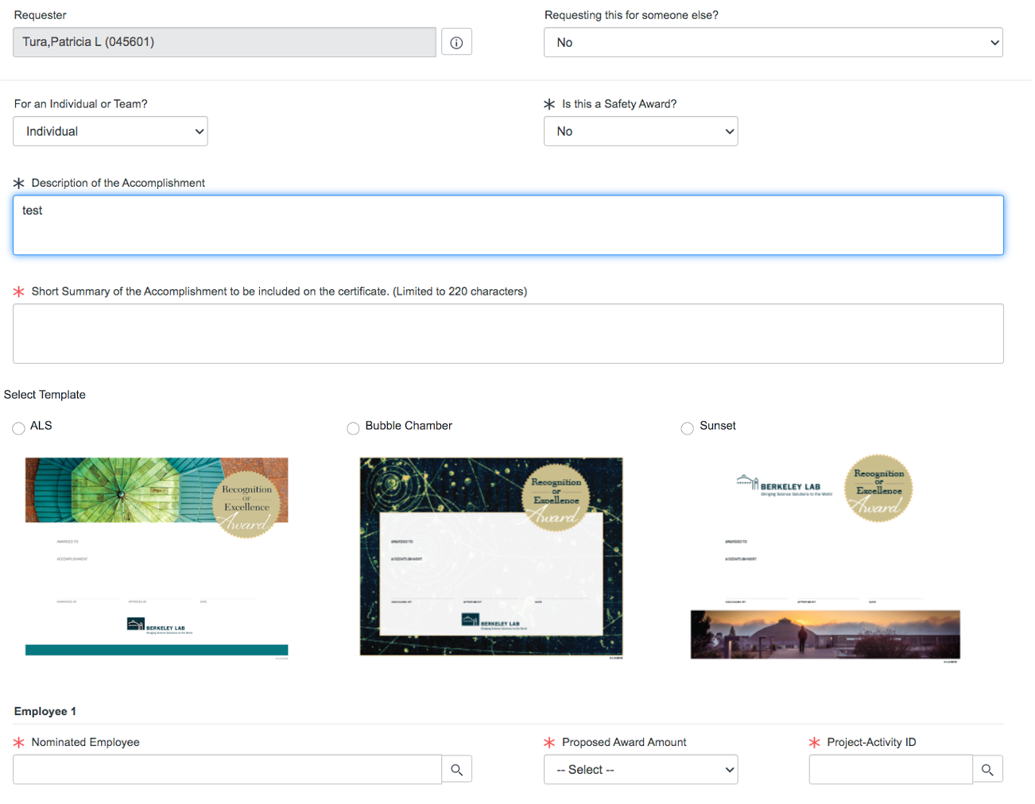
Recognition @ LBNL
SPOT Awards
The Spot Recognition Award program is a way to acknowledge and reward outstanding individual and/or team workplace contributions that occur on a day-to-day basis.
Recipients receive a certificate as well as a monetary award between $25 and $1,500
More information and a link to nomination form can be found here

Slide 6
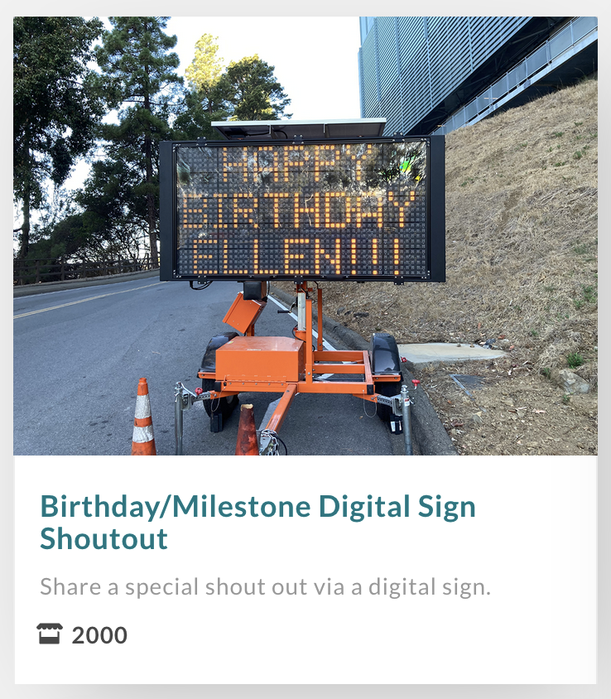
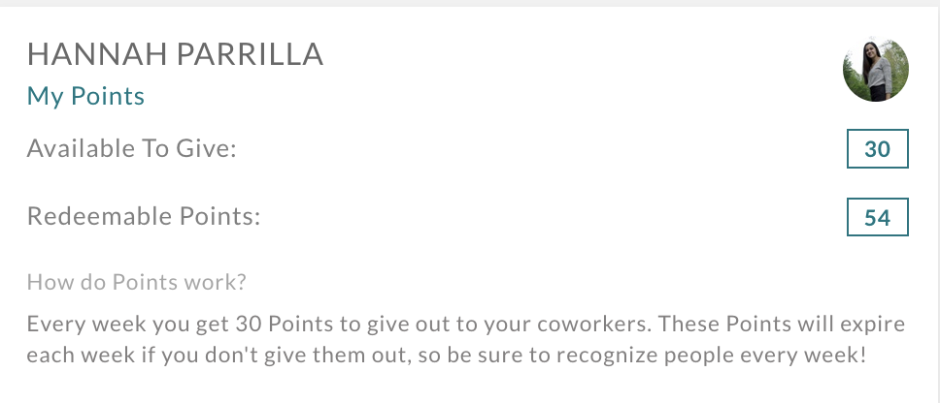
Recognition @ LBNL
Bucketlist Points
Show your appreciation for a job well done with the Lab’s peer-to-peer recognition tool!
You have points that are automatically added to your account each week to give away
Points can be redeemed for non-monetary Lab experiences and badges including naming a goat
Access Bucketlist here and distribute your points (supervisors can see when their supervisees receive points!)

Slide 7
Recognition @ LBNL
Coming Soon:
NSD Community Agreement Award
Recognize fellow NSD staff members for going above and beyond in contributing to NSD’s community culture as outlined in our Community Agreement!
Will be distributed via Bucketlist!
Stay tuned for more updates as we set up this new recognition opportunity.

Slide 8
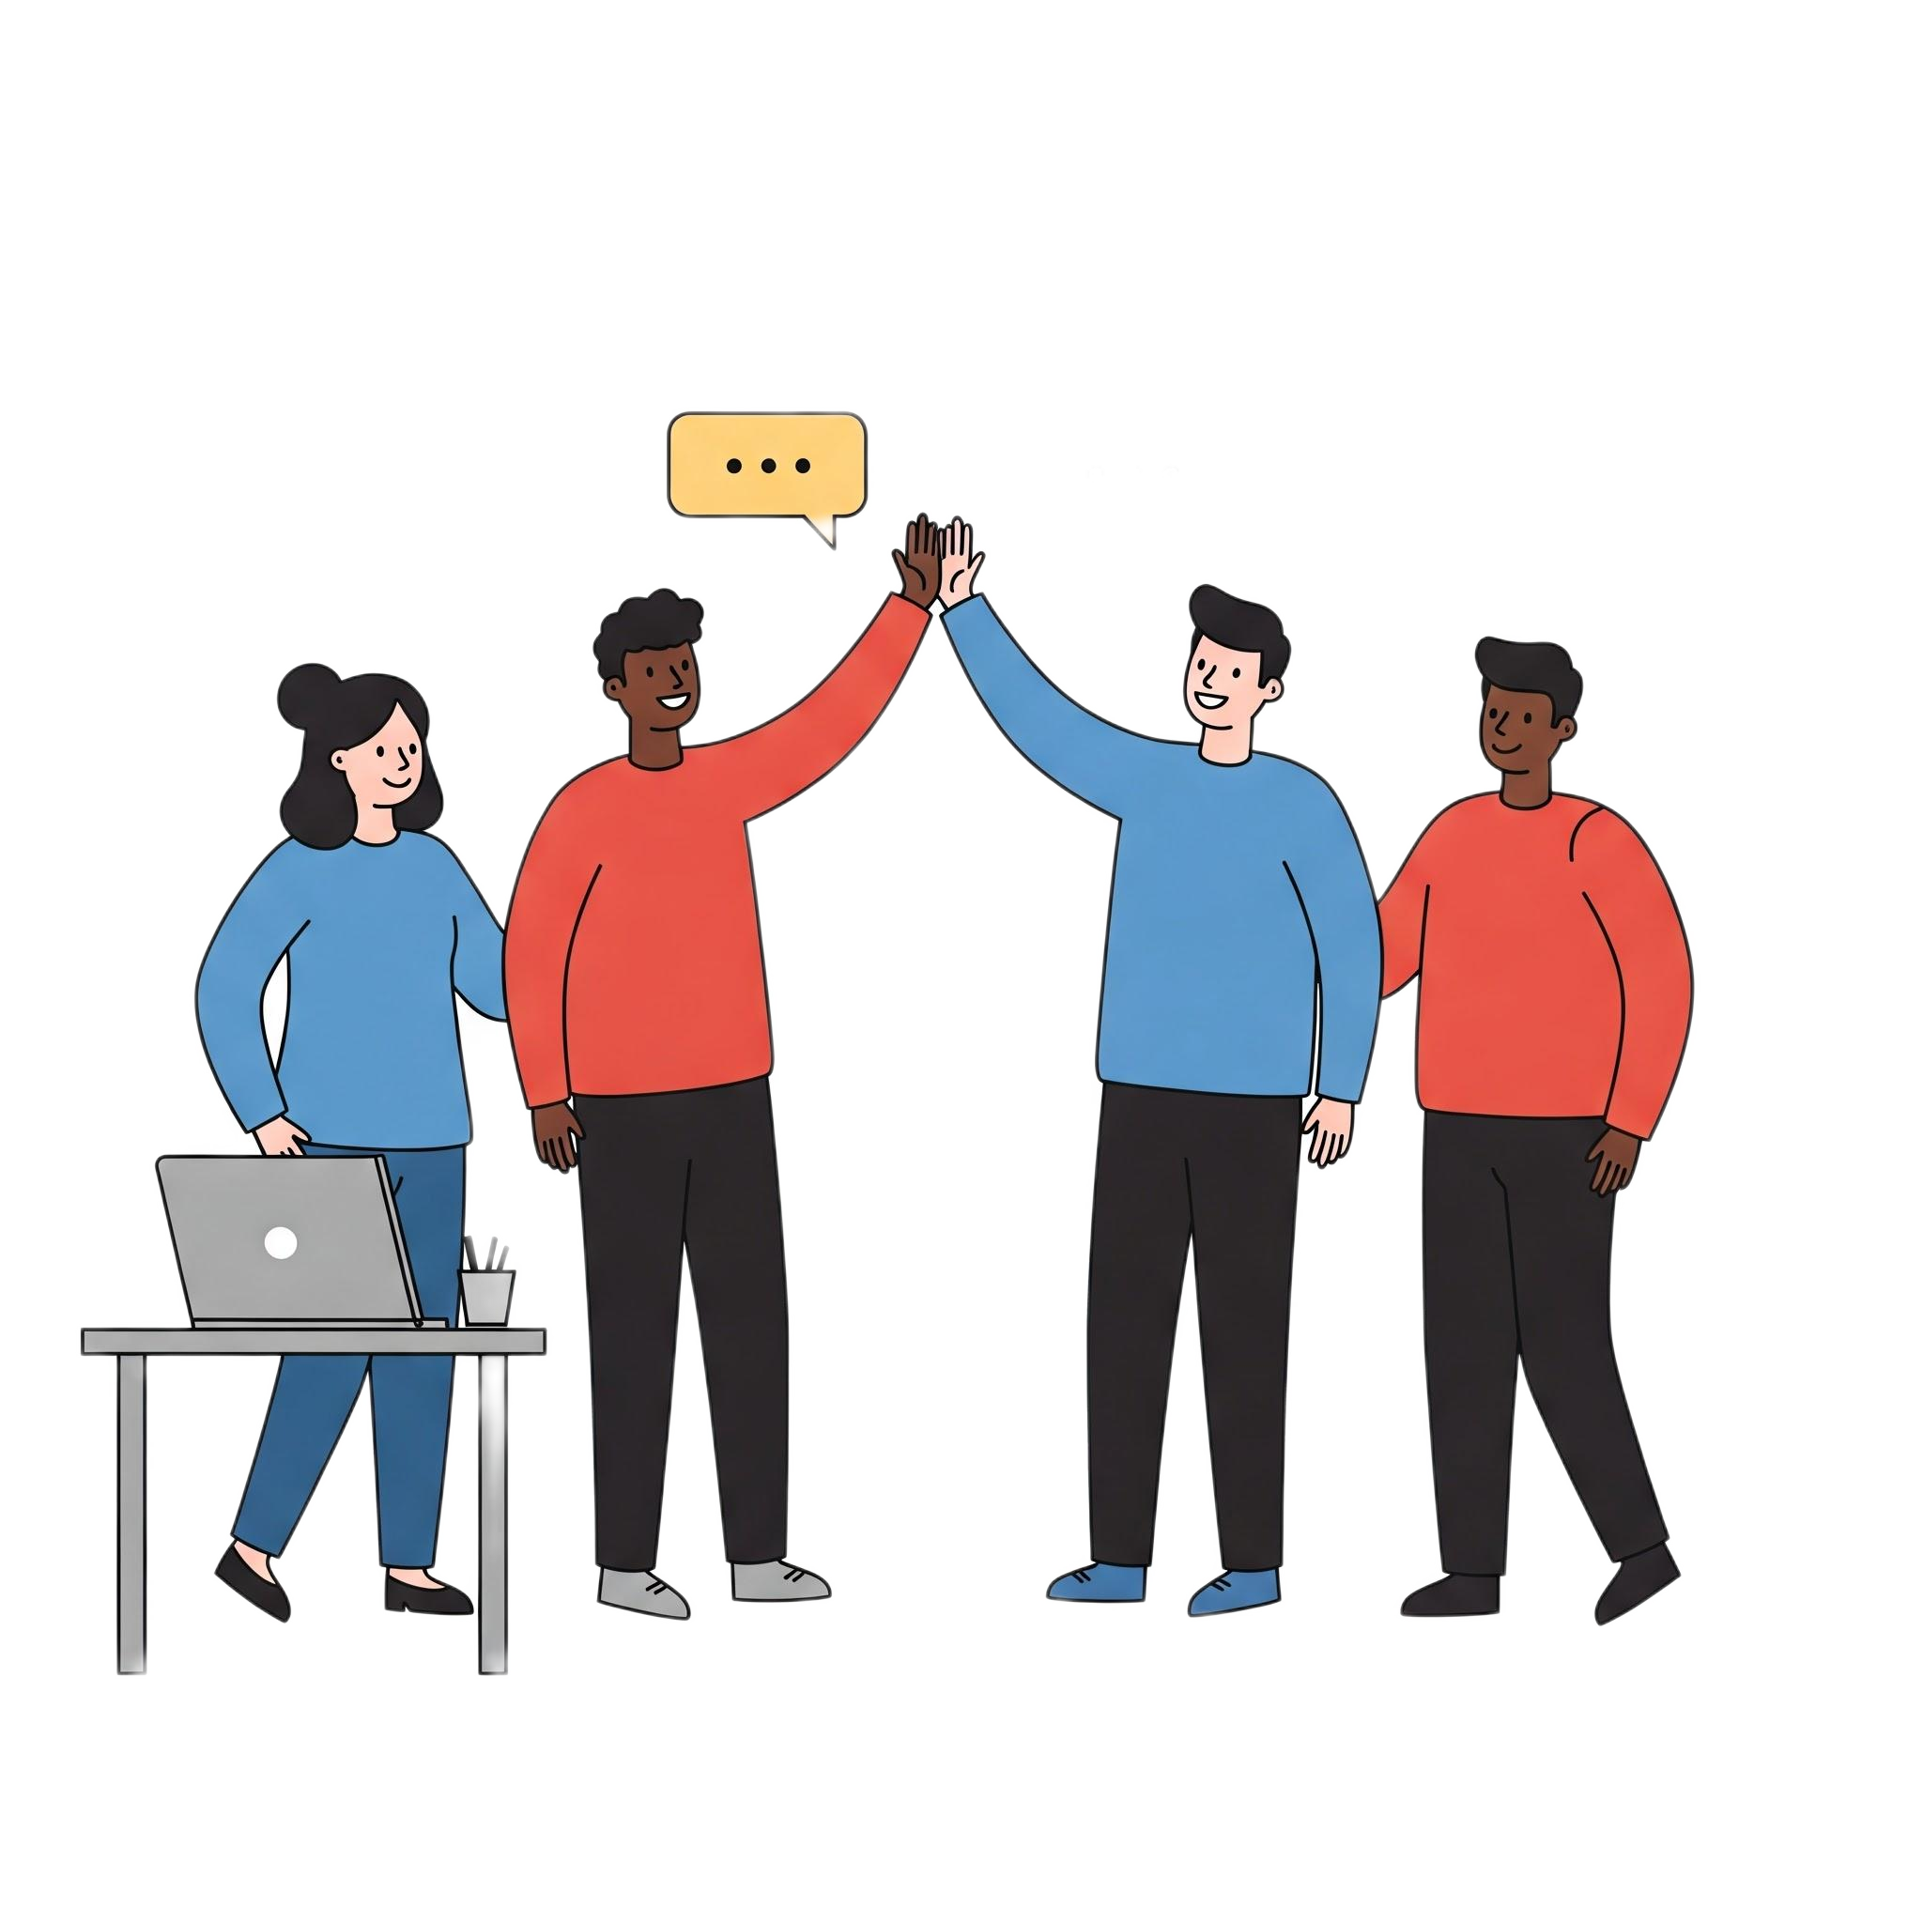
Other Ways to Recognize
Other Ways to Recognize
Give appropriate credit
Presentations
Papers
Conversations
Recognize contributions in direct conversations
Offer opportunities for growth
“You’re contribution to X was so great, that I’d like you to also get involved with Y”
Nominate people for special recognition opportunities
Specific awards for certain career stages, fields, societies, papers, theses, presentations, etc.

Slide 9
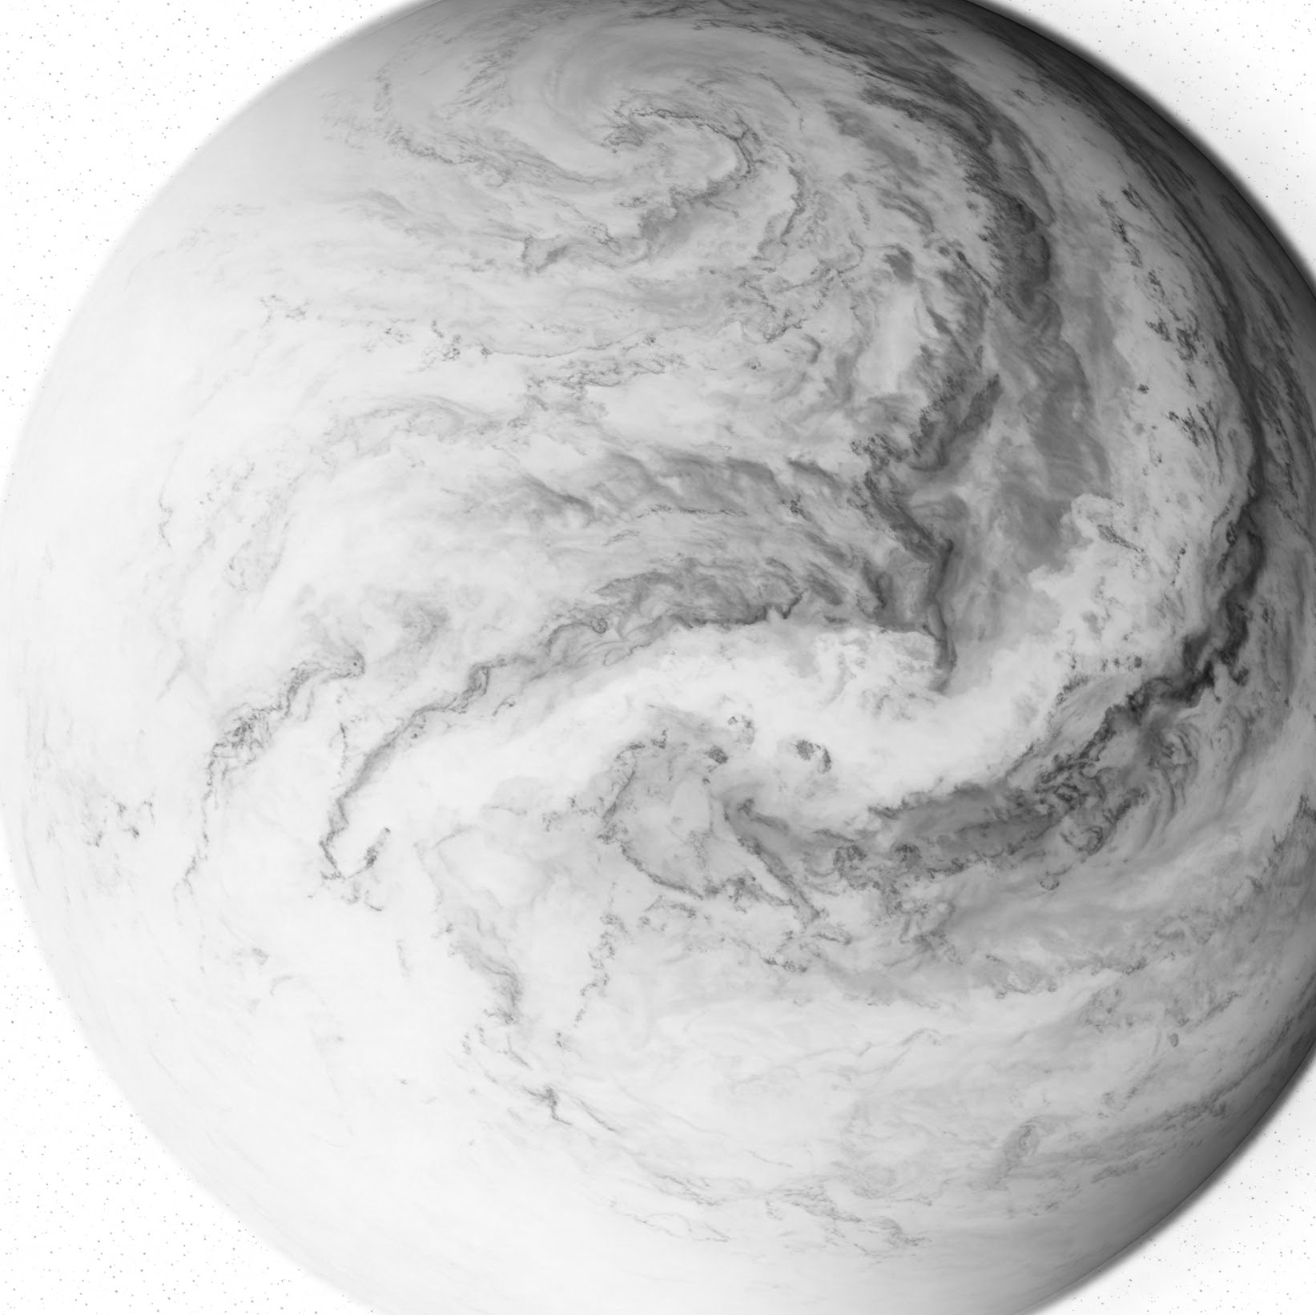
Things to keep in mind
Other Ways to Recognize
Things to Consider
Recognition should be specific
People may have preferences to how they are recognized - ask others what they are comfortable with, ie:
“Is it ok if I share this on LinkedIn?”
“Can I recognize this in the group slack channel?”
Implicit biases* could impact recognition distribution, take measures to counter biases
Multiple people weighing in on recognition distribution
Well-defined criteria that should be met for certain types of recognition
*Implicit bias, also known as implicit prejudice or implicit attitude, is a negative attitude, of which one is not consciously aware, against a specific social group.
https://www.apa.org/topics/implicit-bias
https://atap.lbl.gov/news/understanding-and-addressing-implicit-bias/ | https://ucnet.universityofcalifornia.edu/career-community/career-development/professional-development/uc-managing-implicit-bias-series/

Slide 10
Get Involved in Service and Outreach This Month!
K-12 STEM Outreach Opportunities
Community Service Opportunities
Be a presenter for the Reverse Science Fair
Assist with hands-on STEM activities for Bay Area 6th graders
Facilitate a hands-on STEM workshop for bilingual Science en Acciόn (SeA) STEM camp 2025
Become a Mentor for High School Summer Interns - Summer 2025
Visit the K-12 Outreach and Education homepage to sign up for the newsletter and read more about the programs!
https://k12education.lbl.gov/home
Volunteers needed for Lab Booth at Oakland's 2025 Black Joy Parade Celebration
Volunteer with the Food Bank of Contra Costa and Solano (FBCCS), the UC Berkeley food pantry, or the Alameda County Community Food Bank
Volunteer with Meals on Wheels
Become a tech volunteer for Ashby Village
Get involved with Homies Empowerment
Become a STEM Ambassador for Lawrence Hall of Science
Sign up to volunteer for these opportunities and more at https://service.lbl.gov/need/
Service and Outreach Opportunities

Slide 11
Questions / Comments?

Slide 12
STICKER SHEET

Slide 13
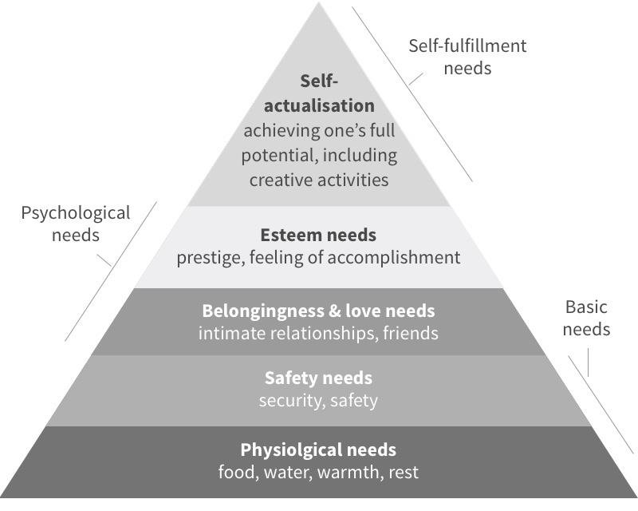
Why Recognize?
Recognition helps satisfy 3 basic needs and aid in self-actualization
Safety needs
Increased job security
Feeling psychologically safe
Belongingness and love needs
Increased connectedness
Feeling cared for
Esteem needs
Accomplishment
Improved self esteem
Recognition can be a tool to foster career development, especially for those who may underestimate themselves
Maslow’s Hierarchy of Needs
[1] Maslow, Abraham H. "A Theory of Human Motivation." Psychological Review, vol. 50, no. 4, 1943, pp. 370-396.

