Slide 1
IPAC2019
May 19- May 24, 2019
G.Velev
US Magnet Development Program

Slide 2
Presntations
From Fermilab there are 2 presntations related to MDP
  FERMILAB SUPERCONDUCTING Nb₃Sn HIGH FIELD MAGNET R&D PROGRAM
  G. Velev et al.
      Conductor R&D
      Materials and technology
      Nb3Sn Magnet R&D
      Magnet test facility
  Magnet design optimization for future hadron colliders
    V. V. Kashikhin et al.
    HTS R&D proposal, discussed on the
    MDP meeting on May 1st

Slide 3
Conductor R&D
Covers FNAL contribution with OSU and Hypertech
  APS
  High specific heat ©

Slide 4
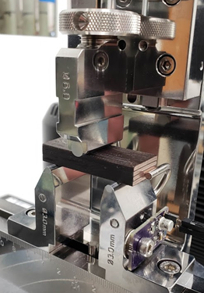
Materials technology
Importance for quench traning rate
10 stack experiments – what result can be obtained

Slide 5
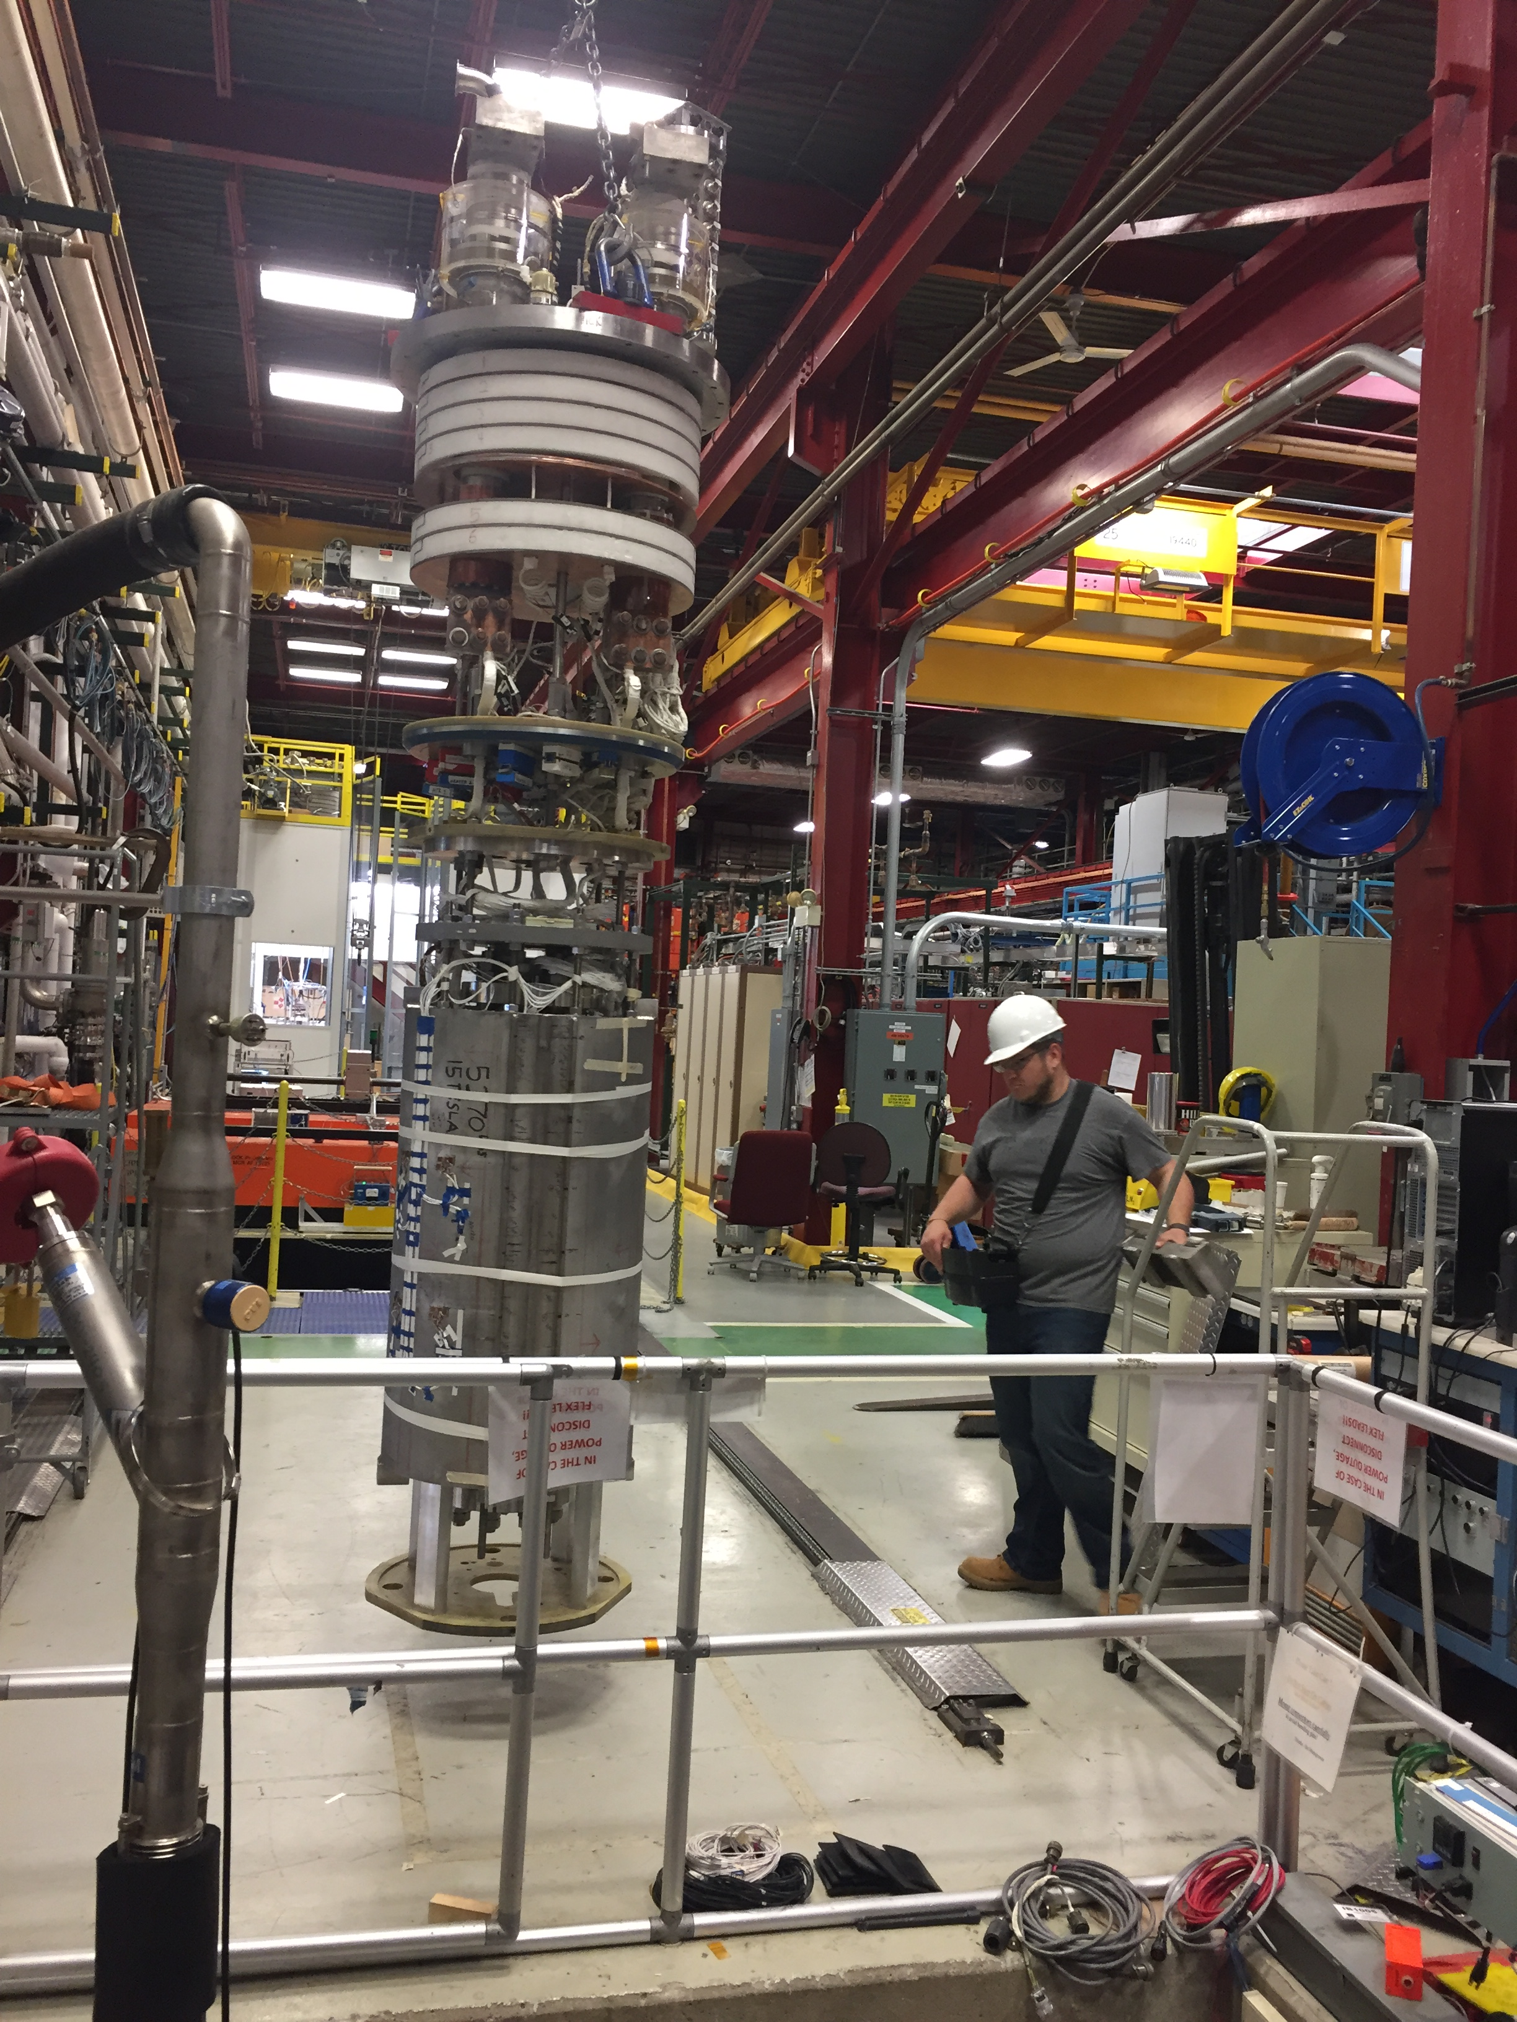
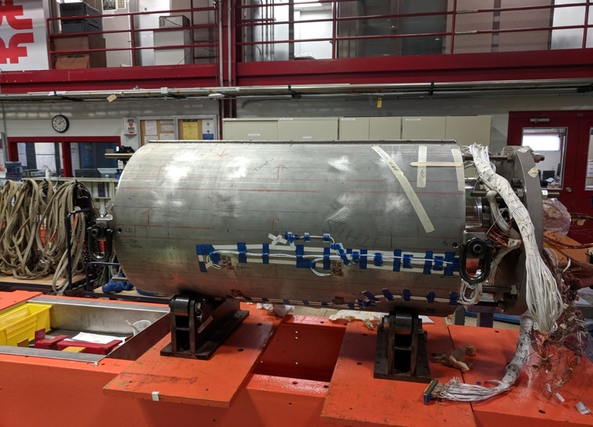
Magnet R&D
15 T
  Short discussion of the design
  Current status

Slide 6
HFVMTF – only stand
Discussing why?
What tests?
Specifications
Table 1: HFVMTF parameters
Parameter | Requirement
Operating temperatures, [K] | 1.9-4.5
Max. energy of the cold mass, [MJ] | 15
Max. magnet diameter and length, [m] | 1.4/3.0
Max. weight of the cold mass, [t] | 15
Max. number of quenches | 15000
Max. number of thermal cycles | 2000
Cool down and warm up speed | Variable
Magnet test position | Vertical
Life span | 25 years

