Slide 1
BNL experience related to
HTS accelerator magnets
MDP Videoconference on May 15, 2019
Ramesh Gupta
Brookhaven National Laboratory

Slide 2
BNL at USMSP
BNL is glad to join US magnet development program…
Funding is in place in May FIN plan, which means we can start working soon.
Key memorandum is being signed, if not done already.
The initial scope of work for this year was planned to do (a) quench studies on CORC cable and (b) magnetization studies of HTS tape coils (field primarily parallel to the wider face), both in the background field of BNL 10 T common coil dipole.
A detailed plan for will be presented in a future presentation for your feedback. We are already in discussion with LBL and ACT.
The purpose of this presentation is to review previous BNL HTS magnet programs related to accelerators. We are open to sharing experimental data for better scientific understanding.

Slide 3
HTS Dipole and Quadrupole Magnet Programs at BNL for Accelerators
Hybrid Dipole with CORC® Cable (Phase II SBIR)
High field hybrid collider dipole (Phase II STTR)
Overpass/Underpass HTS dipole (Phase I SBIR)
Curved dipole with the ReBCO tape (Phase II SBIR)
High radiation HTS Quadrupole for FRIB (FRIB/DOE)
Bi2223 HTS tape common coil dipole (DOE)
HTS magnet for NSLS (BNL Project)
HTS quadrupole for RIA (funded by DOE)
Bi2212 Rutherford cable Common Coil Collider Dipole (DOE)
Cosine theta dipole with 4 mm YBCO/ReBCO tape (SBIR)
Cosine theta dipole with 12 mm YBCO/ReBCO tape (SBIR)
BNL can make a significant contribution to the US MDP for developing high field HTS accelerator magnet technology with the above and other high field HTS solenoid programs

Slide 4
Overview
The goal of this presentation to (re)familiarize everyone with some of these programs to help collaboration to benefit from that experience

Slide 5
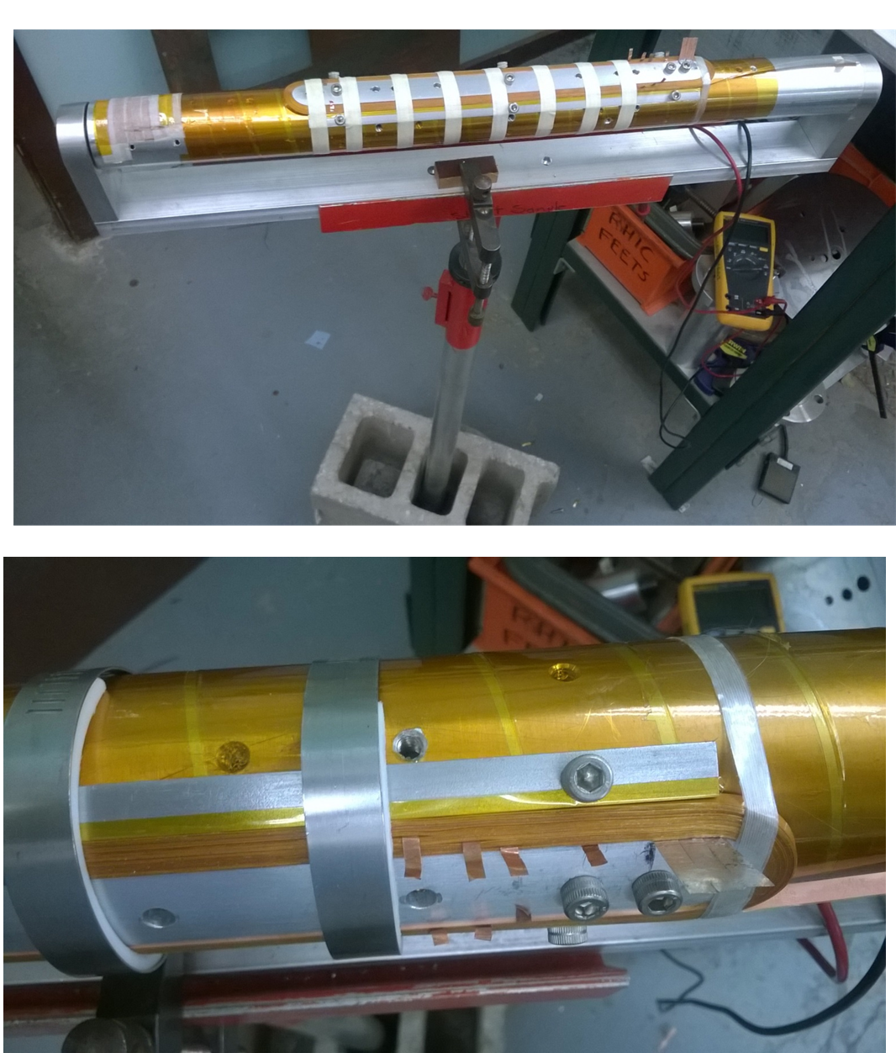
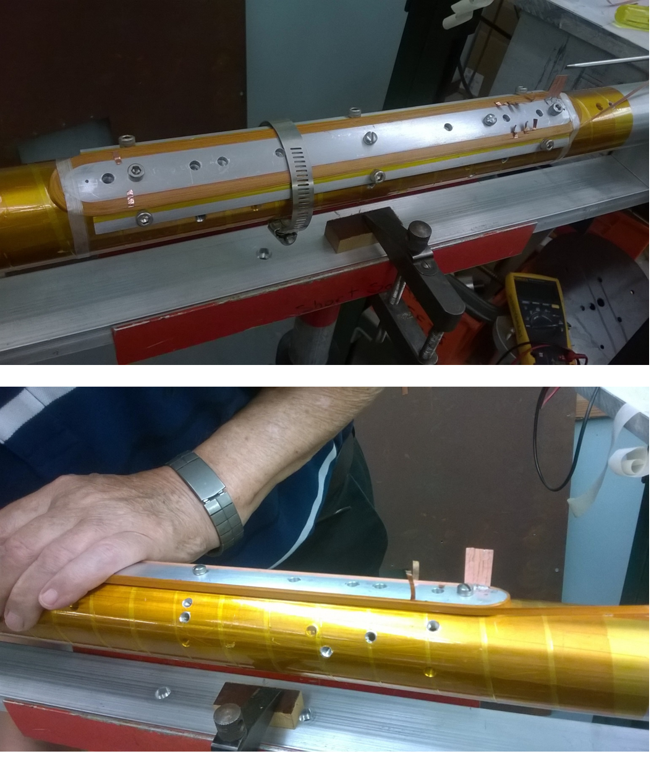
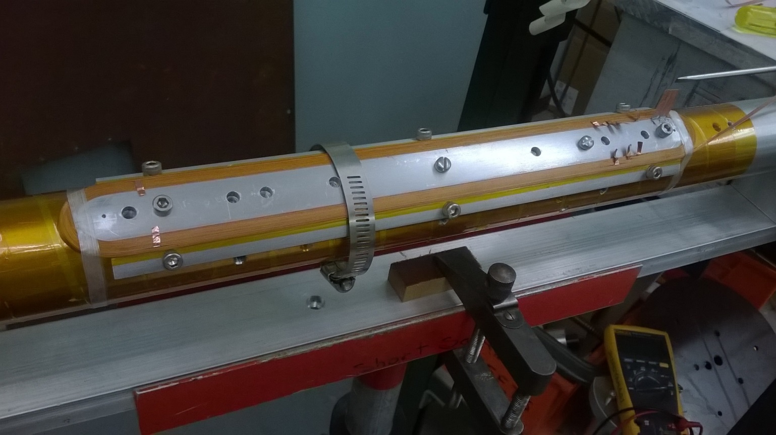
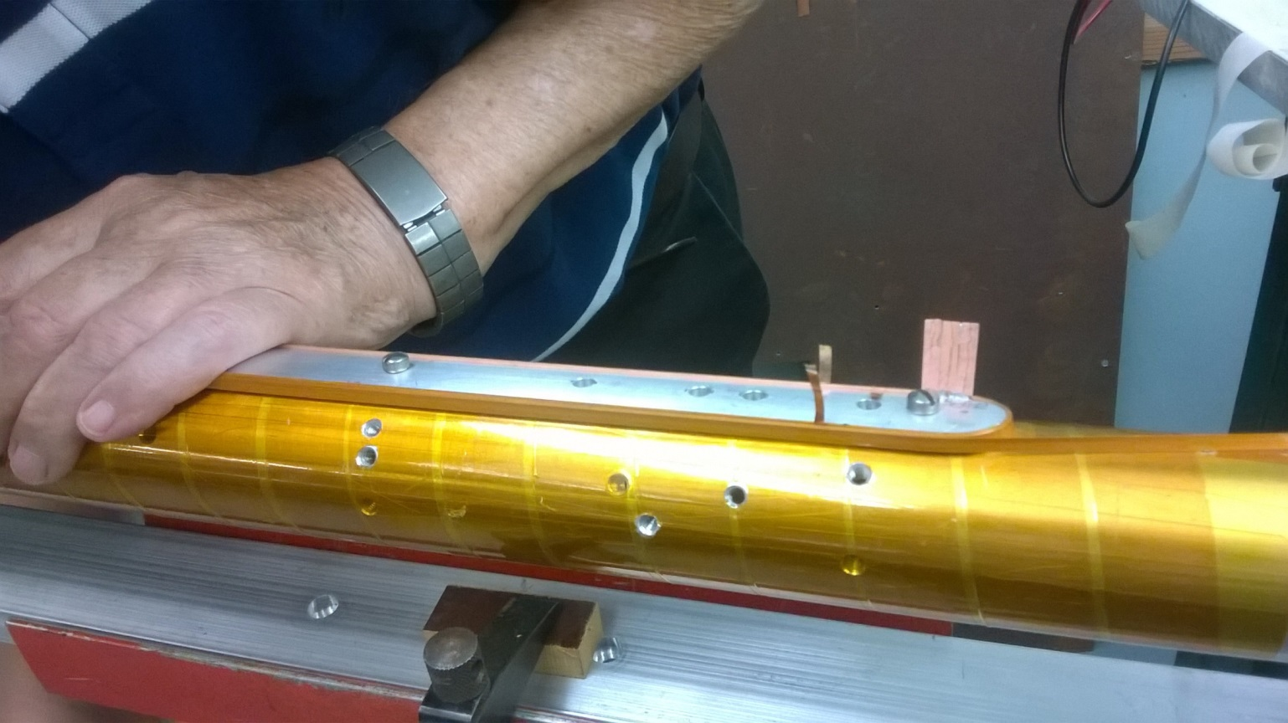
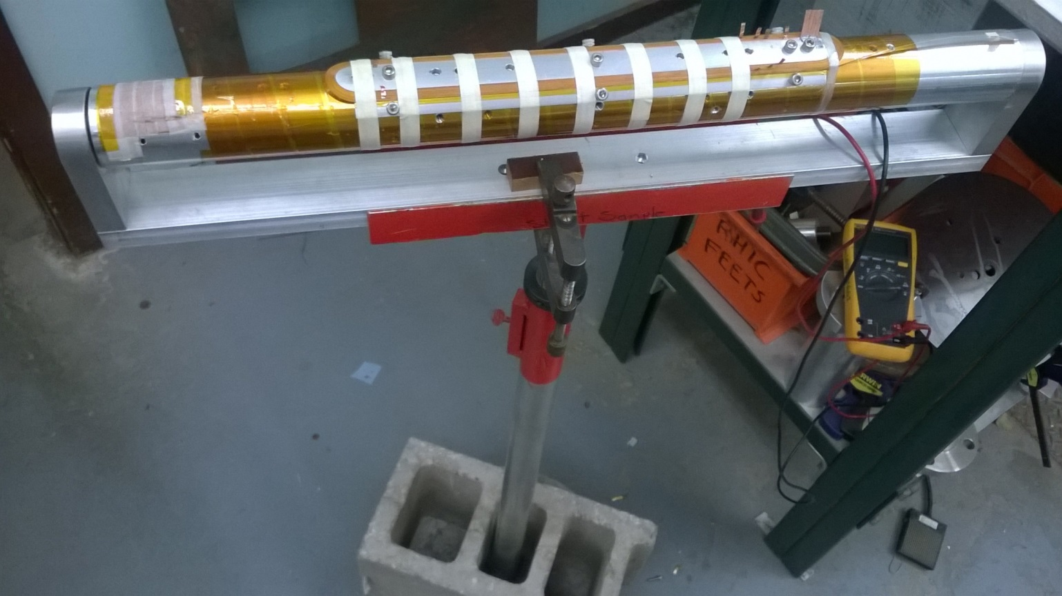
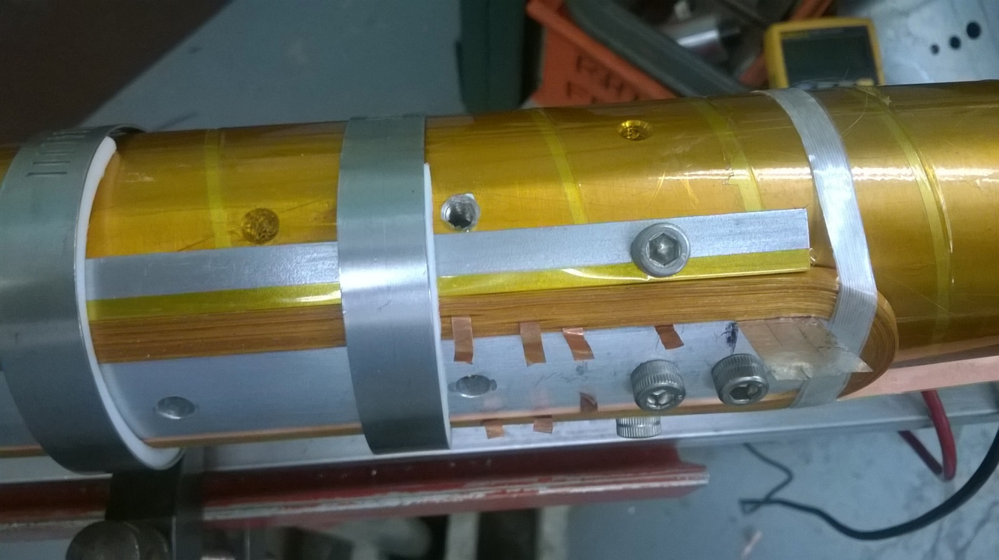
Cosine Theta Coil with
4 mm HTS Tape - SBIR Phase I (1)

Slide 6
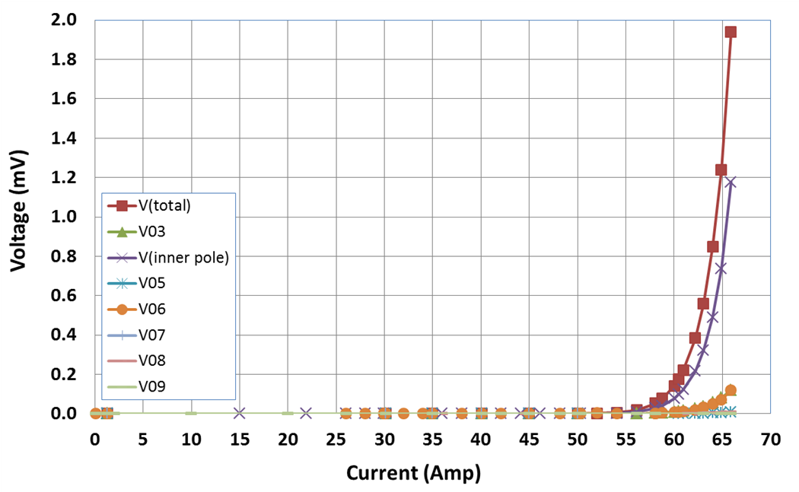
Cosine Theta Coil with
4 mm HTS Tape - SBIR Phase I (2)
No measurable degradation

Slide 7
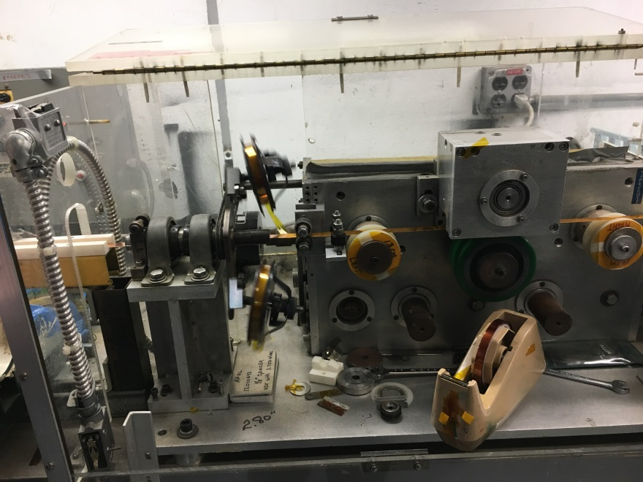
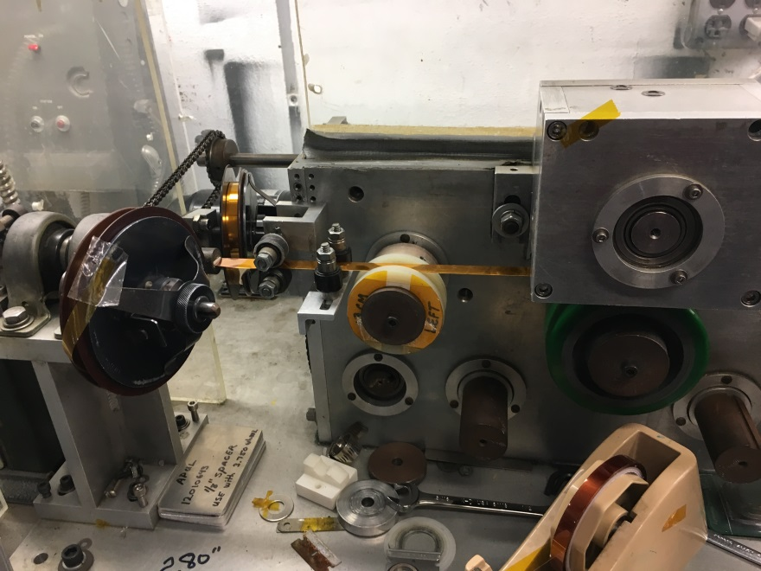
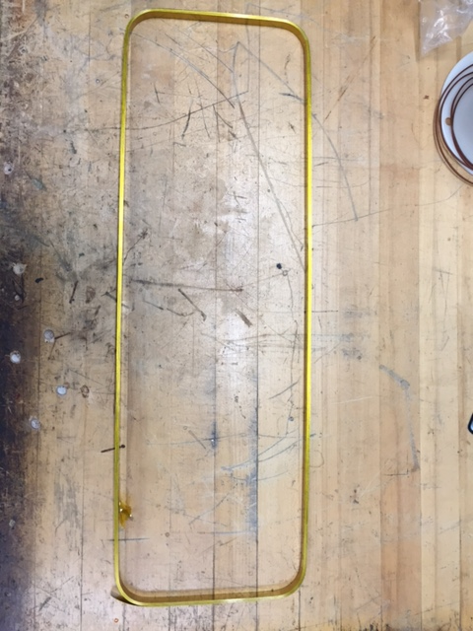
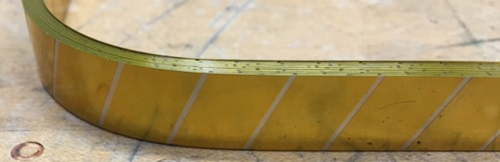
Kapton-Ci Insulation on ReBCO Tape
(and Making a NbTi Type Cured Coil)
Part of an same STTR
77 K tests show no degradation in conductor performance

Slide 8
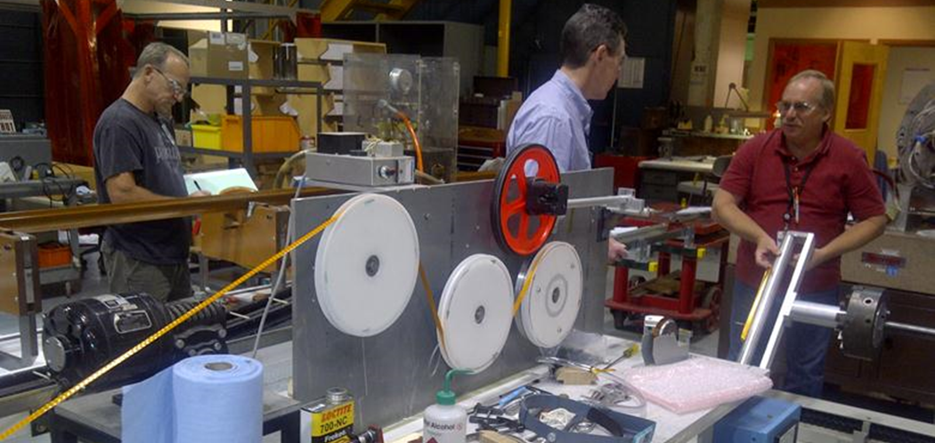
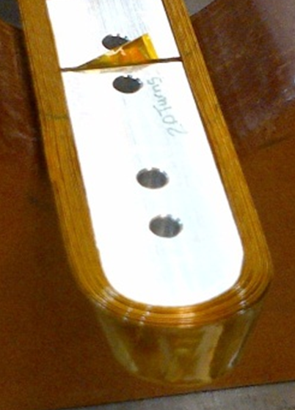
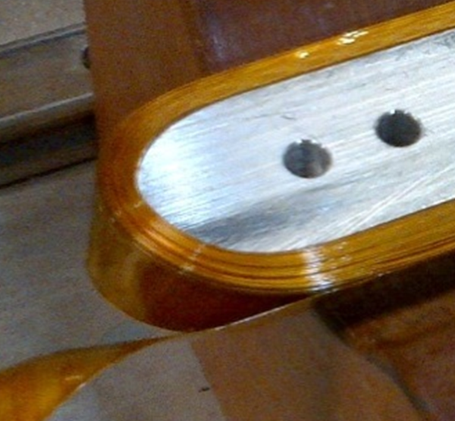
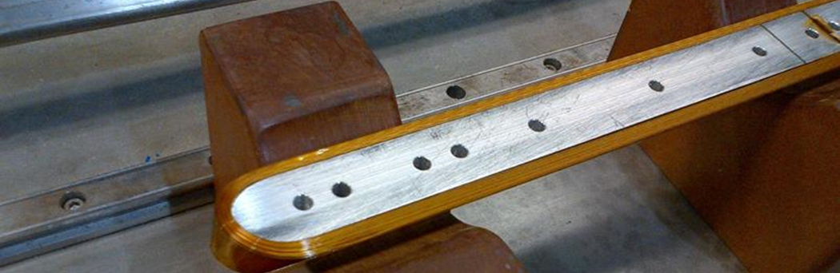
Cosine Theta Coil with
12 mm HTS Tape - SBIR Phase I (1)

Slide 9
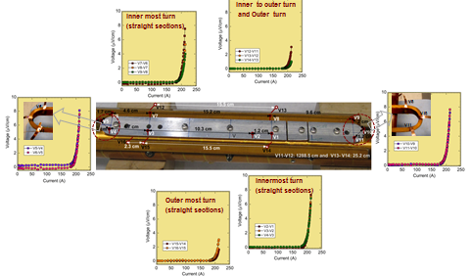
Cosine Theta Coil with
12 mm HTS Tape - SBIR Phase I (2)
No measurable degradation

Slide 10
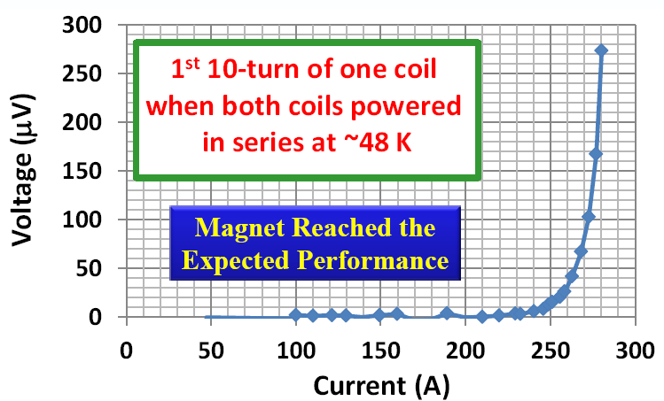
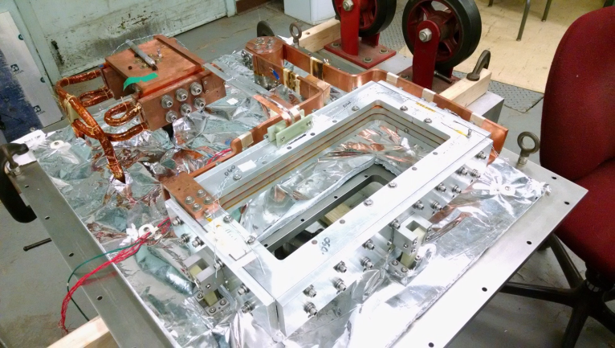
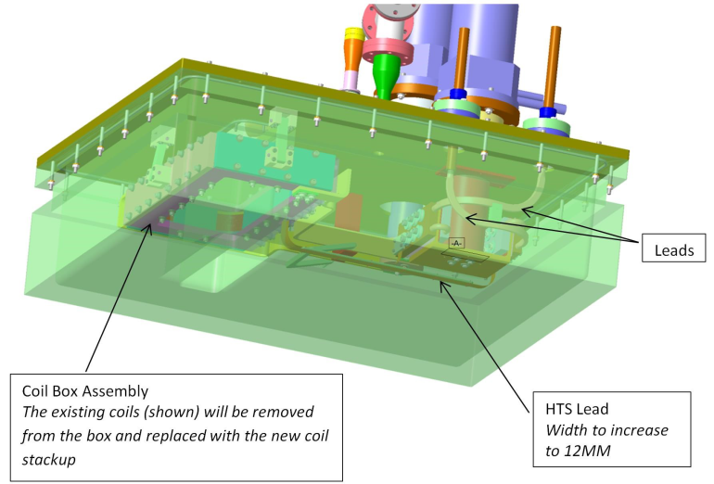
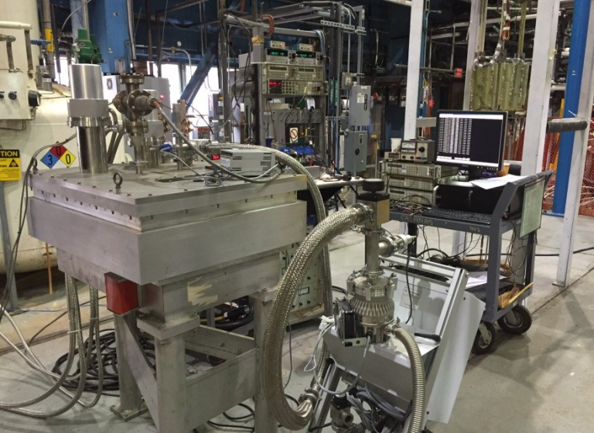
HTS Curved Coil with Cryo-cooler
(SBIR Phase II with Muons, Inc.)

Slide 11
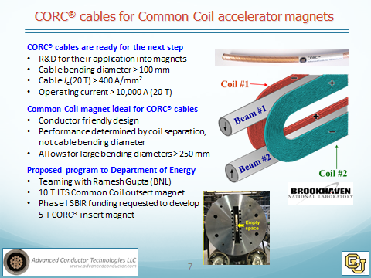
SBIR on CORC Cable with ACT
(Phase I and Phase II)

Slide 12
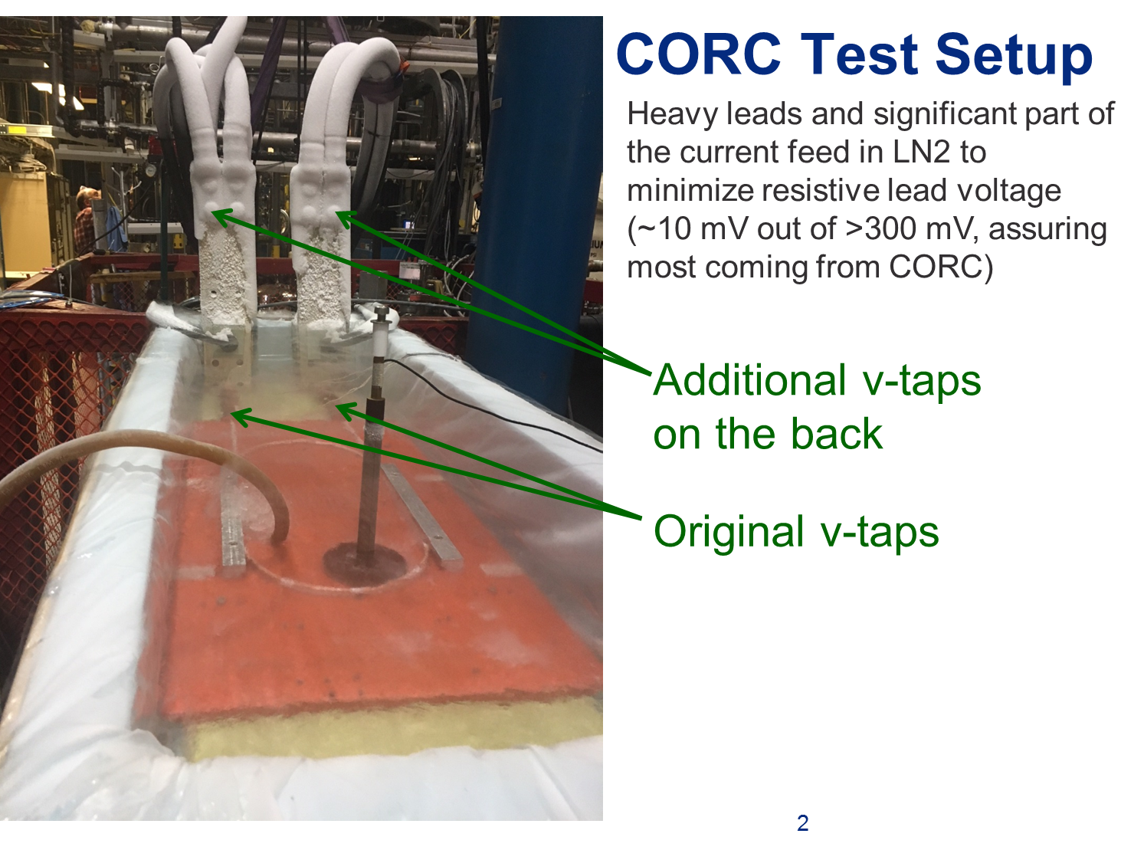
CORC Cable Test at BNL
(Phase I SBIR with ACT)

Slide 13
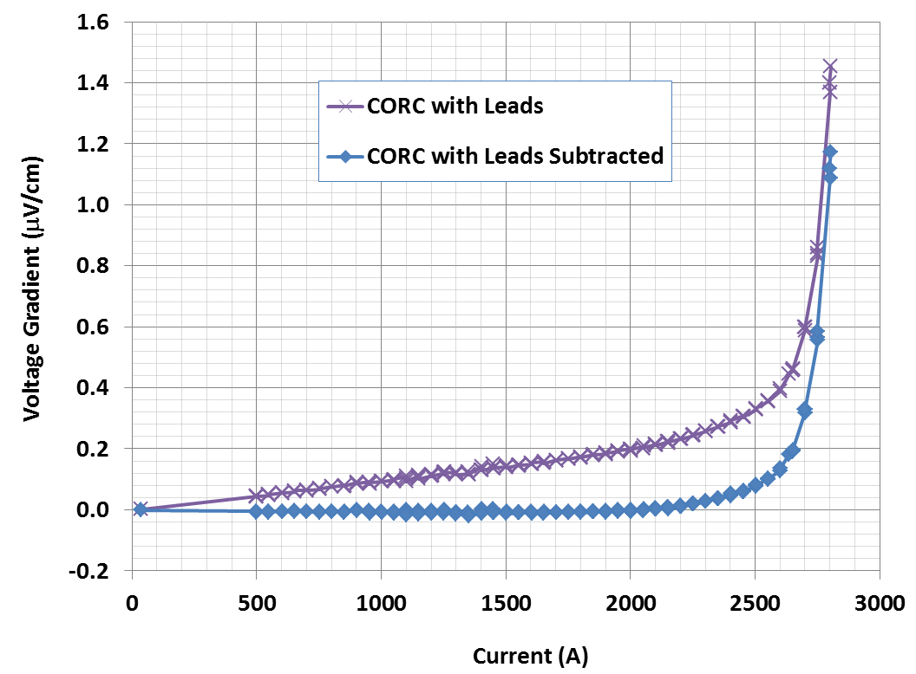
Measurements at the original V-taps

Slide 14
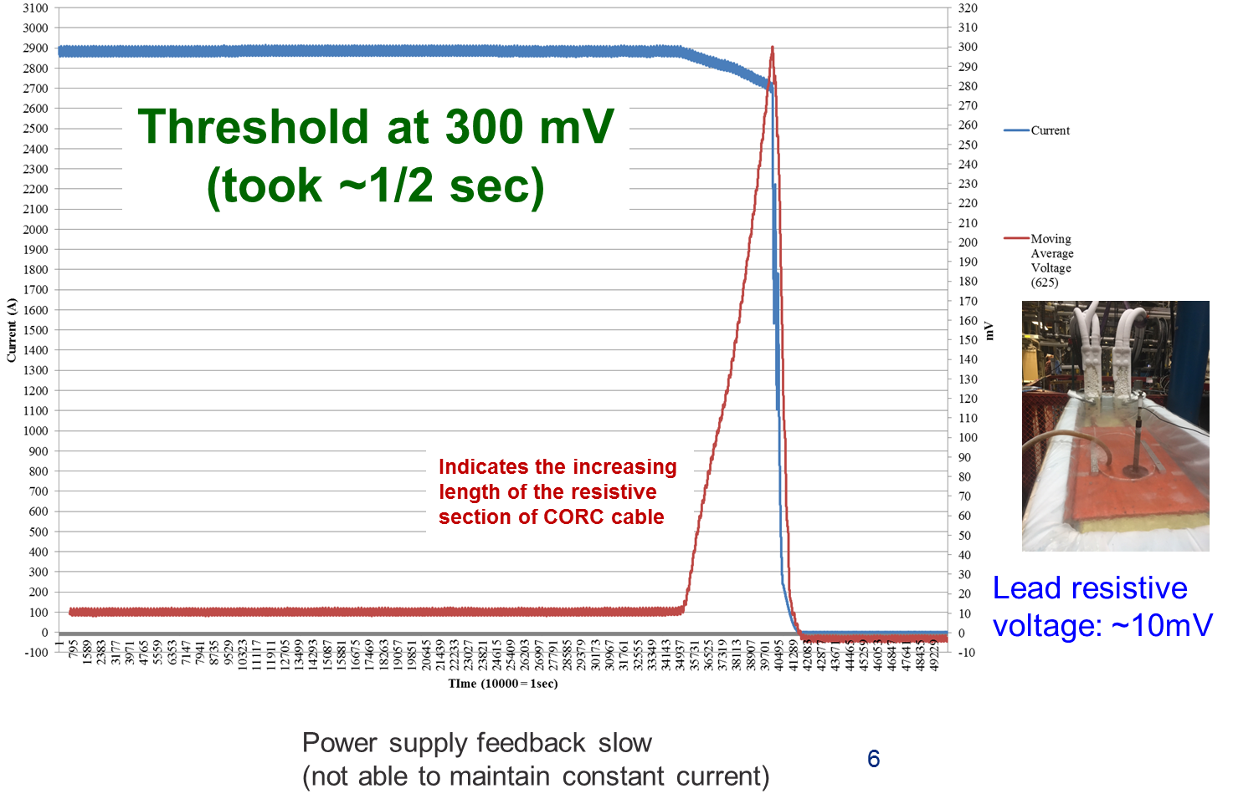
Measurements at the additional v-taps on the leads (data recorded with fast logger every 100 microsec)
77 K Test to ~3000 A

Slide 15
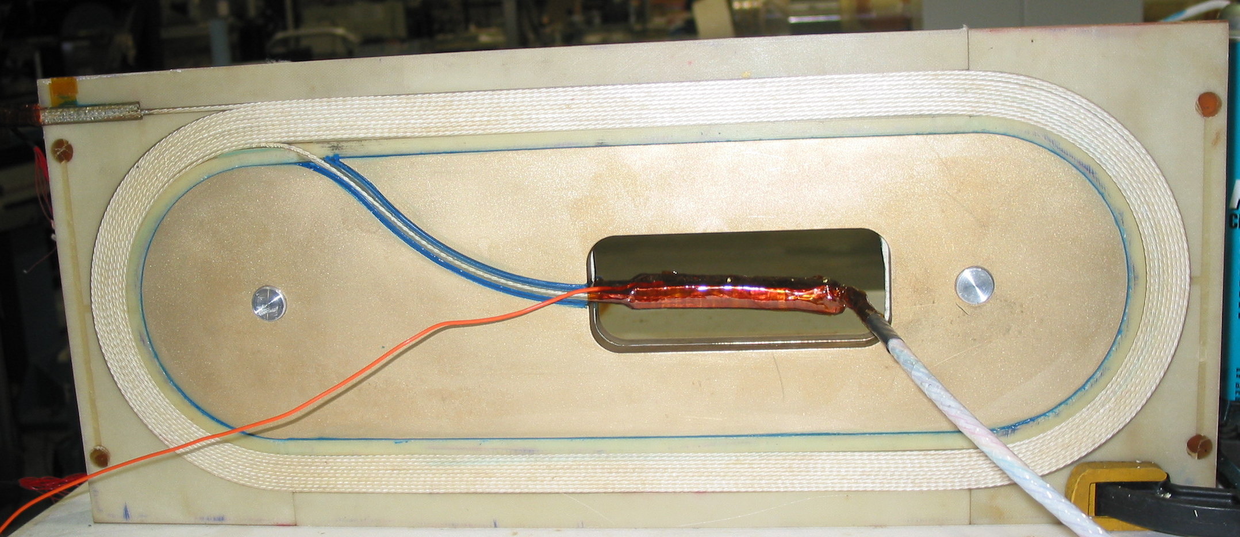
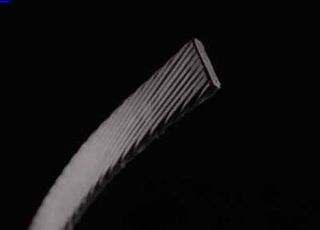
HTS Coil with Bi 2212 Rutherford Cable
(React & Wind)
Several Bi2212 cable racetrack R&D coil built and tested at BNL.
  Minimum bend radius 70 mm; Cable thickness ~1.6 mm.
    Bending strain 1.4% or 0.7% depending on whether the wires in the cable are sintered or not.

Slide 16
Bi2212 Ruther Coils and Magnets
Five Accelerator Type R&D Magnets
HTS from Showa
Cables made at LBL
All React & Wind

Slide 17
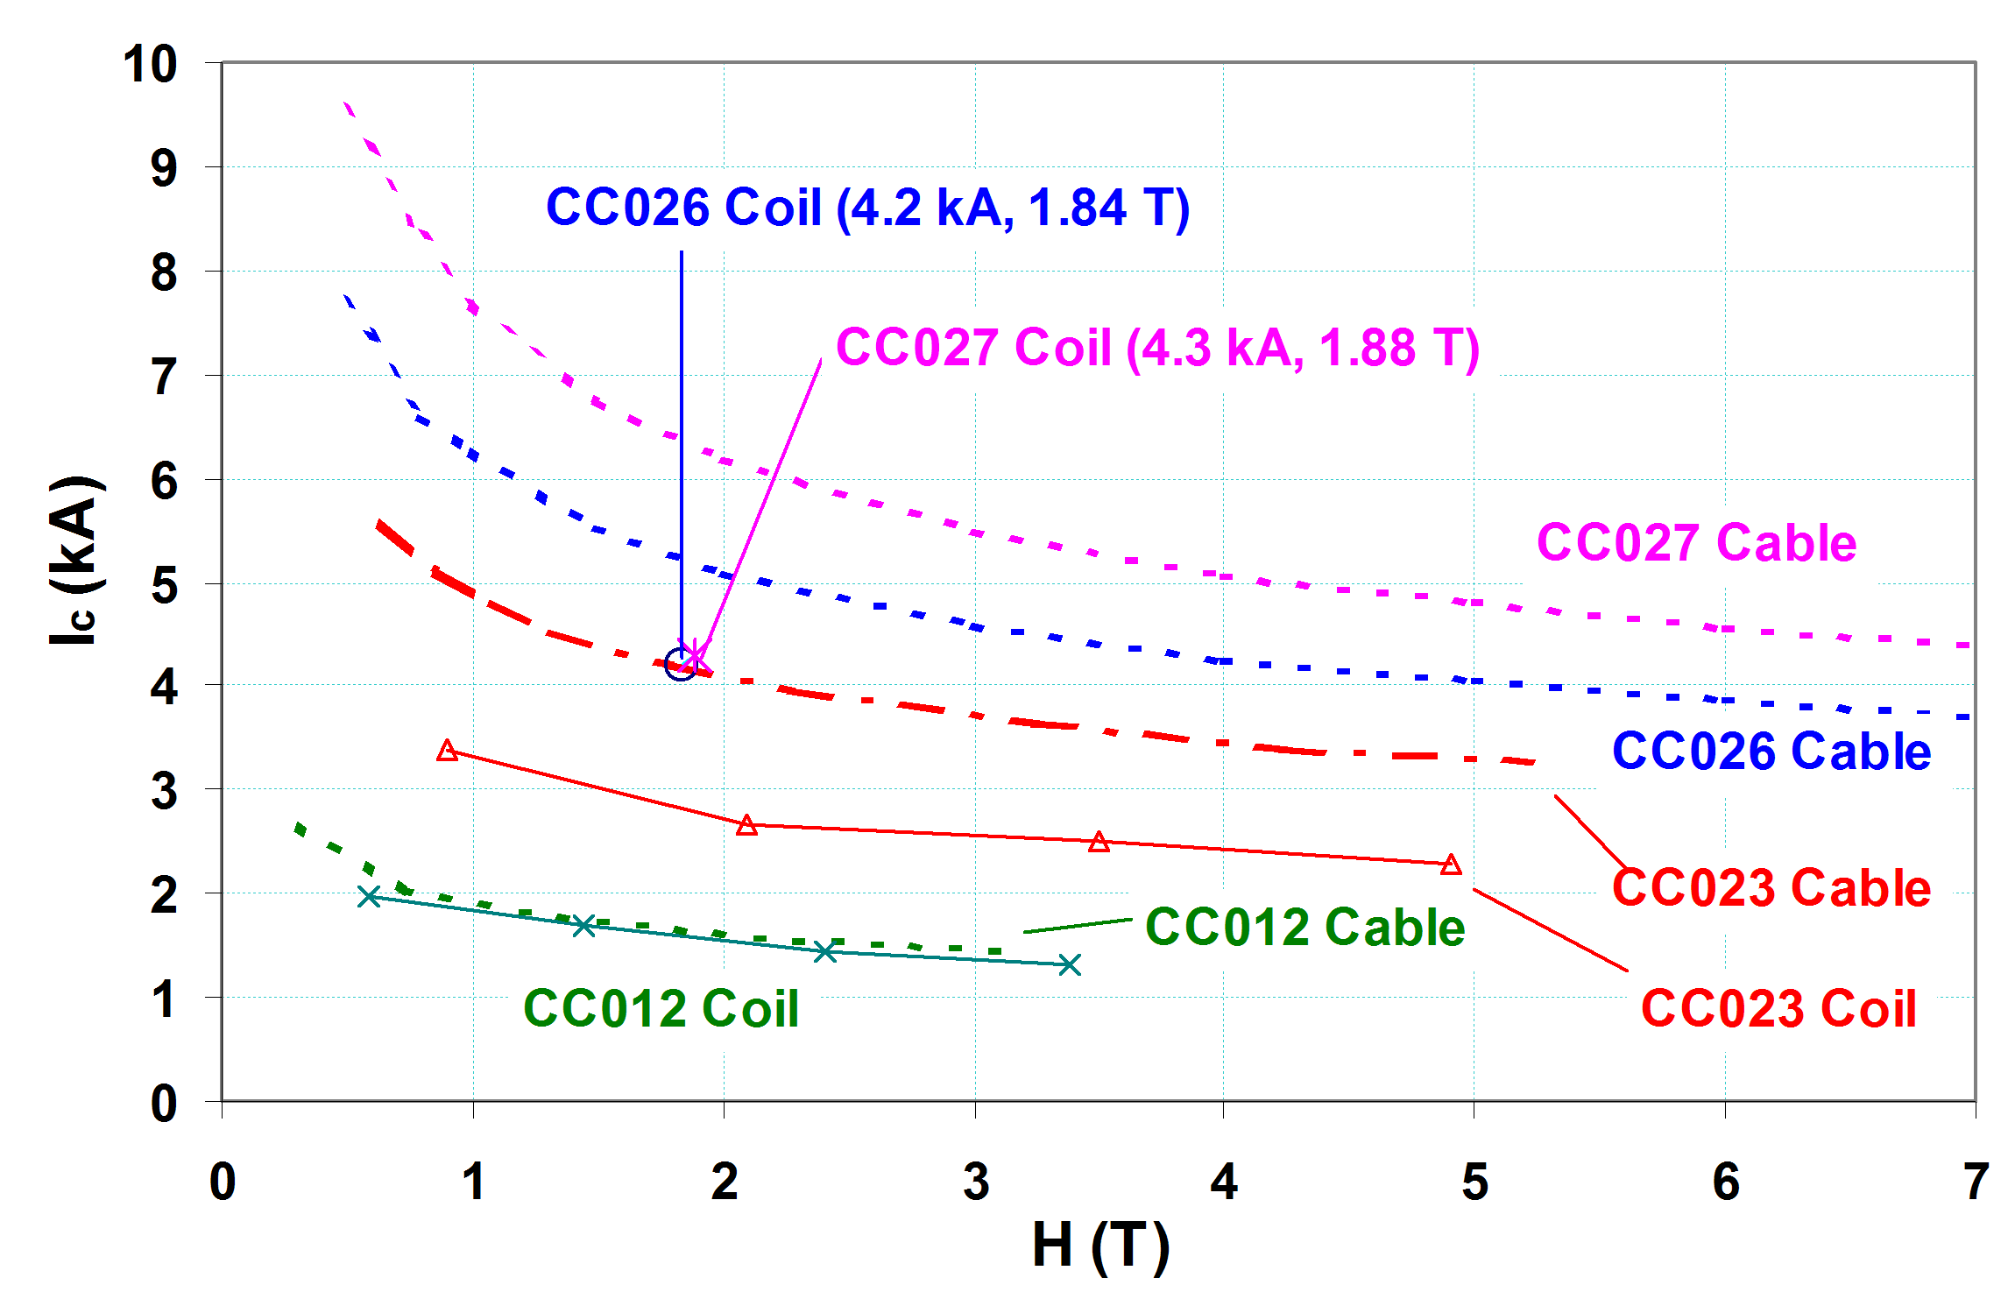
Bi2212/Nb₃Sn Hybrid Dipole
HTS/LTS Hybrid Magnets (background field provided by Nb₃Sn)
7
(Magnet DCC014)
6
6
7
(Magnet DCC012)
(Magnet DCC008)

Slide 18
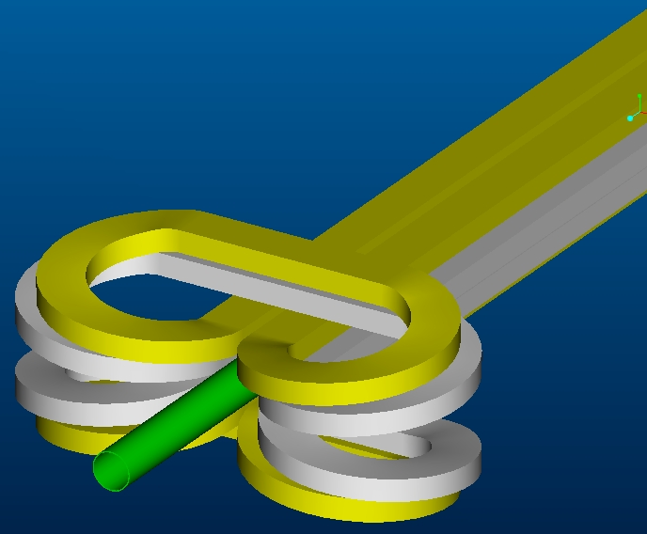
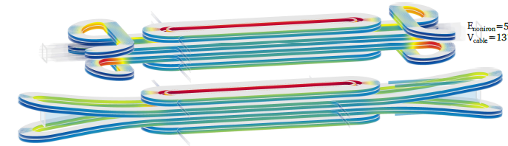
Freeway Overpass/UnderPass
(or clover-leaf) Ends
ASC2002
HTS test coil wound in Phase I with e2P/BNL SBIR
BNL
ASC2018
CERN

Slide 19
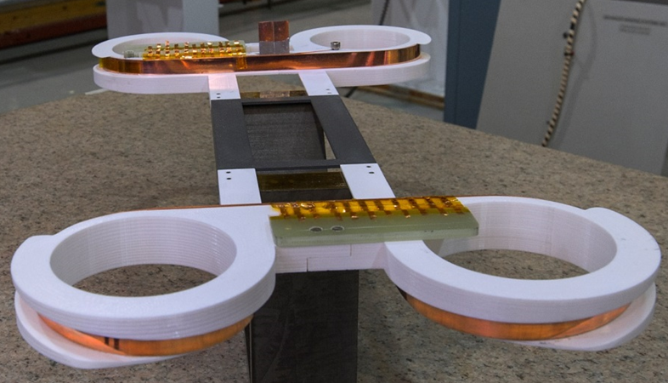
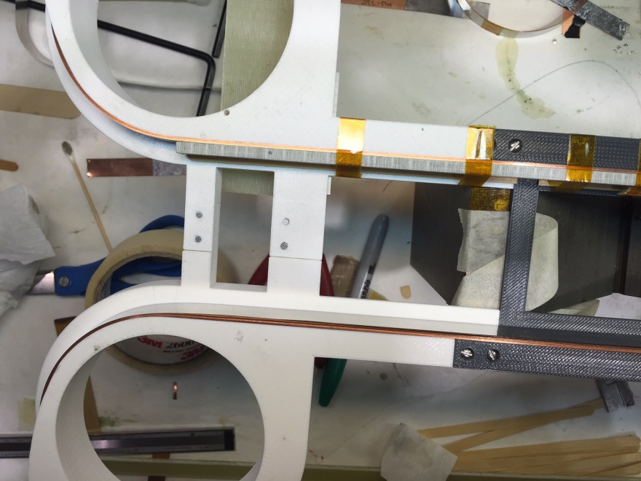
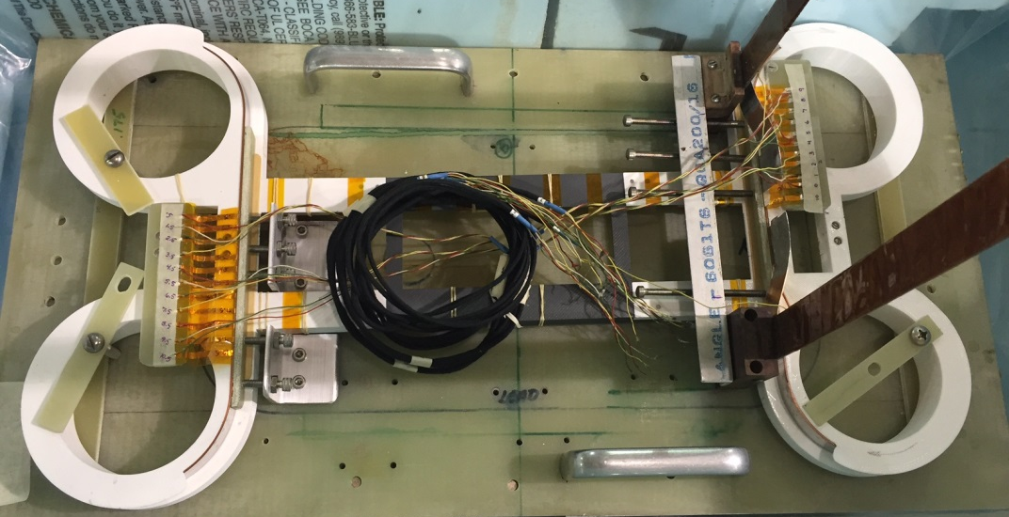
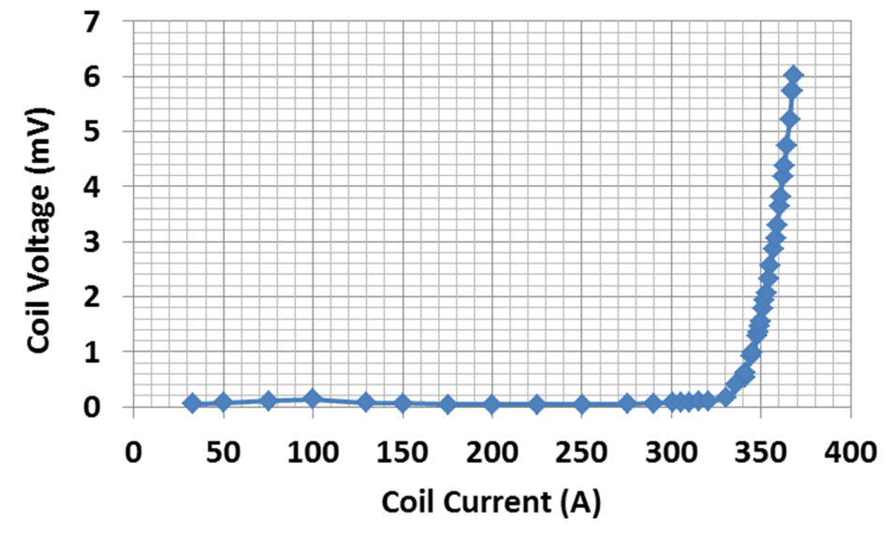
Demonstrations of the Overpass/Underpass in Phase I
77 K Test Results
12 mm wide tape
No degradation
SBIR with e2P

Slide 20
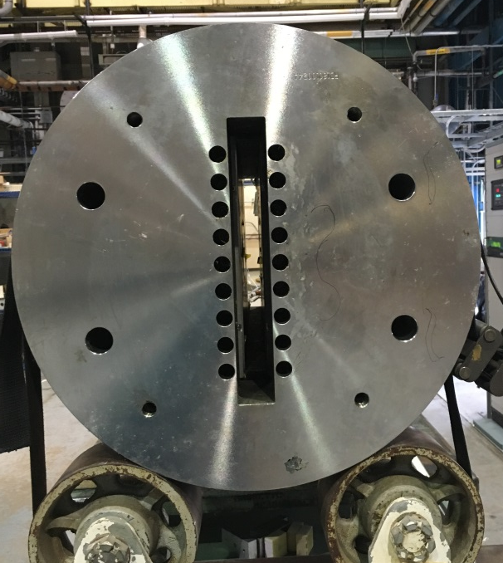
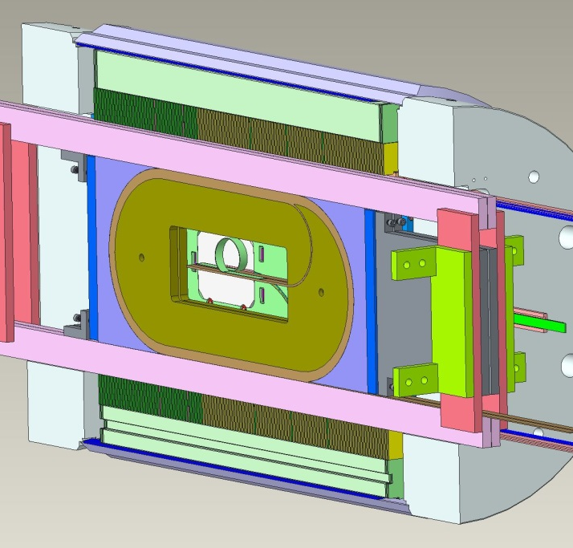
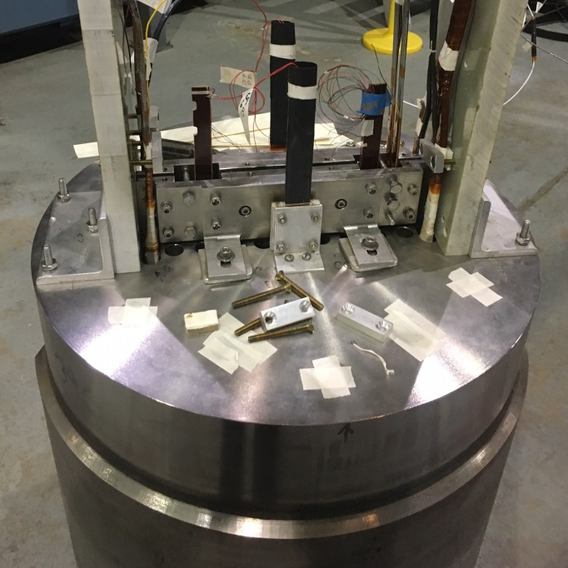
PBL/BNL STTR on HTS/LTS Hybrid Dipole
A unique feature of BNL’s common coil dipole: large open space for inserting & testing “coils” without any disassembly (rapid around, lower cost)
STTR Phase II for (1) Demonstration and protection of High field HTS/LTS hybrid dipole (2) measurement of field parallel and perpendicular field quality
Original structure
Insert coils in Empty space
Empty space
New structure
BNL Nb₃Sn common coil dipole DCC017 without insert coils
New HTS coils with the existing Nb₃Sn coils and become part of the magnet
HTS coils inside Nb₃Sn dipole - early experience of HTS/LTS hybrid dipole

Slide 21
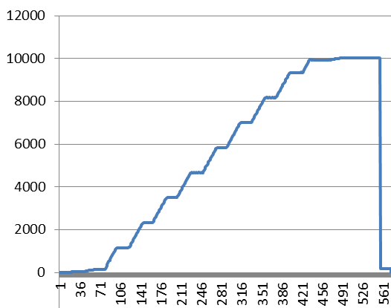
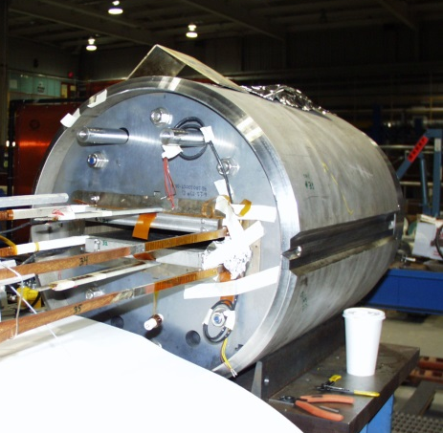
Retest of Nb₃Sn Common Coil Dipole After a Decade
Short Sample: 10.8 kA/10.2 T (reached during 2006 test)
Retest: No quench to 10 kA/9.5 T (>92% of quench, leads limited)
~9.5T@10kA
A reliable magnet for test facility
Current (A)

Slide 22
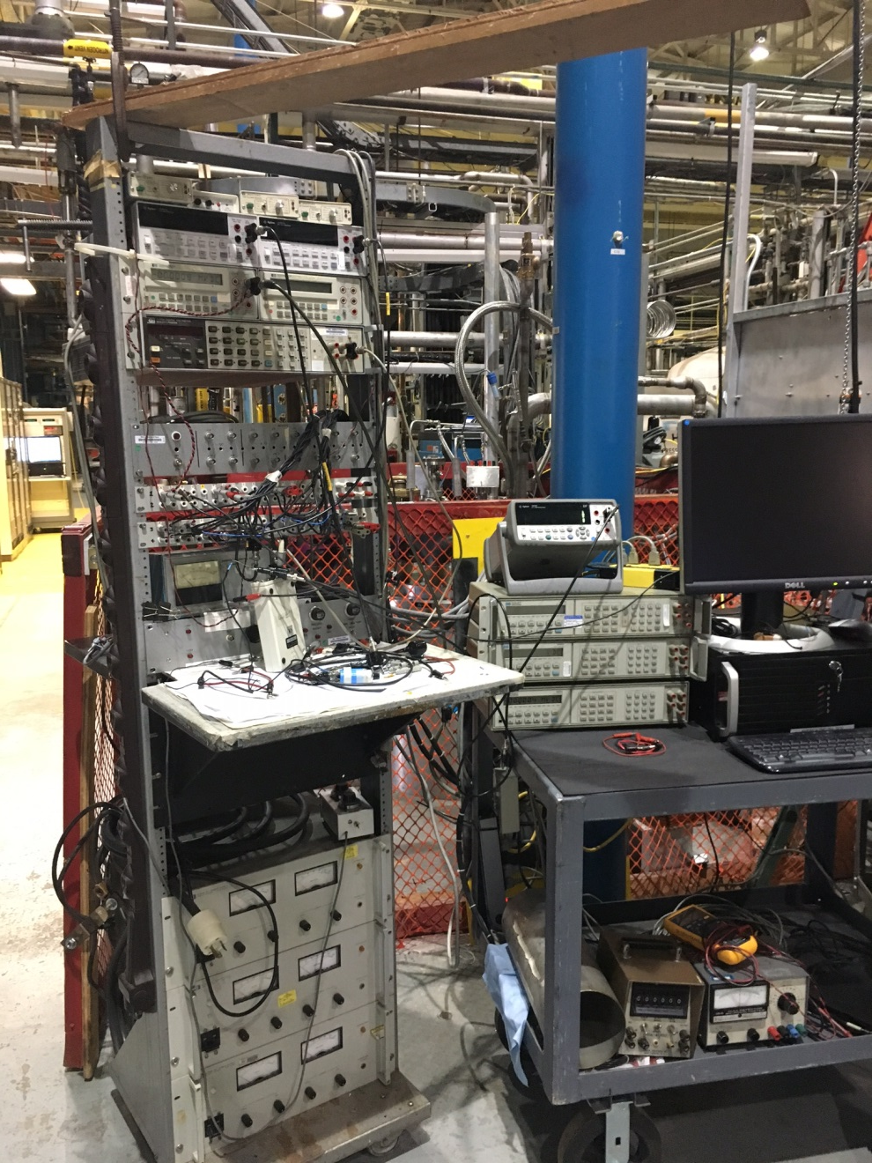
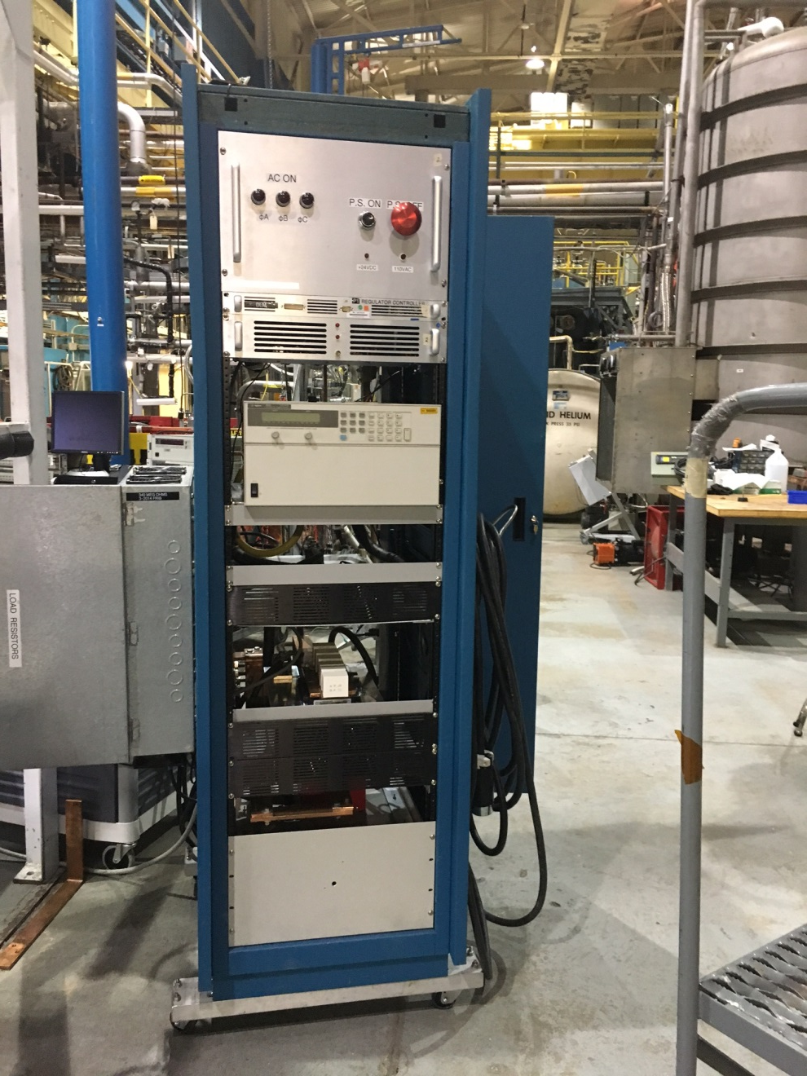
HTS Quench Protection

Slide 23
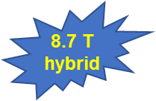
HTS Coil Quench Test in
HTS/LTS Hybrid Dipole Structure
Encouraging Results:
HTS coils were ramped to quench, just like LTS coils
No degradation in HTS coils despite a number of quenches
Significant demonstration. 8.7 T may be the highest field HTS/LTS hybrid dipole magnet

Slide 24
Operation of HTS Coils
HTS coils operated like LTS coils
Significant voltage in HTS coils: >0.2 Volts

Slide 25
HTS and LTS Currents
(just before and after the quench)
LTS Common Coil Current (A)
Separate power supplies and separate energy extraction for HTS and LTS coils
HTS and LTS coils have different inductances and different characteristics

Slide 26
Magnetization studies in high field at 4 K in magnets made with the HTS tapes
(Hall probe measurements)
A select data presented in a couple of slides.
A significantly more data available.

Slide 27
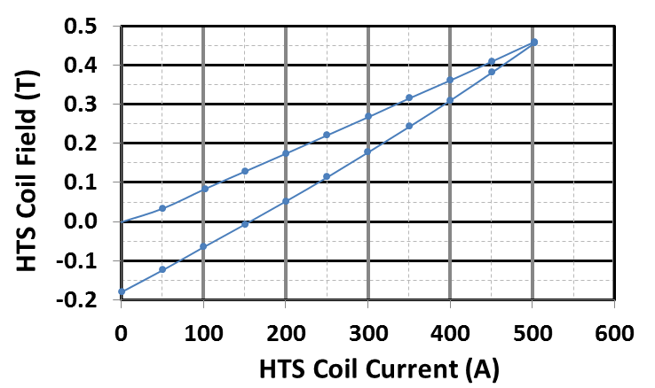
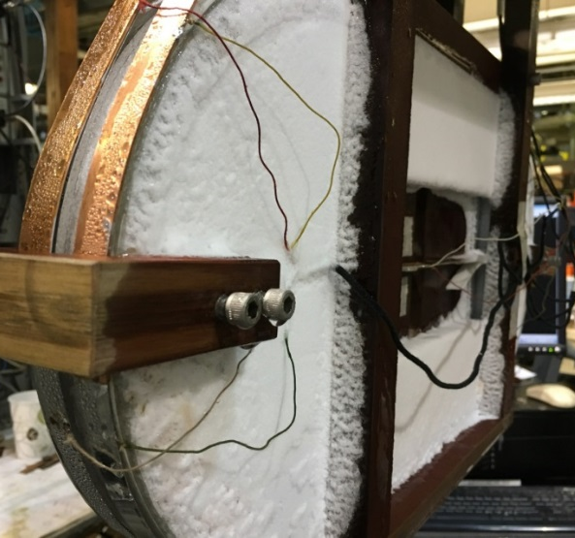
Test Run at 4 K (in 2 T background field from Nb₃Sn coils)
Additional field from the HTS coils in up and down ramp
(offset to start from zero to start up-ramp)
PBL/BNL STTR
field perpendicular configuration

Slide 28
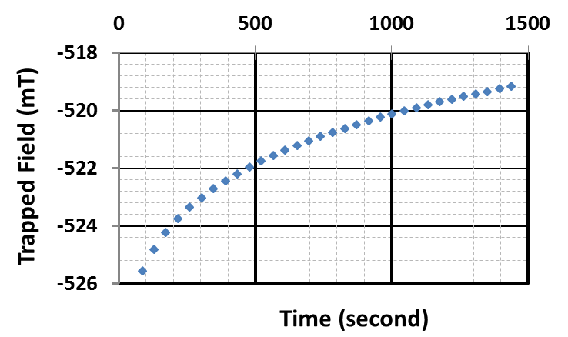
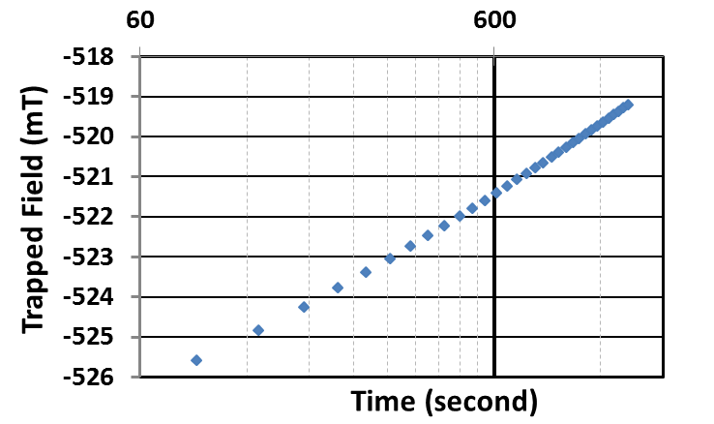
Decay of Trapped Field
(after the final run to ~8.7 T hybrid field @ 4 K)
Flux creep

Slide 29
Summary and Conclusions
With it’s vast and unique experience with various HTS, BNL can provide a strong contribution to US high field Magnet Development Program, particularly in the area of HTS magnets
With a unique team experienced in large scale magnet productions in partnership with industry for superconducting colliders, BNL can help develop HTS magnets that industry can build
BNL common coil magnet provides immediately a unique fast turn around, low cost magnet development test facility
BNL can make unique and significant contributions by providing answers to key basic science and technology within a year

Slide 30
Extra Slides on FRIB Quench Studies

Slide 31
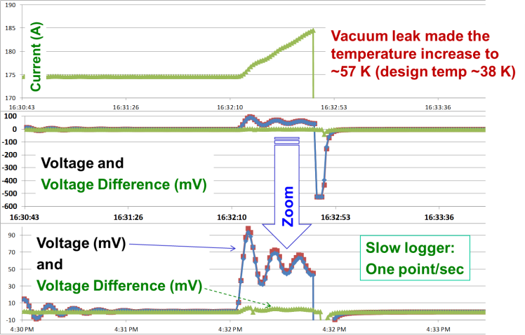
Protection of HTS Magnet During an Operational Accident Near Design Current
Design: 210 A in SP Coils
185A
175A
Ringing in power supply made situation worse
90mV

Slide 32
Snap Shot of the Event (Quench?) that Triggered the Shut-off
Fast data logger:
One point/msec
Diff
voltage
Large inductive voltage in individual coils (ramp)
Small quench detection threshold (2 mV) kept during the ramp by monitoring difference voltage
No degradation in coil performance after the event

Slide 33
Event (Quench?) while ASC Coils were held at 382 A (design: 310 A) at ~50 K (design: 38 K)
Current (A)
Shut-off
Coil Voltages
(mV)
Shut-off
Zoom
Slow logger:
One point/sec
Coil Voltages
(mV)
Events prior
to Shut-off

Slide 34
Snap Shot of the Event in ASC Coils
(individual and difference voltages)
Event at (a)12 K above the design temperature and (b) at 24% above design current
Fast data logger
One point/msec
Difference Voltage
Shut-off
This and previous event appear to be the sign of flux jump
This exceeded quench threshold, triggered shutoff & energy extraction
No degradation in coil performance observed

Slide 35
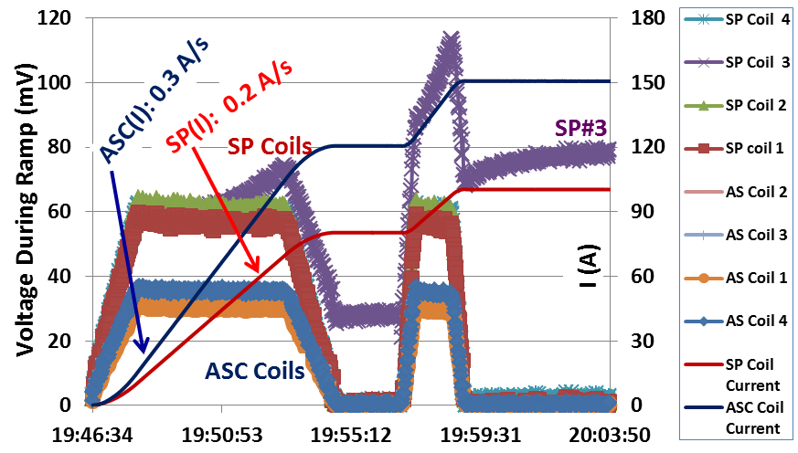
Operation Well Beyond the Quench Detection Threshold Voltage (~ mV)
Test temperature: ~67 K
(ASC to 150 Amp; SP to 100A)
Operated at about two order of magnitude beyond the quench detection threshold. No degradation in coil performance observed.

