Slide 1

The 18th US MDP 2212 WG meeting, Feb 2025
US MDP 2212 WG meeting, Feb 2025
2025/02/25
Meeting series: https://conferences.lbl.gov/category/100/

Slide 2
  Status of each lab’s 2212 MDP program
News from ARDAP project. (1) billet #5 in characterization. (2) billet #6 in production.
News from LBNL CCT program.
  (1) BIN5-CCT5 fully assembled. Test targeted March 2025.
  (2) Bi-CCT2 winding with a 12 mm wide cable ongoing.
News from FNAL SMCT program.
  Alessio is at LBNL to complete winding at LBNL, and will coordinate the first prototype coil fabrication. Mandrels at FNAL machine shop. More parts to fabricate – 1) splice box support, 2) keys, 3) pins, CAD models available. Drawings?
CPRD request. 1) 0.16 mm, single-stack 36 filaments Alex Otto wire. Pure Ag sheath. 1 bar HT solenoid – no leakage – no-insulation. What length is available? Purchase ~20 (or a length that makes sense) meters first. Request in. Waiting for quotation.

Slide 3
  Status of each lab’s 2212 MDP program
Facilities: (1) RENEGADE OP furnace (Reach desired T and pressure. More tuning coming. 85 cm long CCT dummy mandrel used) . (2) DELTECH OP furnace (zone #1 failed. Heating element). O
  OP Furnace Update Renegade 2.0 Shakedown (D. Davis, 2024/11/06), 1.5 zone homogeneity zone.
  Plug at the cold end didn’t improve homogeneity zone length. Will check radial homogeneity. Will run again without baffle tube. Will run with 100% power input to the top four zones, instead of 85%. Dense TCs at the top three zones.
  The most recent heat treatment with 25 T test coil: 1.25 zone. About 12.5” in length. With all zones in 100% power. Will test additional long dwelling steps at low temperatures (400C/600C/800C etc.) to see if temperature zones at high temperature can be increased.
  As a first step, LBNL is interested in getting a longer temperature zone (35-60” long for Bi-CCT1), even if at a lower gas pressure (e.g.g 10-20 bars).
News from NHMFL solenoid program (NIH funding – 28T NMR magnets, HTS inserts in OI outserts).
Funding arrived. Testing coils. Need to manage up to 600 MPa tensile stress.

Slide 4
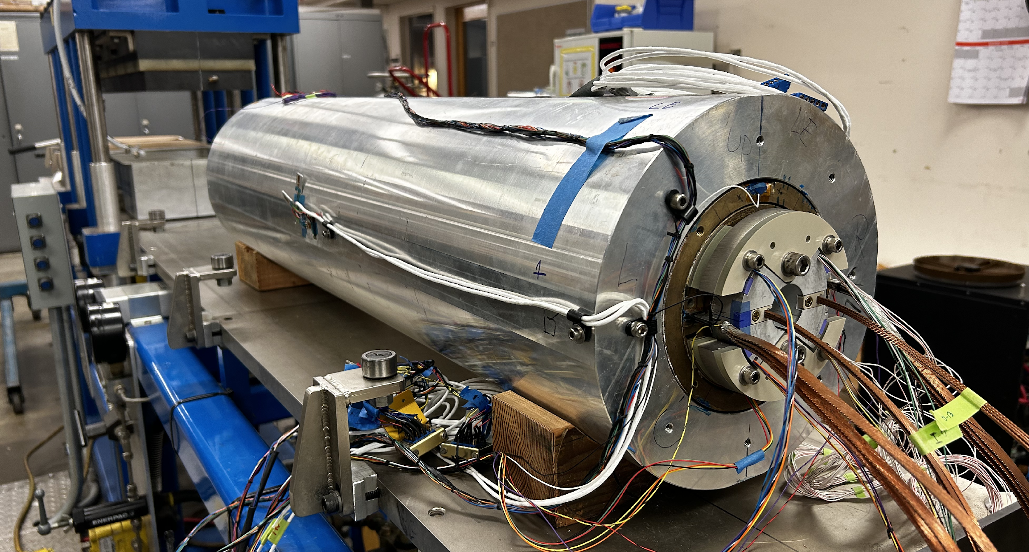
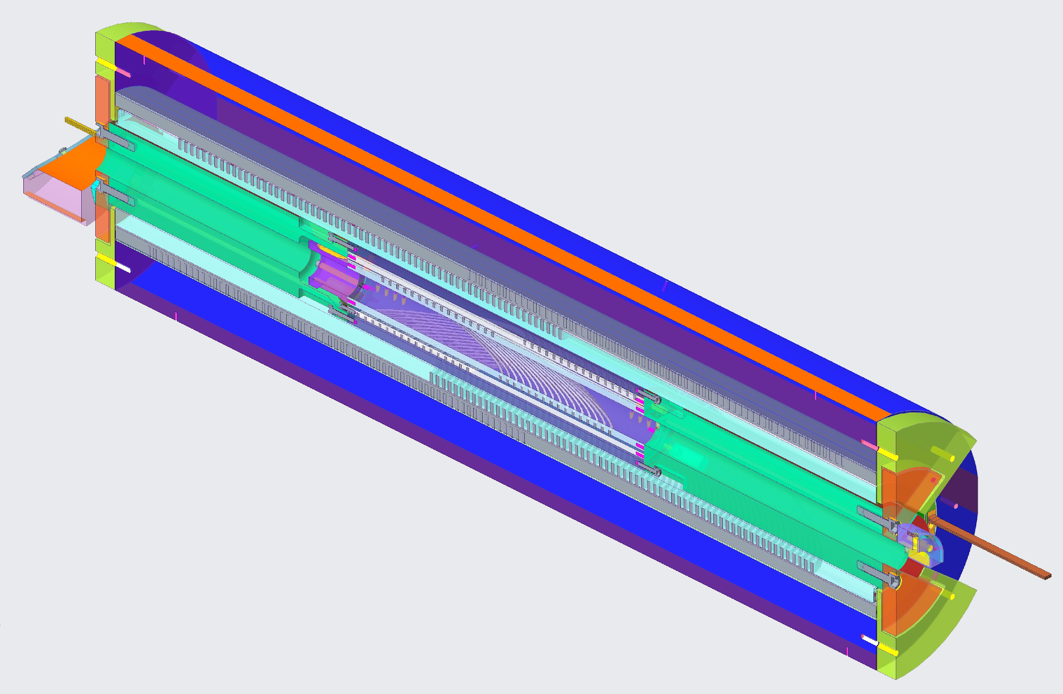
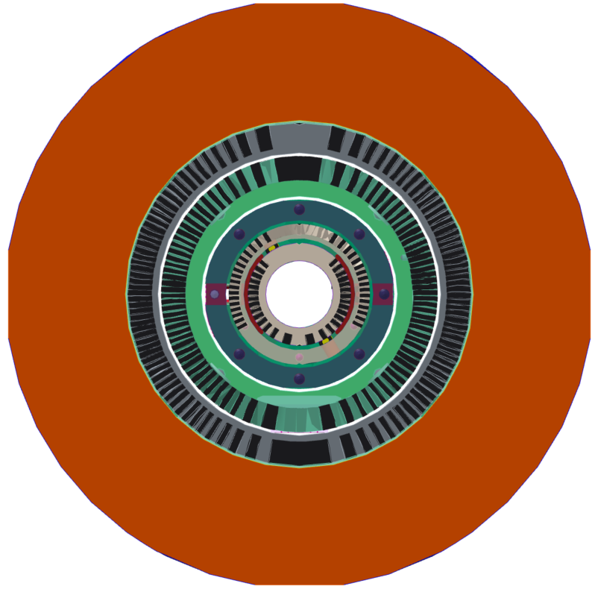
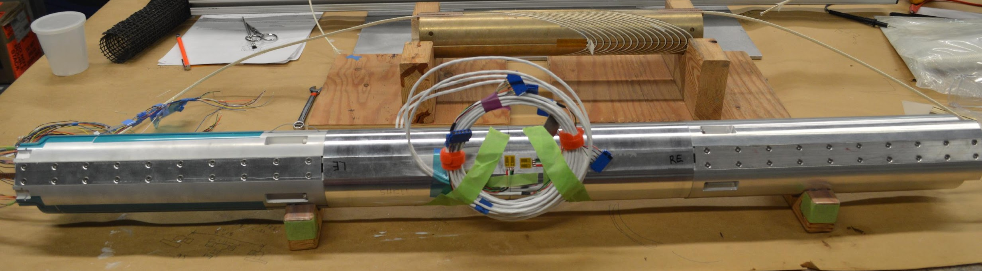
Hybrid Nb₃Sn/Bi-2212 dipole magnet CCT5-BIN5 assembled and ready for test
CCT5/BIN5 hybrid dipole magnet
CCT5
BIN5
BIN5 insert assembly

Slide 5
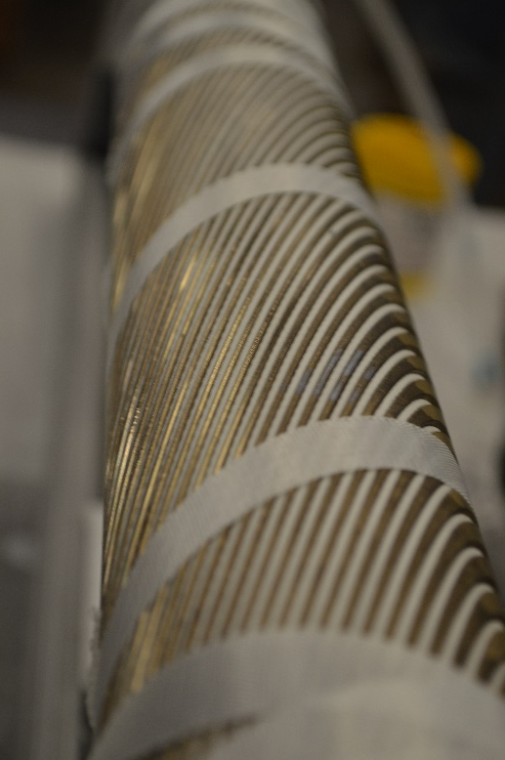
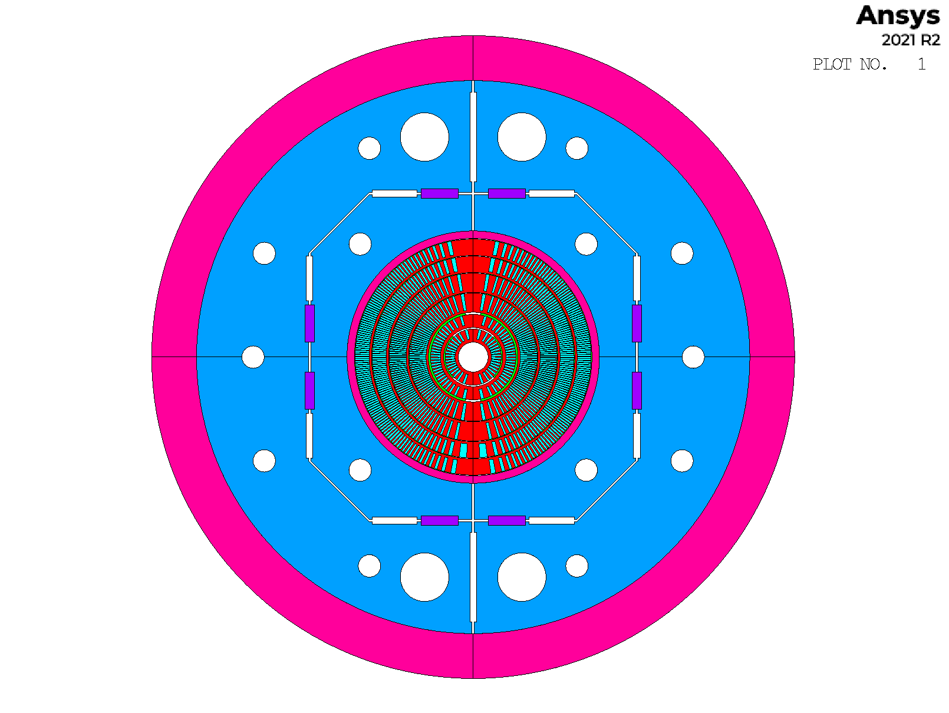
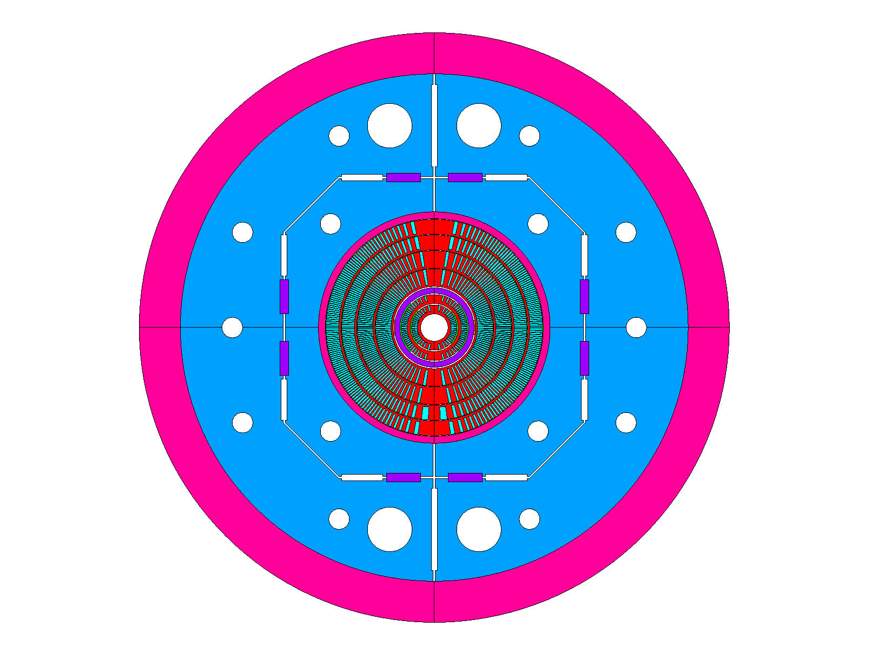
Bi-CCT1 and Bi-CCT2 are an integrated element of US MDP’s hybrid dipole magnet development
Bi-CCT1
Three coils fabricated
Heat treatment@NHMFL’s
RENEGADE furnace
Bi-CCT2 in CCT6
Bi-CCT1 in CCT6
Mandrel | IL (Inner Layer) | OL (Outer Layer)
Material | Aluminum Bronze 954 | Aluminum Bronze 954
Mandrel ID (mm) | 40 | 70
Mandrel OD (mm) | 66.2 | 96.2
Mandrel length (mm) | 850 | 850
  BiCCT1
    Target: ~5 T in 40 mm aperture
    Coils wound and ready for reaction
  BiCCT2
    Target: ~7 T in 40 mm aperture
    Cable fabricated.
    Winding test in progress

Slide 6
CPRD conductor request
On Thu, Jan 23, 2025 at 7:02 PM Ian Pong <ipong@lbl.gov> wrote:
Dear Tengming and Vadim,
Hello. I am writing to you regarding the conductors needs from MDP Area Ib and Ic.
Could you collect from the MDP BI-2212 and REBCO insert dipoles (Area I.b and I.c), for which you are the sub-Area coordinators, any conductor needs and communicate with me please? I am including Paolo here so that he can coordinate and provide input on the hybrid integration.
I would like to have your input before the MDP Collaboration Meeting (end of May). When assessing your conductor needs, please consider:
The lead time. The lead time for orders to deliver has been long and growing. 2 years is what we might need to expect from PO signature to receiving strands. Quotation, negotiations, and approvals for large dollar value orders, and cabling and insulation will easily add several months on either side of the lead time.
The time period. CPRD would like to encourage you to consider your needs into the future (in line with the revised MDP roadmap) as far as you can. Please indicate your needs accordingly.
Where you can, indications on the specification, however general, will be welcomed.
This can be your Area's initial view. Please do not feel you will be bound by it.
The Area plan for conductor usage should be presented at MDP general meetings and/or the annual collaboration meeting. CPRD is preparing the planning of our upcoming portfolio and strategy on conductor procurement. Your input would be very valuable to us.
Please let us know. We look forward to hearing from you.
With best wishes,
Ian.

Slide 7
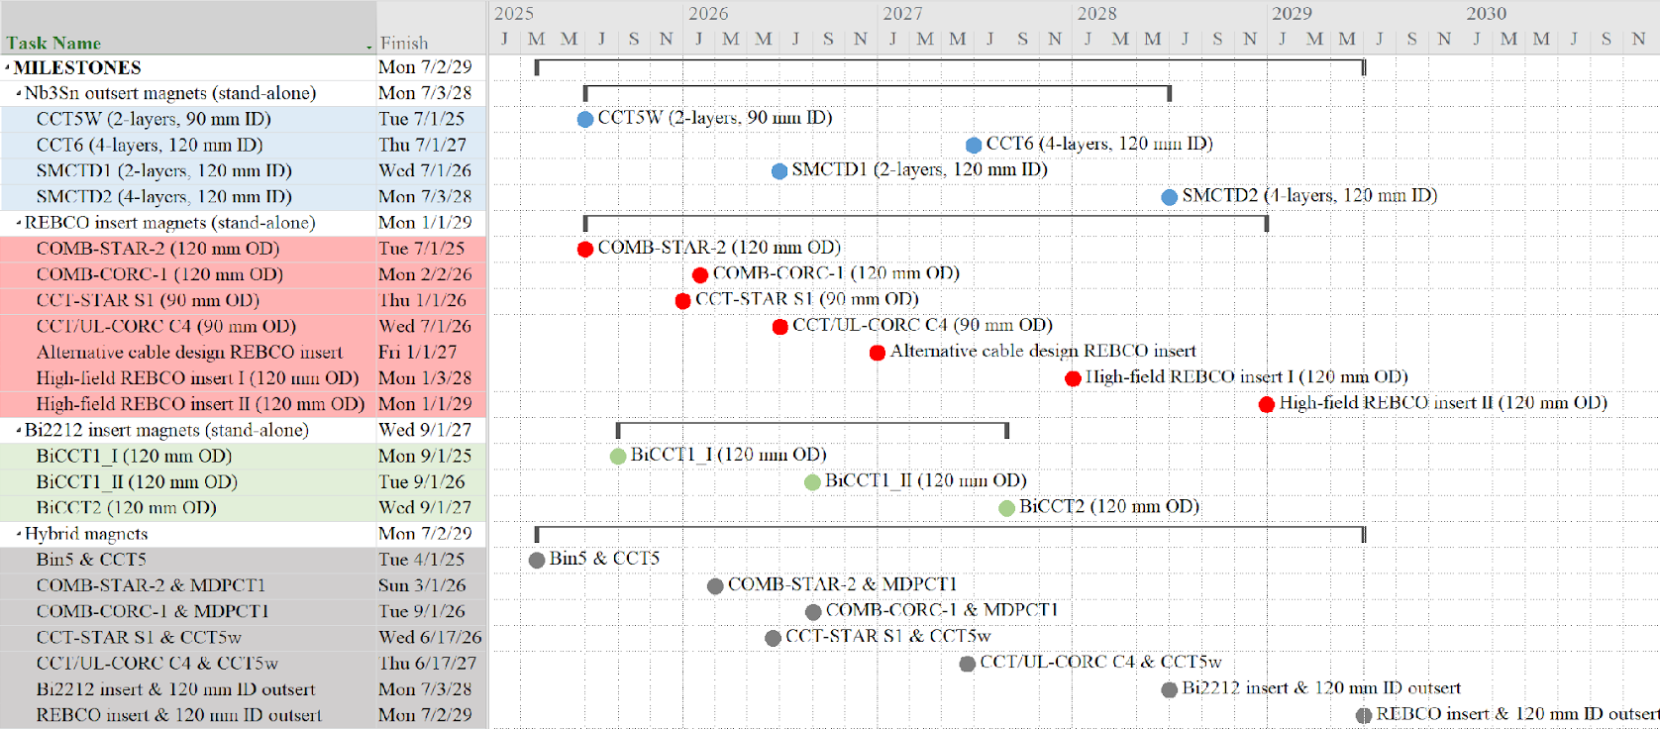
Possible milestones coupled with hybrid magnet program
Paolo Ferracin, US-MDP General Meeting, 11/20/2024

Slide 8
CPRD conductor request (proposal)
Magnet construction:
Bi-CCT1-II: >70 m Rutherford cable (17 strands, 0.8 mm diameter), ideally by Jan 2026.
Bi-CCT2-I: >50 m cable (22 strands, 1.0 mm dia), ideally by Jan 2027.
Exploratory studies with SMCT:
6-around-1 cable? TS has a piece.
17-strand Rutherford cable.
Inputs from solenoids:

Slide 9
SMCT 2212
Alessio made a presentation and a discussion of heat treatment: ¼” central rod (Inconel coated with Alumina). One can attach a 1/16” TCs between this central rod and the mandrel
(Igor) Inconel mandrels: Will be sent from Fermilab to LBNL. Sharp edges removed. Stress relief heat treatment applied.
Need to manufacture keys.
Need to manufacture leads reaction support and splicing tooling etc.

