Slide 1

Reduced Order Models Toward Real Time Computation for HTS Magnets
LBL modeling WG meeting
S. Sorti, on behalf of LASA HTS team
17/03/2025

Slide 2

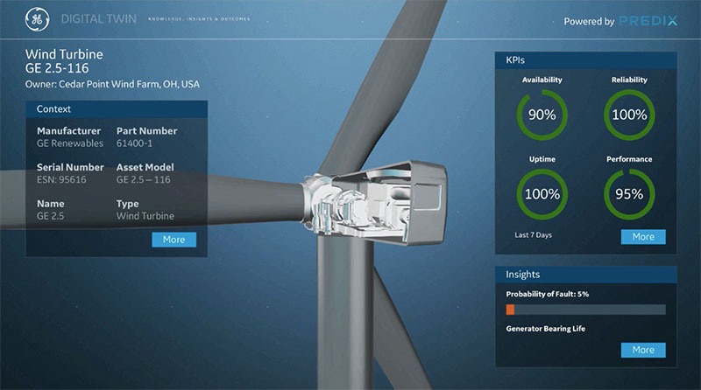
Baseline Motivation
Long Term Goal:
Treat superconducting device like many other complex modern systems: Real-Time sensors & models for a complete
control over its
operation
Today Goal:
share a small brick for
the goal above, to feed
interest in the topic and
in exchanges or collab.

Slide 3
Outline
Background and project-driven motivation
Reduced-models and data-driven models
(resistive magnet examples)
Reduced-models for superconducting magnets
Ongoing activities and future outlooks

Slide 4
Outline
Background and project-driven motivation
Reduced-models and data-driven models
(resistive magnet examples)
Reduced-models for superconducting magnets
Ongoing activities and future outlooks

Slide 5
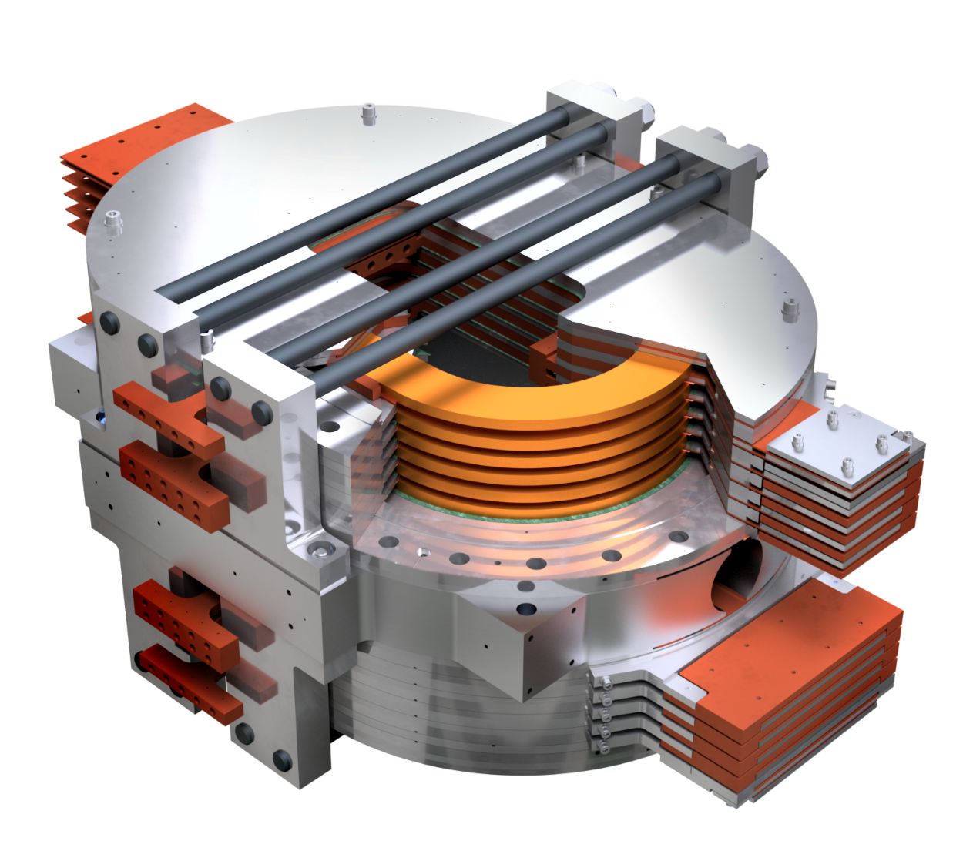


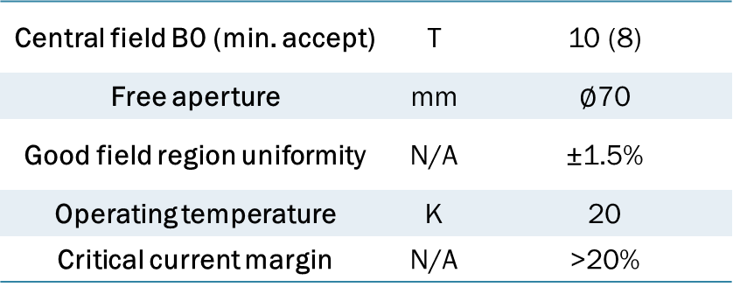
Background and Project-Driven Motivation
The quest for HTS NI coils
Italian PNRR-IRIS project is building a Metal-Insulated, all-HTS, flat-racetracks dipole.
3 years project: 2023-2025, no time for “exotic” solutions.
Central field B0 (min. accept) | T | 10 (8)
Free aperture | mm | $∅$70
Good field region uniformity | N/A | ±1.5%
Operating temperature | K | 20
Critical current margin | N/A | >20%
Engineering Design
and Construction

Slide 6
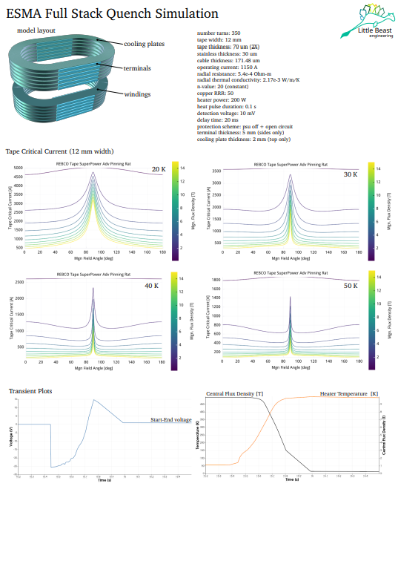
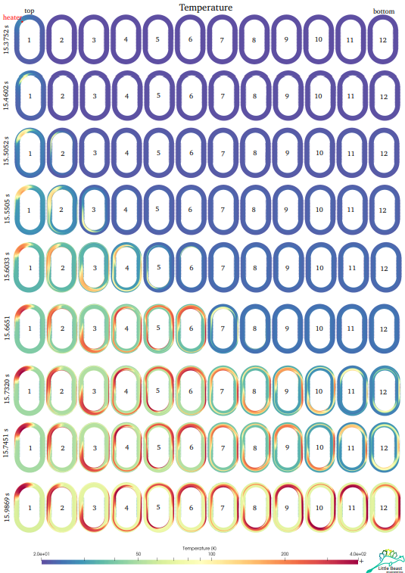
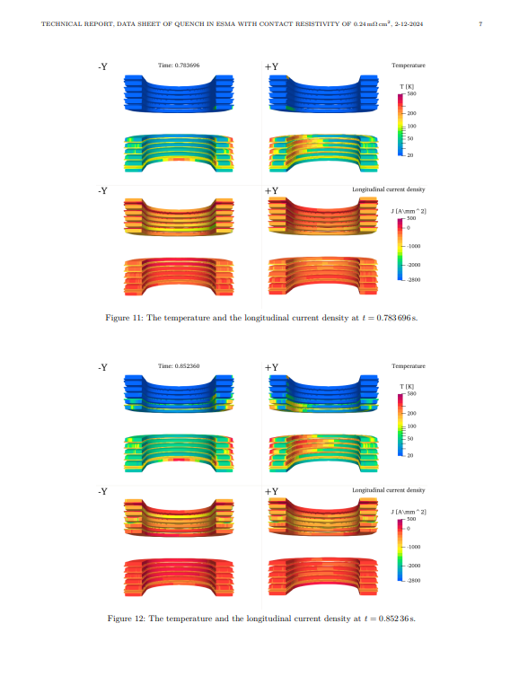
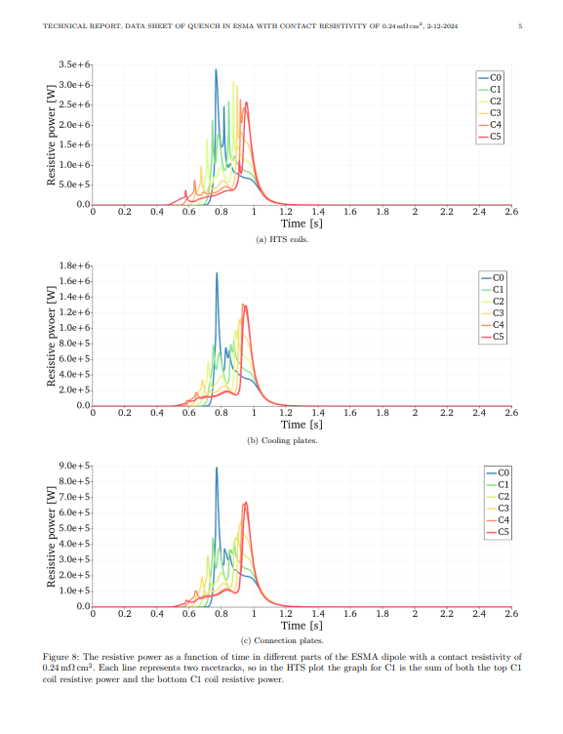
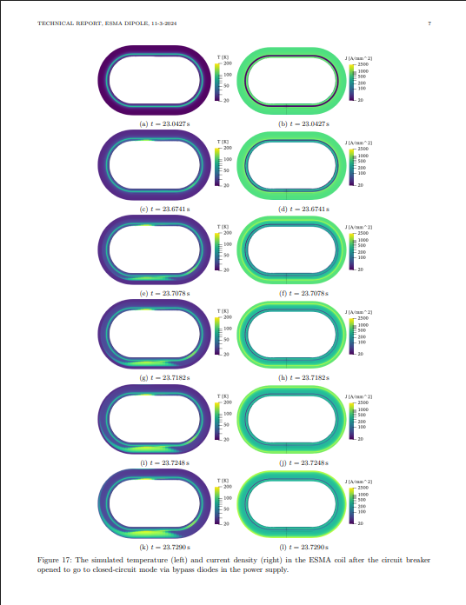

Background and Project-Driven Motivation
The quest for protecting HTS NI coils
A lot of work from an expert consultant
for quench protection. Strong points, after more than 1 year:
  Magnet too big to be self-
  or classically- protected
  Very hard to quench (E>50 J)
Shift to no quench paradigm
Consultancy for
Quench Protection

Slide 7
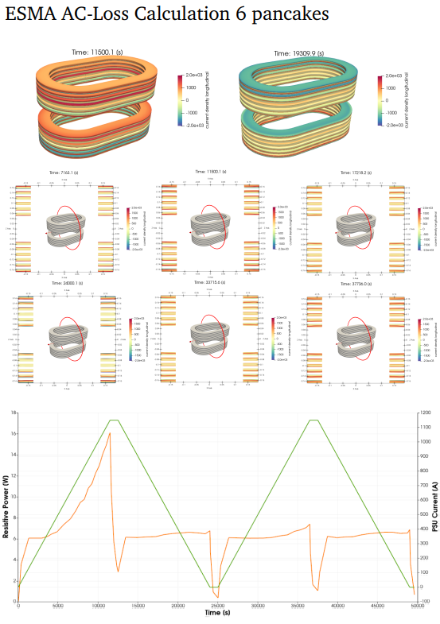
Background and Project-Driven Motivation
The embryonal work
For this purpose, the magnet is having a closed loop control in power
Online empirical algorithm (ASG knowhow)
for power estimation: stop ramping or reduce current if P>P_{lim}
Still, sub-optimal solution:
  Integral quantity (= works for major issues)
  Unquantified accuracy (=algorithm not
  knowing physics)
These simulations are too heavy to run in the algorithm!

Slide 8
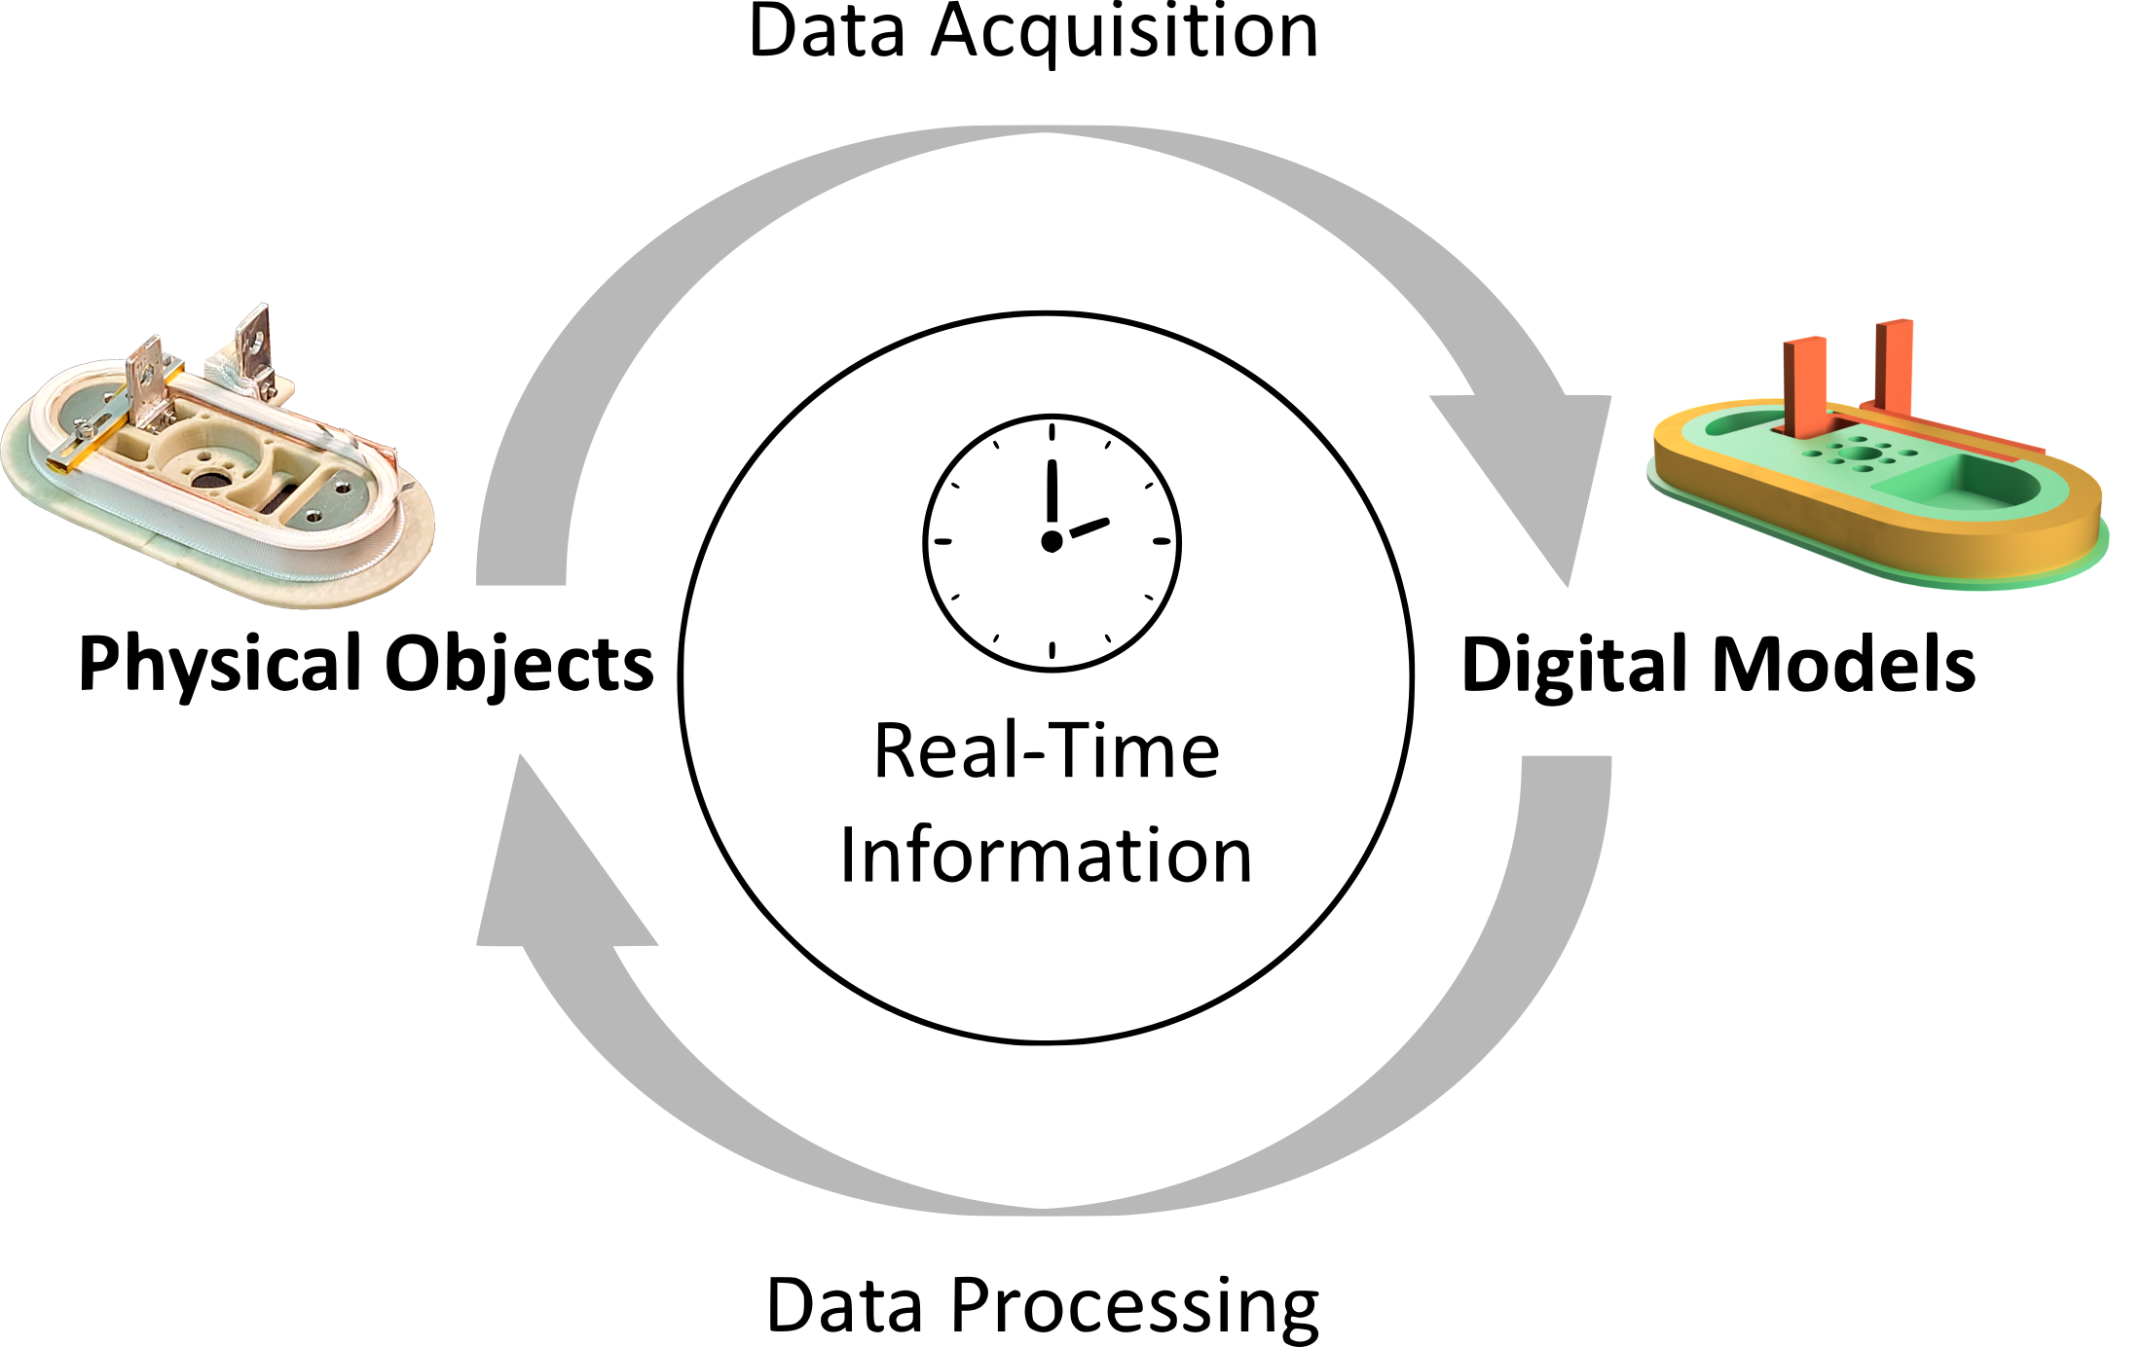
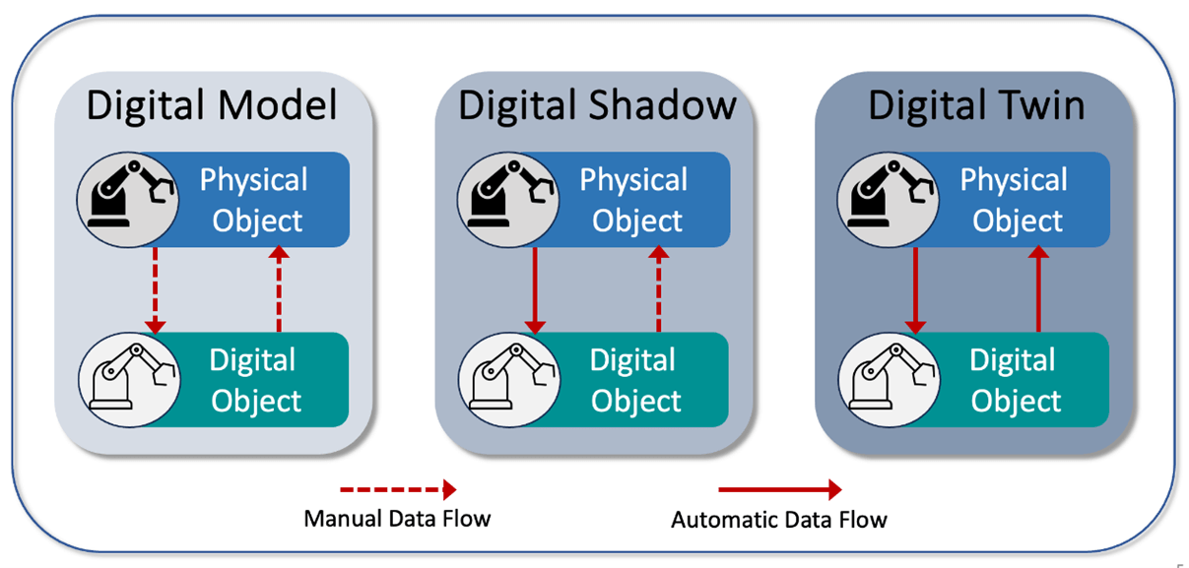
Background and Project-Driven Motivation
The desired work
The desired solution would be a robust description of the whole system.
Ideally able to infer the non-measured quantities by an optimal combination of a physical model and data (Kalman Filter).
Furthermore, this digital object should follow the real device through the entire
operative life → digital twin
Reprinted from Banerjee, Bonny, et al. "Digital Twin: A Quick Overview."

Slide 9
Outline
Background and project-driven motivation
Reduced-models and data-driven models
(+ resistive magnet examples)
Reduced-models for superconducting magnets
Ongoing activities and future outlooks

Slide 10
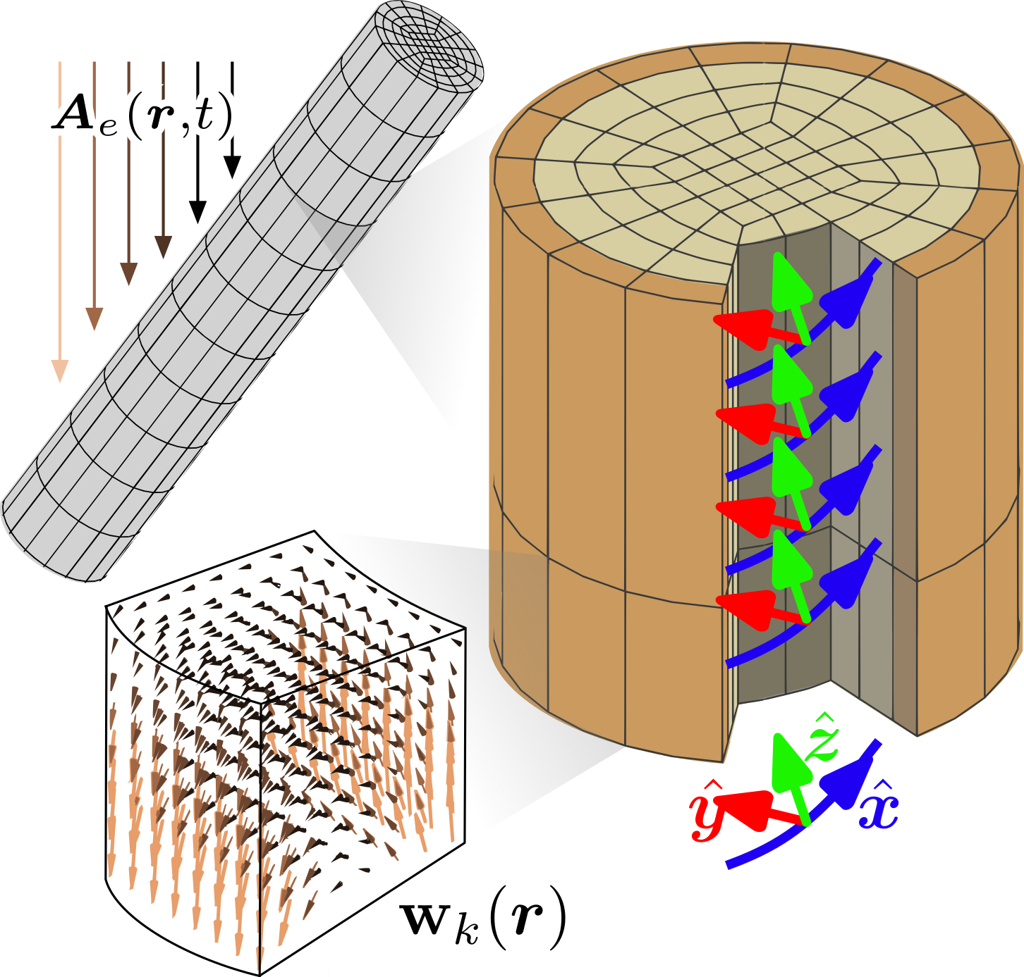
Volume Integral Formulation 1/3
Main features of the model
The chosen model for testing model order reduction is an integral formulation in T.
Main reasons:
key variables (J, B) ready for manipulation
have a compact set of degrees of freedom
(few DOFs for parts not reduced)
accurate computation of measurements everywhere
prioritize computational efficiency of ROM over model-building cost, since the focus is on as-built magnets.
The model applied to a twisted multi-filamentary homogenized strand

Slide 11
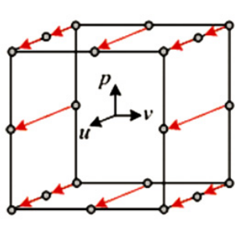
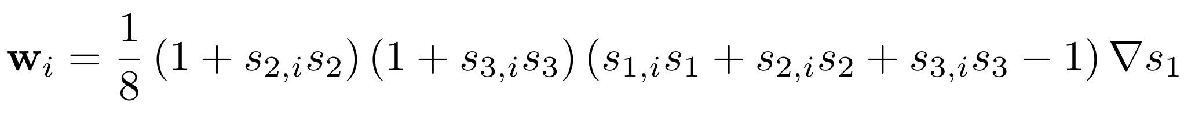
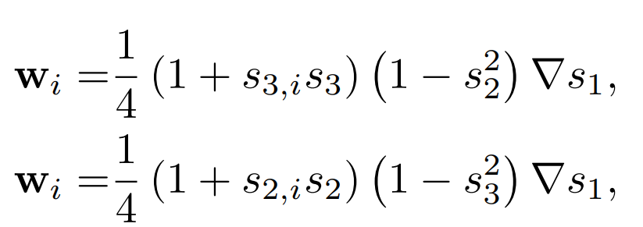
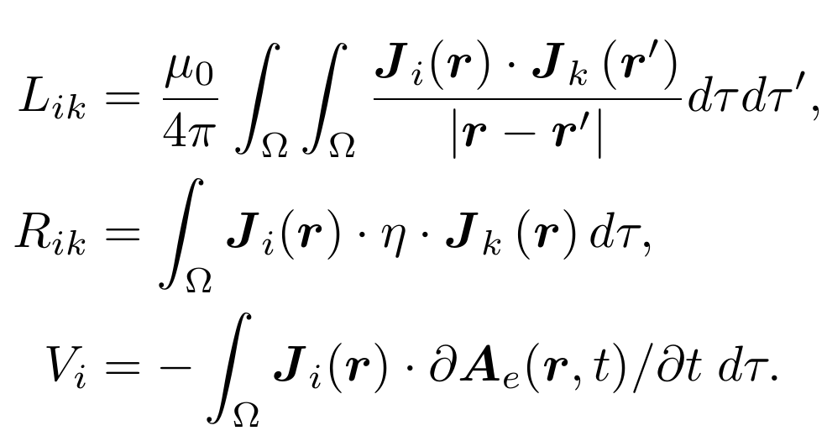
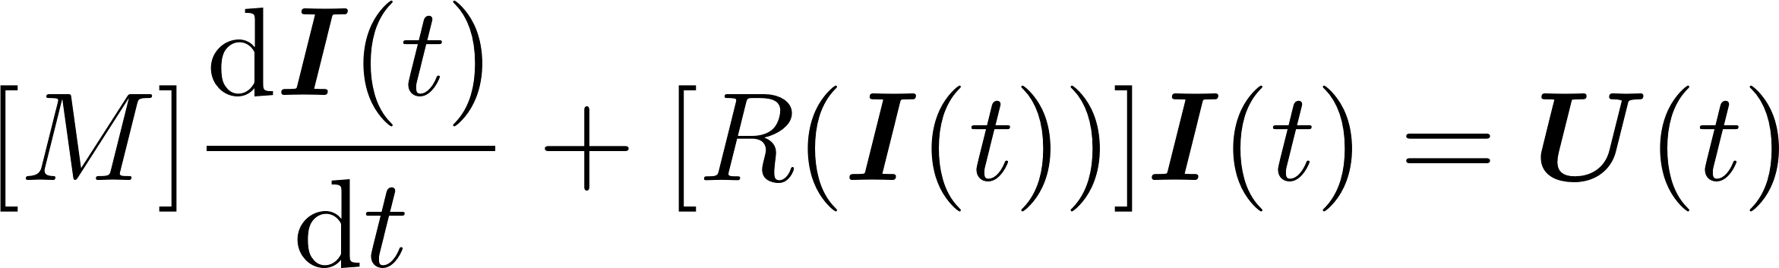
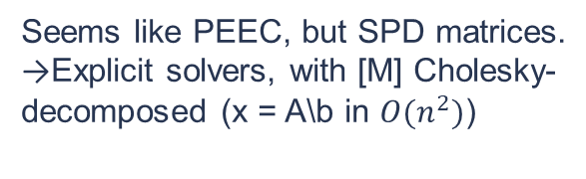

Volume Integral Formulation 2/3
Tree-cotree degauging still working!
Main features of the model
Still, overcoming some VIM limitations: quadratic edge elements
Given $J=∇×T$ we get linear gradients. Using $∇×w_{i}$ as shape functions:
s_{1,i}, s_{2,i}, s_{3,i} local coordinates of the edge
Full. Singularity solved with
sphere interaction method
Sparse. To be reassembled
at every time-step
Seems like PEEC, but SPD matrices.
→Explicit solvers, with [M] Cholesky-decomposed (x = A\b in $O(n^{2})$)
Vector-like. Can include also
transport current

Slide 12
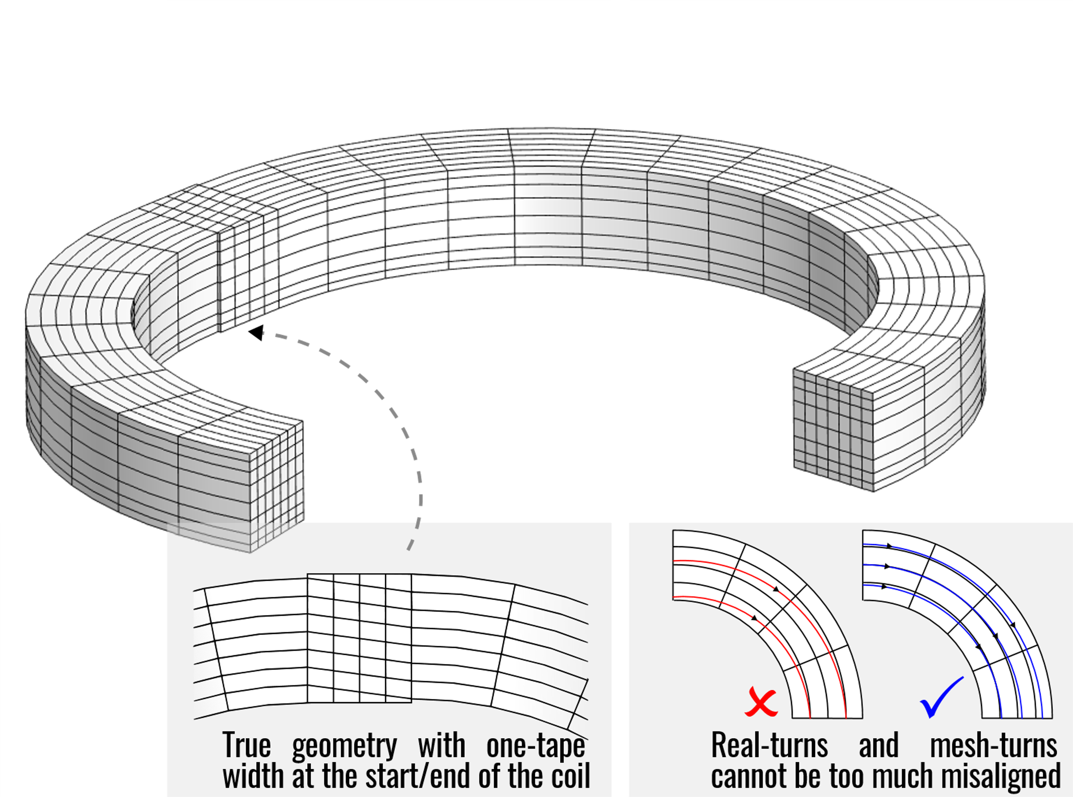
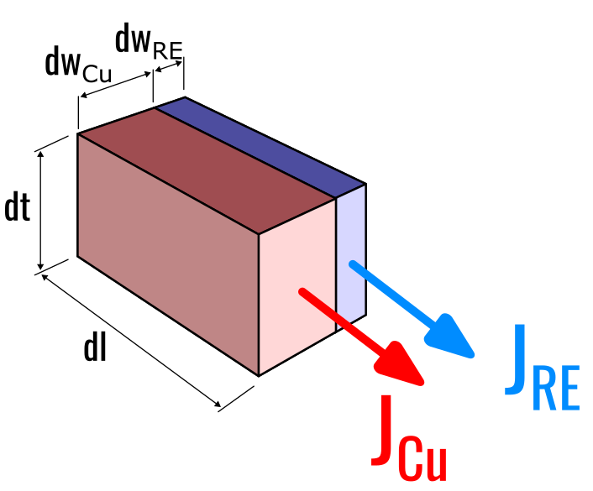
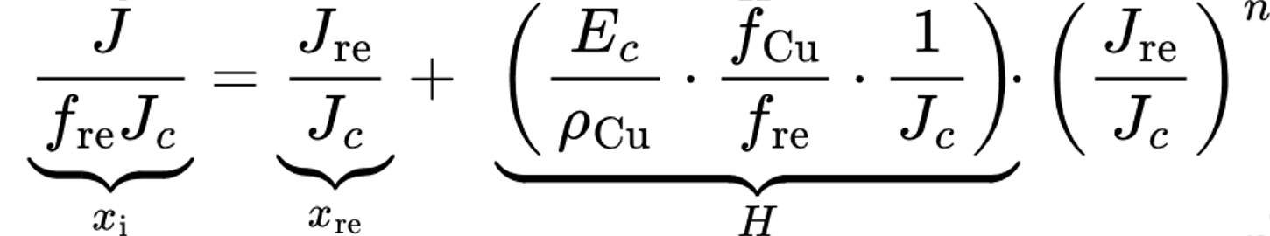
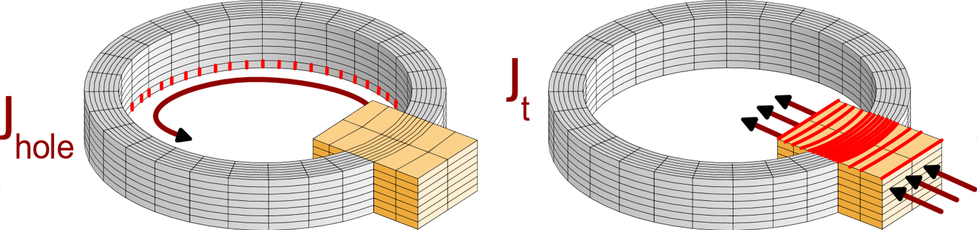
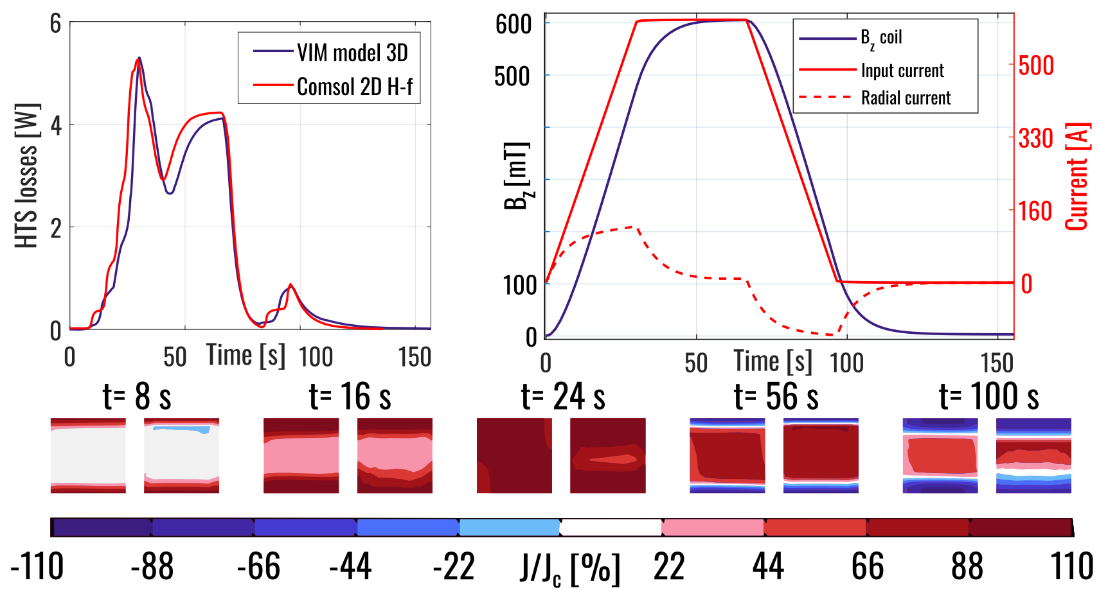
Volume Integral Formulation 3/3
Mesh for 30-40 turns
Main features of the model
Homogenization of conductor:
  merge turns in single mesh element;
  Radial currents for NI coils;
  Fast quality check:
  Current-sharing with stabilizer.
Not trivial multiply-connected domain.
Compared with common literature models
for NI coils (Mataira et al.), experimental
validation in pipeline.

Slide 13
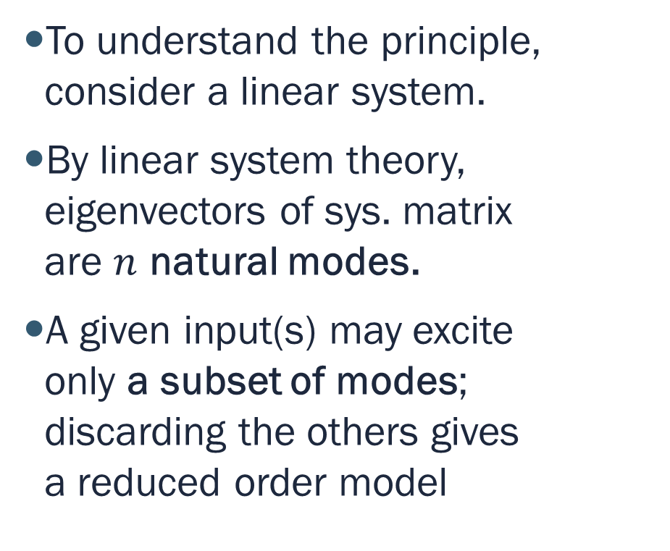
Reduced-order models
The principle
To understand the principle, consider a linear system.
By linear system theory, eigenvectors of sys. matrix
are $n$ natural modes.
A given input(s) may excite
only a subset of modes;
discarding the others gives
a reduced order model

Slide 14
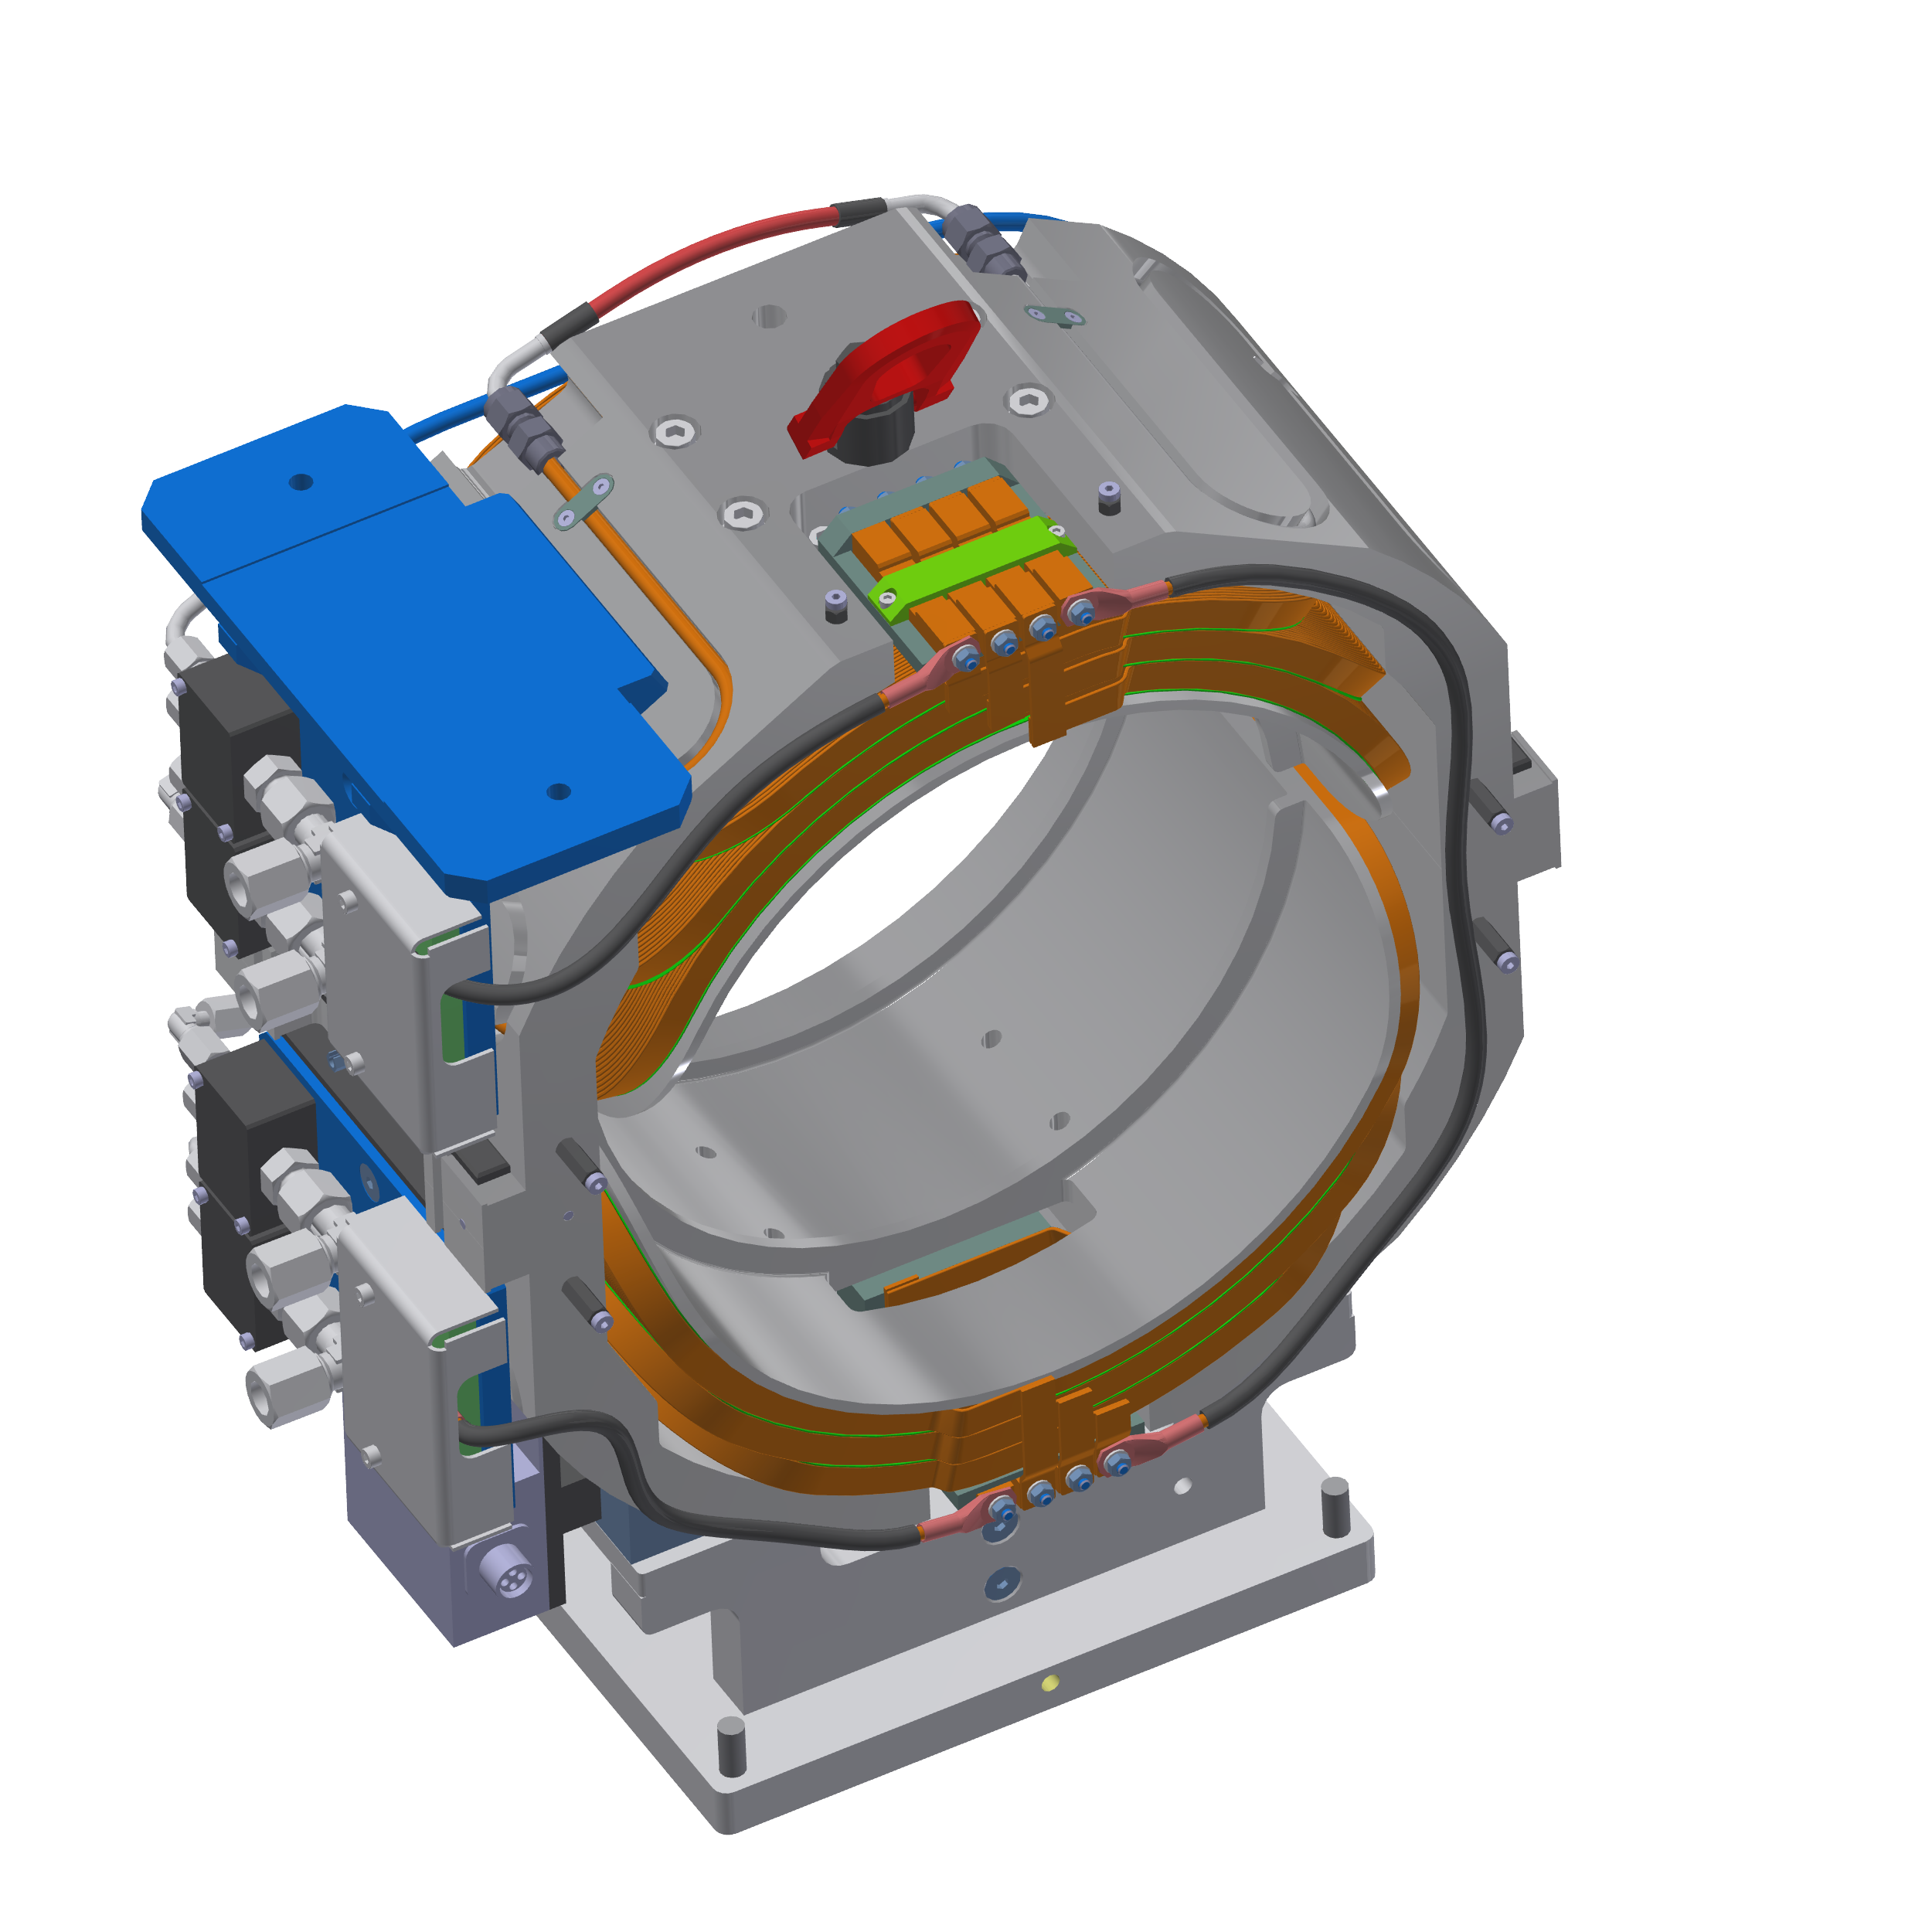
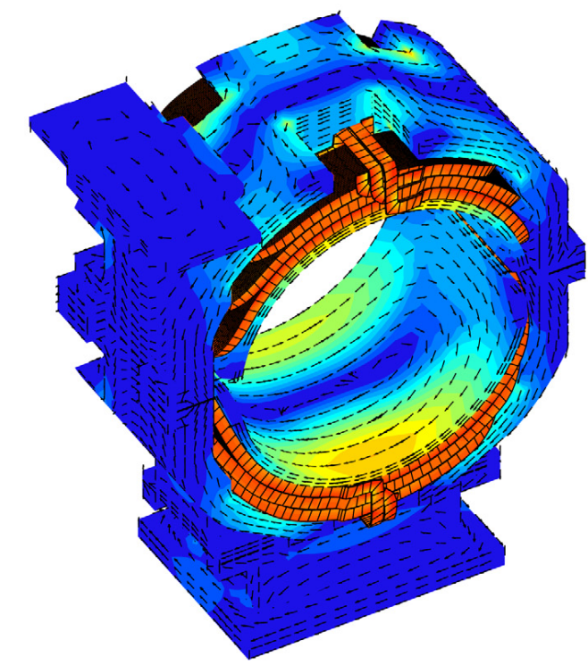
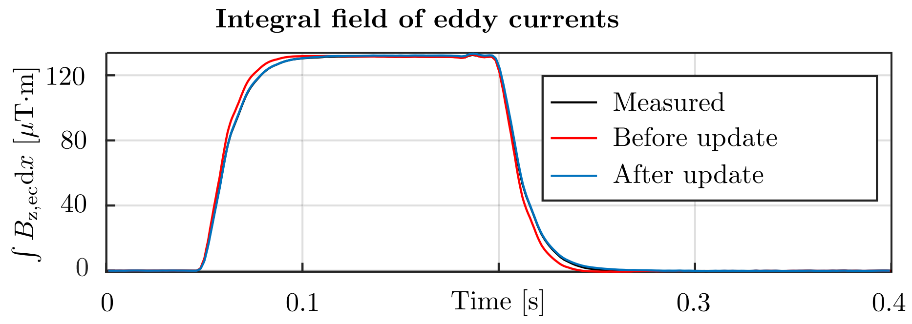
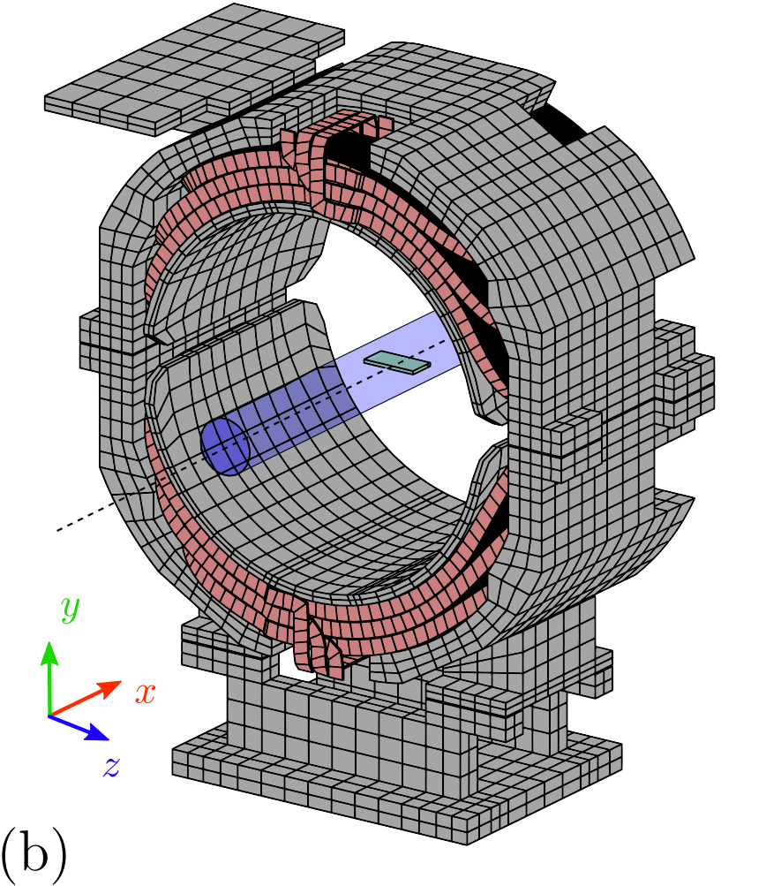
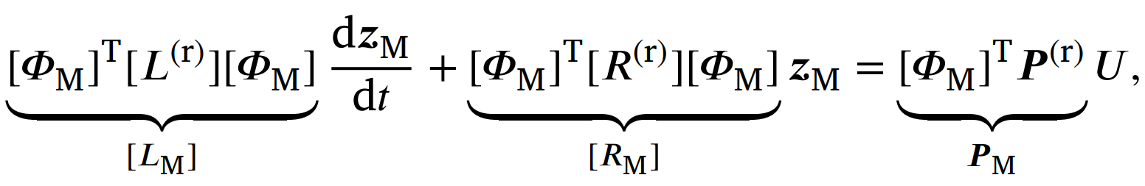
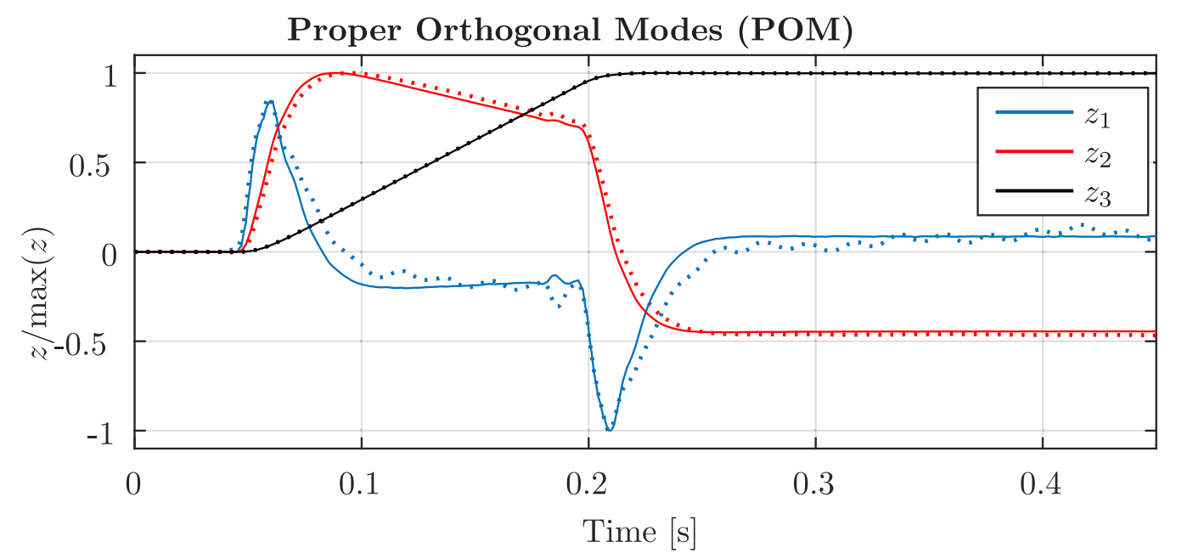
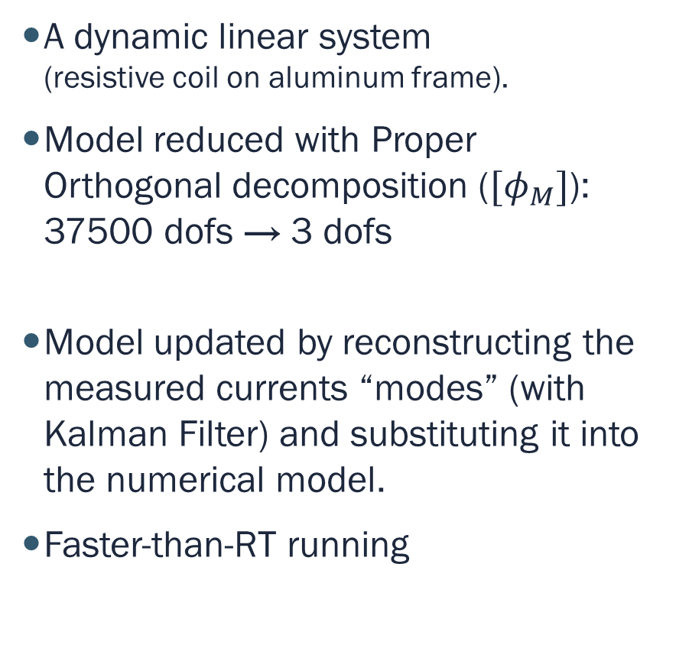
Reduced-order models
First application
A dynamic linear system
(resistive coil on aluminum frame).
Model reduced with Proper Orthogonal decomposition ($[φ_{M}]$):
37500 dofs → 3 dofs
Model updated by reconstructing the measured currents “modes” (with Kalman Filter) and substituting it into the numerical model.
Faster-than-RT running
Simulation
Estimation
from measurement with Kalman Filter

Slide 15
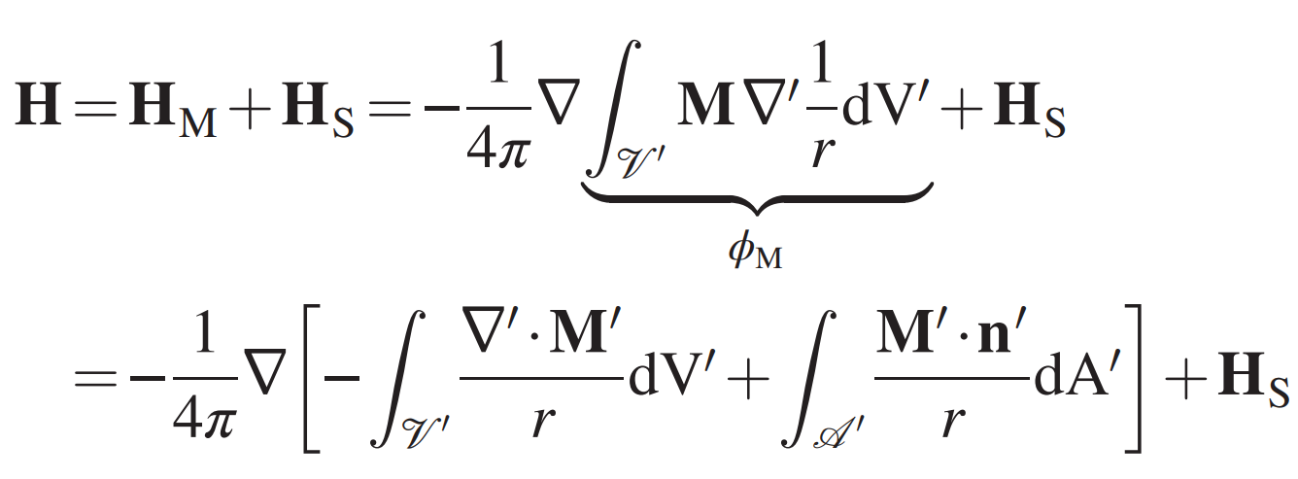
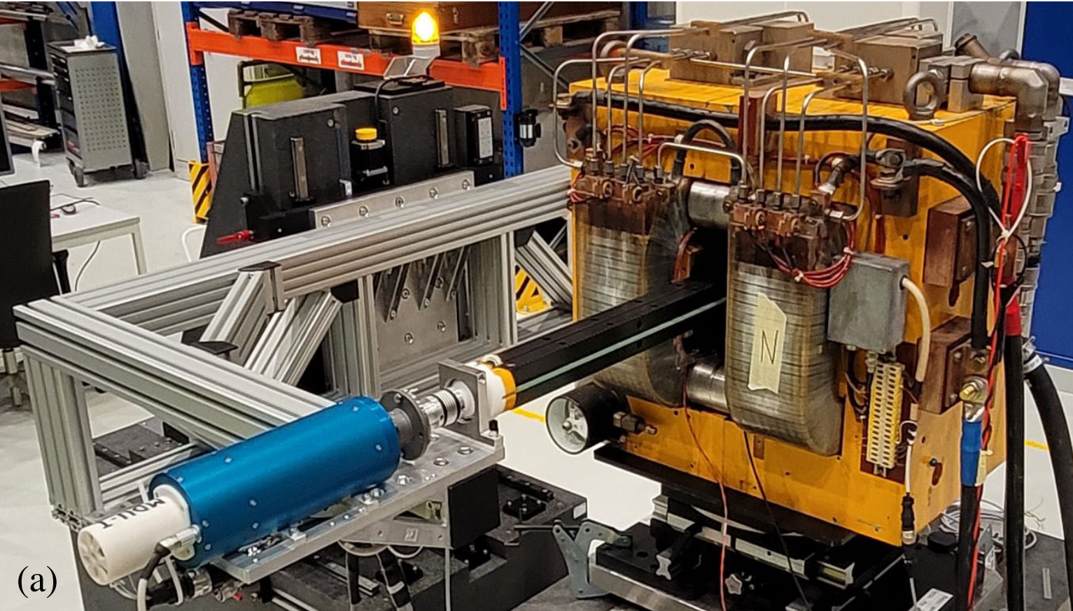
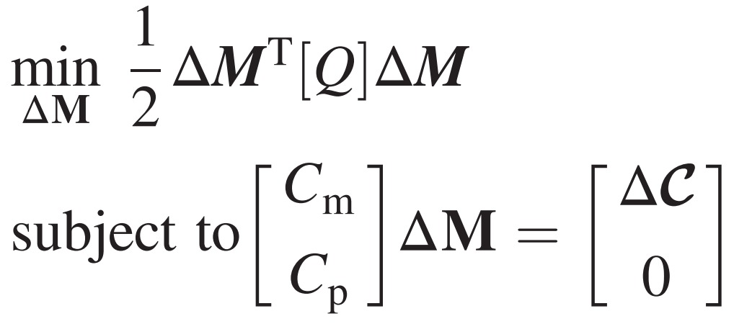
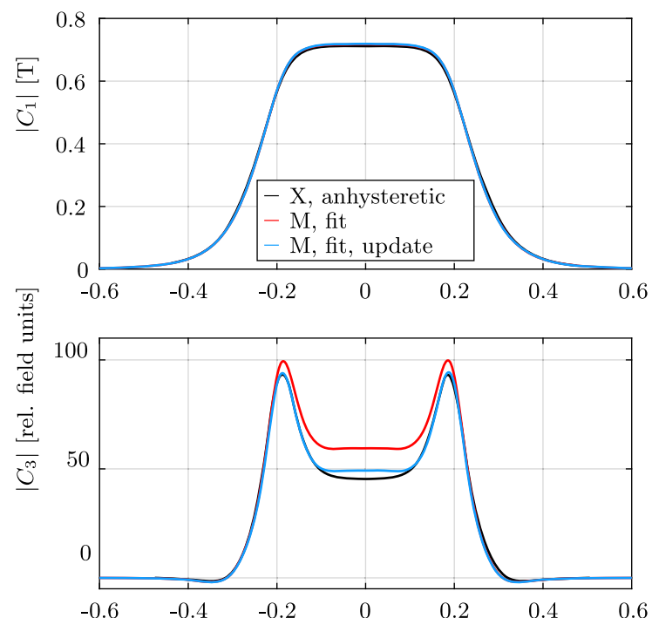
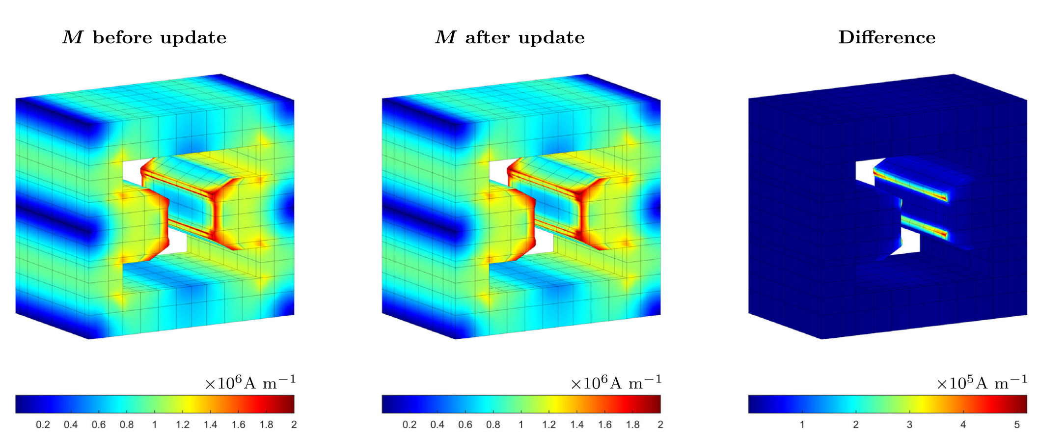
Data-driven models
MOR for Model-updating
A nonlinear yoke model was included in the formulation
(but temporarily discontinued)
The reduced order model makes it practicable to execute the following algorithm:
Nonlinear magnetization field correction
Updated by integral measurements,
Improving also local field map!
Sim. Error w.r.t
measurement
Simulation of measurement
Don’t touch not
measured

Slide 16
Outline
Background and project-driven motivation
Reduced-models and data-driven models
(resistive magnet examples)
Reduced-models for superconducting magnets
Ongoing activities and future outlooks

Slide 17
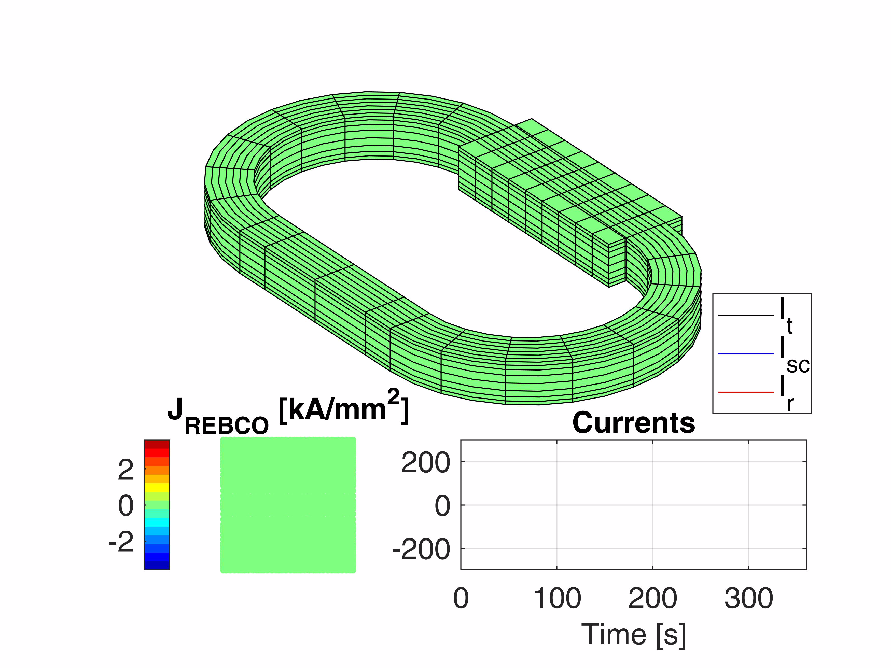
Simulation and model-order reduction
Speeding up the simulations
We want to model the behavior coils in self-field, transport-current imposed.
Ideal reduced-order model should then be able to cover arbitrarily charging profile during operation.
The chosen model-order-reduction technique is the Proper Orthogonal Decomposition (POD)
POD exploits linear projection of variables onto an ad-hoc subspace reducing the size most of the problem. Recalls modal reduction for linear system. Works with any model
|J|

Slide 18
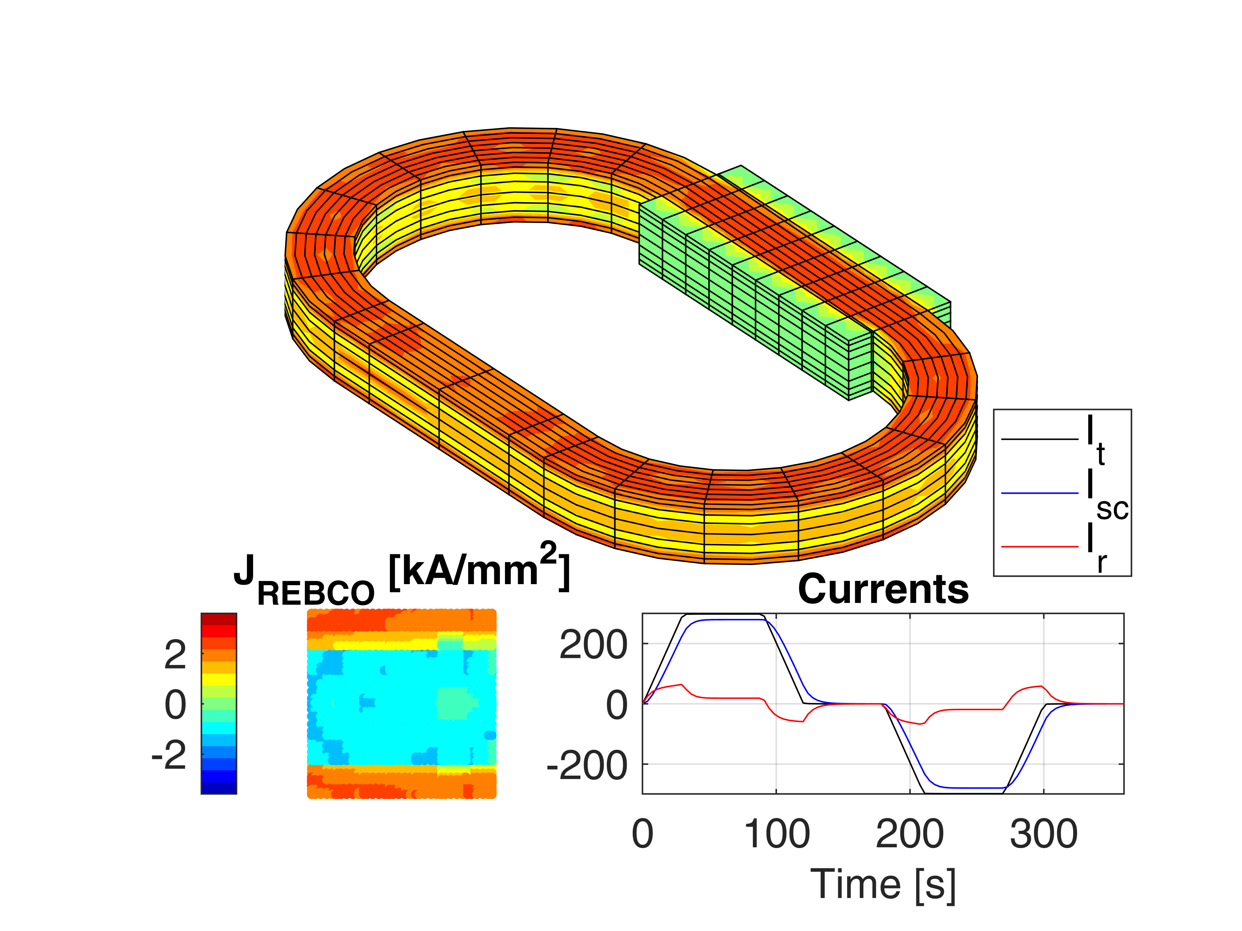
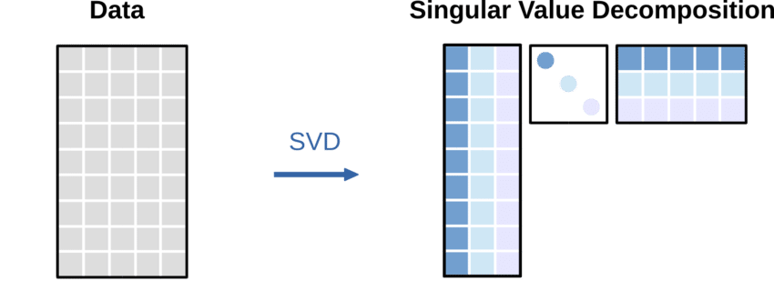
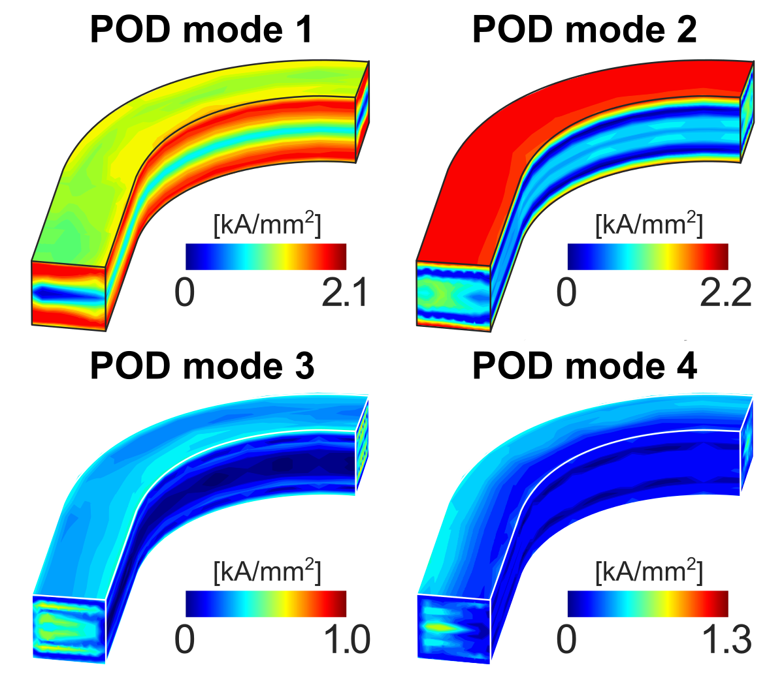

Simulation and model-order reduction
Reduced-order-model
Subspace for POD is selected by taking an “overall” simulation and performing the Singular Value Decomposition of the result:
x
[$ψ$]
t

Slide 19
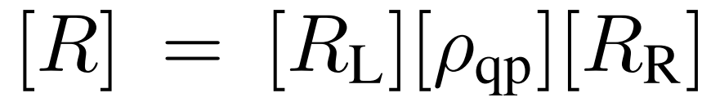

Simulation and model-order reduction
Reduced-order-model
Number of “modes” needed function of the desired
accuracy: singular values express
their “energy”. We thus transform$I_{red}=\left[P\right]I_{full}$
With the same transformation,
back to the full set of current
The weak-form problem is reduced (in blue):
Still, must re-compute in every gauss point,
so R is only partially reduced:

Slide 20
Simulation and model-order reduction
Reduced-order-model validation
We can compare accuracy in transient response and power as function of the modes against new cycles
The weak-form equations have now the size of the selected modes (10 vs 10000). Only step not reduced is the [ρ] update (same number of quadrature points)
→still, 50-100 times faster
(“real time” on a good workstation, as
N=21 took 170 s, against 2h of the full
model)

Slide 21
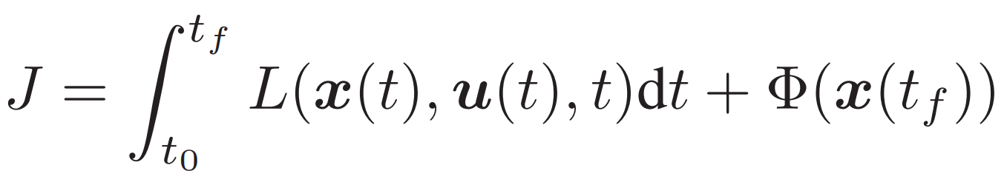
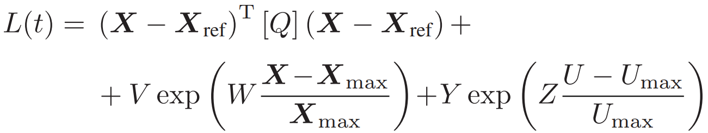
Application Example: Optimal Control
Recap and upgrade
We proposed an optimization algorithm based on Pontryagin's Minimum Principle.
100s of iterations = lumped or reduced order model.
For the moment, VIM + zero-D thermal, incoming thermal FEM.

Slide 22
Outline
Background and project-driven motivation
Reduced-models and data-driven models
(resistive magnet examples)
Reduced-models for superconducting magnets
Ongoing activities and future outlooks

Slide 23
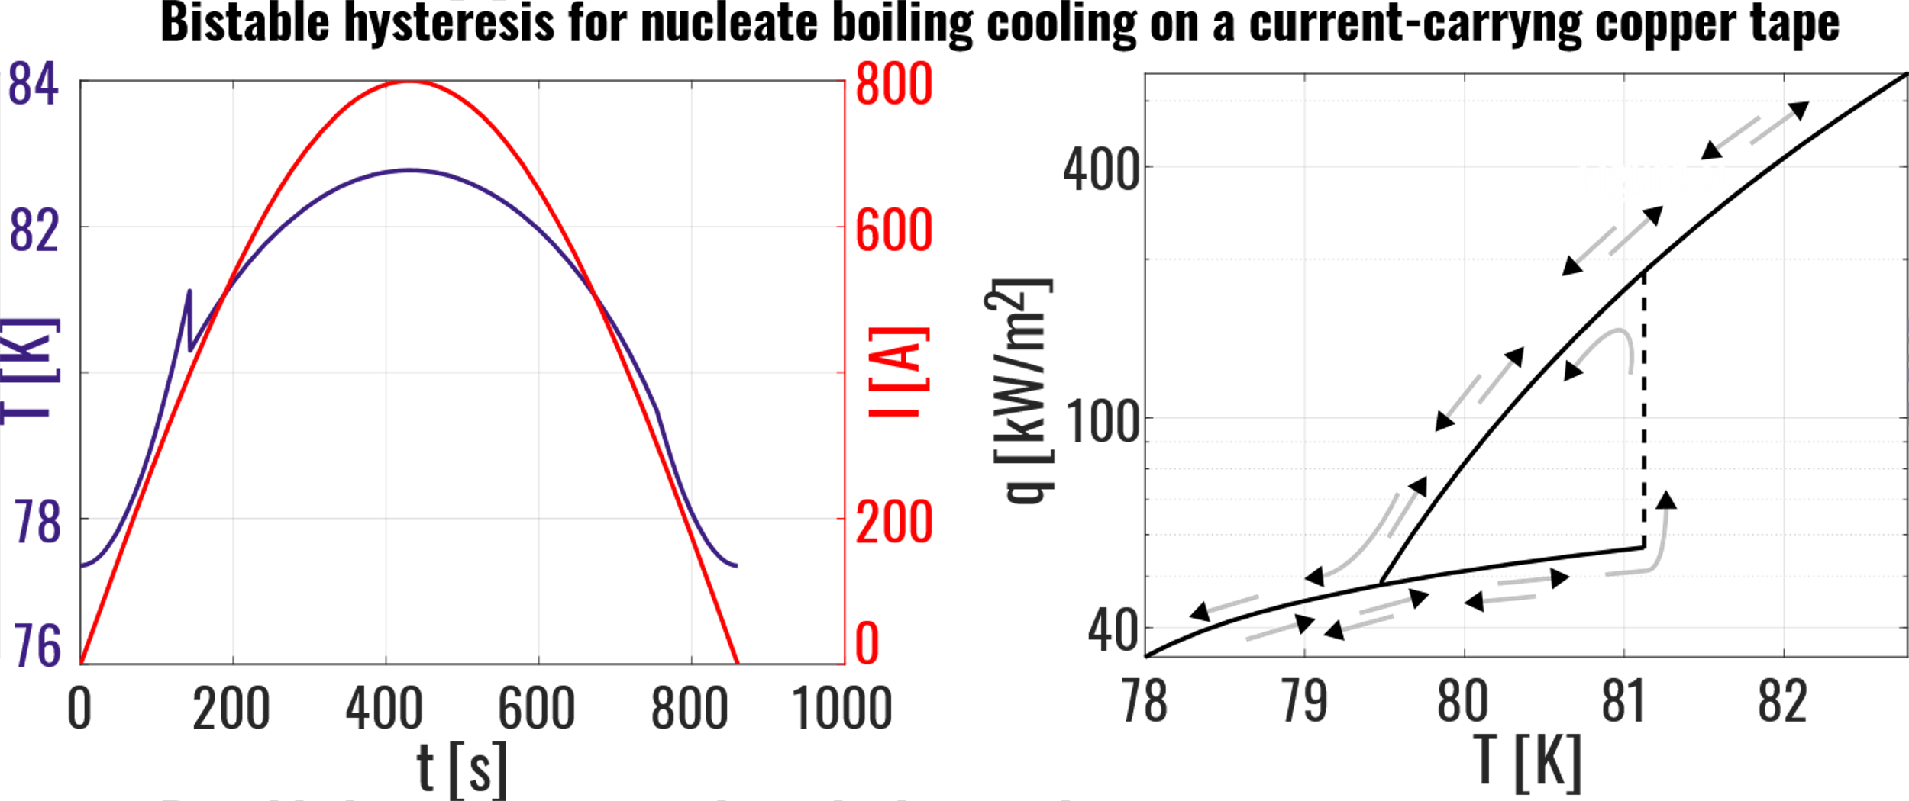
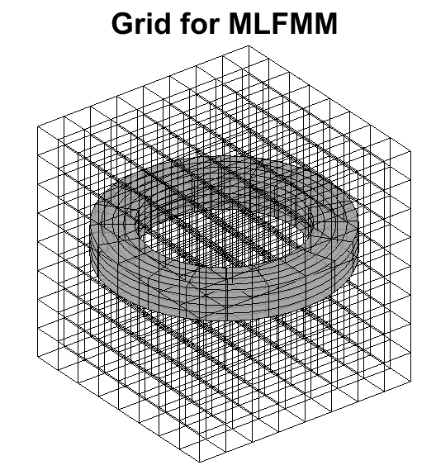
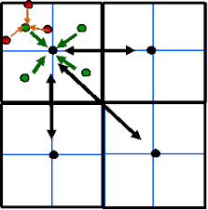
Improvements, software
80% ready thermal model with WIP non-linear LN₂ cooling
(preparing validation for LN₂)
70% ready Multi-Level FMM, to then build “real magnets” models
(debugging stage)
10% ready mechanical model
(just preliminary writing)
0% memory consumption reduction for FPGA

Slide 24
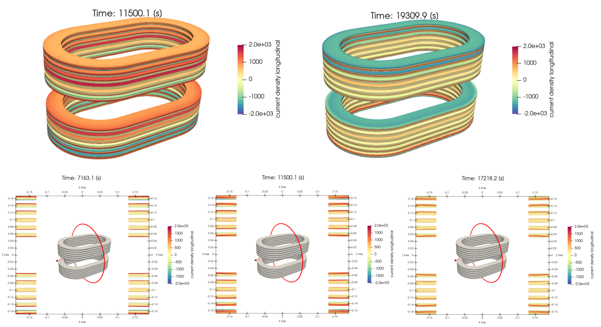
Experimental validation, software
Once improvements are completed, simulate ESMA and compare to LBE calculations.
Models should also be used for
sensor definitions, i.e. simulate where and which sensors to put for running
Kalman Filters or similar.
Many more order reduction techniques to be explored!

Slide 25


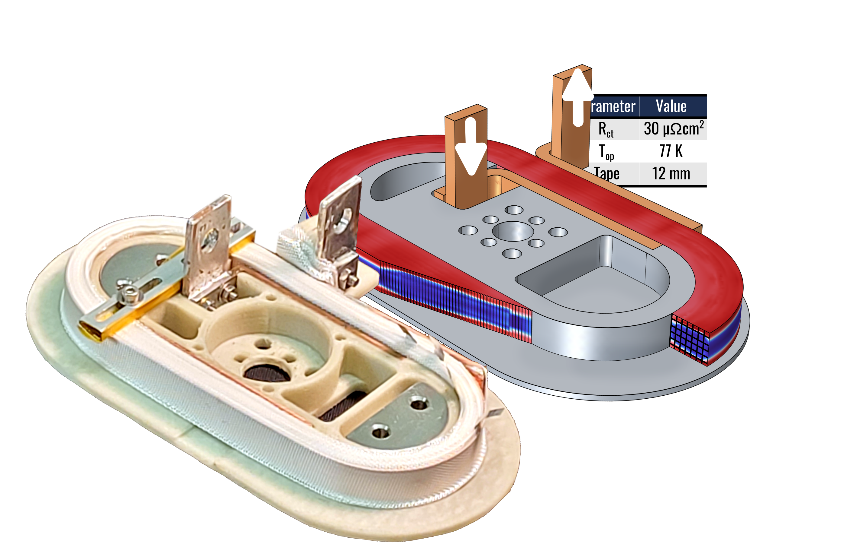
Experimental Validation, hardware
Our target is now the implementation on FPGA (arriving in ~2 months), having a reduced order model run in real-time on online hardware.
Indeed, this model must follow real device → model validation
In theory, possible to provide closed-loop control for Power Supply, but for a later stage.
?
Input
Measurements

Slide 26
Conclusion and outlook
Advanced automation tools are promising wide-range solutions for the various problems still affecting HTS.
The main obstacle to overcome in this pursuit is the availability of accurate models for real-time operations.
Our WIP proposal is to rely on model-order reduction techniques, together with data-driven corrections, on the way to a digital twin
Thanks for your attention! Questions?

Slide 27
INFN MI, LASA Selected Bibliography
S. Sorti, L. Balconi, G. Crespi, L. Rossi, C. Santini and M. Statera, "Enhanced Model for Non-Insulated HTS Coils," in IEEE Transactions on Applied Superconductivity, doi: 10.1109/TASC.2025.3546873.
S. Sorti, L. Balconi, L. Rossi, C. Santini and M. Statera, "Toward Real-Time Electromagnetic Simulations of HTS Non-Insulated Coils Through Proper Orthogonal Decomposition," in IEEE Transactions on Applied Superconductivity, vol. 35, no. 5, pp. 1-5, Aug. 2025, Art no. 4901505, doi: 10.1109/TASC.2025.3526741.
L. Balconi, E. De Matteis, L. Rossi, C. Santini, S. Sorti and M. Statera, "Nonlinear Optimal Control of No-Insulation and Controlled-Insulation HTS Coils and Magnets," in IEEE Transactions on Applied Superconductivity, vol. 34, no. 5, pp. 1-5, Aug. 2024, Art no. 4604405, doi: 10.1109/TASC.2024.3369009
S. Sorti, et al. "Data-driven modeling of nonlinear materials in normal-conducting magnets." Physical Review Accelerators and Beams 25.5 (2022): 052401.
S. Sorti, et al. "Data-driven simulation of transient fields in air–coil magnets for accelerators." Nuclear Instruments and Methods in Physics Research Section A: Accelerators, Spectrometers, Detectors and Associated Equipment 1011 (2021): 165571.

