Slide 1
VLDB+ evaluation kit
Zhengwei Xue
LBNL EIC Meeting
3/18/25

Slide 2

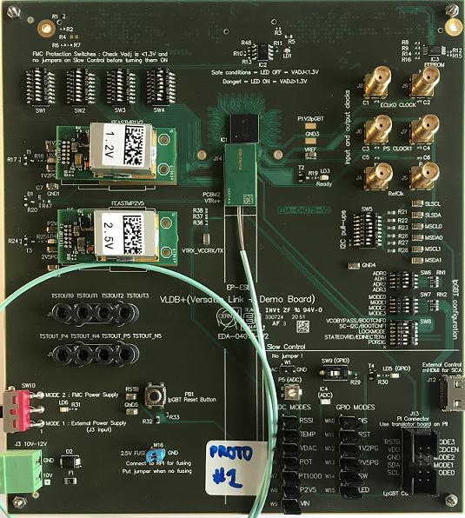
Introduction
  The Low Power Giga Bit Transceiver (lpGBT) is a radiation tolerant ASIC used to implement high speed bidirectional optical links for high-energy physics experiment;
  Versatile Transceiver-plus (VTRx+) is an optical link module for data transmission;
  lpGBT and VTRx+ are planned to be used for AncASIC and AC-LGAD;
    In outer barrel and Disk area of SVT, lpGBT will receive command from control room, and it will initiate communication and send control commands to AncASIC;
    For AC-LGAD, lpGBT is planned to be used in slow-control & data transmission.
  The VLDB+ is a board designed to provide an evaluation kit for lpGBT, with the VLDB+, we can:
    get familiar with the lpGBT
    test our custom front-end system communication to the lpGBT
    emulate a full lpGBT system with a FPGA
2* FMC connector
(On the back)
lpGBT
VTRX+

Slide 3
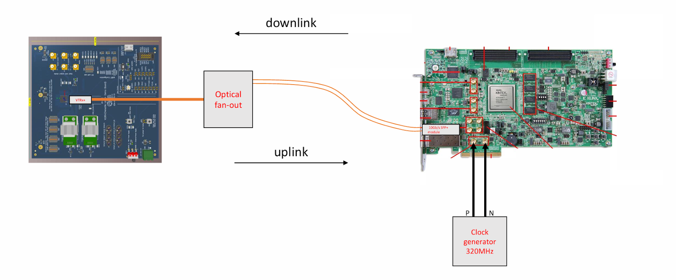
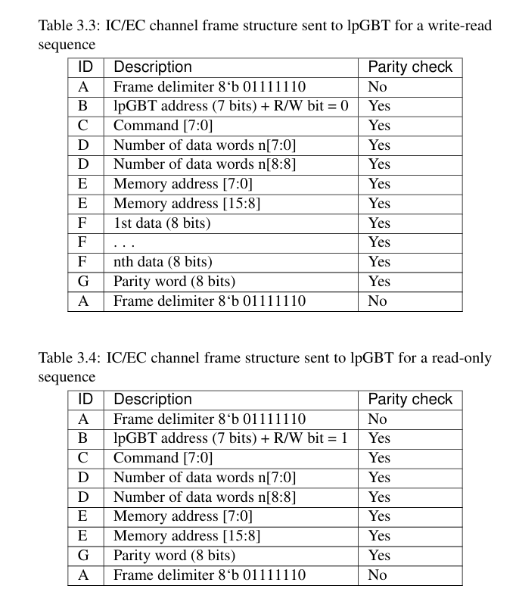
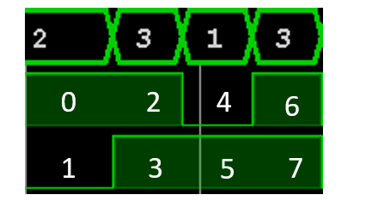
Things that have been completed
The lpGBT group provides an official FPGA demo project: gbt-fpga / lpgbt-fpga · GitLab. This project integrates functions such as downlink data encoding, uplink data decoding, and link status checking.
In order to utilize the full functionality of the lpGBT, being able to read and write the values of the internal registers of the lpGBT is essential, which is not including in the demo;
IC/EC configuration interfaces can be used for the configuration of lpGBT registers. So, I developed an IC/EC control module and import it to lpgbt-fpga project. Here are some important considerations:
  The data rate of IC/EC is 80 Mbps (2-bit width & 40 MHz drive clock );
  Bit stuffing is used in the IC/EC Frame;
  The bit order is unusual and not clear in the manual, as shown in the image near the middle bottom of this page.
After completing the above tasks, I have an FPGA project that can configure the lpGBT on VLDB+.
IC[1]
IC[0]
Byte: ED (8b11101101)

Slide 4
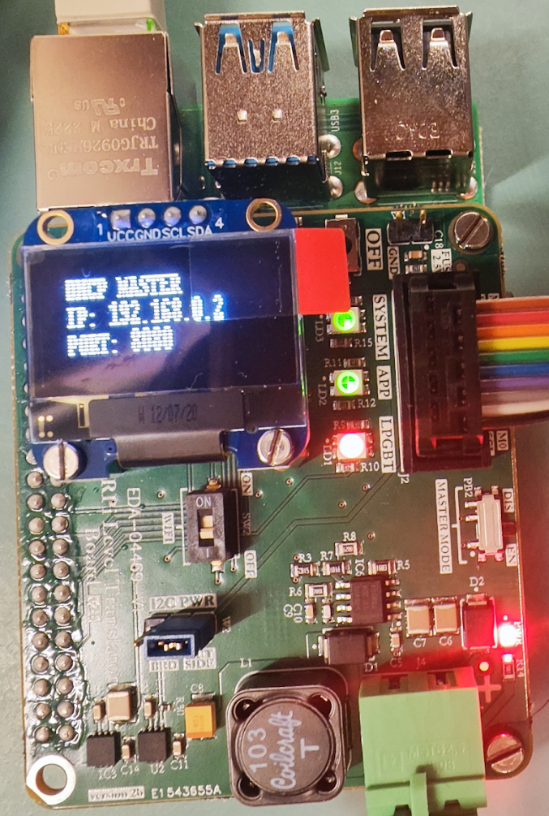
Things need to do
For now, the lpGBT on VLDB+ is initialized by PiGBT (a customized RaspberryPi) and its software. I will implement this process using an FPGA.
In the readout system of a real chip, testing is performed using VLDB+. Taking ETROC2, which is a readout chip developed for the Endcap Timing Layer (ETL), as an example:
  First, develop an FPGA project using lpGBT & VTRx+ as intermediaries to enable the FPGA to configure the ETROC2 by I2C.
  Then, acquire data from ETROC2.
PiGBT

Slide 5
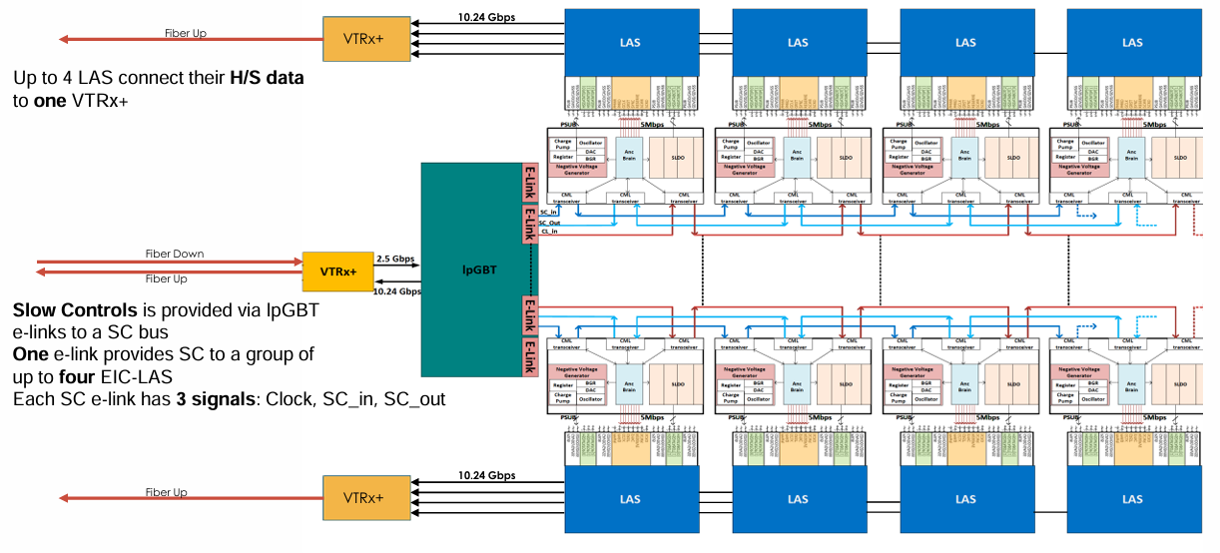
Outer Barrel and Disk Readout Electronics in SVT
In outer barrel and Disk area of SVT, lpGBT will receive command from control room, and it will initiate communication and send control commands to AncASIC;
The high-speed data is transmitted by VTRx+ directly
Back

Slide 6
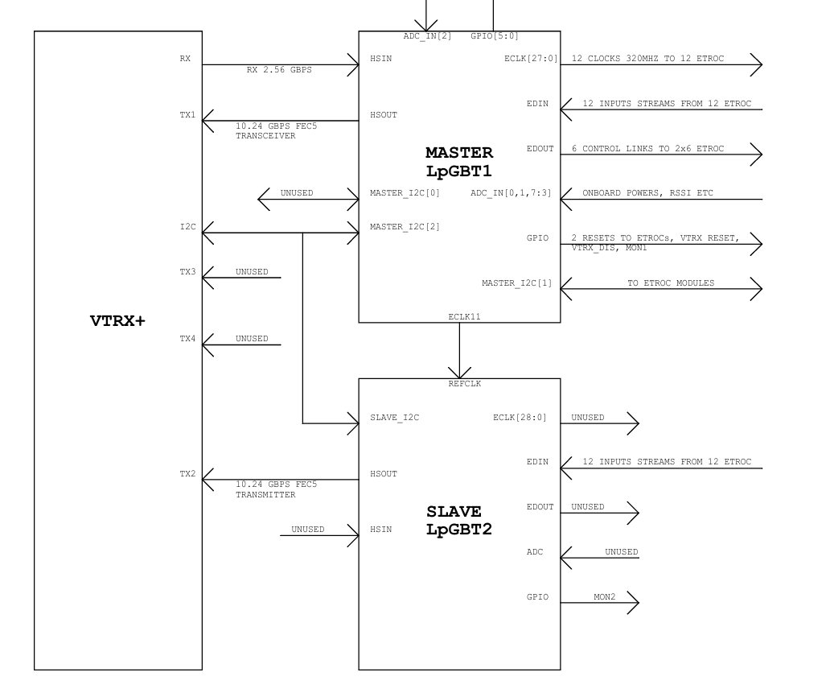
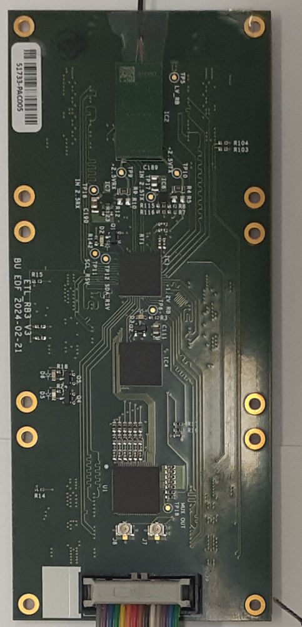
Schematic of ETL Readout Board (for reference)
VTRx+
lpGBT
lpGBT
Data and commands are both transmitted through the lpGBT.
Back

