Slide 1
ePIC Simulation Workflow
Amir Abdou
03/11/2025

Slide 2
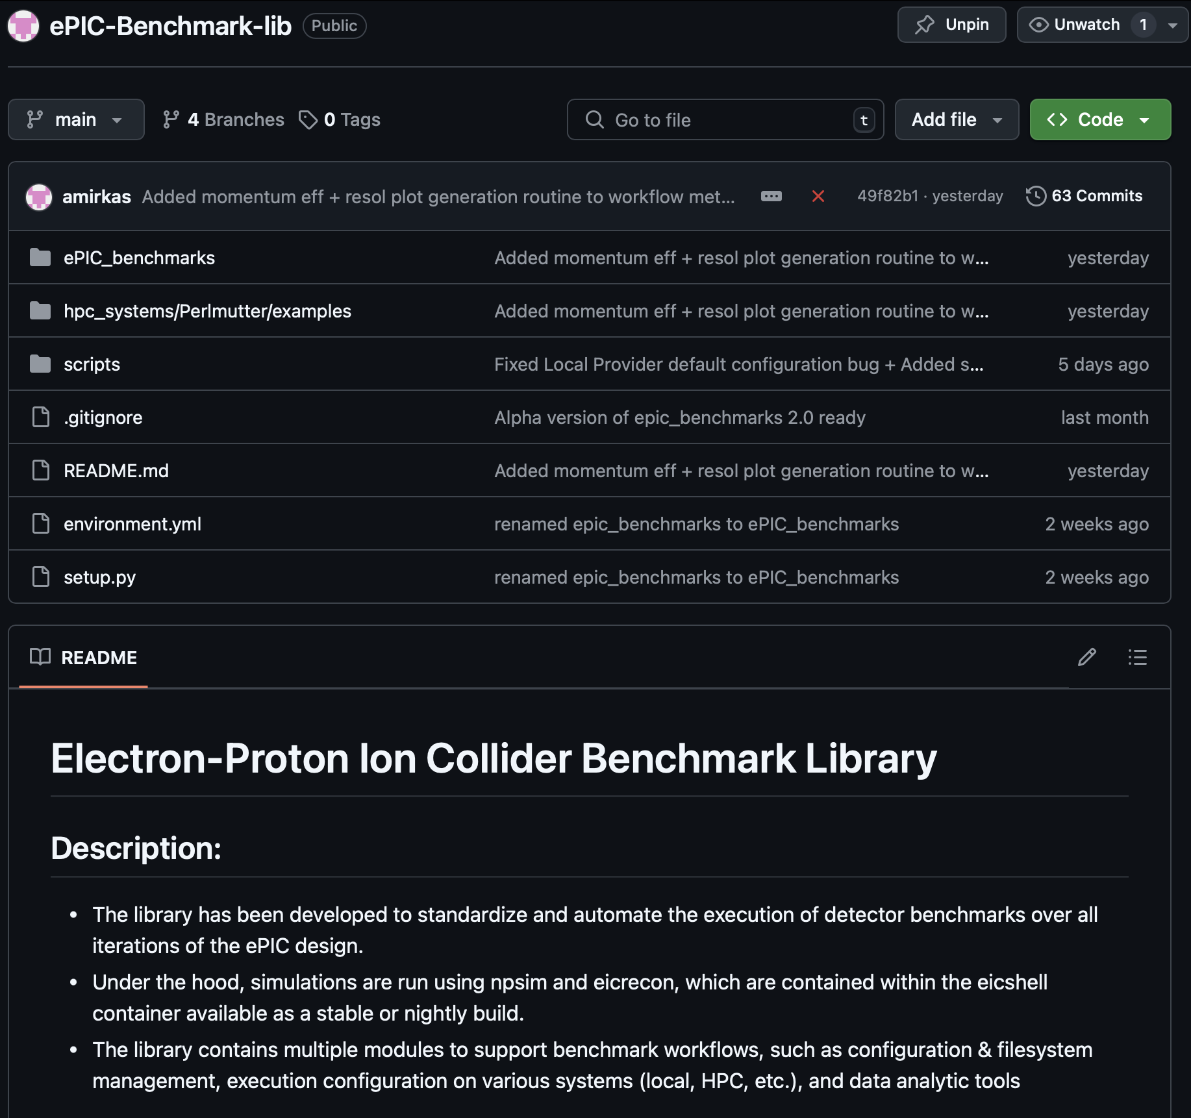
ePIC Benchmarking Library
Fully python based library
Library and its dependencies are all packaged in a conda environment that is easily installable on Perlmutter.
Compatible & highly scalable for most HPC job schedulers
Provides tools for simple, highly configurable workflow creation
Includes a common ePIC simulation workflow, which runs on compute nodes with a non-Slurm high throughput scheduler.
  Pull the eicweb shifter container
  Clone the ePIC repository
  Checkout the desired ePIC branch
  Make changes to detector description xml files
  Compile and build the ePIC repository
  Generate material maps for reconstruction
  Run particle event simulations (npsim)
  Complete simulated particle reconstructions (eicrecon)
  Produce momentum resolution and track efficiency plots.
  Any other tasks that a user designs.
Github Link: https://github.com/amirkas/ePIC-Benchmark-lib
For documentation on running this workflow on Perlmutter, refer to: https://github.com/amirkas/ePIC-Benchmark-lib/tree/main/hpc_systems/Perlmutter/examples
To request more features, open a new issue in the github repository

Slide 3
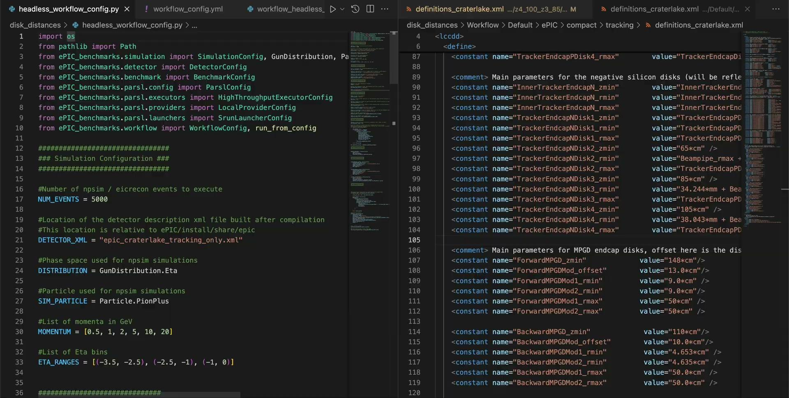
Example Workflow
Benchmarks that evaluate the performance of the negative-direction Silicon Disks with layers at different distances

Slide 4
Thank You

