Slide 1
Initial Thinking on the ReBCO Based
R&D Program at BNL for USMDP
MDP Videoconference on June 5, 2019
Ramesh Gupta
for Magnet Division at BNL

Slide 2
Purpose of the BNL Program (as stated in the FWP for USMDP)
Develop very high field magnet technologies based on Nb₃Sn and HTS.
Take advantage of the unique test bed based on the existing 10 T Nb₃Sn common dipole DCC017 with a large open space.
Facilitate a rapid-turn-around, low cost high field test facility for carrying out innovative and/or systematic R&D with new racetrack insert coils becoming an integral part of the magnet without requiring disassembly of the background field magnet.
Utilize the unique geometry of the dipole DCC017 providing background field of 10 T to perform quench, magnetization and other studies of partial to several turns of high current cables, including those requiring large bend radii.

Slide 3
High Level Goals/Tasks for Year 1 (details to be developed with the collaboration)
Magnetization studies (@4K, up to 10 T) in an HTS coil with field primarily parallel to the wide face of the ReBCO tape
Quench studies in a few turn coil made with CORC cable
Funding became available in late May.
We hope to finish these tasks by the end of this year, definitely by April 2020 (within a year).

Slide 4
Initial Thinking
Carryout both tasks in parallel
Start on task #1: Conductor (HTS tape) is available for winding new coils now. The test setup for this task requires minimum upgrade since the last experiment when the HTS tape coils were tested with field primarily perpendicular to the wide face. Initial studies started.
Design/discussion on task#2: CORC coil requires a significant design, planning and interaction with collaborators, in addition to the cable. Upgrade in test setup (independent higher current in CORC insert coil), though not essential, would enhance the test program. Status/progress and initial thoughts will be presented.

Slide 5
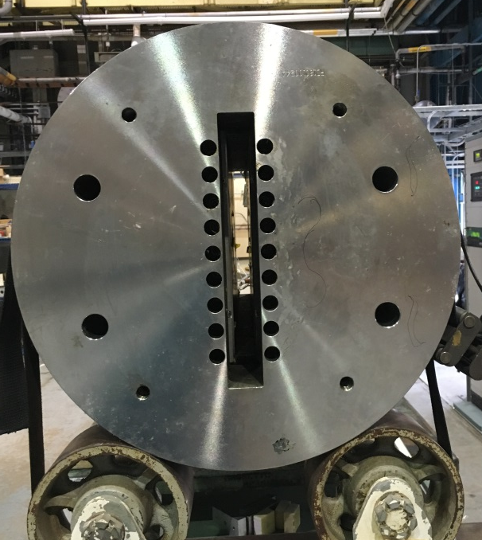
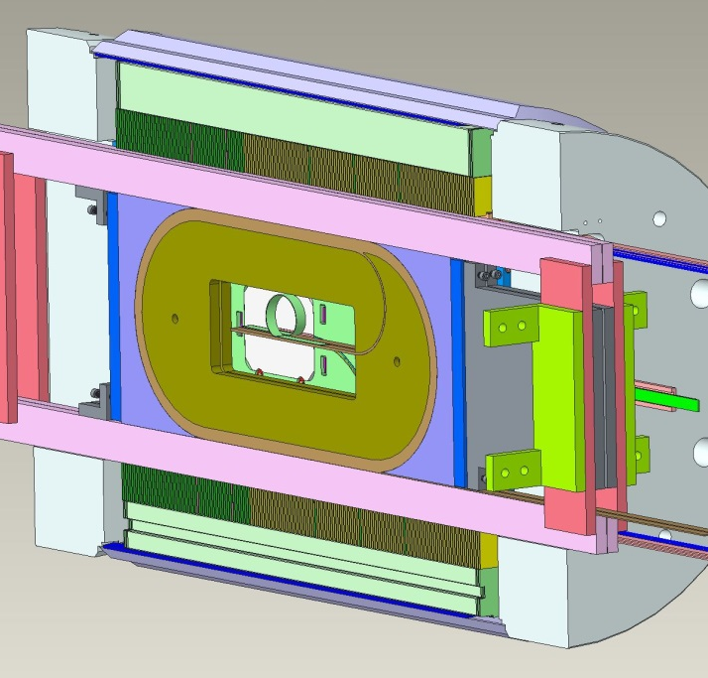
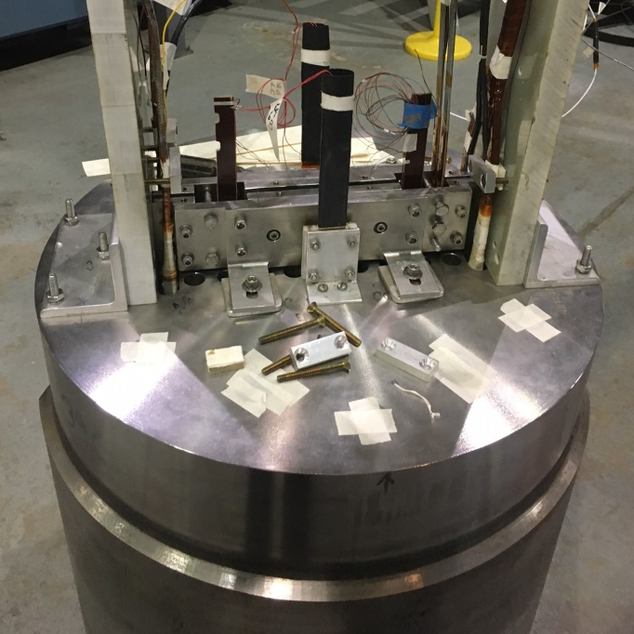
The Test Bed: DCC017
A unique feature of BNL’s common coil dipole:
large open space for inserting & testing “coils” without any disassembly (rapid around, lower cost)
Original structure
Insert coils in Empty space
Empty space
New structure
BNL Nb₃Sn common coil dipole DCC017 without insert coils
New HTS coils with the existing Nb₃Sn coils and become part of the magnet
HTS coils inside Nb₃Sn dipole - early experience of HTS/LTS hybrid dipole

Slide 6
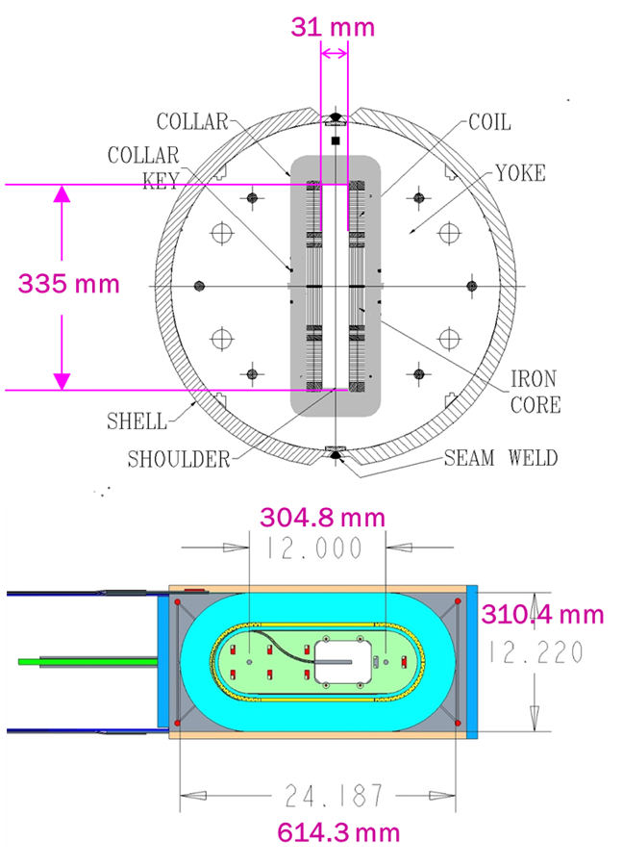
Parameters of BNL Dipole DCC017
Two layer, 2-in-1 common coil design
10.2 T bore field, 10.7 T peak field at 10.8 kA short sample current
31 mm horizontal aperture
335 mm vertical aperture
A unique feature for insert coil or cable testing
0.8 mm, 30 strand Rutherford cable
70 mm minimum bend radius
85 mm coil height
614 mm coil length
One spacer in body and one in ends
Iron over ends
Iron bobbin
Stored Energy@Quench ~0.2 MJ

Slide 7
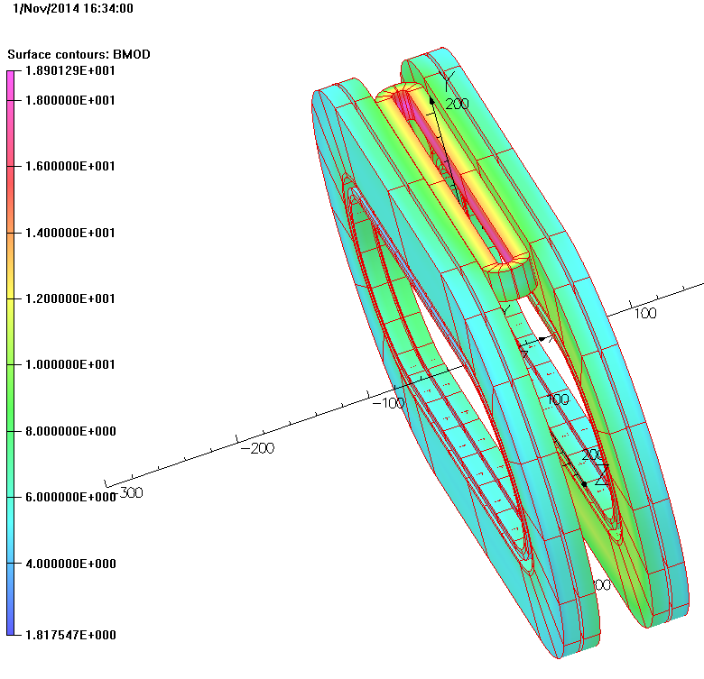
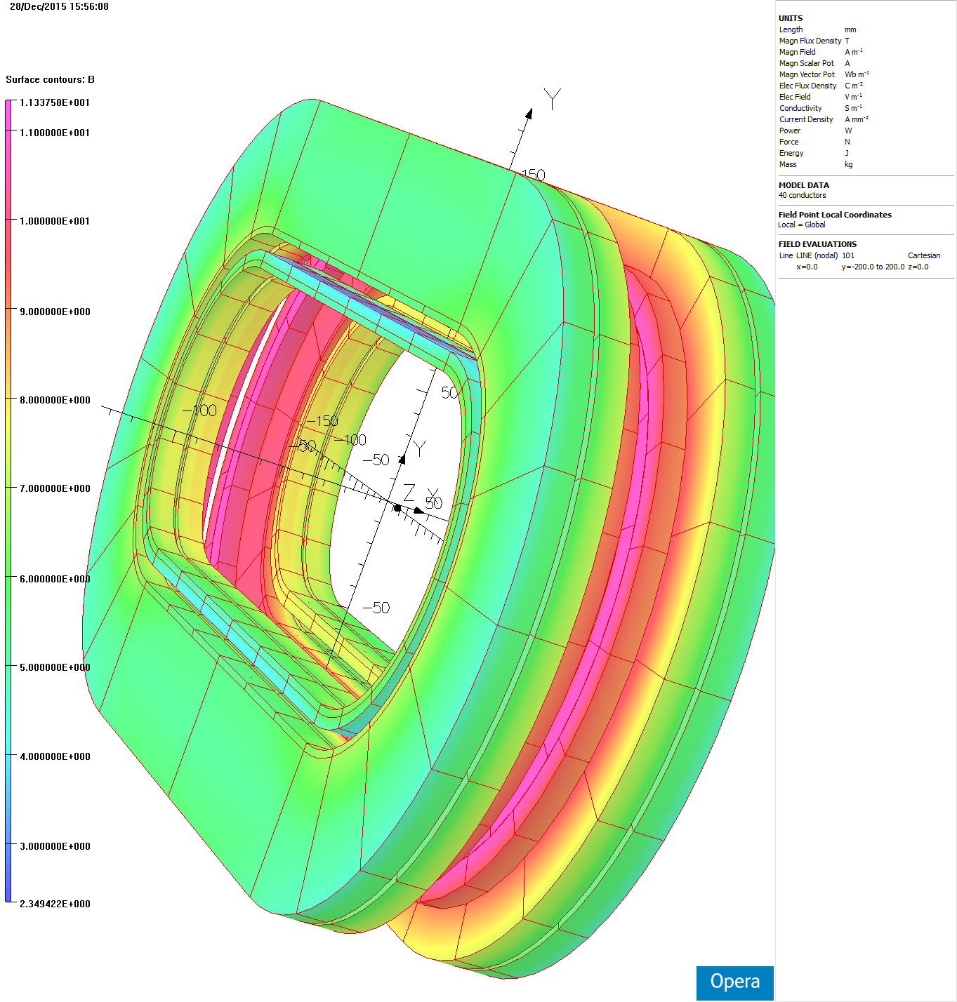
Preparation/Planning for Task #1
HTS insert coil for field parallel studies
Gap for insert coil: 31 mm
Coil aperture (minimum bend diameter): 10 mm
Coil width: 10 mm
(this allows 1 mm for insulation/clearances)
Coil length: ~300 mm
HTS insert coil for field perpendicular studies
(already done)
Bending tests being performed to ensure that 10 mm bend diameter is ok

Slide 8
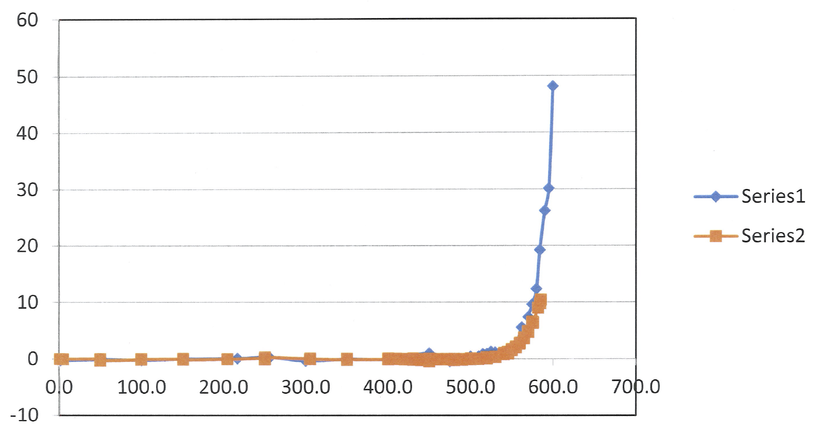
Plot from Bill Sampson (inserted <30 minutes ago)
Cable bent at 10 mm diameter on SC layer on tension (blue) and on compression

Slide 9
Initial Thinking
Basic Configuration:
Two apertures allow two types of coils
One coil with full Nomex insulation
Another coil with “No” or “Partial” insulation (no insulation in the end region - ~ 5cm or so non-insulated region)
Goals:
Basic: Measure magnetization at various applied fields
Additional: Perform quench studies (requires more planning)
What do we want to study?
Instrumentations?
Allow coil to be destroyed?
Impact of partial insulation on field quality and quench protection

Slide 10
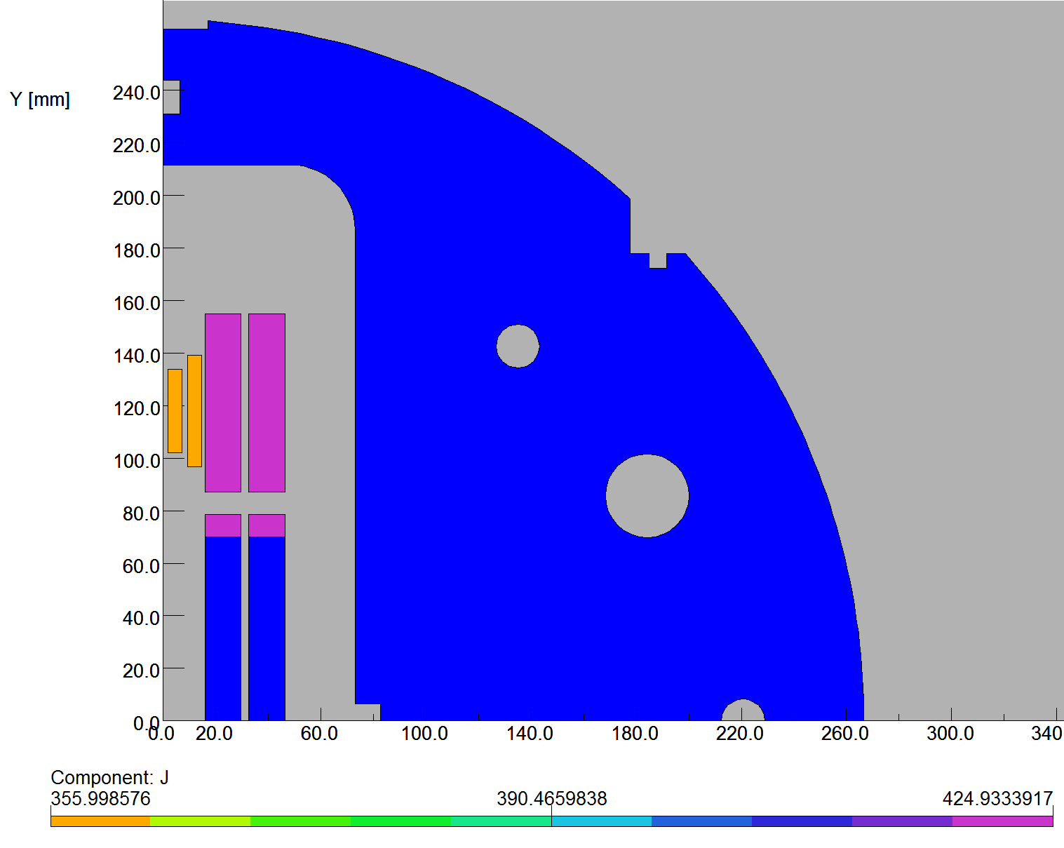
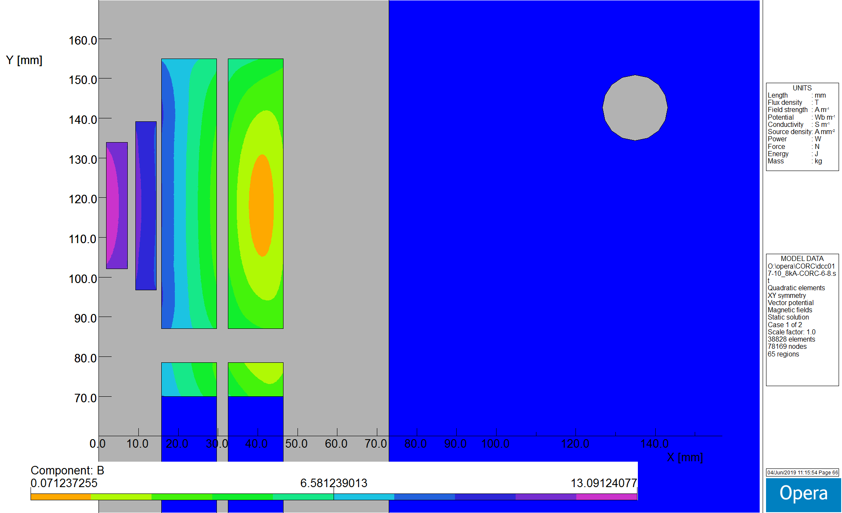
CORC Coils in the STTR Program
CORC coils:
6 and 8 turns, running
in series with Nb3Sn coils
Hybrid field: 13.1 T @10 kA
: 14.4 T @11 kA
(peak field in Nb3Sn coils reduced by CORC coils)
2-d model
Nb₃Sn Coils
CORC Coils

Slide 11
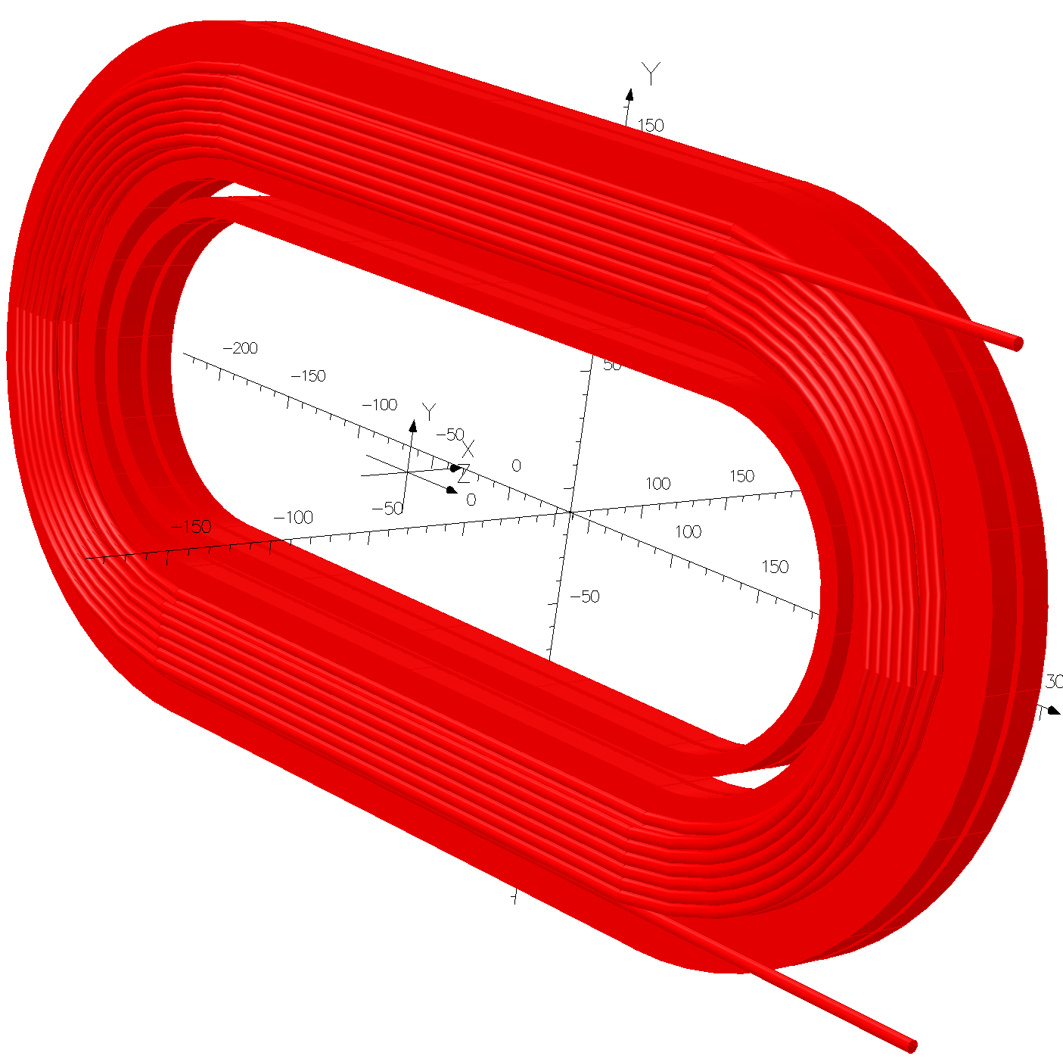
CORC Coils (with 6 and 8 turns) inside the Nb₃Sn coils
One side only for clarity

Slide 12
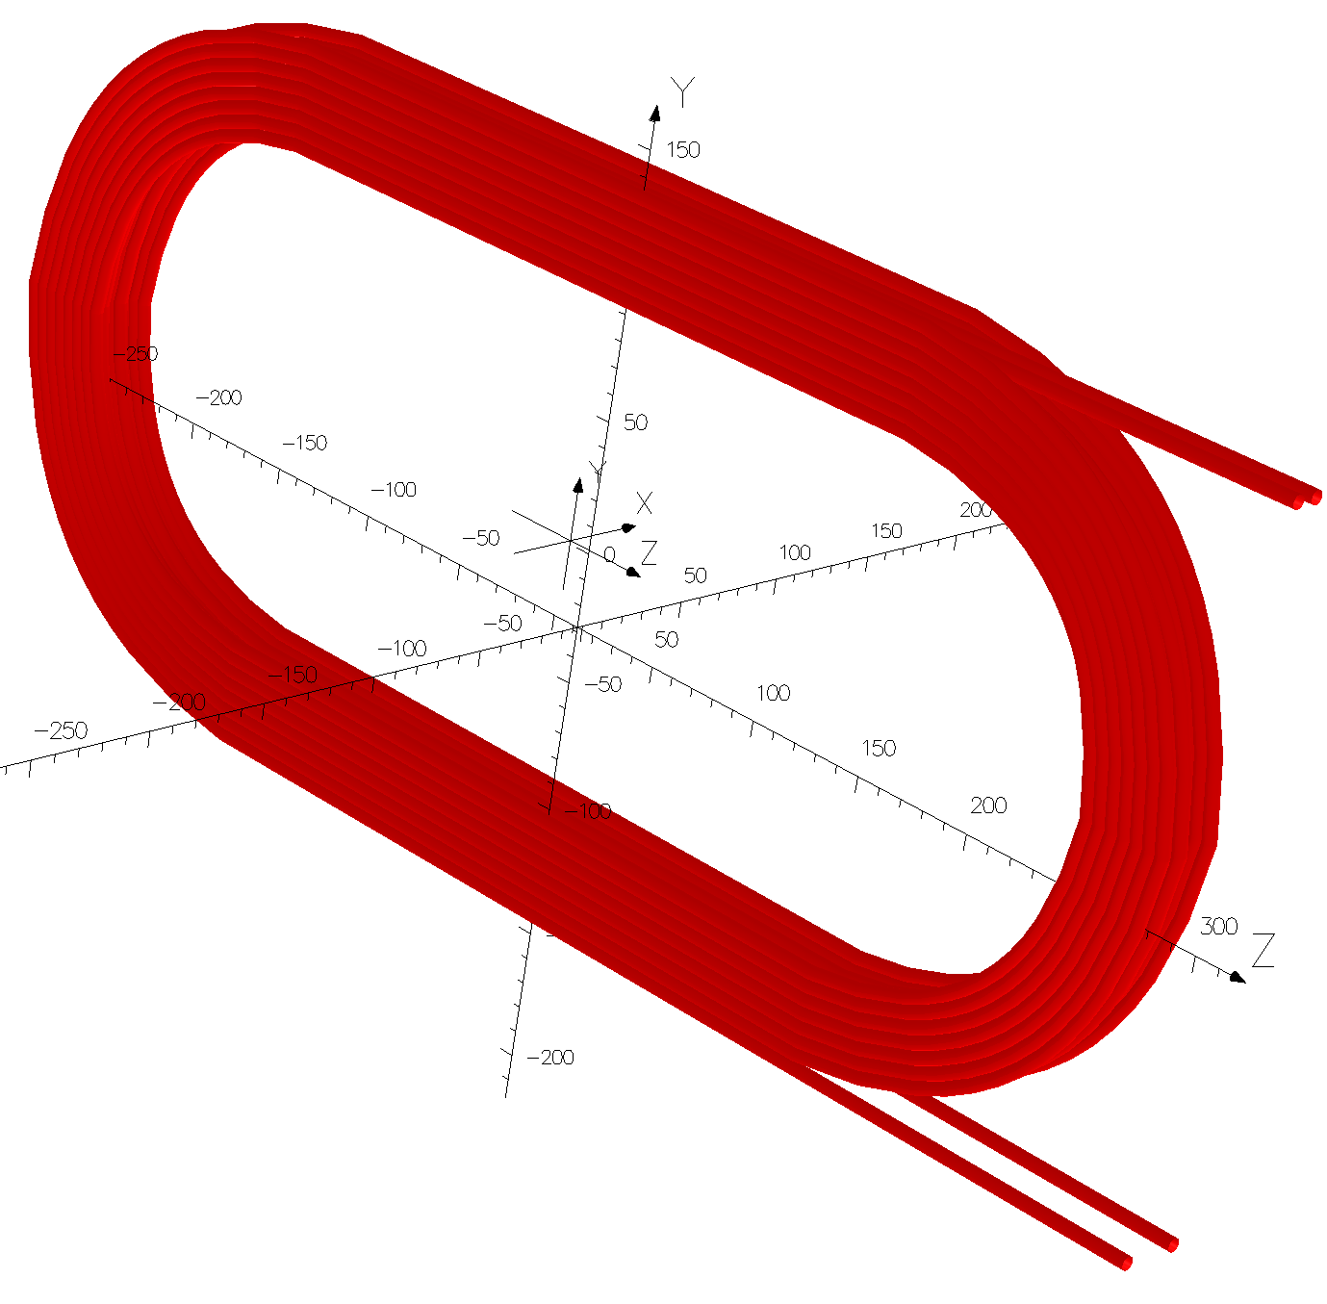
3-d modeling of the 6&8 turn CORC Coil (with 20 node BRICK in OPERA3d)
Two double pancakes
One double pancake
Modeling includes, leads and transition regions

Slide 13
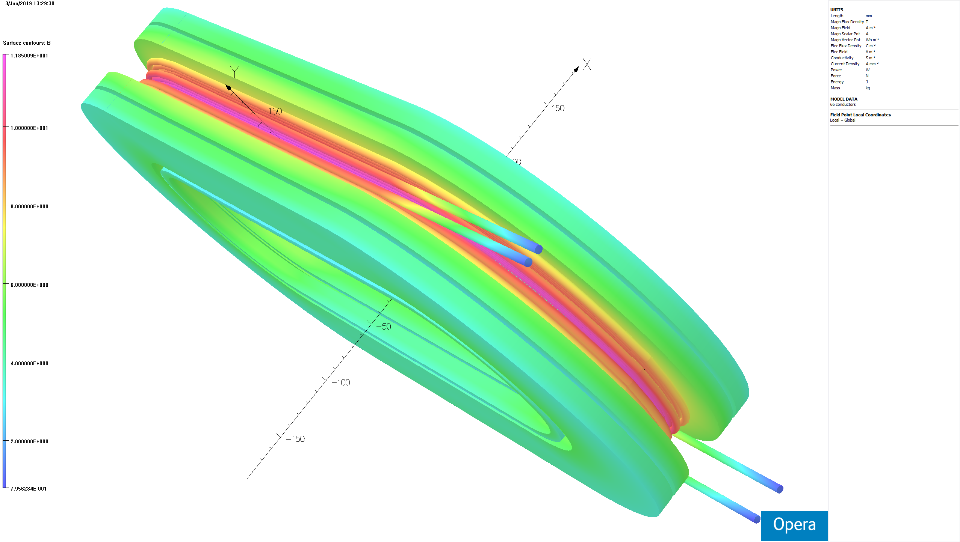
Field on the Hybrid coils at 10 kA (1) (6 & 8 turn CORC cable coil with Nb₃coils)

Slide 14
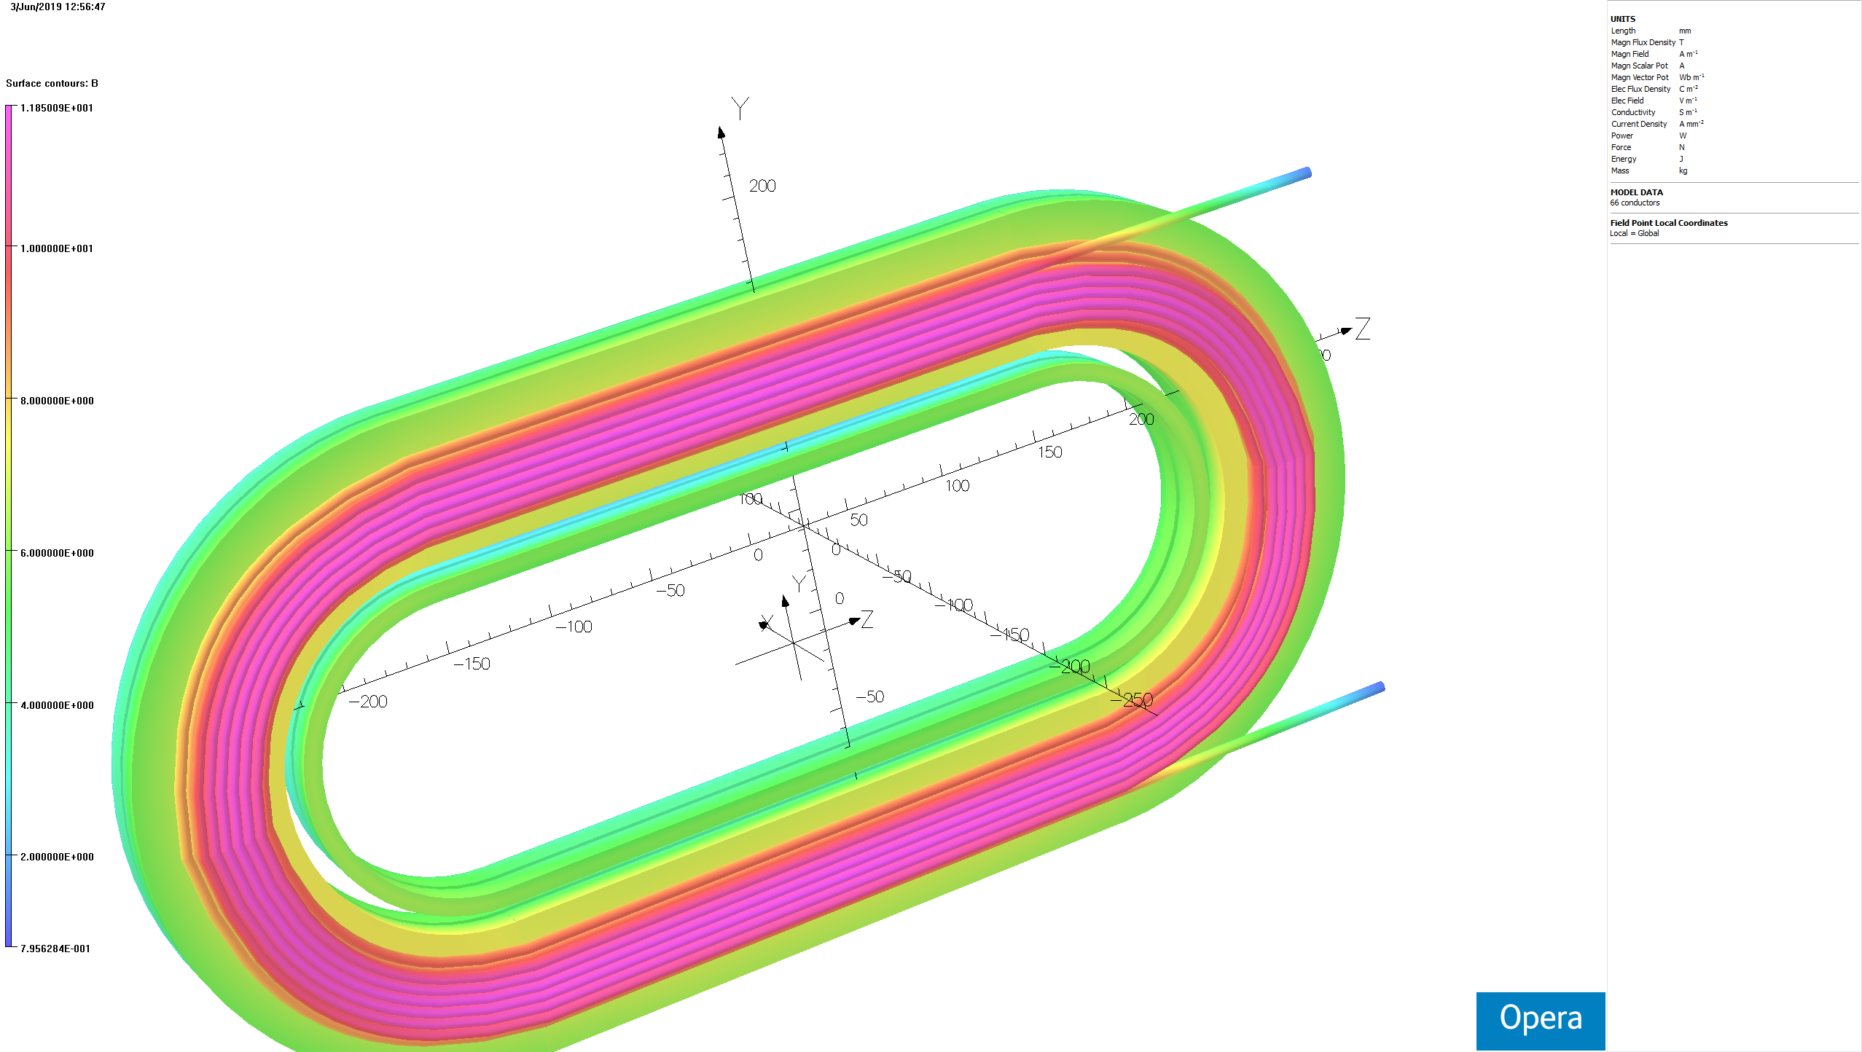
Field on the Hybrid coils at 10 kA (2) (6 & 8 turn CORC cable coil with Nb₃coils)

Slide 15
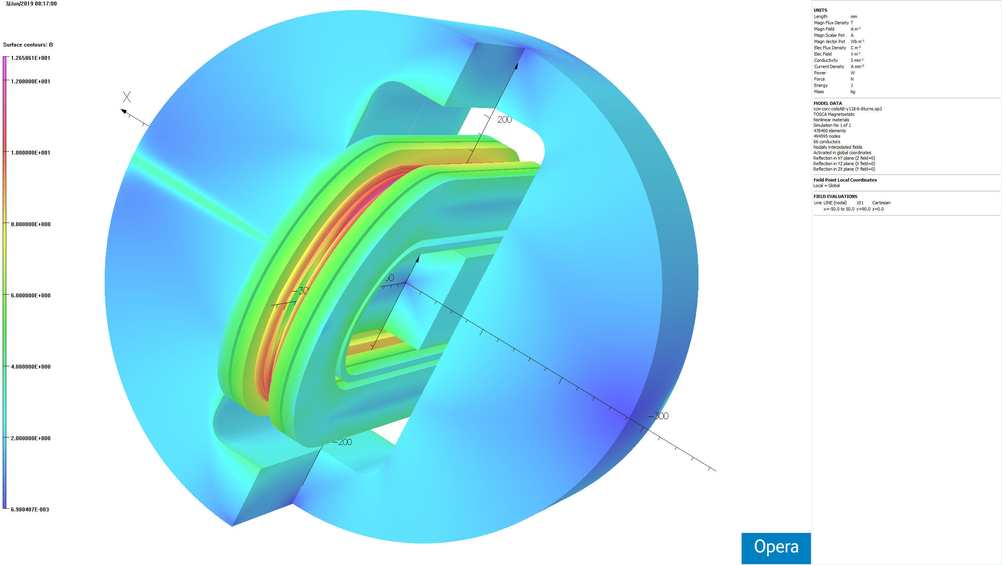
Hybrid Magnet Model with Iron

Slide 16
Coil Winding and the Mechanical Structure
BNL and ACT are working together on developing the coil winding techniques and on the mechanical structure.
BNL task in STTR is to help ACT with the design, etc.. ACT will purchase the parts and wind the coil (limited budget of STTR precluded BNL to actually wind the coils).
BNL will design, purchase all parts and wind the coil for MDP with the ACT supplied cable.
This presentation will include the initial BNL design geared for efficiency and providing mechanical support to individual cable.
As such major forces on the CORC cable are in horizontal direction but vertical forces also become significant on certain turns.

Slide 17
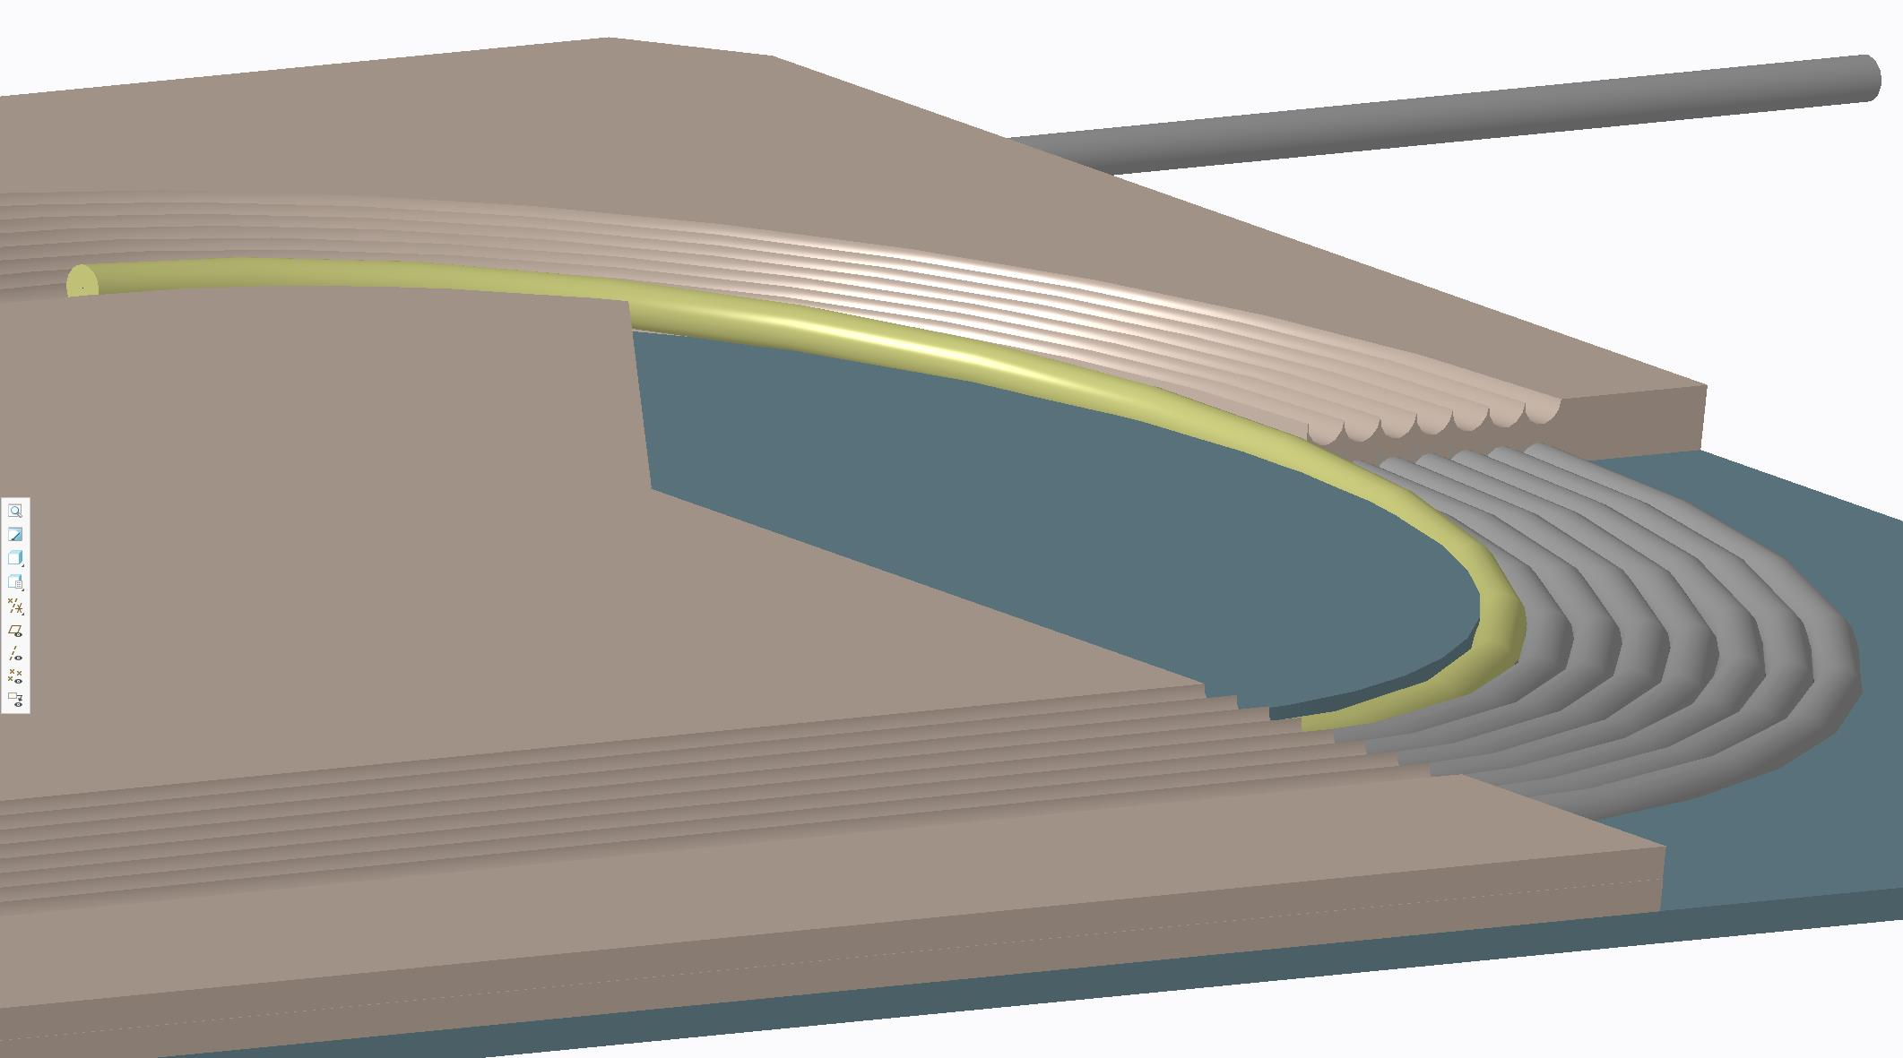
The Basic Design Concept
The conductor is placed inside the groves machined in the SS plates (or 3-d printed). Each turn is fully captured (with thin epoxy) and thus fully supported. We may need to work with the cable to place it in the grooves. Major component of the Lorentz force is horizontal which can be taken by the thickness of the plate, as and if needed (as such CORC coil lean on Nb₃Sn coils). Small component of the vertical Lorentz force can be taken by the structure between the grove. The two turns nearly touch each other for the maximum current density.
Groove in the top plate
Top plates also captures the cable in the bottom layer
Cable in the transition region
Cable placed inside the groove of the bottom plate
All CAD models and design engineering by Steve Plate

Slide 18
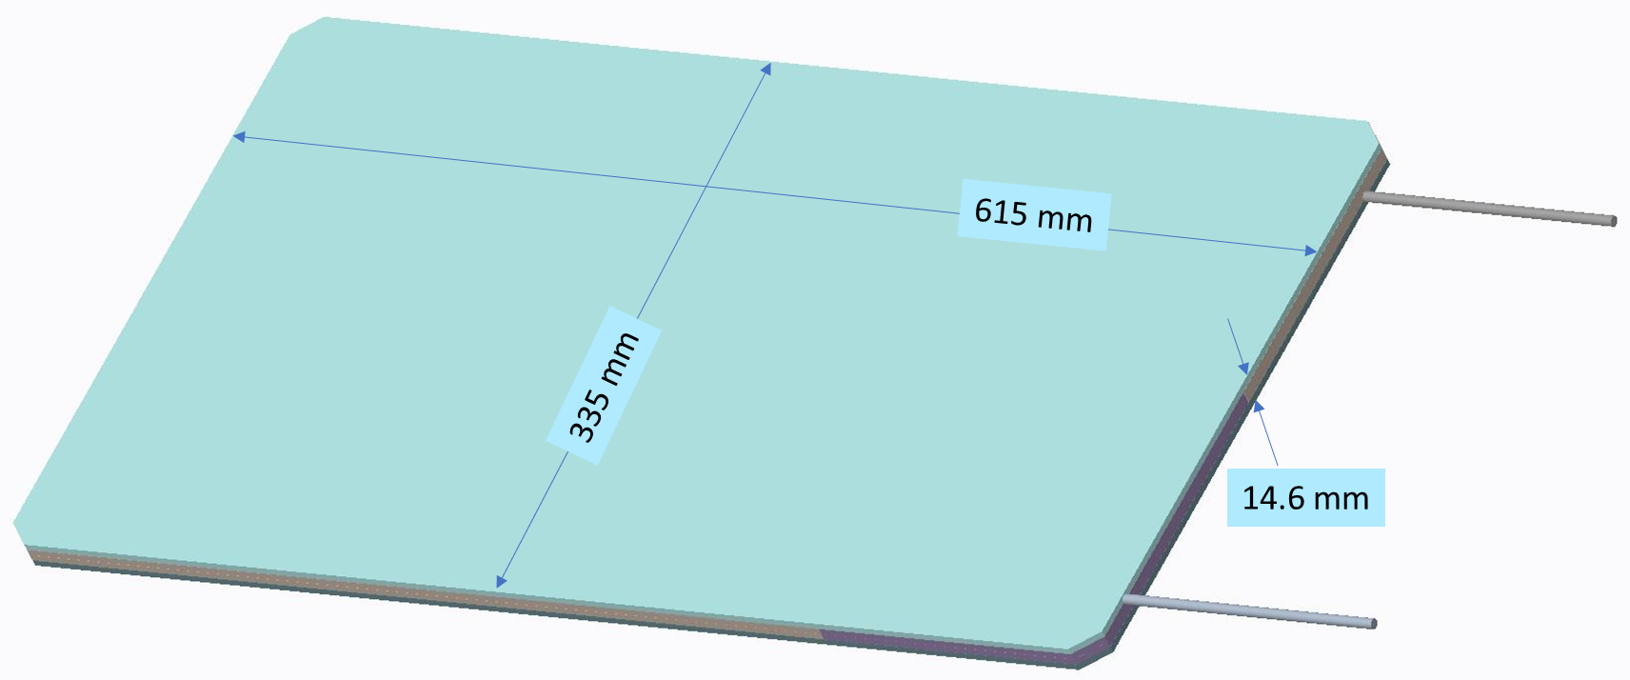
Overall Design of a Double Pancake Package
Horizontal Gap: 31 mm
Space for Hall Probe, etc.
: ~0.8 mm
Two such packages will be inserted inside the common coil dipole DCC017

Slide 19
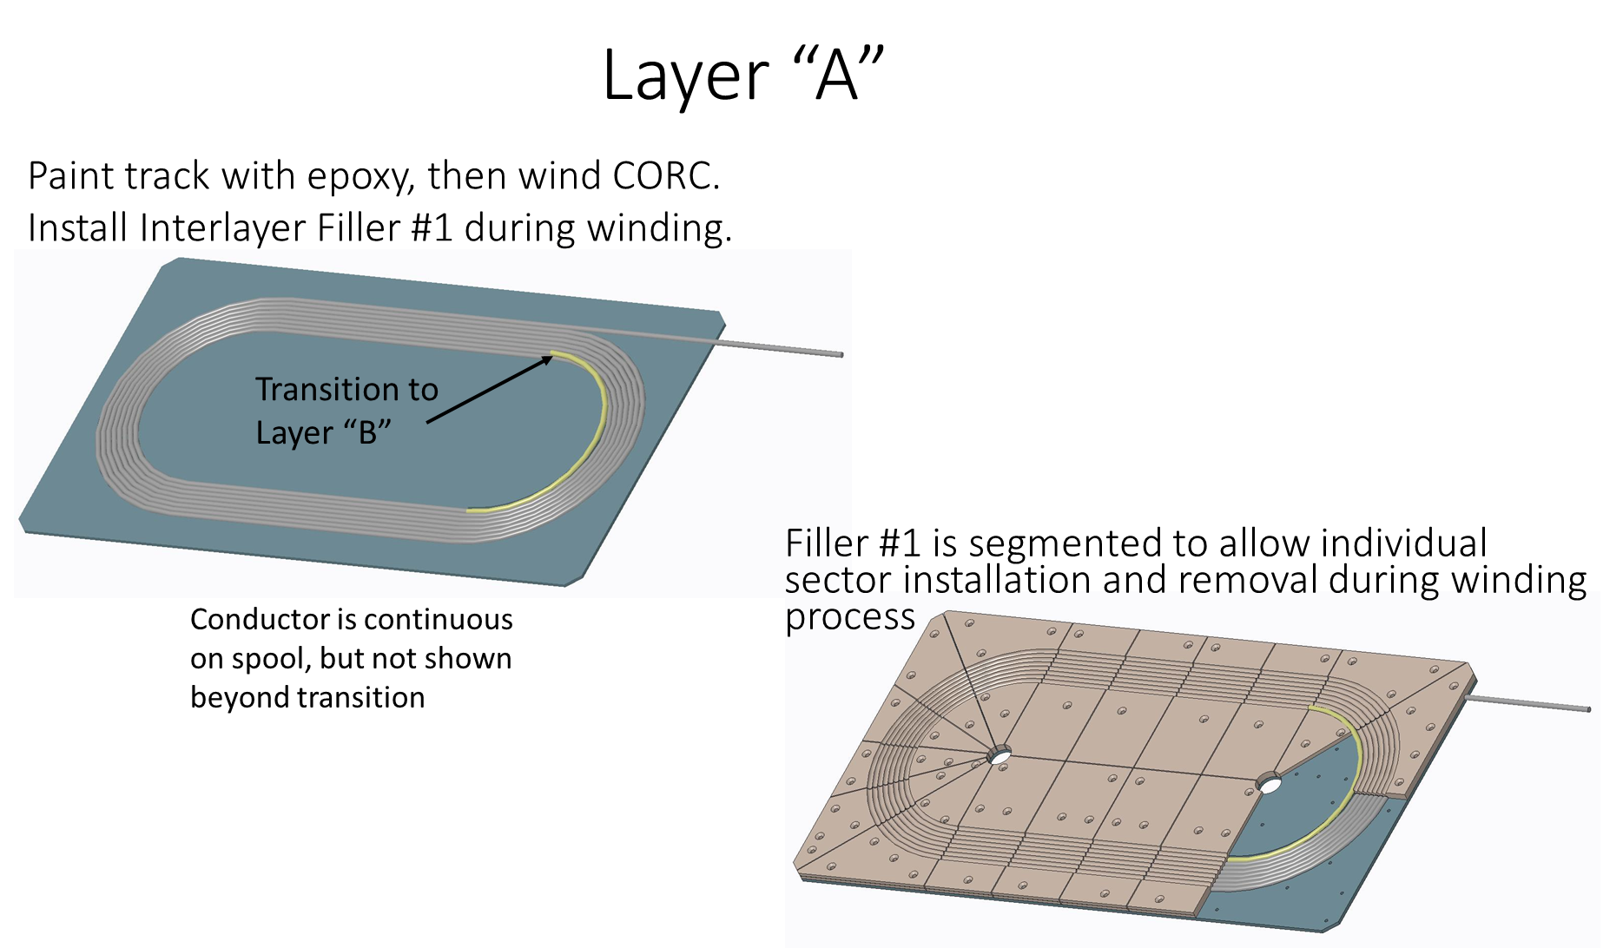
Key Coil Winding Steps (1)

Slide 20
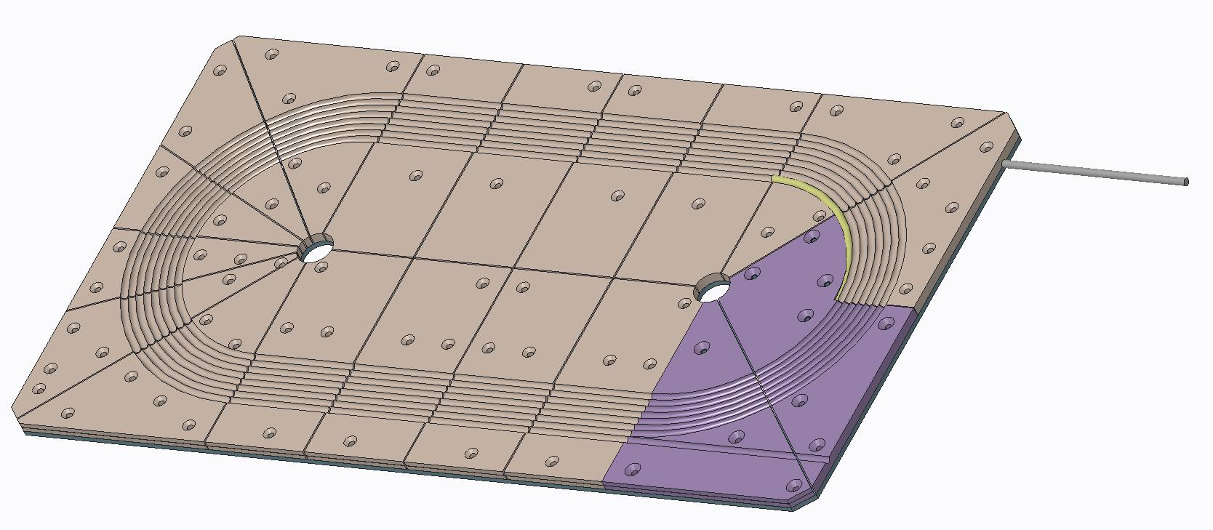
Key Coil Winding Steps (2)
Fully enclose Layer “A” by installing Filler #2
Track grooves for Layer “B” are visible

Slide 21
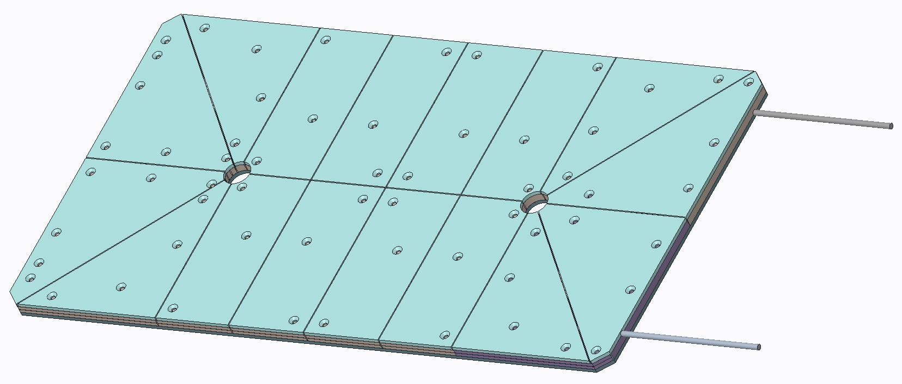
Key Coil Winding Steps (3)
Segmented Track “B” clamps coil

Slide 22
CORC Coil for MDP
As mentioned earlier, the CORC coil for MDP will have a total 8 turns (4 + 4), instead of 28 in the STTR coil.
A significant amount of cable (~13 meters) for quench studies.
There are three options for designing and placing this insert coil:
Two 4 turns form a double pancake with S-transition to reverse the direction of current with ~15 mm gap for instrumentation.
Small gap in the middle but more gap and support structure on either side.
A double pancake making contact to the Nb3Sn coils on one side and gap on the other side.
The baseline design is option #1. But we may evaluate others as well.

Slide 23
Initial Design of MDP 4-turn Coil
Step 1: Base Track for Layer “A”

Slide 24
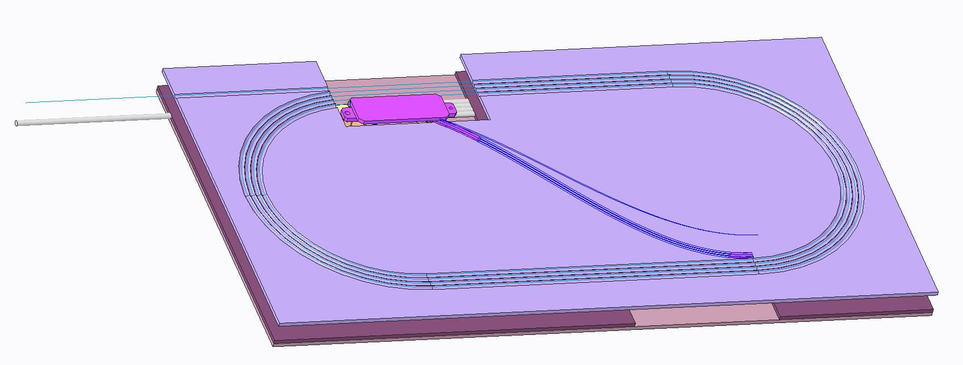
Special 4-turn Double Pancake Coil in support Structure (current in the 2 pancakes in opposite direction and a gap in between)
Step 5: Install Base Track for Layer “B”
Baseline Option
S-turn in transition region changes the direction of the current between the two pancakes.
It should tolerate some horizontal motion (as was the case for the splice during the last test).

Slide 25
Initial Discussions (1) (Notes from Xiaorong Wang)
Powering scheme
Baseline: the CORC® coil will be connected in series with the power supply for the Nb₃Sn magnet up to 10 kA.
BNL is working to set up a 17 kA power supply to power the CORC® coil separately.
Driving questions for the quench experiments
Can we study the transition behavior of the coil with the series-powering scheme? [see required information below] If yes, how does the coil transition in 10 T background field? Is the transition smooth with the capability to ramp the current up and down along the transition?
Considering the margin of the CORC® coil at various fields, can we induce a quench with a heater? What is the total power generated by the heater to induce a quench at various background fields? Does the normal zone propagate during a quench at various background fields? Can we measure the propagation velocity?
How does current distribute between tapes at the front of growing normal zone?
Can we detect the local temperature rise due to the heater with different instrumentations such as acoustic and fiber-optic sensors? How does different instrumentations compare with each other?

Slide 26
Initial Discussions (2) (Notes from Xiaorong Wang)
With the fiber-optic sensor, can we tell if the coil starts the transition in the peak field region?
Does the transition current of the CORC® coil depend on the number of ramping? Any impact of the current/Lorentz force cycling? Similarly, does the quench energy reduce after cycling? Does the normal zone propagates faster after cycling? Does the current sharing behavior change after cycling? Does the transition current of the CORC® coil depend on the ramp rate?
Can we probe the MIITs limit for the CORC® coil at 10 T? This can potentially degrade the CORC® coil and should be performed toward the end of the test campaign.
Information needed to design the experiments and plan the required instrumentation:
Coil design or dimensions to determine locations of potential instrumentation
Predicted short-sample performance for the CORC® coil at 4.2 K, different fields up to 10 T. The peak field region in the CORC® coil and the fields at other specific locations. This information can help to optimize the location(s) of the spot heater(s).

Slide 27
Initial Discussions (3) (Notes from Xiaorong Wang)
Desired instrumentation:
Acoustic sensors to detect temperature rise and quench (coordinate with Maxim)
Hall sensor array to detect local current sharing between tapes and propagation of normal zone (Maxim)
Fiber optic sensor to measure temperature profile along the conductor (coordinate with Justin)
Voltage taps in the conductor terminal (installed by ACT or during coil fabrication)
At this initial stage, we need to do high level planning in terms of evaluating what we want to do, what is technically important, what can be done with the resources we have, what space is needed to do various experiments, what groups involved in planning, etc. ,…
For most of this we need to have a separate smaller group working meeting. We should do that soon, perhaps about now.

Slide 28
Summary and Conclusions
Our initial thinking on the ReBCO based R&D program for USMDP has been laid out. We welcome input from collaboration.
Common coil dipole DCC017 has been designed as a test facility magnet. We would like this R&D to progress with that philosophy.
Please let us know if you would like to join and we would include you in smaller group discussions.
Task #1 is primarily for magnetization studies but other components can be included as long as it fits with the resources.
Task#2 for quench studies has been just started. We need significant planning, etc.

Slide 29
Extra Slides

