Slide 1
MDPCT1 test status
Stoyan Stoynev
5 June 2019

Slide 2
Run Plan (at 1.9 K)
At 1.9 K operation with 60 mΩ dump resistor (90 mΩ if MIITs are too high):
Manual trip at 5 kA (no protection delays; MIITs check)
Magnetic measurements – Z-scan (could be at 4.5 K if time allows)
The maximum current will be limited to 15 MIITs projected
Quench Training at 20/50 A/s to 9.502 kA (13 T) or to a plateau
Plateau is 5 quenches with no improvement above 50 A
More than one detraining (above 200 A) quench or multiple detraining quenches at above 50 A will urge a team review meeting
Flux-jump measurements to be taken
Decision to be taken to proceed or not to 10.335 kA (14 T) based on data analysis
Ramp rate studies (80 A/s if no plateau; 10/100/200/300/400 A/s otherwise)
Magnetic measurements – see the Magnetic measurements plan
Studies if plateau reached
Temperature dependence studies (2.1/2.7/3.4/4.0/4.5 K)
Done
In progress

Slide 3
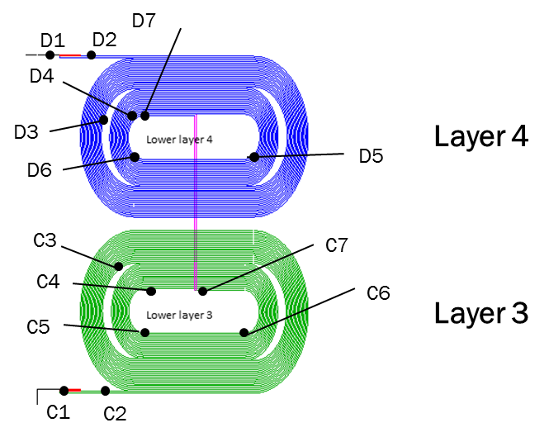
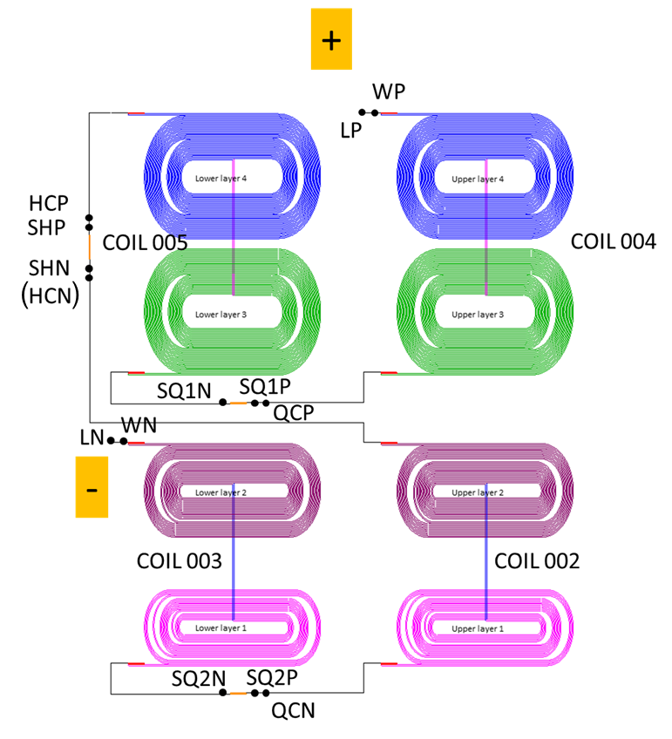
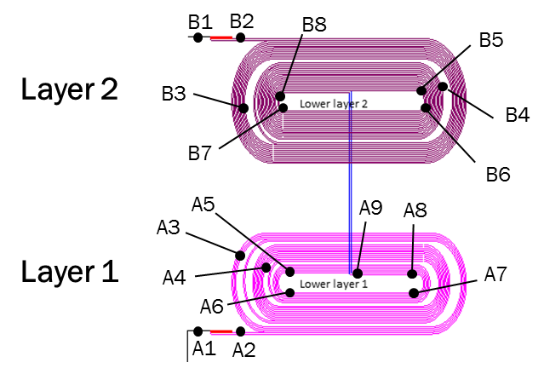
Magnet VT schematics

Slide 4
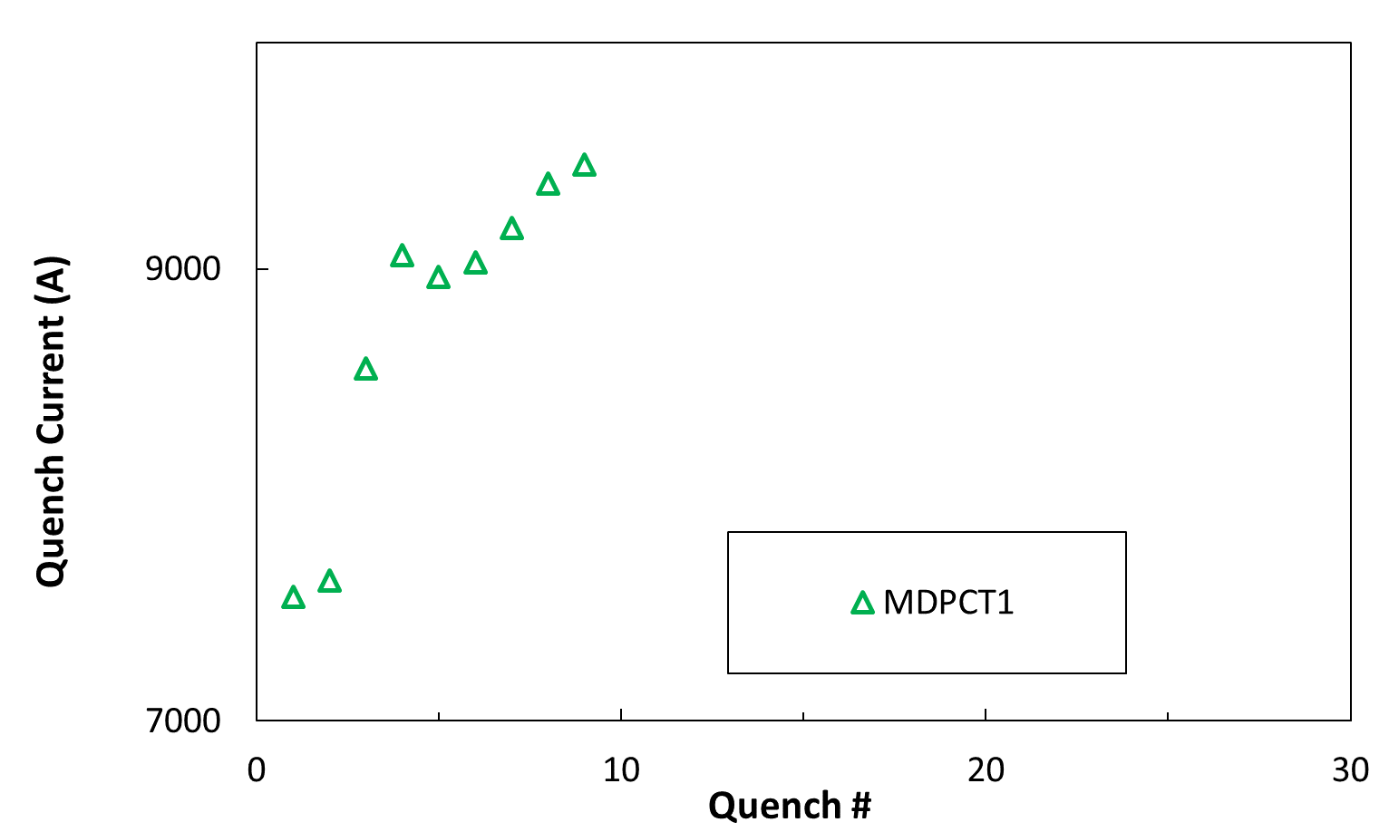
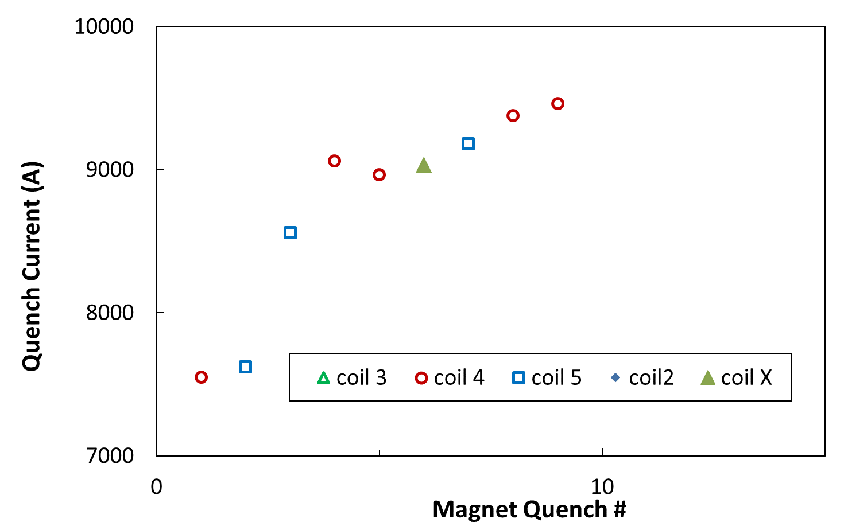
Quench history
Short-sample
 | Current | Current
 | 4.5 K | 1.9 K
 | kA | kA
Coil 2 | 11.3 | 12.6
Coil 3 | 11.3 | 12.6
Coil 4 | 12.7 | 14.3
Coil 5 | 12.8 | 14.4
13 T ~ 9.5 kA
14 T ~ 10.2 kA

Slide 5
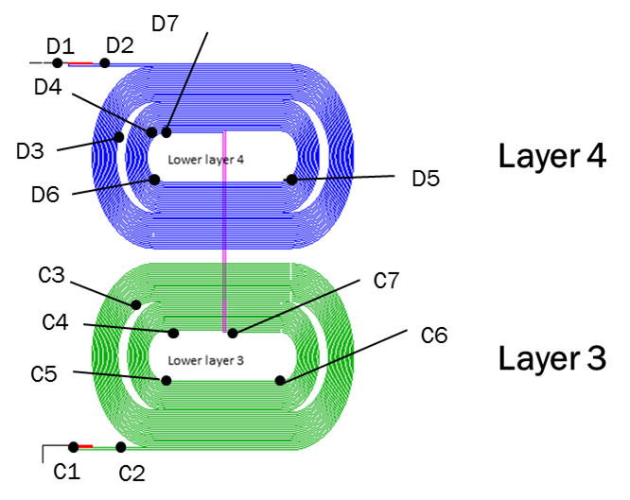
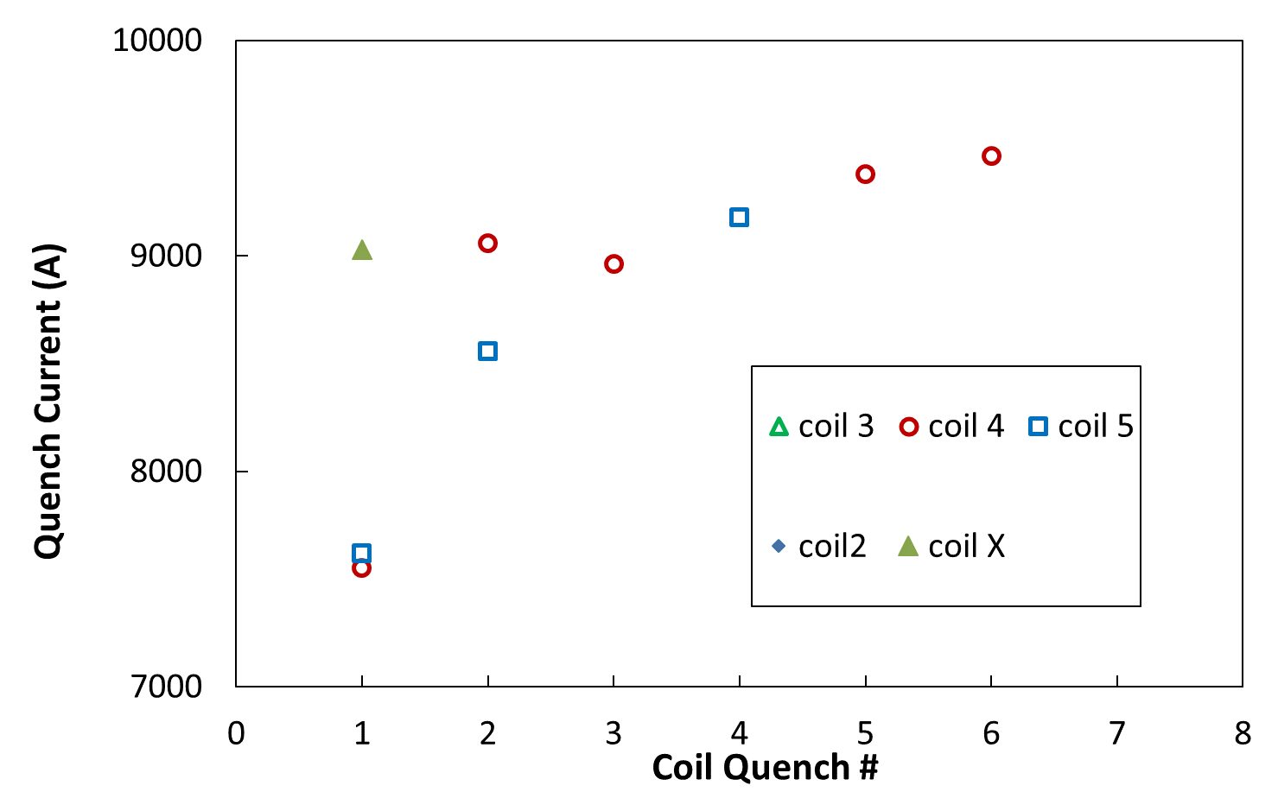
Quench history and locations
4c5_c4
5c4_c5
5d6_d5
4d3_d4
4d5_d6
X
5d6_d5
4d5_d6
4c5_c4
Locations (day-by-day)

Slide 6
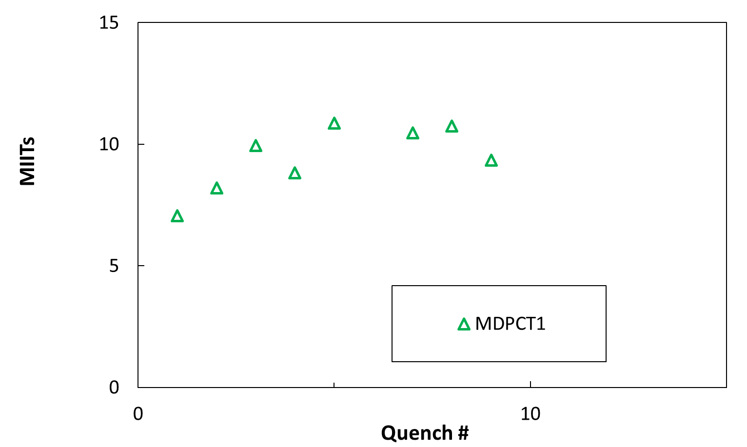
MIITs (seen)
15 MIITs ~ 300 K
Data lost,
approximate
*

Slide 7
Instrumentation status
Voltage taps: one dead and one inactive (both by-passed by using longer segments)
Strain Guages
- Skin gauges - OK
- Bullet gauges – two (on different bullets) dead, the rest are OK
- Pole gauges – layer 3 and 4: all gone or inactive
layer 1: OK
- Coil gauges – one switched off (problems during ramp up),
another off for technical reasons (could be recovered if needed)
Quench antennas:
no known issues but only sensitive to quenches in Layer 1 (didn’t happen yet)
Acoustic sensors
we don’t see any useful data (very noisy signal)

Slide 8
Current status
Recovering after electronics issues
- three of the key computers showed problems and
at one point or another were unable to boot
- could have been some subtle networking problem
- the problems were tackled separately after no common cause found
A manual trip showed systems working as expected now
Debugging of the acoustic system (above ground)
Cooling back to 1.9 K
(to safe LHe we had to lower the liquid level and the temperature dropped to 4 K)

Slide 9
Spare

Slide 10
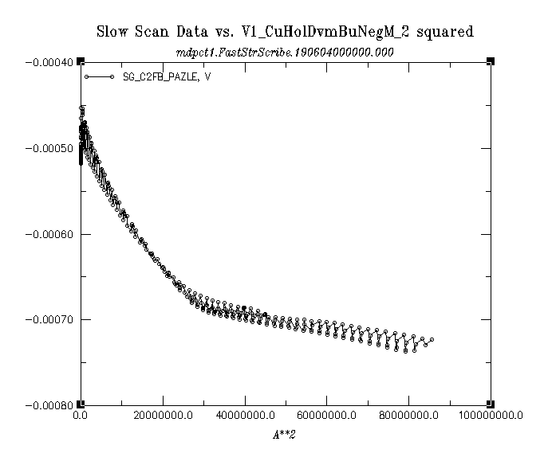
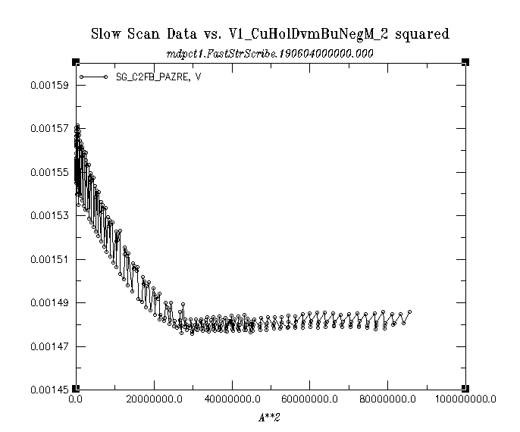
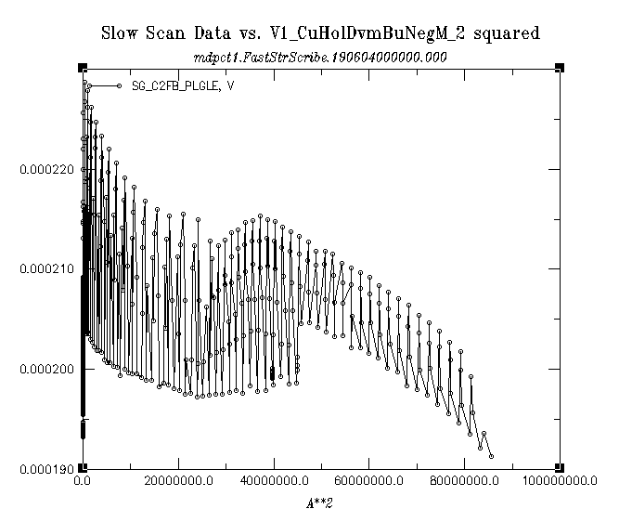
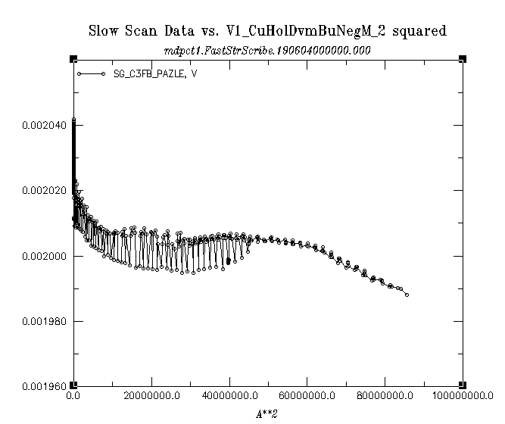
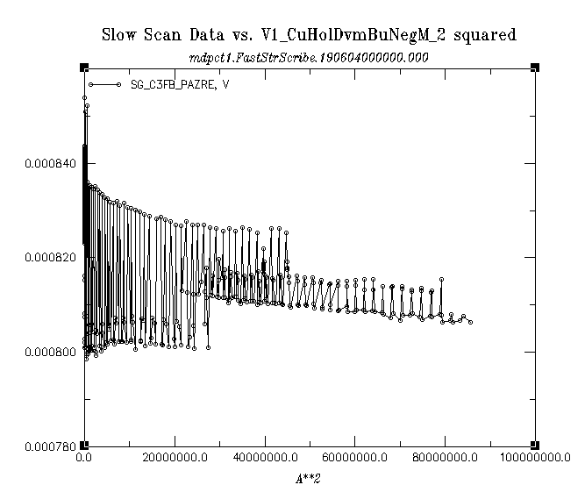
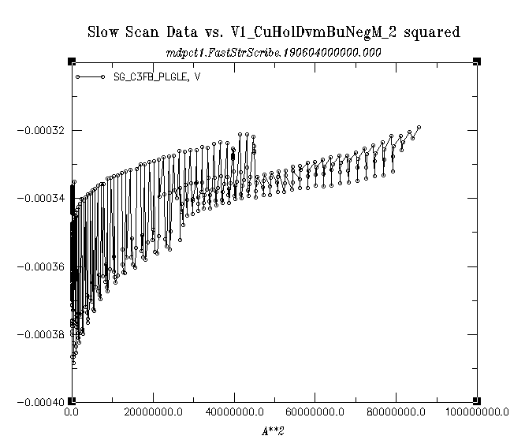
Strain Gauges (readings) vs I²
Ignore signs
Pole
C2_RE_AZ
Pole
C2_LE_LG
Pole
C2_LE_AZ
Pole
C3_LE_AZ
Pole
C3_RE_AZ
Pole
C3_LE_LG

Slide 11
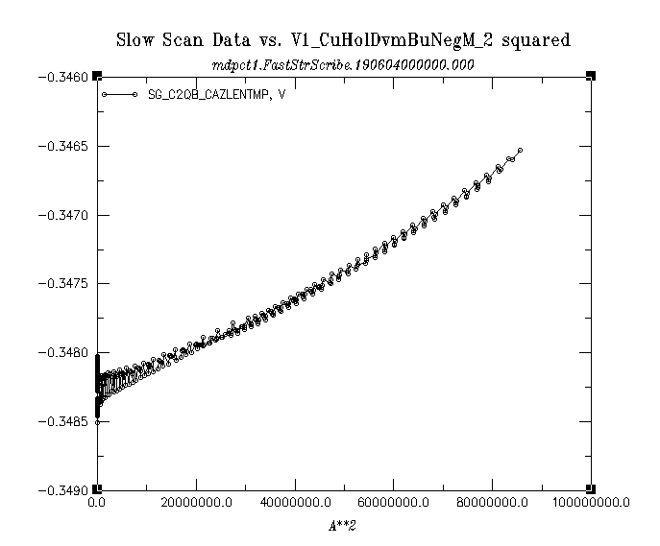
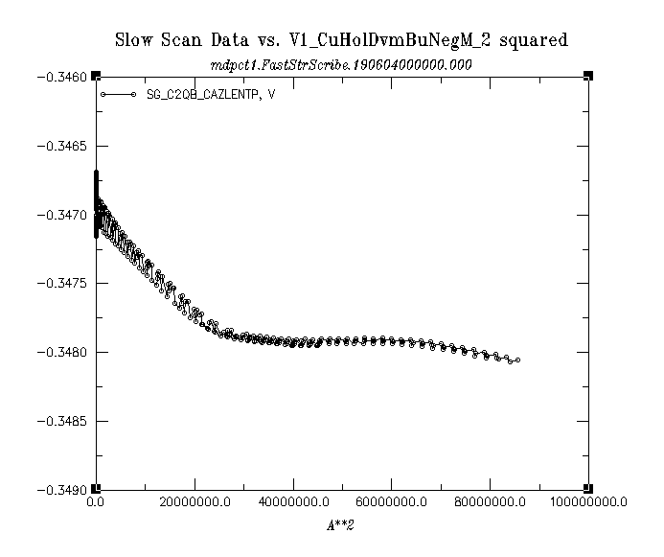
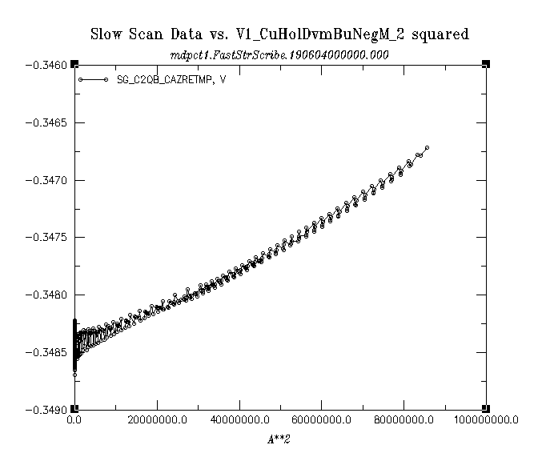
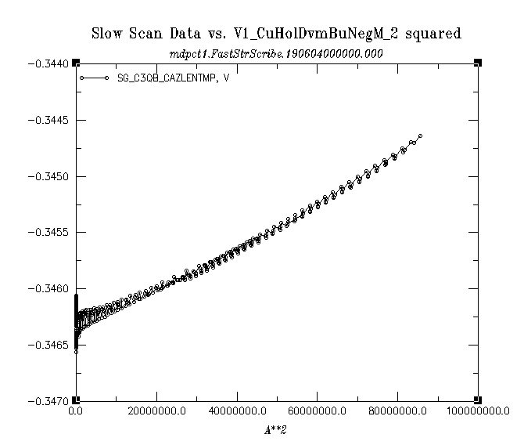
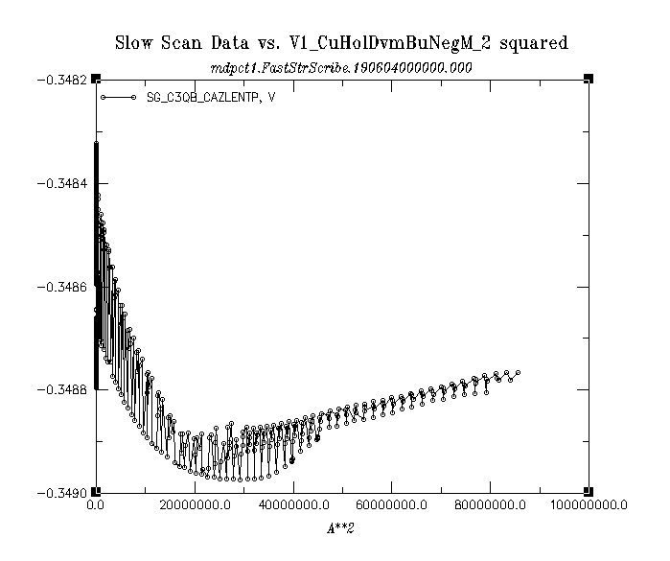
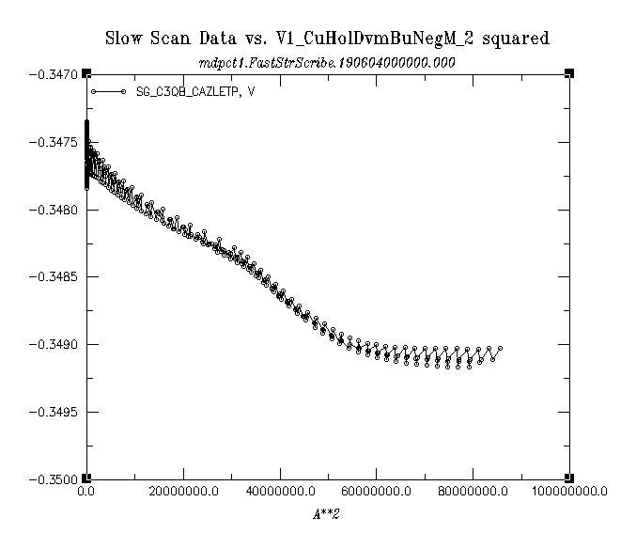
Strain Gauges (readings) vs I²
Ignore signs
Coil
C2_LE_P_NT_AZ
Coil
C2_RE_MP_T_AZ
Coil
C2_LE_MP_NT_AZ
Coil
C3_LE_P_NT_AZ
Coil
C3_LE_P_T_AZ
Coil
C3_LE_MP_NT_AZ

