Slide 1
FRIB Nb₃Sn ECR ion source magnet:
Schedule, Cost, and Progress monthly report
Tengming Shen for the Supercon team
Lawrence Berkeley National Laboratory
March 2025 report
2025/03/24
FRIB: Yoonhyuck Choi, Junwei Guo, Xiaoji Du, Dalu Zhang, Ting Xu, Guillaume Machicoane, Tomofumi Maruta, Jie Wei
LBNL: Tengming Shen, Ye Yang, Philip Mallon, Ray Hafalia, Lianrong Xi, Mariusz Juchno, Paolo Ferracin, Soren Prestemon
The Indico site where the meeting slides can be downloaded: https://conferences.lbl.gov/event/2102/
Access key: FRIB
Past meetings slides are available at https://conferences.lbl.gov/category/109/

Slide 2
Progress since our last meeting, 2024/02/24
Prototype coil fabrication.
Coil winding completed.
Reaction completed.
Impregnation completed.
Prototype coil cold test: Mirror magnet structure components received. Preparation for assembly.
Coil mechanical measurement instrumentations ongoing.

Slide 3
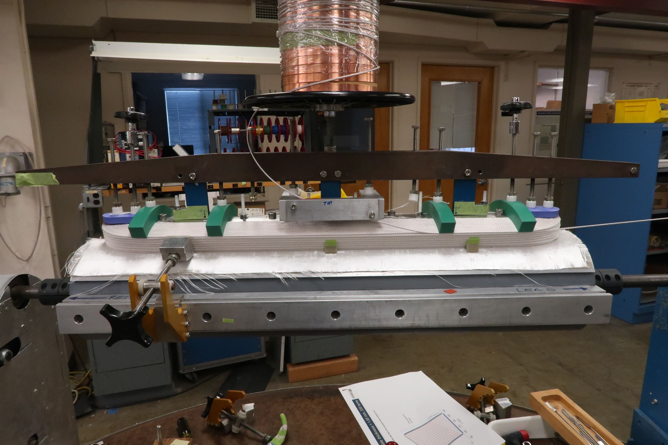
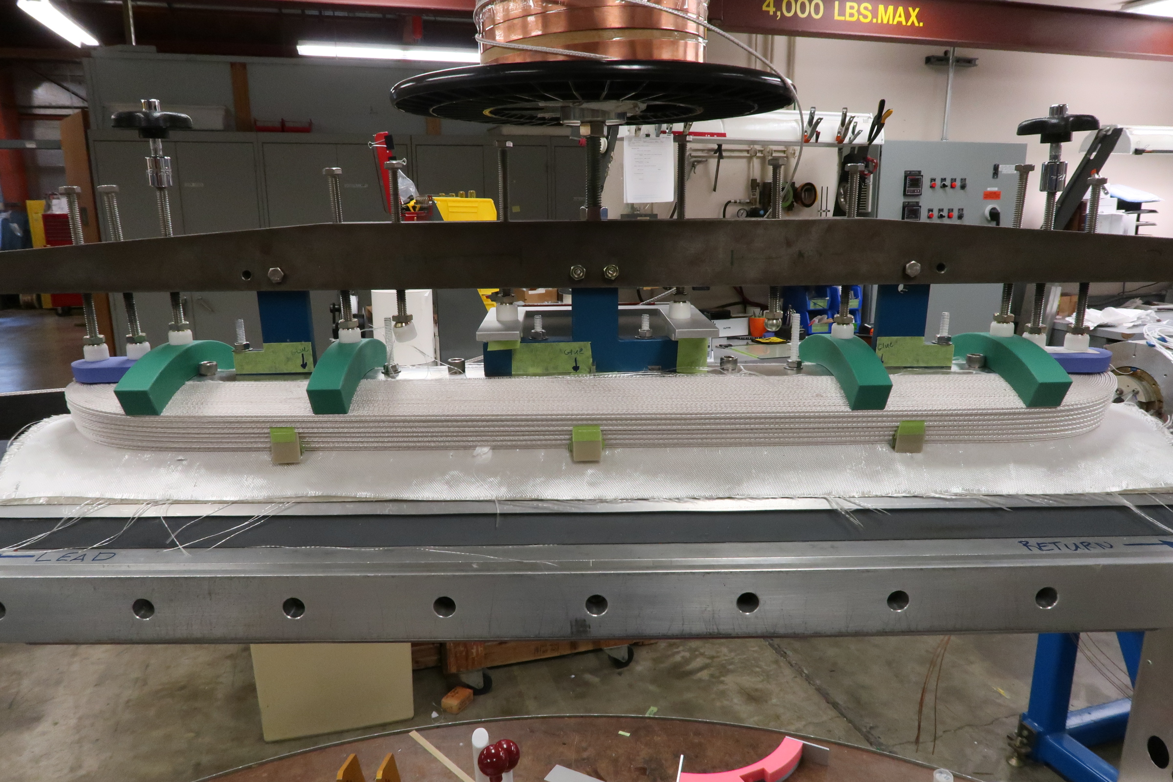
Prototype coil winding completed
Prototype coil winding completed on 11/21/2024.

Slide 4
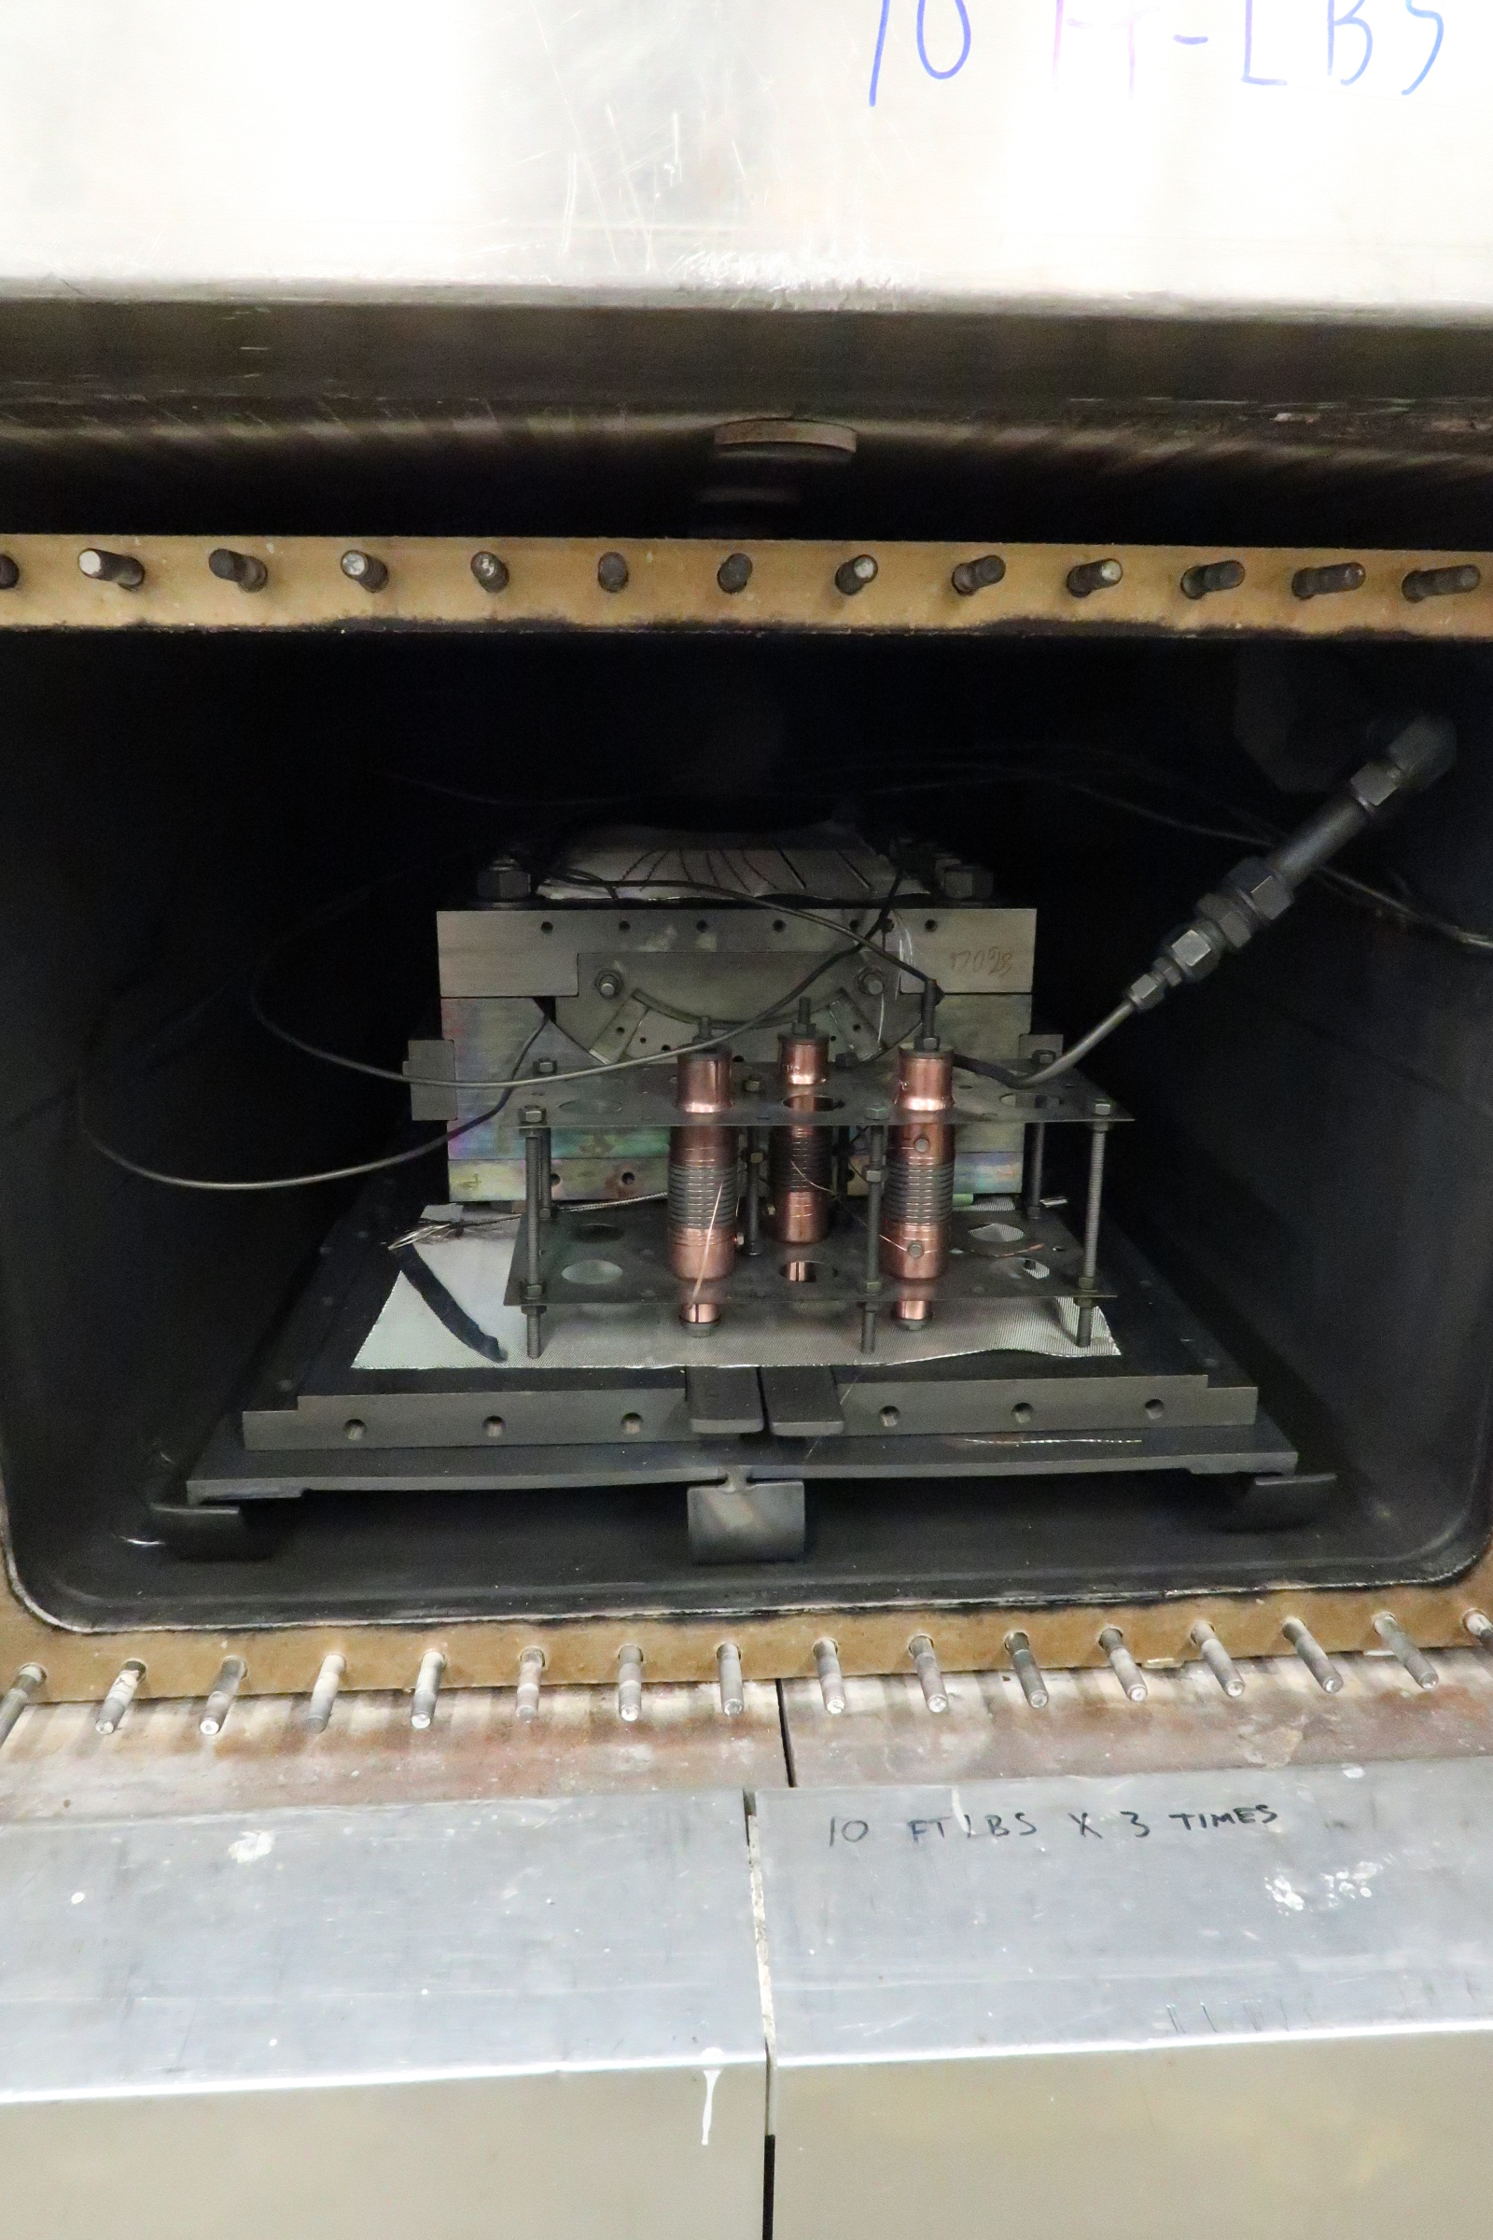
Heat treatment of prototype coil completed
Three barrel samples (round strands) for I_{c}(B) measurements.
Extracted strands for RRR measurements.

Slide 5
Impregnation of prototype coil completed
CTD-101K.
The entire process went well.

Slide 6
Prototype coil impregnated

Slide 7
Coil electrical QA/QC measurements
Before impregnation, coil inside the impregnation mold
Coil resistance (ohm) | 6.33
Coil to LE endshoe (M-ohm) | 40
Coil to RE endshoe (k-ohm) | open
Coil to half pole island (LE) (M-ohm) | 31
Coil to half pole island (RE) (M-ohm) | 50
Coil to impregnation mold baseplate (M-ohm) | 1.5
After impregnation, coil inside the impregnation mold. OD mold removed
Coil resistance (ohm) | 6.3
Coil to LE endshoe (M-ohm) | Open
Coil to RE endshoe (k-ohm) | Open
Coil to half pole island (LE) (M-ohm) | 15.4
Coil to half pole island (RE) (M-ohm) | Open
Coil to impregnation mold baseplate (M-ohm) | Open

Slide 8
Goals next four weeks
Complete mirror magnet assembly.
Prepare mirror magnet cold testing.

Slide 9
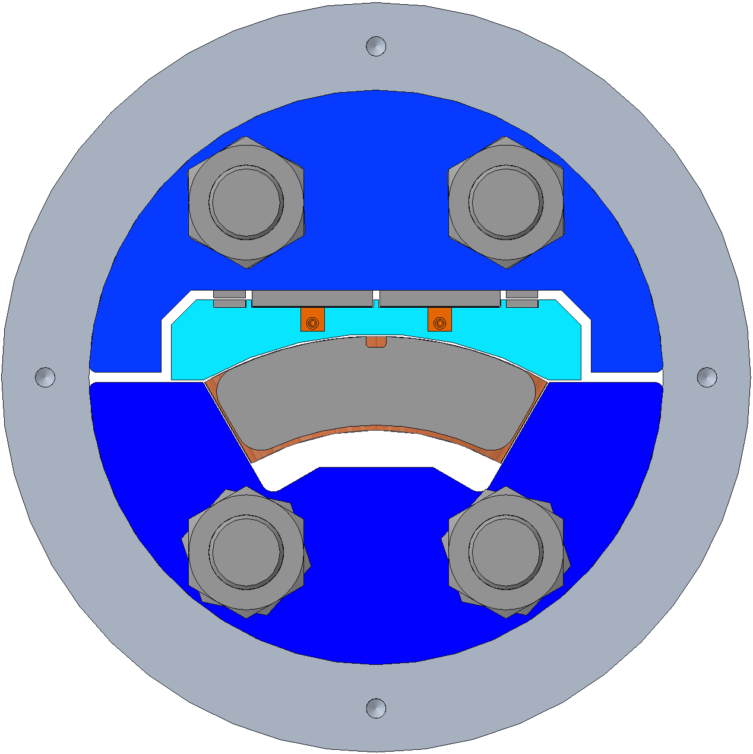
SGs being installed
N
General goal: use similar gauge and wire layout to AUP in order to save effort
One HBM MX1615B module required, 12 SG channels + bladder pressure channel
Coil - 4 channels
Two T & Z Stations along centerline
HBM XC-11-6/350 Bi-directional gauges
Both are independently temperature compensated half bridges
Shell – 4 channels
Two T & Z Stations, 50° apart
HBM XC-11-6/350 Bi-directional gauges
Both are independently temperature compensated half bridges
Rods – 4 channels
One Z Station per rod
HBM LC-11-6/350 Uni-directional gauges
Full bridge comprising two active and two compensating (Poisson & Temp.) gauges
Totals
XC gauges: 8
LC gauges: 16
Cables: 12 (XC) + 8 (LC) = 20
Channels: 12
2
1
3
4
S

Slide 10
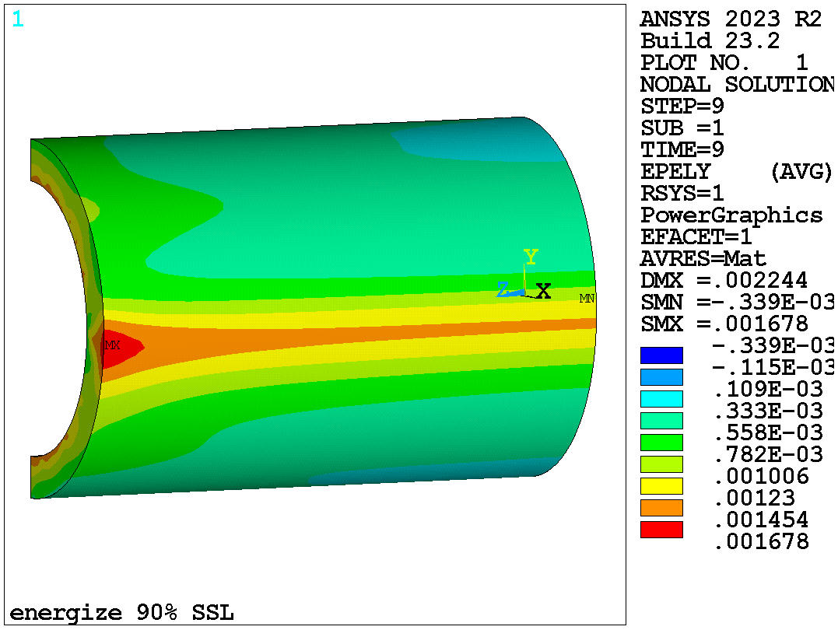
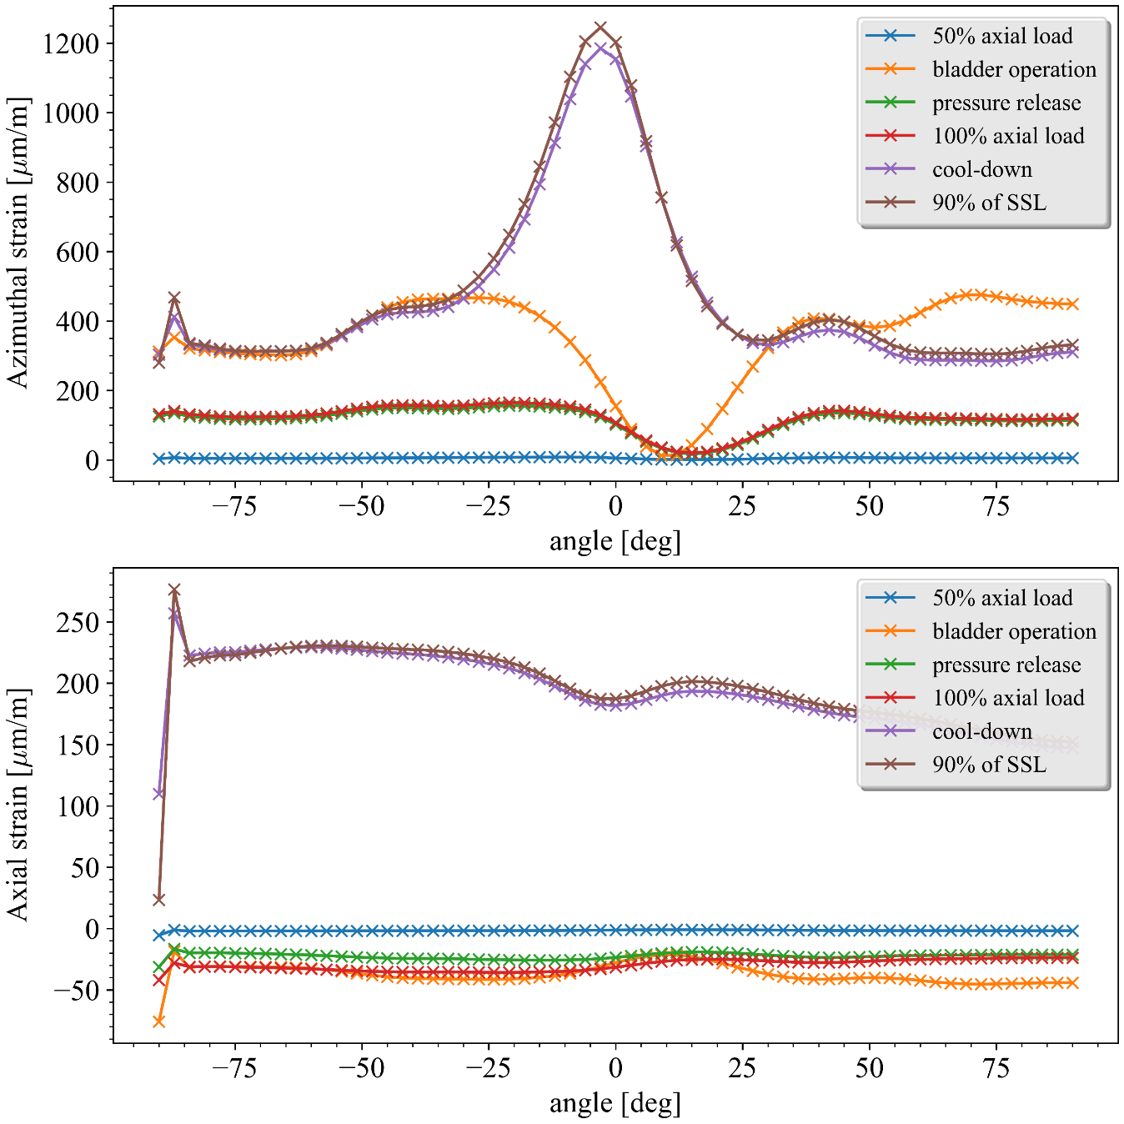
Strain distribution in the shell
-40deg
40deg
Ye Yang
N
PATH
S
Angle for the shell strain gauge, +40deg, -40deg
Also 90deg is possible

Slide 11
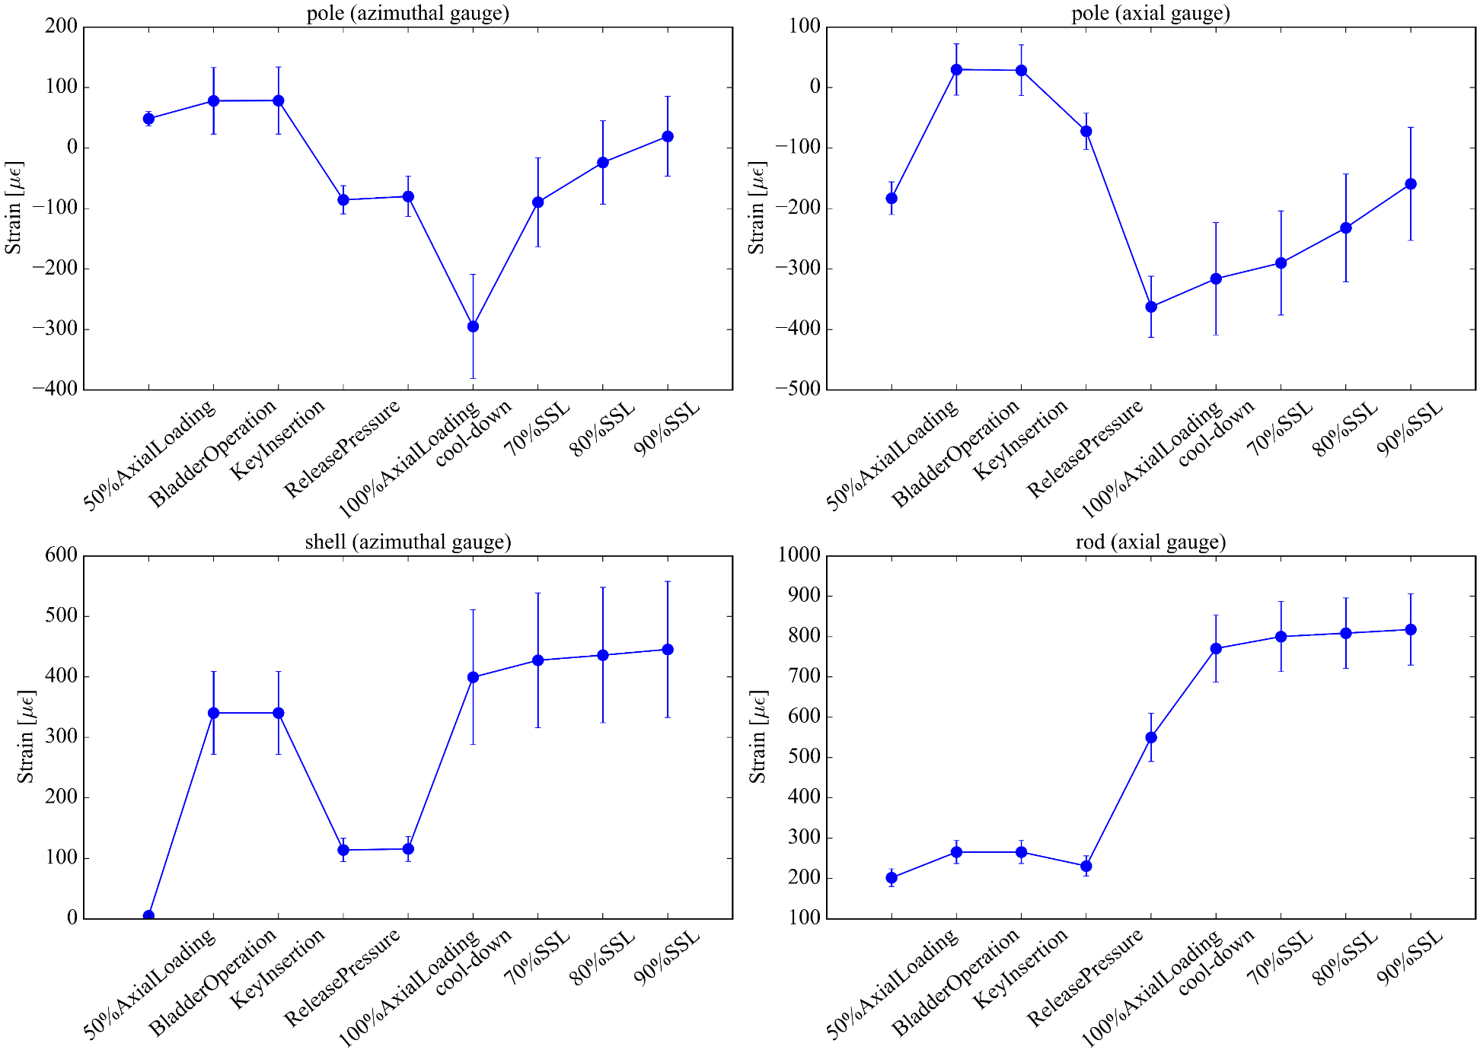
Strain at each step
Ye Yang
Off North by 50-deg

Slide 12
Loading assembly in production
Philip Mallon, Ryan Norris, Lianrong Xu et al.
A production issue to solve.

Slide 13
Conductor started to arrive.
Info from Xiaoji.
14 unit pieces of (>650 m unit piece length) received.
9.1 km out of 39 km.

Slide 14
QA/QC discussions for arrived and incoming conductors
For the 14 unit pieces of (>650 m unit piece length) received (9.1 km out of 39 km), I assume that they are one billet and assume that Bruker will or have provided certificate of round wire Ic(4.2K,12 T), RRR, and 15% rolled wire Ic(4.2K,12 T), RRR. Since there are so many breaks, it is unlikely and costly for us to check every break point.
From these 9.1 km (and add 4 km more), we make 3 cables. I talked to Soren. We can likely check each cable (one round wire, and one extracted strand (strand extracted from cable)). We will need to heat treat 12 barrel samples and test six of them. Then the QA cost of each cable is about $5400.

