Slide 1


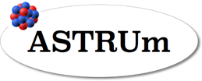


From Shape Coexistence to
Shape Isomers in Atomic Nuclei
The Nuclear Two-Photon decay
to study 0⁺ shape isomers
Berkeley, June 13-17, 2022
Wolfram KORTEN
IRFU - CEA Paris-Saclay

Slide 2
Outline
Nuclear shapes and the occurrence of shape isomers in N~Z nuclei
The nuclear two-photon (or double-gamma) decay
Mass measurements of highly-charged ions in the Experimental Storage Ring (ESR) at GSI/FAIR
Preliminary results for the two-photon decay in ⁷²Ge

Slide 3
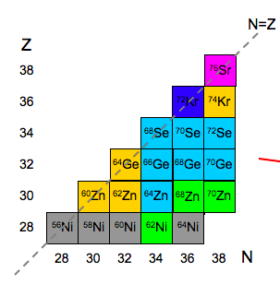
Variation of ground-state shapes of atomic nuclei
Michel Girod et al., HFB-GCM(GOA) Gogny D1S interaction
Pb-Hg
N~Z
Zr, Sr, …
A~100
Dominance of prolate ground-state shapes over most of the nuclear chart
Islands of oblate (or triaxial) nuclei and shape coexistence

Slide 4
Shape coexistence and isomers
Potential energy surface from “macroscopic-microscopic” approach:
Phenomenological nuclear potential plus shell-correction energies
P. Moeller et al., Phys.Rev.Lett.103, 212501 (2009) & Atom. Data Nucl. Data Tables 98, 149 (2012)

Slide 5
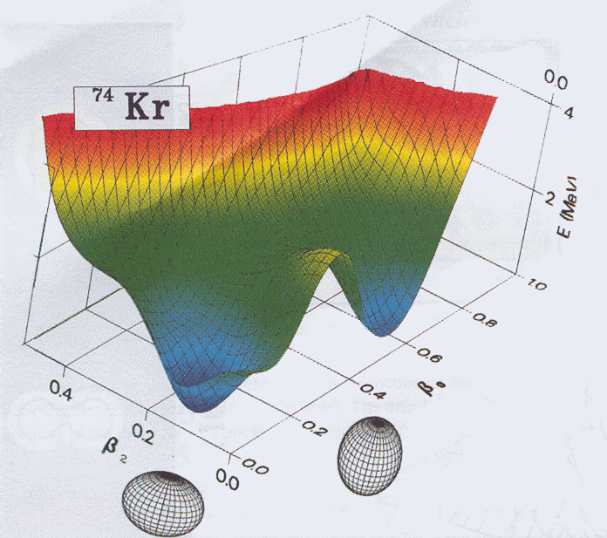
Shape coexistence in N~Z nuclei around A~70
M. Bender et al., PRC 74, 024312 (2006)
Potential energy surface
oblate
prolate
8⁺
Configuration mixing:
6⁺
4⁺
6⁺
2⁺
4⁺
electric monopole (E0) transition
0⁺
E0
2⁺
0⁺
Search for new low-lying 0⁺ shape isomers
using conversion-electron spectroscopy
Notes:
Top left: Single-particle energies as a function of deformation, where negative beta means oblate and positive beta is prolate. Large shell gaps are found for proton AND neutron numbers 34, 36, and 38, both on the prolate and on the oblate side leading to a competition of these shapes in many nuclei in this mass region. Kr-74, with 36 protons and 38 neutrons is one of the archetypes. Its PES (top right) shows two distinct minima corresponding to a very deformed prolate and a lesser deformed oblate shape. They are well separated and almost equally deep. Schematically the situation looks like this: we expect two 0+ states in each minimum, each with a rotational band built upon them. If the excited 0+ state is close to the first 2+ state we expect a relatively long lifetime (shape isomer which will (mainly) decay via an electric monopole transition. If the two 0+ states are close in energy we can also expect the wave functions to mix, and in fact an E0 decay will only be strong if there is a mixing of configurations of different shape.

Slide 6
Search for shape isomers in Kr isotopes near N~Z
LISE3@GANIL (2002)
Fully-stripped ions → no CE
decay in flight
⁷⁸Kr → ⁷²Kr
70 MeV/u
~10¹² pps
⁹Be target
2⁺
710
671
0⁺
38 ns
γ
e⁻
energy loss
0⁺
Ge detectors
Kapton
New (shape) isomer in ⁷²Kr
Si detectors
veto
E. Bouchez et al., PRL 90, 082502 (2003)
time of flight
Si(Li) e⁻ detector

Slide 7
Excited 0⁺ states in neutron-deficient Kr, Se and Ge isotopes
26(2)
0.048(2)
13(1)
T_{1/2} [ns]
ρ²=[m.u.]
0.011(5)
18(2)
0.75(5)
? ?
<0.02
3.7(2)
? ?
444(1)

Slide 8


Nuclear two-photon or double-gamma decay
Rare decay mode whereby two gamma rays are simultaneously emitted
Second order quantum mechanical process proceeds through
virtual excitation of (high-lying) intermediate states
Branching ratio: Γ_{γγ}/Γ_{γ} usually << 10⁻⁴
Observable when first order decays are (strongly) hindered
ex. 0⁺ → 0⁺ E0 decay : single γ-ray emission is forbidden
virtual excitation of giant dipole resonance
1±
1±
0⁺
2E1
2M1
0⁺

Slide 9
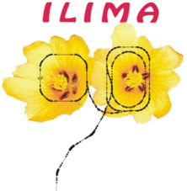
Nuclear two-photon or double-gamma decay
Rare decay mode whereby two gamma rays are simultaneously emitted
Second order quantum mechanical process proceeds through
virtual excitation of (higher-lying) intermediate states
Observable only when first order decays are (strongly) hindered
ex. 0⁺ → 0⁺ E0 decay : single γ-ray emission is forbidden
First clear observation in 1984 at MPI-K HD-DA Crystal Ball (4π NaI array)
¹⁶O
⁹⁰Zr
⁴⁰Ca
J. Schirmer et al., PRL 53 (1984) 1897
J. Kramp et al., Nucl. Phys. A474 (1987) 412

Slide 10
Two-Photon decay candidates in stable nuclei
Isotope | E_{x} (0₂) [MeV] | Τ_{1/2} [ns] | Decay modes | Γ_{γγ}/Γ_{tot} | Γ_{γγ}/E_{x}⁷ [s⁻¹/MeV⁻⁷]
¹⁶O | 6.05 | 0.067 | e⁺e⁻, e⁻, 2γ | 6.6 10⁻⁴ | 23.0
⁴⁰Ca | 3.35 | 2.1 | e⁺e⁻, e⁻, 2γ | 4.5 10⁻⁴ | 30.2
⁹⁰Zr | 1.76 | 62 | e⁺e⁻, e⁻, 2γ | 1.8 10⁻⁴ | 38.9
Quasi constant “reduced” 2γ decay strength (Γ_{γγ}/E_{x}⁷) : average 30.7
Candidates |  |  |  |  | τ_{γγ}/s
⁷²Ge | 0.691 | 444 | e⁻, (2γ) | ➔ 1.7 10⁻⁷ | ~0.43
⁹⁸Mo | 0.735 | 22 | e⁻, (2γ) | ➔ 1.3 10⁻⁷ | ~0.28
⁹⁸Zr | 0.854 | 64 | e⁻, (2γ) | ➔ 1.1 10⁻⁶ | ~0.10
Low-energy 0⁺ states not accessible in direct spectroscopy :
Γ_{γγ}/Γ_{tot} ∼ 10⁻⁶ − 10⁻⁷

Slide 11
Nuclear two-photon or double-gamma decay
Rare decay mode whereby two gamma rays are simultaneously emitted
Second order quantum mechanical process proceeds through
virtual excitation of (higher-lying) intermediate states
Observable only when first order decays are (strongly) hindered
ex. 0⁺ → 0⁺ E0 decay : single γ-ray emission is forbidden
0⁺
0⁺
e⁺e⁻ pairs
internal
conversion
γ
γ
γ
0⁺
0⁺
E_{x}(0⁺) < 2 m_{e}c² ➔ no e⁺e⁻ decay
E_{γ1} + E_{γ2} = ω = E_{x}(0⁺)
fully stripped ions ➔ no ce decay
Two-photon decay is the only allowed 0⁺ → 0⁺ decay in stable bare nuclei

Slide 12
Two-Photon decay half lives in stable nuclei
⁷²Ge
Γ_{γγ} ∝ ω⁷ [α²(E1) + χ²(M1) +
ω⁴ α²(E2)/4752]
Low-energy 0⁺ states long-lived isomeric states
with lifetimes of several hundred ms in bare nuclei

Slide 13
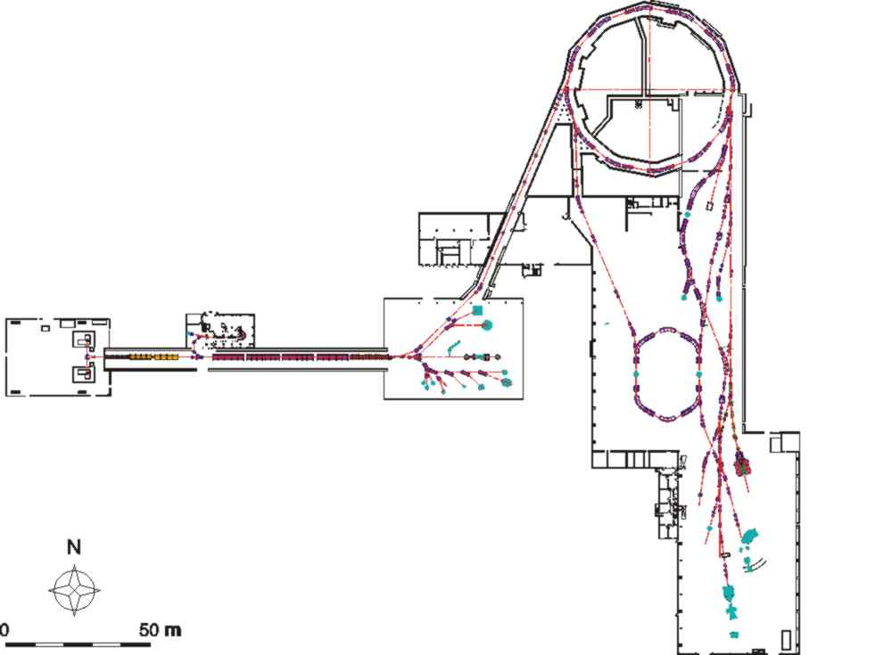
The SIS18 + ESR experiment at GSI
⁷⁸Kr (~460 A.MeV), ~10⁹/spill
Fragmentation in a Be foil (~2 g/cm²)
Bρ selection in the SIS-ESR beam line
high cross section for ⁷²Ge (~10 mb)
large acceptance & transmission
limited selectivity (Bρ only)
SIS
Be foil
Ion sources
SIS-ESR
„TE“-Line
UNILAC
ESR

Slide 14
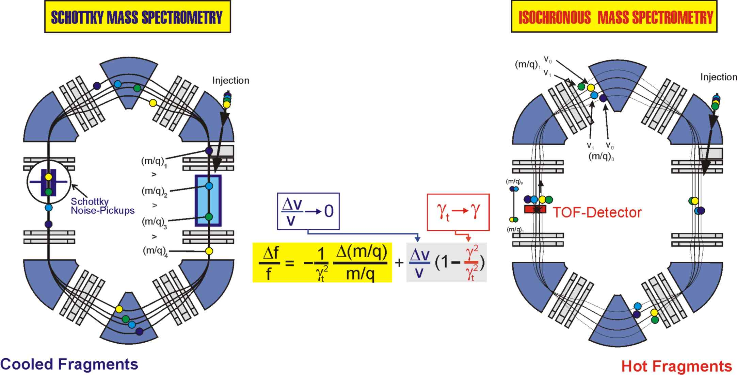
Mass measurements in a storage ring
Measurement
SMS: revolution frequency (~2 MHz)
IMS: revolution time (~500 ns)
Combined Isochronous and
Schottky Mass Spectrometry
(ISMS)
Very fast (few ms)
Good precision
Destructive method
Very high precision
Non destructive
Slow (many seconds)
Notes:
Experimental challenge : short lifetimes as compared to cooling times

Slide 15
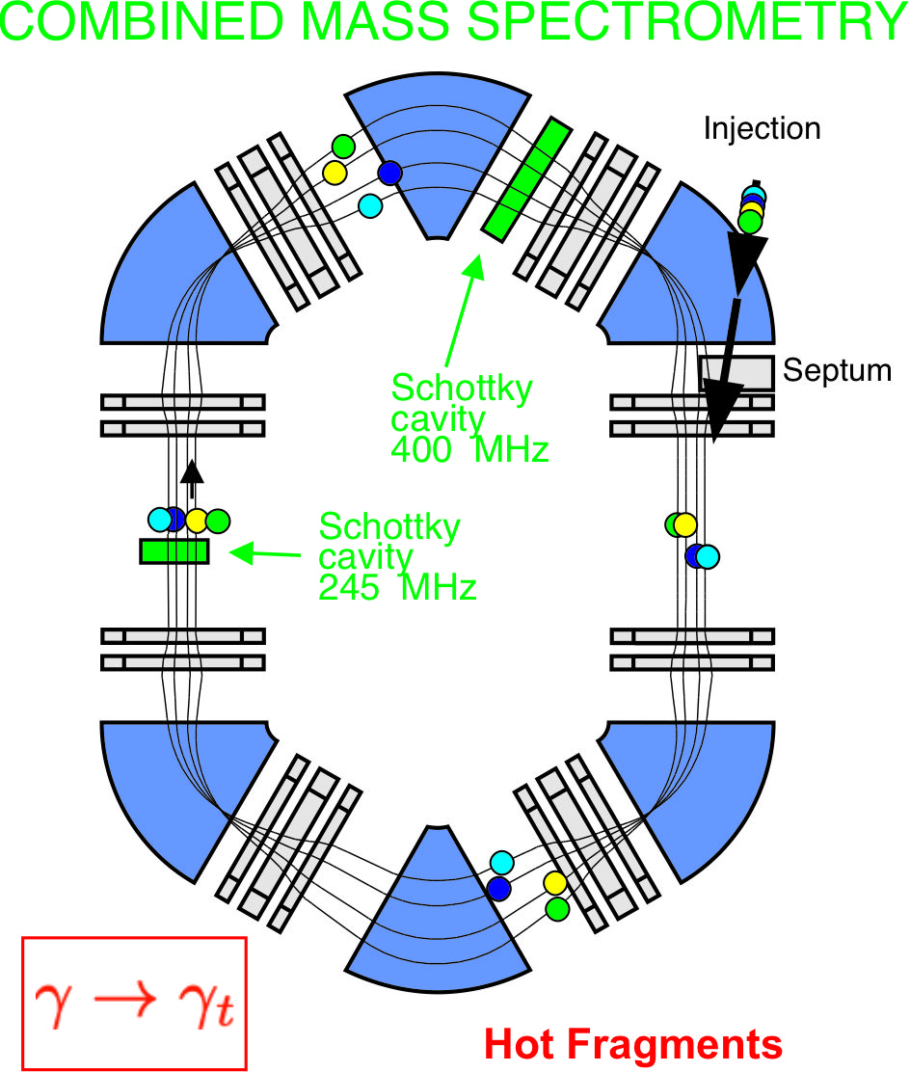
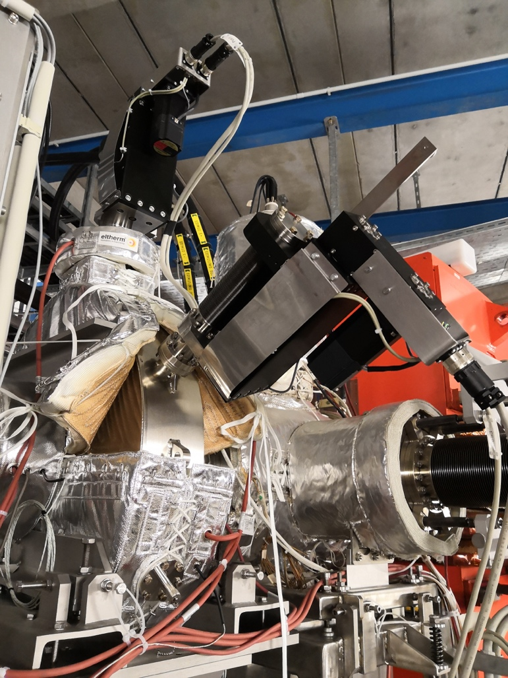
First time combined Isochronous and Schottky
Mass Spectroscopy (ISMS) at the ESR
Combined Isochronous and Schottky
Mass Spectroscopy (ISMS)
New 400 MHz Schottky cavity
M. S. Sanjari et al.,
Rev. Sci. Instr. 91, 083303 (2020)

Slide 16
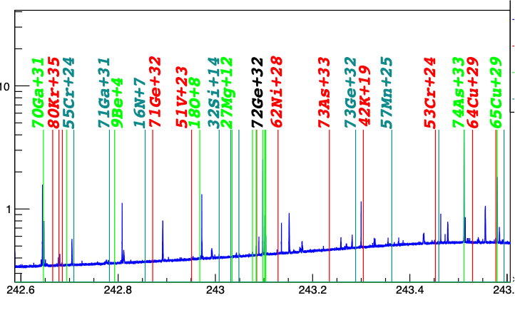
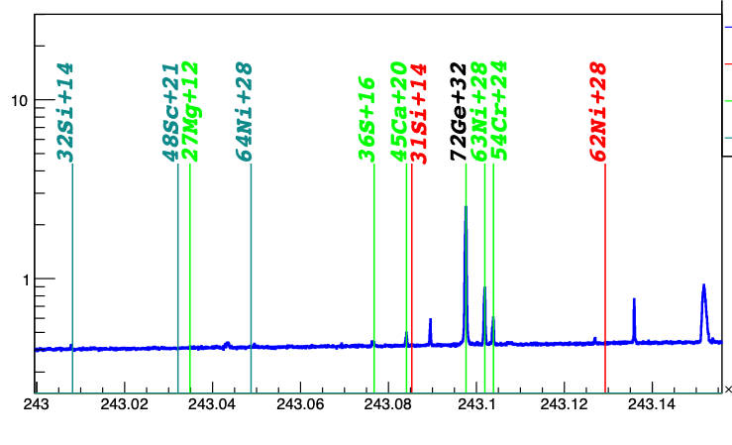
Identification of isotopes through Schottky spectra
All stored nuclei can be identified via A/q
Colour code indicates different harmonics of the original revolution frequency

Slide 17
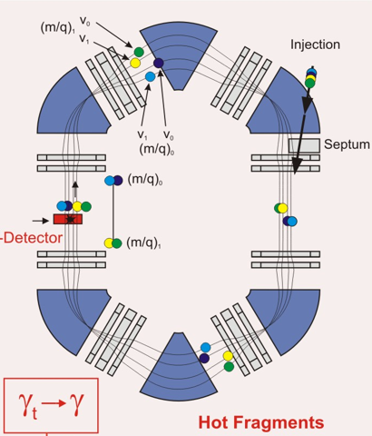
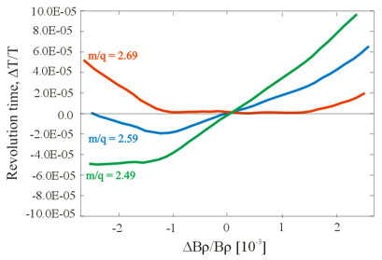

Challenges of IMS at the ESR
γ_{t} is not constant with Bρ,
but depends on the orbit in the ESR
γ ~ 1.41
need to limit Bρ acceptance
good mass resolution for limited Bρ range

Slide 18
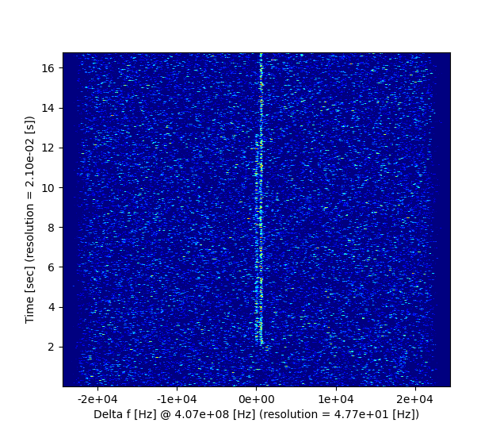
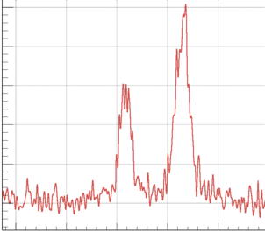
Observation of a 101 keV isomer in ⁷²Br
Combined Isochronous and Schottky
Mass Spectroscopy (ISMS)
Schottky spectrum for a single event
(Δm/m < 10⁻⁶)
~101 keV
⁷²Br
Decay
^{72m}Br
⁷²Br
Time after injection
Time after injection
⁷²Br^{m}
Injection
Injection
Frequency

Slide 19
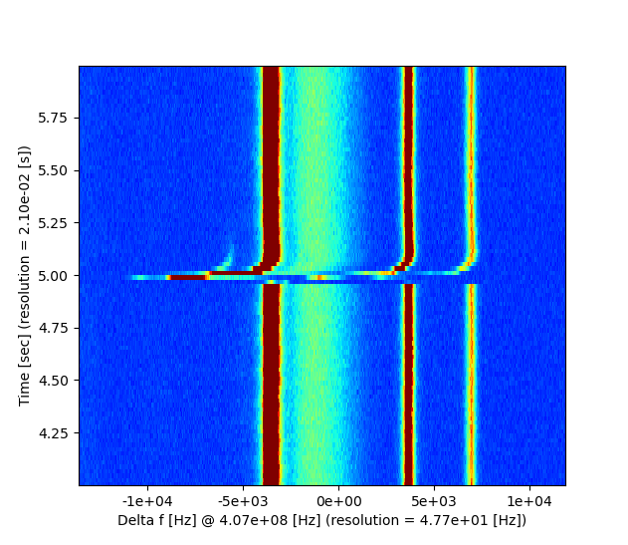
Observation of a very short-lived isomer in ⁷²Ge^{m}
Combined Isochronous and Schottky
Mass Spectroscopy (ISMS)
“Schottky spectrum for a single event
Decay
⁷²Ge^{m}
Before injection Time after injection
Injection
⁷²Ge
⁶³Ni
⁵⁴Cr
Frequency difference

Slide 20
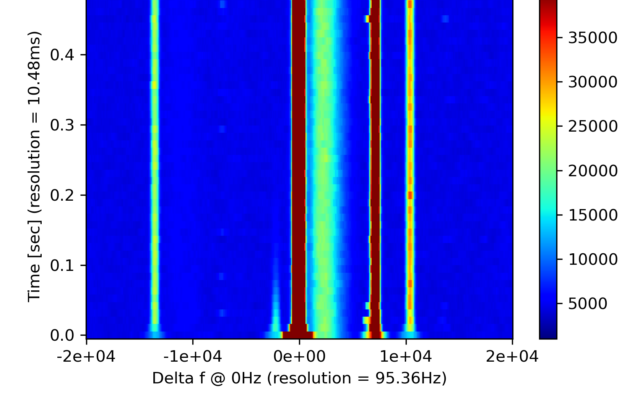
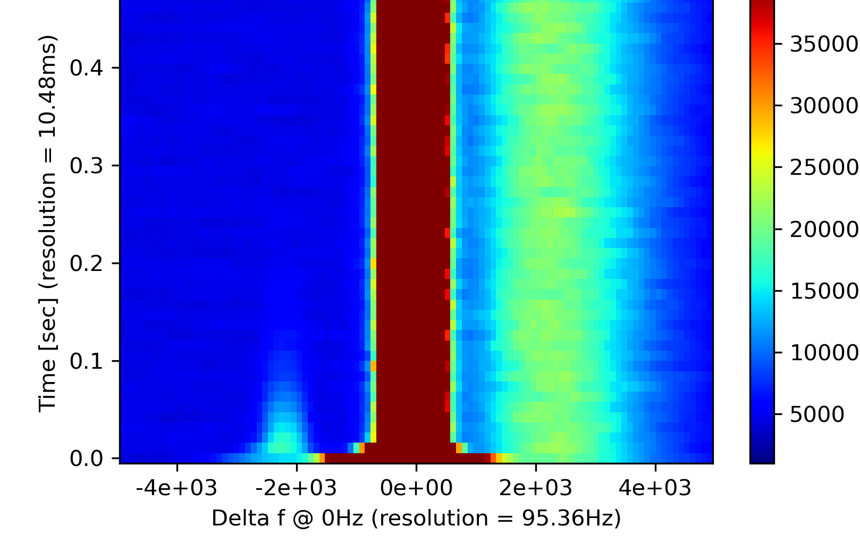
Observation of a very short-lived isomer in ⁷²Ge^{m}
⁷²Ge
⁶³Ni
⁷²As³²⁺
⁷²Ge³²⁺
⁶³Ni²⁸⁺
⁵⁴Cr²⁴⁺
⁷²As
⁵⁴Cr
Time after injection
ufo
⁷²Ge^{m}
⁷²Ge^{m}
⁷²Ge
⁷²Ge^{m}
noise
Power
Time after injection
⁷²Ge^{m}
Time after injection
“Schottky frequency”
Notes:
UFO: undefined frequency object,

Slide 21
Comparison of two-photon decay half lives
⁷²Ge
Γ_{γγ} ∝ ω⁷ [α²(E1) + χ²(M1) +
ω⁴ α²(E2)/4752]
Two-photon decay in ⁷²Ge substantially faster than expected
Theoretical calculations of electric dipole polarizability α²(E1)
and magnetic dipole susceptibility χ²(M1) necessary

Slide 22
Summary
Different nuclear shapes can appear within the same nucleus giving rise to long-lived excited 0⁺ states (“shape isomers”).
The 0⁺→ 0⁺ E0 decay to the ground state in even-mass isotopes may proceed via nuclear two-photon decay.
The competing first-order decays (internal electron conversion or internal pair conversion) can be be eliminated for low-energy decays in bare nuclei.
Combined Schottky and Isochronous Mass Spectroscopy (ISMS) was demonstrated to measure short-lived isomers (>few ten ms) down to low energies of ~100 keV (at A~70).
The lifetime of the two-photon decay of the 0⁺ isomer in ⁷²Ge is much faster than expected from previous studies of the “magic” nuclei (¹⁶O, ⁴⁰Ca, ⁹⁰Zr).
Very promising new technique for 0⁺ isomer searches at FAIR

Slide 23

The E143 Collaboration
W. Korten, D. Kalaydjieva , IRFU, CEA Paris-Saclay, France
C. Akinci, D. Freire, M.S. Sanjari, Y. Litvinov, H. Weick, H. Albers, M. Armstrong, A. Banerjee,
C. Brandau, R. Chen, M. Cortes, O. Forstner, N. Hubbard, H. Geissel, J. Glorius, M. Gorska,
N. A. Gumberidze, K. Kanika, G. Kosir, S.A. Litvinov, A. Mistry, M. Polettini, M. Selina, M. Steck, R. Singh Sidhu, T. Stöhlker, R. Zidarova, et al., GSI and TU Darmstadt, Germany
K. Blaum, MPI-Kernphysik and University of Heidelberg
F.G. Kondev, Argonne National Laboratory, U.S.A.
C. Bruno, J. Marsh, University of Edinburgh, UK
J. Vesic, JSI Ljubljana, Slovenia
B. Jurado, M. Sguazzin, J. Swartz, LP2i, Bordeaux, France
A. Görgen et al., University of Oslo, Norway
T. Yamaguchi, et al., Saitama University, Japan
Ph. Walker, Zs. Podolyak, University of Surrey, UK
I. Dillmann, C. Griffin, G. Leckenby, TRIUMF, Vancouver, Canada
A. Ozawa, Tsukuba University, Japan
J.J. Carroll, C.J. Chiara, US Army Research Laboratory, Adelphi, U.S.A.
and the ILIMA collaboration

Slide 24
Supplements

Slide 25
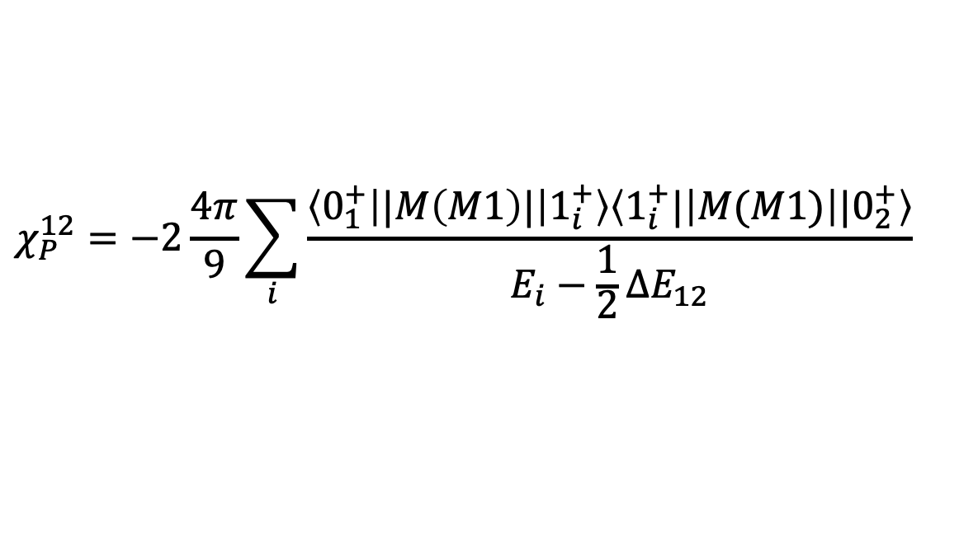
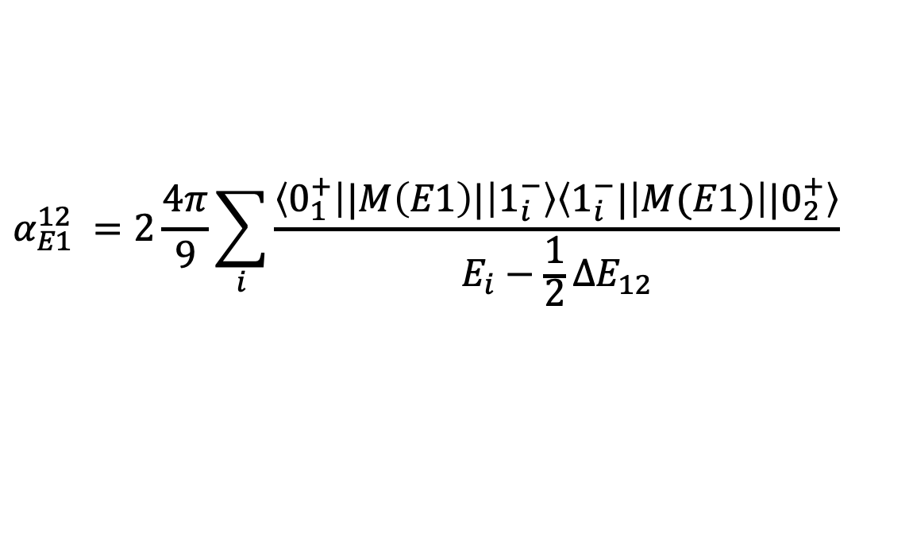

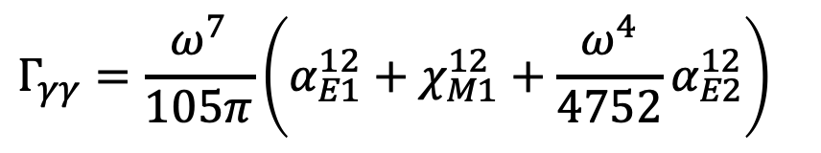
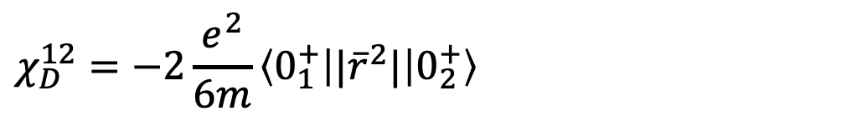
Two gamma decay rate and nuclear matrix elements
$$Γ_{γγ}=\frac{ω^{7}}{105π}\left(α_{E1}^{12}+χ_{M1}^{12}+\frac{ω^{4}}{4752}α_{E2}^{12}\right)$$
Two-gamma
decay rate
usually$α_{E1}^{12}≪χ_{M1}^{12}≪α_{E2}^{12}$
$$α_{E1}^{12} =2\frac{4π}{9}\sum_{i}{\frac{\left\langle 0_{1}^{+} | |M\left(E1\right)| | 1_{i}^{−}\right\rangle \left\langle 1_{i}^{−}| | M(E1) | |0_{2}^{+}\right\rangle }{E_{i}−\frac{1}{2}ΔE_{12}}}$$
Electric dipole
polarisability
Paramagnetic
magnetic dipole
susceptibility
$$χ_{P}^{12}=−2\frac{4π}{9}\sum_{i}{\frac{\left\langle 0_{1}^{+} | |M\left(M1\right)| | 1_{i}^{+}\right\rangle \left\langle 1_{i}^{+}| | M(M1) | |0_{2}^{+}\right\rangle }{E_{i}−\frac{1}{2}ΔE_{12}}}$$
Diamagnetic
magnetic dipole
susceptibility
$$χ_{D}^{12}=−2\frac{e^{2}}{6m}\left\langle 0_{1}^{+} | |{\overline{r}}^{2}| | 0_{2}^{+}\right\rangle$$

Slide 26
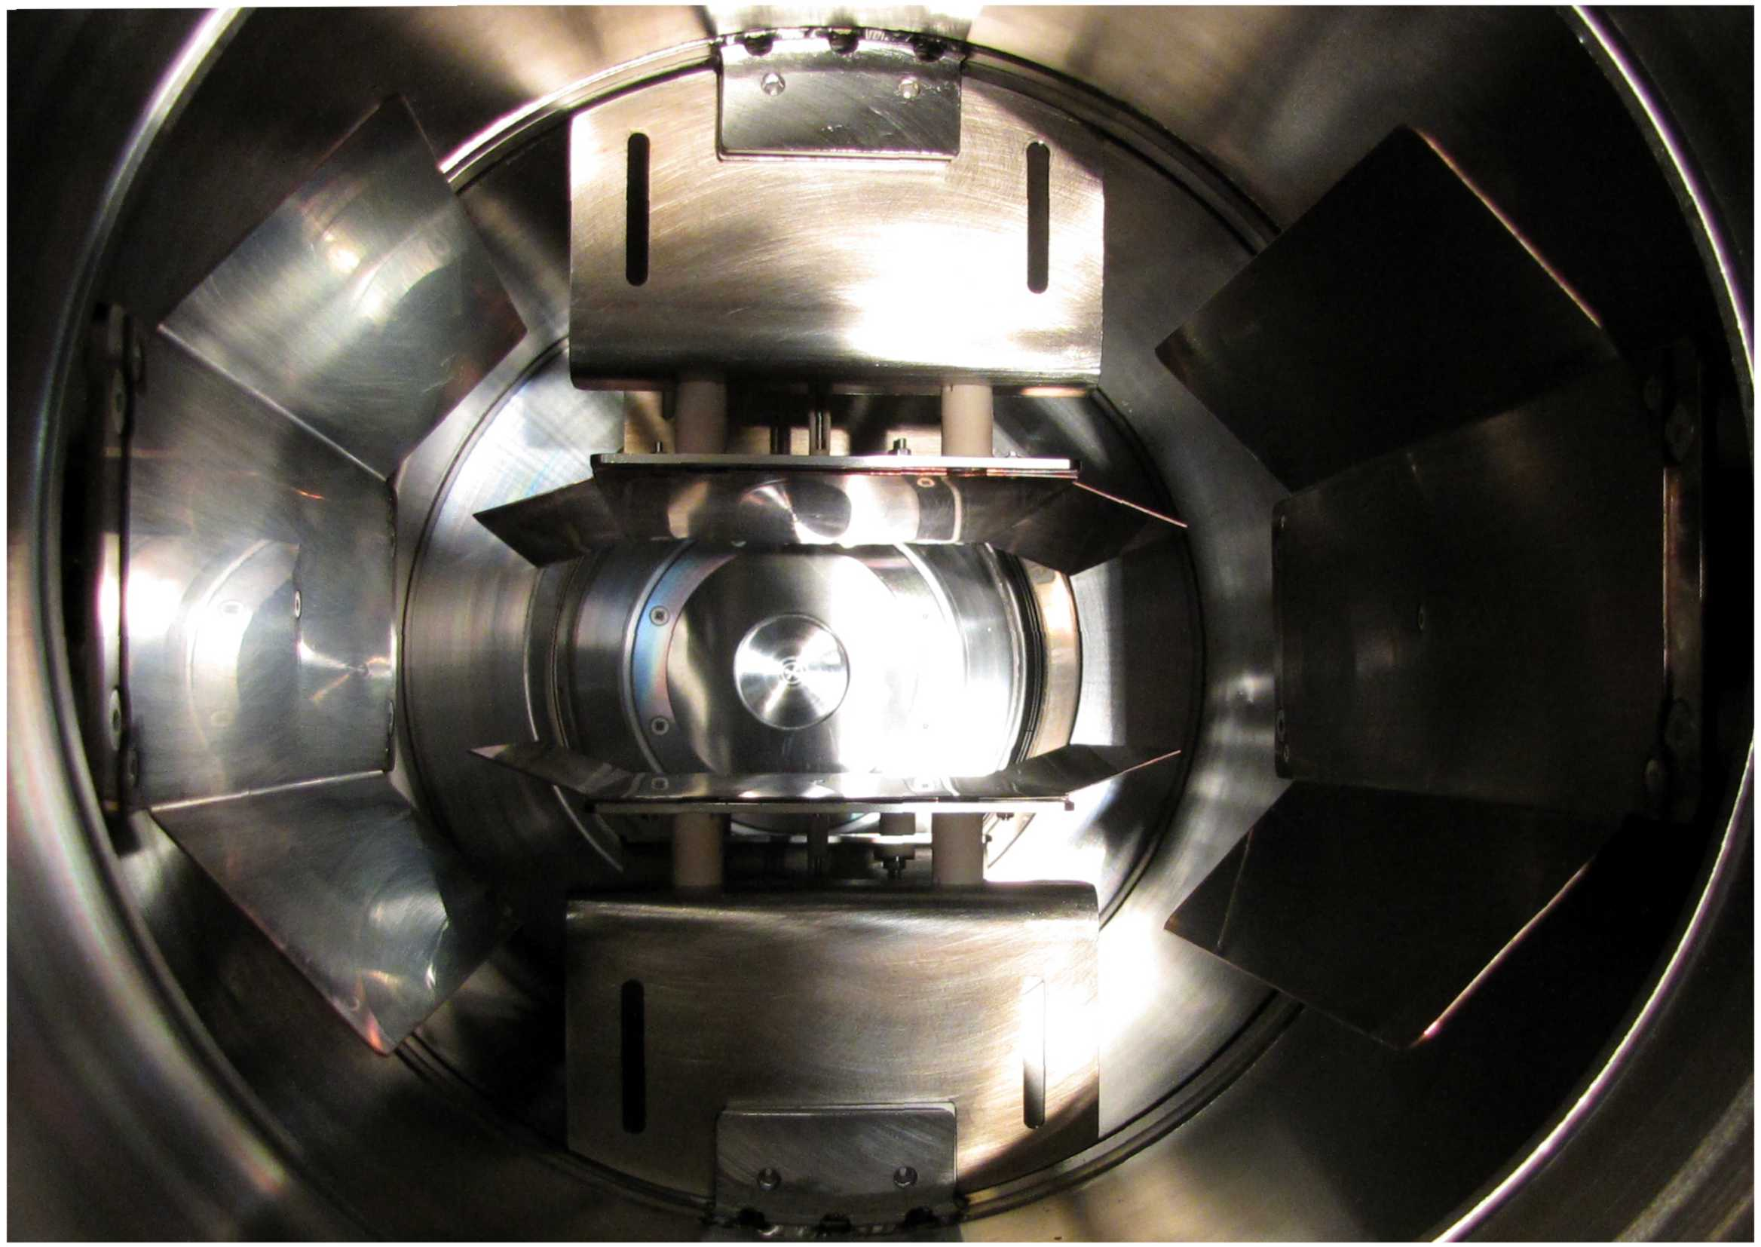
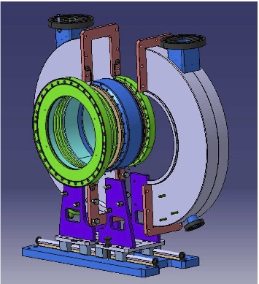
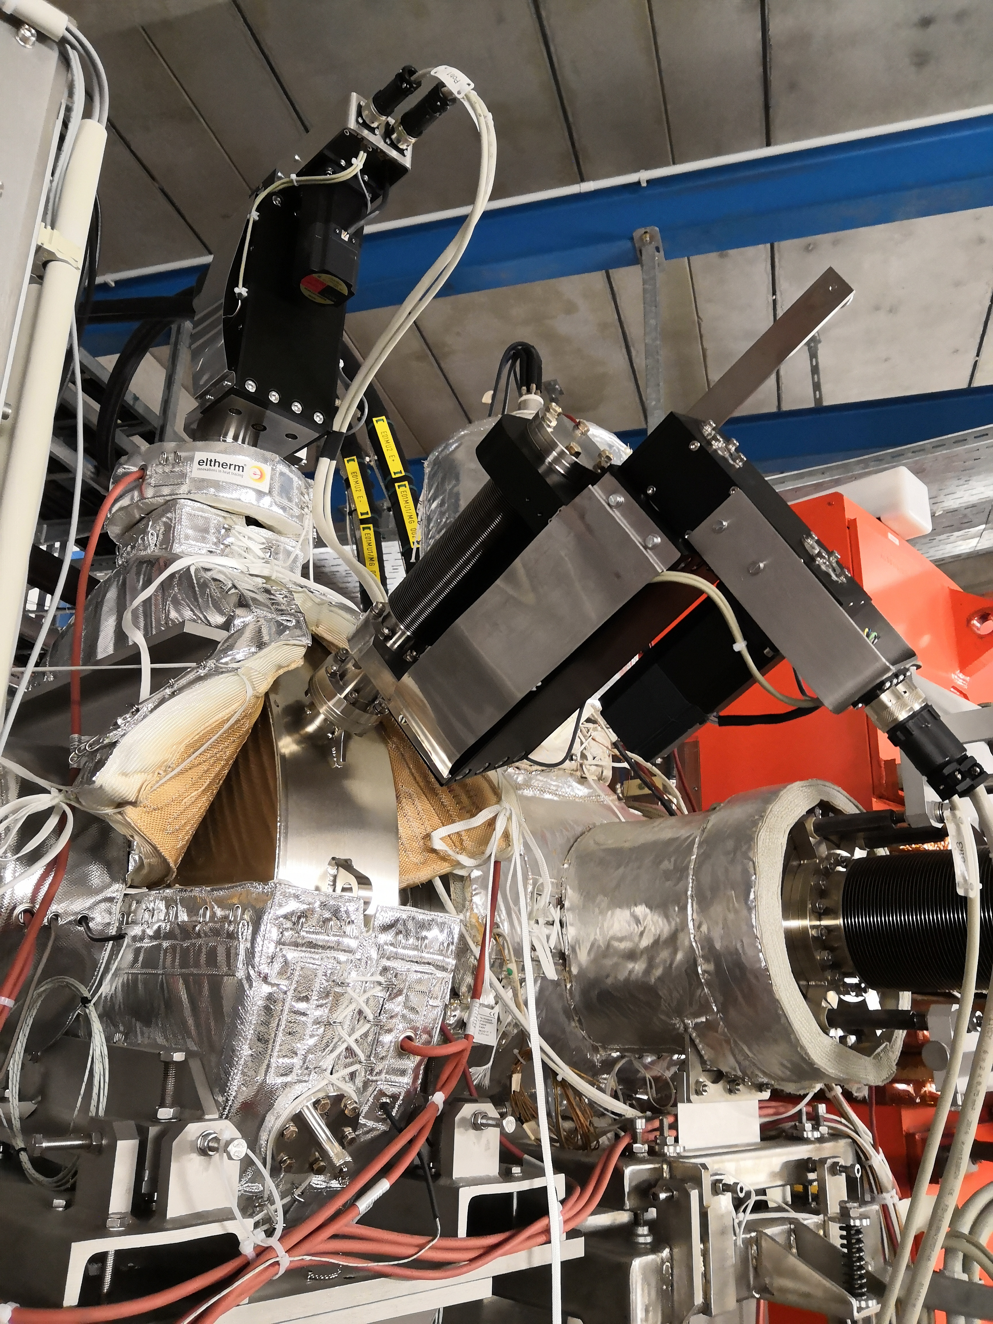


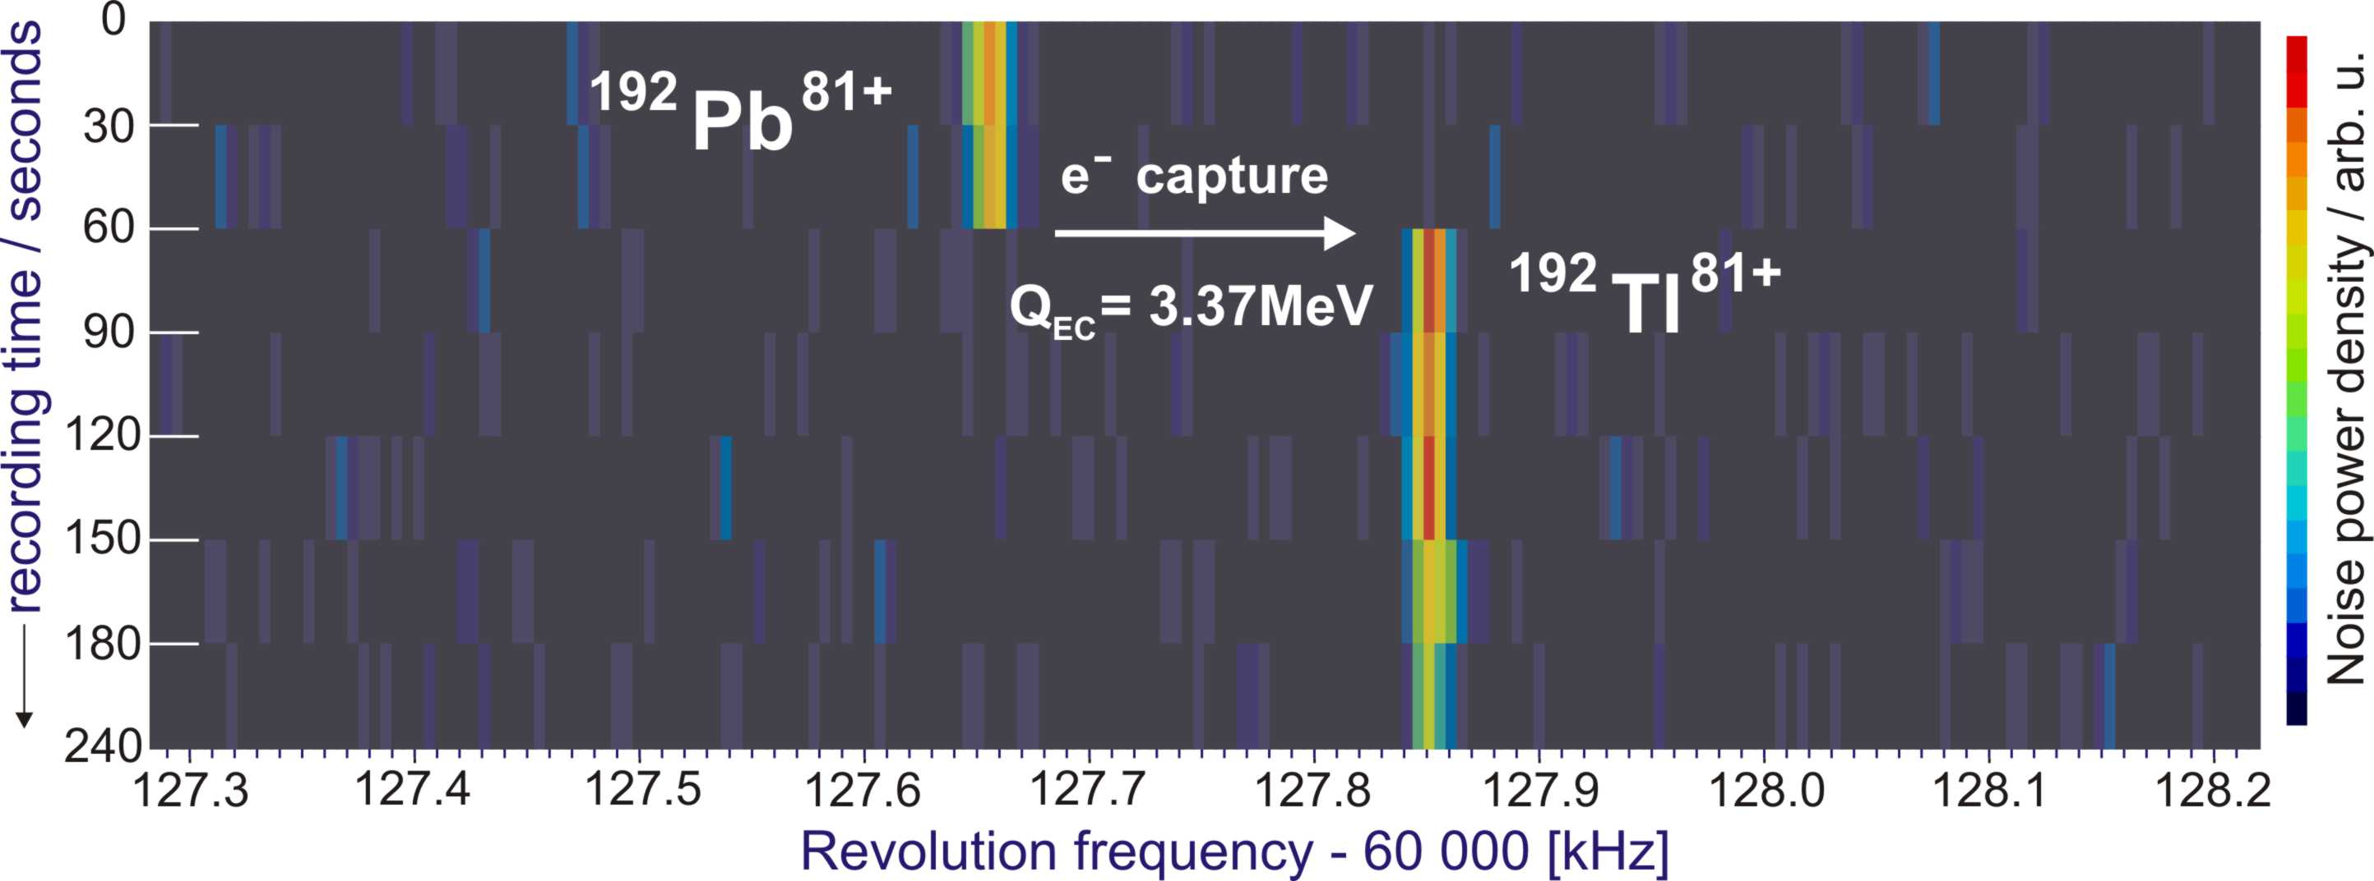
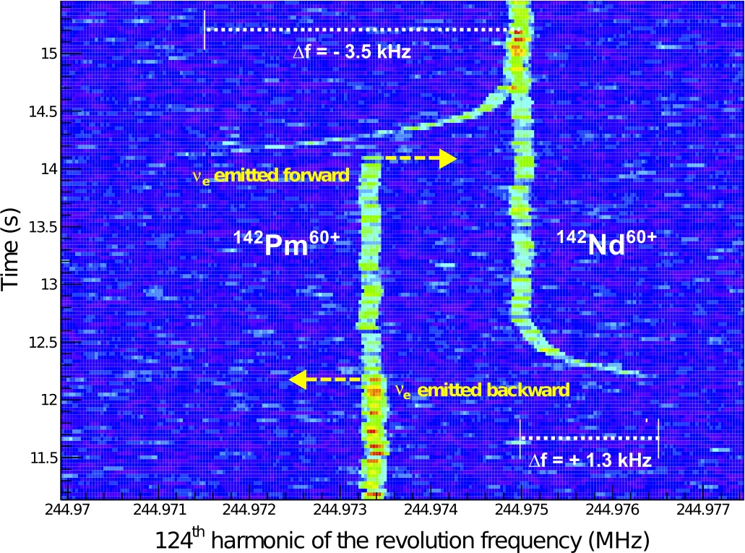
Development of Schottky Detectors:
Sensitivity to single ions
1992
2011
2020
F. Nolden et al., NIM A (2011)
M. S. Sanjari et al.,
Rev. Sci. Instr. 91, 083303 (2020)
~30 sec / spectrum
- Massese and lifetimes (T_{1/2}> 5 s)
~30 ms/spectrum
Longitudinal changes of momenta
E-cooling process
Intra-beam scaterring

Slide 27
Shape isomers in Kr isotopes near N~Z
Spectroscopy of ^{72,74}Kr
“after fragmentation”
electron
First excited 0⁺ state at 671keV state in ⁷²Kr
is a shape isomer
τ =38(3)ns → ρ² (0⁺→0⁺)~70 10⁻³
~2 pps, 6% isomeric ratio
K508
electron
L508
0⁺ state at 508 keV confirmed and clearly attributed to ⁷⁴Kr
2⁺
52
0⁺
gamma
456
508
0⁺
E. Bouchez et al., PRL 90, 082502 (2003)

Slide 28
Extrapolated states
Experimental states
Pures states
Mixed states
2
p
63.5 keV
α |0⁺> + β |0⁺>
+
1
|0⁺>
δ
p
o
0
+
δ
+
0
0
p
2
Interaction V
p
p
V
544 keV
671 keV
Mixing amplitudes
α, β
+
+
0
0
+
o
0
o
|0⁺>
δ
1
o
δ
α |0⁺> + β |0⁺>
63.5 keV
o
p

