Slide 1



Furnace Status
Daniel Davis and Shaon Barua
04/11/2025
DOE ARDAP - Enhancing Domestic Production of High Temperature Superconducting Bi₂Sr₂CaCu₂Ox/Ag wires for High Field Magnets
ASC-NHMFL is supported by US DOE-OHEP (DE-SC0010421, DE-SC0018683), US DOE-ARDAP DE-AC02-05CH11231/AWD00007176, NHMFL Core Grant (NSF 2128556), FSU special allocation for Bi-2212 commercialization, the State of Florida, and the US DOE-MDP for much context and many collaborations​. LBNL is supported by US DOE-OHEP-MDP under contract No. DE-AC02-05CH11231. The National High Magnetic Field Laboratory is supported by National Science Foundation through NSF/DMR-2128556* and the State of Florida.

Slide 2
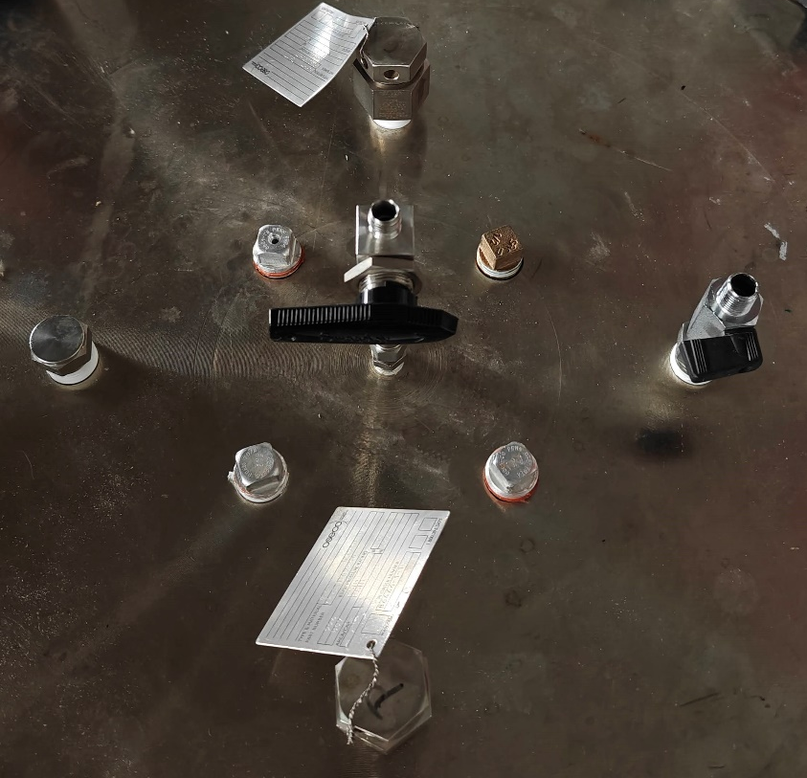
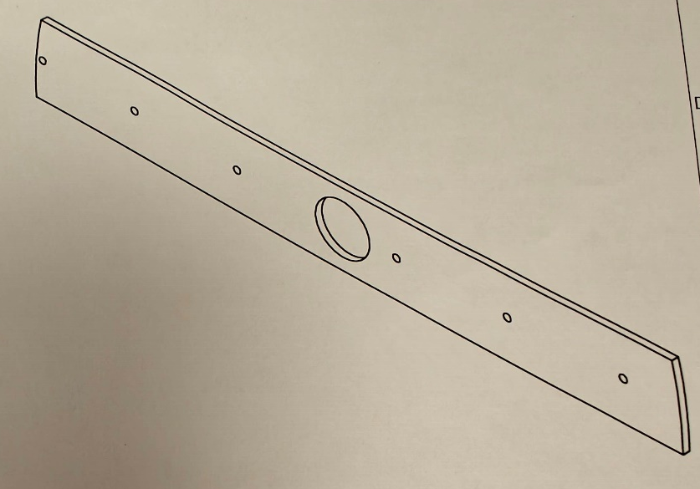
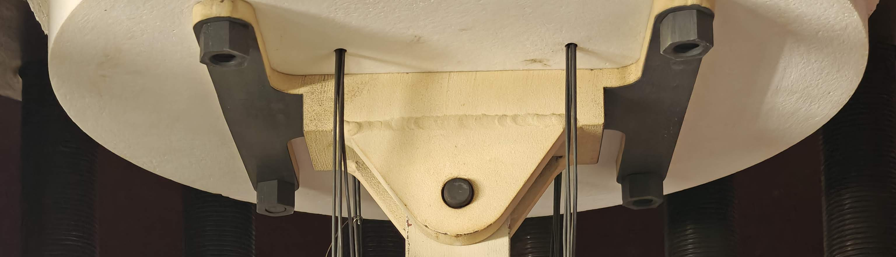
Radial Mapping
3 TC in zone 1 & 2 centers each
Spiral path out for the rest
∙A
∙B
Z1.0
∙C
∙D
∙A
∙B
∙A
Z2.0
∙C
∙B
∙D
∙A
∙B
Z3.0
∙C
∙D
∙C
∙D
∙A
Z4.0
∙B
Z5.0
∙C
Z6.0
∙D

Slide 3
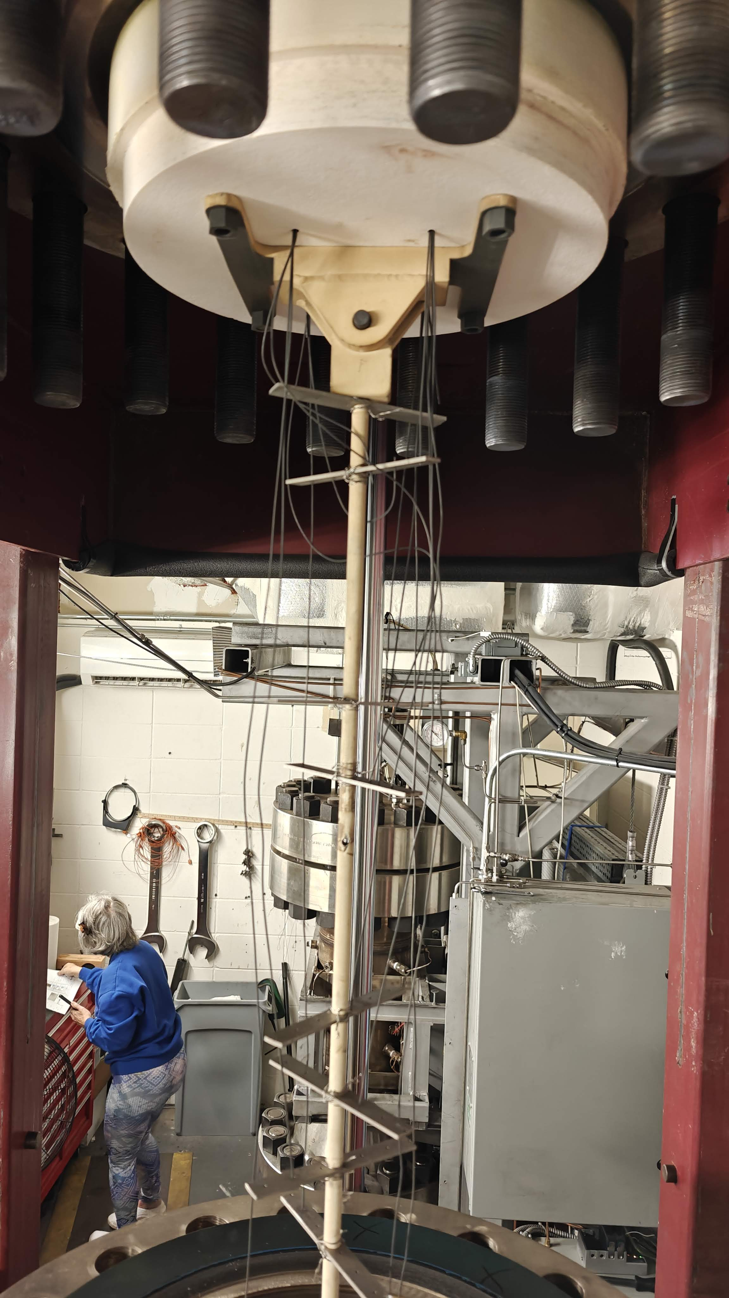
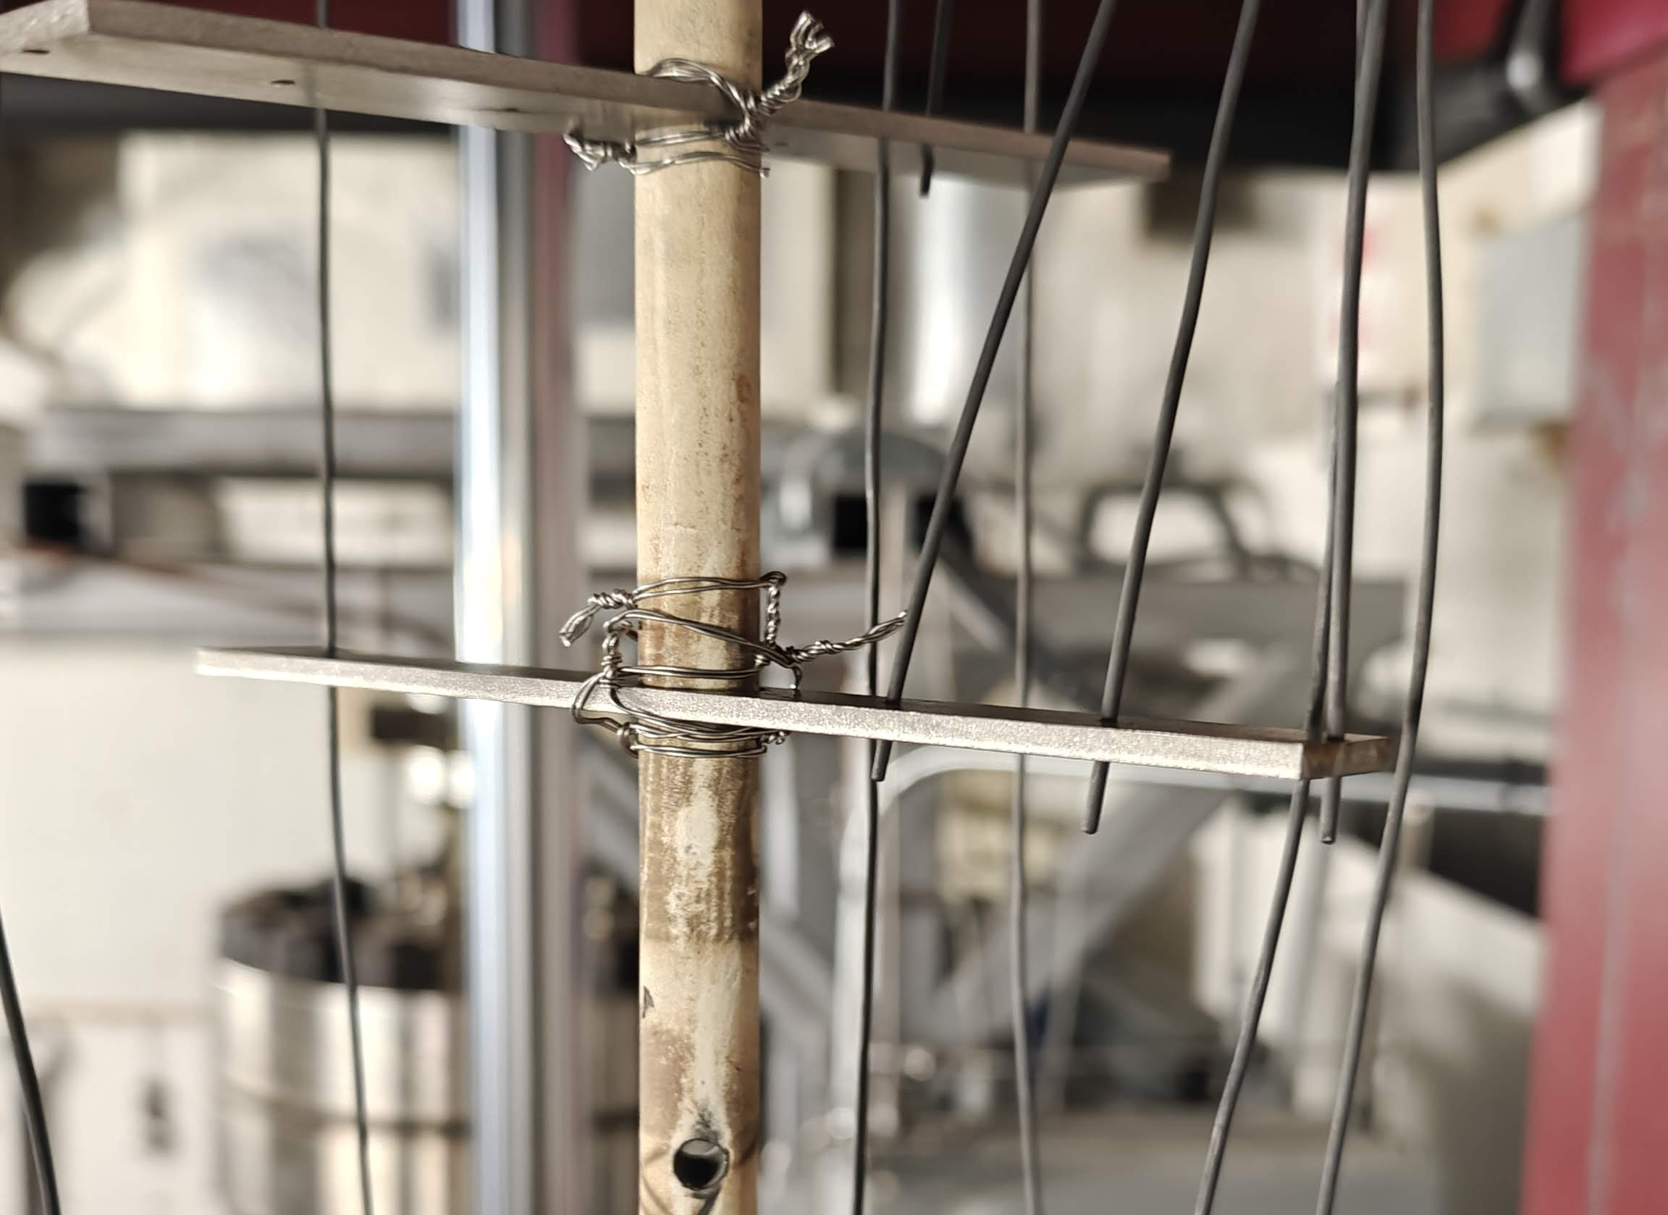
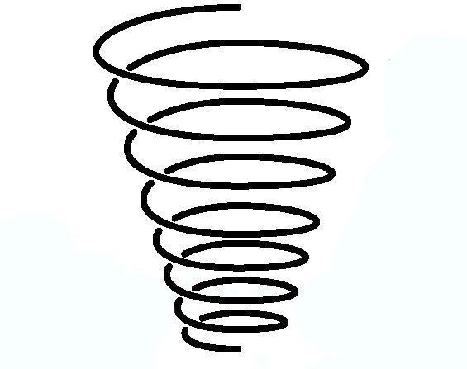
Radial Mapping
Initial plan is 3 TC in zone 1 & 2 centers each
Spiral path out for the rest
∙A
4”
∙B
Z1.0
∙C
∙D
∙A
14”
∙B
Z2.0
∙C
∙D
∙A
∙B
Z3.0
∙C
∙D
∙A
Z4.0
∙B
Z5.0
∙C
Z6.0
∙D

Slide 4
No consistent significant radial gradient
Middle
Outside
Middle
Inside
Outside
Inside
Outside
Inside
Middle
Difficult to distinguish between radial gradient and thermocouple drift
Suggest recalibrate thermocouples
Do we need to look at the standard thermocouple?
Outside
Inside
Middle

Slide 5
Slower Heating Increases Uniformity to 0.5 m
Zone 0.75 ̶ Zone 2.75
  0.508 m
Zone 0.5
Zone 3.0
Zone 3.25

Slide 6
Lowering Pressure to Increase Uniform Zone
After Hot-Soak ramp lowered pressure in 5 bar steps at peak temperature and adjusted offsets to narrow spread
To use this data, would need to calibrate PID, control calibration offsets, and buy certified gas
Length of zones within +2 C at T_{max} after hot-soak
Hot Soak Ramp

Slide 7
Witness Samples Low and Variable
Nominally the T_{max} and t_{melt} look alright
Samples that barely have made it into the melt have good performance
Shaon has looked at samples and they appear over-melted, i.e. high T_{max} and/or long t_{melt}

Slide 8
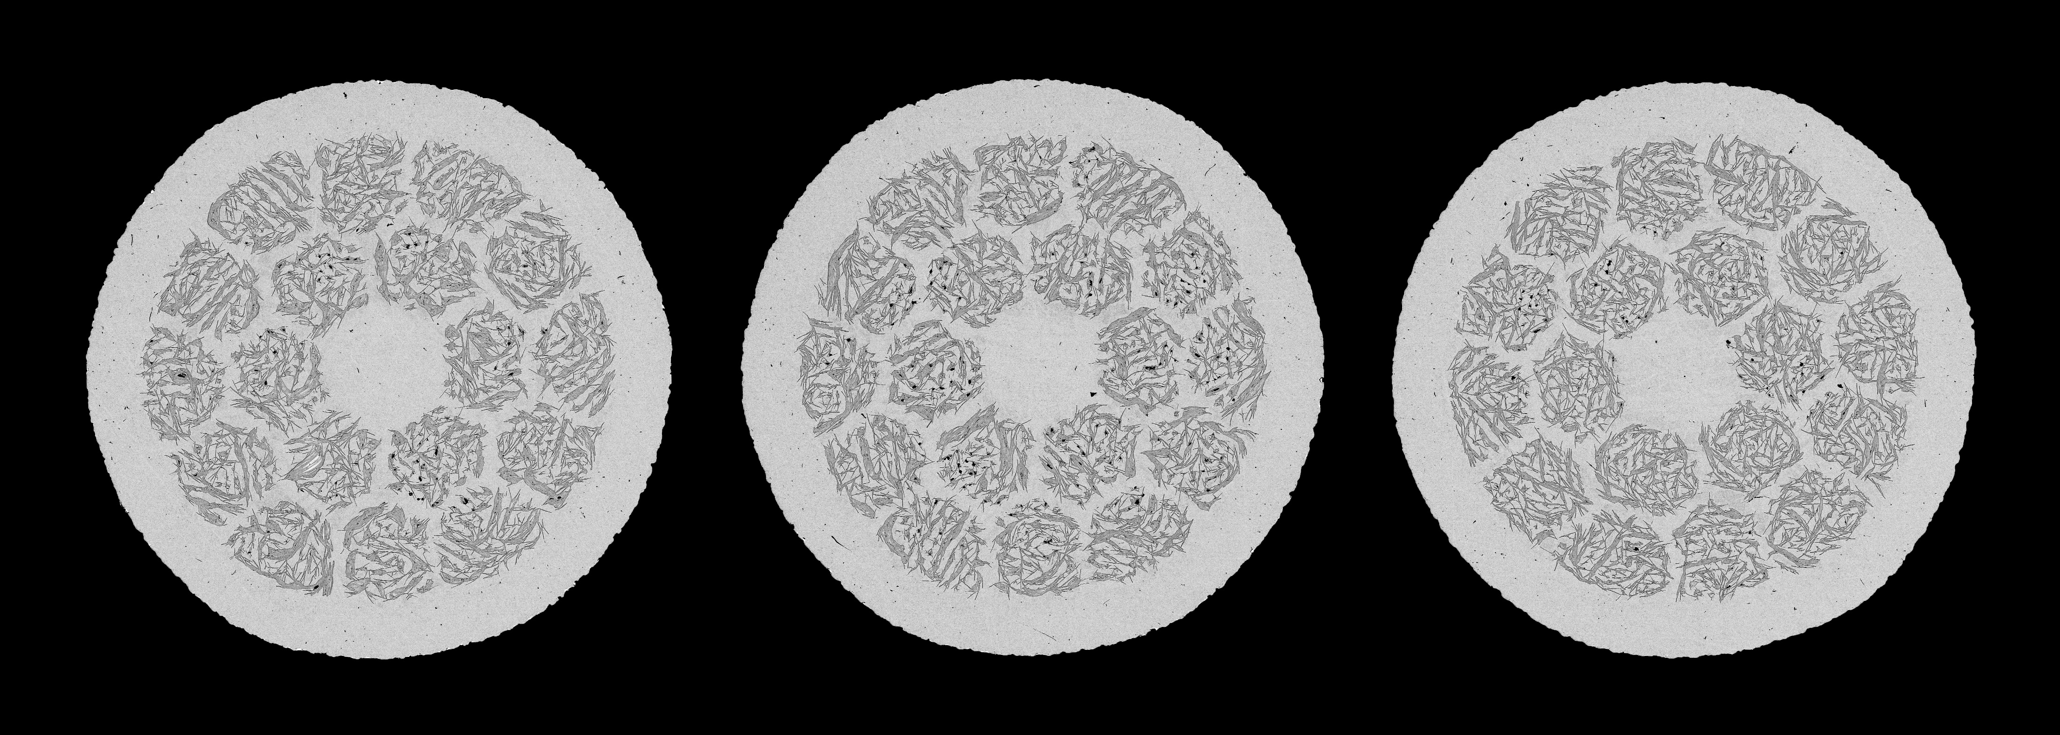
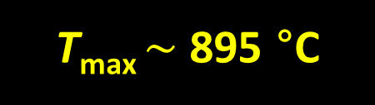
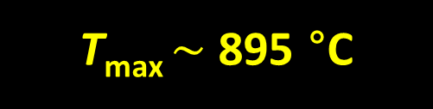
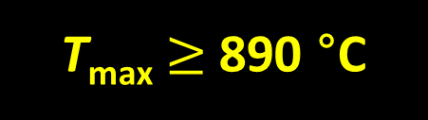
Sideways coil: Temperature gradient during OPHT is evident. The zone 2.5 sample shows less bridging compared to other zones, although significant filament merging is present.
High
T_{max}
Z 1.5
High
T_{max}
Z 2.0
Z 2.5
T_{max} $\sim$ 895 °C
T_{max} $\sim$ 895 °C
T_{max}$≥$890 °C
Witness Samples: PMM160301

Slide 9
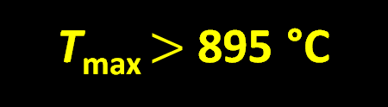


Cryo-6: All 3 witness samples are over melt (high t_{melt}). The microstructure indicates T_{max}> 895 $°$C
High
T_{max}
Z 1.0
High
T_{max}
Z 1.75
High
T_{max}
Z 1.875
T_{max} $>$ 895 °C
T_{max} $>$ 895 °C
T_{max} $>$ 895 °C
Witness Samples: PMM160301

Slide 10
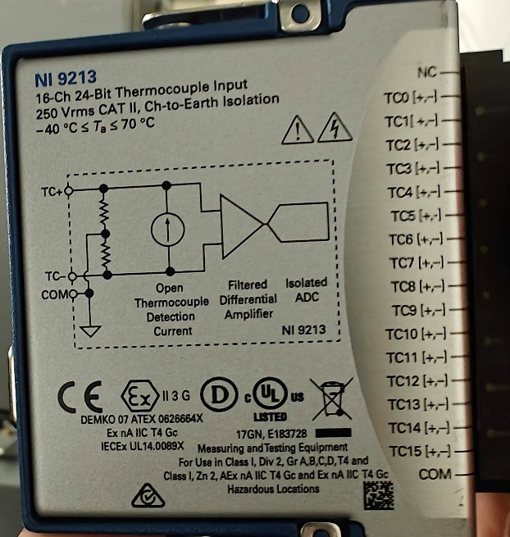
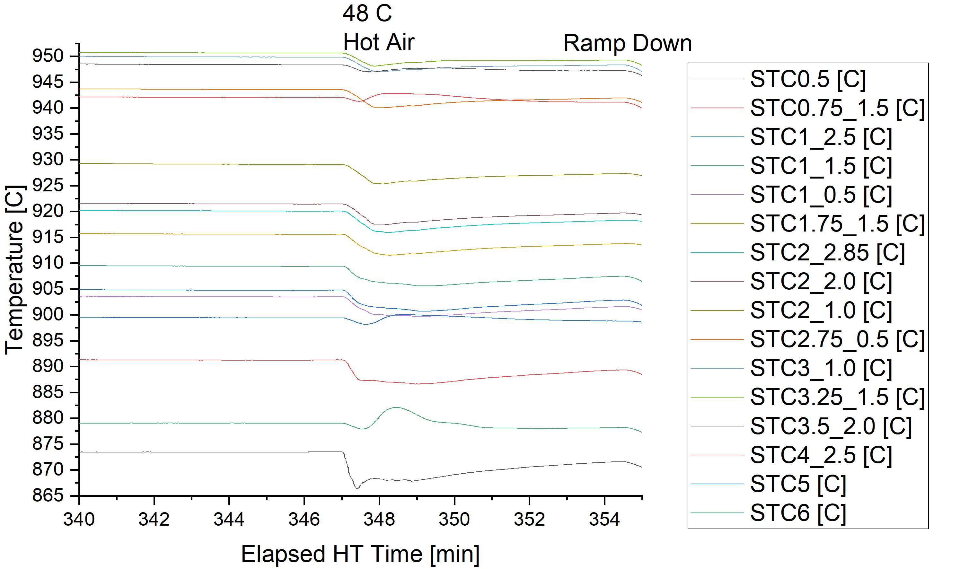
Found that the culprit was DAQ temperature
Discussed options
  Low oxygen content varying melting point
  Thermal gradient
  Certified thermocouple used for calibration being off
  TC Thermal EMF elsewhere than the joint…
Easiest to test was the thermal EMF and it is a difference for larger furnace where the room gets much warmer than when running the smaller
Setting up to move DAQ outside of the room

Slide 11
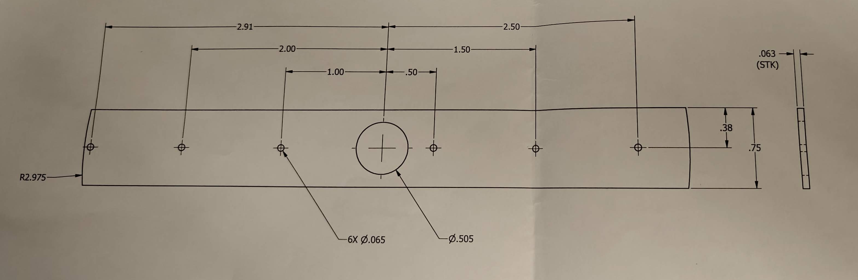
Recent Furnace Work
Furnace mapping with TC and short sample locator plates
  Run normal rates with baffle tube and plug
    no significant radial gradient observed
  Run heat soak with baffle tube and plug
    About 2-3x longer run time yields about x2 longer hot zone (~0.5 m)
  Run lower pressure to find max uniform hot zone length
    30-35 bar is enough to get to 0.7 m uniform hot zone
    25 bar is enough for about 0.82 uniform hot zone
    20 bar is enough for about 1 m
  Run without baffle tube or plug to map max heat load condition
Upgrade smaller furnace to new heating element (in-progress) and hydraulic lift (done)
Address DAQ heating issue
Test fuzzy logic algorithm in Deltech furnace, where more zone-zone coupling has been observed
Working with high school extern DJ Davis

Slide 12
Furnace Plans
Move DAQ outside room
Continue Deltech upgrade
Calibrate a more optimal heat soak recipe
Run short samples at various heights with the optimized heat soak recipe and DAQ outside
If good performance, run a calibration with dummy BIN CCT
OPHT BIN5E in Renegade with dummy calibrated optimized heat soak recipe
Run gradient/heat-soak/pressure study without baffle tube to continue to evaluate furnace limits and convection
Commission Deltech 2.0
Continue furnace queue

