Slide 1
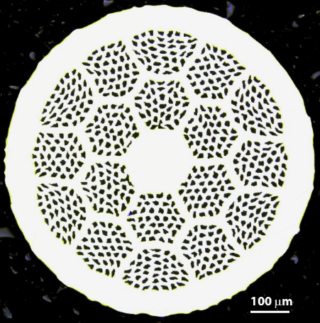
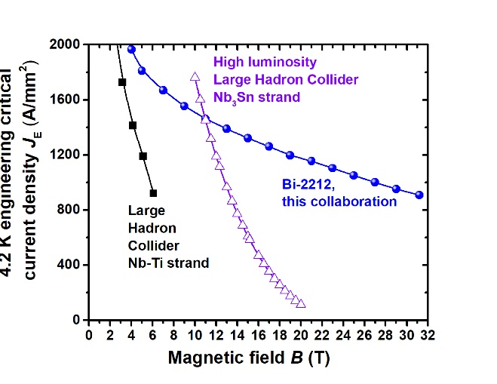
ARDAP - Enhancing Domestic Production of High Temperature Superconducting Bi₂Sr₂CaCu₂O_{x}/Ag wires for High Field Magnets March 2025 Meeting
Tengming Shen
With the project team
LBNL 17-strand Rutherford cable
Mullite braided insulation
Bi-2212
‹#›
2025/04/11

Slide 2
Today’s agenda
Billet #6 performance (Jianyi)
Billet #7 production status.
Billet #8 production planning.
Review powder production and discuss next steps.
Furnace update (Daniel Davis).
Some observations with billet #3/#4 and leakage trials with cable 2007 and 2008. (Chris Escobar)

Slide 3
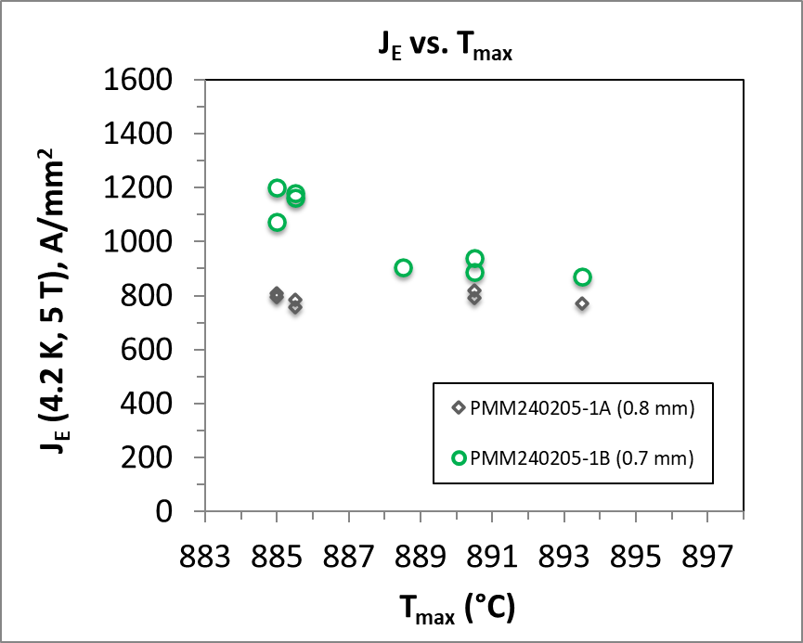
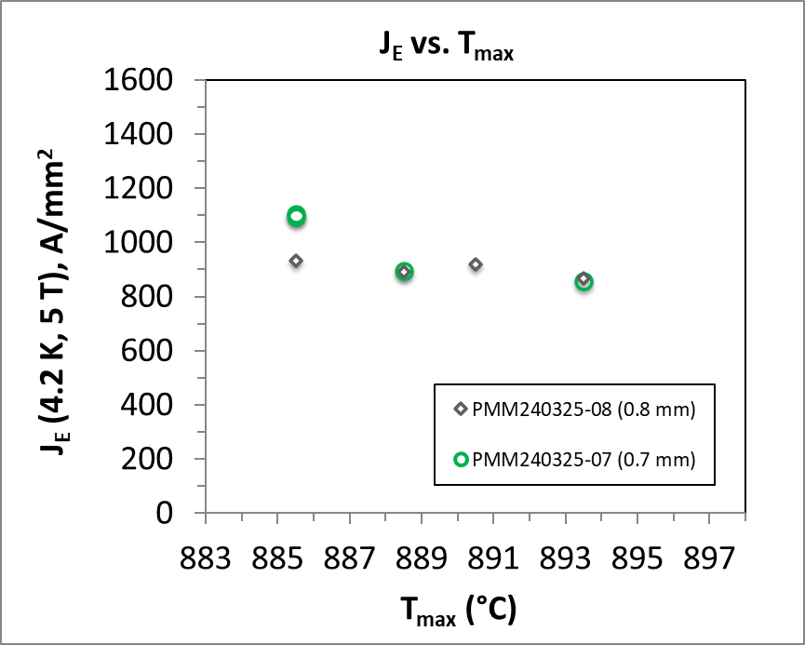
Two wire billets have been produced and the third billet in the final phase of wire drawing
ARDAP billet #1 (505 m in 0.7 mm)
ARDAP billet #2 (510 m in 0.7 mm)
Performance Target
Performance Target
J. Jiang, NHMFL

Slide 4
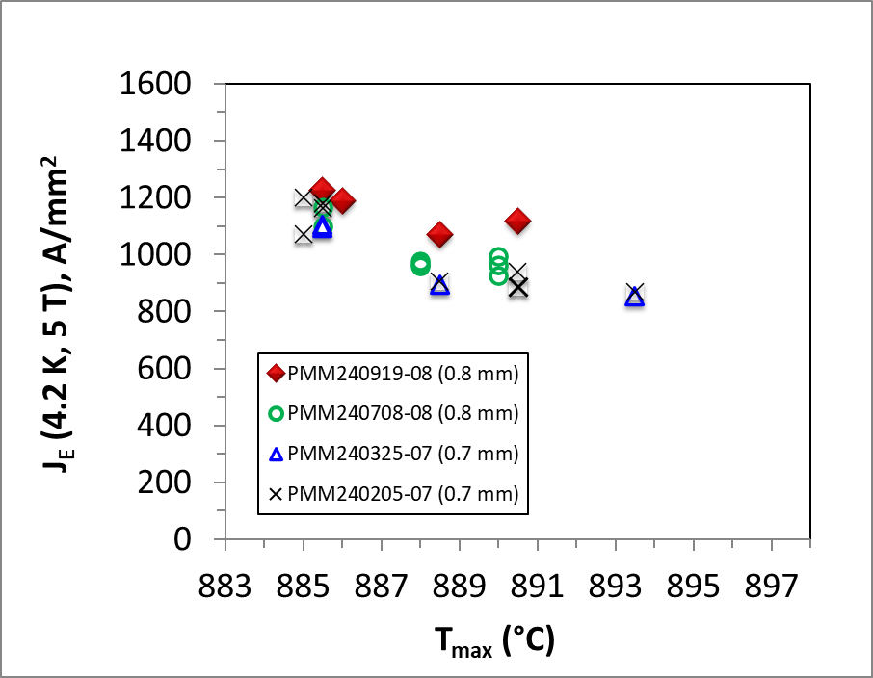
Five billets have been produced and four billets have been characterized, with increased performance
Target of this project
ARDAP billet #4
ARDAP billet #3
ARDAP billet #2
All 37 x 18.
ARDAP billet #1

Slide 5
Billet #5 (PMM241113) production and performance
Ag-Mg external sheath.
Billet #5 increases Ag-Mg sheath thickness by 25% to increase wire mechanical strength and minimize leakage during reaction.
Reduce wire J_{E} by 6%.
Ag
 |  | Conventional design | New design
Ag-Mg sheath thickness | μm | 53 | 66
Wire diameter | mm | 0.8 | 0.826
Filament size, spacing, and total area |  | Remain the same
I_{c} | A | Remain the same
Wire architecture: 55x18
Wire diameter: 0.8 mm
Thermo-processing: standard 150C/1h intermediate annealing. Final annealing 250C/1h annealing.
Powder: batch 27A; lot LXE-038
Tensile properties at 77 K;
small bend radius evaluation 0 6 mm Inconel screw.
@FSU. How to check leakage? We should. How?

Slide 6
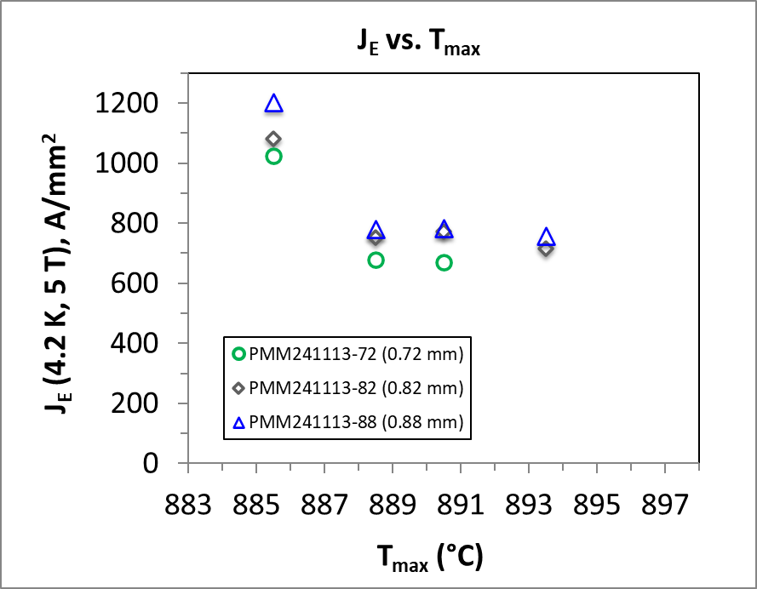
Billet #5 performance
PMM241113-88

Slide 7
Billet #6 production
Wire architecture: 37x18
Wire diameter: 0.8 mm
Thermo-processing: standard 250C/1h intermediate annealing. Final annealing 250C/1h annealing.
Essentially repeat billet #4 but with standard thermo-mechanical processing.
Powder: batch 38A. Lot LXE-049.
Best quality so far. With Desired characteristics.
Production started 1/29/2025 and projected to be completed before March 1.
Jianyi – samples for heat treatment, repeat billet #4.
Wire delivered as one piece to LBNL.

Slide 8
Billet #7 production
Wire architecture: 37x18
Wire diameter: 0.8 mm
Thermo-processing: standard 250C/1h intermediate annealing. Final annealing 250C/1h annealing.
Lot LXE-056 from batch G2A-42A: Delivered to Bruker OST on 02/27/2025.
Samples and wires will be ready in the week of 04/13/2025.

Slide 9
Billet #8 planning
 |  | Powder |  | Wire
Billet | Wire ID | powder des | Powder batch | architecture | Billet size (kg) | final diameter (mm) | Yield piece-length (m) | Intermediate annealing condition | Final annealing condition | Remark | Remark II (from Jiang 250110-Jianyi-Grain size of Ag-Mg sheath of ARDAP wires)
1 | pmm240205 | LXE-014 | 07A | 37x18 | 2 | 0.70 | 210 & 295 | 250Cx1h | 250Cx1h |  | Large Ag-Mg grains for 0.7 mm wires.
2 | pmm240325 | LXE-022 | 14A | 37x18 | 2 | 0.70 | 510 | 250Cx1h | 250Cx1h |  | Large Ag-Mg grains for 0.7 mm wires.
3 | pmm240708 | LXE-032 | 18A | 37x18 | 2 | 0.80 | 345 | 250Cx1h | 250Cx1h |  | Fine Ag-Mg grains
4 | pmm240919 | LXE-035 | 19A | 37x18 | 2 | 0.80 | 124 & 258 | No annealing | 250Cx1h |  | Very large Ag-Mg grains
5 | pmm241113 | LXE-038 | 27A | 55x18 | 2 | 0.82 | 170, 95 & 93 | 150Cx1h | 250Cx1h | Thicker AgMg sheath to match 1.0mm wire configuration | Large Ag-Mg grains, especially 0.7 mm wires.
6 | PMM250208 | LXE-049 | 38A | 37x18 | 2 | 0.80 | 383 |  | 250Cx1h | 250Cx1h
7 |  | LXE-056 | 42A
8 |  | LXE-063 | 44A
9 |  |  | 45A or 46A
Wire architecture: 37x18
Wire diameter: 0.8 mm
Thermo-processing: standard 250C/1h intermediate annealing. Final annealing 250C/1h annealing.

Slide 10
Powder characteristics evolution for the ARDAP billets

Slide 11
Powder production for Billet #7/8/9 and 10 kg billet #11
Powder batch 42A – SEM done 2025/02/04 by Jianyi.
Decarburization heat treatment/C&H analysis/tap density/SSA.
There are two batches being produced - both will go to Jianyi in about 2 weeks.
- 44A (ARDAP #13?) and 45A (ARDAP #14?) delivered and checked by Jianyi on
02/28/2025.
- other properties?

Slide 12
Powder production for Billet #7/8/9 and 10 kg billet #11
Powder batch 42A – SEM done 2025/02/04 by Jianyi.
Decarburization heat treatment/C&H analysis/tap density/SSA.
There are two batches being produced - both will go to Jianyi in about 2 weeks.
- 44A (ARDAP #13?) and 45A (ARDAP #14?) delivered and checked by Jianyi on
02/28/2025.
- other properties?

Slide 13
Task #7 review
BIN5E heat treatment?
Pure Alumina insulation is very brittle. Alternative insulation fibers?

Slide 14
Tasks
Task 0: Understanding the root cause of performance variation in existing Bi-2212 wires
Task 1: Making precursor powder reproducible and improving production yield
Task 2: Manufacturing 2 kg billets with reproducible plateau J_{E}(4.2 K and 5 T) > 1100 A/mm²
Task 3: Manufacturing 10 kg billets with the target J_{E}(4.2 K and 5 T) > 1100 A/mm²
Task 4: Powder and wire characterization
Task 5: Understanding the science and technology of attaining high J_{E} in Bi-2212 Rutherford cables
Task 6: Demonstrating predictability in Bi-2212 coil heat treatment
Task 7: Insulation and leakage reduction for Rutherford cable coils
Task 8: Contracts to procure powder as a strategic reserve

Slide 15
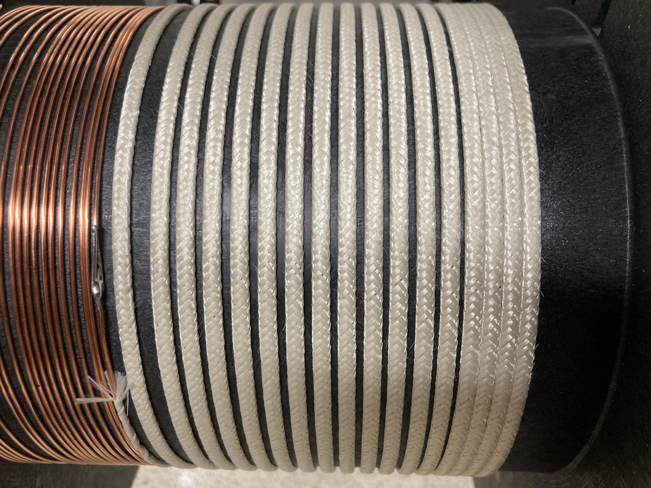
Task 7 – new insulation and removing leakage
7 m insulation braiding and coil winding trial completed.
24 m pure alumina insulated cable received.
Winding of two coils completed.
ARDAP CCT coil BIN5E_OL, after winding, not yet reacted.
CCT ARDAP coil BIN5E:
Outer layer coil wound. No electrical shorts.
Have to use TiO₂ slurry to “repair, reinforce and lubricate” alumina fibers.
Possible to replace TiO₂ slurry with Al₂O₃ slurry (courtesy of Dr. Jun Lu, NHMFL)
By Youngjae Kim, FSU et al.
CCT ARDAP coil BIN5E:
Inner layer coil wound. No electrical shorts.
NEW: Use Al₂O₃ slurry to “repair, reinforce and lubricate” alumina fibers. (courtesy of Dr. Jun Lu, NHMFL)

Slide 16
Thank You

