Slide 1
A Methodology to Compute the Critical Current Limit in Nb₃Sn Magnets
G. Vallone, E. Anderssen, B. Bordini, P. Ferracin, J. F. Troitino, S. Prestemon
General MDP Meeting
07/31/2019

Slide 2
Outline
Introduction
Cable Stacks Under Transversal Pressure
FRESCA Sample Holder Experiment
Application to Superconducting Magnets
Conclusion

Slide 3
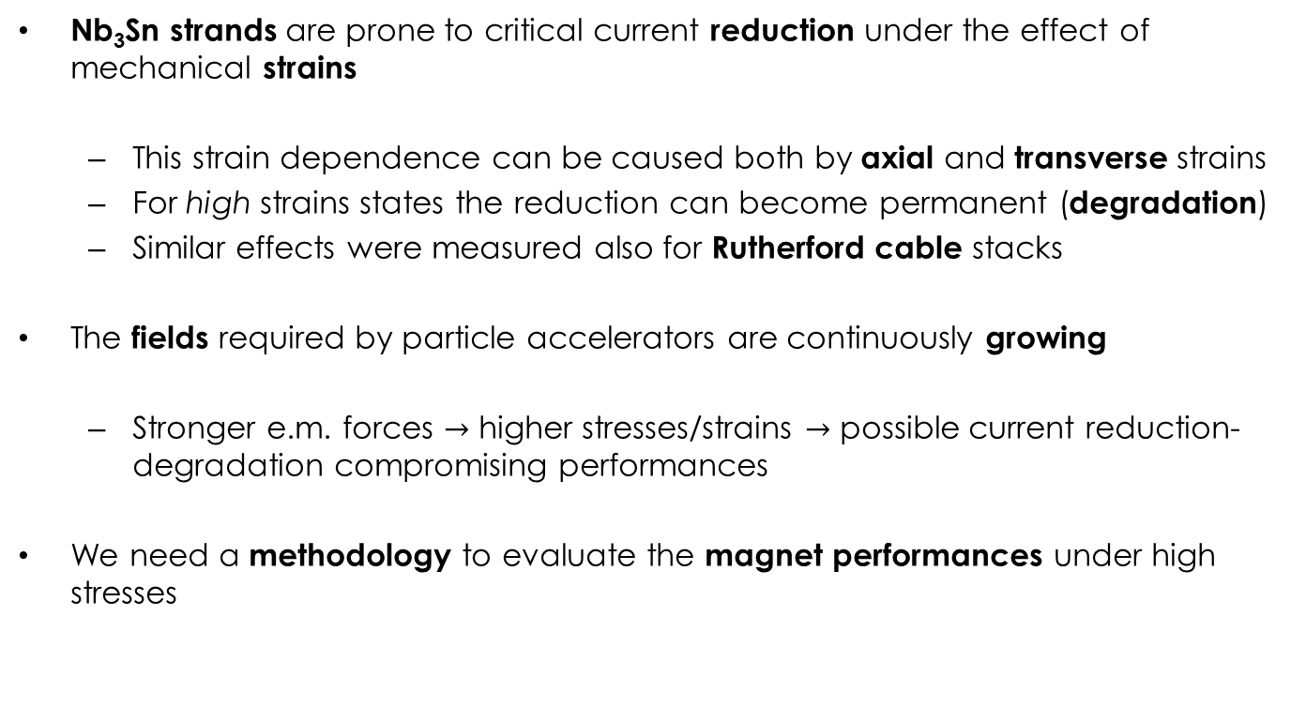
Introduction
Nb₃Sn strands are prone to critical current reduction under the effect of mechanical strains
  This strain dependence can be caused both by axial and transverse strains
  For high strains states the reduction can become permanent (degradation)
  Similar effects were measured also for Rutherford cable stacks
The fields required by particle accelerators are continuously growing
  Stronger e.m. forces $→$ higher stresses/strains $→$ possible current reduction-degradation compromising performances
We need a methodology to evaluate the magnet performances under high stresses

Slide 4
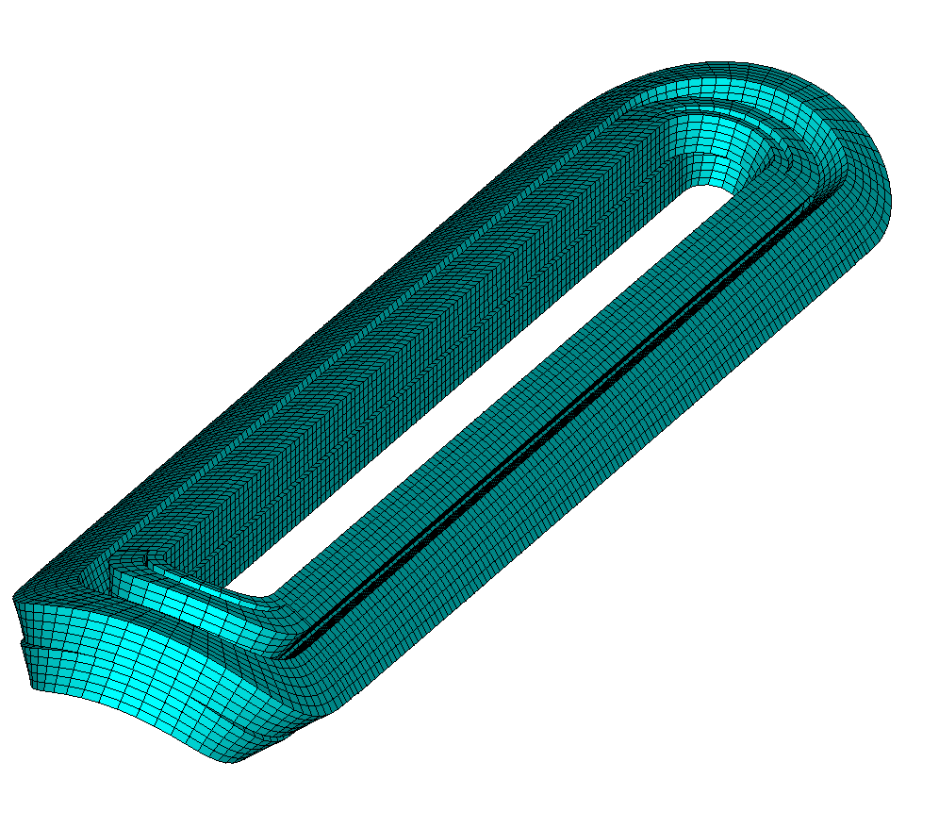
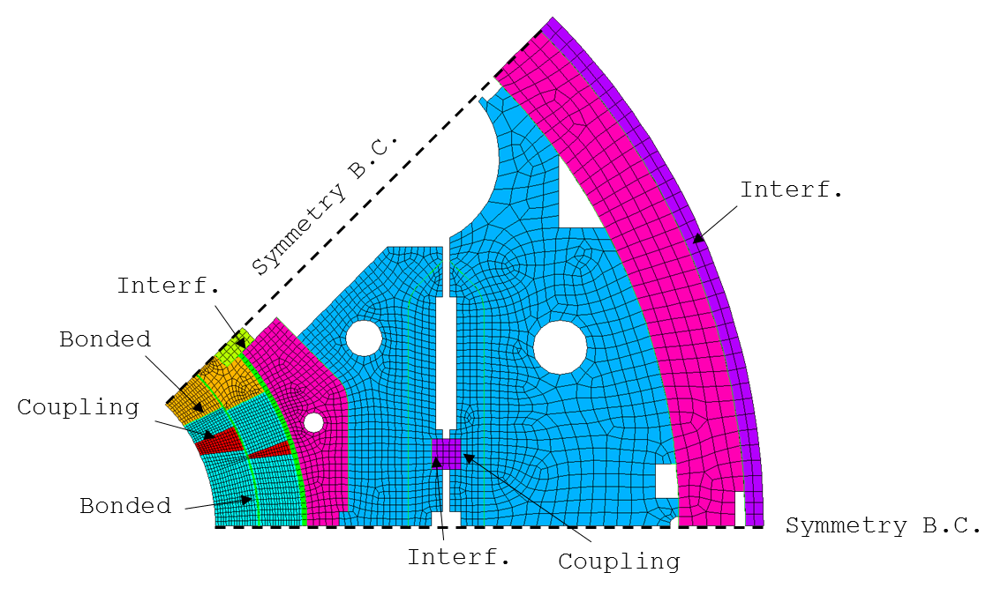
Coils Mechanical Limits
Currently, we use an empiric limit of 150-200 MPa on the coil equivalent stress
We cannot measure directly the strain on the coil
  This limit is verified against numerical model results (eventually validated with indirect measurements)
  In these models the coil is considered a block with uniform elastic properties, measured on cable stacks
H. Felice et al., IEEE TAS, 2011

Slide 5
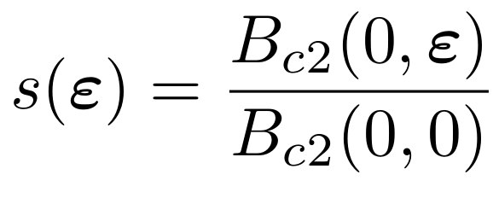
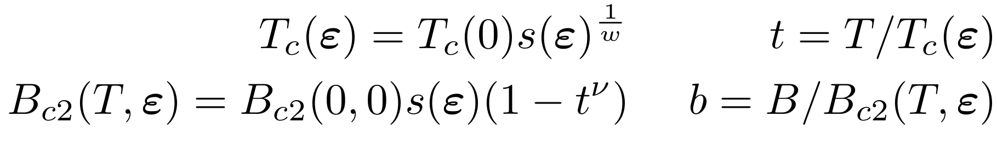
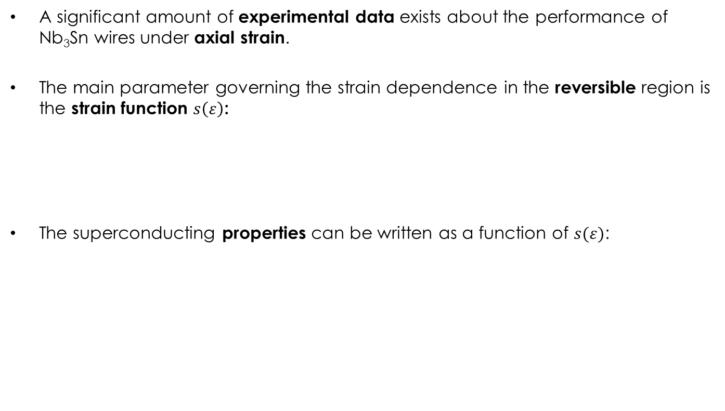
Critical Current Strain Dependence
A significant amount of experimental data exists about the performance of Nb₃Sn wires under axial strain.
The main parameter governing the strain dependence in the reversible region is the strain function $s\left(ε\right)$:
The superconducting properties can be written as a function of $s(ε)$:

Slide 6
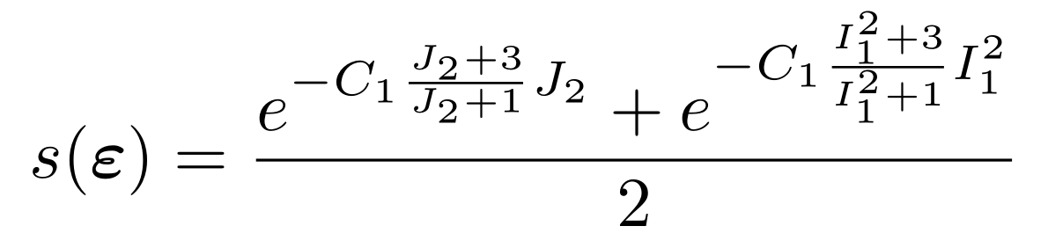
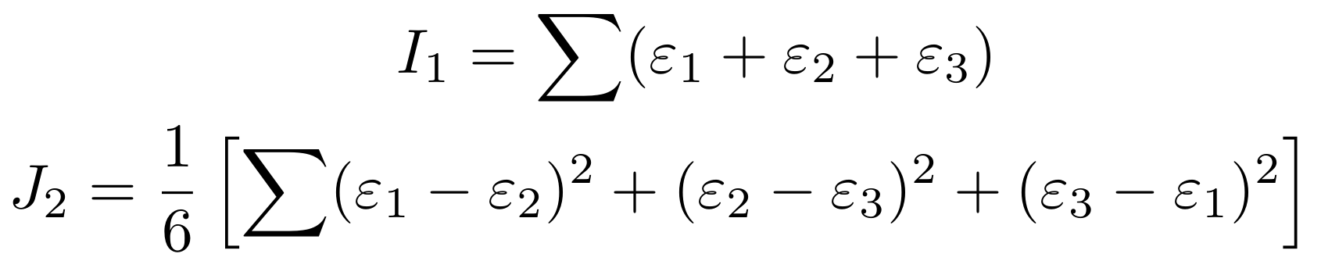
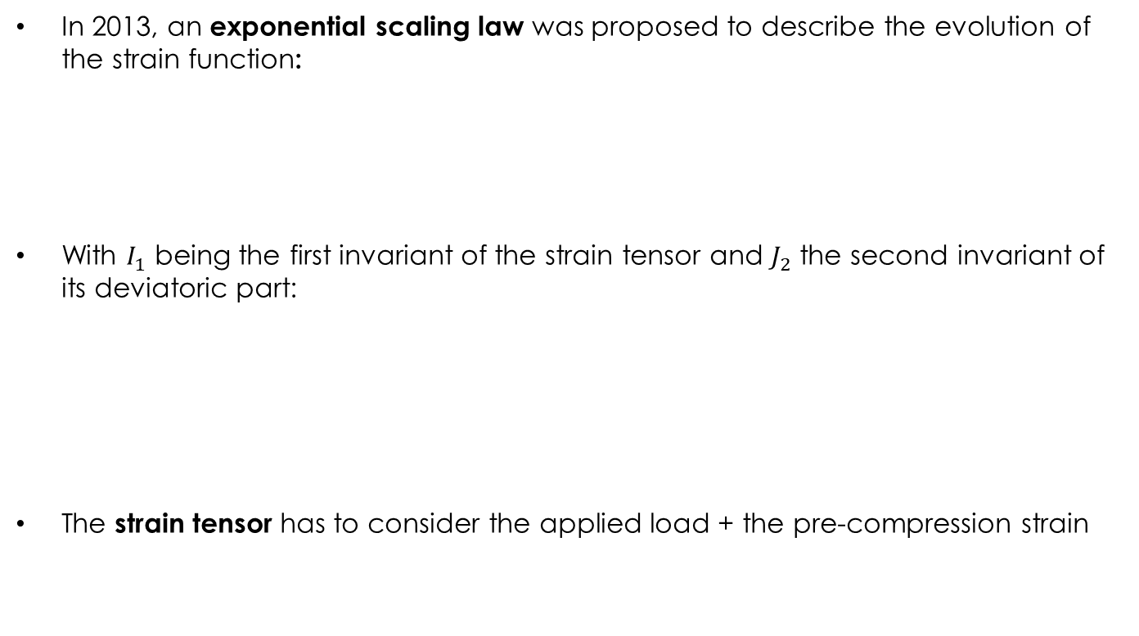
The Exponential Strain Function (1)
In 2013, an exponential scaling law was proposed to describe the evolution of the strain function:
With $I_{1}$ being the first invariant of the strain tensor and $J_{2}$ the second invariant of its deviatoric part:
The strain tensor has to consider the applied load + the pre-compression strain
B. Bordini et al., SuST, 2013

Slide 7
Outline
Introduction
Cable Stacks Under Transversal Pressure
FRESCA Sample Holder Experiment
Application to Superconducting Magnets
Conclusion

Slide 8
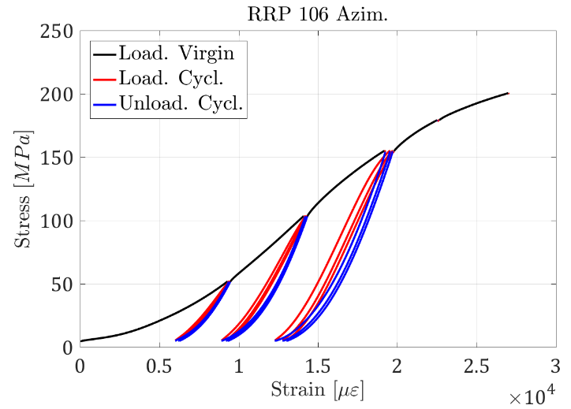
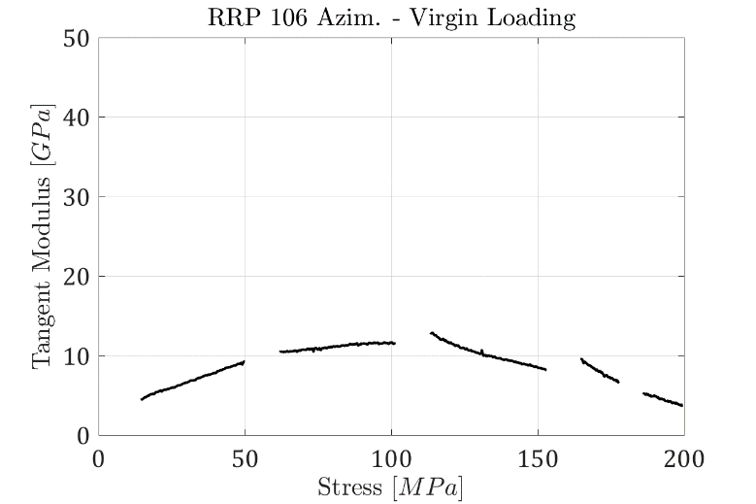
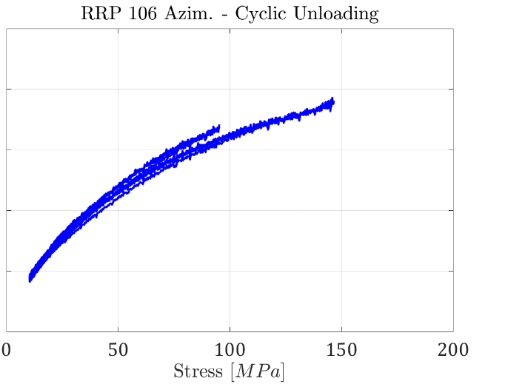
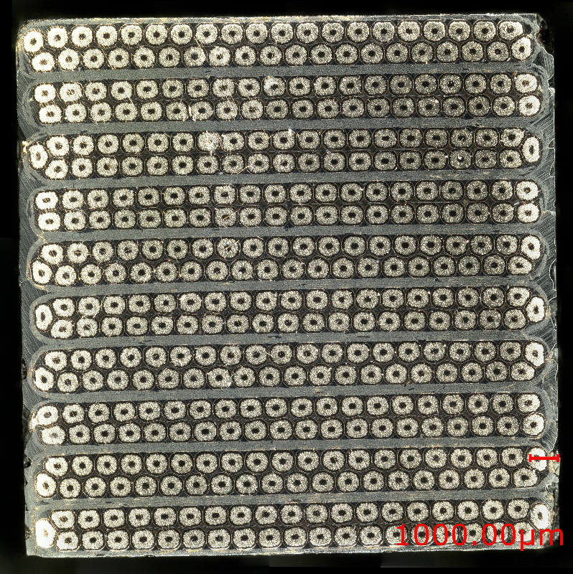
Cable Stacks – Transversal Pressure
Measurements on stacks of impregnated cables:
  Very different behaviour in the three phases
  The chord and tangent modulus† vary continuously during the test
Probably difficult to condensate the coil elastic properties in a single number (elastic modulus)
Non-linear stress-strain relationship
† ASTM - E111 - 04

Slide 9
Cable Stacks – Hysteresis
Hysteresis behaviour test:
  ~35 cycles, sample used also to study creep
  Need to repeat also at lower load levels
The width of the curve (~energy dissipation) converges
The residual strain keeps increasing
Energy dissipation ~ 100/150 mJ/cm³

Slide 10
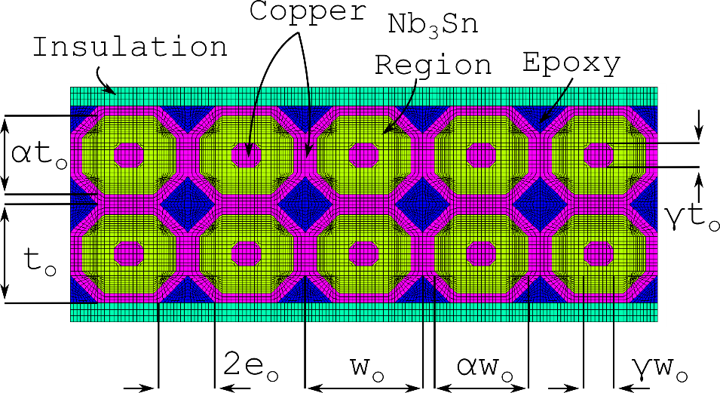
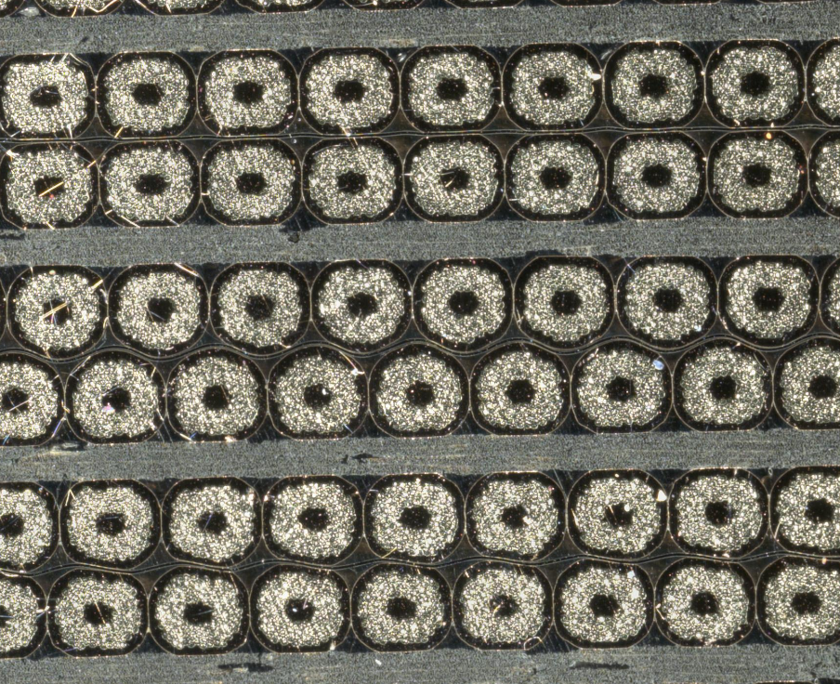
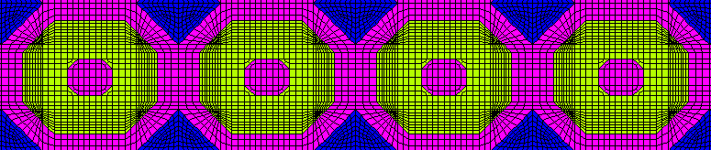
Cable Stacks – FE Model (1)
2D FE model of a Rutherford cable stack
Material properties from literature
Geometry from a mix of image analysis and simple geometric formulas to match the filling factor, copper-non copper etc.
Stiffness validated against measurements on impregnated 10 stacks

Slide 11
Cable Stacks – FE Model (2)
Virgin/cyclic behaviour explained by copper plasticization
FE slope reasonably good especially considering that no model calibration was performed
Initial phase may be due to compaction
Model successfully predicts the higher stiffness (20%) of 11T cables

Slide 12
Outline
Introduction
Cable Stacks Under Transversal Pressure
FRESCA Sample Holder Experiment
Application to Superconducting Magnets
Conclusion

Slide 13
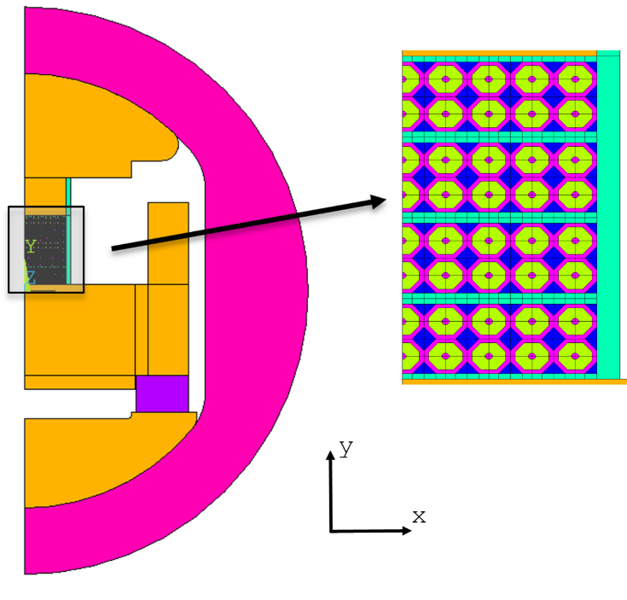
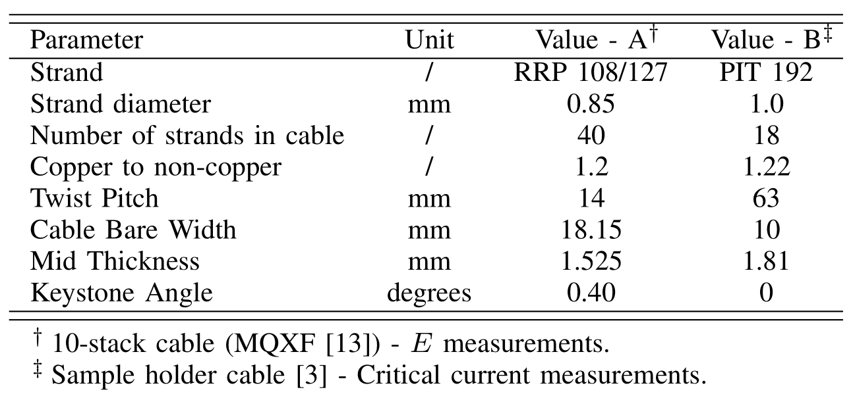
FRESCA Sample Holder
2D mechanical and electro-magnetic model of the sample holder
Cable stack represented with the mechanical approach validated from 10-stack measurements
  Same methodology but different strand/cable parameters

Slide 14
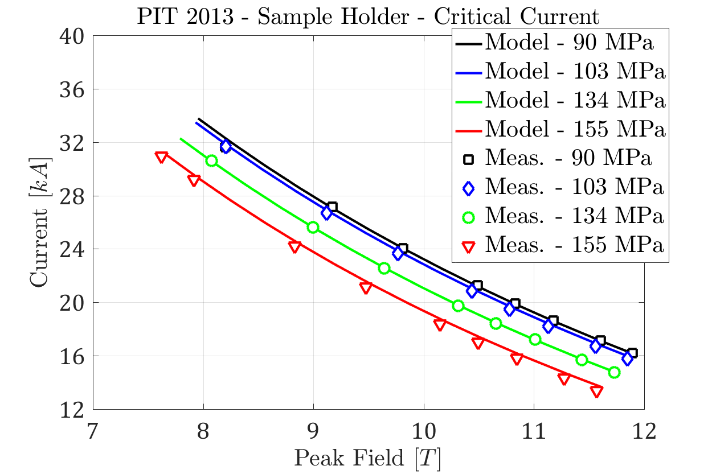
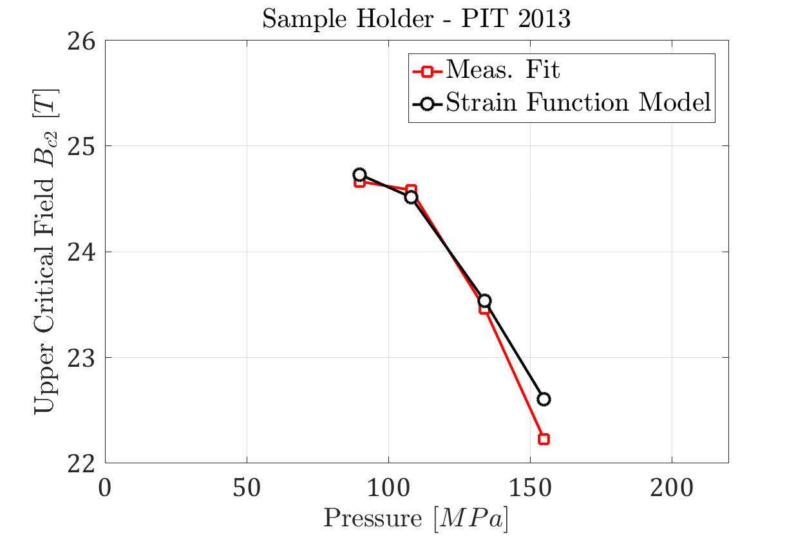
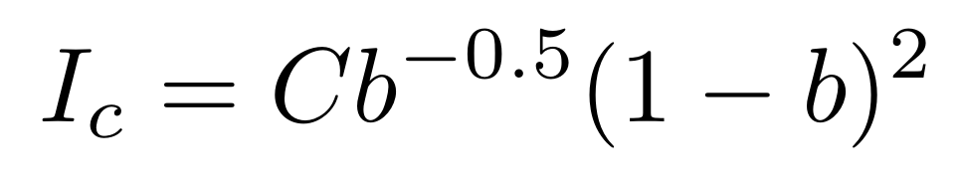
Stack Critical Current – Results
Quench currents are matched reasonably well. Notice that:
  On the last loading there was a small irreversible degradation
  The quenches at 90 MPa were at short sample limit. The model correctly predicts the same strain function at 0 MPa
The upper critical field as computed fitting the critical currents is also well captured by the model

Slide 15
Outline
Introduction
Cable Stacks Under Transversal Pressure
FRESCA Sample Holder Experiment
Application to Superconducting Magnets
Conclusion

Slide 16
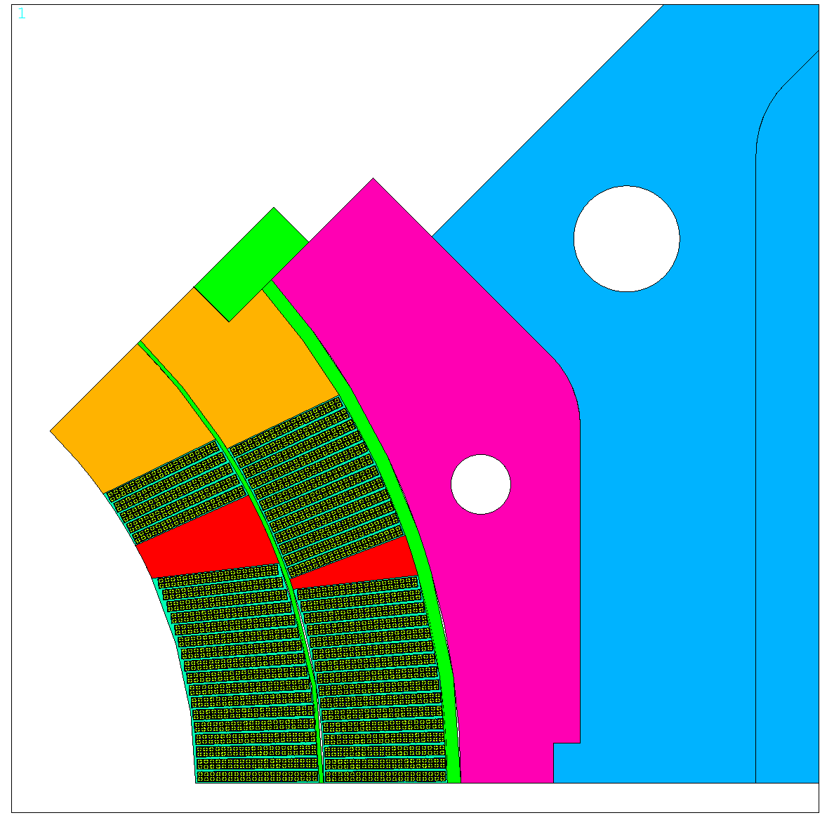

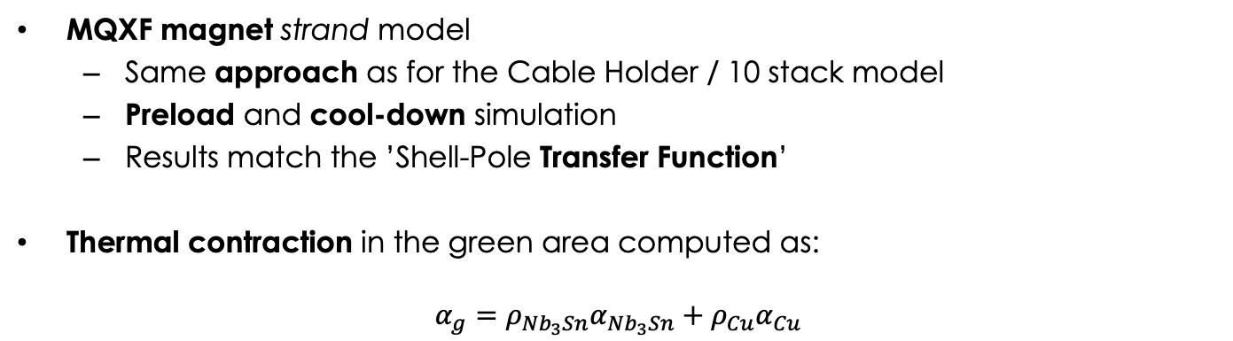
MQXF – Strand Model
MQXF magnet strand model
  Same approach as for the Cable Holder / 10 stack model
  Preload and cool-down simulation
  Results match the ’Shell-Pole Transfer Function’
Thermal contraction in the green area computed as:
$$α_{g}={ρ_{Nb_{3}Sn}α}_{Nb_{3}Sn}+ρ_{Cu}α_{Cu}$$

Slide 17
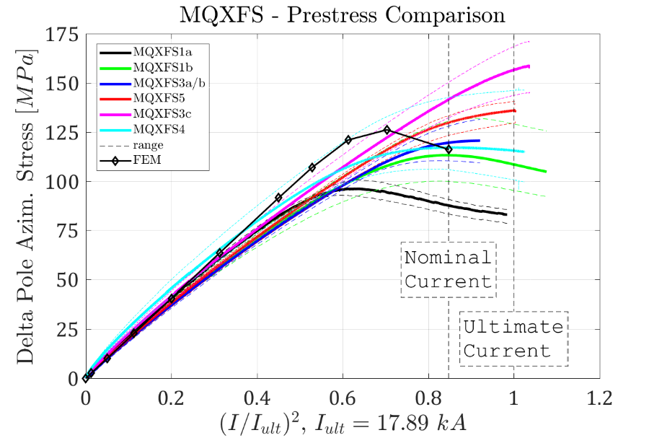
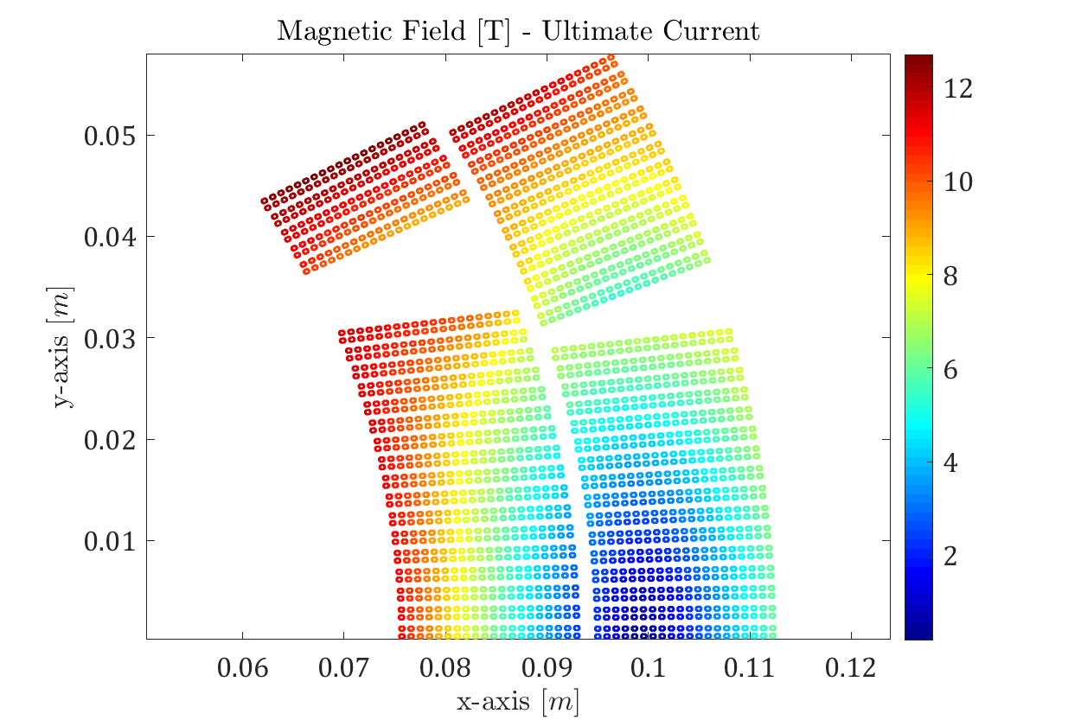
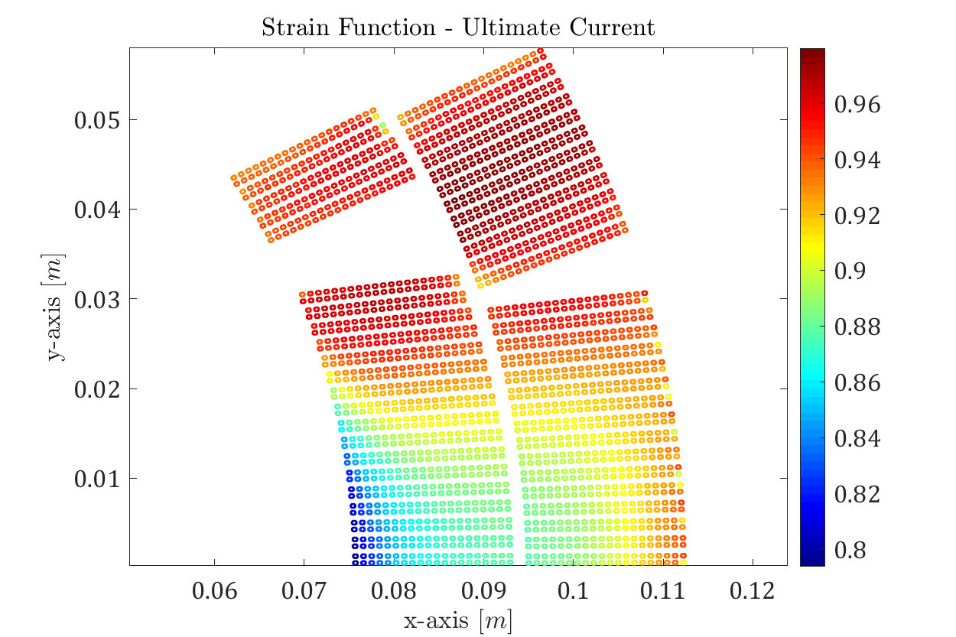
MQXF – Strand Model
Powering simulation:
  Mechanics simulation during powering refined in the past †
  The strand model during unloading is slightly stiffer than expected from the measurements
Strain Function at ultimate current > 0.8
† G. Vallone and P. Ferracin, IEEE TAS, 2017

Slide 18
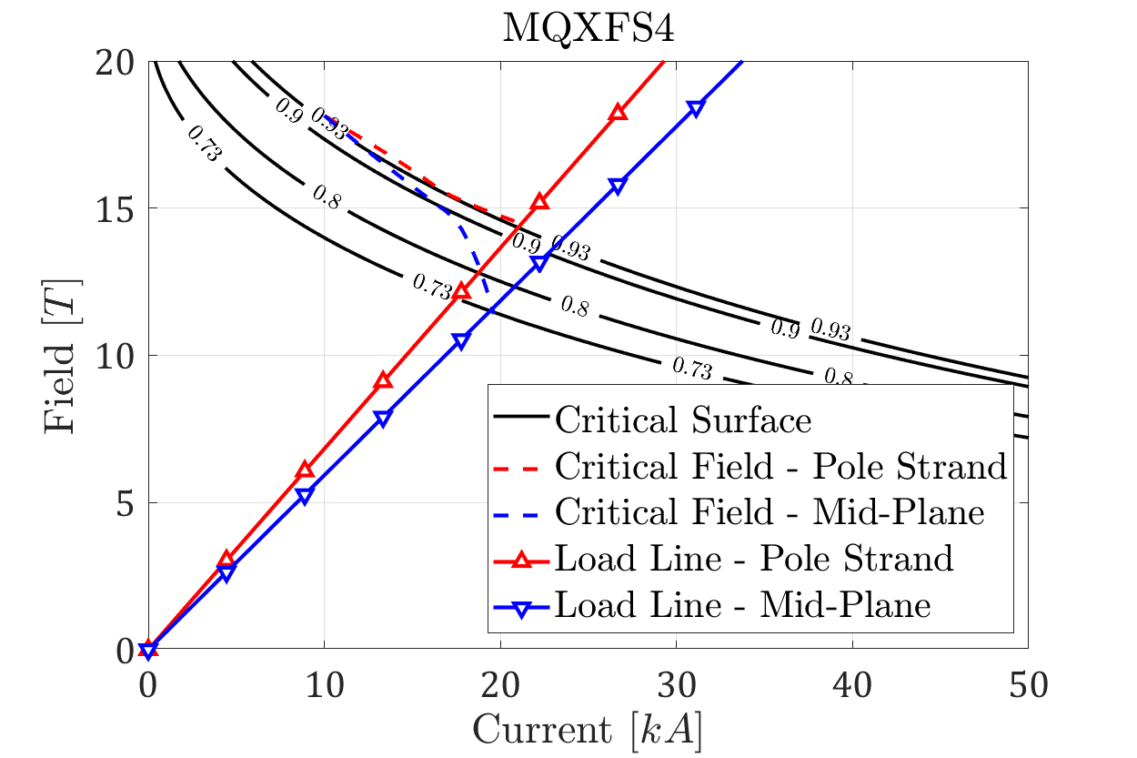
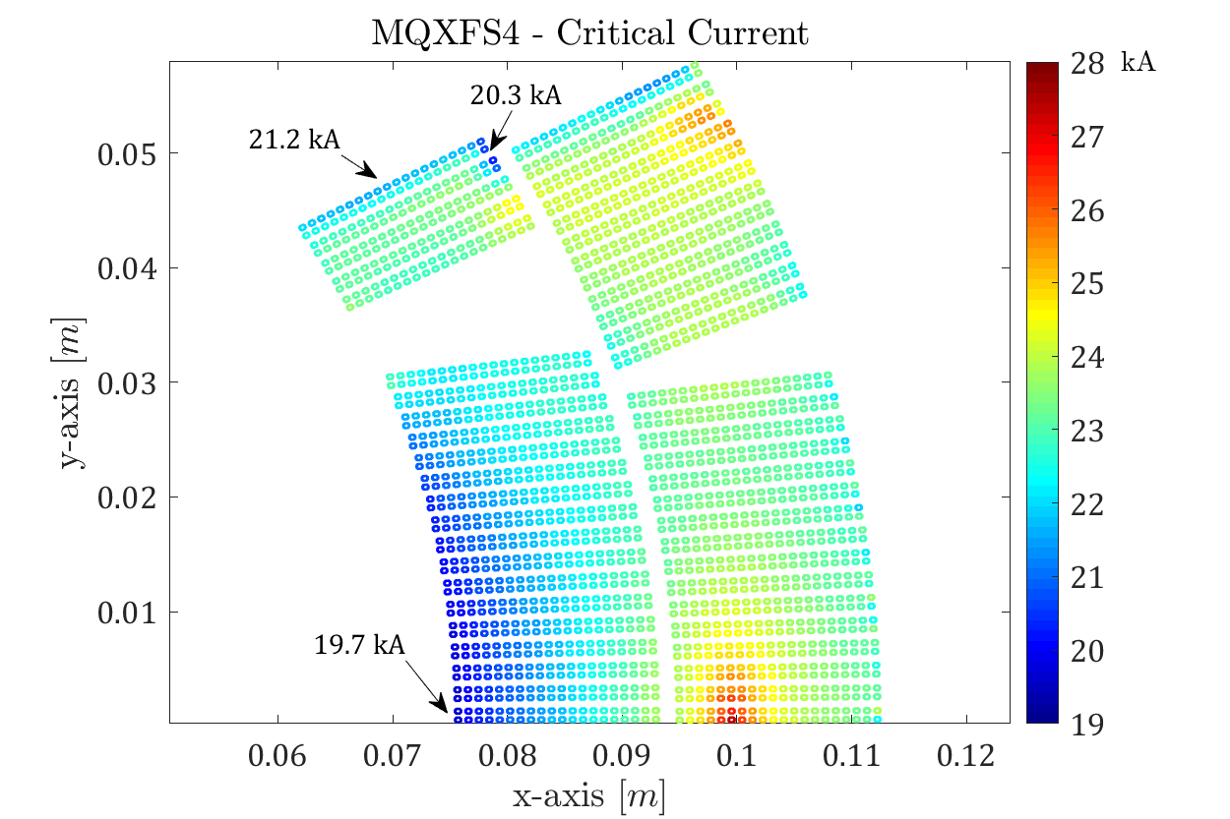
MQXF – Strand Model
Powering results:
  Critical strands near the mid-plane
  Actual SSL of the magnet is reduced from 21 kA to 19.7 kA
  As the magnet is unloaded, this does not depend on the applied prestress
  In the pole region the radial component of the e.m. forces and the 2nd layer pole corner create a stress concentration on the 1st and 2nd turns of the 1st layer, reducing the available margin.

Slide 19
Outline
Introduction
Cable Stacks Under Transversal Pressure
FRESCA Sample Holder Experiment
Application to Superconducting Magnets
Conclusion

Slide 20
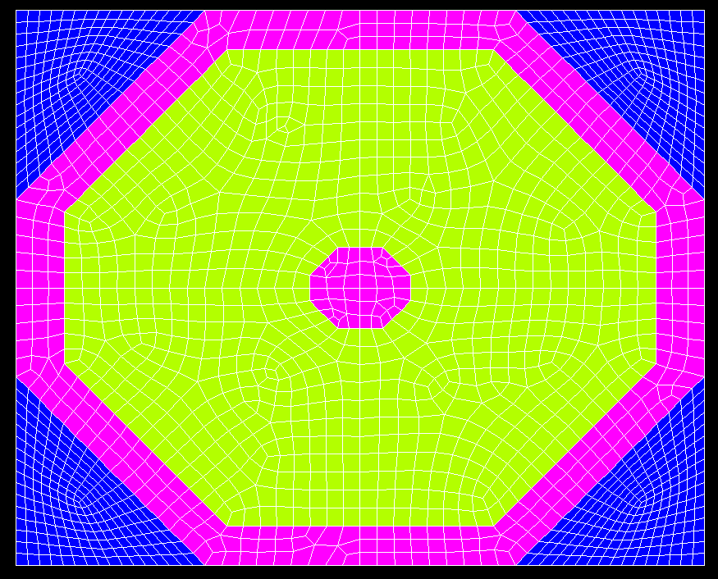
Conclusion
Impregnated cable stacks under transversal pressure:
  Stiffness is continuously varying
  Comparison with FE model shows that the copper plasticization may explain part of this behaviour
Cable stack critical current model results suggest that:
  The critical current reduction can be reproduced using a law developed on axial tests
  It seems that we do not need to model the filaments
The methodology was applied to a superconducting magnet:
  Reasonable agreement between the measurements and computations
  The results provide:
    A more accurate critical current and load margin computation
    Location of potential critical regions in the magnet (e.g. pole corners)

Slide 22
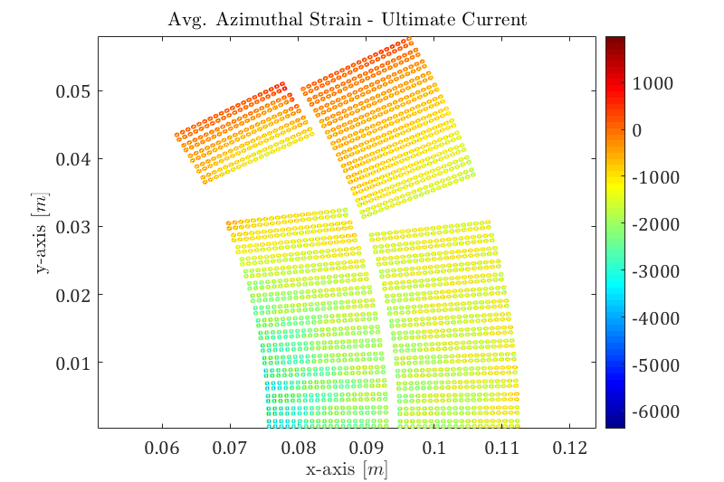
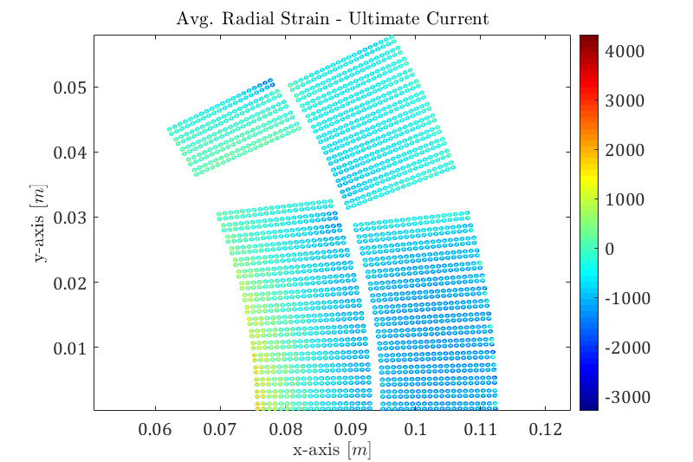
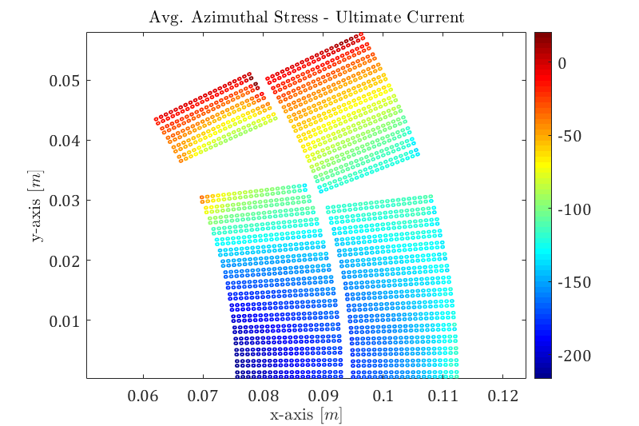
MQXF – Strand Model
Stress and strain in the Nb₃Sn region at ultimate current, for reference

Slide 23
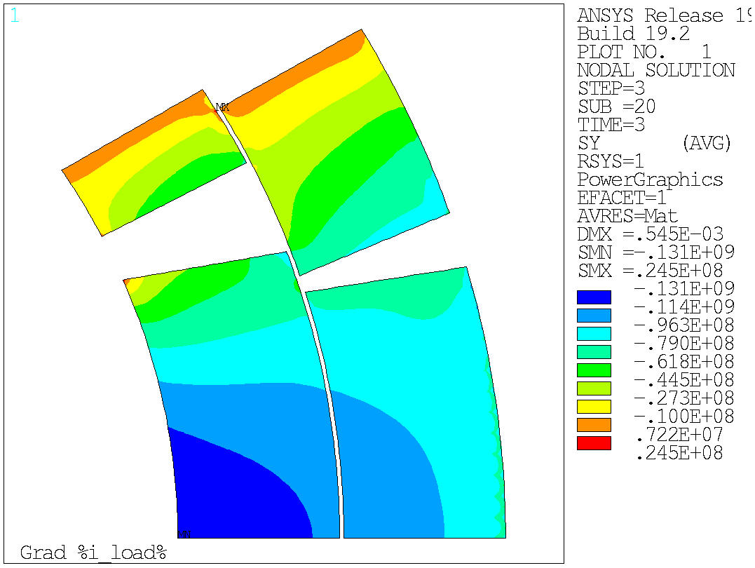

MQXF – Block Model
Azimuthal stress at ultimate and at 21 kA, for reference

Slide 24
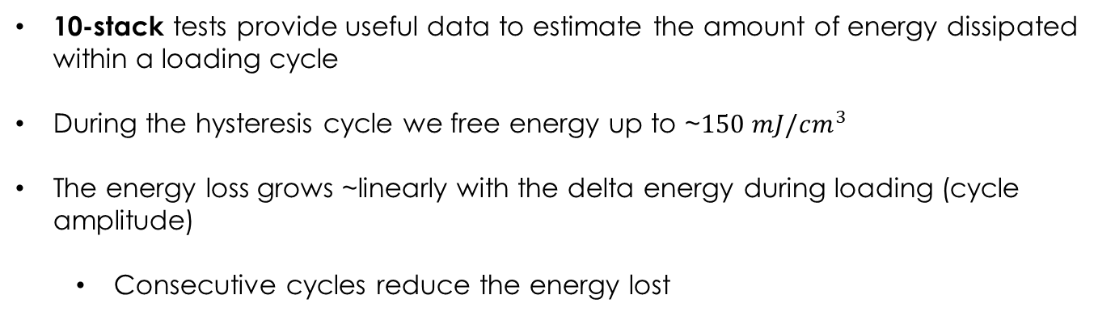
10 Stack Tests – Energy Loss
10-stack tests provide useful data to estimate the amount of energy dissipated within a loading cycle
During the hysteresis cycle we free energy up to ~$150 mJ/cm^{3}$
The energy loss grows ~linearly with the delta energy during loading (cycle amplitude)
  Consecutive cycles reduce the energy lost

Slide 25
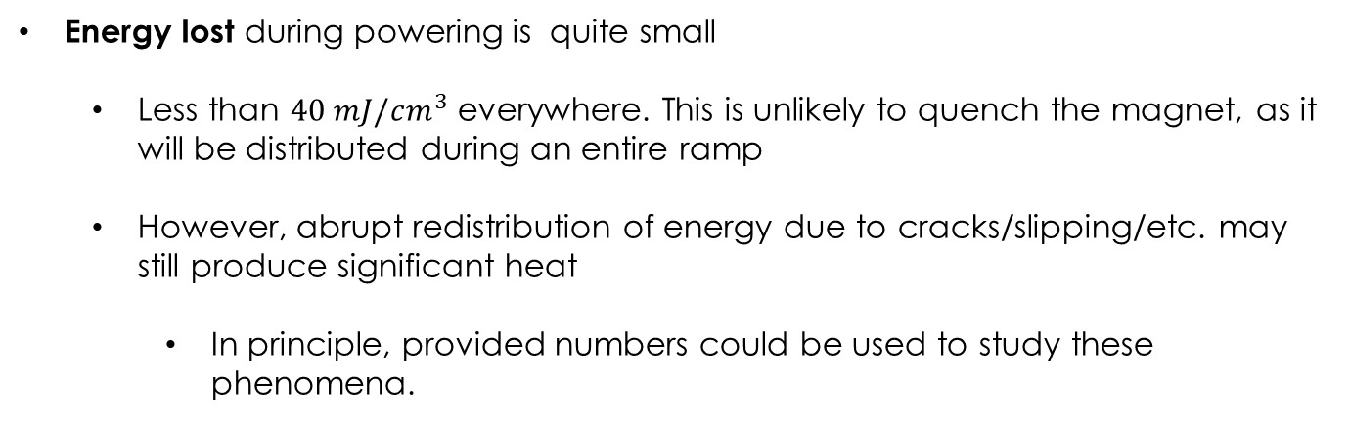
MQXF Case – Powering With Prestress
Energy lost during powering is quite small
  Less than $40 mJ/cm^{3}$ everywhere. This is unlikely to quench the magnet, as it will be distributed during an entire ramp
  However, abrupt redistribution of energy due to cracks/slipping/etc. may still produce significant heat
    In principle, provided numbers could be used to study these phenomena.

