Slide 1
Investigation of Thermoplastic Matrix Materials for Nb₃Sn Superconducting Coils
Steven Krave
MDP Meeting
31 July 2019

Slide 2
Outline
Permeability Measurements
Thermoplastic Impregnation and Short Beam Measurements
Energy Analysis and Acoustic Correlation of 4-stacks
Thermoplastics
CTD-101K

Slide 3
Introduction
Epoxies are great, but lately have been a focus of discussion for several reasons in coil fabrication
Cracking
Quench training
Coil Degradation
Impregnation Quality
Leading to the above?
Touchy
We can work to substantially improve our results through a few routes:
Design Improvements: Designing coils for impregnation and balancing required properties
Materials Improvements: Use higher performing materials with characteristics that benefit magnets
Process Improvements: Improve processing parameters and reduce variability.

Slide 4
Design for Impregnation: Darcy’s Law
Impregnating a coil really only involves two things:
Get gas out.
Get resin in.
We accomplish the first with vacuum.
We accomplish the second with by flowing resin into the coil.
As coils present a porous medium to and epoxy is a fluid flowing in it, Darcy’s law is a great way to direct your methods.
If we assume some potlife, we can integrate over the working time of the epoxy to compare or normalize different epoxy systems
How do we do better on large or long coils?
More fill ports?
Cheat?
By re-configuring coil geometry for a fixed permeability, we can maintain a fill rate and for a viscosity ~3,000,000 times higher than our current system.
We can modify permeability as well for another couple orders of magnitude
What is the permeability?
$Q=\frac{−κA }{μ}\frac{∆P}{L}$ or $\frac{−κA }{μ}\frac{∂p}{∂l}$
Q is the discharge rate
κ is the permeability constant of the porous medium
A is cross sectional area perpendicular to the flow direction
$∆P$ is applied pressure
$μ$ is viscosity
L is the length scale in the flow direction

Slide 5
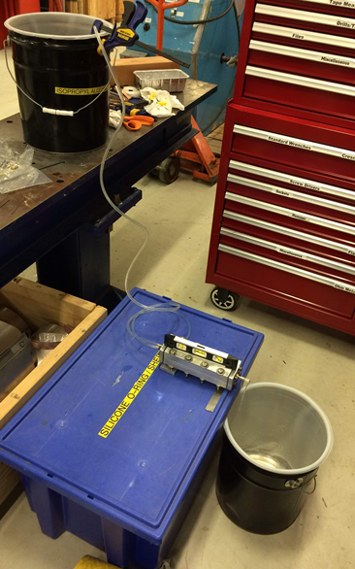
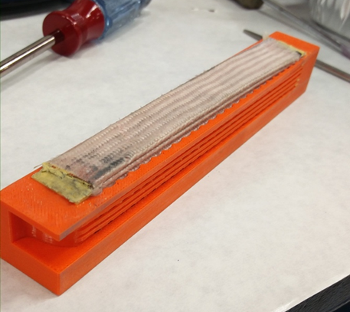
Designing for Impregnation: Permeability Measurements
To establish real world values, we have measured the hydraulic permeability of some cable, roughly per ASTM D2434-68
Impregnation fixtures used with inserts to control flow to direction of interest.
Investigated radial and longitudinal permeability
Reasonably easy measurement with fast turn around

Slide 6
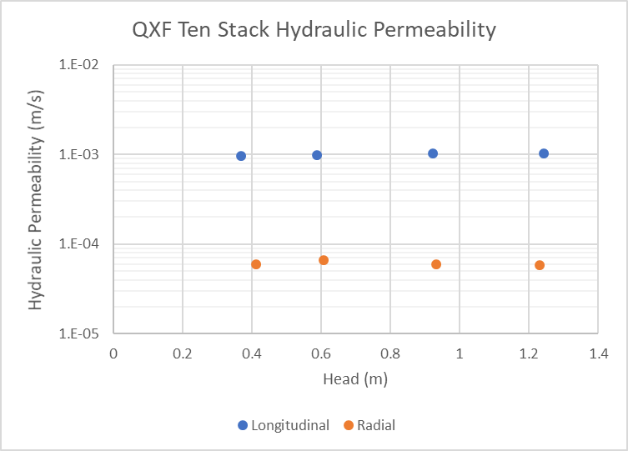
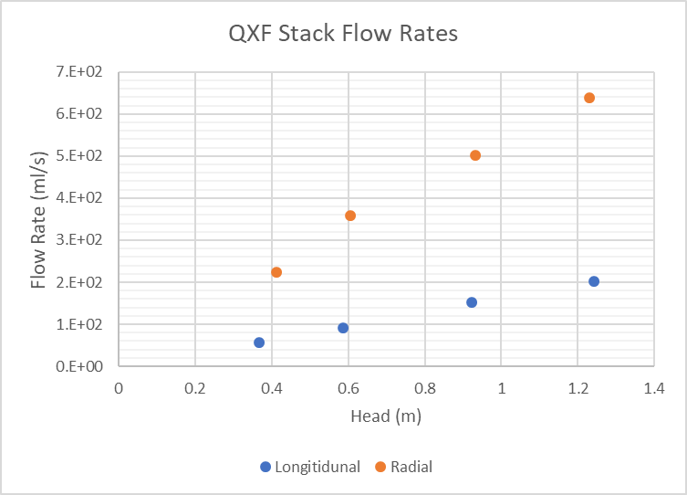
QXF Cable with S-Glass Braided on Insulation
Cable has similar permeability as clean sand.
Longitudinal
Radial
Radial Sample has drastically higher flow rate for an order of magnitude lower permeability.
The volumes of the small samples are similar, however we swapped a dimension between cross section and area
Permeability value remains ~constant regardless of pressure. As it should.

Slide 7
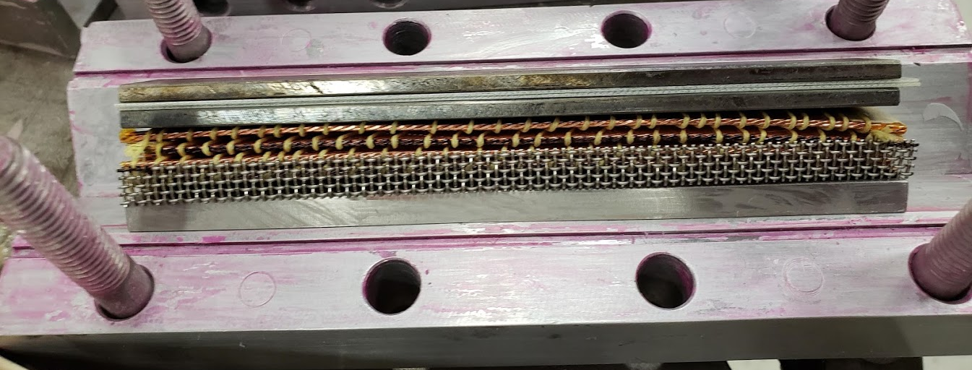
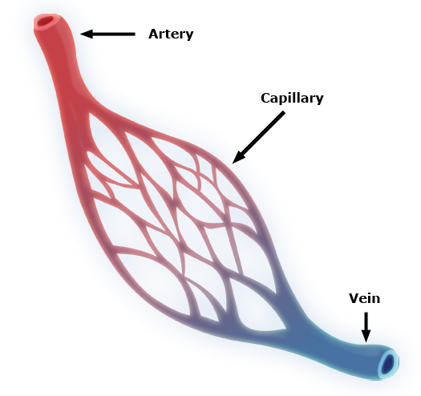
Integration of “Infusion Media” into Coil Pack
Copper cable wrapped in Kevlar string
Or fiberglass yarn…
We don’t care about the glass insulation anyway, we can do better using filled resin everywhere that matters Azimuthally without sacrificing too much radially or longitudinally
Get rid of it.
We still need space between turns
Use a spacer, like thread or string
When wrapped around cable, it provides a natural flow path for matrix resins orders of magnitude larger than the fiberglass it replaces
At the strand level: Transposition allows flow channels at the lowest level
Flow media is integrated into coil impregnation tooling.
Do not count on the coil to partake in resin distribution
In the case below, the flow media is stainless wire mesh. This could be varied to enable better surface finish or higher flow (or both)
Use a release layer between
Teflon or Teflon coated glass for Epoxies
Metals for more exotic things
Note: If you rely on perfect filling of epoxy in a coil, it is not going to happen. It is going to fail.

Slide 8
Permeability with infusion media built in
Infusion media leads to nonlinear permeability in the range of measurement
Turbulent flow?
Huge amount of room for additional improvement
Setup losses major component of results
Fill Rates of ~ 15-40(or more?) times faster for low aspect ratio sample
High aspect ratio improves substantially

Slide 9
Making Thermoplastic Samples
The 1st round of thermoplastic samples use Ultem 1000
Poly-Ether-Imide (PEI)
Amorphous
Radiation Resistant
Rather tough
Used in RHIC end parts in a GF variety
Tg = 217°C
Viscosity ~4700 poise
101K is ~1 poise

Slide 10
High Temperature Compatible Tooling
Since we need something to withstand the high processing temperatures of the thermosets, we need a new mold release
Why even bother looking for regular releases, find something that will stand up to reaction
Same thing with seals
It’s a small thing, but now we have a solution for reaction compatible impregnation tooling.
Alumina sealant, boron nitride mold release, silica gaskets
Negligible vapor pressure, 1000°+C compatible

Slide 11
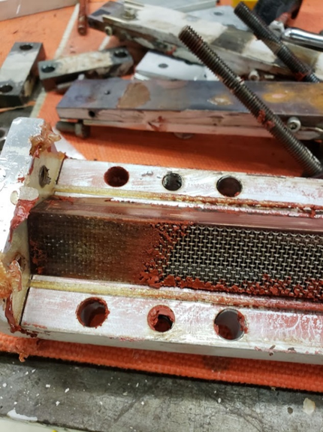
Impregnation
1st attempt with ULTEM melted all the seals and made a mess
Heat all tooling to process temperature
Melt resin in injector
Drive in resin with screw in a hot metal block…
Ten Stack tooling and heated injection block
nth attempt with ULTEM worked sort of. We have useful samples.

Slide 12
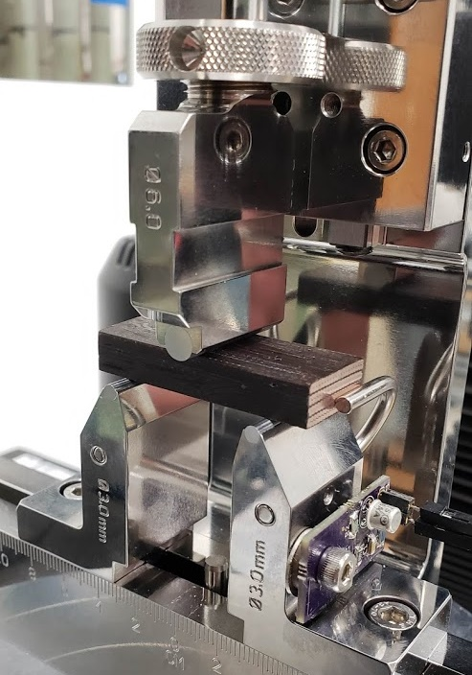
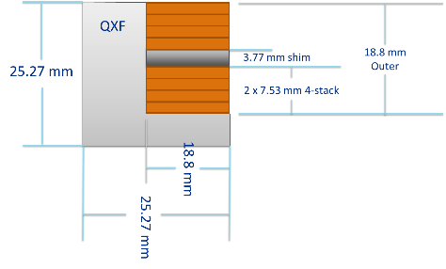
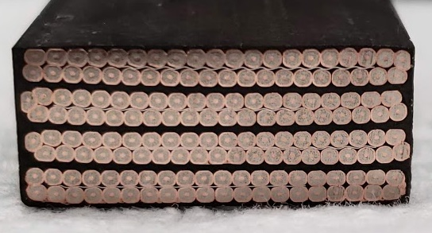
Sample Evaluation and Characterization
An appropriate test to quantify any changes in mechanical performance
Compression tests don’t tell us much that we can’t predict
Tensile is not well suited to coil like structures
We want to break things and see how they behave
Short Beam Shear
Easy sample geometry
Sample hints at coil behavior
Short Beam strength uses a symmetric beam with a span to thickness ratio of ~4.
Also Microscopy.

Slide 13
Shear Testing and Energy Release
dN of ~555N
Assuming that K ≈ constant, that the samples behave in a plastic fashion, and some basic spring stuff while conserving energy, we can evaluate an instantaneous change in energy of the system
These are nearly adiabatic and can lead to an instantaneous temp rise
Events are tagged and sorted, and we can generate nice histograms
Ideally a system will have no large events, and the generated heat can be extracted over some amount of time
Load (N)
ΔE
Displacement (mm)

Slide 14
Thresholding and limiting of events
Load
Displacement (mm)
Displacement (mm)
Before and after event load curve is reasonably flat
Assume Steady state
Zoomed in (F vs disp)
~90 samples between peak and min
Set threshold window to ~2X length (200 samples)

Slide 15
Room temperature Tests
Ultem 1000 Potted sample
Notes:
Unreacted 15T practice cable
Nothing on acoustic sensor
Typical behavior

Slide 16
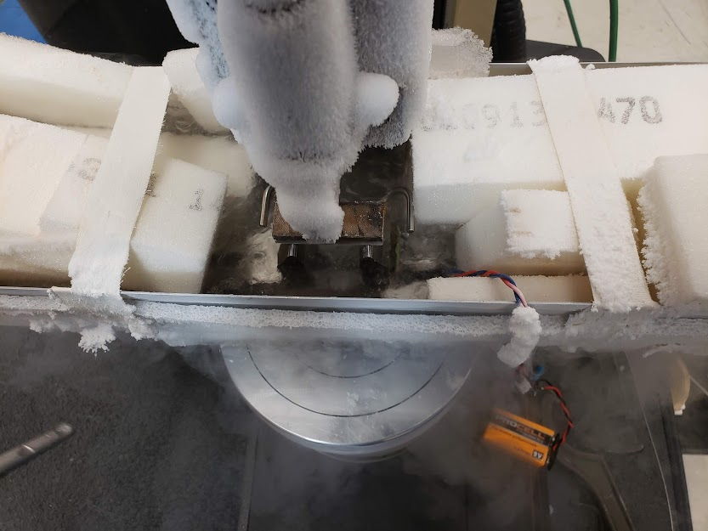
77K Test
Higher Ultimate SBS with caveat above
Some events approaching Ultimate SBS
Substantially more extension before ultimate
Should be more generous in loading
Quieter to ultimate
Faster load falloff
Less elongation

Slide 17
Event Comparison
Acoustic Amplitude Histogram for 1st ~90 seconds
Load Energy Histogram Same Sample
Acoustic signals and load events line up and amplitudes are correlated. The histograms above roughly illustrate this feature
There are a lot of events per sample (thousands), and handling them is a challenge.

Slide 18
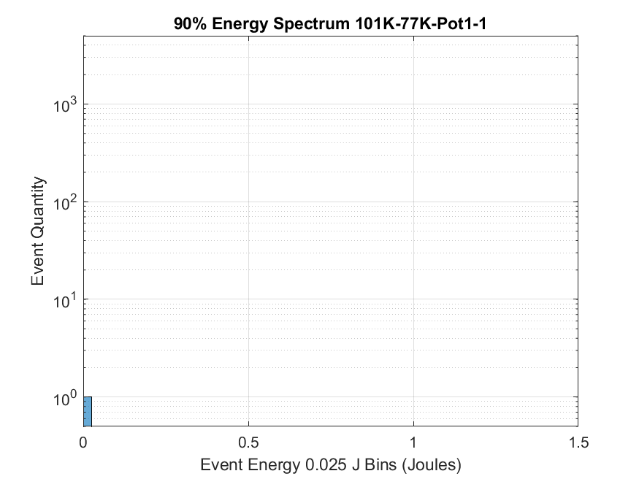
90% energy histograms
Since we don’t really want to be operating anything beyond the ultimate stress, I have set an arbitrary limit of 90% of f_sbs as an end point.
Looking at systems to this point may give a better picture of how they behave in something that hasn’t “failed”
Full Data
To 90% of SBS

Slide 19
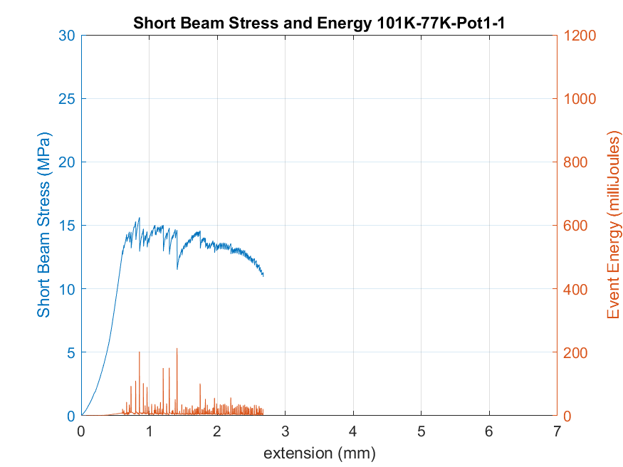
Sample Analysis
Acoustic data is then binned into events by exceeding rms noise level of signal and counted
Record Max value and sort
FFT of event samples, maybe something interesting will appear
300 events over 100s of loading
Event window set at 10 milliseconds

Slide 20
Grouping of acoustic events for Ultem
A selection of the Ultem Acoustic events
Recorded at 1MHz, the sampling period was only 100 seconds
Same loading rate as CTD stacks, significantly fewer events
Or more deformation per event
Still reasonably high SBS
Note audio file playback speed is result of input sample rate. I plan to re-sample in the next iteration for consistent playback speed.

Slide 21
Acoustic Events through ~100 seconds of loading
Ultem only shows 53 events
Only one of which was above the max detectable voltage
CTD-101K shows 305 events
Several of which were above the max detectable voltage

Slide 22
MQXFS01d Ramp 2
Lots of events (thousands) that mostly sound similar to the cracking sounds we hear in the SBS test
Only recorded at 100 khz
Occasional “Bong”
A lot of stuff at quench, then sounds of gas in piping

Slide 23
Conclusions
We have mostly successfully potted some small samples with thermoplastic and high viscosity filled resins
The current sample size is small, and not quite a direct comparison, as the new processes have some unexpected learning events
We have at least one test that tells us something new
Make more samples and increase dataset and range of thermoplastics resins
(PEEK, GF Reinforced PEEK, Thermoplastic Polyimide)
We have additional materials with some testing complete as part of an SBIR that are interesting to share at a later date

Slide 24
More test data
Example data.
All results are typical of sample set when a sample larger than 1 is available

Slide 26
40% by Volume Al₂O3 Loaded 101K at RT
Note: Room Temperature tests on Copper 11T Cable

Slide 27
Results on Copper Cable

Slide 31
Other…

Slide 32
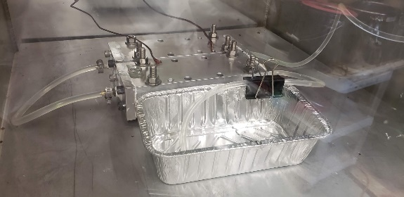
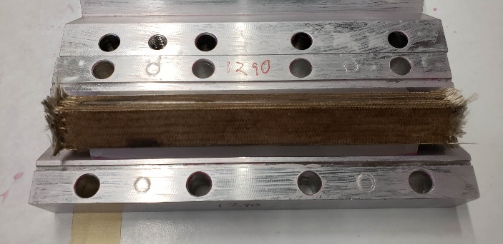
Sample Preparation
Samples were:
Cut and Fused
Insulated (by leftover sleeve removed previously)
Cured to nominal size
Reacted
Impregnated
Sectioned

Slide 33
Magnet Performance and Training
Ultimate magnet performance is limited by the ability of a magnet to remain under control as it approaches the conductor short sample limit (SSL).
As the operating point of the magnet approaches the SSL, thermal margin is reduced to 0.
Since materials at helium temperatures have extremely low specific heat (usually), minuscule amounts of energy lead to non-negligible local temperature increases with the potential to quench a magnet.
A(the?) major contributor is epoxy cracking as forces increase
You can hear it, you can see it.
Cracked epoxy after testing

Slide 34
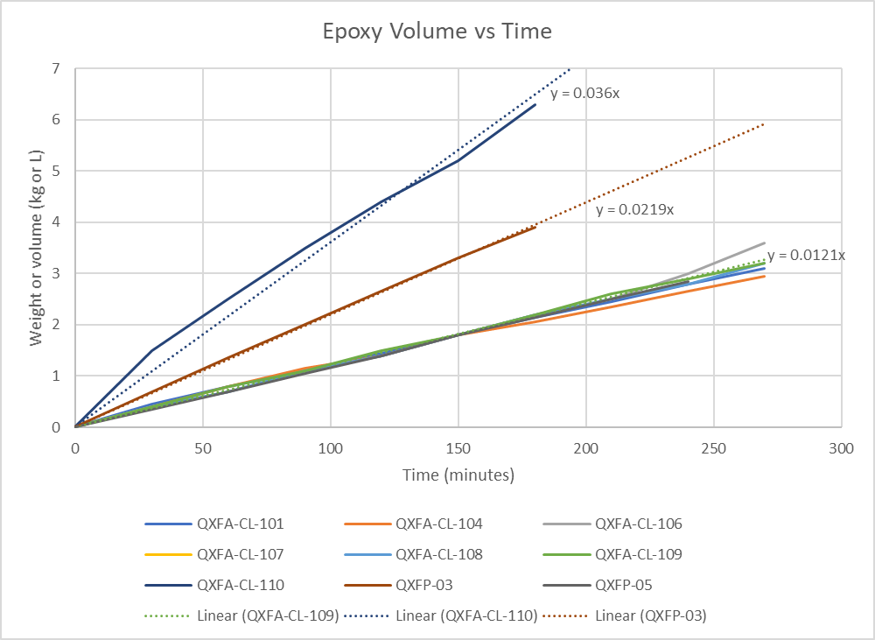
Cheating Darcy’s Law
$$t∝\frac{μ∗l^{2}}{2∗κ∗∆P}$$
Low viscosity resin is nice, but…
We could work a lot faster of we change the length scale of the flow direction.
An AUP Quadrupole is ~40mm thick and ~4000mm long
This is a factor of 10000 for the same pressure drop
Add another factor of 10-100 for pressurized resin injection or over pressure processing
We can add at least another factor of 3 from experience filling coils with less pump control
All of these assumptions are for Newtonian fluid in isotropic media
Still a factor of 3,000,000 +1/-99% wouldn’t be bad…
We might lose out a little on permeability, lets check
QXF Coil Fill rates. Flow controlled by pump, inlet absolute pressure remains below ~2 bar in all cases

Slide 35
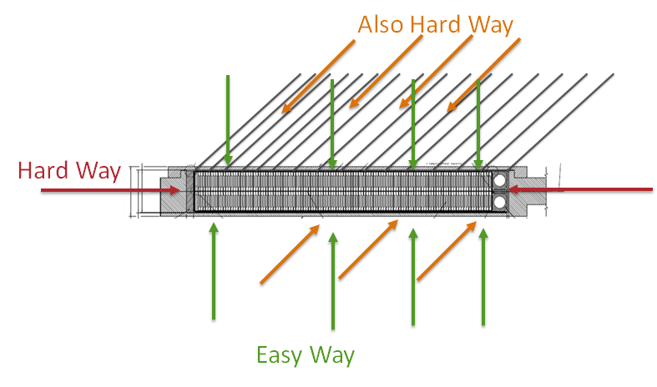
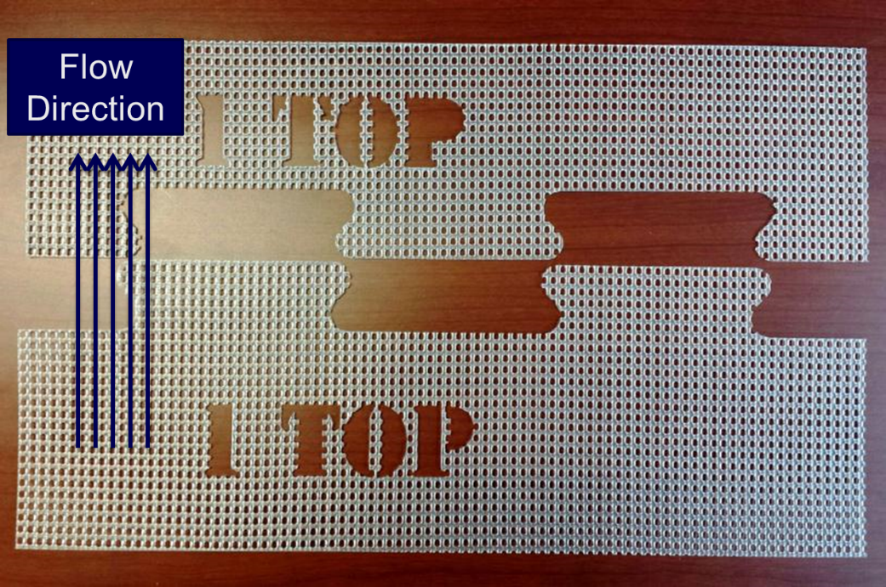
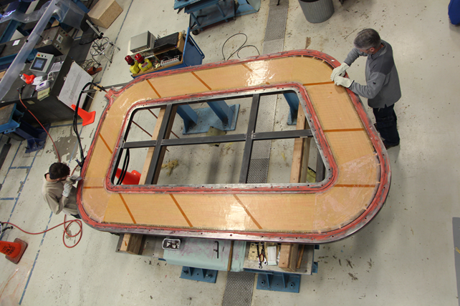
Infusion Media to the Rescue
Whenever possible, try not to make things difficult.
Solid conductor has 0 permeability
Big coils can be tricky
Allow opportunity for inspection after potting
Solid Copper sheets on both sides of the coil were temporarily replaced with highly permeable mesh to allow resin to saturate coils from the coil faces
Peel ply/ perforated FEP Release film was used to strip mesh after potting
FEP and mesh came off in a matter of minutes
Coils ready for CMM within 8 hours of demolding
In the case of CLAS12, there were 2 sheets of tightly packed fiberglass on either side of the coil that all of the resin had to pass through. This was solved by using infusion media to change the relative length scale of the impregnation process

Slide 36
Thermosets vs Thermoplastics (Roughly)
Long cycle times
Typically lower fracture toughness
Baseline system for current magnets
Low(er) processing temperatures
Low(ish) viscosity
Low(er) cost
Short Cycle Times
High toughness
Re-meltable
Recyclable
High Processing Temperatures
High Viscosity
Thermosets:
Epoxies
Cyanate Esters
Bismaleimides
Polyesters
Some polyimides
Thermoplastics
Polyethylene
PET
PEEK
PEI
Some Polyimides
Paraffin (Wax)

Slide 37
High Viscosity Impregnation: Enabling Filled and Thermoplastic Resins
Tailoring matrix mechanical properties can be used to engineer coil properties substantially
Probably the most important ones for magnets
Strength
CTE
Modulus
Ductility
Homogeneity
Other properties that are good
Thermal Conductivity
Specific Heat
Radiation resistance
Cost
Things that we care about for fabrication, but not that much for coil performance
Viscosity
Processing Temperature/melt temperature/Tg
Processing Time

