Slide 1
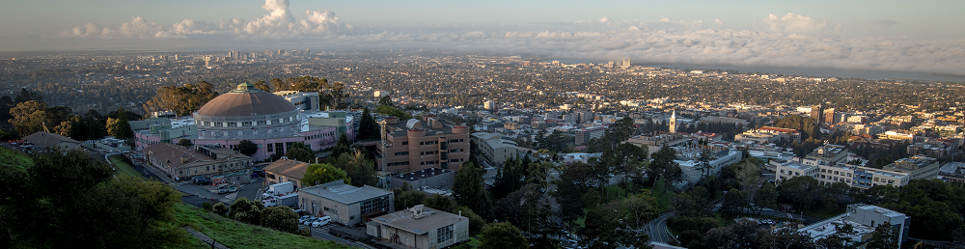
Waveform Digitization Hardware Options
Hybrid Neutrino Detection Workshop – University of Pennsylvania
Carl Grace 06/04/2025
Lawrence Berkeley National Laboratory

Slide 2
Introduction
The key goals of front-end electronics are typically precise timing and energy measurements
  Other goals such as pulse-shape discrimination are common
Many ways to achieve fast timing in practice
  Leading-edge Discrimination + Time-to-Digital Converter (TDC)
  Constant-Fraction Discrimination + TDC
  Full-speed Digitization (Nyquist-Rate Analog-to-Digital Converter)
  Waveform Digitizer (also called Switched-Capacitor Array or SCA)
Often other features of the signal are needed beyond timing
Feature extraction can also be done in a number of ways
  Post-processing of raw full-speed digital data
  Online-processing (digital pulse processing)
  Shaping + lower-rate ADC
  Analog feature extraction
Choices involve complex tradeoffs between cost, size, power, scalability, area, and performance

Slide 3
Introduction
Threshold
ADC
~MHz
+
-
TDC
(Clock)
Threshold
Stefan Ritt
Traditional data acquisition approach with independent timing and energy paths

Slide 4
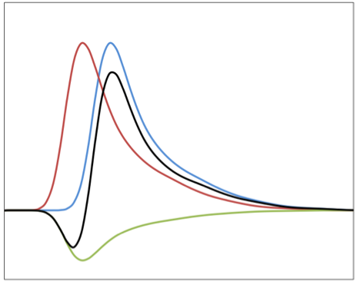
Direct Timing Measurement
Single Threshold
Multiple Thresholds
Constant Fraction (CFD)
Inverter & Attenuator
T1
Σ
Threshold
T2
0
Adder
T3
Delay
“Time-Walk”
T1
T2
T3
Stefan Ritt

Slide 5
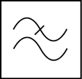
Digital Approach
ADC
FPGA
Angelo Rivetti
How fast of an ADC do you need?
J.-F. Genat et al., arXiv:0810.5590 (2008)
Need to sample faster than 2X the highest frequency component in your signal
To first order, BW ~ 0.35/risetime. (so, for 1 ns tr, BW = 3.5 GHz, fsample > 7 GS/s)
Also need to account for dynamic range (10 - 12 bits, typically)
12-bit, 6+ GS/s ADCs are available, but extremely expensive
Also, better timing with multiple samples on the leading edge!

Slide 6
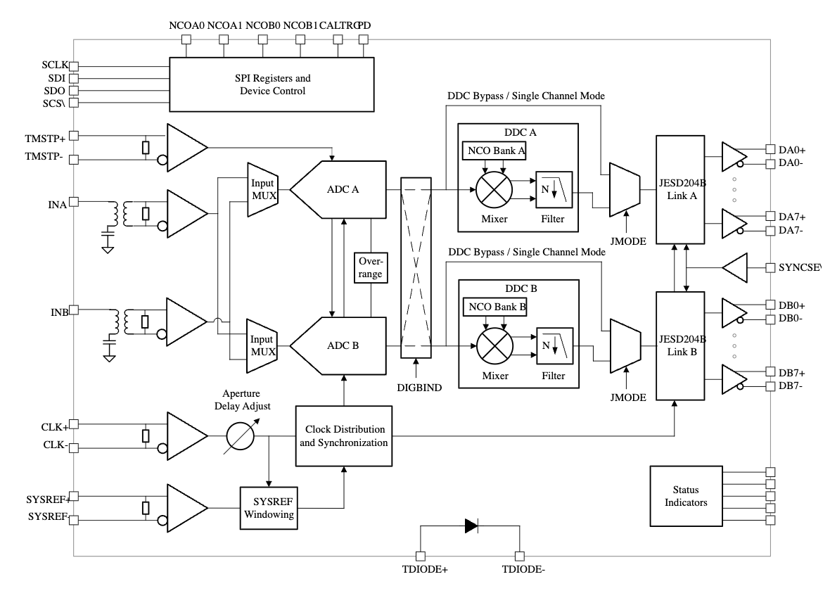
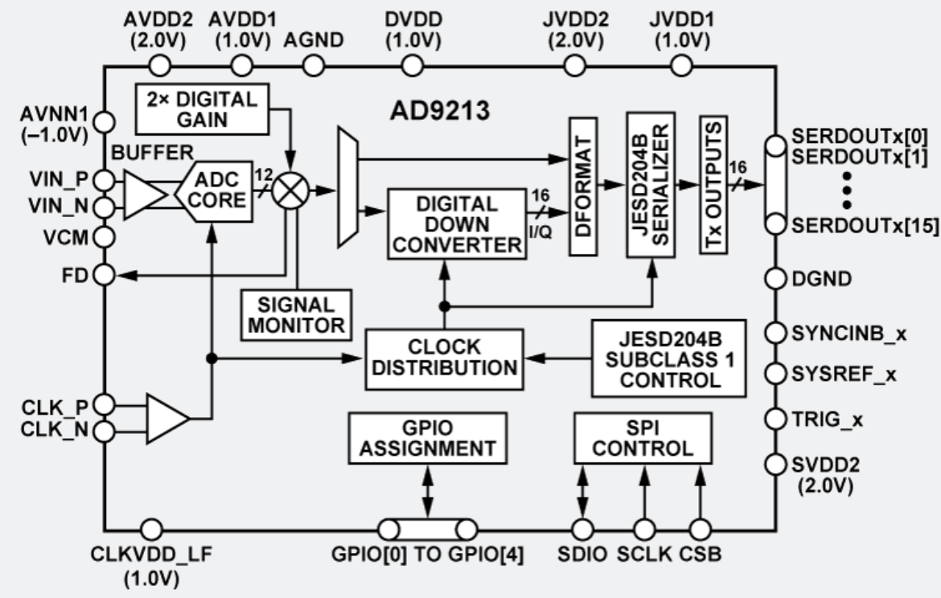
Commercial Ultra-High-Speed ADCs
Analog Devices AD9213
12 bits, 10 GS/s, 5.1 W, ~$1.0k/channel (!)
Texas Instruments ADC12DJ5200
12 bits, 10 GS/s,4.0W, ~$1.2k/channel (!)
Not practical for fast timing. Can be a useful approach in applications with relaxed requirements (e.g. Mu2e)

Slide 7
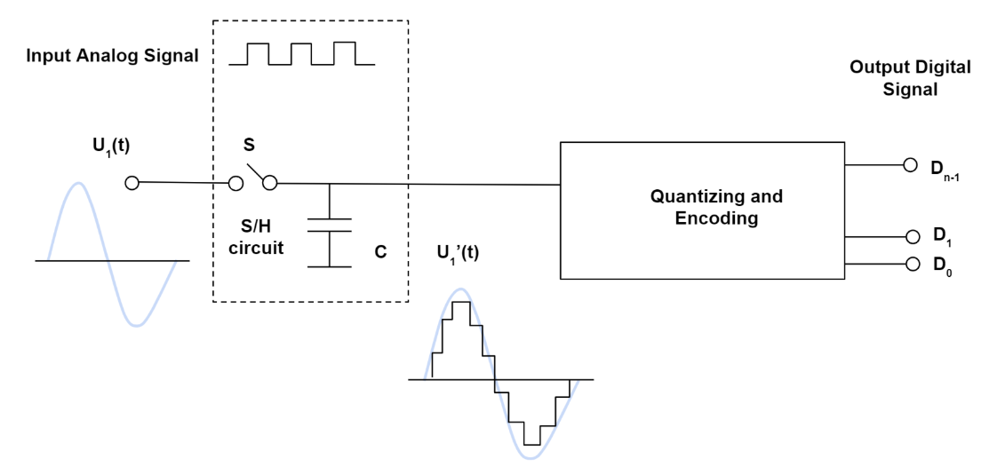
How Can We Get Around This?
Key innovation in the Switched Capacitor Array (SCA) is decoupling the sampling and quantization processes
Monolithic Power Inc.

Slide 8
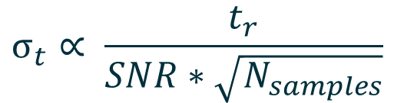
Waveform Samplers – PSEC4
In a waveform digitizer you continually sample the input at high speed into an analog memory. When you get a trigger you read out with a slow ADC.
$$σ_{t}∝ \frac{t_{r}}{SNR∗\sqrt{N_{samples}}}$$
Power-Hungry slope ADC
PSEC4 – U Chicago, Switched-Capacitor Array, 130 nm CMOS
< 100 ps sampling, 1.6 GHz BW. 6 channels, 256 deep analog memory
50 kevents/s, 16 mW/channel max, ~10 ps timing resolution, 1 W for 64 channels

Slide 9
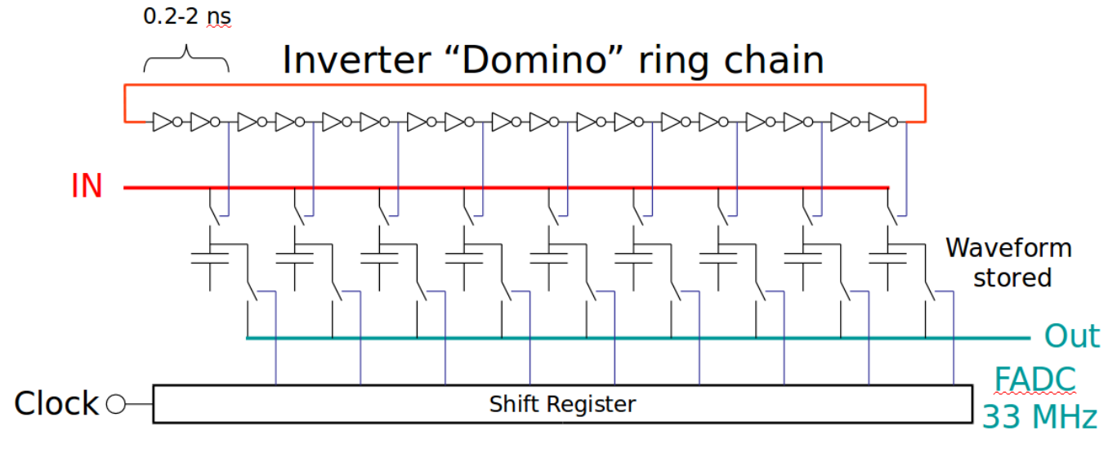
Waveform Samplers – DRS4
DRS4 – PSI, Switched-Capacitor Array, 250 nm CMOS
200 ps sampling, 650 MHz BW, 9 channels, 1024 deep analog memory
~30 kevents/second readout, 33 mW/channel quiescent → 2.1 W for 64 channels
~11.5 bits SNR, 5 ps timing resolution

Slide 10
Practical consideration: SCA “Time Stretch Ratio”
δt_{s}
IN
Clock
Out
Typical values:
δt_{s} = 0.5 ns (2 GSPS)
δt_{d} = 30 ns (33 MHz)
→ TSR = 60
δt_{d}
Stefan Ritt

Slide 11
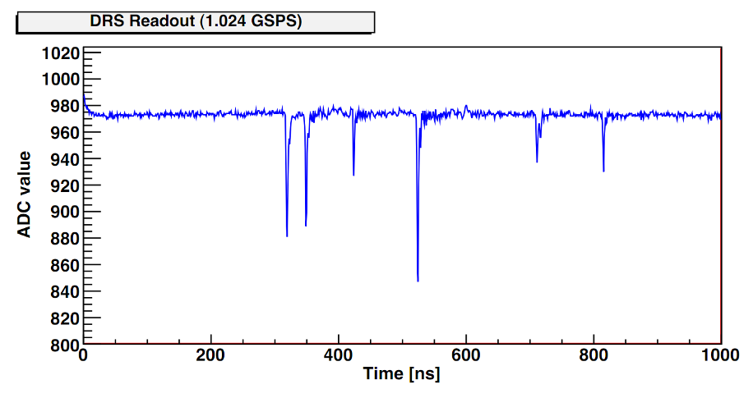
TSR Leads to SCA Deadtime
sampling
digitization
sampling
digitization
Sampling Windows * TSR
lost events
Dead time =
Sampling Window ∙ TSR
(e.g. 100 ns ∙ 60 = 6 μs)
Chips usually cannot sample during readout ⇒ “Dead Time”
Technique only works for “events” and “triggers”
Stefan Ritt

Slide 12
SCA Deadtime can be addressed
digitization
FIFO sampler becomes immediately active after hit
Samples are digitized asynchronously
“De-randomization” of data
Can work dead-time less up to
average rate = 1/(window size * TSR)
Example: 2 GSPS, 10 ns window size, TSR = 60 → rate up to 1.6 MHz
Stefan Ritt

Slide 13
Summary of a few SCAs
ASIC | Lab | Sample Buffer Size | Sampling Rate [GS/s] | Analog BW [GHz] | # of Channels | Dynamic Range [bits]
DRS4 | PSI | 1024 | 5 | 0.7 | 8 | 12
PSEC4 | U Chicago | 256 | 15 | 1.5 | 6 | 12
AARDVARK | Nalu | 30k | 14 | 2.0 | 8 | 12
FPS | LBNL | 90 | 32 | 8.2 | 4 | 10
Aardvark has deadtime-less operation capability up to 100 kHz (sample buffer size reduced in this mode)

Slide 14
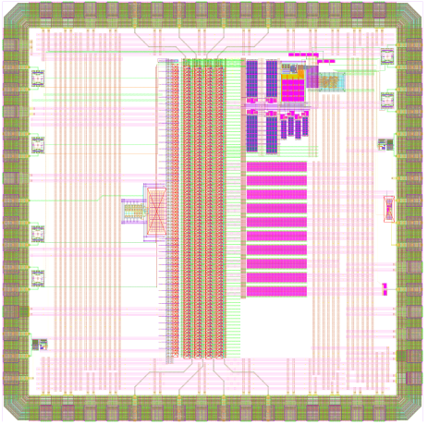
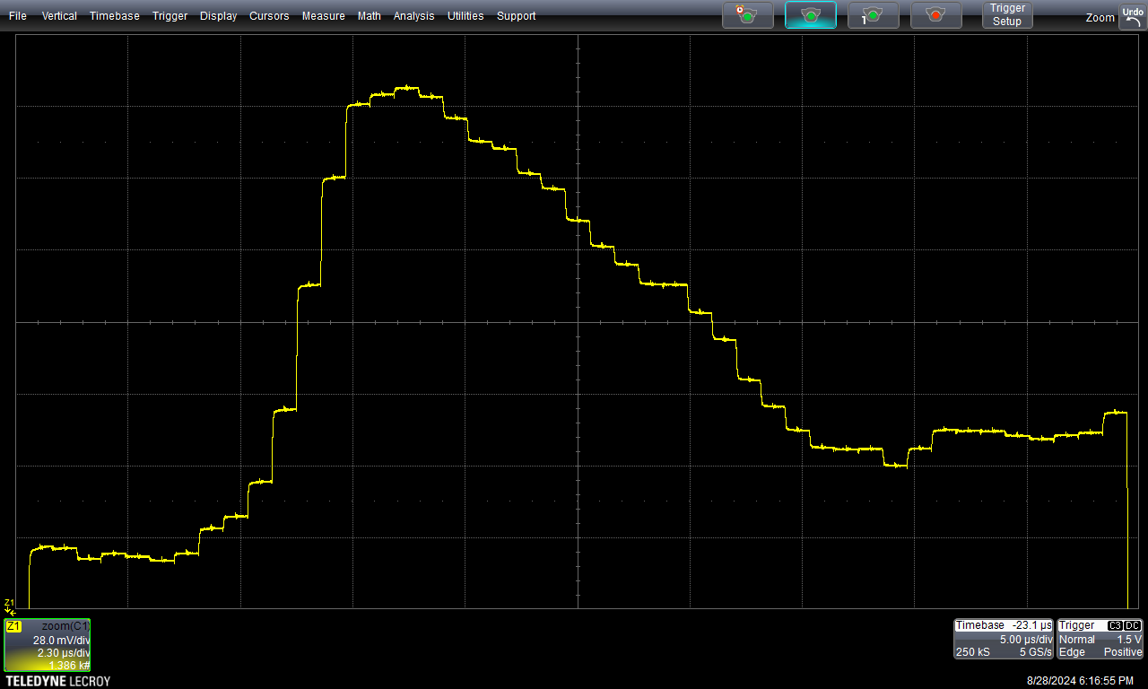
FastPulse Precision Sampler (LBNL 2025)
45 elements of SCA
RMS noise ~550 µV
Response to fast calibration pulse
FPS-II – 65 nm, 4 mm²
Measurement of FPS-I

Slide 15
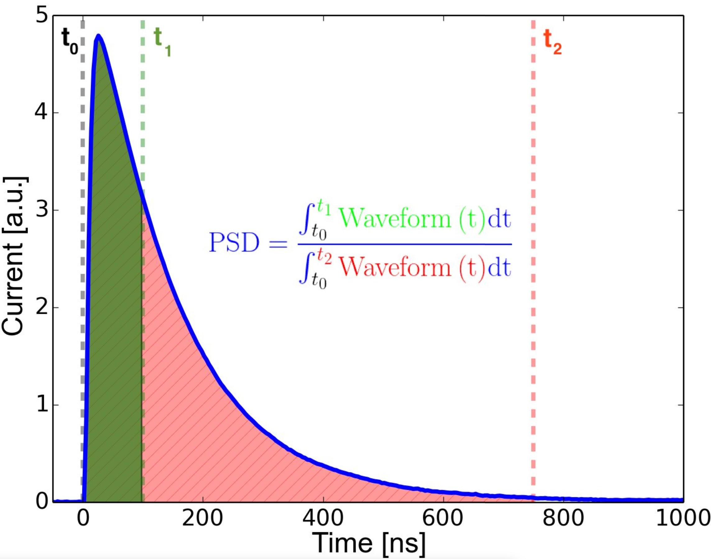
Another option: Analog Feature Extraction
Example application: Pulse Shape Discrimination
We can extract relevant features directly from the waveform using analog techniques. This could be much lower power and more compact (to allow more channels in a given space).
This calculation can be done in the digital or analog domain.
Widely used ”Q-ratio” approach.

Slide 16
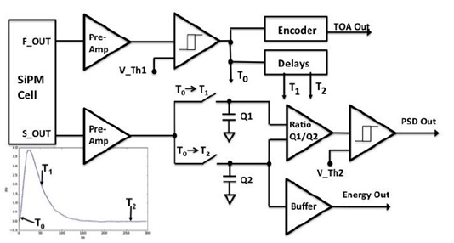
NeuPIX: custom analog PSD ASIC
Very simply, the NeuPix compares the area ratio between a long and short integration to determine if an incident particle is a fast neutron or a gamma.
Analog signal processing has potential for lower power operation relative to a digital processor coupled with a fast waveform digitizer.

Slide 17
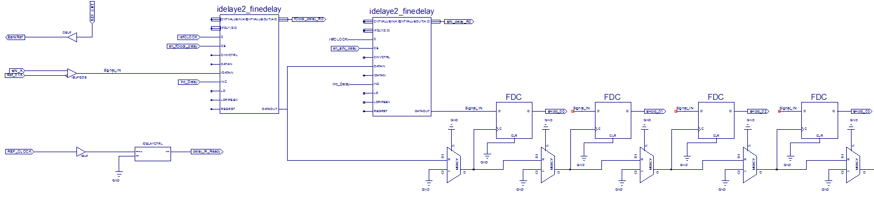
Yet Another Approach: Fast Discriminator w/ FPGA TDC
Bank Ref
Signal In
1024
Channel Ref
CLK
Basic Cell
Uses internal FPGA resources to implement low-resolution ADC & TDC
Can implement many channels in single FPGA device → excellent for high-resolution, high channel-count systems
Can be complementary to analog feature extraction

Slide 18
FPGA timing
Virtex UltraScale (20 nm) XCVU440 | Average Power/channel @10 kevent rate (mW) | #Channels | #Bits | Logic Cells (k)
50ps, 1024 | 3 | 1400 | 1 | 6%
50ps, 1024 | 12 | 330 | 2 | 9%
50ps, 1024 | 32 | 120 | 3 | 12%
Low per-channel power dissipation possible
Virtex UltraScale+ (16 nm) XCVU13P | Average Power/channel @10 kevent rate (mW) | #Channels | #Bits | Logic Cells (k)
50 ps, 1024 | 2 | 700 | 1 | 9%
50 ps, 1024 | 9 | 160 | 2 | 12%
50 ps, 1024 | 23 | 80 | 3 | 15%

Slide 19
SCA vs Analog Timing Considerations
How many channels needed in the system?
How much deadtime can you accept (or if none, what is the max average signal rate)?
What is the signal BW?
What is the sampling rate requirement?
How deep do the records need to be?
What are your cost constraints?
What are you size constraints?
…

Slide 20
Conclusion
There are a number of useful approaches to fast timing that allow tradeoffs between a number of important parameters
Waveform digitization is a powerful technique to decouple sampling and quantization. Allows huge reductions in power dissipation and cost.
Analog techniques (such as leading-edge discrimination + TDC) can be simpler and more compact, but are not as flexible and don’t have as good performance
Analog feature extraction can allow customized processing of a waveform for a particular application with further reduced power and cost
Implementing the TDC in an FPGA can potentially reduce cost and power
The best solution could be a mix of these.

Slide 21
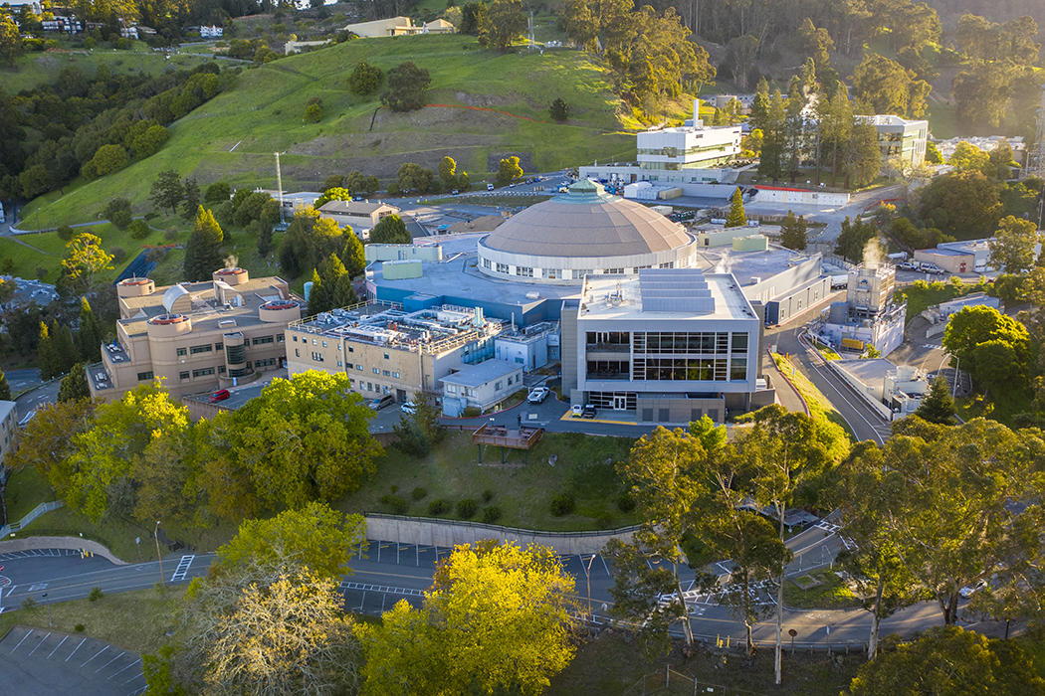
Thank You
This work was supported in part by the U.S. Department of Energy under Contract No. DE-AC02-05CH11231

