Slide 1
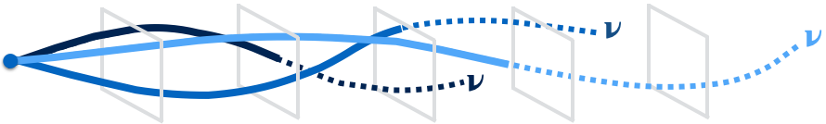


Physics with Precision Time Structure in On-Axis Neutrino Beams
Matt Wetstein
June 5, 2025

Slide 2
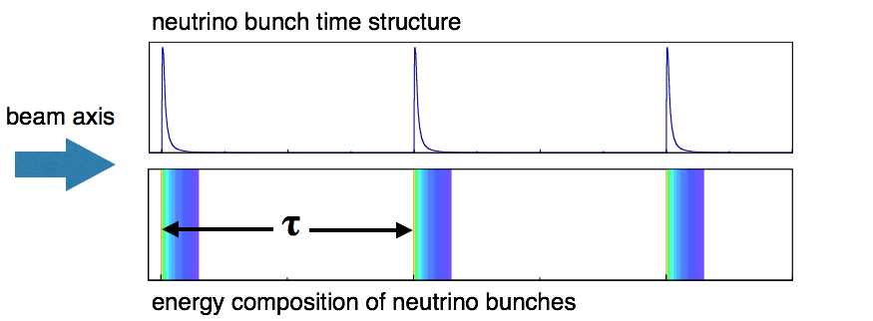
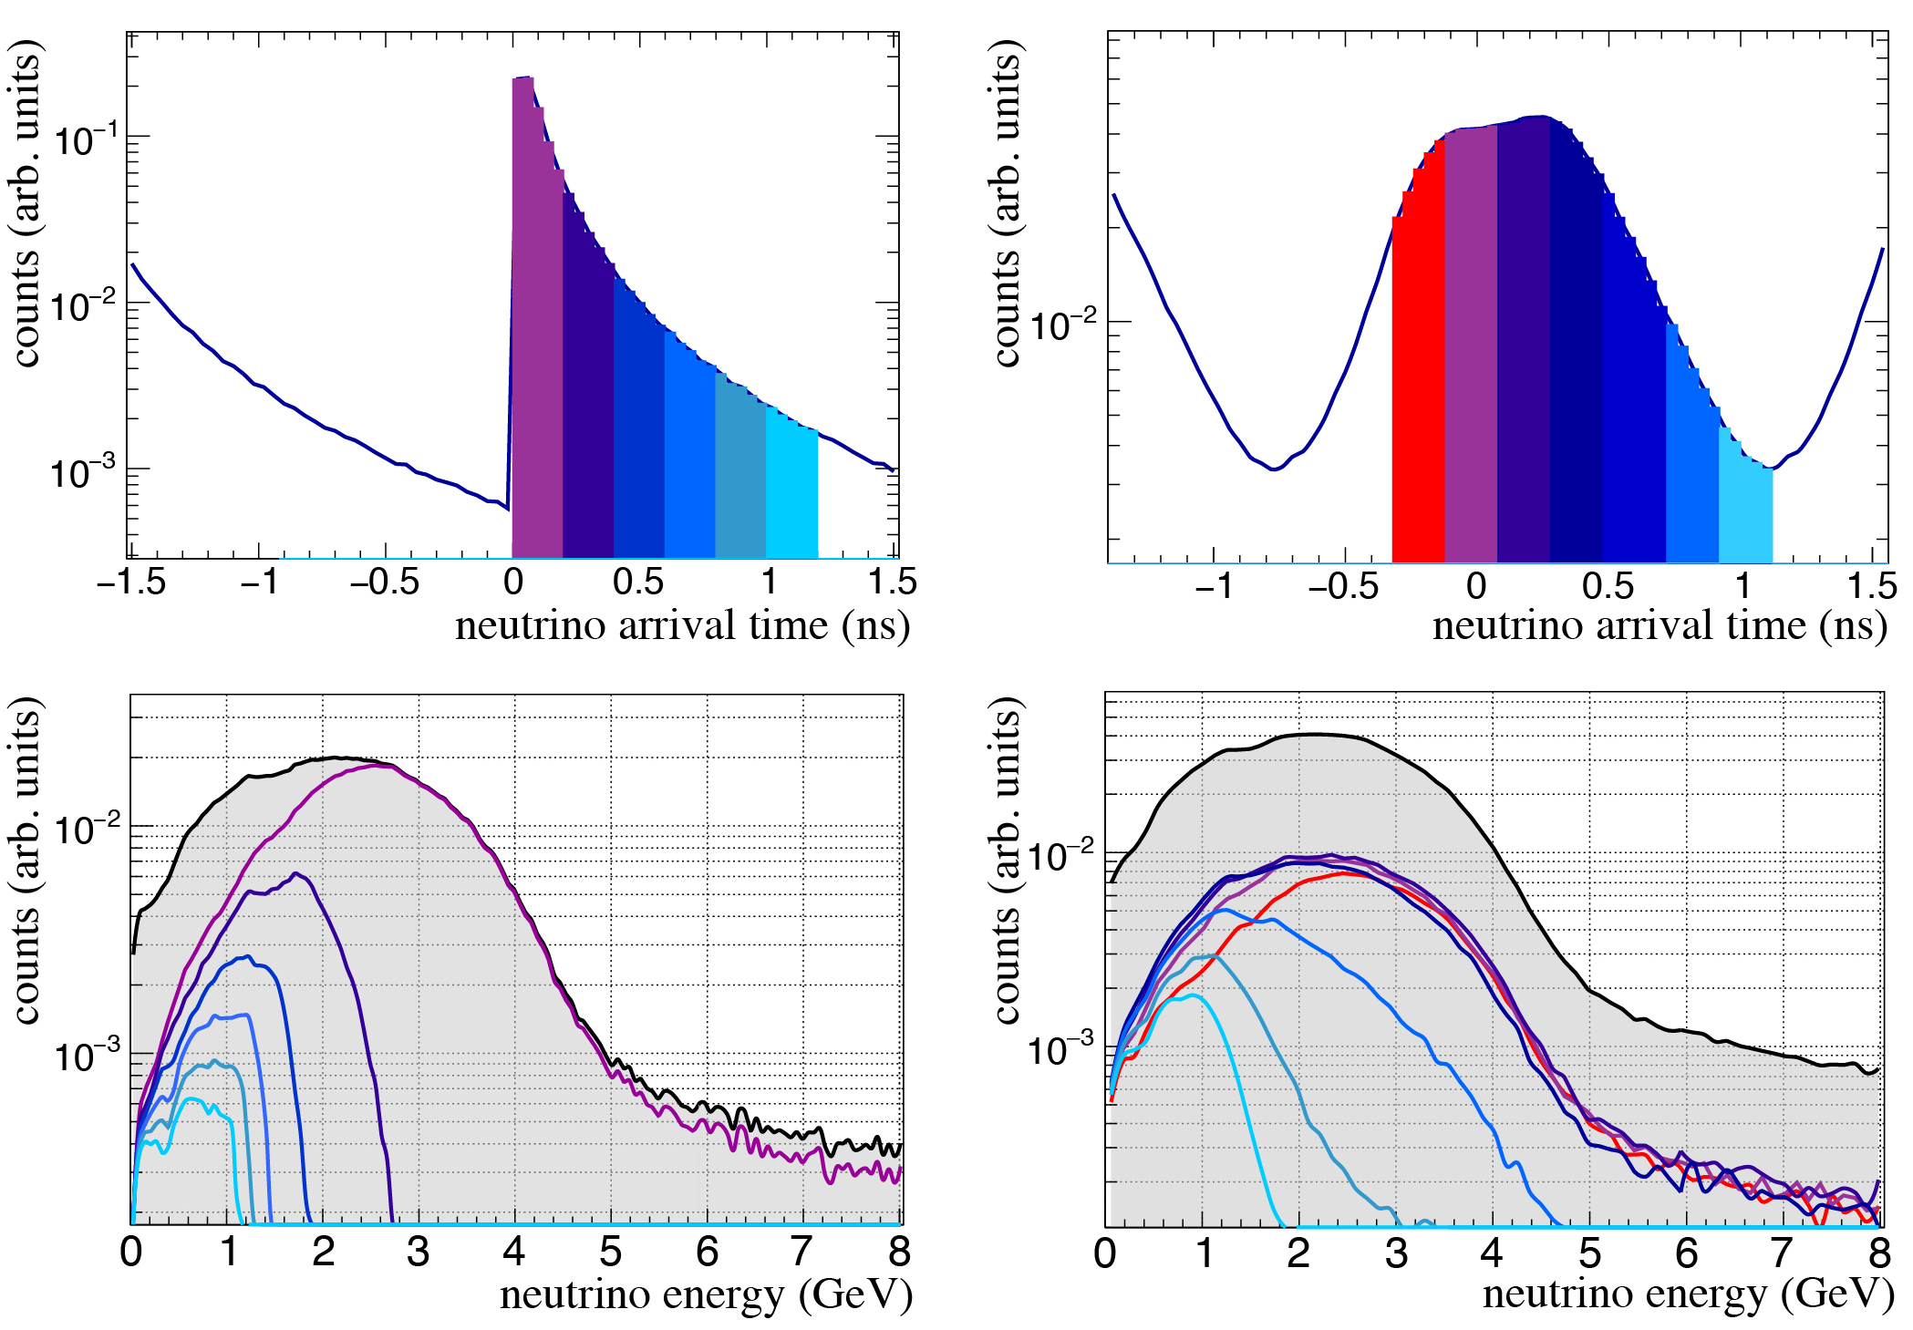
Introduction
Neutrinos beams have an intrinsic time structure imprinted on them by the accelerators used to produce them
The relative arrival time of neutrino with respect to the bunch correlates with the neutrino energy, parent hadron, and flavor
Timing in neutrino beams could therefore provide a strong experimental handle to help understand and reduce beam systematic uncertainties on flux, cross section, and energy reconstruction in DUNE
It may also provide a new handle in searching for new physics
Hybrid Cher/Scint Workshop, Penn - June, 20256

Slide 3
Introduction
Neutrinos beams have an intrinsic time structure imprinted on them by the accelerators used to produce them
The relative arrival time of neutrino with respect to the bunch correlates with the neutrino energy, parent hadron, and flavor
Timing in neutrino beams could therefore provide a strong experimental handle to help understand and reduce beam systematic uncertainties on flux, cross section, and energy reconstruction in DUNE
It may also provide a new handle in searching for new physics
Hybrid Cher/Scint Workshop, Penn - June, 20256

Slide 4
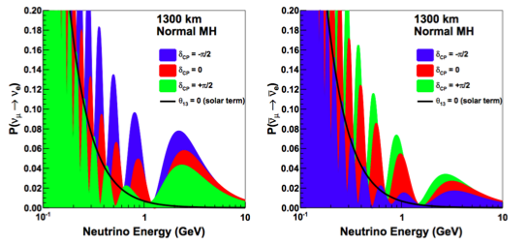
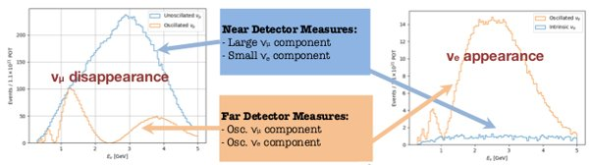
Neutrino oscillations are energy dependent
Hybrid Cher/Scint Workshop, Penn - June, 20256

Slide 5
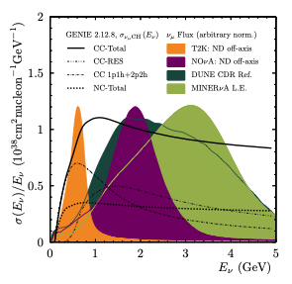
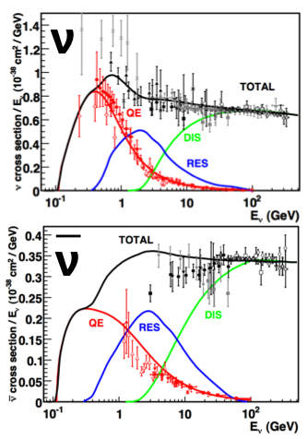
LBNF covers a wide range of energies
This is advantageous because it enables shape fitting of the oscillation spectrum over a wide range
    It is also presents a challenge: it must rely on accurate reconstruction of neutrino energy and knowledge of the beam composition
Hybrid Cher/Scint Workshop, Penn - June, 20256

Slide 6

Neutrino rates are cross section (and detector) dependent
…and sensitive to nuclear effects
We do not always directly measure primary interactions. Neutrino scatters are often subject to Final State Interactions (FSI)
Multiple combinations of primary interaction + FSI can yield final states with degenerate experimental signatures
Missing energy can be carried away by undetected particles (e.g. neutrons)
Argon is a particularly large and complex target nucleus
Hybrid Cher/Scint Workshop, Penn - June, 20256

Slide 7
Systematics do not entirely cancel between near and far
Near Detector
process
target
∫
E_{max}
R(k) =
∑
∑
𝛟(E_{𝛎}) x 𝛔i(E_{𝛎},k) x 𝛆(k) x Nj x P_{𝛎a→𝛎b}(E_{𝛎})
dE_{𝛎}
i
j
E_{min}
Far Detector
Energy dependent cross sections are sampled by a very different energy spectrum in the far detector than that of the near detector
The DUNE Prism working group has shown that it is possible to tune the cross sections and flux model to achieve data-Monte Carlo near detector agreement and get the oscillation measurement wrong
Hybrid Cher/Scint Workshop, Penn - June, 20256

Slide 8
The importance of adding multi-dimensional constraints
If we can identify reconstruction-independent observables that allow us to select different energy spectra within the same beam…
…Then we have multiple constraints with which to disentangle flux and cross-section uncertainties
Hybrid Cher/Scint Workshop, Penn - June, 20256

Slide 9
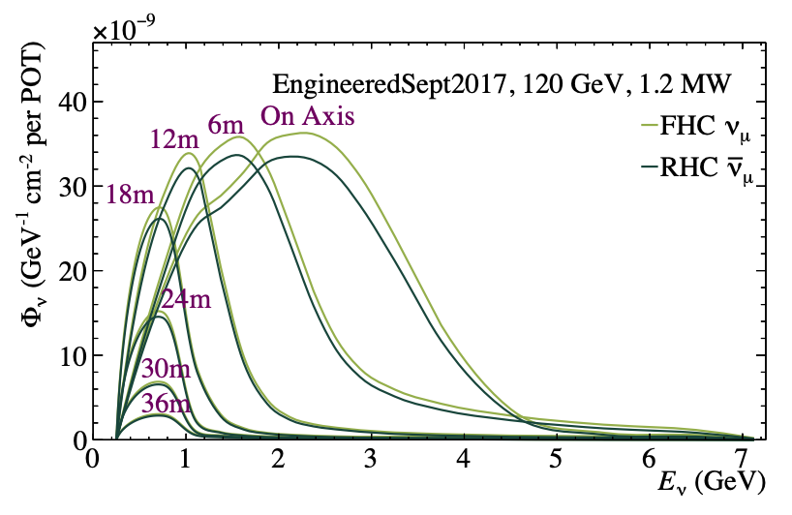
The importance of adding multi-dimensional constraints
If we can identify reconstruction-independent observables that allow us to select different energy spectra within the same beam…
…Then we have multiple constraints with which to disentangle flux and cross-section uncertainties
Off-axis fluxes
DUNE has already recognized this and placed a priority on DUNE-Prism, which explores the LBNF near neutrino flux at different off-axis angles
Hybrid Cher/Scint Workshop, Penn - June, 20256

Slide 10
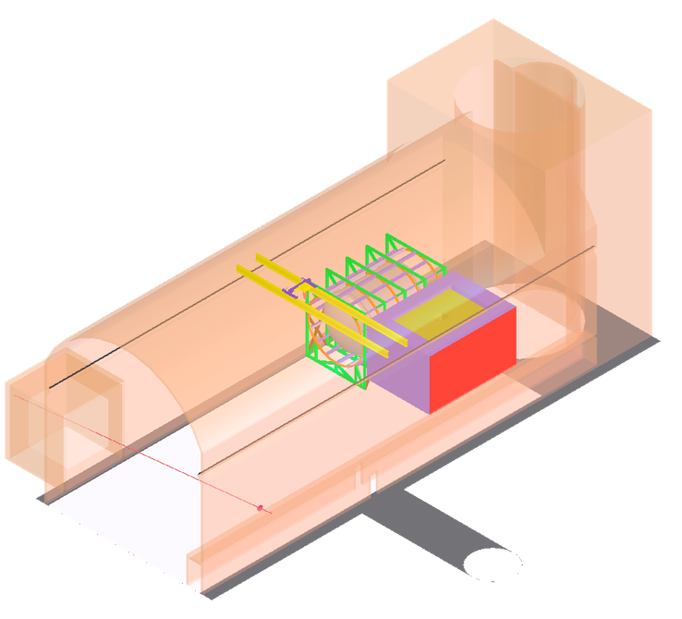
The importance of adding multi-dimensional constraints
If we can identify reconstruction-independent observables that allow us to select different energy spectra within the same beam…
…Then we have multiple constraints with which to disentangle flux and cross-section uncertainties
DUNE has already recognized this and placed a priority on DUNE-Prism, which explores the LBNF near neutrino flux at different off-axis angles
Hybrid Cher/Scint Workshop, Penn - June, 20256

Slide 11
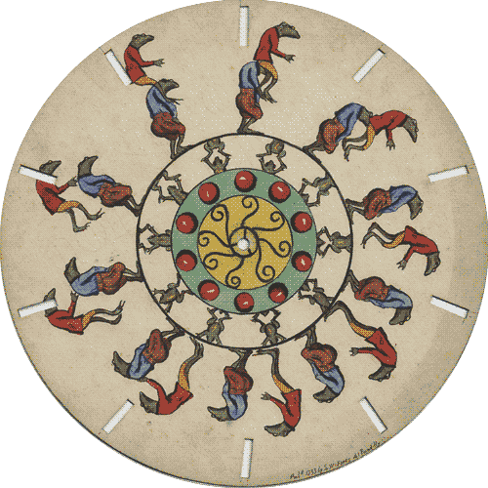
Time-Slicing of Neutrino Fluxes
Hybrid Cher/Scint Workshop, Penn - June, 20256
Notes:
Phenakistiscope
Joseph Plateau (Belgian Physicist and Mathematician)

Slide 12
Basic Timing Concept
Precision timing can be used to measure the arrival time of neutrinos with respect to the rest of the bunch
Later neutrinos tend to have lower energies due to the correlation between neutrino energy and the velocity of the parent hadron
This allows one to select different flux spectra based on timing
All of these fluxes co-exist within a single on-axis detector
Hybrid Cher/Scint Workshop, Penn - June, 20256

Slide 13
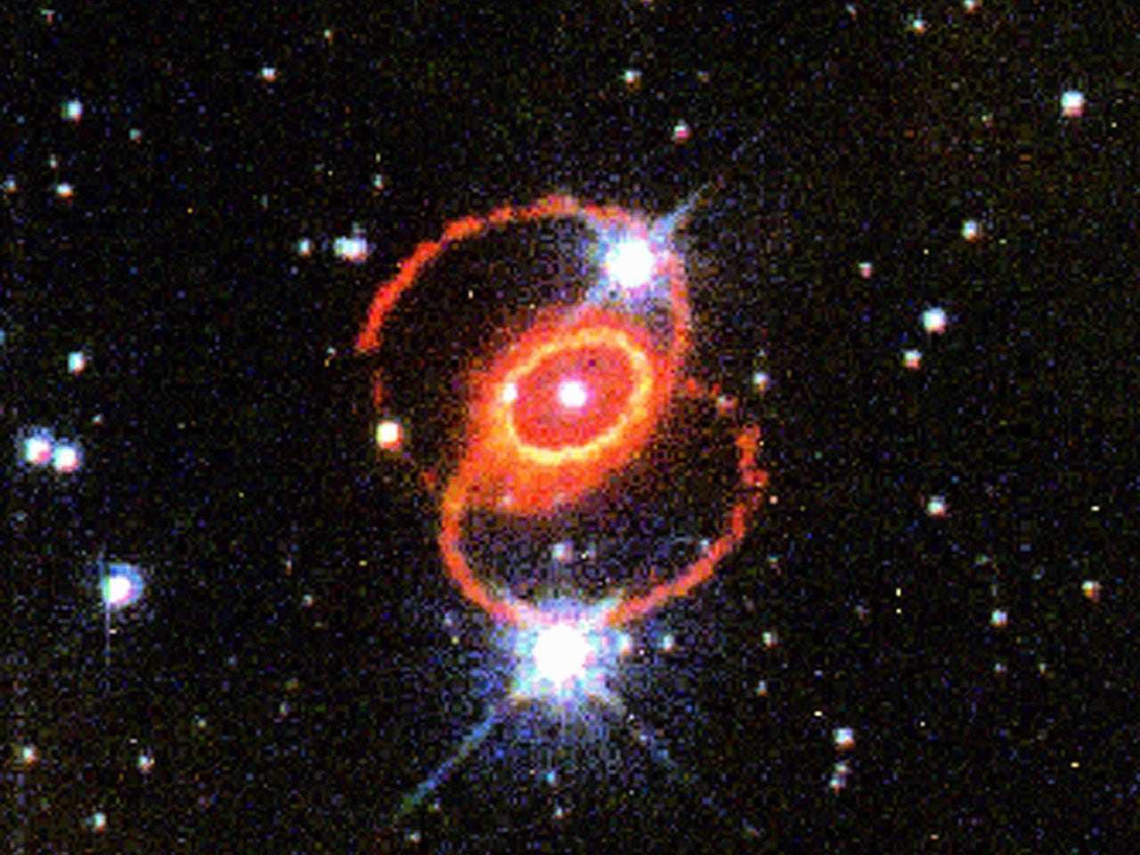
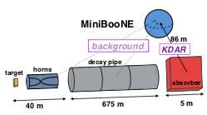
Prior Efforts on Timing
M Goldhaber suggested that neutrino arrival times could be used in the analysis of SN1987a
MINOS demonstrated precision timing with the sub-structure of NUMI in their neutrino time-of-flight paper
MiniBooNE recently published a stopped Kaon analysis based on arrival time with respect to the bunch.
MiniBooNE also explored the idea of selecting different energy spectra
10.1142/S0217751X03017154
https://arxiv.org/abs/1408.6267
https://arxiv.org/abs/1801.03848
Melanie L Novak, Bucknell (2002)
Hybrid Cher/Scint Workshop, Penn - June, 20256

Slide 14
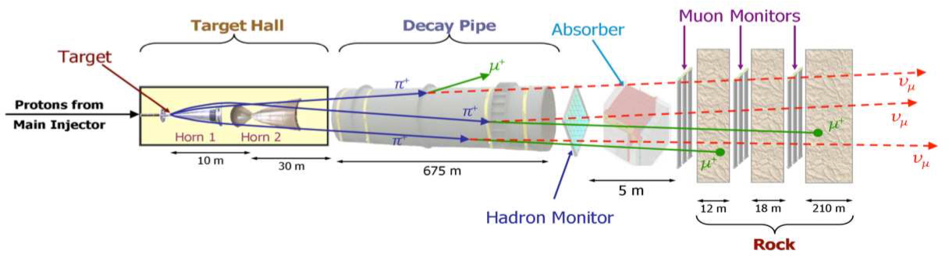
Proton beams collide with a target, producing pions and kaons
These hadrons are selected by sign and momentum and focused by a series of magnetic horns
The hadrons decay into muons and 𝜈_{𝜇}’s with a strongly forward directionality.
An intrinsic background or 𝜈_{e}’s originates from early-decay of the muons. An additional wrong-sign component originates from hadrons not rejected by the magnetic horns.
The final kinematics of the neutrinos are driven by hadron kinematics & decay time
Hybrid Cher/Scint Workshop, Penn - June, 20256

Slide 15
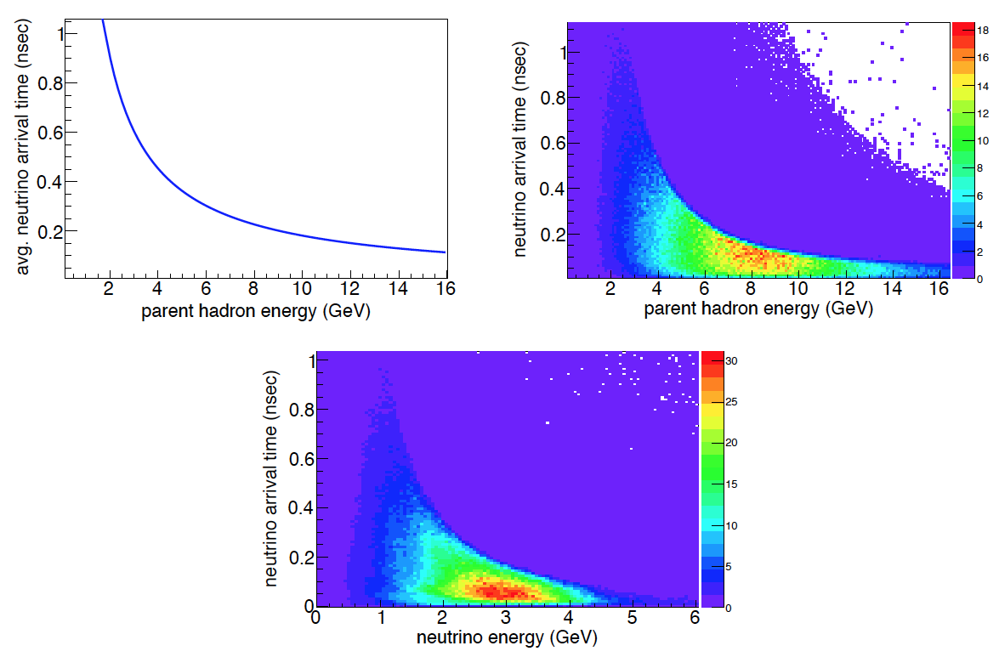
Kinematics of the Neutrino Timing
The arrival time difference between neutrinos from relativistic hadrons and neutrino from hadron of energy E:
16
𝚫t(E) = 𝝉(E)[1-𝜷(E)]
14
12
𝚫t(E) = (𝛄𝝉0)[1-√(1-1/𝜸²)]
10
pion energy (GeV)
8
𝚫t(E) → 𝝉0
as
𝛄 → 1
6
4
𝚫t(E) → 𝝉0/2𝛄
for
𝛄 >> 1
2
0.2
0.6
1.0
relative neutrino arrival time (ns)
Hybrid Cher/Scint Workshop, Penn - June, 20256

Slide 16
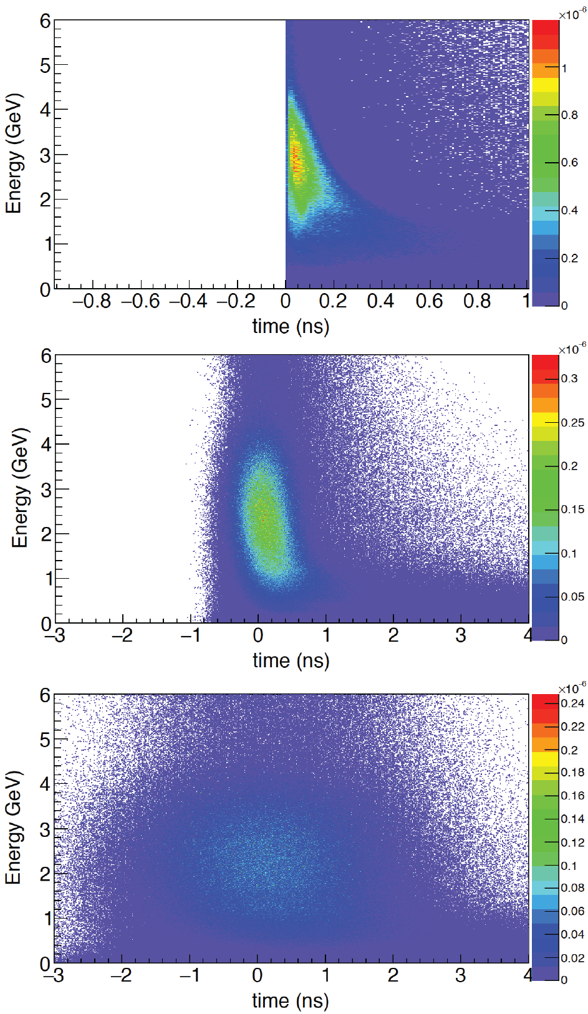
Kinematics of the Neutrino Timing
𝚫t(E) = 𝝉(E)[1-𝜷(E)]
𝚫t(E) = (𝛄𝝉0)[1-√(1-1/𝜸²)]
pion energy (GeV)
𝚫t(E) → 𝝉0
as
𝛄 → 1
𝚫t(E) → 𝝉0/2𝛄
for
𝛄 >> 1
0
0.2
0.6
1.0
relative neutrino arrival time (ns)
Hybrid Cher/Scint Workshop, Penn - June, 20256

Slide 17
Characteristic Timescales/Limiting Factors
Stroboscopic techniques require sufficiently short bunch sizes
If all hadrons are produced at the same time, the different neutrino energies will stratify over roughly ~1 nsec
This effect starts to wash out if the proton beam width or detector resolutions exceed a nsec
The current Fermilab RF structure is not designed to deliver proton bunches much shorter than 1 nsec.
infinitesimal proton bunch
200 psec smearing
1 nsec smearing
Hybrid Cher/Scint Workshop, Penn - June, 20256

Slide 18
Rebunching the Beam
Compressing the existing proton bunches in time in not feasible
However, imposing a higher frequency harmonic on top of the bunch structure would be compatible with FNAL accelerator operation.
The 10x harmonic, going from 53.1 MHz to 531 MHz, has a particularly advantageous relationship between bunch size and spacing
The total number of protons is preserved, just “reorganized”
53.1 MHz → 531 MHz
O(1) ns bucket every 20 ns → O(100) ps bucket every 2 ns
1 ns
20 ns
100 ps
2 ns
Hybrid Cher/Scint Workshop, Penn - June, 20256

Slide 19
PRECISION TIMING IN BEAM DELIVERY
Artwork by Sandbox Studio, Chicago with Ana Kova
Hybrid Cher/Scint Workshop, Penn - June, 20256

Slide 20
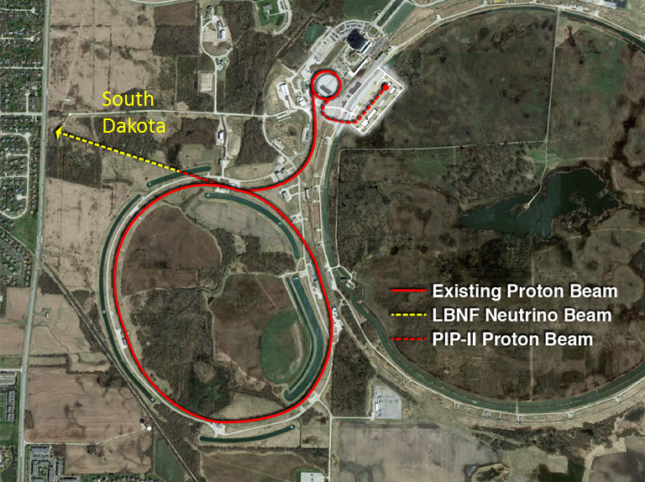
Intro: Delivering Protons on Target
6 + 6 booster cycles
Empty booster cycle (kicker)
The Recycler and Main Injector (MI) rings are 7 times the diameter of the Booster
The Recycler accumulates Booster protons in 6/7 of its circumference (504/588) RF buckets. An 84 bucket gap is left for the Kicker to direct the beam to the target
The Main Injector accelerates the protons from the Recycler from 8 GeV to 120 GeV, after which the Kicker directs them onto the neutrino target
The typical MI cycle time is 1.2 s with a typical spill length of 11 microseconds
Hybrid Cher/Scint Workshop, Penn - June, 20256

Slide 21
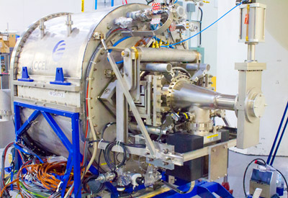
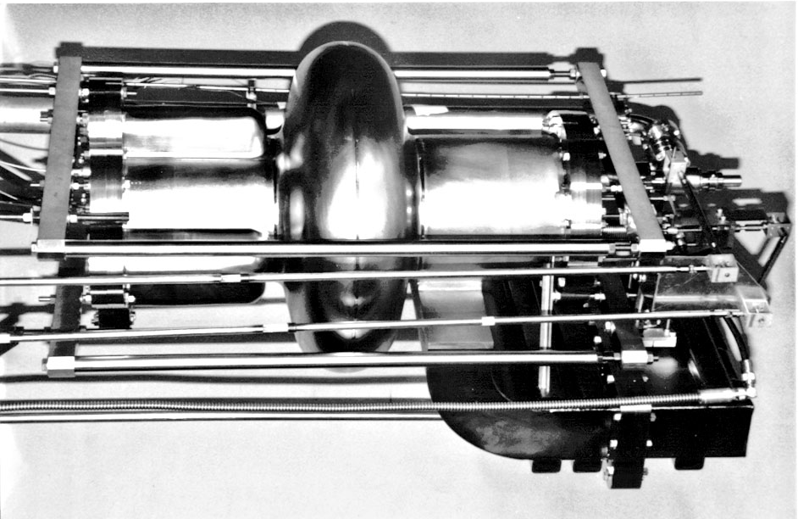
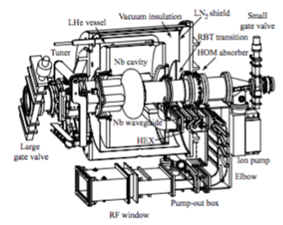
Adding a Superconducting RF Cavity
Rebunching could be achieved with the addition of just 1 or 2 superconducting RF (SRF) cavities
There is a commercially available SRF cavity that closely matches our needed expectations: The Cornell B Cavity:
  500 MHz (versus 531 MHz)
  Well tested in the field
  Large aperture
Feasible to implement, would be first MI cryomodule
Cornell B Cell Cavity
Hybrid Cher/Scint Workshop, Penn - June, 20256

Slide 22
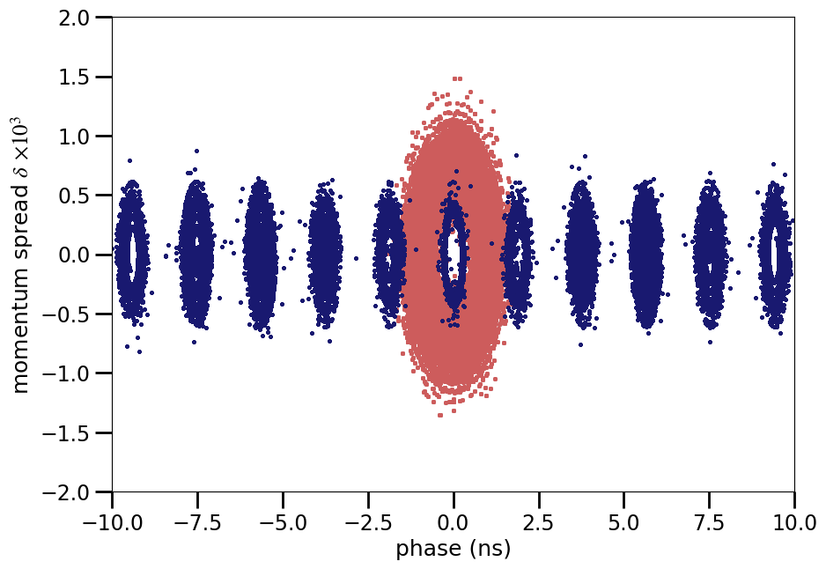
RF Simulation
A realistic, multi-particle simulation was performed to study the following properties of the rebunching procedure:
  ramp-down/ramp-up functions for rebunching at a higher frequency
  the final time structure/RMS time widths of the 531 MHz bunches
The resulting rebunched structure is promising
Typical 531 MHz bunches have an RMS of around 200 ps
These bunches have sharp edges and substructure, which could be measured by RF monitors and exploited for better extracting time information
Evan Angelico, Sergei Nagaitsev
Hybrid Cher/Scint Workshop, Penn - June, 20256

Slide 23
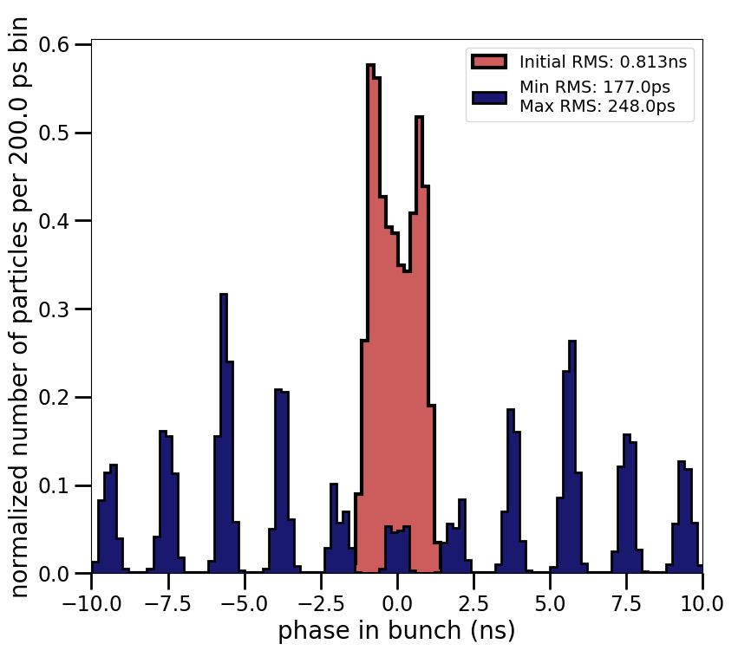
RF Simulation
A realistic, multi-particle simulation was performed to study the following properties of the rebunching procedure:
  ramp-down/ramp-up functions for rebunching at a higher frequency
  the final time structure/RMS time widths of the 531 MHz bunches
The resulting rebunched structure is promising
Typical 531 MHz bunches have an RMS of around 200 ps
These bunches have sharp edges and substructure, which could be measured by RF monitors and exploited for better extracting time information
Evan Angelico, Sergei Nagaitsev
Hybrid Cher/Scint Workshop, Penn - June, 20256

Slide 24
Time slicing in a more realistic scenario
Even with
a realistic simulation of the 531 MHz rebunched time structure
an additional 100 ps Gausian to account for detector affects
the effects of pileup between the bunches
it is still possible to select isolated, lower energy flux bins
Inifinitesimal proton bunches
"realistic scenario"
Hybrid Cher/Scint Workshop, Penn - June, 20256

Slide 25

Putting Together a Physics Program
Hybrid Cher/Scint Workshop, Penn - June, 20256

Slide 26
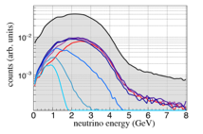
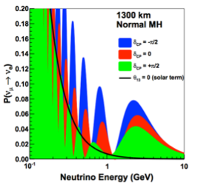
The second maximum
Time slicing in the far detector is particularly advantageous as it can
select a more pure sample of neutrinos from the second maximum
suppress “feed down” from higher energy backgrounds
  Resonant pion production
  Deep Inelastic Scattering
Suppress downward migration of reconstructed energy from higher energy interactions
Being able to fit both maxima would place strong constraints on oscillation parameters
Hybrid Cher/Scint Workshop, Penn - June, 20256

Slide 27
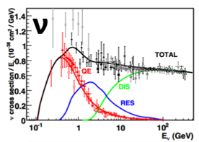
The second maximum
Time slicing in the far detector is particularly advantageous as it can
select a more pure sample of neutrinos from the second maximum
suppress “feed down” from higher energy backgrounds
  Resonant pion production
  Deep Inelastic Scattering
Suppress downward migration of reconstructed energy from higher energy interactions
Being able to fit both maxima would place strong constraints on oscillation parameters
Hybrid Cher/Scint Workshop, Penn - June, 20256

Slide 28
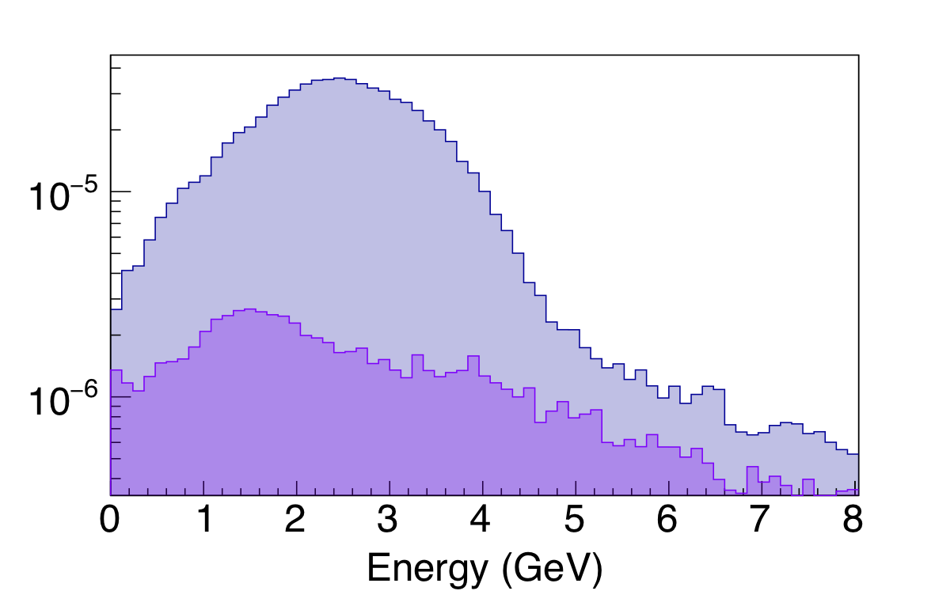
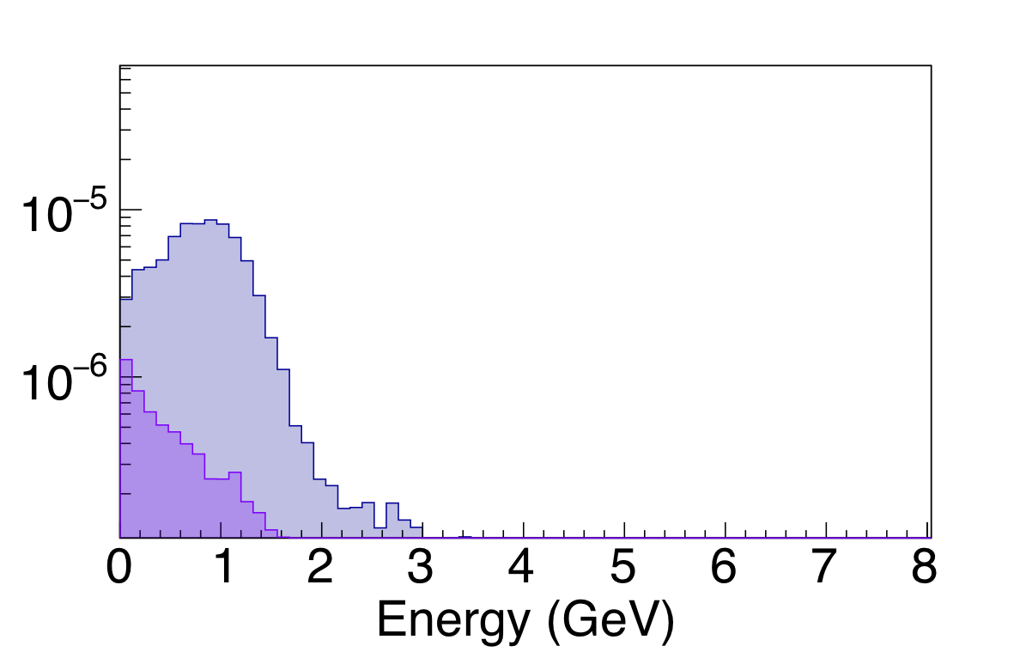
Separating different components of the beam
The relative normalization and shape of the different components of the neutrino flux (wrong-sign, intrinsic 𝜈_{e} , K/π) evolve differently and in deterministic ways with respect to the timing cuts
Fitting in multiple time slices greatly constrains the fit to the overall flux
time slice from -0.3 to –0.1 ns
time slice from 0.9 to 1.1 ns
Overall LBNF ND (RHC) flux
Overall LBNF ND (RHC) flux
Wrong-sign flux
Wrong-sign flux
Hybrid Cher/Scint Workshop, Penn - June, 20256

Slide 29
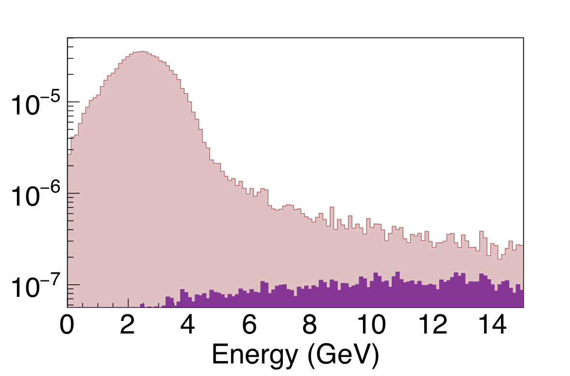
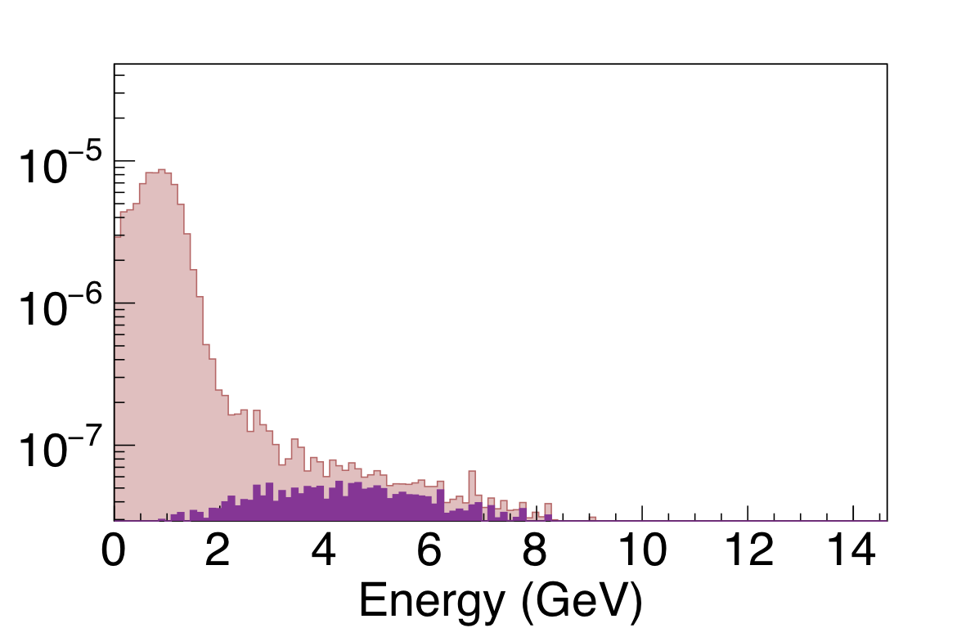
Separating different components of the beam
The relative normalization and shape of the different components of the neutrino flux (wrong-sign, intrinsic 𝜈_{e} , K/π) evolve differently and in deterministic ways with respect to the timing cuts
Fitting in multiple time slices greatly constrains the fit to the overall flux
time slice from -0.3 to –0.1 ns
time slice from 0.9 to 1.1 ns
overall LBNF ND (RHC) flux
overall LBNF ND (RHC) flux
Kaon daughters
Kaon daughters
Hybrid Cher/Scint Workshop, Penn - June, 20256

Slide 30
Separating different components of the beam
The relative normalization and shape of the different components of the neutrino flux (wrong-sign, intrinsic 𝜈_{e} , K/π) evolve differently and in deterministic ways with respect to the timing cuts
Fitting in multiple time slices greatly constrains the fit to the overall flux
time slice from -0.3 to –0.1 ns
time slice from 0.9 to 1.1 ns
overall LBNF ND (RHC) flux
overall LBNF ND (RHC) flux
Kaon daughters
Kaon daughters
Imagine having to fit the flux model to a 2-d grid of spectra binned in off-axis angle and time slice!
Hybrid Cher/Scint Workshop, Penn - June, 20256

Slide 31
…Also Dark Sector Searches/N-body decays?
Hybrid Cher/Scint Workshop, Penn - June, 20256

Slide 32
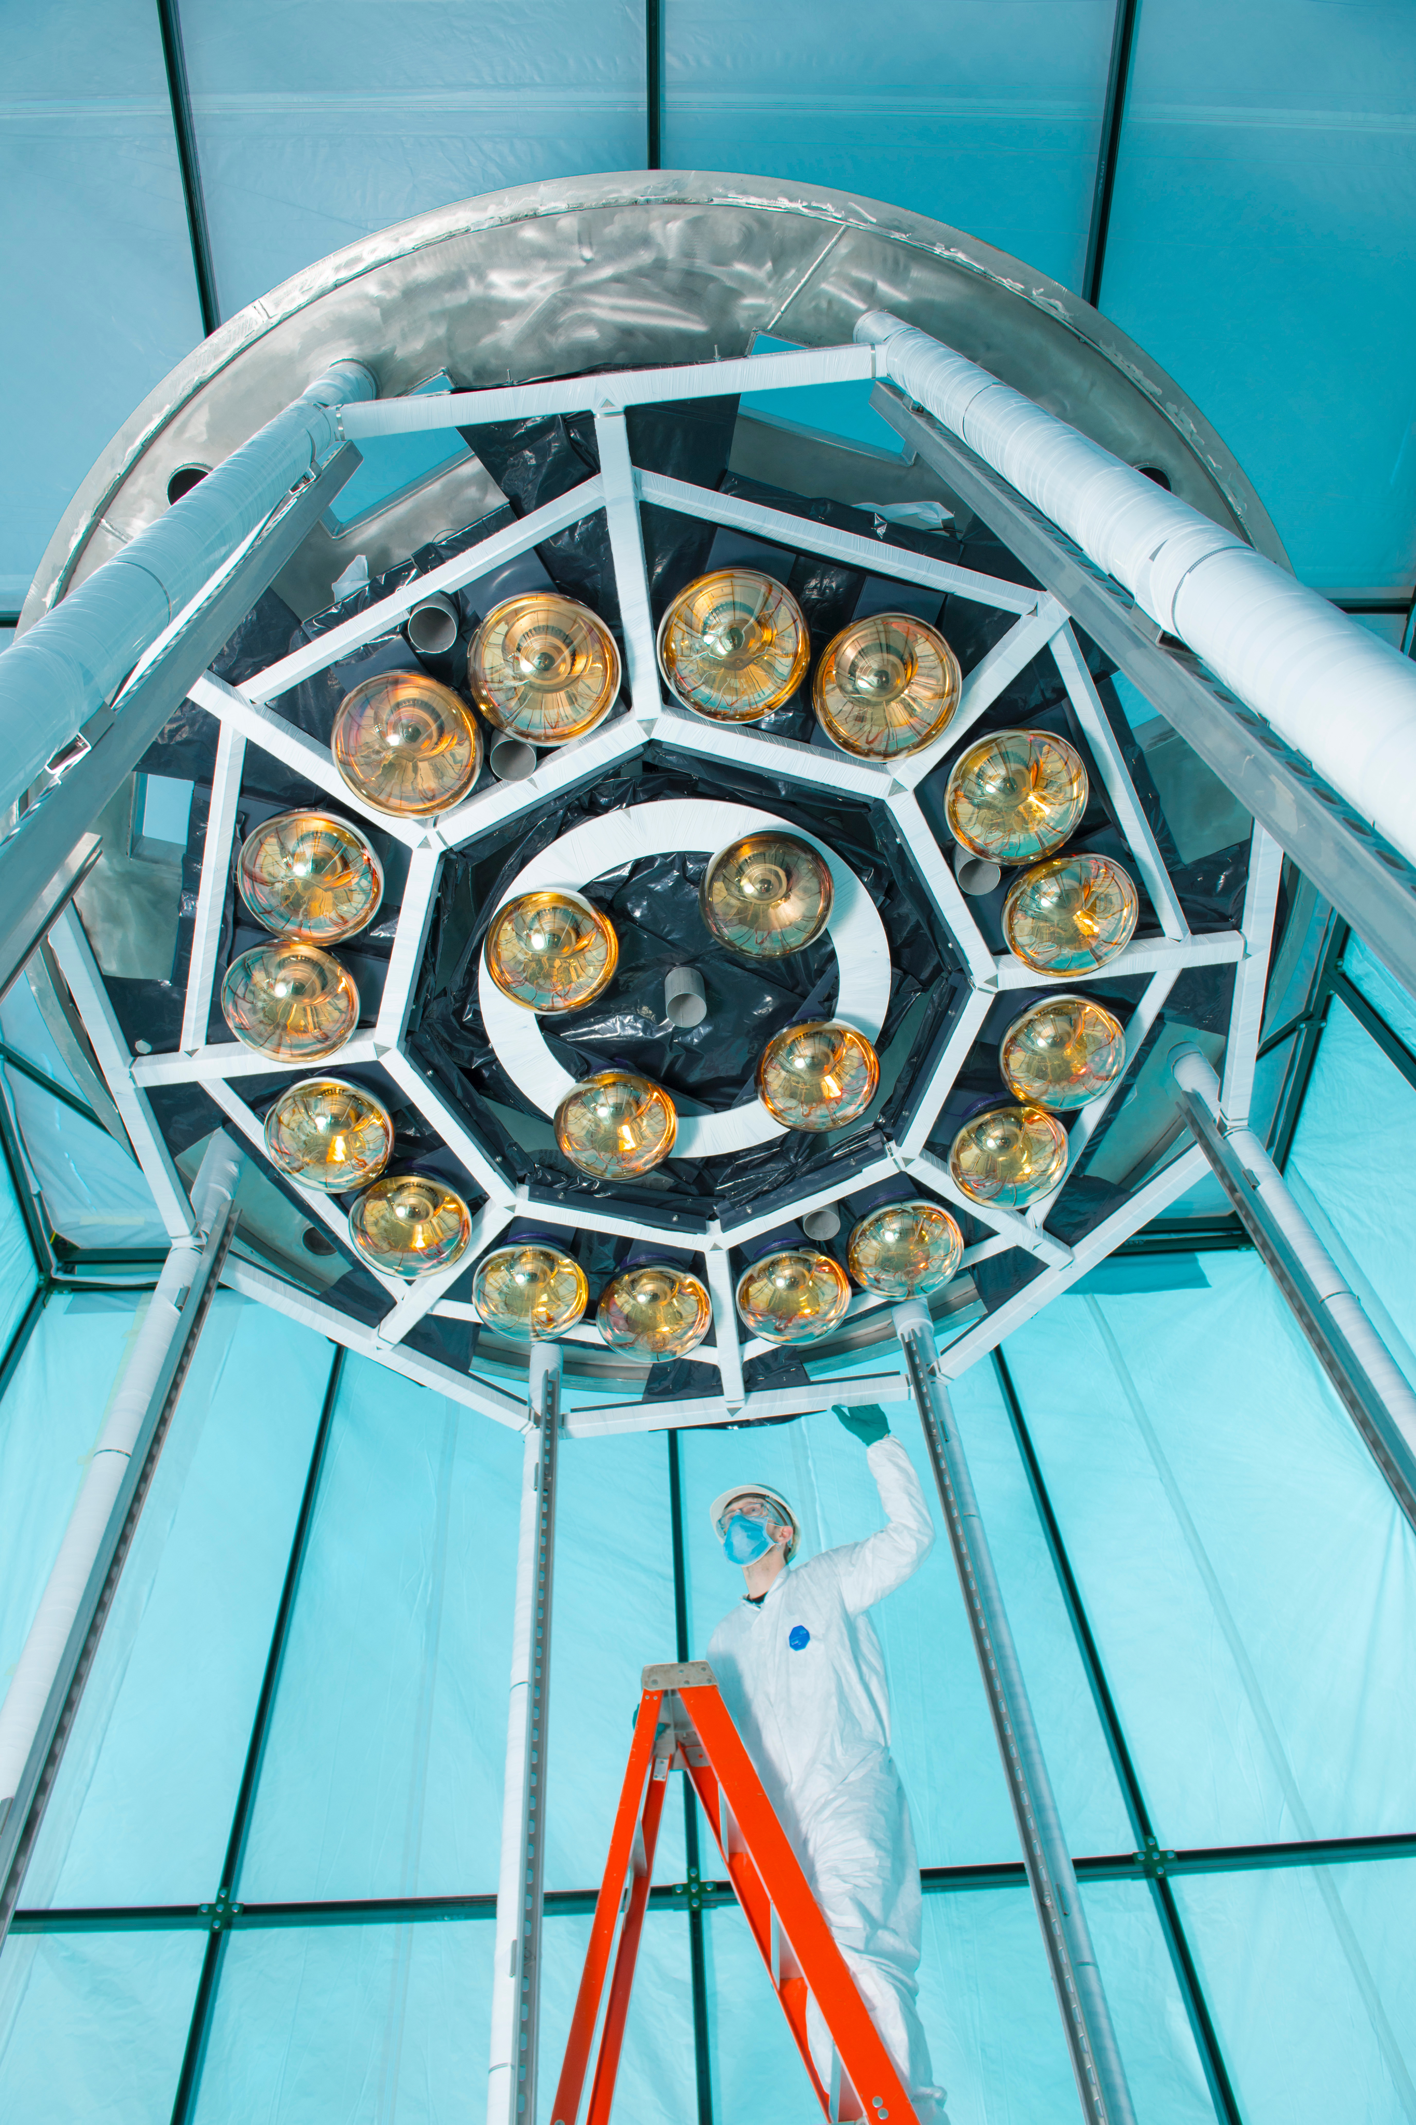
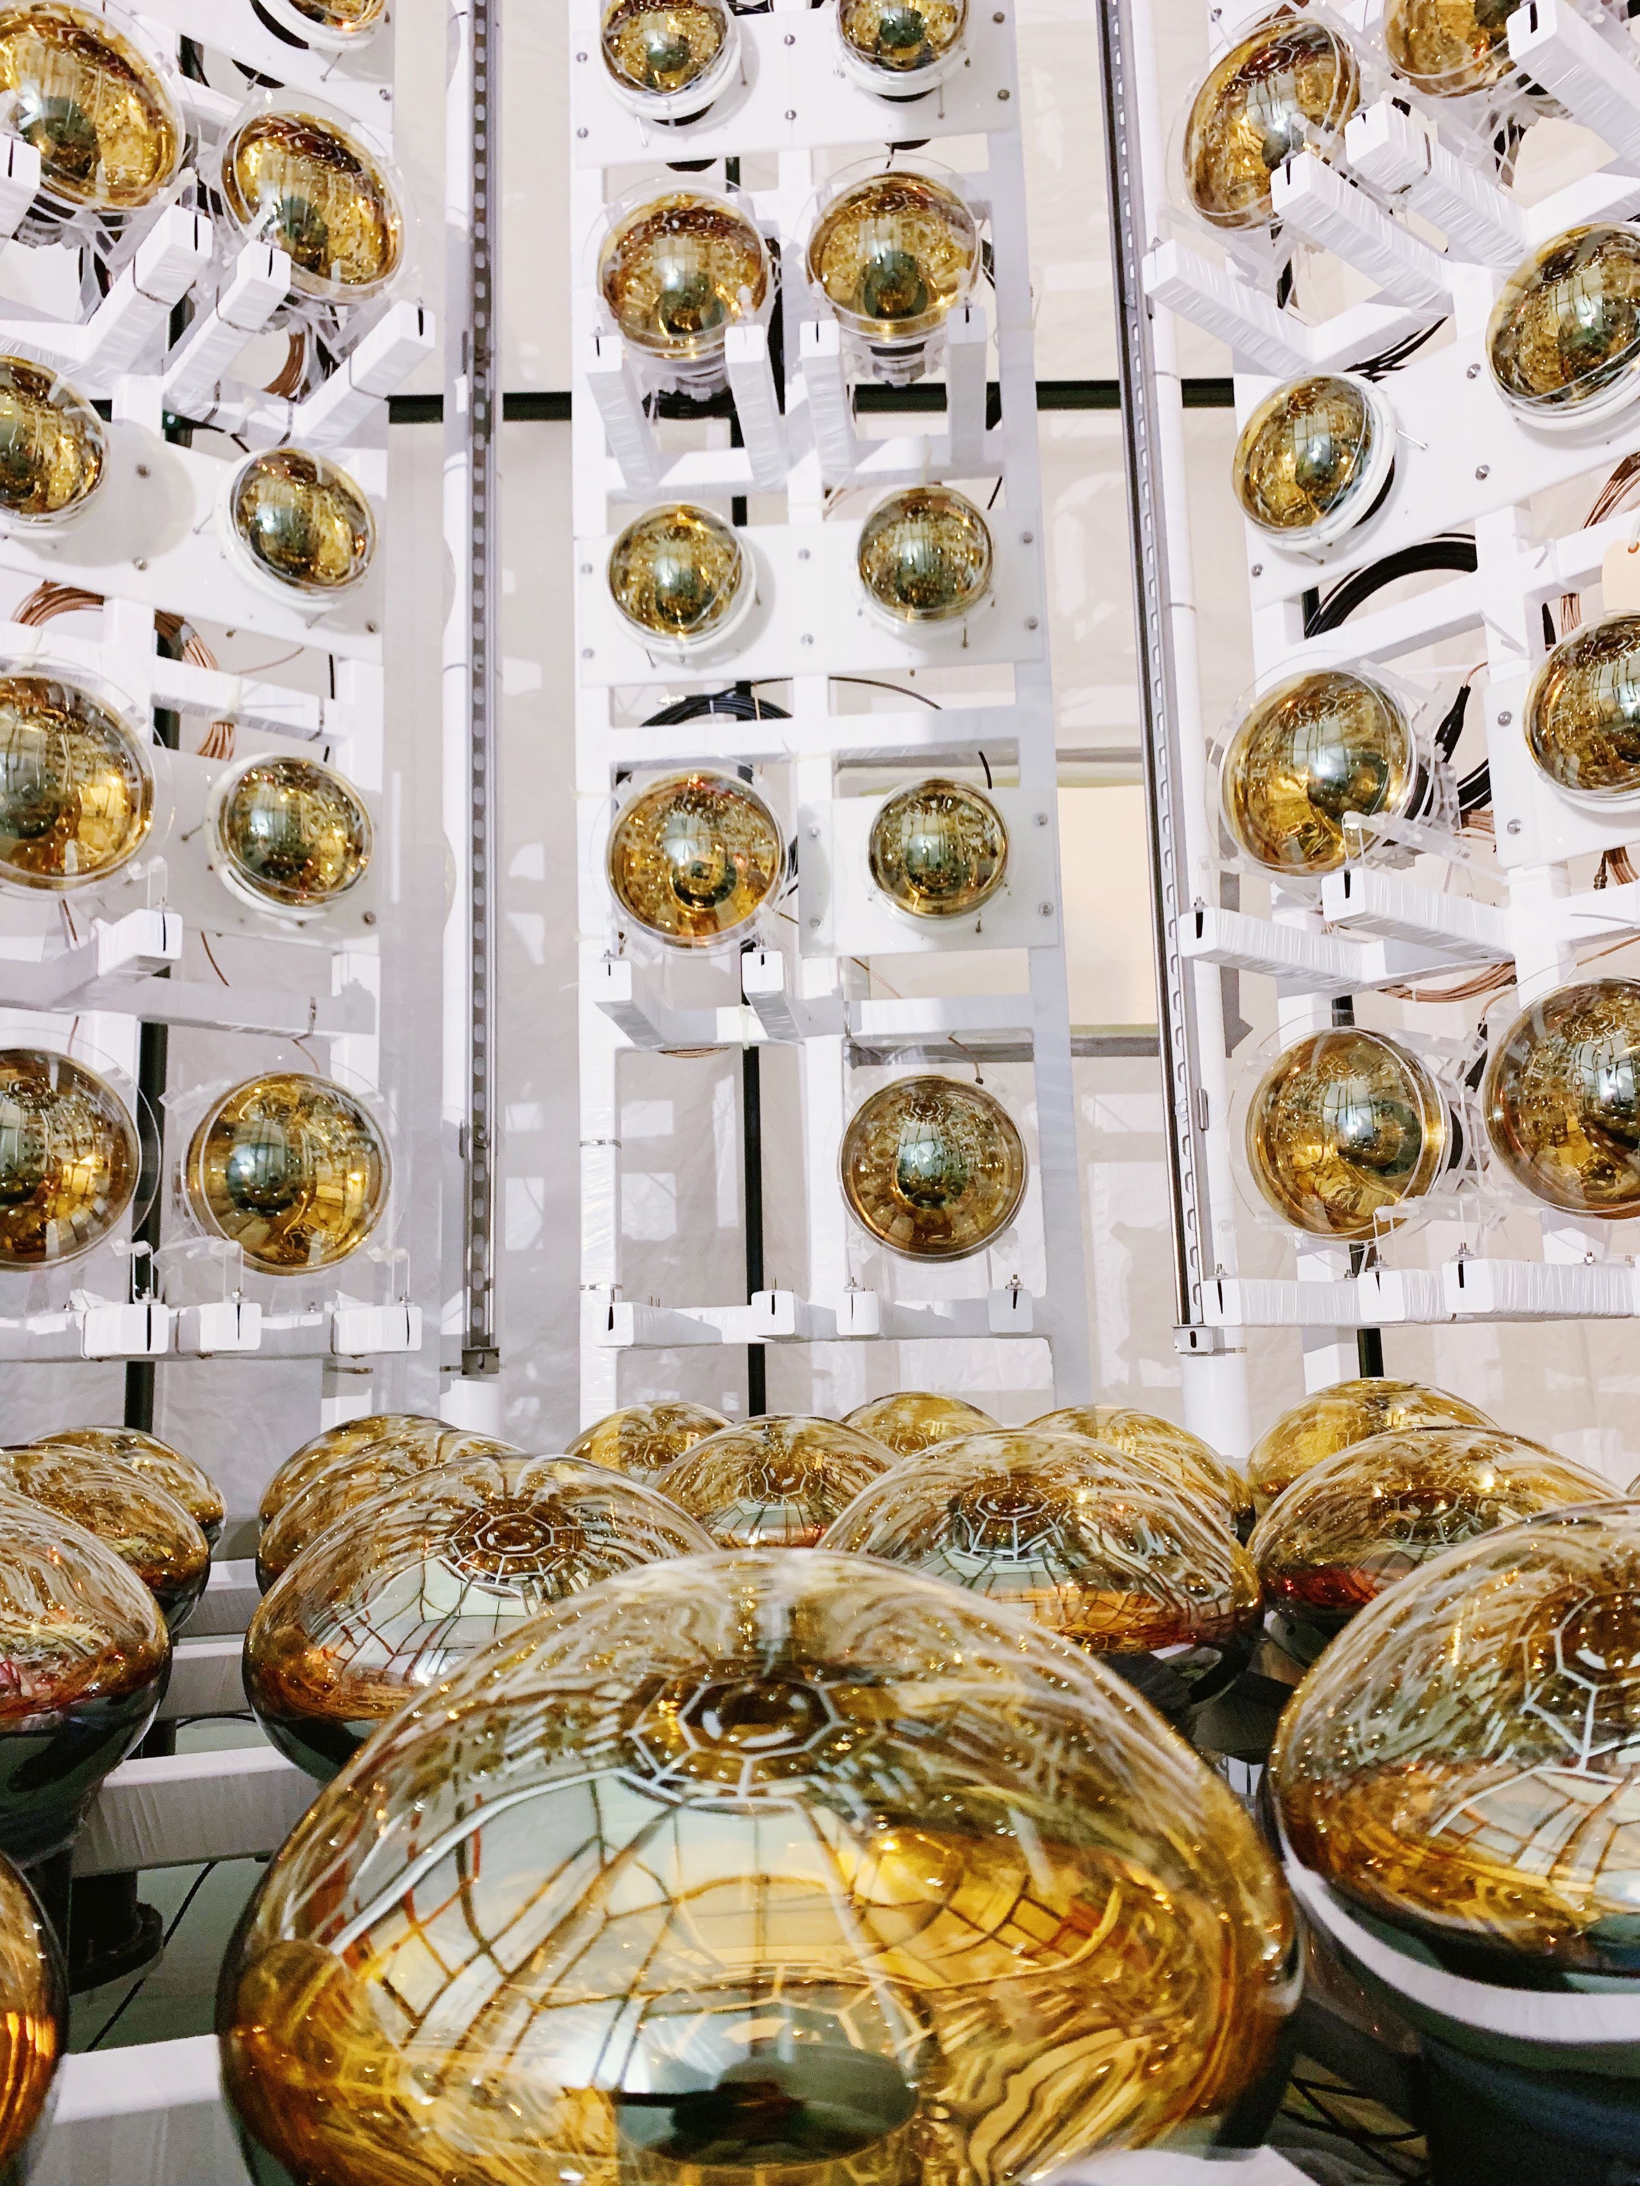
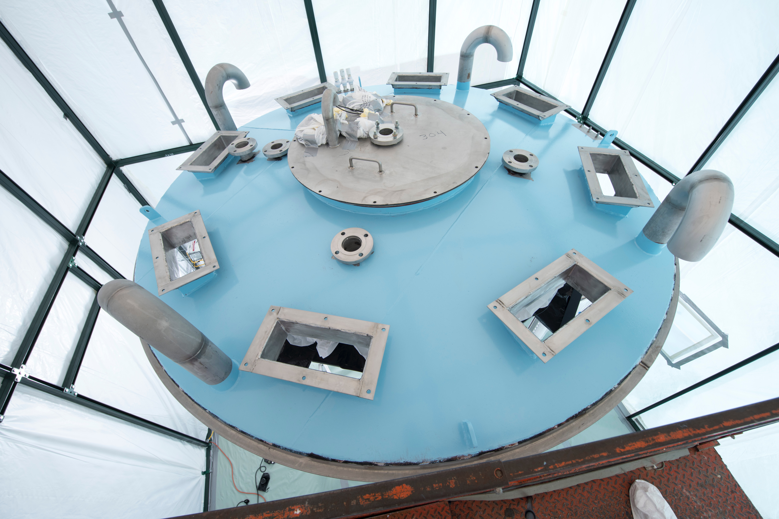
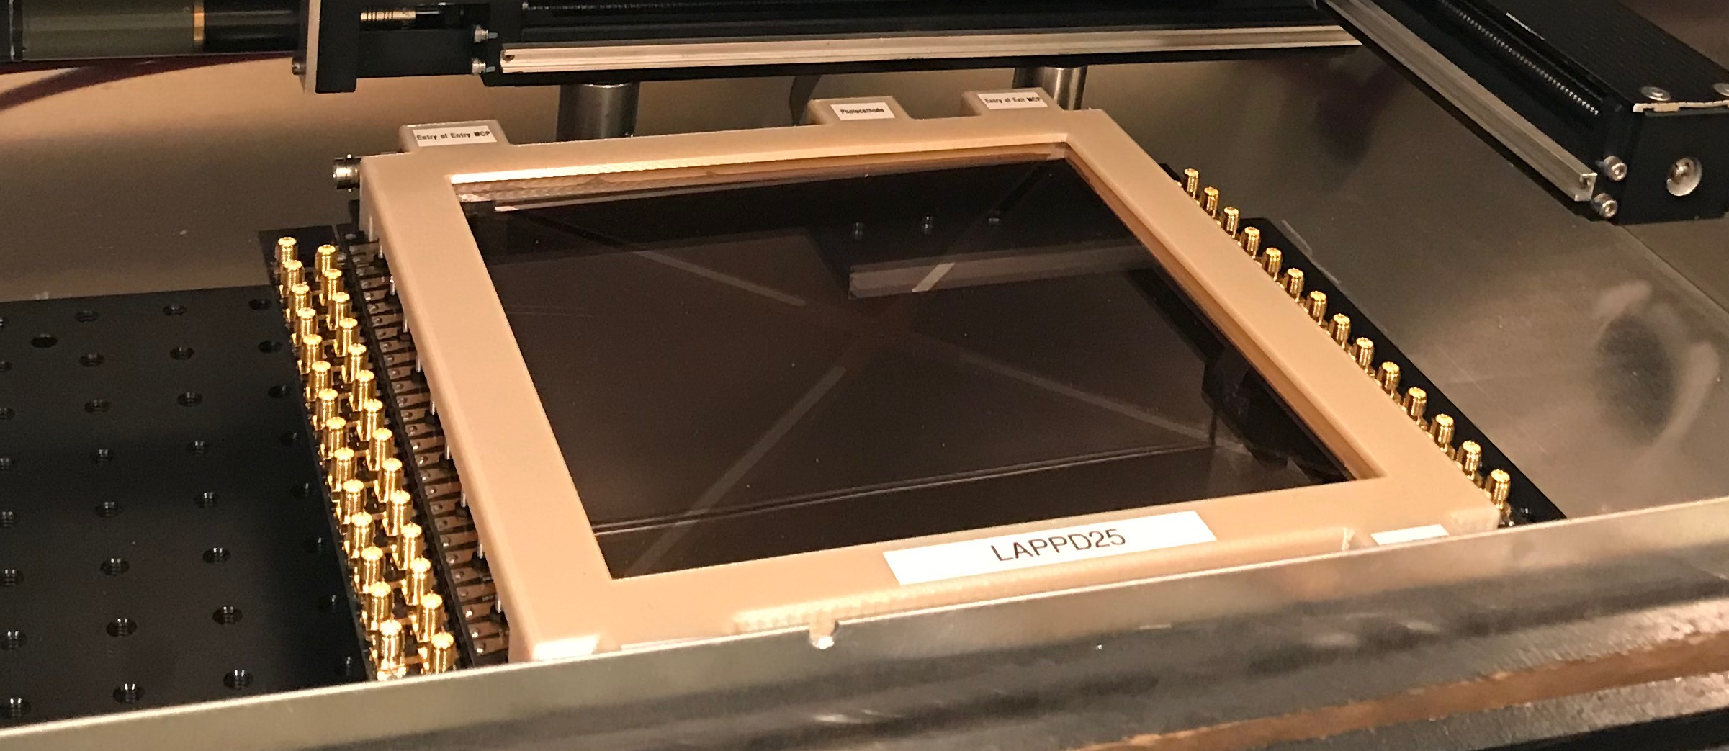
Towards a Measurement in ANNIE
Hybrid Cher/Scint Workshop, Penn - June, 20256

Slide 33
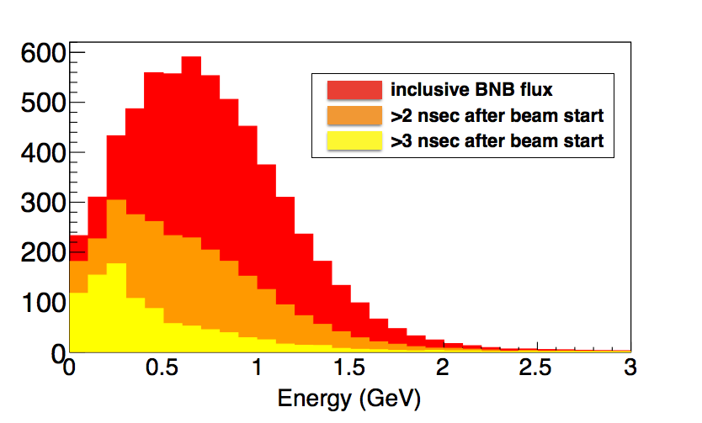
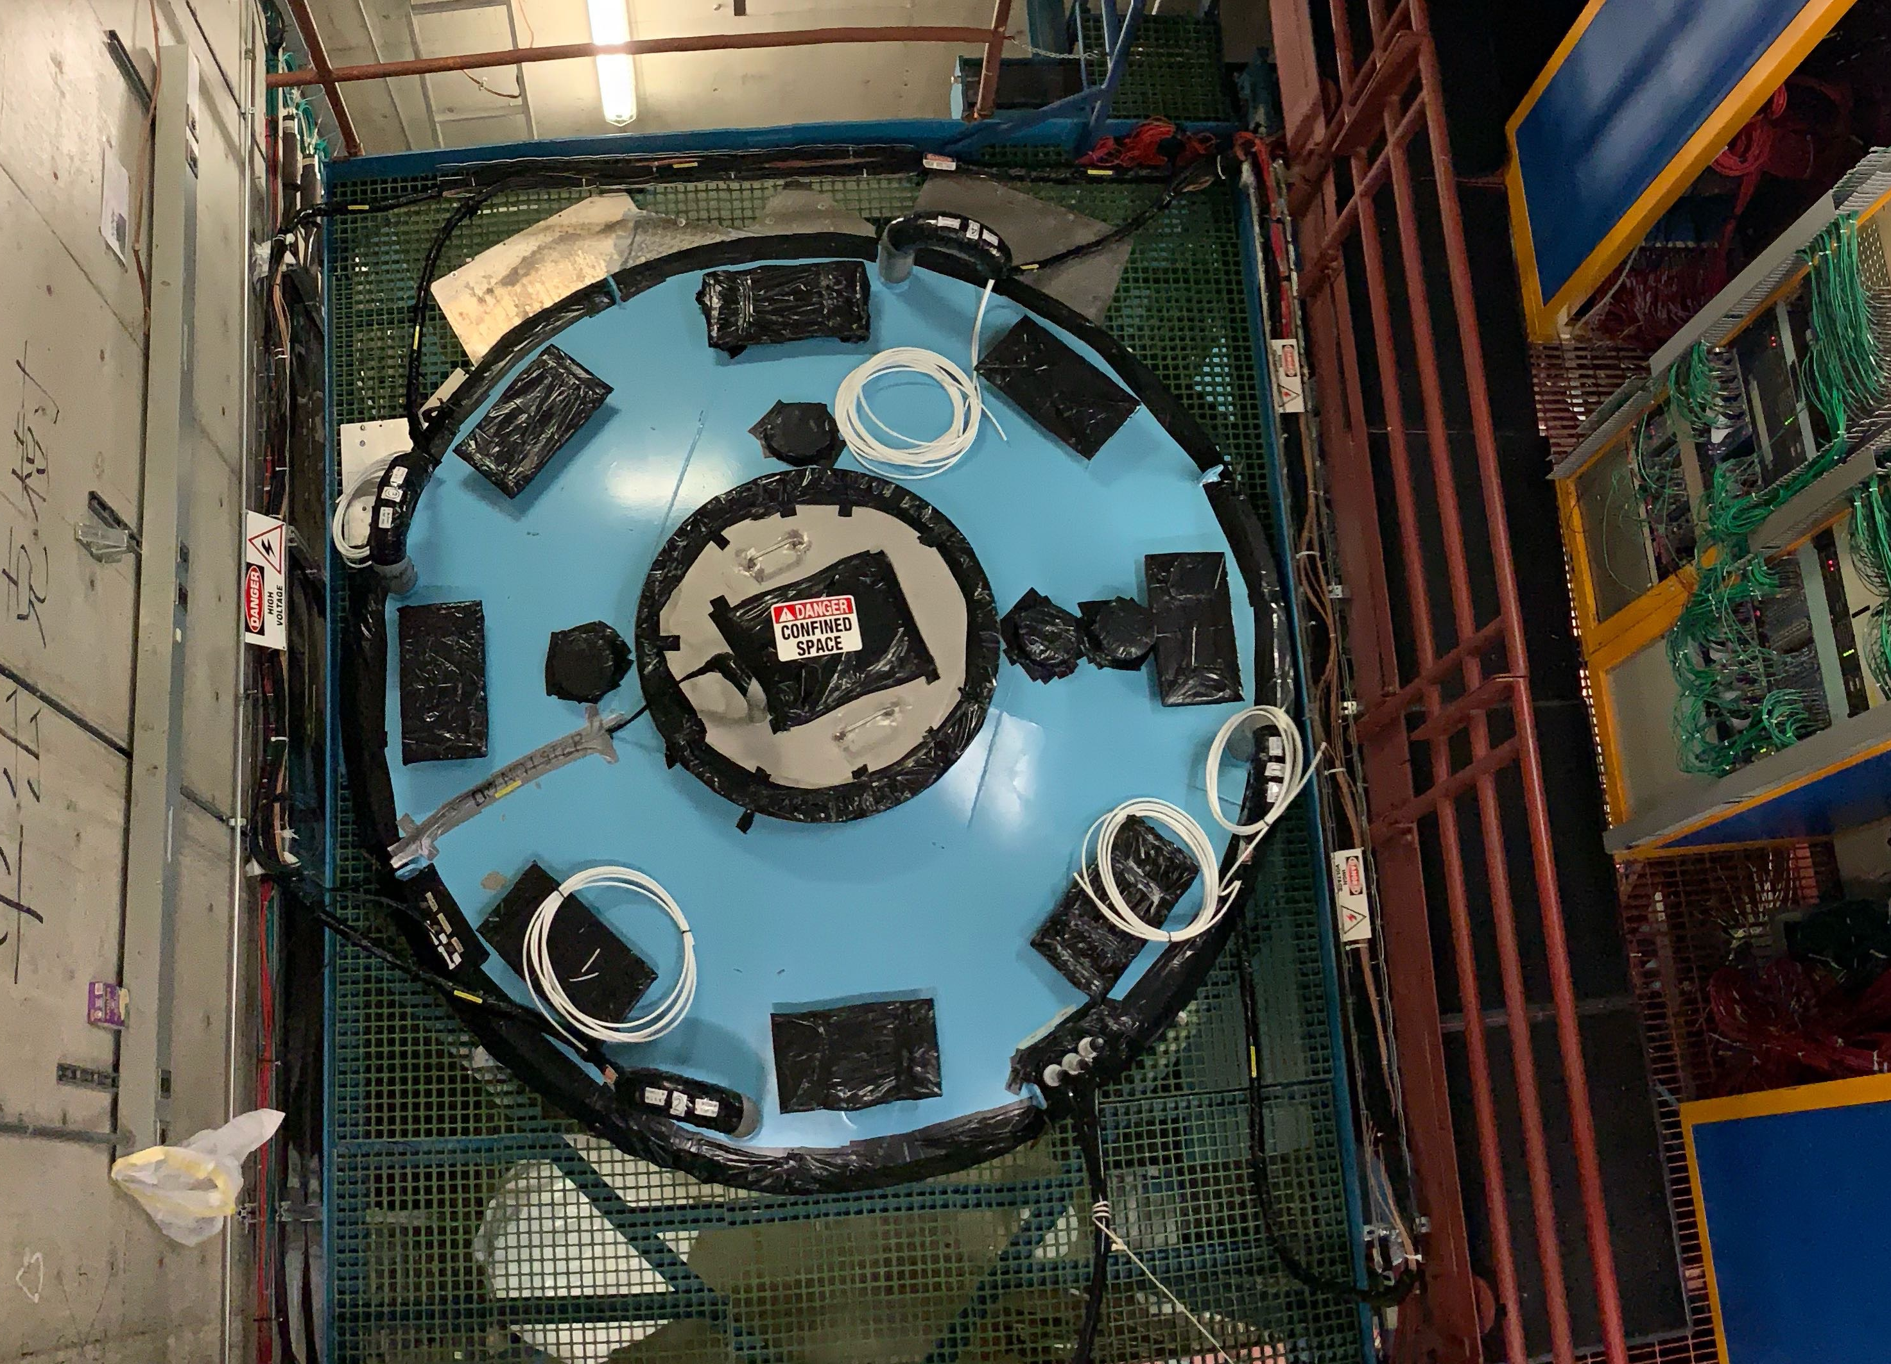
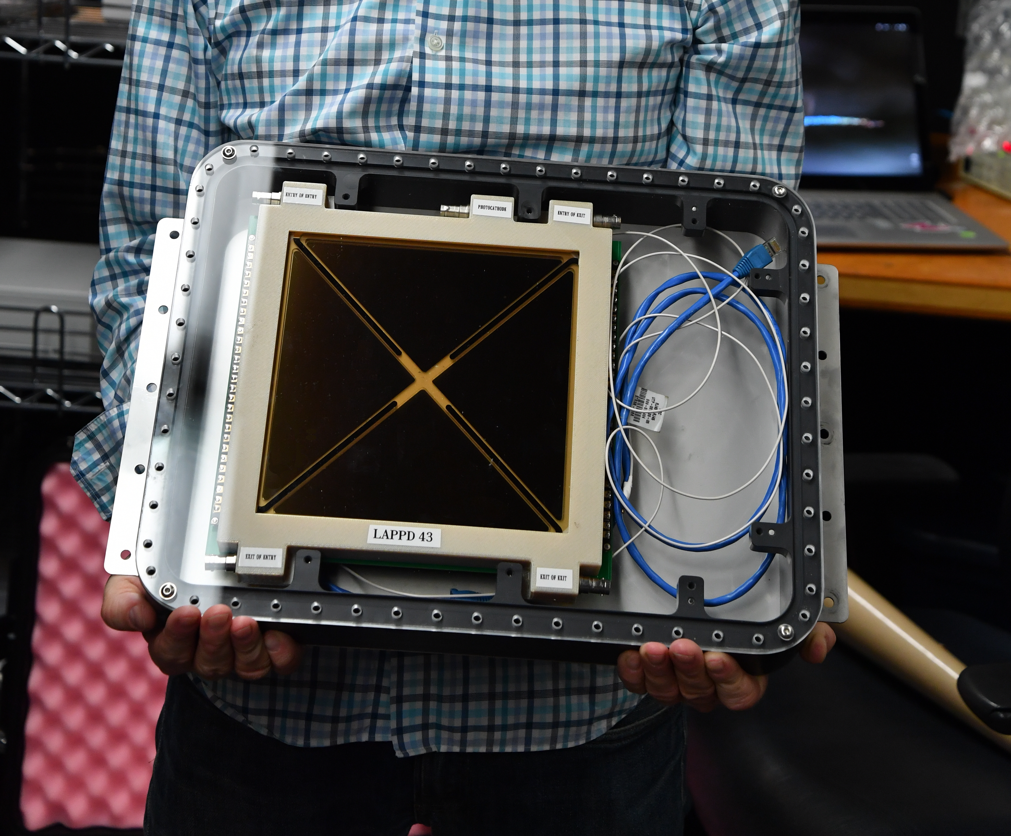
The Opportunity
ANNIE can provide a first demonstration of this technique on neutrinos from the BNB
The ANNIE detector has the needed time resolution
Because the energy of the BNB spectrum skews towards the low end, there is a broader tail of low-energy neutrinos
Thus. detecting the time-slicing effect should be possible, even with 1 ns bunches
Hybrid Cher/Scint Workshop, Penn - June, 20256

Slide 34
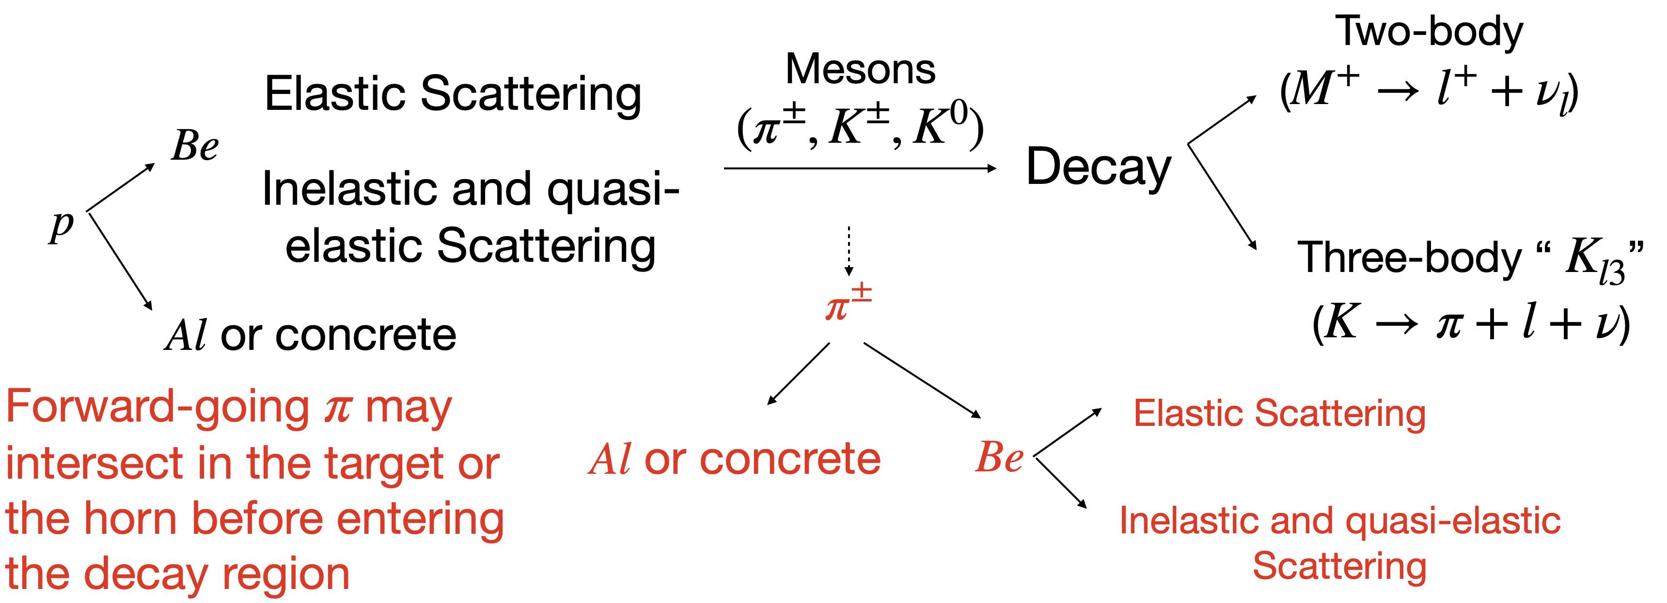
Credit: Dr. Marvin Ascensio Sosa (ISU)
Reproducing Earlier Studies
Simulation made with G4BNB developed for SBND.
The G4BNB is based on the MiniBoone flux simulation.
MC flow:
Hybrid Cher/Scint Workshop, Penn - June, 20256

Slide 35
Credit: Dr. Marvin Ascensio Sosa (ISU)
Reproducing Earlier Studies
Simulation made with G4BNB developed for SBND.
The G4BNB is based on the MiniBoone flux simulation.
MC flow:
Possible Opportunity:
Dark Sector/New Physics Searches?
Hybrid Cher/Scint Workshop, Penn - June, 20256

Slide 36
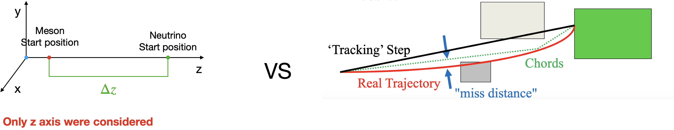
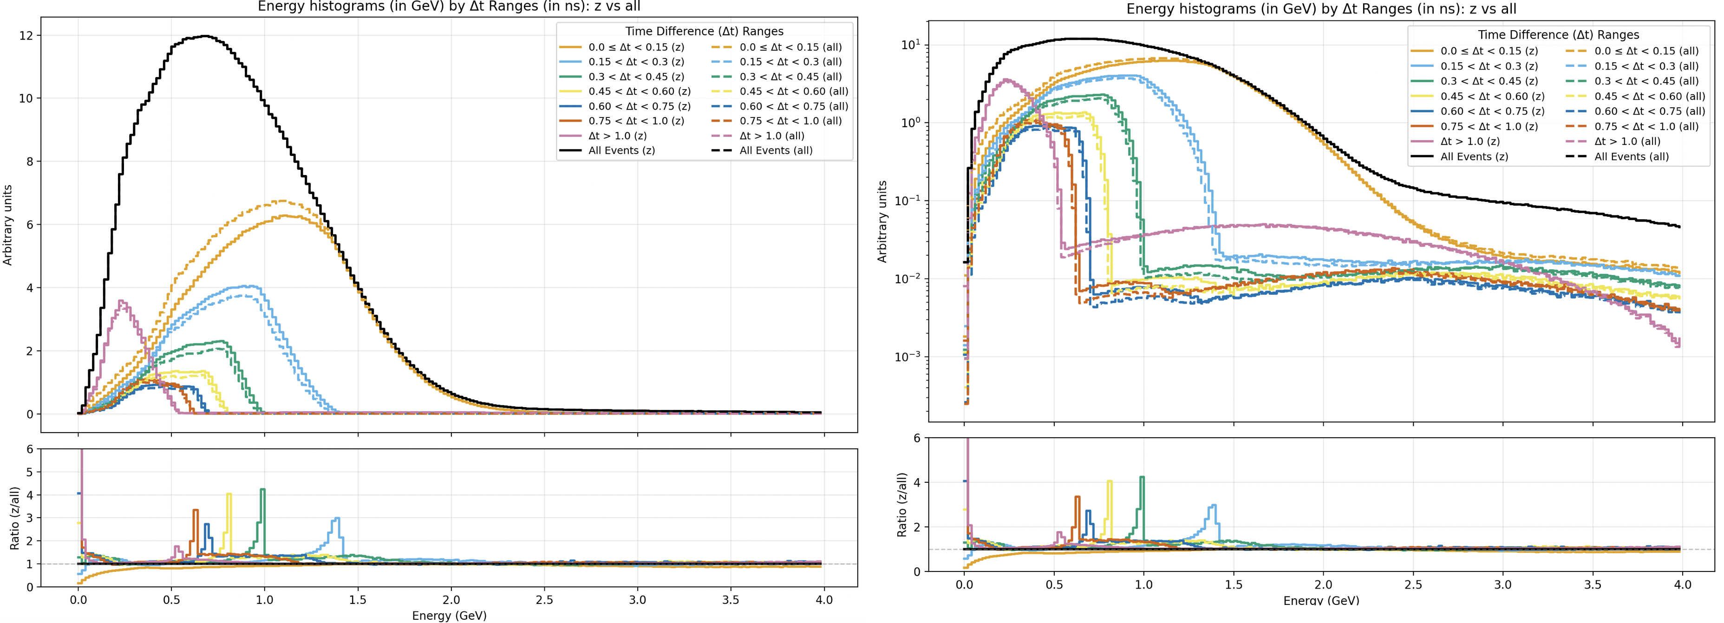
Credit: Dr. Marvin Ascensio Sosa (ISU)
Reproducing Earlier Studies
Preliminary
G4BNB/ANNIE
Preliminary
G4BNB/ANNIE
Dashed histogram with curved trajectory.
Hybrid Cher/Scint Workshop, Penn - June, 20256

Slide 37
Direct Measurement
ANNIE can already resolve the sub-structure of the beam with conventional PMTs
The LAPPD group has reproduced a first-pass version with LAPPDs
Work is underway to improve use of reference Beam-RF signal to better sync ANNIE to the bunch-by-bunch accelerator timing
Getting T0 right also requires track reconstruction for proper TOF-corrections…this is also underway!
Hybrid Cher/Scint Workshop, Penn - June, 20256

Slide 38
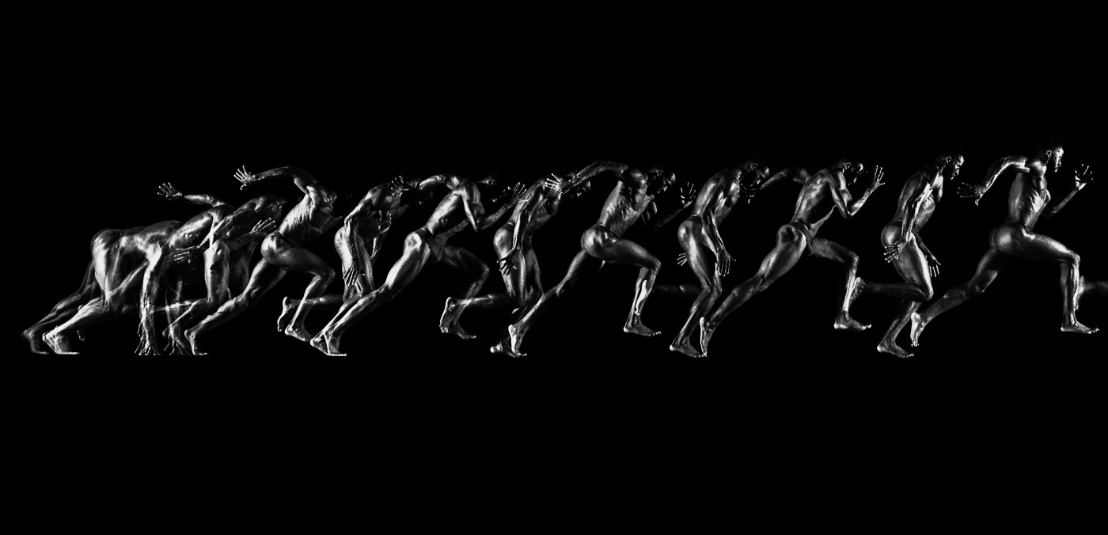
6. Conclusions
Hybrid Cher/Scint Workshop, Penn - June, 20256

Slide 39
Conclusions
Precision timing could be used to select different beam fluxes based on neutrino arrival time, due to the correlation between the energy of the beam neutrinos and the velocities of the parent hadrons.
The ability to select different fluxes is a powerful capability for constraining complicated and correlated systematic uncertainties on flux, cross sections, and neutrino energy. This is important for guarding against unknown unknowns and in searching for new physics
This technique has some interesting and complementary aspects to off-axis techniques, like those of DUNE Prism and would thus strengthen the DUNE program
The rebunching technology in delivering beam is potentially compatible with exsiting accelerator plans for DUNE
Timing in the Near Detector may be achievable within the framework of the current design.
Timing in the DUNE far detectors is not likely for the current 1st and 2nd modules but could be incorporated in later installations
New technological capabilities often bring new physics reach in areas that weren't originally planned. Continued thinking about precision timing is worthwhile
This idea is new and there is much work ahead to establish it's feasibility and cost-benefit.
We welcome feedback from the community in establing the feasibility and cost-benefits of this technique and look forward to the discussions!
Hybrid Cher/Scint Workshop, Penn - June, 20256

Slide 40
Workshop on Precision Time Structure in On-Axis Neutrino Beams
Fermilab
November 2-3 2019
https://indico.fnal.gov/event/21409/
PHYS REV D 100, 032008 (2019)
https://arxiv.org/abs/1904.01611
Hybrid Cher/Scint Workshop, Penn - June, 20256

Slide 41
Thank you!
Hybrid Cher/Scint Workshop, Penn - June, 20256

Slide 42
Backups
Hybrid Cher/Scint Workshop, Penn - June, 20256

Slide 43
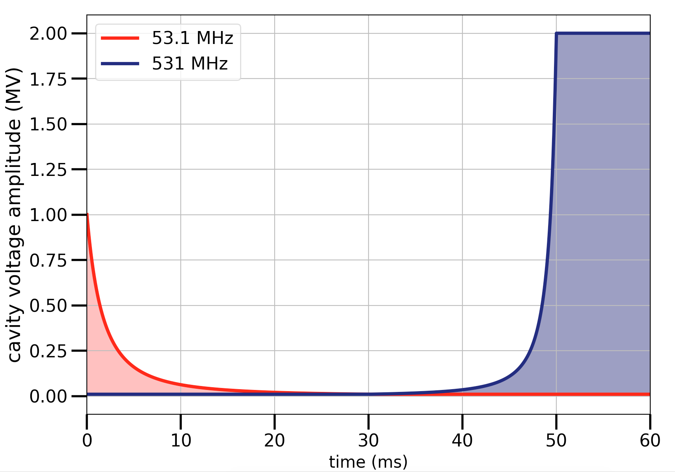
Execution of the Rebunching
The 10x rebunching (531 MHz) would happen in the MI, after the acceleration phase
This has the advantage that the rebunching is applied at a fixed energy and will only require 1-2 RF cavities
The process of rebunching consists of adiabatically ramping down the existing 53 MHz cavity and ramping up of a single 531 MHz SRF cavity
The proposed rebunching process aims to add no more than 60 ms on to the present MI cycle. We estimate a loss of no more than 5% POT due to this increase in cycle time​
There may be clever ways to recoup duty-cycle losses
Hybrid Cher/Scint Workshop, Penn - June, 20256

Slide 44
Timing and Far Detection: LAr-TPCs
Detection of Cherenkov light emission in liquid argon - Antonello, M. et al. Nucl. Instrum. Meth. A516 (2004) 348-363 Index of refraction, Rayleigh scattering length, and Sellmeier coefficients in solid and liquid argon and xenon - Grace, Emily et al. Nucl. Instrum. Meth. A867 (2017) 204-208 arXiv:1502.04213 [physics.ins-det] Refractive Indices of the Condensed Inert Gases - Sinnock, A.C. et al. Phys.Rev. 181 (1969) 1297-1307 Seidel, G.. Rayleigh scattering in rare-gas liquids - 2002. Nucl. Instrum. Methods Phys. Res., Sect.,A489,189 Bideau-Mehu, A.. Measurement of refractive indices of neon, argon, krypton and xenon in the 253.7 140.4 nm wavelength range. dispersion relations and estimated oscillator strengths of the resonance lines - 1981. J. Quant. Spectrosc. Radiat. Trans.,25,395
JETP Seminar, Fermilab - November 1, 2019

Slide 45
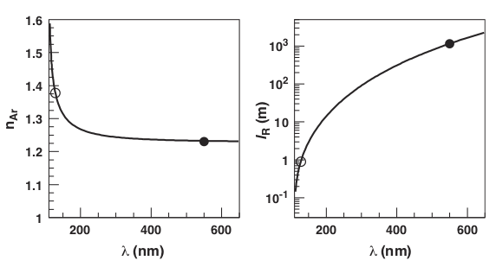
Timing and Far Detection: LAr-TPCs
The optical properties of Liquid Argon detectors are very similar to those of water
Cherenkov light in combination with the reconstructed track from electron drift could provide an excellent handle for establishing T0 of the vertex
One option for photodetection - mirror the top, bottom, sides, and place photodetectors on the end caps
JETP Seminar, Fermilab - November 1, 2019

Slide 46
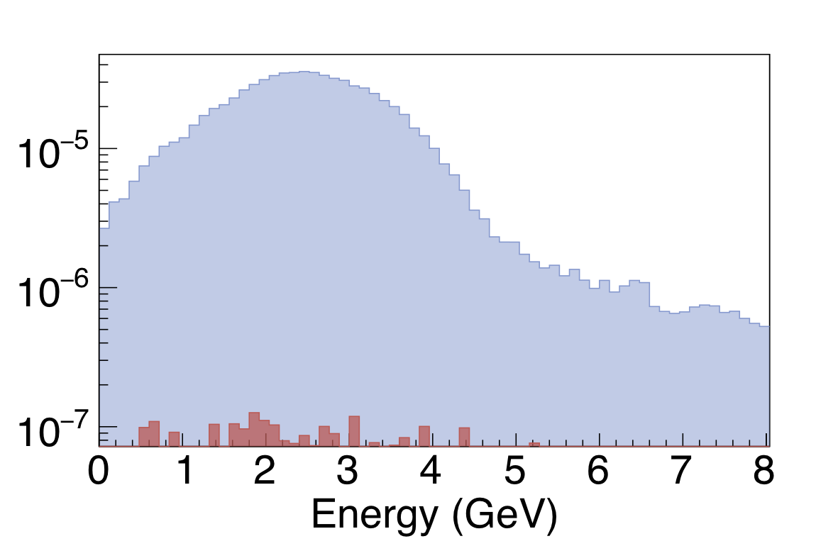
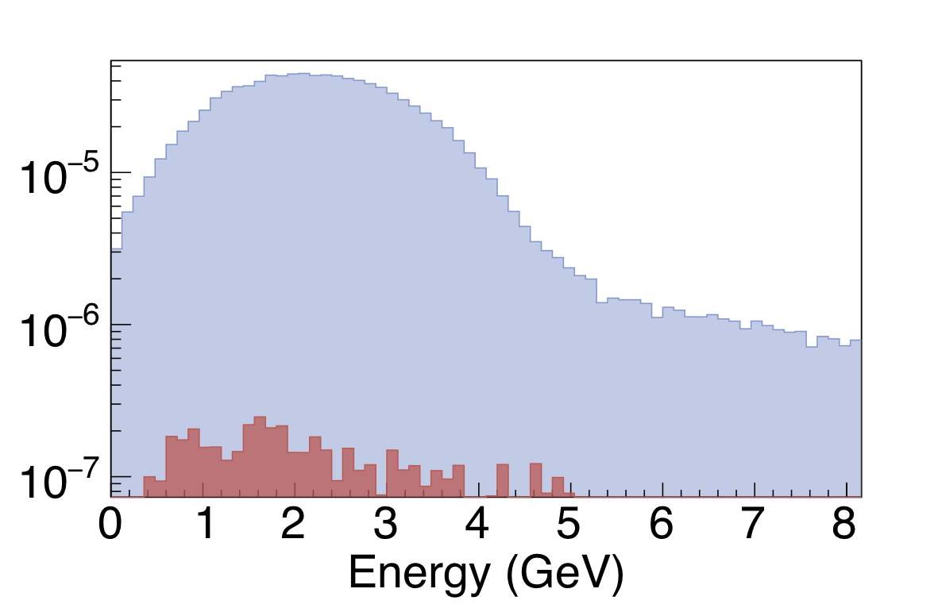
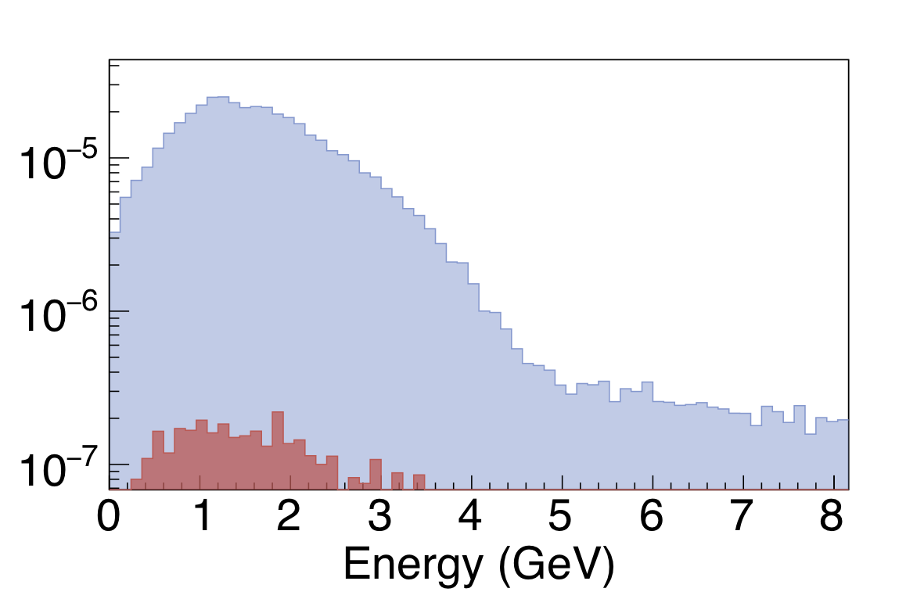
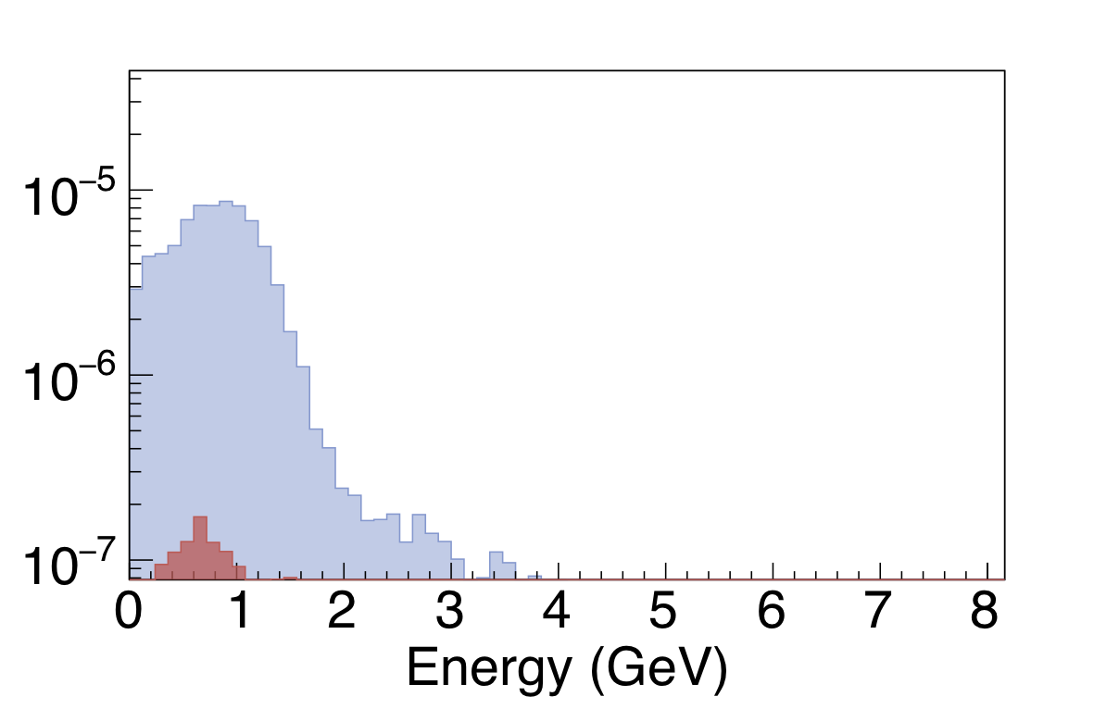
Intrinsic Nuebar Contamination (RHC)
Slice 0: -0.3 to –0.1 ns
Slice 2: 0.1 to 0.3 ns
Slice 4: 0.5 to 0.7 ns
Slice 6: 0.9 to 1.1 ns
JETP Seminar, Fermilab - November 1, 2019

Slide 47
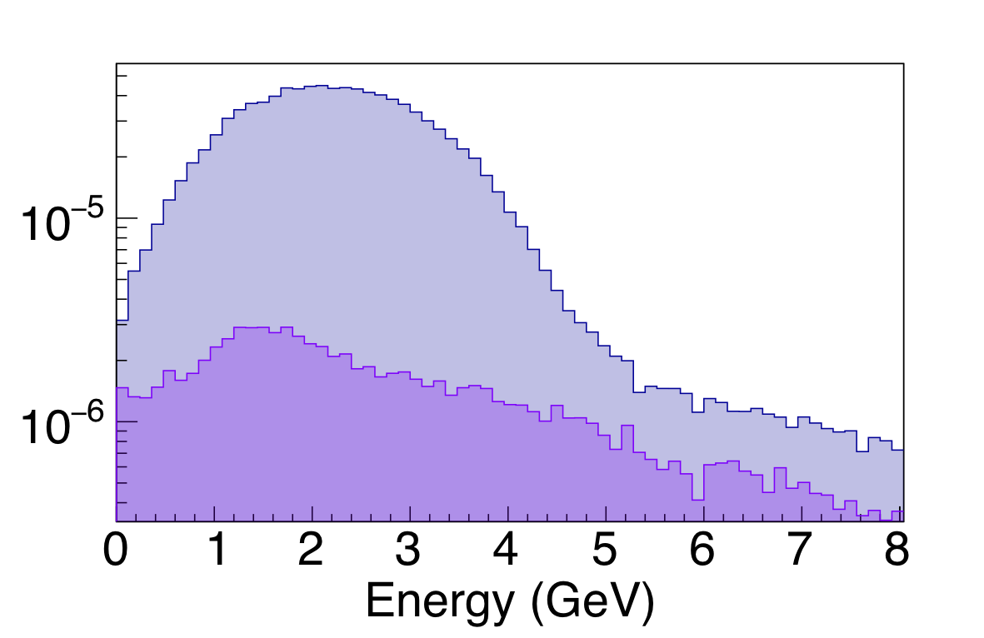
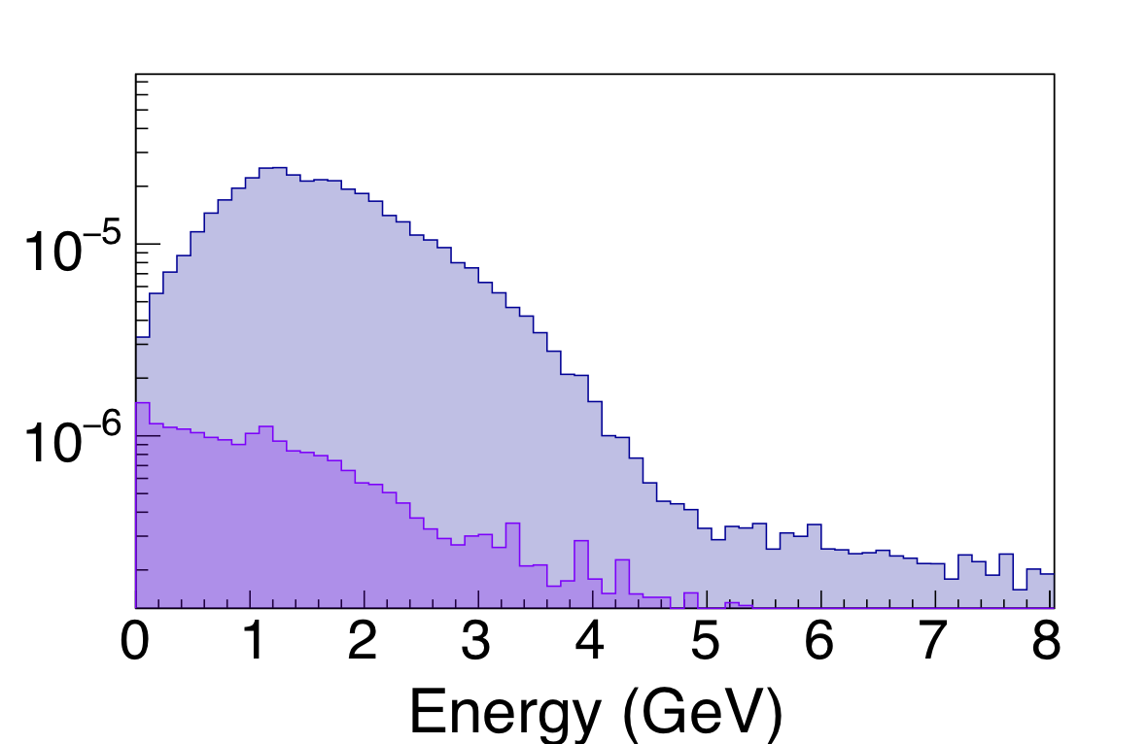
Wrong Sign Contamination (RHC)
Slice 0: -0.3 to –0.1 ns
Slice 2: 0.1 to 0.3 ns
Slice 4: 0.5 to 0.7 ns
Slice 6: 0.9 to 1.1 ns
JETP Seminar, Fermilab - November 1, 2019

Slide 48
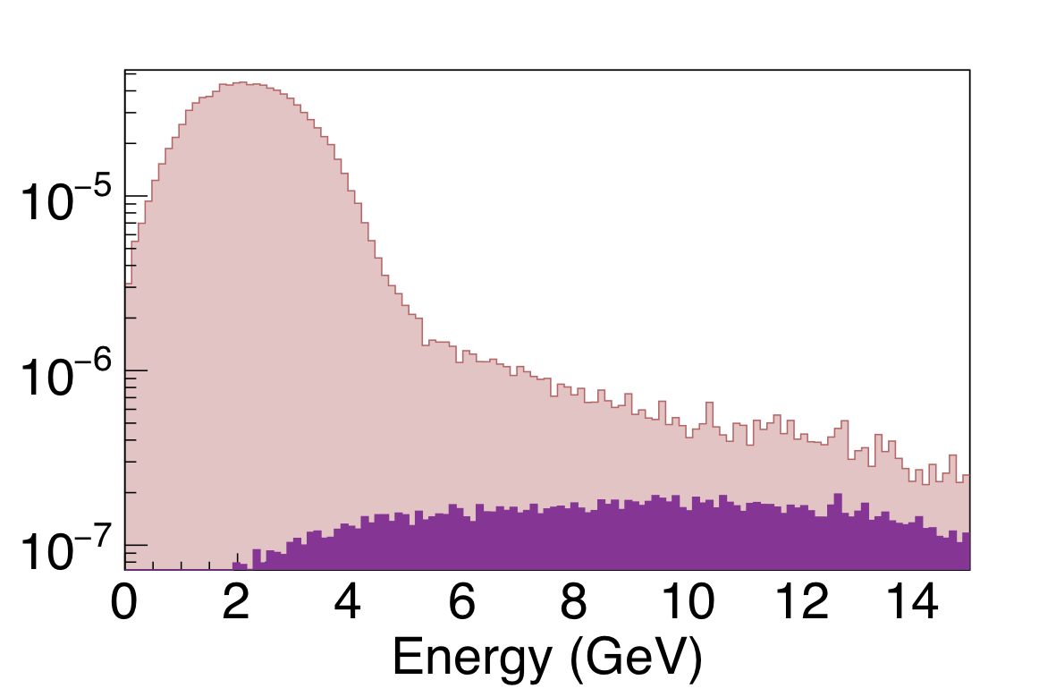
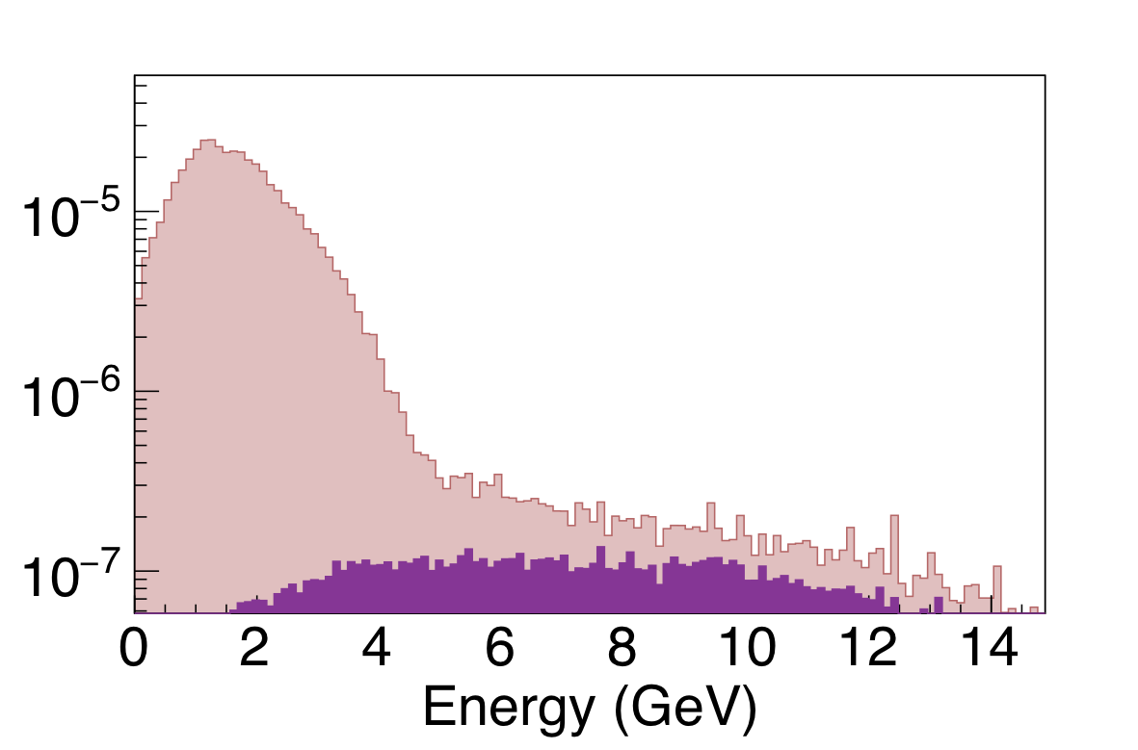
K⁻ component(RHC)
Slice 0: -0.3 to –0.1 ns
Slice 2: 0.1 to 0.3 ns
Slice 4: 0.5 to 0.7 ns
Slice 6: 0.9 to 1.1 ns
JETP Seminar, Fermilab - November 1, 2019

Slide 49
Additional Motivations Slides
JETP Seminar, Fermilab - November 1, 2019

Slide 50
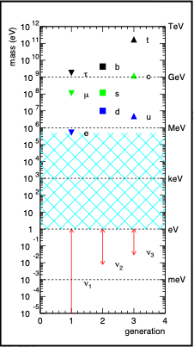
Motivations: Neutrinos and the Big Questions
Why are neutrinos so light?
Are neutrinos their own anti-particles (Majorana)?
Are neutrinos CP violating? How much?
Alternative (non-Higgs) mechanism
Seesaw mechanism
Possible explanation for matter/anti-matter asymmetry
JETP Seminar, Fermilab - November 1, 2019

Slide 51

Motivations: Neutrinos and the Big Questions
The flavor states which govern how neutrinos interact, are a quantum superposition of the mass states, which govern how they propagate in time
JETP Seminar, Fermilab - November 1, 2019

Slide 52
Motivations: Precision Neutrino Oscillometry
𝜈e
𝜈𝝁
𝜈_{𝝉}
Ue1 Ue2 Ue3
U𝝁1 U𝝁2 U𝝁3
U_{𝝉1} U_{𝝉1} U_{𝝉1}
𝜈1
𝜈2
𝜈₃
=
=
JETP Seminar, Fermilab - November 1, 2019

Slide 53

Motivations: Precision Neutrino Oscillometry
𝜈e
𝜈𝝁
𝜈_{𝝉}
𝜈1
𝜈2
𝜈₃
=
=
PMNS Matrix: Pontecervo, Maki, Nakagowa, Sakata
JETP Seminar, Fermilab - November 1, 2019

Slide 54
Motivations: Precision Neutrino Oscillometry
𝜈e
𝜈𝝁
𝜈_{𝝉}
𝜈1
𝜈2
𝜈₃
=
=
PMNS Matrix: Pontecervo, Maki, Nakagowa, Sakata
CKM Matrix
JETP Seminar, Fermilab - November 1, 2019

Slide 55
Motivations: Precision Neutrino Oscillometry
𝜈e
𝜈𝝁
𝜈_{𝝉}
Ue1 Ue2 Ue3
U𝝁1 U𝝁2 U𝝁3
U_{𝝉1} U_{𝝉1} U_{𝝉1}
𝜈1
𝜈2
𝜈₃
=
=
c12 s12 0
-s12 c12 0
0 0 1
c₁₃ s₁₂ s₁₃e^{-i𝛿cp}
0 1 0
-s₁₃e^{-i𝛿cp} 0 c₁₃
1 0 0
0 c23 s23
0 -s23 c23
"atmospheric"
"reactor"
"solar"
JETP Seminar, Fermilab - November 1, 2019

Slide 56
Motivations: Precision Neutrino Oscillometry
𝜈e
𝜈𝝁
𝜈_{𝝉}
Ue1 Ue2 Ue3
U𝝁1 U𝝁2 U𝝁3
U_{𝝉1} U_{𝝉1} U_{𝝉1}
𝜈1
𝜈2
𝜈₃
=
=
c12 s12 0
-s12 c12 0
0 0 1
c₁₃ s₁₂ s₁₃e^{-i𝛿cp}
0 1 0
-s₁₃e^{-i𝛿cp} 0 c₁₃
1 0 0
0 c23 s23
0 -s23 c23
"atmospheric"
"reactor"
"solar"
θ₁₂ = 45±3°
θ₁₃ = 8.5±0.15°
θ₂₃ = 33.6±0.8°
|Δm²₁₂| = 2.52±0.04 x 10⁻³ eV²
|Δm²₁₃| =2.52±0.04 x 10⁻³ eV²
|Δm²₂₃| = 7.5±0.18 x 10⁻⁵ eV²
𝛿_{cp} = ????
mass hierarchy????
JETP Seminar, Fermilab - November 1, 2019

Slide 57

Fermilab and the worldwide neutrino community are building a world class neutrino beamline and cutting edge neutrino detectors to make neutrino oscillation measurements at unprecedented levels of precision
High among the goals of DUNE, the observation and measurement of CP violation in the neutrino sector
LBNF/DUNE represents the transition from statistics limited oscillations measurements to a new era of systematics limitations
Given the high priority of DUNE, anything we can do to control systematics and protect against “unknown unknowns”, the better
More handles on systematic uncertainties, also means more sensitivity to possible new physics: non-standard interactions, non-standard oscillation
JETP Seminar, Fermilab - November 1, 2019

Slide 58
2. Limiting Systematics on DUNE
credit: xkcd
JETP Seminar, Fermilab - November 1, 2019

Slide 59
Neutrino rates are cross section (and detector) dependent
For a given set of kinematic variables k, the event rate R(k) is given by
process
target
∫
E_{max}
R(k) =
∑
∑
𝛟(E_{𝛎}) x 𝛔i(E_{𝛎},k) x 𝛆(k) x Nj x P_{𝛎a→𝛎b}(E_{𝛎})
dE_{𝛎}
i
j
E_{min}
Hybrid Cher/Scint Workshop, Penn - June, 20256

Slide 60
Neutrino rates are cross section (and detector) dependent
E_{reco}, p_{𝜇}, E_{had}, etc
For a given set of kinematic variables k, the event rate R(k) is given by
process
target
∫
E_{max}
R(k) =
∑
∑
𝛟(E_{𝛎}) x 𝛔i(E_{𝛎},k) x 𝛆(k) x Nj x P_{𝛎a→𝛎b}(E_{𝛎})
dE_{𝛎}
i
j
E_{min}
Hybrid Cher/Scint Workshop, Penn - June, 20256

Slide 61
Neutrino rates are cross section (and detector) dependent
For a given set of kinematic variables k, the event rate R(k) is given by
process
target
∫
E_{max}
R(k) =
∑
∑
𝛟(E_{𝛎}) x 𝛔i(E_{𝛎},k) x 𝛆(k) x Nj x P_{𝛎a→𝛎b}(E_{𝛎})
dE_{𝛎}
i
j
E_{min}
what we detect
what we want to measure!!
We want to measure the oscillation probability, but we actually detect the rates of events defined by a set of specific experimental observable.
Hybrid Cher/Scint Workshop, Penn - June, 20256

Slide 62
Neutrino rates are cross section (and detector) dependent
For a given set of kinematic variables k, the event rate R(k) is given by
process
target
∫
E_{max}
R(k) =
∑
∑
𝛟(E_{𝛎}) x 𝛔i(E_{𝛎},k) x 𝛆(k) x Nj x P_{𝛎a→𝛎b}(E_{𝛎})
dE_{𝛎}
i
j
E_{min}
what we detect
flux
cross sections
detector effects
(efficiency /number of targets)
what we want to measure!!
We want to measure the oscillation probability, but we actually detect the rates of events defined by a set of specific experimental observables
In between what we want to measure and what experimentally detect, we need to deconvolve the initial neutrino flux and reaction cross sections (as well as detector affects), which are themselves energy dependent.
Hybrid Cher/Scint Workshop, Penn - June, 20256

Slide 63
Timing in LAr-TPCs/DUNE
JETP Seminar, Fermilab - November 1, 2019

Slide 64
Timing and Far Detection: LAr-TPCs
The optical properties of Liquid Argon detectors are very similar to those of water
Cherenkov light in combination with the reconstructed track from electron drift could provide an excellent handle for establishing T0 of the vertex
One option for photodetection - mirror the top, bottom, sides, and place photodetectors on the end caps
photodetectors
photodetectors
JETP Seminar, Fermilab - November 1, 2019

Slide 65
Timing and Far Detection: LAr-TPCs
The optical properties of Liquid Argon detectors are very similar to those of water
Cherenkov light in combination with the reconstructed track from electron drift could provide an excellent handle for establishing T0 of the vertex
One option for photodetection - mirror the top, bottom, sides, and place photodetectors on the end caps
photodetectors
photodetectors
JETP Seminar, Fermilab - November 1, 2019

Slide 66
Timing and Far Detection: LAr-TPCs
The optical properties of Liquid Argon detectors are very similar to those of water
Cherenkov light in combination with the reconstructed track from electron drift could provide an excellent handle for establishing T0 of the vertex
One option for photodetection - mirror the top, bottom, sides, and place photodetectors on the end caps
photodetectors
photodetectors
JETP Seminar, Fermilab - November 1, 2019

Slide 67
Timing and Far Detection: LAr-TPCs
The optical properties of Liquid Argon detectors are very similar to those of water
Cherenkov light in combination with the reconstructed track from electron drift could provide an excellent handle for establishing T0 of the vertex
One option for photodetection - mirror the top, bottom, sides, and place photodetectors on the end caps
photodetectors
photodetectors
JETP Seminar, Fermilab - November 1, 2019

Slide 68


Timing and Far Detection: LAr-TPCs
The optical properties of Liquid Argon detectors are very similar to those of water
Cherenkov light in combination with the reconstructed track from electron drift could provide an excellent handle for establishing T0 of the vertex
One option for photodetection - mirror the top, bottom, sides, and place photodetectors on the end caps
Far detector synchronization with the beam RF is challenging but not so far from the level of precision available in commercial GPS technology
A 1ps over 1km white rabbit system is currently being commissioned at the FNAL test-beam
JETP Seminar, Fermilab - November 1, 2019

Slide 69


There is broad interest in the community in thinking about the future, beyond the first LAr-TPC modules in DUNE​
In two weeks there will be a meeting to discuss some of these forward thinking ideas​
This is an excellent opportunity to start thinking about fast timing in LAr-TPCs
It is also an excellent opportunity to think about complementary technologies such as Theia
  A water-based neutrino detector as a possible candidate for the fourth module in Homestake​
Key technological elements of Theia include the addition of water based liquid scintillator and advanced, high resolution photodetection​
Because fast timing is an inherent part of the Theia concept, it is an excellent candidate for time-slicing in the far detector.
JETP Seminar, Fermilab - November 1, 2019

Slide 70


Realistic Flux Simulation
https://home.fnal.gov/~ljf26/DUNEFluxes/
Optimized 3-Horn Design presented at the October 2017 Beam Optimization Review (used in the DUNE TDR)
Timing information is included in the ntuples
All simulated protons hit the target at the same time
We convoluted the proton hit times with the timing of the emergent bunch structure from the accelerator simulations
We also added 100 psec Gaussian smearing to account for plausible, albeit ambitious detector capabilities
We also added in the effects of pileup from the previous bunches
Hybrid Cher/Scint Workshop, Penn - June, 20256

