Slide 1
Community White Paper on Advanced Computing in Nuclear Physics
Peter Jacobs, RNC

Slide 2
https://www.jlab.org/conference/2024SANPC
JLab June 20-22 2024
co-chairs: Amber Boehnlein (JLab) and myself
Commissioned and supported by Xiaofeng Guo (DOE/NP Computing)
Charge: provide community guidance to agencies on directions and opportunities in Advanced NP Computing

Slide 3
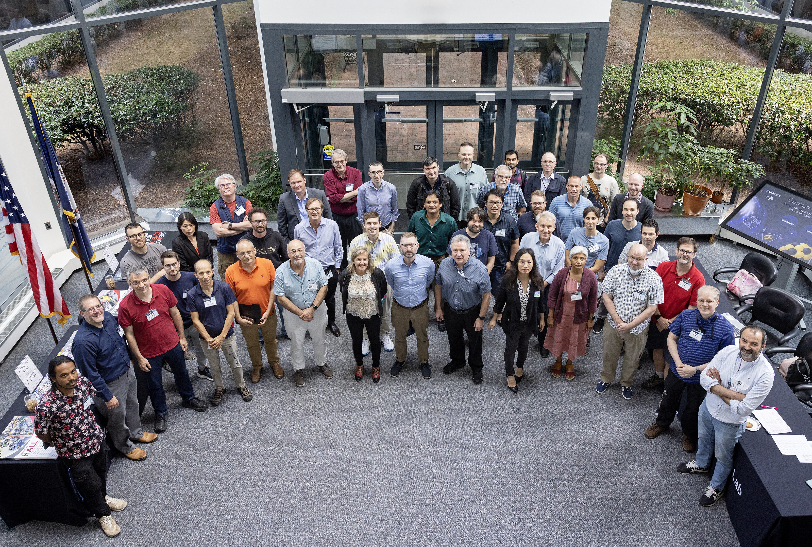
https://www.jlab.org/conference/2024SANPC
Org and Writing Committee:
Amber Boehnlein (JLab), co-chair Peter Jacobs (LBNL), co-chair Joe Carlson (LANL) Ian Cloet (ANL) Markus Diefenthaler (JLab) Robert Edwards (JLab)
Kyle Godbey (FRIB/MSU) Raphael Hix (ORNL)
Kostas Originos (William & Mary) Thomas Papenbrock (UTK)
Mateusz Ploskon (LBNL)
Claudia Ratti (Houston)
Ron Soltz (LLNL) Brad Sawatzky (JLab) Torre Wenaus (BNL)
~ 60 participants (incl. remote)

Slide 4
Agenda
https://indico.jlab.org/event/827/timetable/#all
Thursday
Funded projects
Funded projects
Contributed talks
SciDAC, NNSA
Experiment overviews: colliders, FRIB, Jlab, neutrinos
Friday&Saturday: agency talks, parallel sessions, White Paper writing

Slide 5
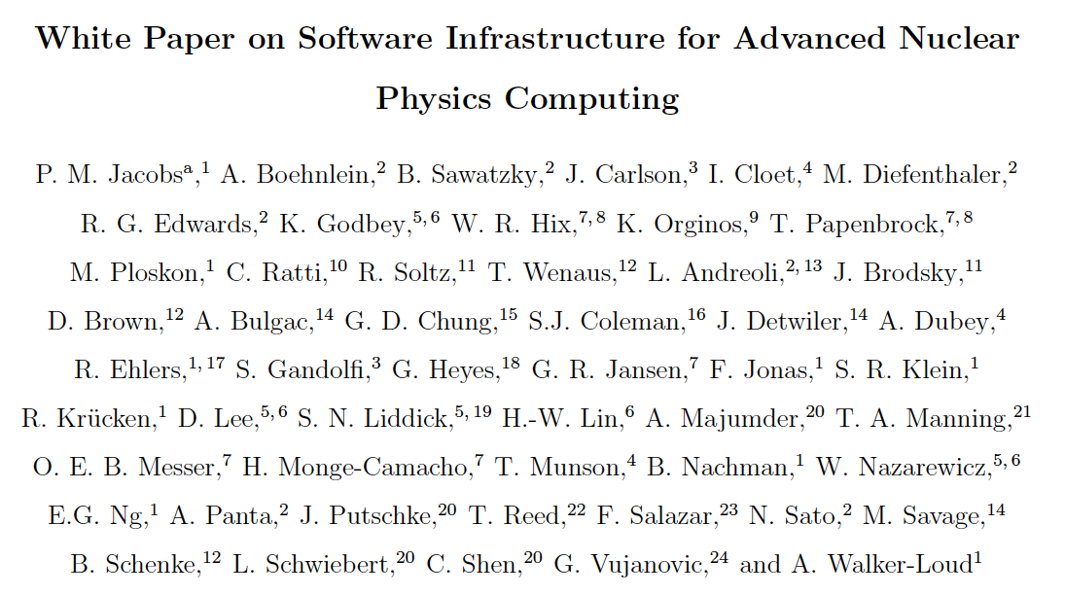
arXiv:2501.00905

Slide 6
arXiv:2501.00905

Slide 7
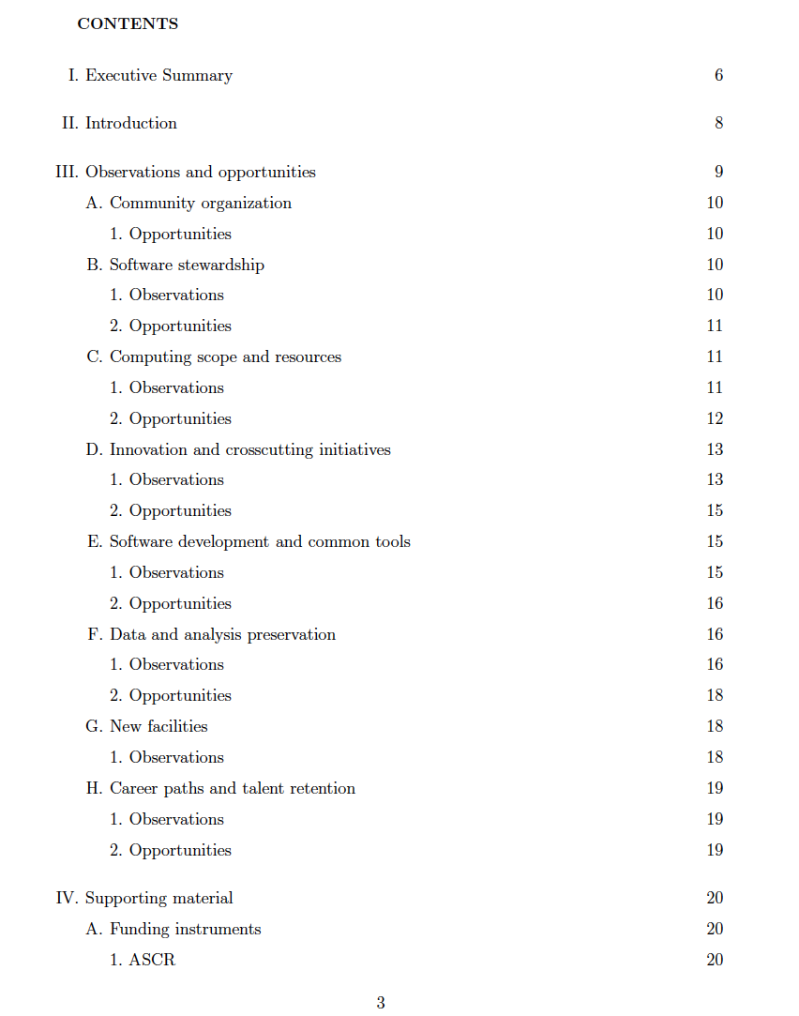
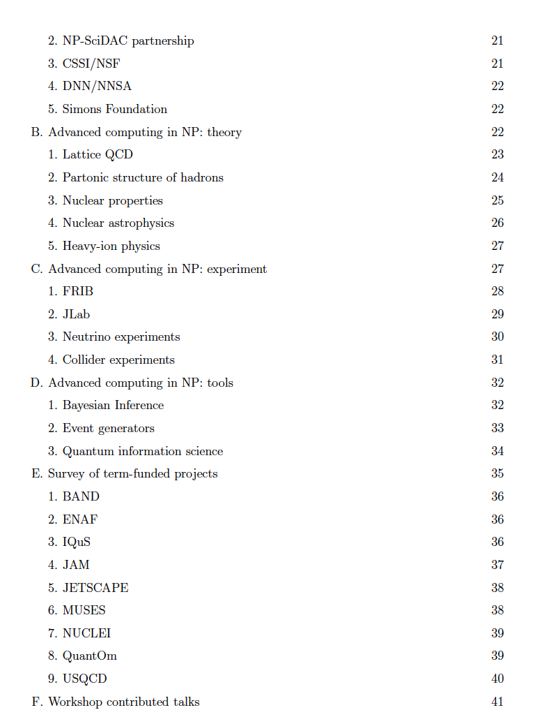
Executive summary
agencies
Observations and opportunities
Not an official NSAC subcommittee
cannot provide recommendations to the agencies
Alternative: observations and opportunities
Analogous to DOE project review rubric:
“Findings” → observations
“Recommendations” → opportunities
theory overview
experiment overview
techniques
funded projects
Supporting material
workshop report

Slide 8
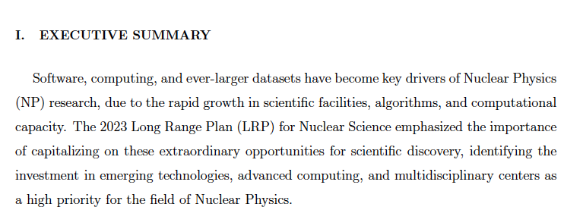
→ follow-on to LRP, not a replacement

Slide 9
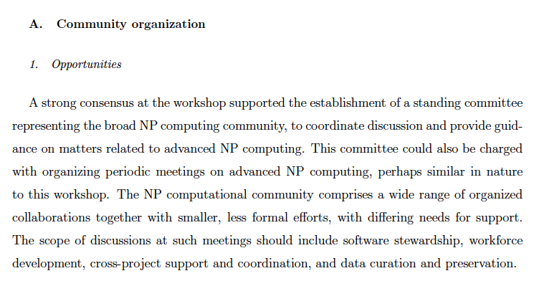

Slide 10
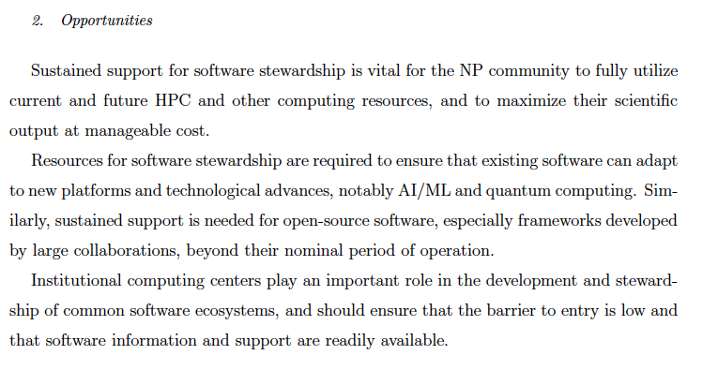

Slide 11
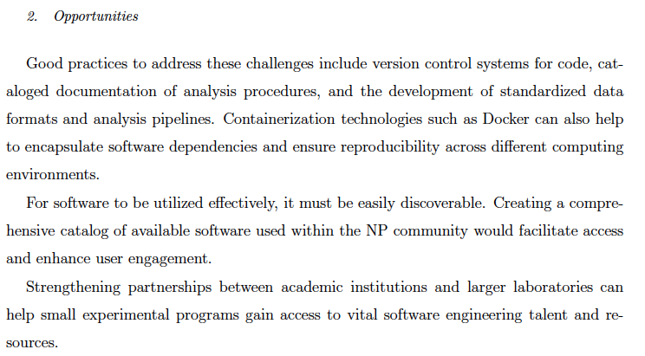
Mainly good software management practices; no specific guidance to agencies

Slide 12
Side product of the workshop: was very productive to get computing practitioners from all NP sub-areas (Th&Exp) + related areas in one room for extended discussion
→ interest in making this an ~annual event

Slide 13
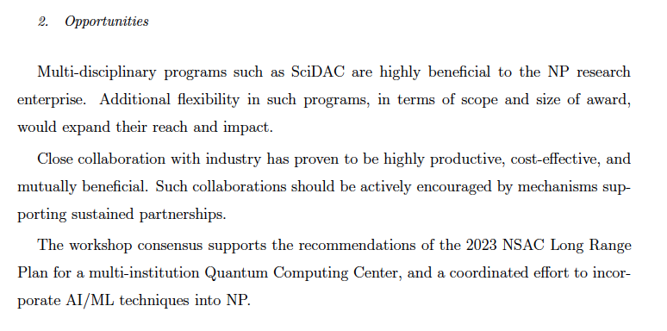

Slide 14
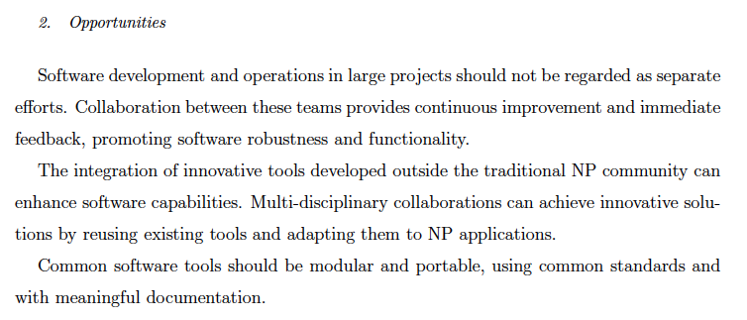

Slide 15
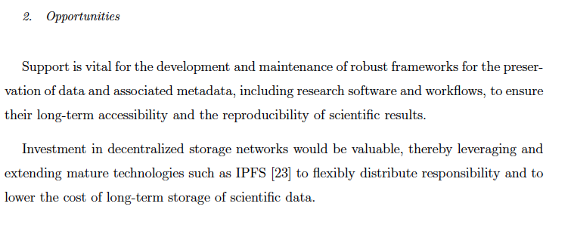

Slide 16
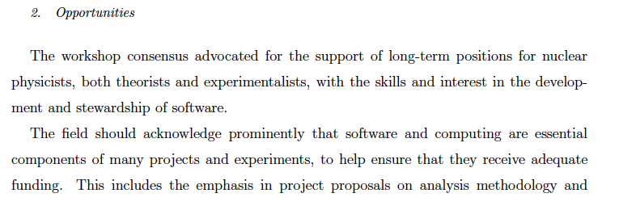
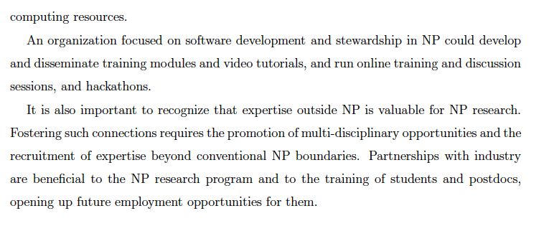

Slide 17
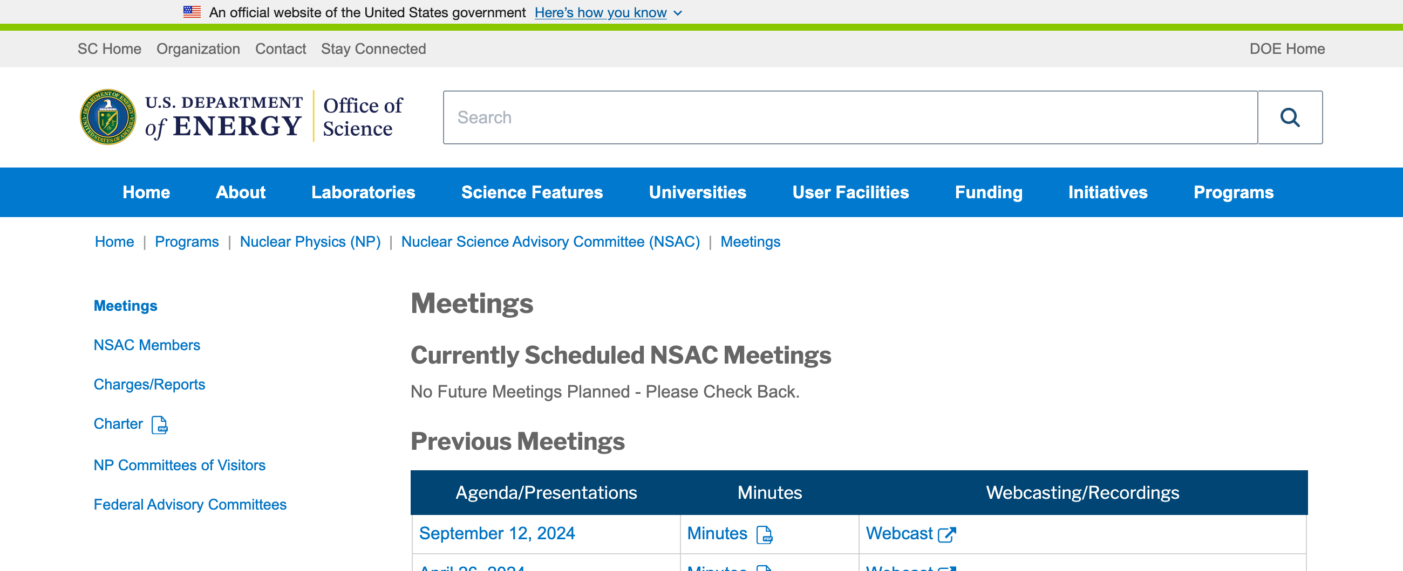
Comments and next steps
First draft (v1) of White Paper posted in arXiv in early January
call for community comment
About 15 sets of substantive comments received and implemented
Final version (v2) posted April 21 (https://arxiv.org/abs/2501.00905)
that’s it; will not be submitted for publication
Xiaofeng requested a presentation to NSAC

