Slide 1
Ian’s selected review on Cu RRR
Ian Pong (ipong@lbl.gov)

Slide 2
References
IEC 61788
Various papers by Fickett, including his 1974 MSE review
Munday et al. 1982 J. Phys. F: Met. Phys
N. J. Simon et al. NIST Monograph 177
ITER experience IEEE 2010, 2012 Jewell, Pong et al.
AUP experience Cryogenics 2024 Pong et al.

Slide 3
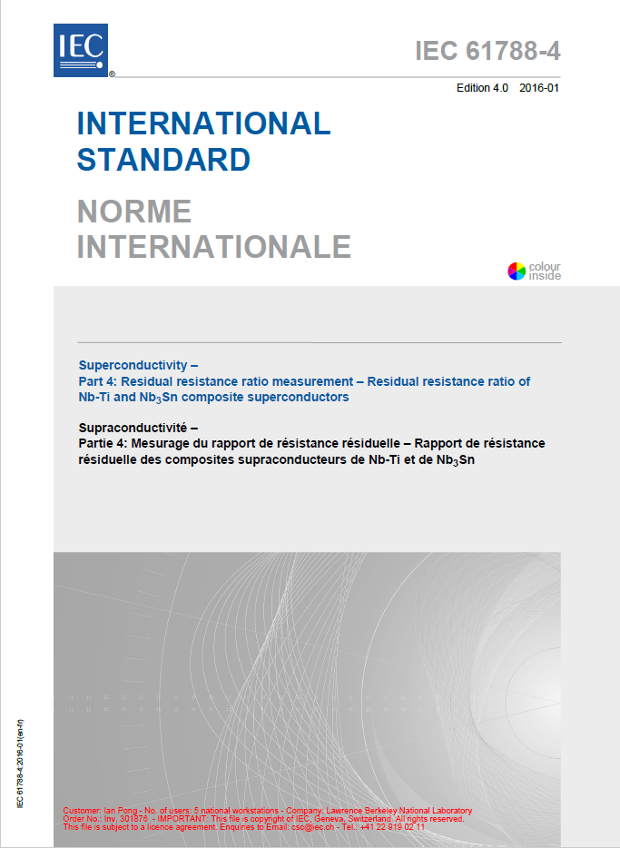
RRR Definition
Residual Resistance Ratio – as defined by IEC 61788
Also typical usage:
LT
Cu at 4.2 K
Nb-Ti wire at ~10 K (just above T_{C})
Nb₃Sn wire at ~20 K (just above T_{C})
RT
Often 273 K - 308 K, definition 293 K
Correction formula available

Slide 4
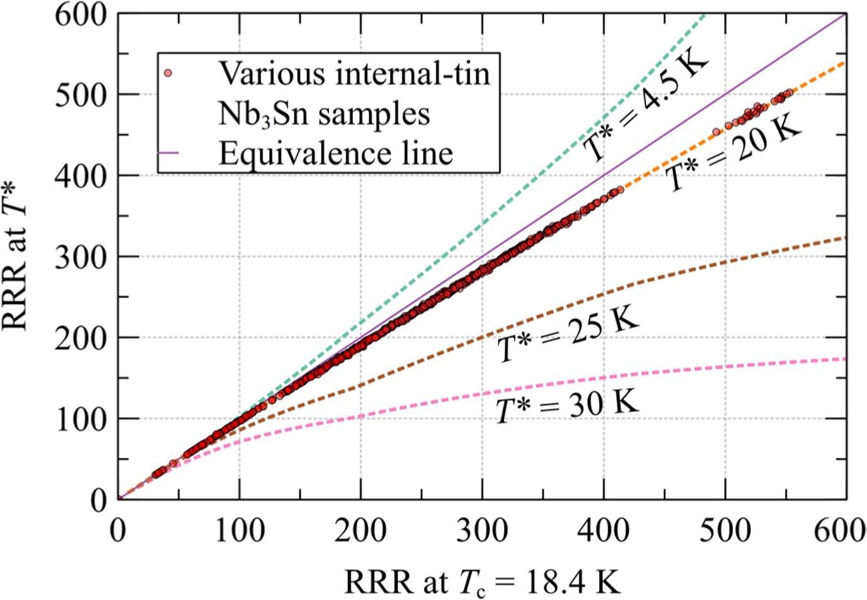
Pong et al. Cryogenics (2025)

Slide 5
IEC 61788-4
Formerly 61788-4 (Nb-Ti) and 61788-11 (Nb₃Sn); since 2016 (4th edition) just 61788-4
Resistance, not resistivity
For composite superconductors under TC 90, scope:
“monolithic structure”
RRR < 350
Rectangular or round cross-section, area < 3 mm²
For Nb₃Sn, after HT

Slide 6
RRR Notable Details
Resistivity can change when the dimension gets close to the mean free path
Impurities at concentration much below chemically detectable levels can still impact electrical conductivity considerably, that’s why RRR is an important SC QC
“Chemical purity” vs. “electrical purity”
Magneto-resistance effect (applied B impacts RRR)
Microstructure effect (annealing condition impacts RRR)
~17 K - 20 K resistance rise depends on RRR

Slide 7
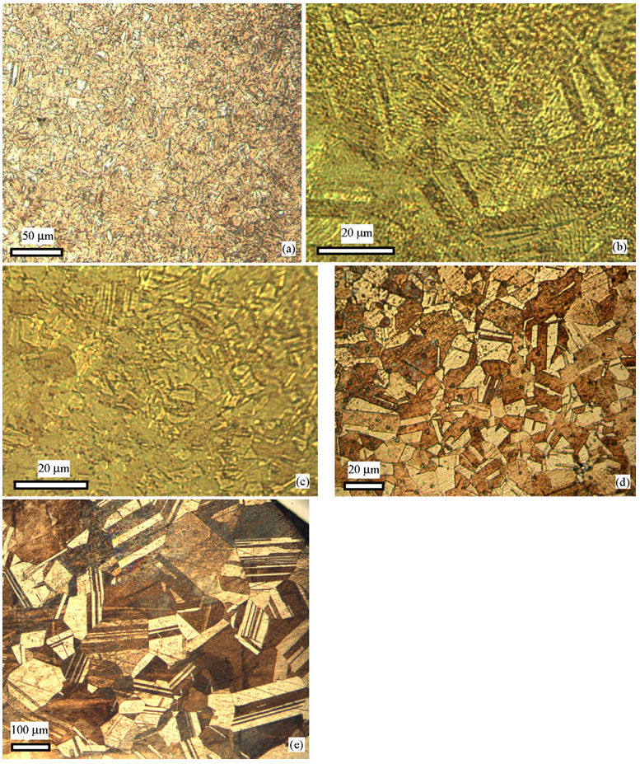
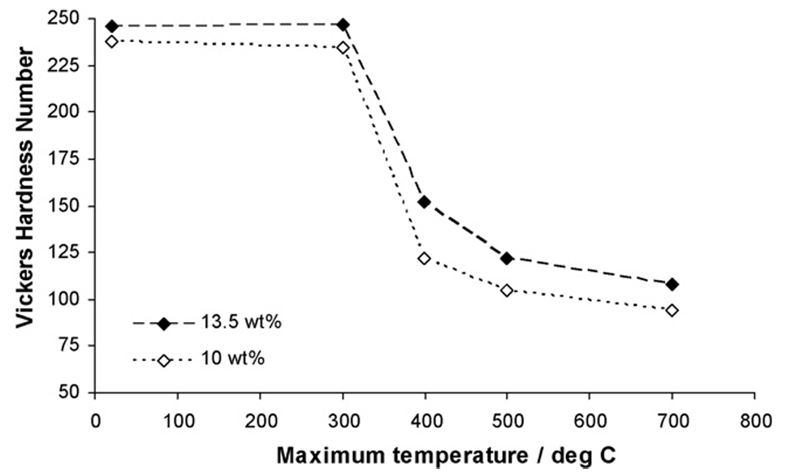
Hopkins et al. MSE A (2007)

Slide 8
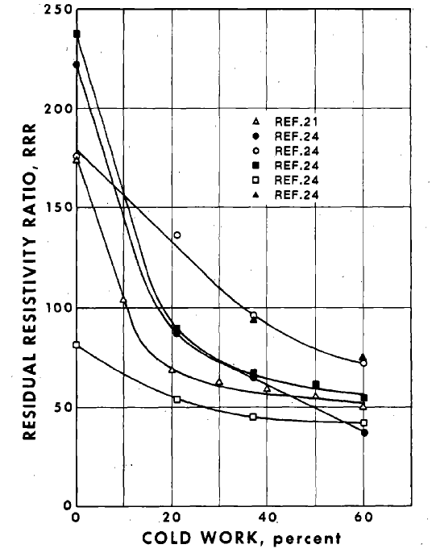
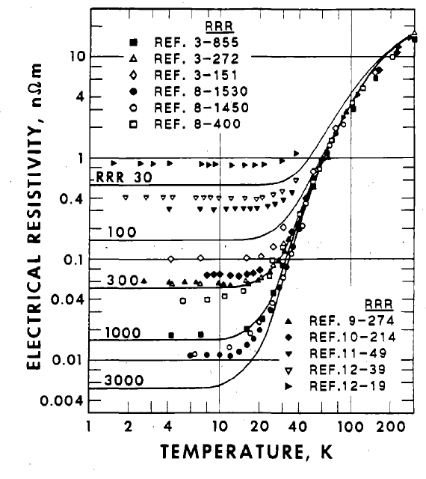
Simon et al. NIST Monograph 177

Slide 9
Heat Treatment
Recovery and recrystallization: RT resistance may not be much affected, but LT resistance may decrease markedly (dislocations annihilate, grains grow → RRR increases)
An important factor: furnace impurity (line of sight from heating elements, environmental residue from retorts, etc.) – easy fix: quartz tube and/or glass fibre
Atmosphere: trace oxygen may help by oxidizing ferromagnetic impurities, reducing their ability to scatter electrons at LT and thereby boosting RRR

Slide 10
Oxygen Annealing
CuO black, Cu₂O “red”
Redox – can be reversed (reduction is slower)
Impurity must have a greater affinity for oxygen than Cu
Oxidation is internal (not surface) because of a much higher oxygen diffusion rate in Cu than impurity diffusion
Experiment: oxidize, remove surface, reduce
A small effect: oxide + interstitial oxygen

Slide 11
Nitrogen annealing
Some reported Nb₃Sn HT in pure N₂ improves RRR
Some reported no change
Possibly depends on the concentration of trace oxygen

Slide 12
Some numbers
Oxygen solubility in Cu increases with T (i.e. oxide would precipitate on cooling)
Ref.: 400 at. ppm O ~ 0.01 wt% O₂
Commercial “oxygen free” typically <0.04 wt% O₂ (Cu₂O)
Cu₂O not considered to have a significant effect on RRR of the relatively pure Cu we would typically care
Oxygen diffusion depends on T and t – but typical Nb₃Sn HT is fine

Slide 13
A few more numbers
OFHC typical RRR >100
“Five nines” (99.999%, or 5N) typical RRR ~1,500
In very high purity Cu (RRR ~10,000), e⁻ mean free path ~0.4 mm at 4 K and size effect contribution to LT resistance of wires may be considerable to that of bulk
In very high purity Cu (RRR ~10,000), 0.15 at. ppm Fe may contribute just as much (0.15 nΩ.cm)
Notes:
λ=mvF​​/ne2ρ

Slide 14
IACS
The International Annealed Copper Standard resistivity should not be confused with the IEC RRR
IACS is for 20°C, mostly power transmission
A resistivity value is defined, and industry typically give conductivity values solely as a % of the IACS figure

Slide 15
C101
Copper alloy 101, or UNS C10100
A.k.a. OFE or OFHC
~99.99% (four nines, 4N)

Slide 16
Iron
Fe → FeO → Fe₃O₄ → Fe₂O₃
0.1% Fe oxidized copper alloy can become magnetic
Ferromagnetism of the oxide magnetite depends on the size of the oxide particles
Resistivity depends on the volume of the impurity that is oxidized
No simple relationship between Cu resistivity and impurity magnetization

Slide 17
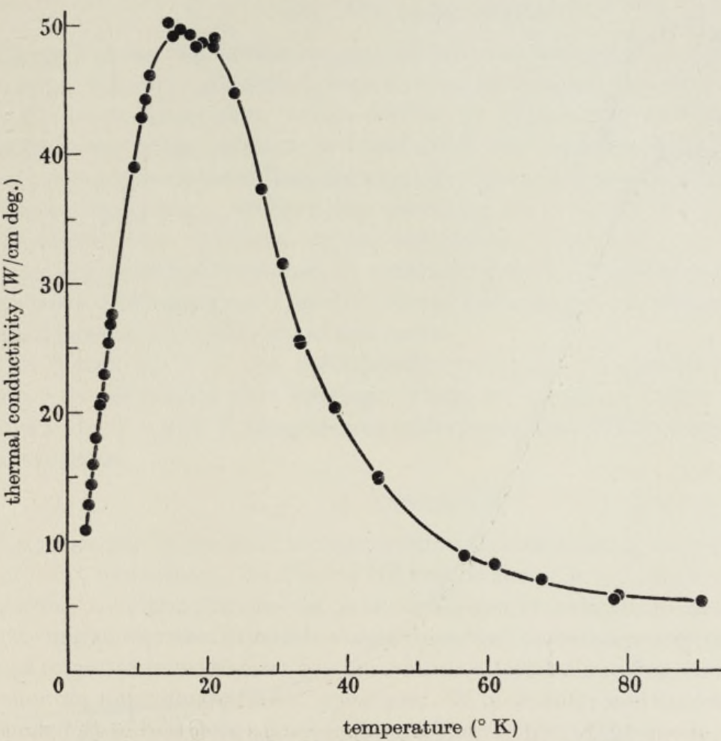
Kondo Effect
Electrical resistance versus T at LT
Minimum before rising again
Related to magnetic impurity in nominally pure metals
As electrical conductivity is related to thermal conductivity by the Wiedemann-Franz law, the same may be observed in thermal properties
Berman and Macdonald Proc. Royal Society (1952)

Slide 18
Other Effects
Wire processing
Typically only degrades the initial Cu
Drawing die cleanliness and wear are known to impact RRR
Diffusion barrier integrity is critical for Nb₃Sn (due to HT)
Coating (Cr) impurities diffusing into the wire during HT
Wire cross section
RRR contribution across the wire cross section is not uniform in multifilamentary bundled / restacked wires
Subelement orientation in rolled wire matters (Baskys et al. IEEE TAS 2023)

Slide 19
International BM / CC / RR
61788-4 (2016) Nb-Ti:
Sigma 4.4 on x-bar 178.5 → 2.44% COV
Recommend COV <2.5%
61788-4 (2016) Nb₃Sn:
COV 6.07%
ITER:
COV Nb-Ti (0.8%), Nb₃Sn BR (9.7%), Nb₃Sn IT (14.1%)
IO-prep vs. Self-prep – HT isolated from measurement
AUP:
LBNL RRP® RRR ref COV 0.15%(!!); witness ref COV ~1.3%(!!)

Slide 20
Summary
RRR for Cu, Nb-Ti, Nb₃Sn BR, and Nb₃Sn IT have different definitions and different uncertainties (COV)
Microstructure (processing history and HT) impacts RRR
HT controls (time, temperature, trace oxygen, cleanliness) are very important for reliable and repeatable RRR
Oxygen can take out ferromagnetic impurities, reducing their ability to scatter electrons at LT and boost RRR

