Slide 1
Fission Theory Needs
WANDA 2026
February Xth, 2026
Nicolas Schunck | NACS

Slide 2
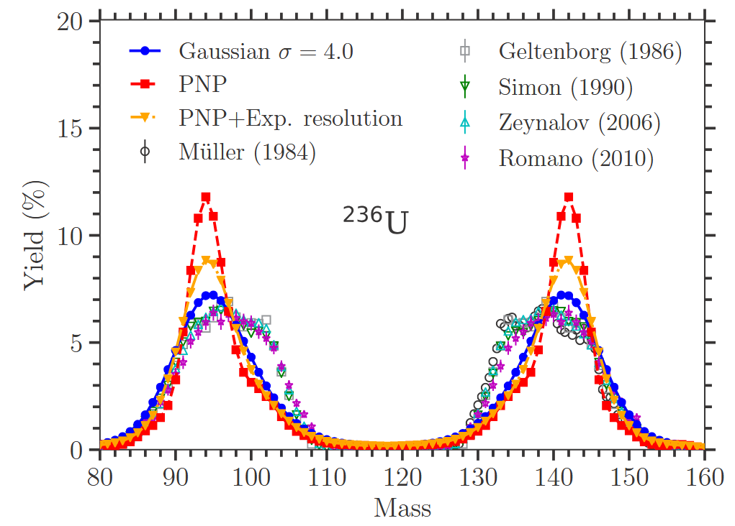
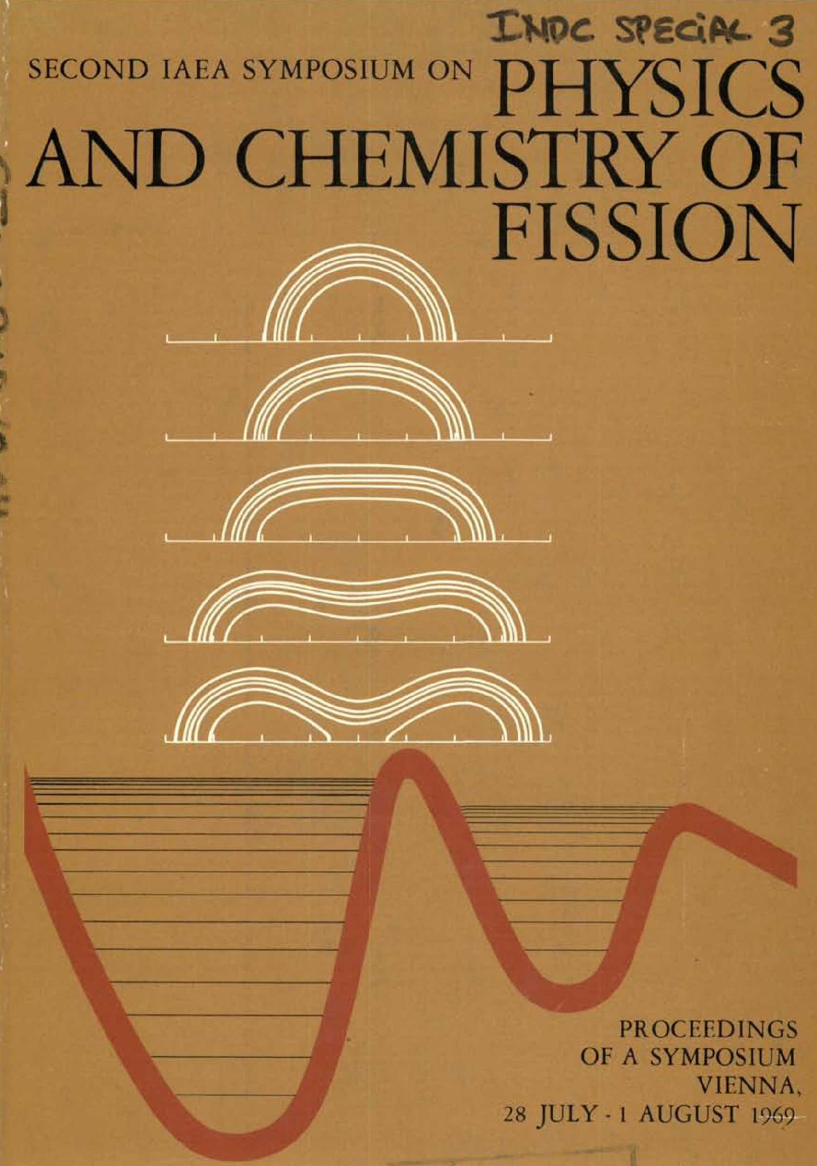
There are currently three major bottlenecks on the road to a predictive and comprehensive theory of fission
1. In spite of recent progress, theory cannot predict fission fragment distributions (pre-emission) at the required precision
2. Nuclear structure theory methods applicable across the chart are needed to describe hundreds of very excited, neutron-rich nuclei
3. The theoretical framework for fission cross sections has not been (significantly) updated since 1969…

Slide 3
Nuclear structure theory underpins every single facet of fission theory and modeling
Nuclear structure of heavy nuclei
Current status of theory
Level densities, spin distributions, decays from 0 to 40 MeV
Low-lying states, quantum numbers and transitions
Properties of isomeric states
Phenomenological mean field theory (ex.: FRLDM): expertise is gone from US
DFT & shell model: barely surviving in the US; Europe, China and Japan are leaders
Ab initio: healthy, doesn’t scale to heavy nuclei

