Slide 1
The nuclear observables of the lesser Gods
Jean-Christophe Sublet
United Kingdom Atomic Energy Authority,
Culham Science Centre, Abingdon OX14 3DB, United Kingdom
Exploring the nuclear and technology landscapes

Slide 2
Preamble
Nuclear data are provided in ENDF-102 or GNDS format
Nuclear data processing systems are used to convert evaluations in the Evaluated Nuclear Data Files (ENDF) format into forms useful for practical applications such as fission, fusion, space, astrophysics, earth and life sciences, technology for criticality safety, radiation shielding, power, propulsion, stockpile stewardship, nuclear material damage, fuel and waste management, nuclear medicine, radioisotope production, health physics, and more…
Each application, dedicated analysis that relies on particle transport, material Inventory and radiation Source Term simulation, have specific, sometimes unique nuclear data form needs, requirements and priority that depends on the type of results envisaged.
Processing codes, methods and protocols allow the required data forms to be extracted.

Slide 3
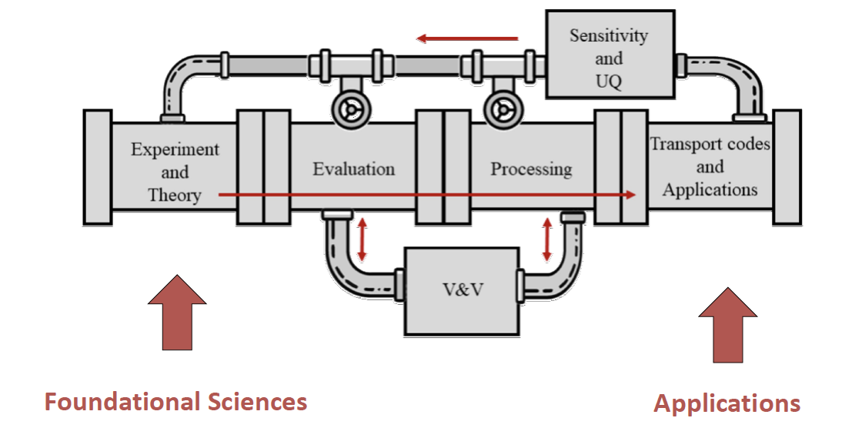

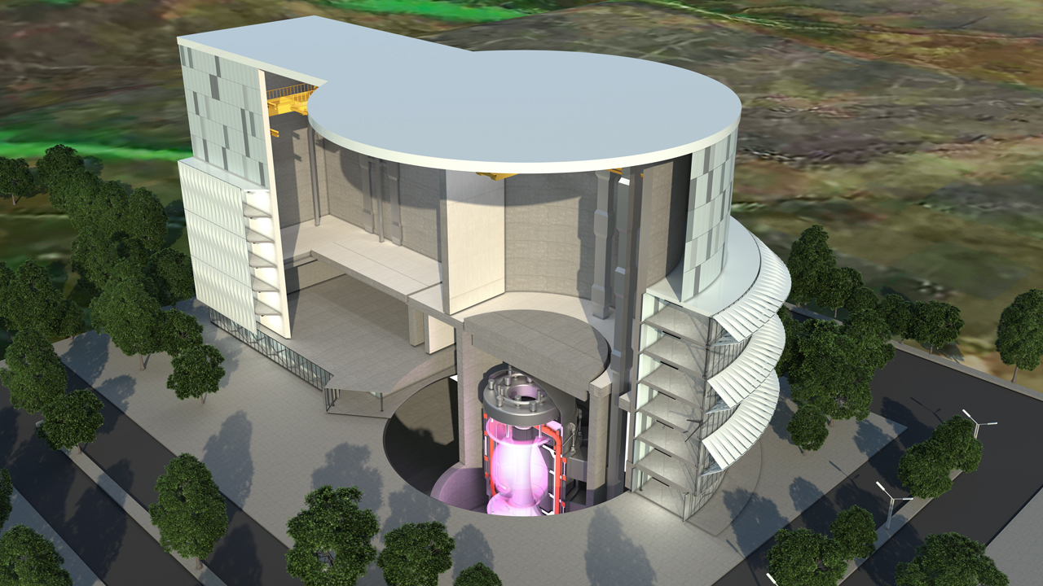
Nuclear data pipeline
The nuclear data pipeline moves data from basic science model to evaluated libraries, application libraries and then simulation tools & results
Courtesy: D. Brown
build a modern durable partnership between fundamental sciences and applications needs

Slide 4
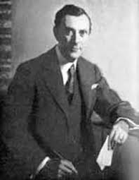
Inventory, radiation source term models
The Bateman equation is a (1910) mathematical model describing abundances and activities in a decay chain as a function of time, based on the decay rates and initial abundances.
Inventory requires a set of stiff Ordinary Differential Equations to be solved
= −N_{i} (λ_{i} + σ_{i}φ ) +∑N _{j} (λ_{ij}
j≠i
dN_{i}
+ σ φ )
dt
Here λ_{i} and σ_{i} are respectively the total decay constant and cross-section for reactions on nuclide i
σ_{ij} is the cross-section for reactions on nuclide j producing nuclide i, and for fission it is given by the product of the fission cross-section and the fission yield fractions, as for radionuclide production yield
λ_{ij} is the constant for the decay of nuclide j to nuclide i
Backward Differentiation Formula; Exponential, Matrix Exponential, Newton-Krylov implicit integrators,
Markovian chains, first to fifth-order Runge-Kutta, Chebyshev Rational Approximation, …

Slide 5
Nuclear data forms e.g., FISPACT-II
FISPACT-II is an enhanced Multiphysics time inventory, radiation, source term code system providing a wide variety of advanced, predictive, spectral and and temporal simulation methods.
The system needs to rely on complete nuclear data forms: reaction and decay covering neutron, gamma and charged-particle interactions.
The data forms encompass energy dependent reaction cross-sections, productions cross-sections for radionuclides, multiplicity, branching, fission and radionuclides yields, decay for all radioactive products, gas production, Kerma and dpa and biological responses
The processing steps need to be able to handle both explicit and implicit ENDF-6 data format: two-bodies, multi-bodies, complex, breakup and isomeric channels and all (28) decay types.
To account for all projectile, target, emitted, residual possible events with time.
Projectile b on target a -> [compound]^{(*)} -> emitted c and residual d
a + b -> c + d + Q - a(b,c)d - _{z}A(b,c)_{z}D - with ^{A}D > ^{A}c

Slide 6
Grid of reactions, MTs in ENDF-6 format
Explicit ENDF notation
n in ➔ Z_{res} = or decrease
α, p in ➔ Z_{res} increase
The emitted particles may
differ, not the residual
The residual product could
be another element, stable
isomeric or radioactive
Z_{res} = activation
Z_{res} ≠ transmutation
Z_{res} = 0 disappearance, mt18
sum of 19,20,21 and 28; mt5; breakup
Z < 4 gas production
emitted particle Z < 4
target Fe⁵⁶
Proton number Z
Neutron number N
At high energy, above 30 MeV generally, the implicit ENDF notation is used: MF3-mt5*MF6

Slide 7
Grid of reactions, decays (some) & CPs
Nuclear
breakup
Be⁹(𝑛,2𝑛)Be⁸
C¹²(𝑛,𝑛′)3He⁴
Li⁶(𝑛,t)He⁴
Li⁷(𝑛,𝑛’t)He⁴
…
T(d,γ)⁵He*
Inelastic levels
Proton number Z
Neutron number N

Slide 8
FISPACT-II – Inventory radiation Source Terms data
Solver | Numerical - LSODES
Incident particles (5) | ✔ α, γ, d, p, n
ENDF’s style libraries: TENDL-2025 & GEFY, JEFF-4.0 , JENDL-5, ENDF/B-VIII.1, CENDL-3.2,… s30 MF-1-2-3-8-10 & MF-33-40 & PTs & breakup LR *The European Activation File EAF-2010 neutron-induced cross section library | XS data Decay data nFY, sFY, otherFY Biological hazard, clearance indices, A2
Dpa, Kerma, Gas production, s0 style high energy radionuclide yields | ✔
PKA, primary recoils and emitted particles spectra | ✔
Uncertainty Quantification and Propagation - UQP | ✔ Variance-covariance
Temperatures (from reactor Kelvin to astrophysics KeV) 1 KeV ~ 12 million Kelvin | ✔ 0, 294, 600, 900K,…5, 30, 80 KeV
Self-shielding with probability tables or with resonance parameters | ✔ Resolved and Unresolved Resonance Range
Energy range | ✔ 10⁻⁵ eV – 30, 200 MeV, 1GeV
Sensitivity | ✔ Monte Carlo
Pathways analysis, routes of production | ✔ multi steps
Thin, thick targets yields | ✔

Slide 9
Processing trails: three interlinked codes
ENDF file
NJOY-2016
  reconr
  broadr
  unresr
  thermr
  heatr
  gaspr
    purr
    acer
    groupr
    mixr
PREPRO-2023
  linear
  recent
  sigma1
  sixpack
  activate
  merger
  dictin
  groupie
  legend
  spectra
CALENDF-2010
  calendf
  regroutp
  condentp
  lecritp
  ….
cross check
cross check
pendf
pendf
PT
Single script for an entire library
ace
groupr
HybridENDF file
Inventory radiation Source Term
Done over
the
week-end
pka

Slide 10
Processing trails: Inventory, Source Terms
ENDF file
NJOY-2016
  reconr
  broadr
  unresr
  heatr
  gaspr
    groupr
    mixr
PREPRO-2023
  linear
  recent
  sigma1
  sixpack
  activate
  merger
  dictin
  groupie
CALENDF-2010
  calendf
  condentp
pendf
Probability Table
MF=1
MF=2 res. parameters
MF=3 channels, kerma, dpa, gaz, radionuclide prod., alpha, eta,…
MF=8 dictionary
MF=10 partials
MF=33 channels cov.
MF=40 radionuclide cov.
Probability table: 01. eV to Eh
Element
MF6 recoil matrix
Legendre order 0,1
all proton, alpha, A>4
MF3 capture
HENDF file
Inventory radiation Source Term
FISPACT-II - 1102 grps
@ Temperature
@ Dilution
Spectra-PKA
80 grps

Slide 11
Processing trails: charge particles
ENDF file
NJOY-2016
  reconr
  acer
  groupr
PREPRO-2023
  linear
  sixpack
  activate
  dictin
  groupie
  legend
pendf
-p -d -α
-γ
MCNP6
gendf
Spectra-PKA
IrST HENDF 162 grps
FLUKA
283 stable targets
Light targets
CM LAB conversion
Multiscale simulation
FISPACT-II
PHITS
Single script for an entire library
GEANT4

Slide 12
Nuclear landscape: isotopic targets range
TENDL 7 incident particles ~2850 targets
neutron*
gamma
proton
deuteron
alpha
helion, triton
*complete for transport, inventory, source term, material sciences in term of MF’s, targets ( >1 s.) and daughters ( >0.1 s.)
816 in EAF-2010
795 in JENDL-5
818 in CNAF
593 in JEFF-4
1036 in IrST for T_{1/2} > 1 hr. + inclusive
of all “special” from the above legacy libraries - 117m, 7n isomers
T_{1/2} > 1 hr. = 995 & naturals = 287

Slide 13
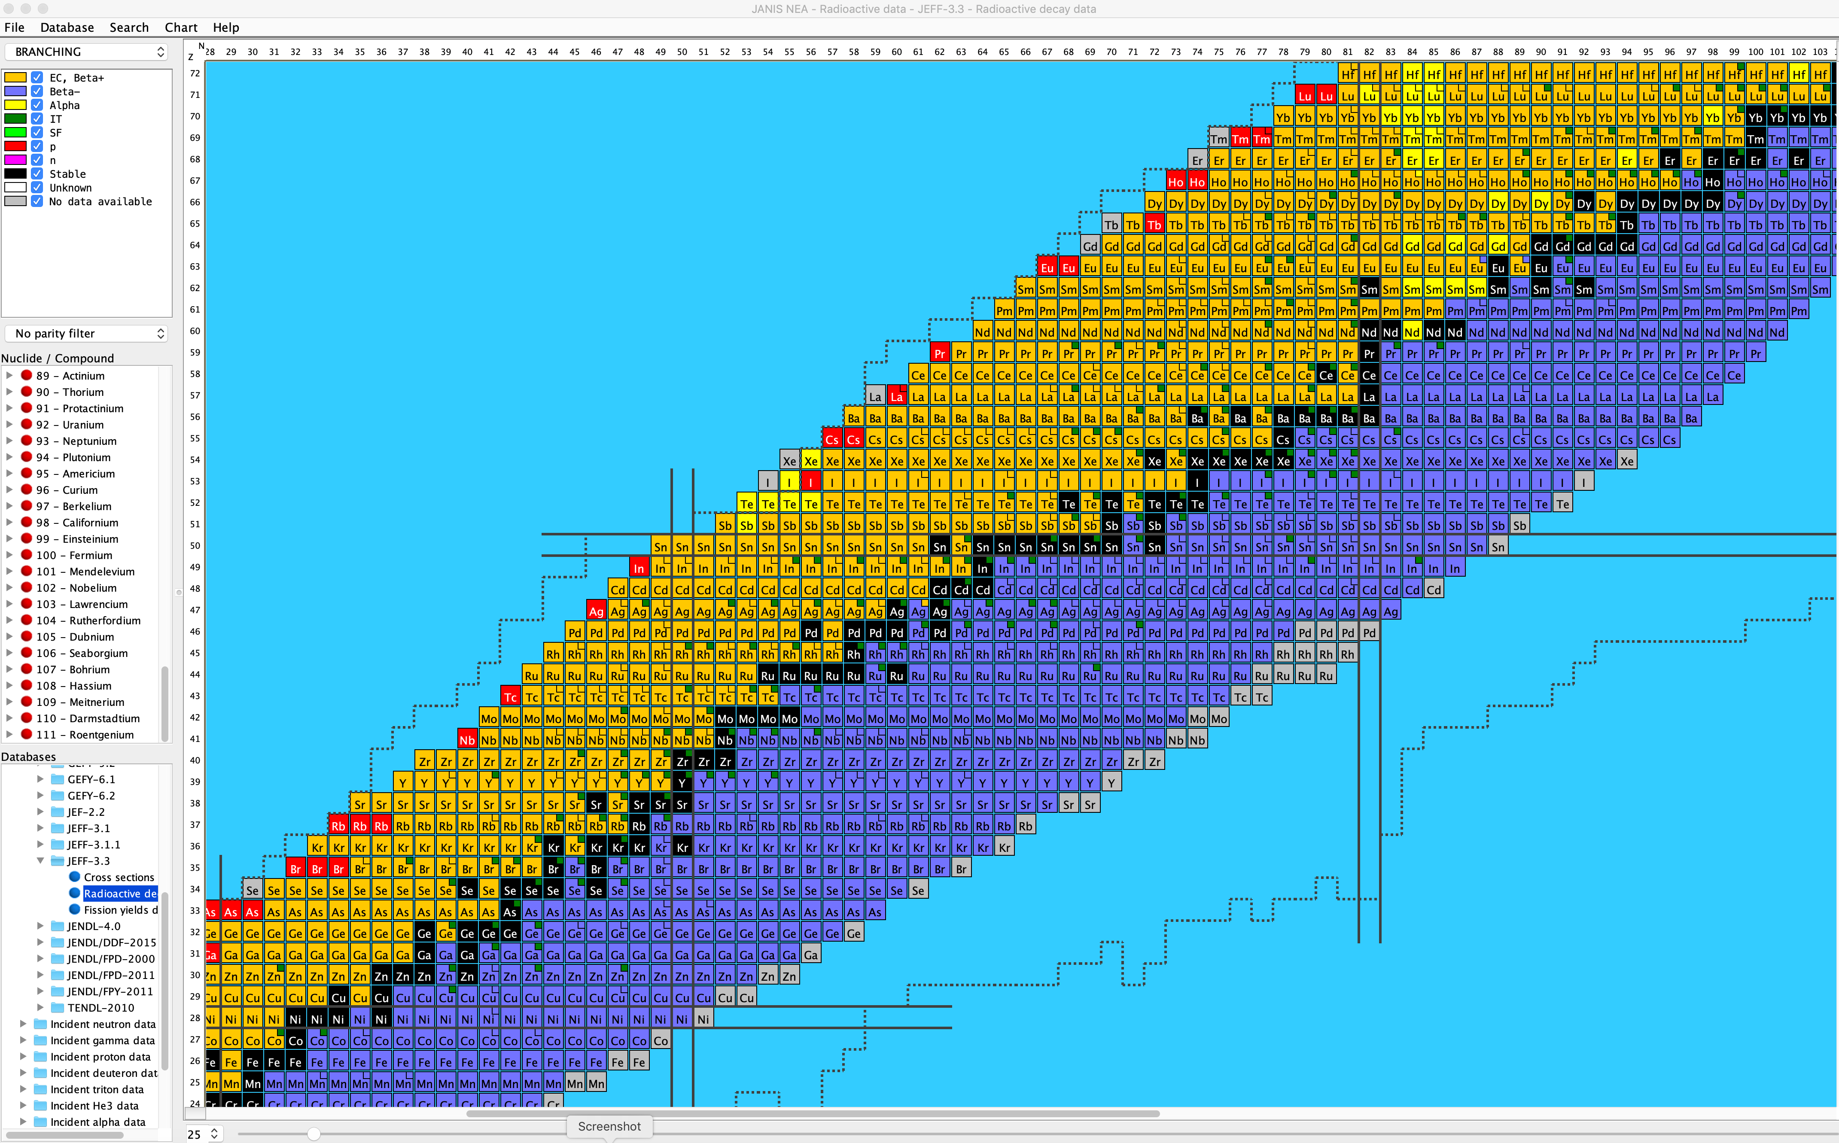
Nuclear landscape: isotopic residuals & decays
Radioactive decay products: 4035 “daughters” or “residuals”
UK Decay Data series
EAF series to 2007 ✘
Decay_2012
Decay_2020
Ground and isomeric daughters. Subtle difference
between discrete level, excited and isomeric state
Uniquely defined by the
Elevel and T_{1/2}
MF8 contains the unique
daughter metastable Elevel from mainly RIPL-4
ENDF ⧣ ENSDF

Slide 14
NJOY-2016 & CALENDF-2010 processing steps
  0 Kelvin run
  Single temperature pendf, 294 Kelvin to… 100 KeV
  UNRESR: URR processing, because…
  PURR: URR PTs processing
  GASPR: independent gas production
  HEATR: n only or n + g heating, two runs 7 + 4 responses
  MIXR: elemental reconstruction
  ACER: energy-angle outgoing, graphical checks
  GROUPR: MF3-mt5*MF6 implicit processing
  PENDFs, GENDFs
  Ace c, t, y, u & h, o, a
  Group data MF3,10, 8, 9
0 Kelvin run
Single temperature pendf, 294 to… 1200K
CALENDF: RRR & URR PTs from 0.1 eV to E_{h}
PTs in MF50

Slide 15
PREPRO-2023 processing steps
  0 Kelvin run
  Single temperature pendf, 294 Kelvin to… 100 KeV
  SIXPACK: MF3-mt5*MF6 “implicit” processing
  ACTIVATE: MF9 processing
  LEGEND: tabulated angular distribution
  SPECTRA: tabulated outgoing energy distribution
  MERGER: merge NJOY2016 dpa, kerma, pendf responses on pendf
  GROUPIE: 1102 grps @ 1 GeV
  1067 grps @ 200 MeV
  1025 grps @ 30 MeV
  615 grps @ 10 eV
  162 gprs @ 200 MeV (for charge particle)
  MF2 processed, but also kept in for further usage (target yield)
  The resulting hendf or pendf or gendf “tape” fully comply to the ENDF-6 format frame and many utilitarian process (display, merge, concatenate, etc. ) can be performed on such data forms

Slide 16
Group structure - 1102 groups
For all target nuclides, applications, libraries alike
50 equal U per decade
237 grps
Equal energy 0.025 eV
378 grps
50 equal U per decade
285 grps
Equal energy
200 KeV
125 grps
50 equal U per decade
27 grps
Equal lethargy
50 grps
Thermal
Resonance fine
Resonance shielded
Fast Fusion
Fast
High Energy
1e-5 eV 0.55 eV 10 eV 5 MeV 30 MeV 100 MeV 1 GeV
615 groups 1025 groups
237 fine groups for proper 1/E < 0.55 eV
378 fine groups in the resonance range < 10 eV
Resonance shielded data available in the RRR (>0.1 eV) up to the end of the URR for all nuclides IDs
Fast fine enough structure for accurate threshold reaction rate

Slide 17


They pave the way - Harry Bateman mathematician FRS
EAF series:
1, 2, 3, 4 ✘ -99,
2001, 2003, 2005, 2007, 2010 ✘
TENDL series: 2008, 2009, 2010, 2011, 2012, 2014, 2015, 2017,
2019, 2021,
2023, 2025…
GEFY series:
4.2, 5.2, 5.3, 6.1,
6.2, 7.1, 7.2, 8.1,
9.1, 10.1…
The model codes:
ALICE
STAPRE
SAFEPAQ
GEF
TALYS
…
The 1920s
Jarvis O. N., ”Description of the Transmutation and Activation Data Library UKCTR-III-A”, (1980), AERE-R9601

Slide 18
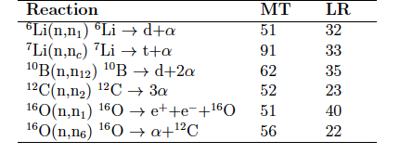
Reactions – ENDF rules – n entrance
neutron production MTs to ground, exited states or continuum with further breakup
Particle transport code generally handles prompt outgoing n, γ, e,.. < 10⁻¹⁶ s
Materials sciences tends to follows elemental residual and emitted Z<4 production
Inventory code need to be able to follows all possible combinations: parent, daughter, emitted, through nuclear chain reactions, breakup and decays
Time matters 10⁻⁶s to millennia, isomeric states (# excited levels)

Slide 19
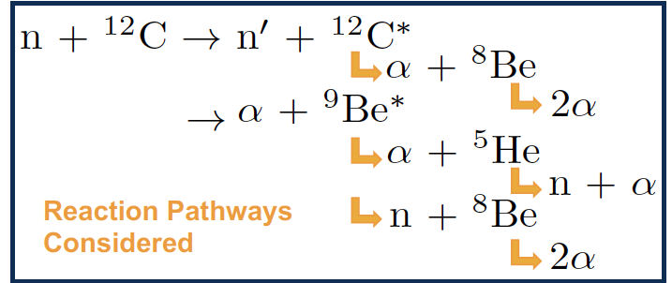
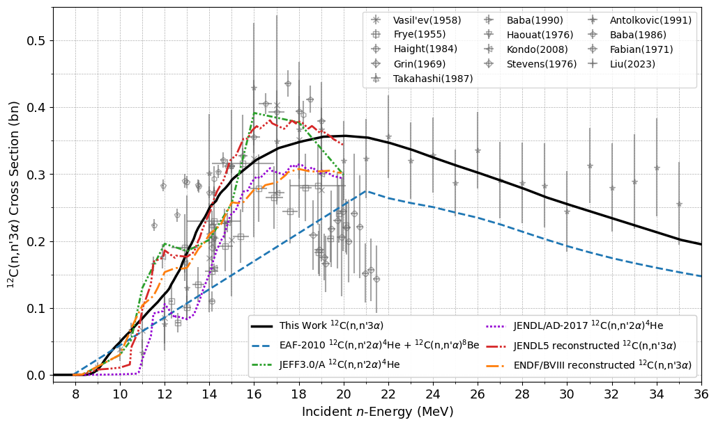
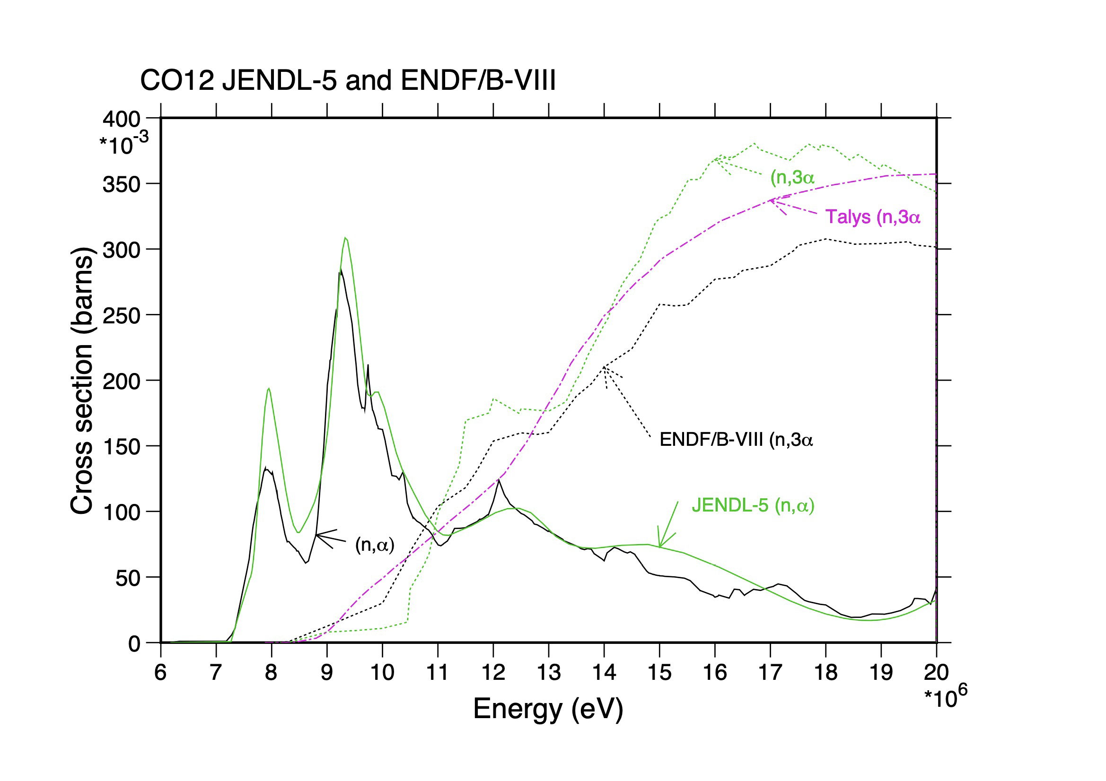
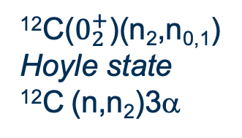
Processing steps, breakup, LR flags
¹²C($0_{2}^{+}$)(n₂,n_{0,1})
Hoyle state
¹²C (n,n₂)3α
EXFOR recorder quantity ??
EXFOR ¹²C(n,2a+n)⁴He and ¹²C(n,X)⁴He ??
Compiled as MT=29, n2α !!! one α residual ??
EXFOR data, not particularly reliable !!!
¹²C full breakup: (n,3α
Inelastic channels LR=23 flag ➔ derived form MT=23, constructed during processing
Energy range well above R-matrix code capability so HF TALYS, no discrete level on ¹²C, ⁹Be and ⁸Be

Slide 20
LR’s flag processing steps
JENDL-5, JEFF-4.0 and ENDF/B-VIII.1 “additional” channels
Targets | JENDL-5 | JEFF-4.0 | ENDF/B-VIII.1
Li006 | 32=+( 51, 56)+( 58, 86) | 32=+( 51, 56)+( 58, 86)
Li007 | 33=+( 52, 84) | 33=+( 52, 82) | 33=+( 52, 82)
Be009 |  | 30=+(875,885)
B010 | 35=+( 61, 89) | * | *
C012 | 23=+( 52, 91) |  | 23=+( 52, 91)
O016 | 22=(22, 22)+( 55, 79)
*
20=+( 55, 56)+( 58, 61)+( 63, 63)+( 66, 67)+( 69, 69) temp. 21=+( 72, 72)+( 75, 75)+( 82, 82)+( 85, 85). temp. 22=+( 20, 21) α emitted 28=+( 65, 65)+( 78, 78) p emitted 33=+( 62, 62)+( 68, 68)+( 71, 71)+( 73, 74)+( 76, 77) t emitted 34=+( 79, 81)+( 83, 84) ³He emitted 35=+( 33, 34) d2α emitted
JEFF-4.0 C012 MT=23 explicit, from TALYS
JEFF-4.0 Be009 MT=30 from partials (n,2n_{x})
Complex sums, sometimes only clearly described in MF1-mt451

Slide 21
LRs flags impact & subtility
Usually transport codes do not transport, track all breakup secondaries.
NJOY-gaspr keeps track of the total production of light particles ^{1,2,3}H & ^{2,4}He as residual ¹H(n,2n)²H, ⁹Be(n,2n)2α and emitted but as single responses: MT203 to 207, no residual tracking possible
Traditionally inventory codes only processes the inelastic partials when super-elastic: the residual is an isomer (T_{1/2} > 10⁻³s ≠ discreet state, level).
Reduced chains inventory simulations only accept simple MTs with residual: (n,2a)⁴He instead of breakup (n,3a , e.g. SERPENT CRAM solver.
Breakup usually means burnup, target disappearance event, like handling fission target inventory in a way
In cases, the yield per reaction for the light product, breakup residual may be tabulated directly (and even fractional) when a MF6 is used.

Slide 22
Conclusions
Reactions: MF3 cross-section, MF10 partials, MF9 branching ratio, MF8 dictionary for mt5*MF6 radionuclide production, MF12 photon production
Decays & Fission product yields: MF8 subtility, correspondence between excited and isomeric state
Covariances: MF33-40 (-34,35?)
Rather complex, unique to a target, processing steps are necessary to account for the LR flags in Inventory, radiation Source Term simulations.
Without such additional steps inventory systems cannot account for breakup, burn, deplete properly, have the target disappear when it should.
In the major libraries it impacts ⁶Li, ⁷Li, ⁹Be, ¹⁰B, ¹²C and ¹⁶O inventory under n-irradiation.
JENDL-5, ENDF/B-VIII.1 and JEFF-4.0 Multiphysics Inventory, radiation Source Terms IrST application libraries for FISPACT-II now includes these additional steps.

Slide 23
The Nuclear Observables of the Lesser Gods a playful mythological analogy for inventory, radiation source terms observables
In the grand pantheon of nuclear physics, all observables live on mount NucleOlympus, but not all enjoy the same fame.
⚡ The “Major Gods” at the summit sit the well‑known, mighty deities:
Elastic scattering, Zeus himself - ruler of reaction channels, consulted by all.
Prompt gammas, Apollo - bright, immediate, shining with clarity.
Fission observables, Poseidon - powerful, dramatic, sometimes destructive.
Neutron multiplicities and spectra, Hera - ever-watchful, essential to the harmony of the realm.
These are the observables that everyone quotes, measures, models, argues about, and builds facilities for. They get the temples, the offerings, the citations.

Slide 24
The Nuclear Observables of the Lesser Gods a playful mythological analogy for inventory, radiation source terms observables
And then, a little further down mount NucleOlympus, dwell the humble radiation observables. Not weak — just quietly powerful.
🔥 The “Lesser Gods” :
Activities and radiations, the tireless Hephaestus, hammering away in the workshop long after the beam is off.
Decay gammas, the Hestia of the family — steady, constant, the warm glow at the hearth.
Cumulative and independent yields, the Fates, weaving the threads of fissions events.
Isomeric ratios, the mysterious Hermes, messenger between ground states and metastable realms.
Integral reaction rates, the Demeter of the group — nourishing the fields of dosimetry, radionuclides production and diagnostics.
They don’t draw lightning or split mountains, but when the great Gods are silent or unreachable, it is the lesser Gods who speak.
Playwright: G. Schnabel & Co

Slide 25
Complementary slides
Software - https://github.com/fispact/PATHFINDER
PATHFINDER
Paper reference -> P. Kanth, M.R. Gilbert, D. Foster, PATHFINDER: A tool for calculating pathways for fusion-activated materials, in: 31st International Conference Nuclear Energy for New Europe, 2022.

Slide 26
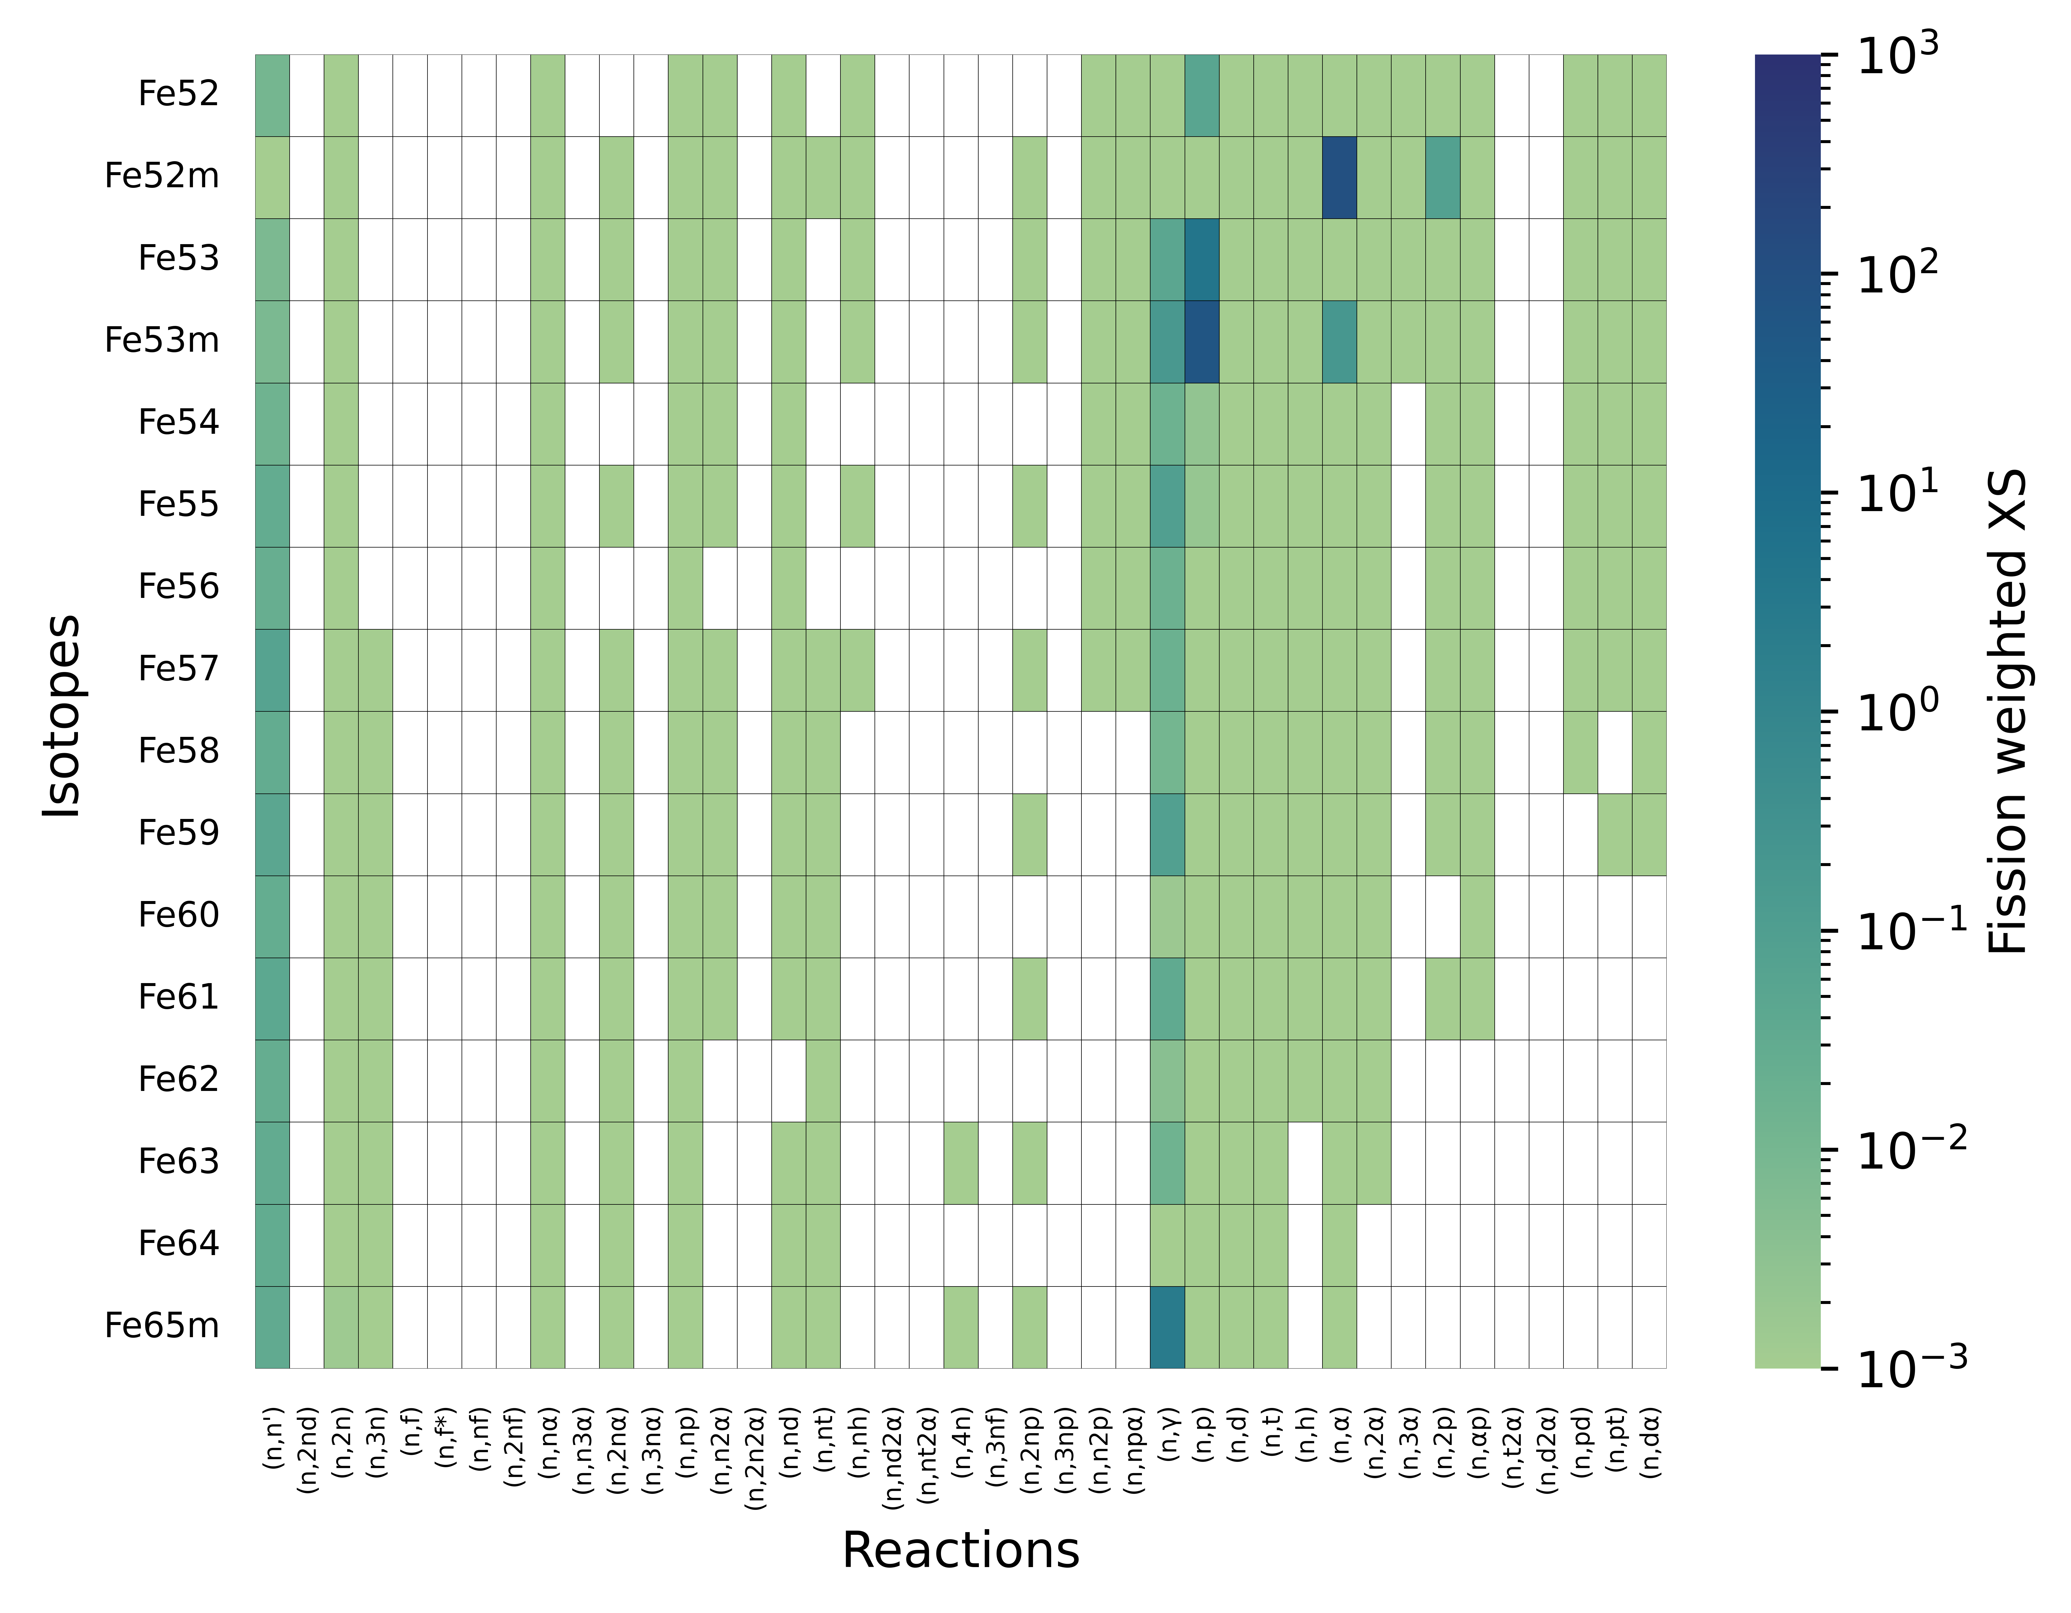
Fission weighted XS – TENDL-2025
Fe isotopes
T_{1/2} > 1. s
white box
=
no xs data
Courtesy: P. Kanth

Slide 27
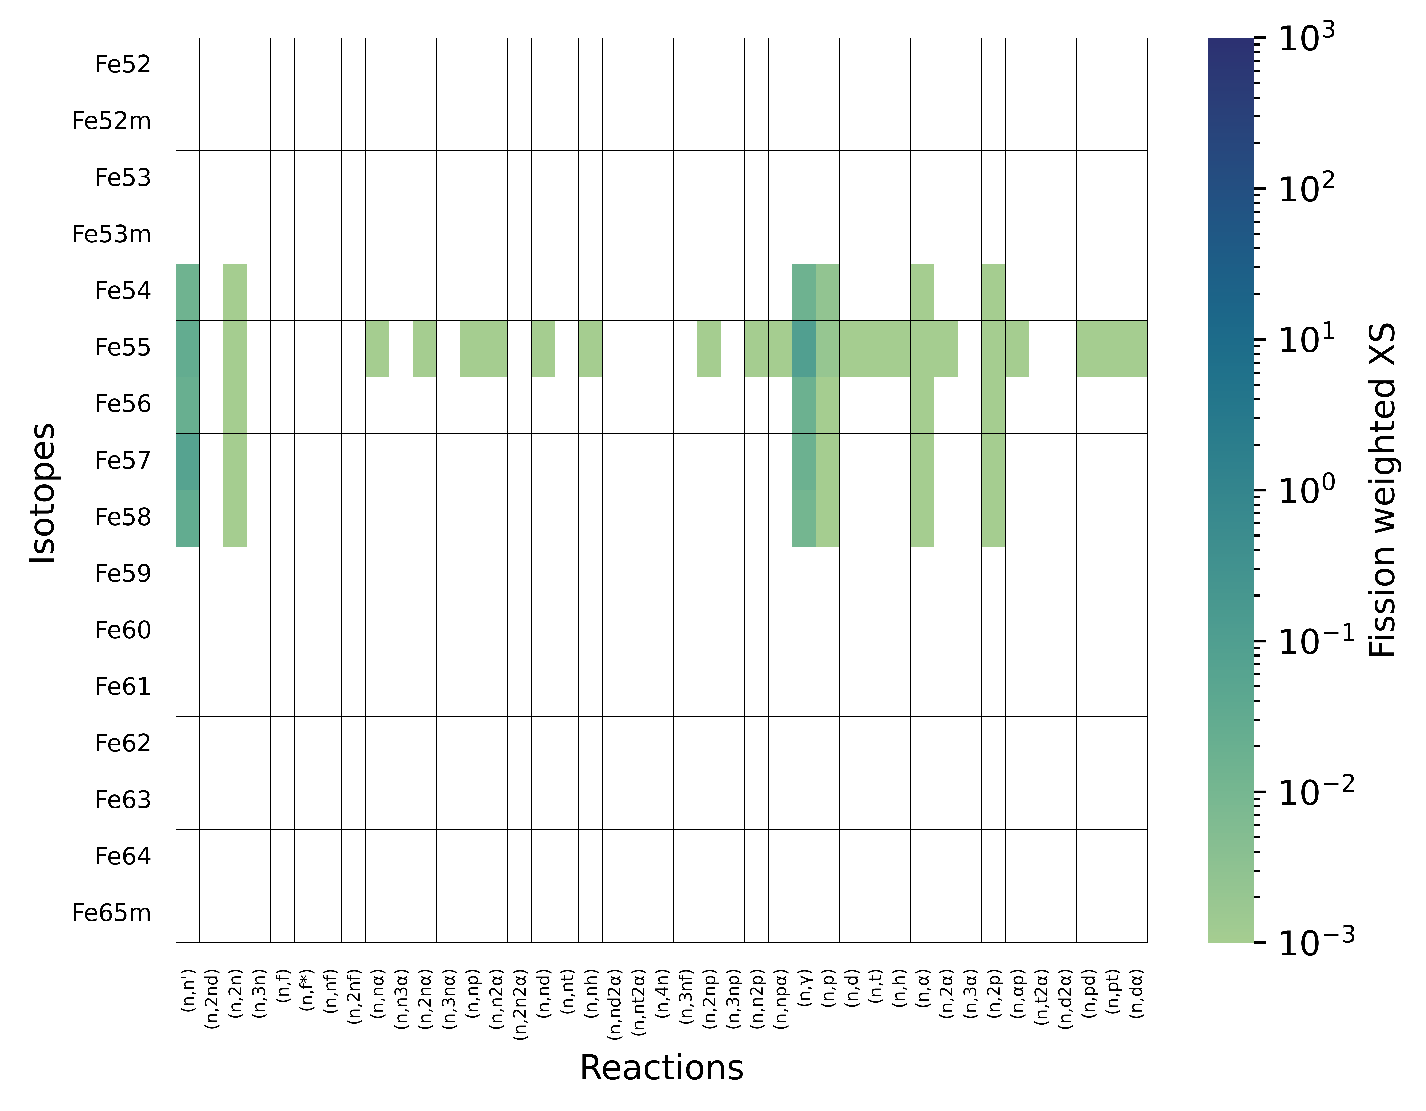
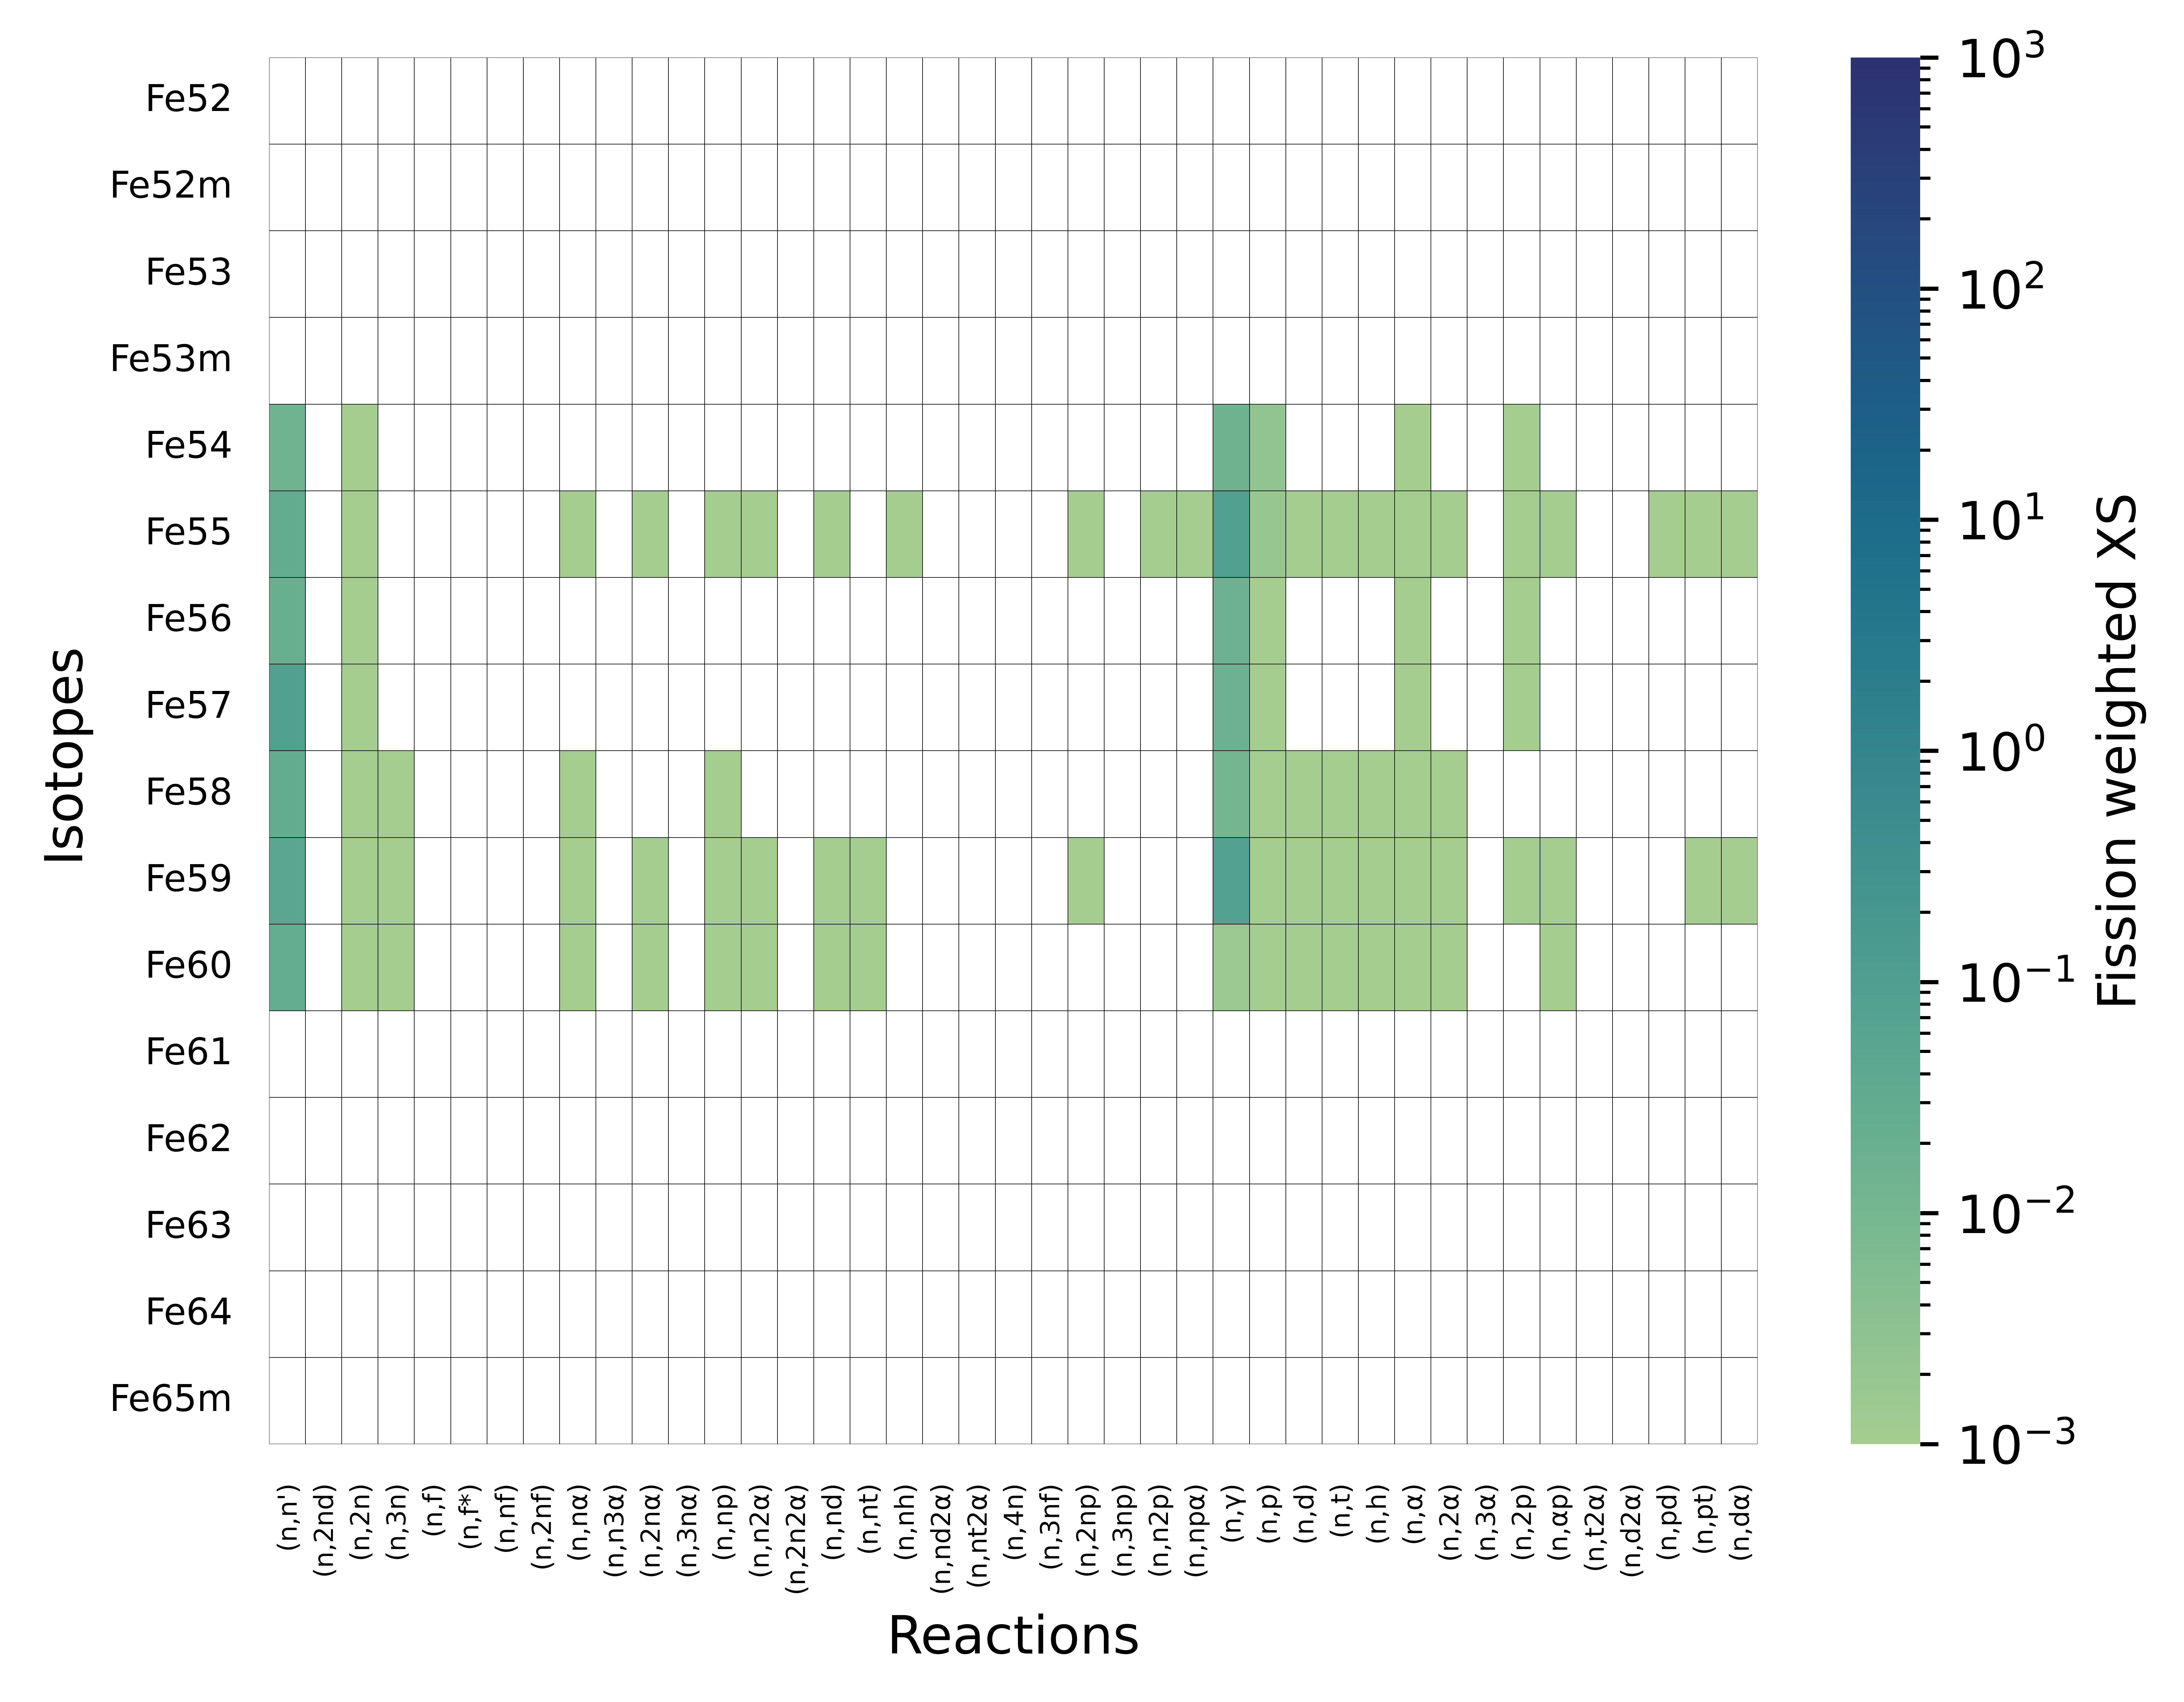
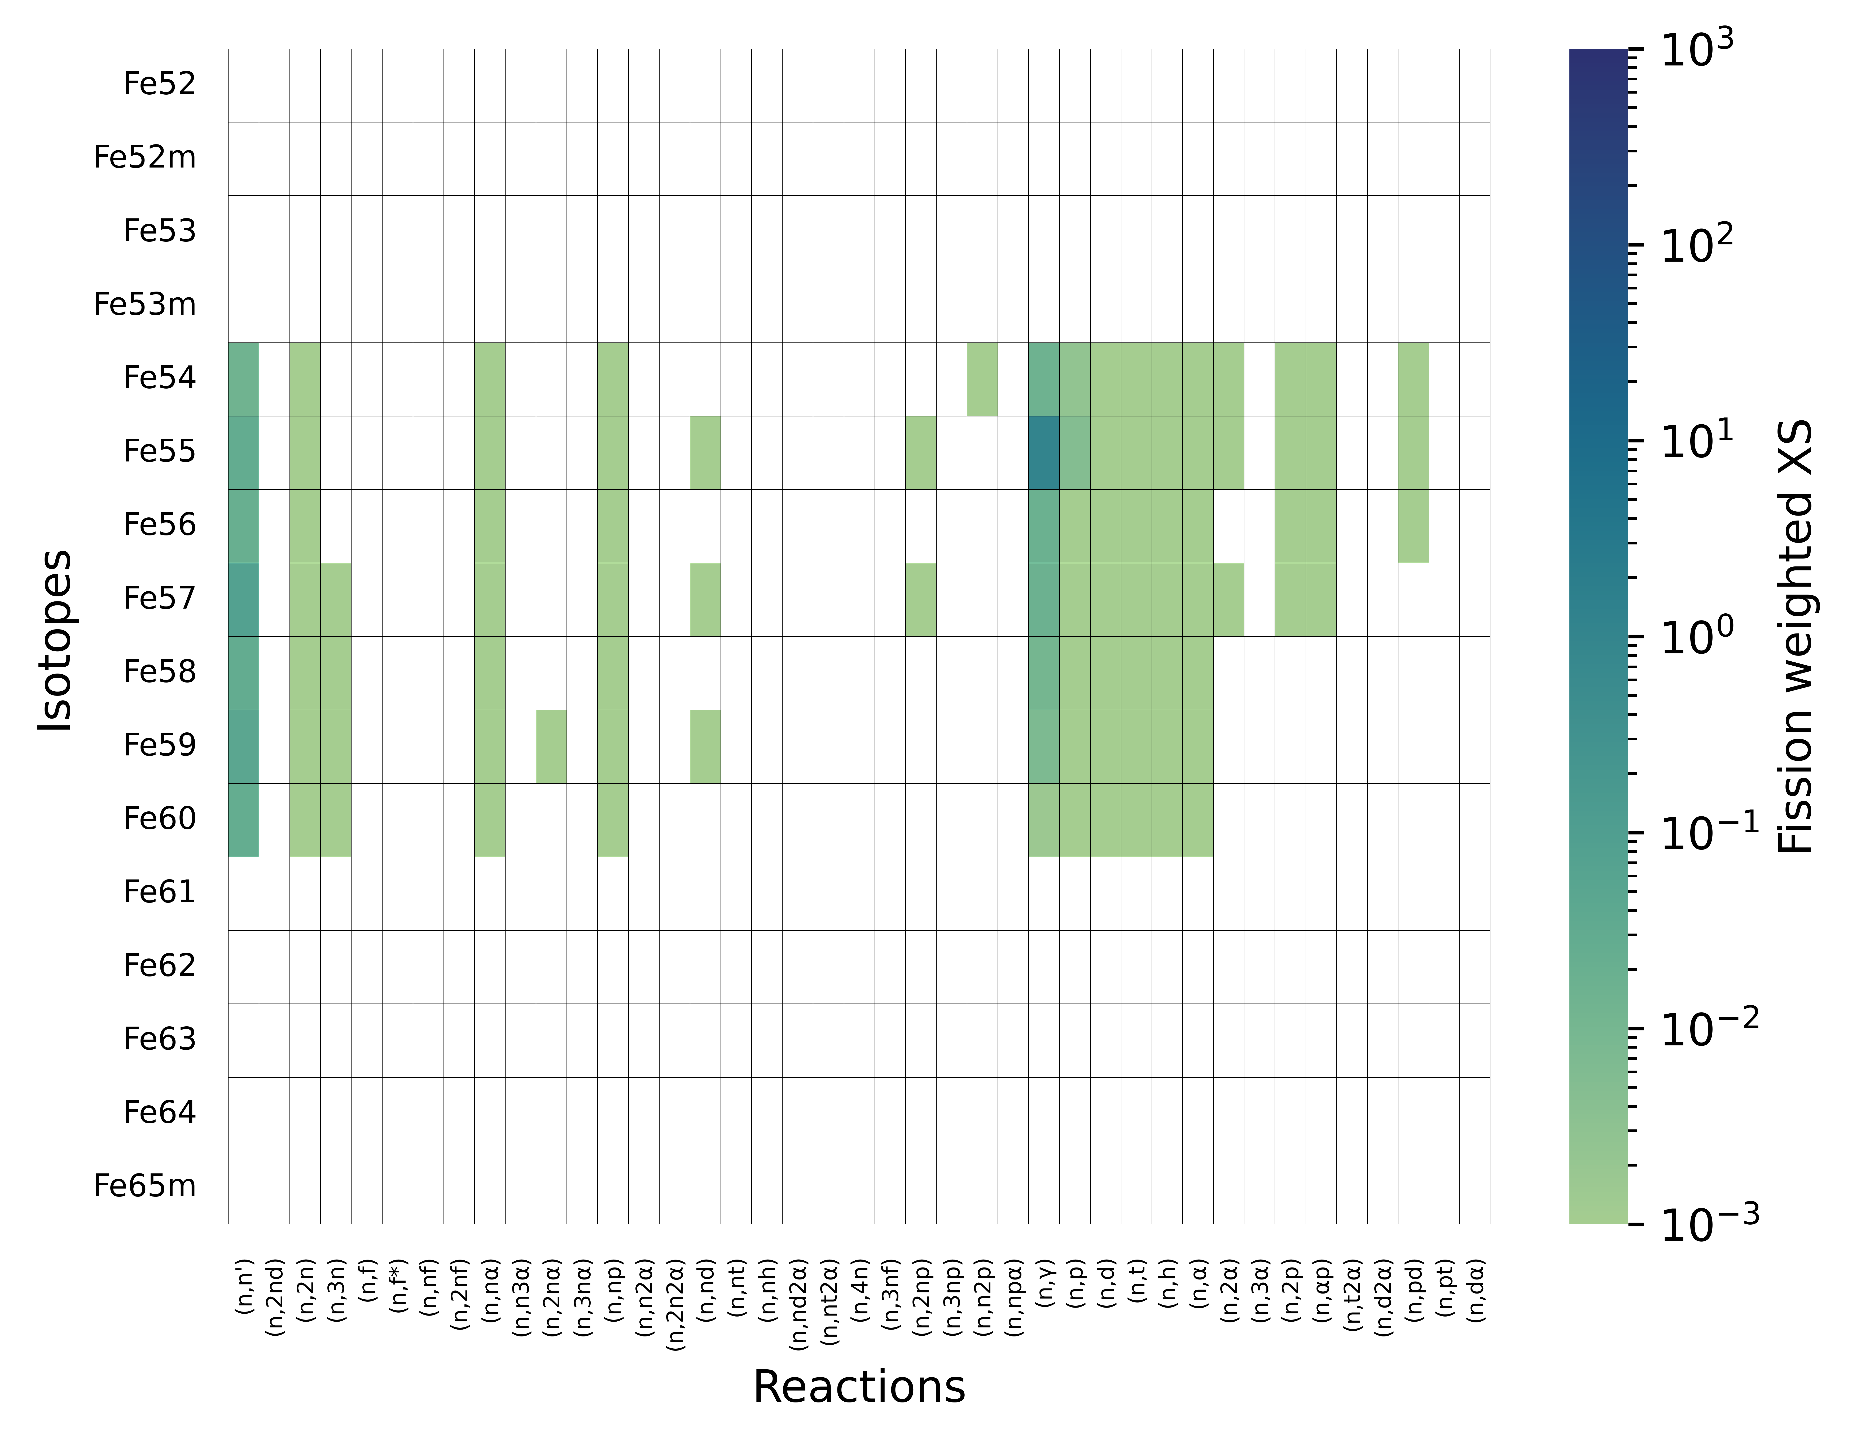
Fission weighted XS
ENDB/B-VIII.1
JEFF-4.0
TENDL-2025
JENDL-5

