Slide 1
One brick after another:
Solid foundations for accelerated progress in FENDL and TENDL
Georg Schnabel
IAEA / NAPC / Nuclear Data Section

Slide 2
Outline
History and evolution of the FENDL fusion nuclear data library
Key ingredients of the comprehensive TENDL nuclear data library
Recent developments in the FENDL project
Potential future infrastructure directions

Slide 3
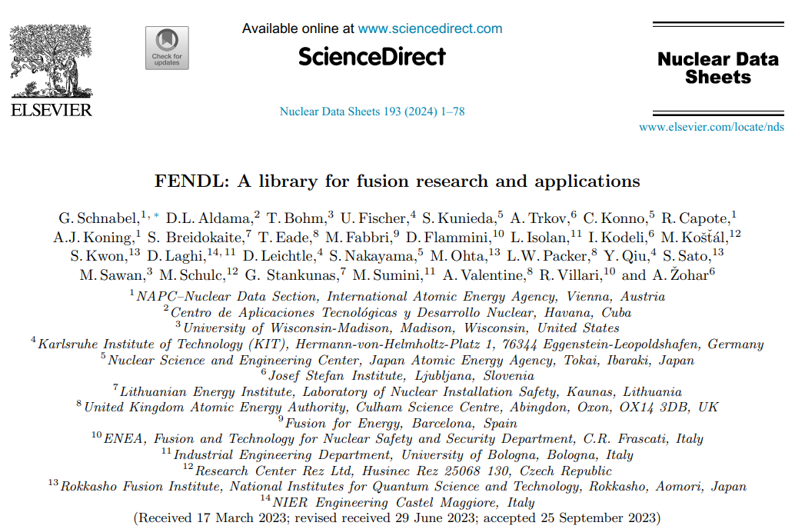
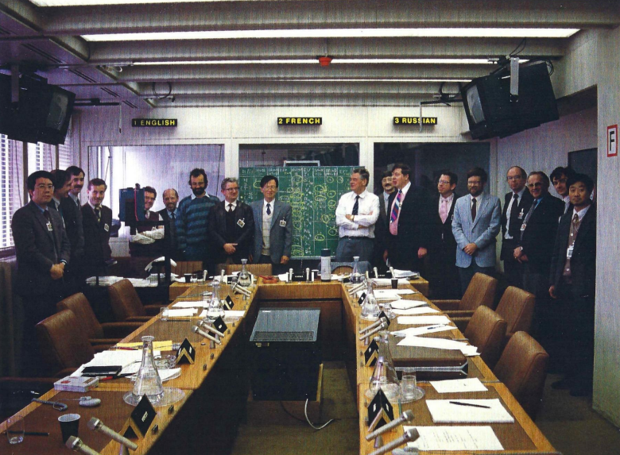
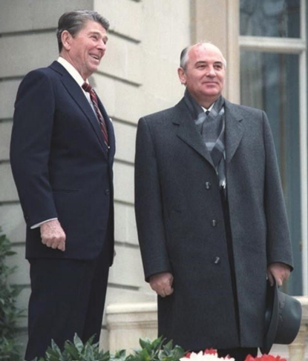
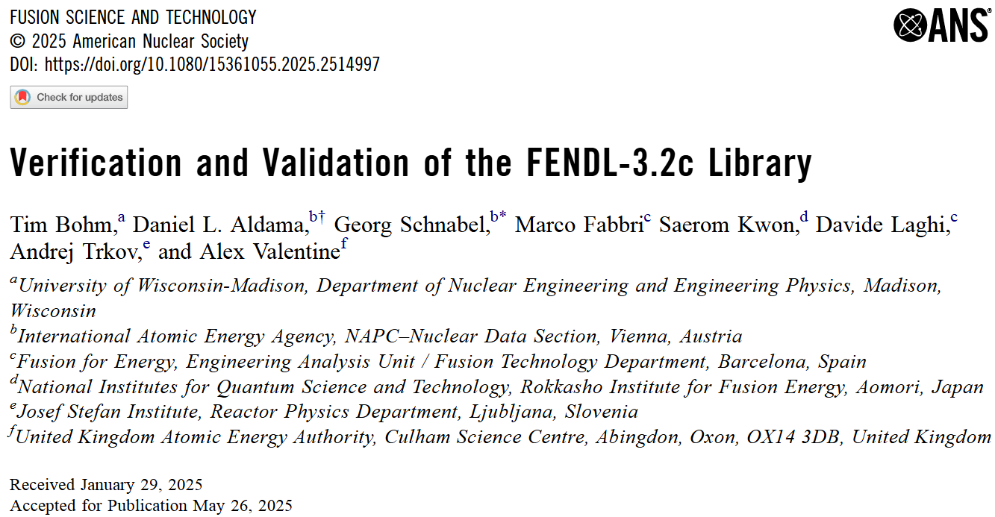
FENDL
Recent releases FENDL-3.2b and FENDL-3.2c
Reagan and Gorbachev
at Geneva summit 1985
Idea of cooperation on peaceful fusion energy research
FENDL’s birth:
IAEA Specialists Meeting on
“Fusion Evaluated Nuclear Data Library Related to the ITER Activity”
IAEA, Vienna, 16-18 Nov 1987
Information and pictures from U. Fischer presentation at IAEA Consultancy Meeting on “Further Development of FENDL”, 30 Oct-2 Nov 2023
History of collaboration

Slide 4
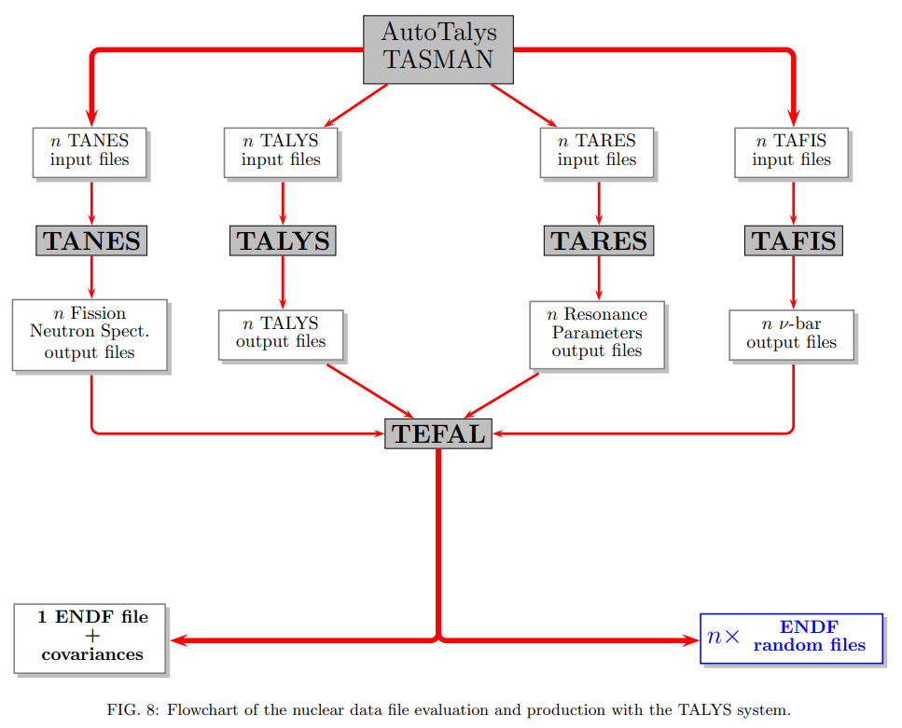
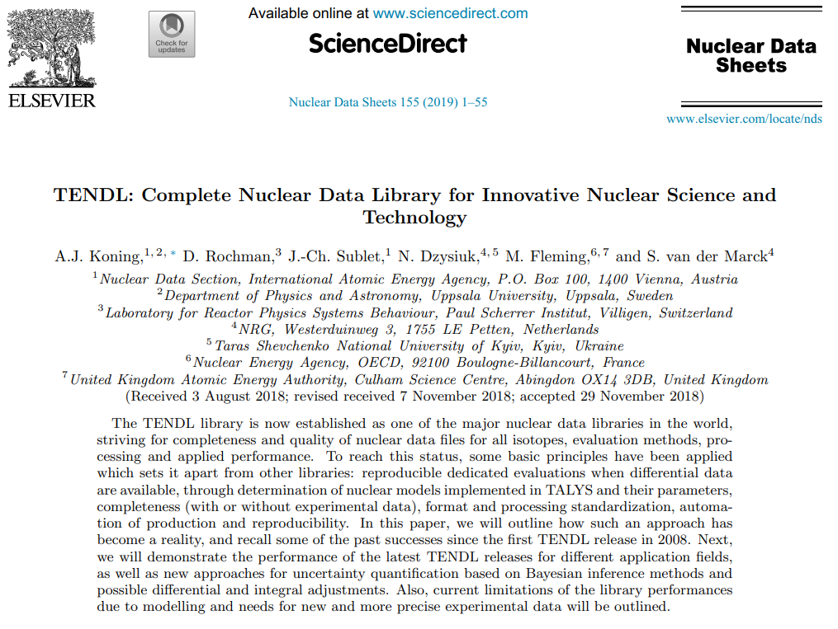
TENDL
Figure taken from
A.J. Koning and D. Rochman “Modern Nuclear Data Evaluation
with the TALYS Code System,” Nuclear Data Sheets 113 (2012)
automated and comprehensive

Slide 5
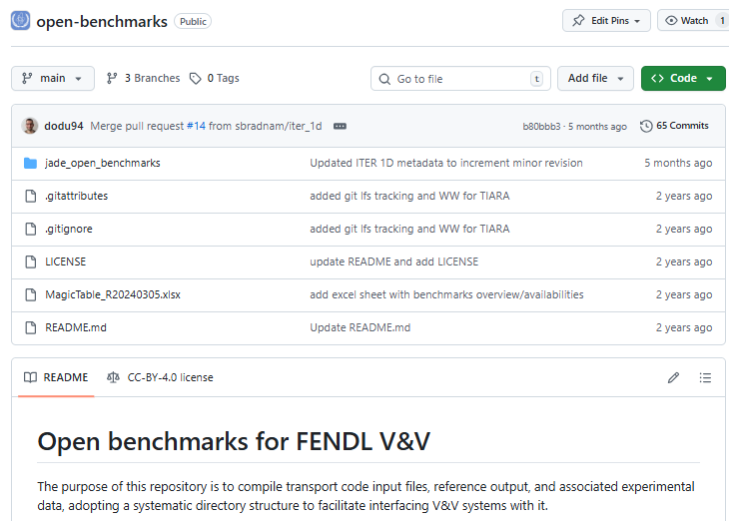

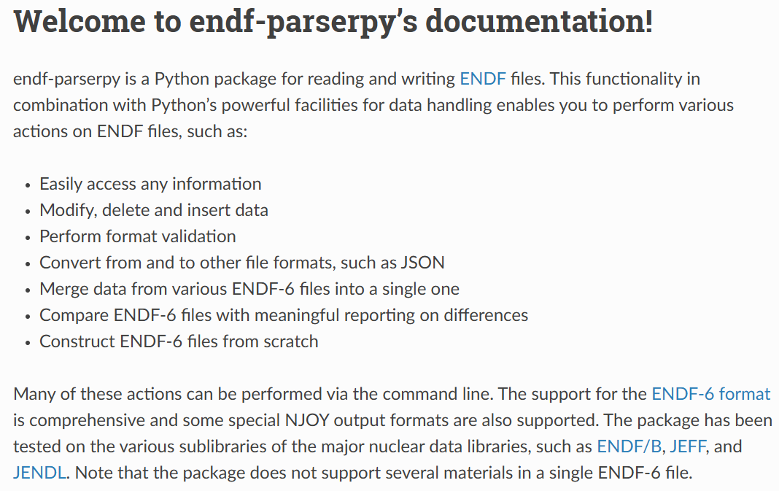
FENDL-related developments
Public benchmark repository
Open-source V&V automation tool
Nuclear data editing toolkit
https://github.com/JADE-V-V/JADE
https://github.com/IAEA-NDS/open-benchmarks
Partly based on CoNDERC:
https://nds.iaea.org/conderc/

Slide 6
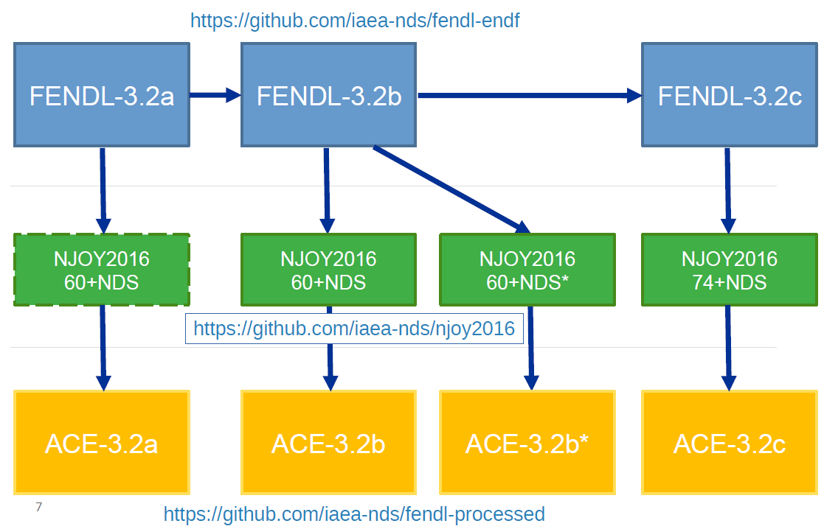



Transparent tracking of library development
Mirror of https://github.com/njoy/NJOY2016 (LANL) with IAEA-NDS patches

Slide 7
Future developments: Improved tracing granularity
Future approach
Current approach
Nuclear data file
Angular distributions
Isomeric ratios
Nuclear data file
Excitation functions
Energy 2
Energy 1
Person A
Person A
Cross Sections 2
Cross Sections 1
Nuclear data file’
Time
Nuclear data file’
Angular distributions
Person B
Isomeric ratios
Nuclear data file’’
Excitation functions
Energy 2’
Energy 1
Cross Sections 2
Cross Sections 1

Slide 8


Future developments:
Improved inter-institutional nuclear data tracking
Nuclear data file
Future approach
Current approach
Excitation functions
Energy 2
Institution 1
Person A
Cross Sections 2
Nuclear data file’
Institution 2
One Server
Files + Tracking information
Excitation functions
Energy 2’
Institution 3
Cross Sections 2

Slide 9
Summary
FENDL remains a long-established library project developed by an international collaboration
TENDL has grown into a major library, grounded in core principles of robustness, comprehensiveness and automation, and is the basis of the FENDL activation library
Recent efforts within the FENDL community are strengthening traceability and expanding automation
Looking ahead, enhanced granularity of nuclear data and interoperability between data producers and users could significantly accelerate library development

