Slide 1
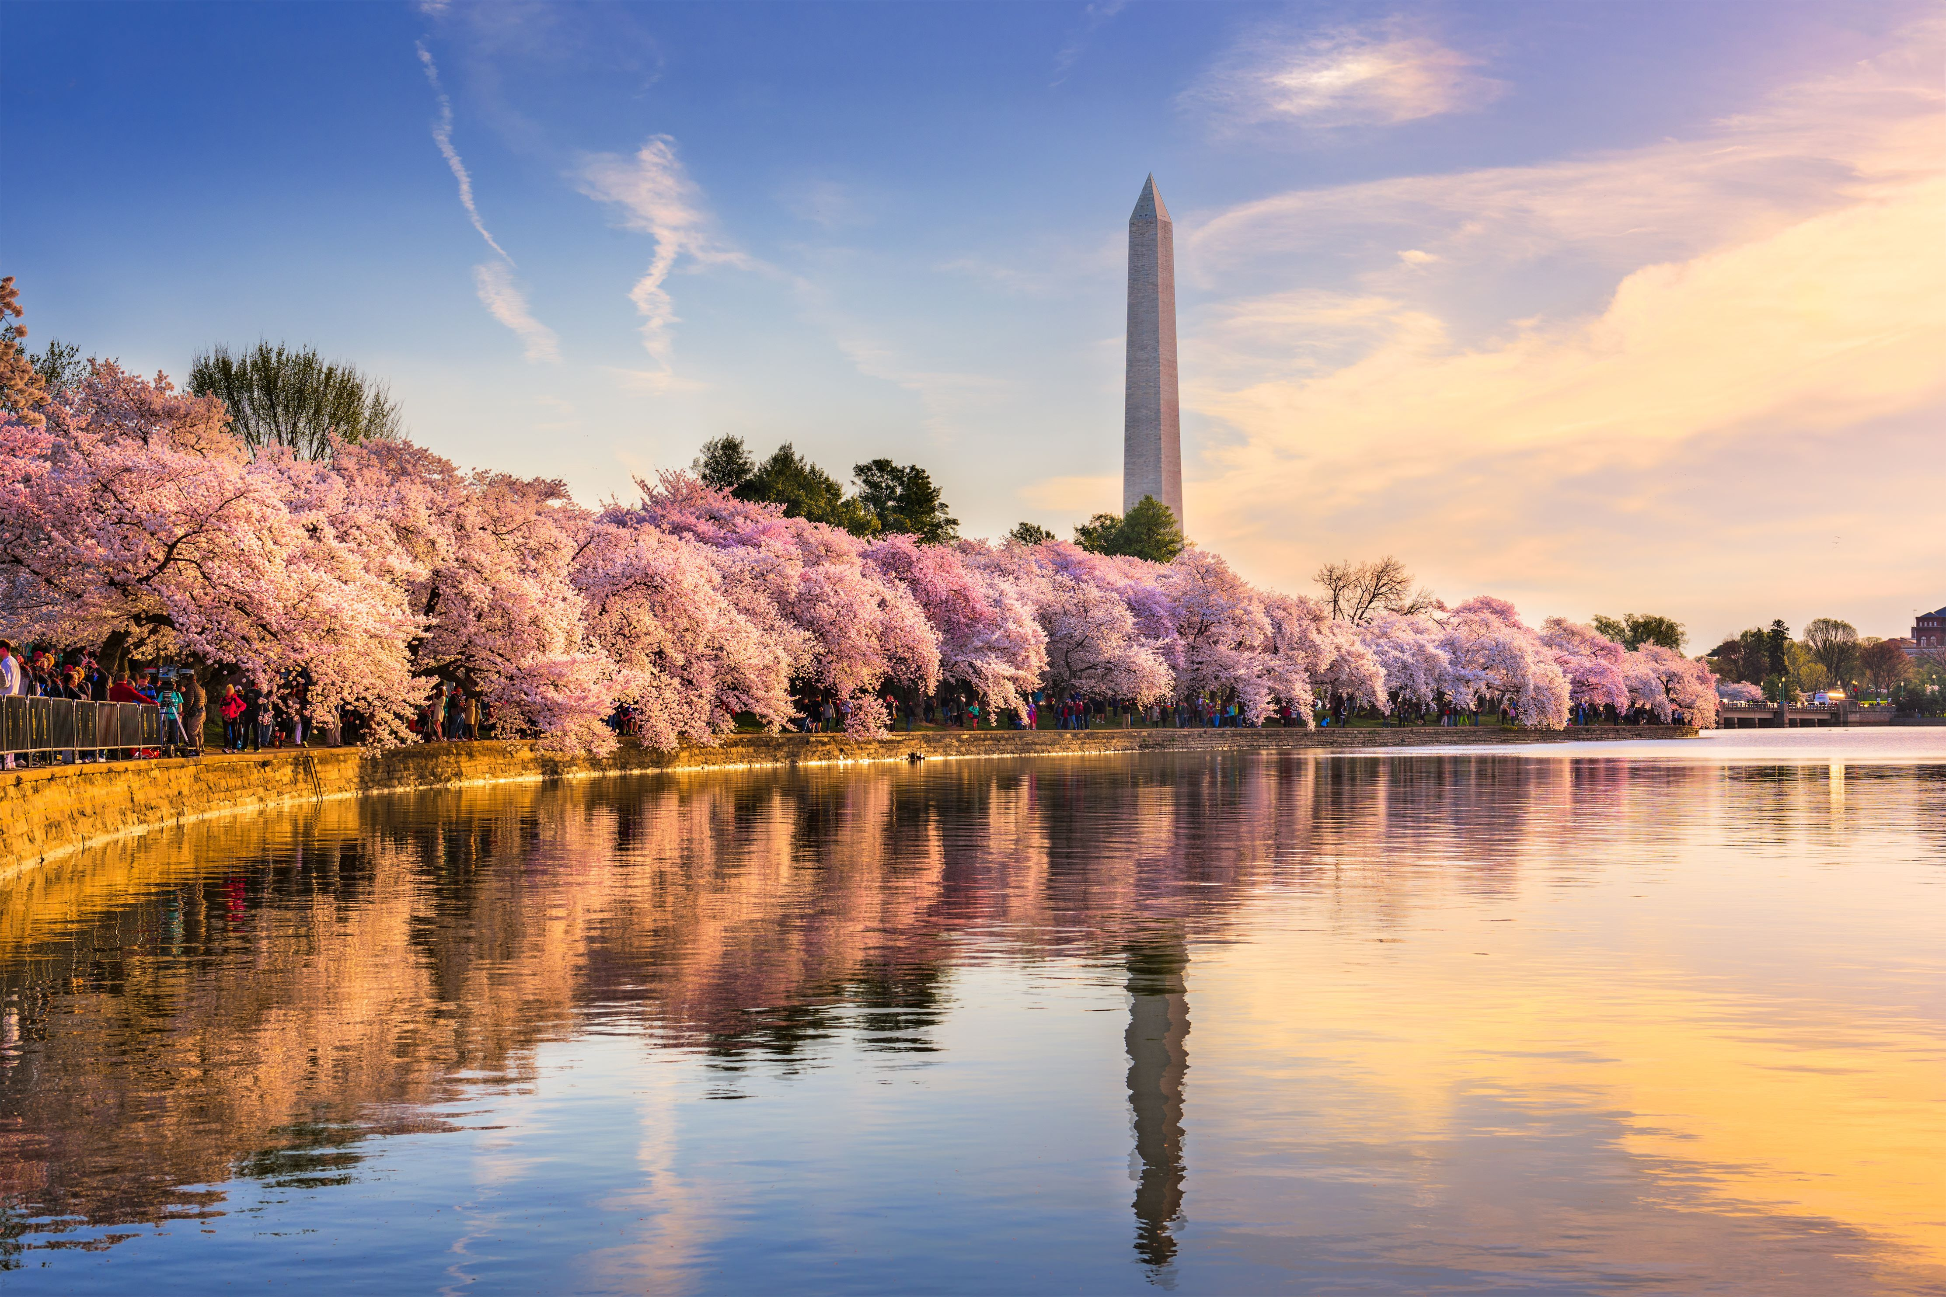
Welcome!
WANDA 2026
February 9th-12th
Workshop for Applied Nuclear Data Activities
Sponsored by the Nuclear Data Interagency Working Group

Slide 2
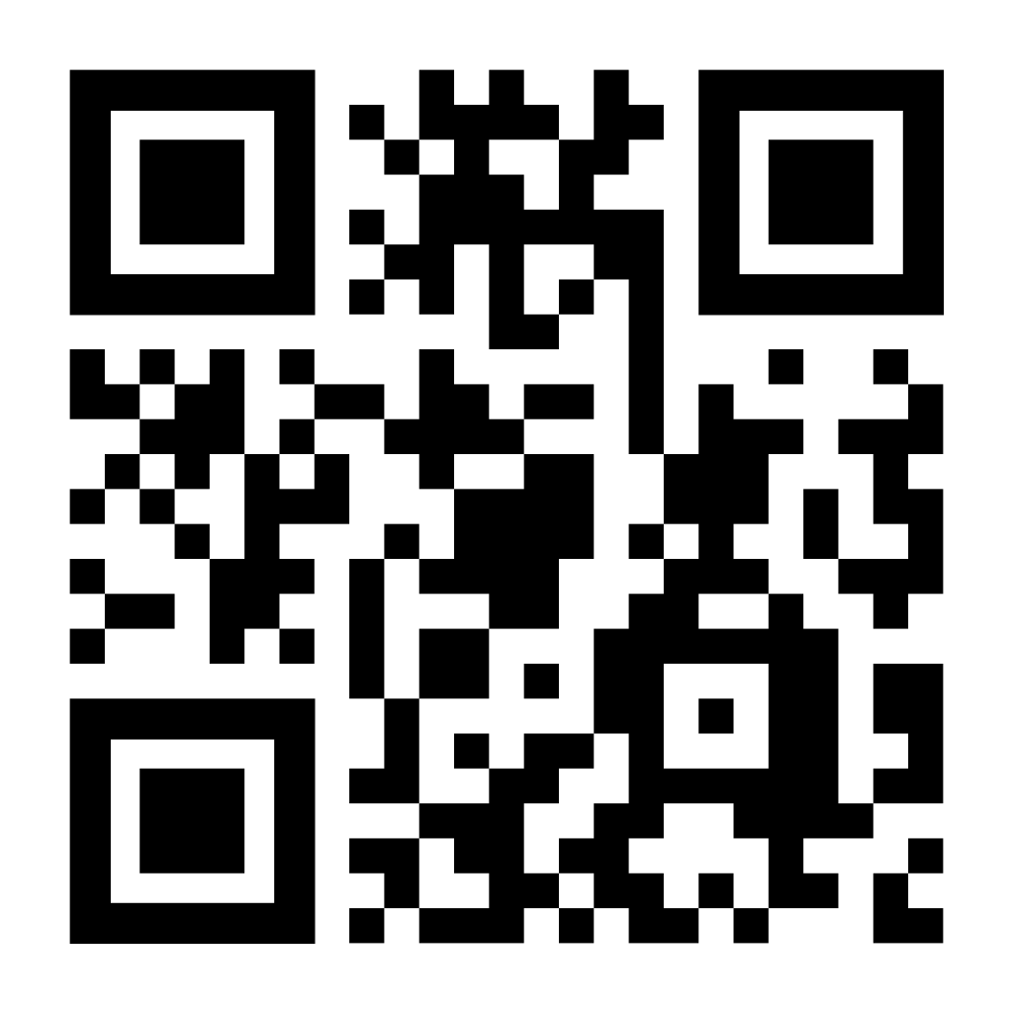
Workshop for Applied Nuclear Data Activities
Scan for:
Agenda
Poster Abstracts
Presentation Uploads
Have a question of concern? See Ellen or Stephanie up front, or Lisa at the Registration Desk!

Slide 3
Workshop for Applied Nuclear Data Activities
WiFi:
Hilton Honors Meeting
Password: DCANA
Have a question of concern? See Ellen or Stephanie up front, or Lisa at the Registration Desk!

Slide 4
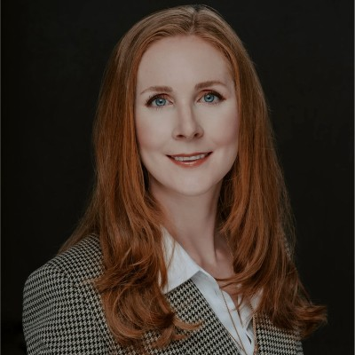
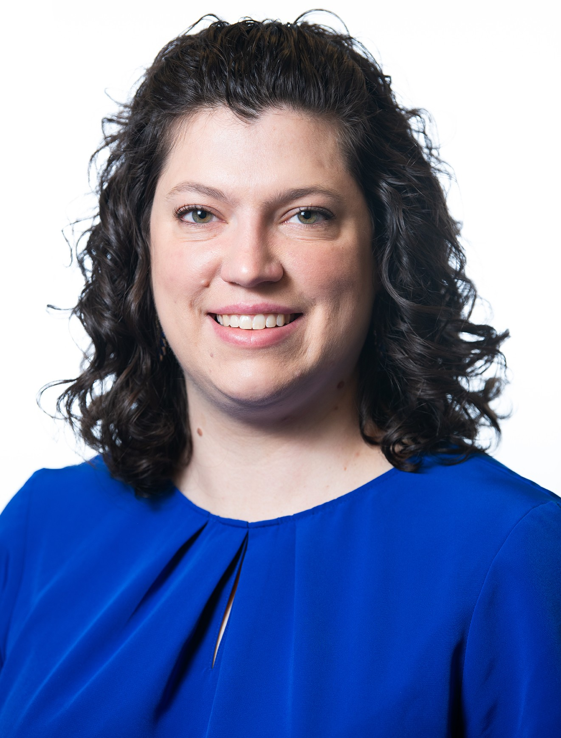
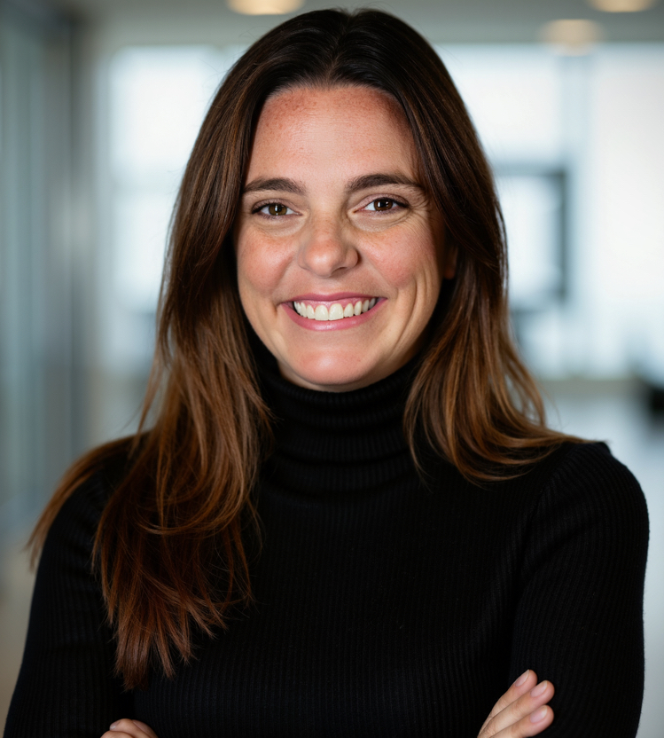
Workshop for Applied Nuclear Data Activities
Ellen O'Brien
Staff Scientist
Los Alamos National Laboratory
emobrien@lanl.gov
Stephanie Lyons
Staff Scientist
Pacific Northwest National Laboratory
stephanie.lyons@pnnl.gov
Lisa Felker
Logistical Coordinator
Lawrence Livermore National Laboratory
felker7@llnl.gov
Co-Chairs
Logistics

Slide 5

WANDA 2023
Workshop for Applied Nuclear Data Activities
We’re delighted to be at the Hilton Arlington National Landing this year
All sessions are in this room
The Monroe I and II are available for side discussions all week
225 registrants over the course of the week
Social (for those who registered) Wednesday evening, 6-8pm, at the Hilton in the Crystal Ballroom

Slide 6
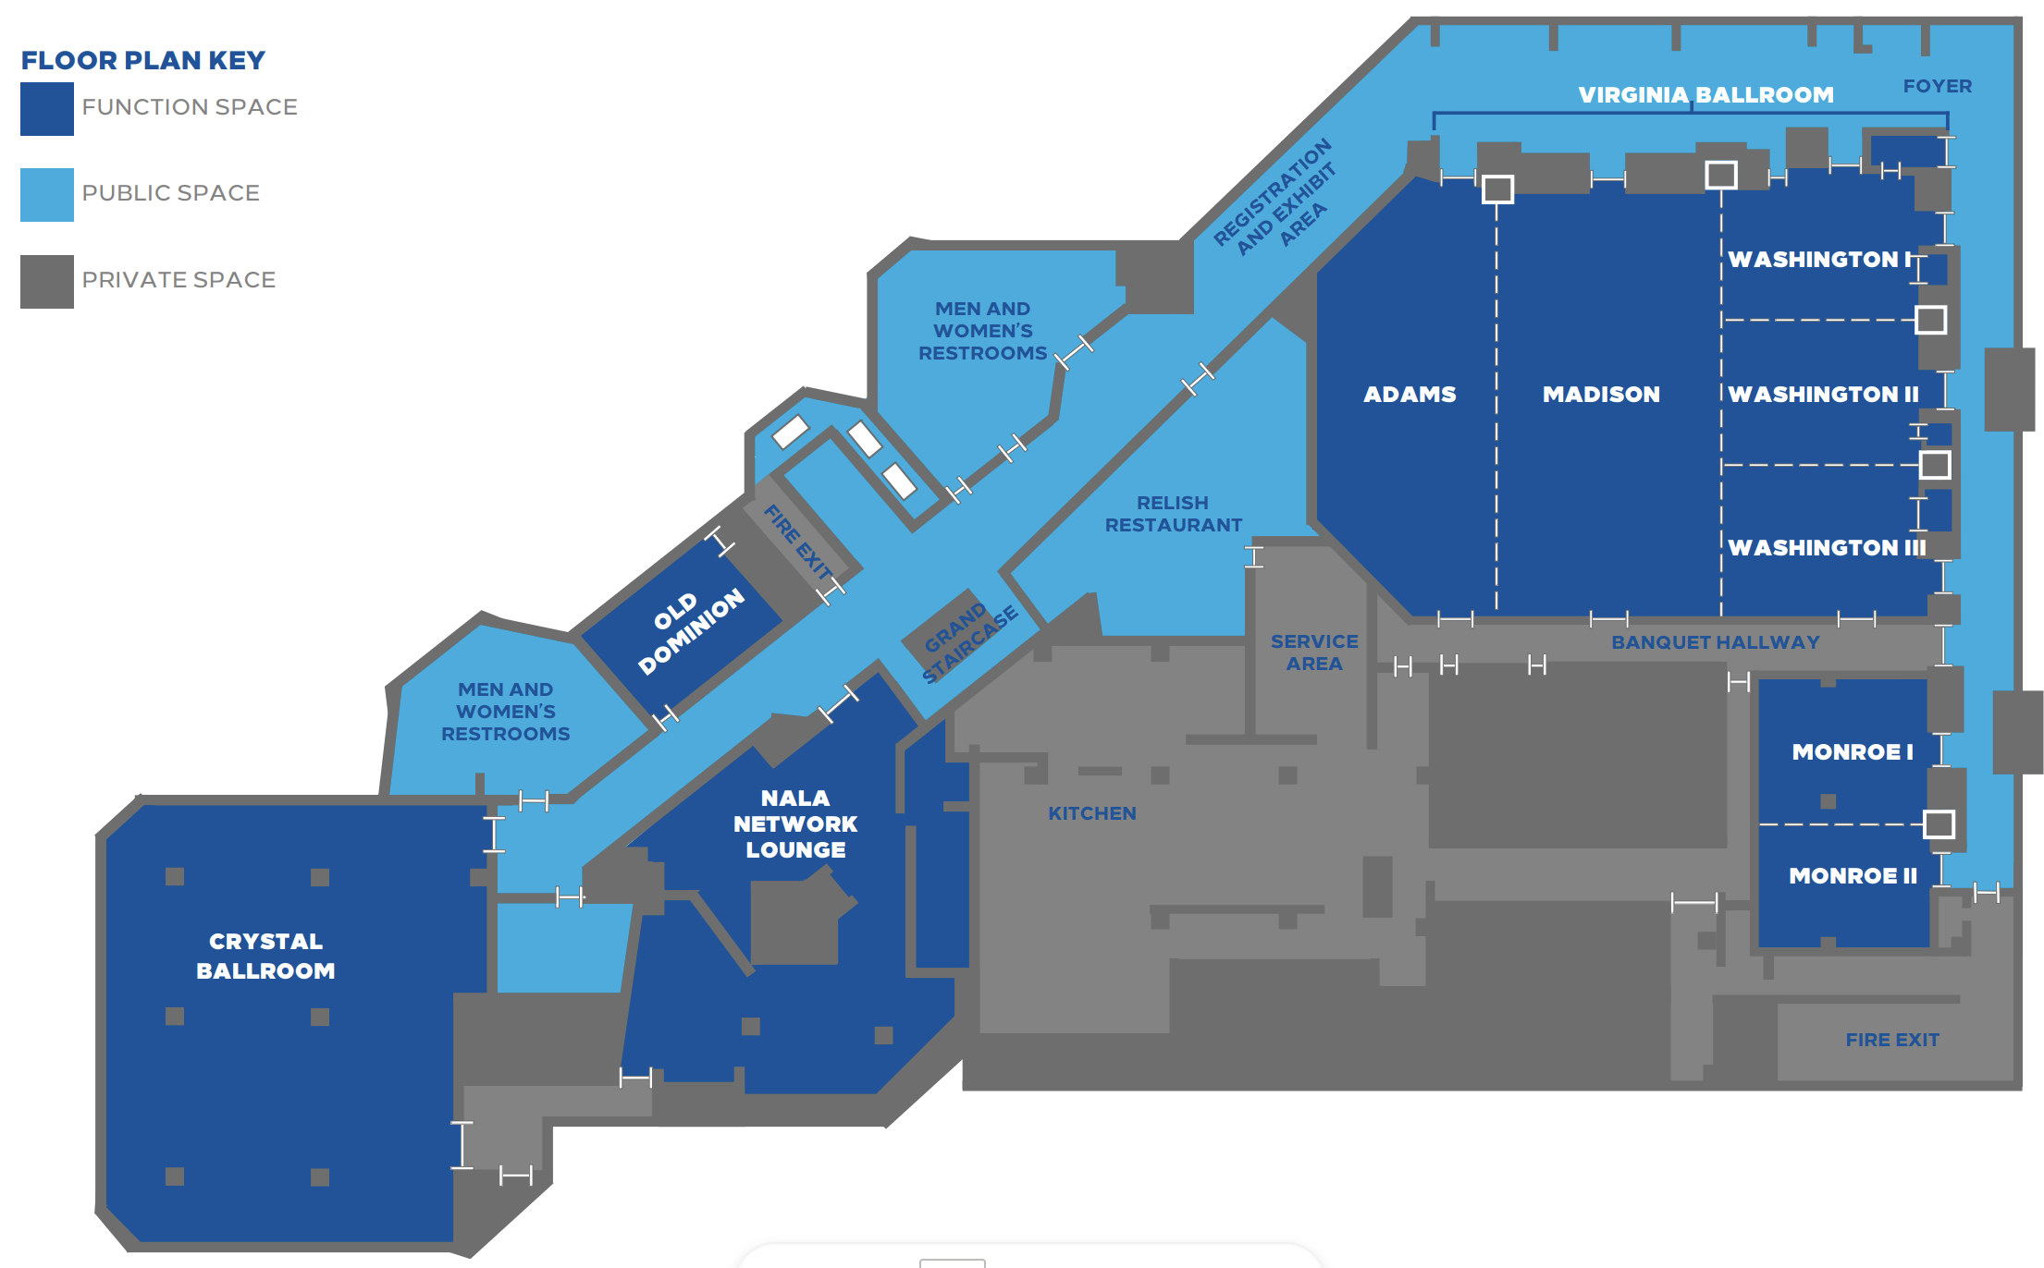
Main Meeting
Posters
Side-Bars
Dinner

Slide 7
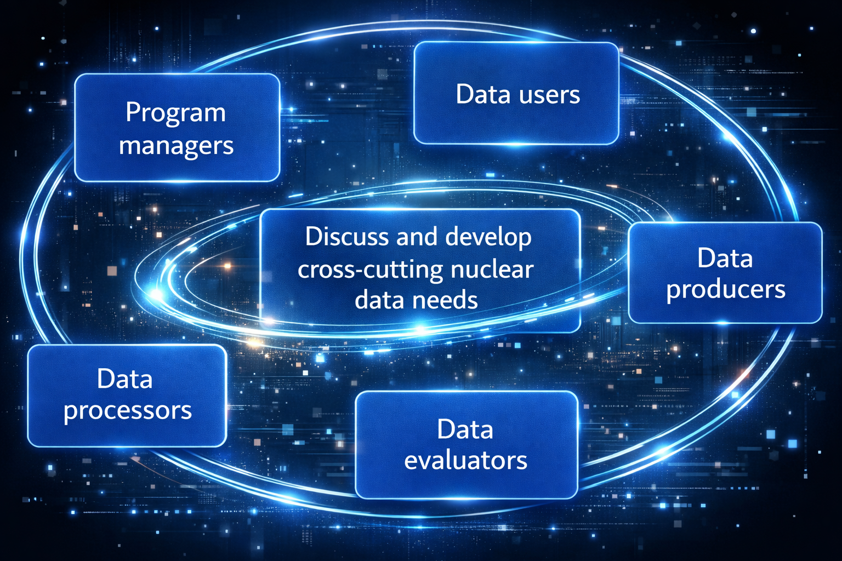
WANDA 2026 Goals
Present and discuss nuclear data needs from all steps along the pipeline
Prioritize these needs
Develop a plan to address the needs
At the end of WANDA, an overview document will be produced from the outcomes of each session
Previous workshop reports and presentations can be found:
https://www.nndc.bnl.gov/ndwg/wanda.html

Slide 8
WANDA Session Goals
The goal of each session (Monday afternoon – through Wednesday) is to identify actionable nuclear data tasks that will have an impact on the application of interest, i.e. road mapping
Focus on all stages of the nuclear data pipeline: measurements, theory, evaluation, processing, validation; what is needed to get data to the users, not just now but also in the future?
Where are there overlaps with multiple mission spaces?
Where can opportunities be leveraged within existing and planned work?
Your participation in crucial! The reported outcomes are based on comments and discussions that occur over the course of the week

Slide 9
2 Poster Sessions, Monday & Tuesday 1:00 – 2:00 PM
Immediately following lunch, before the afternoon session.
Located in the main room
Please check them out during breaks!
The indico site has all poster titles, presenters, and abstracts for each day.

Slide 10
WANDA 2026
February 9th-12th
Thank you in advance!
WANDA is not possible without all of your participation:
Session chairs
Speakers
Rapporteurs
Project PIs and DC program managers
Nuclear Data Working Group
Office of Nuclear Physics and the Nuclear Data Interagency Working Group (NDIAWG)
Lisa Felker
Comments, questions, and suggestions?
Ellen O'Brien, emobrien@lanl.gov
Stephanie Lyons, stephanie.lyons@pnnl.gov
Lisa Felker, felker7@llnl.gov
Todd Bredeweg, toddb@lanl.gov
Jo Ressler, ressler2@llnl.gov

