Slide 1
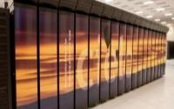
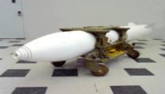
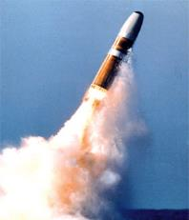
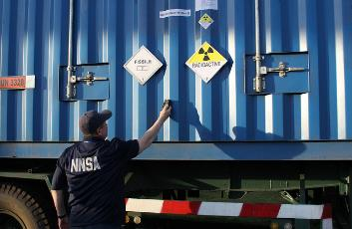
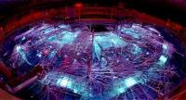
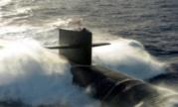
Nuclear Data for Nonproliferation Applications
Program Manager: LTC Nicholas Antonio
NNSA Office of Defense Nuclear Nonproliferation R&D (NA-22)
Workshop for Applied Nuclear Data Activities (WANDA)
09 February 2026

Slide 2
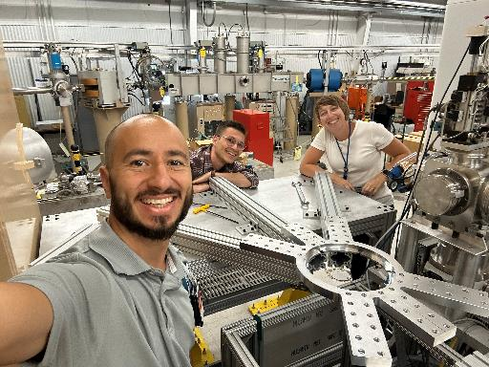
Opening Remarks: Impact of WANDA & Nuclear Data
Since WANDA FY25:
  Multiple discussions about nuclear data needs across several program offices
  NDIAWG serves as the primary collaboration forum for NA22 and the larger community
  Partnership with national laboratories, industry, and academia continue to provide opportunities for new measurements
Connections at WANDA have led to:
  Initiating new measurements relevant to industry partners
  Identifying complimentary measurements to support evaluations process
  Discussing nuclear data capability needs at multiple user facilities and labs
Collaborating on priority nuclear data needs remains key

Slide 3



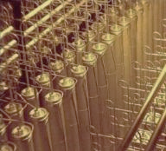
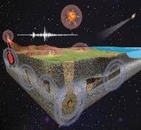
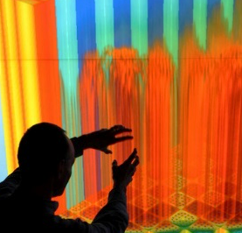

Defense Nuclear Nonproliferation R&D
Our
Purpose
Advance technical capabilities in support of the U.S. Government’s
nuclear nonproliferation and nuclear security goals
Our
Environment
Applications in cooperative and non-cooperative environments
that address horizontal and vertical proliferation
Our
Mission
Develop technical capability resident at the DOE National Labs,
to be leveraged by mission partners for specific applications
2. Monitor Weapons and Improve Nuclear Security
Our
Goals
1. Detect Foreign Nuclear Weapons Development
3. Detect Nuclear Explosions
4. Sustain Nonproliferation Capabilities

Slide 4
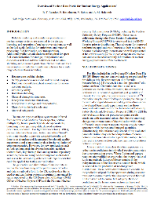
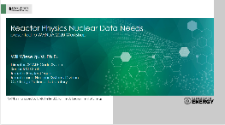
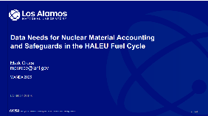
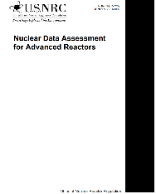
Meeting the nonproliferation mission in the rapidly-evolving nuclear energy landscape
Examined nuclear data needs discussed at previous workshops (e.g., WANDA), documented needs and sensitivity efforts
Six nuclear data themes relative to nonproliferation:
  Activation/inventory and decay data
  Fission characteristics: Minor actinides and emissions
  Neutron scatter: fuels, structural, coolant materials
  Light element data: Li, Be, C, F; including thermal models
  Improve coverage and quality of uncertainties
  Benchmarks beyond criticality:
    Neutron, gamma, fission products for fuels and components

Slide 5
On-Going DNN R&D Nuclear Data Projects for FY26
BNL/LLNL : Realistic Reaction Evaluations for Fission Products Off Stability
LLNL/PNNL/LBNL/Ohio/MSU : Constraining ¹³⁵Xe(n,g) Through B-Oslo Measurements Of ¹³⁶I Decay
LLNL : Cross Section Measurements Of ^{17,18}O(α,n)^{20,21}Ne And ²⁷Al(α,n)³⁰P For Nuclear Safeguards
PNNL/LLNL : Systematic Study of Neutron-Capture Reactions on Peak Fission Products
LBNL: Gamma Production Cross Sections for Active Neutron Interrogation with GENESIS
LANL/BNL/LBNL/PNNL/LLNL: Evaluation of Energy Dependent Fission Product Yields
LANL/LLNL: Evaluation of Gamma-ray Production Data
LANL/LLNL: New measurements of spontaneous fission properties of Pu isotopes
ORNL/LANL/AFIT/NDU : Reaction Cross Sections, Secondary Gamma-Ray Yields, and Measured Neutron Spectra for Alpha-Induced Reactions on Light Nuclei
Sample harvested at CARIBU
Target chamber for installation in the Gammasphere array
The GENESIS detector array at the LBNL 88” cyclotron
FY09-FY26, DNN R&D’s investments to improve nuclear data through experiment and theory total ~$97.2M

Slide 6
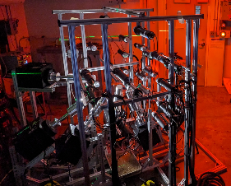
Neutron inelastic scattering data for active neutron interrogation
Why? New capabilities in active interrogation demand new nuclear data
What? Gamma-ray production cross section measurements using GENESIS on top priority nuclides for active neutron interrogation
Impact: Increased utility of active neutron interrogation systems for material identification, emergency response, oil well logging, space exploration, and controlled substance detection (plus benchmark data to facilitate reaction modeling improvements!)
GENESIS: 7 HPGe γ-ray detectors and 27 organic liquid scintillators for neutron detection
Absolutely normalized ¹²C(n,n’) cross section published in Gordon et al. PRC 2025; ²³Na partial γ-ray cross sections submitted for publication

Slide 7
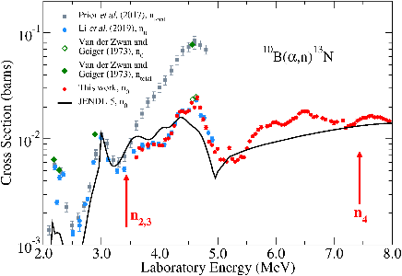
Alpha-Induced Reactions on Light Nuclei
Applications for nuclear safeguards, emergency response, reactors and fuels, etc. need better alpha-induced reaction data
Measure ¹⁹F, ^{10,11}B, ¹³C, ⁷Li with FN Van de Graff accelerator at University of Notre Dame
Better data is expected to improve results
from Monte Carlo calculations essential to
nonproliferation applications
^{10,11}B, ¹³C complete and ¹⁹F underway
Impact calculations will validate and assess
collected data

Slide 8
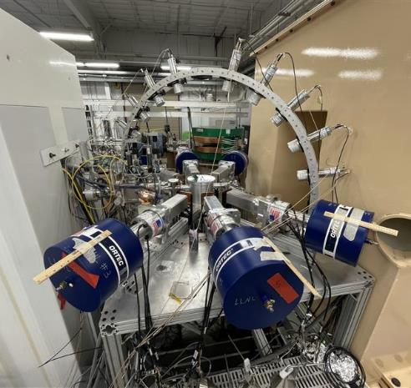
High-Resolution (⍺,n) @ LLNL
Cross section data for (⍺,n) reactions is lacking
  Few measurements in actinide alpha energy region
  Limited/no partial cross section data
These data are paramount in support of accurate and efficient nondestructive assay measurements
High-resolution measurement capability established at LLNL to measure ^{17,18}O(⍺,n)^{20,21}Ne and ²⁷Al(⍺,n)³⁰P
  Neutron and gamma ray detection
  Direct incorporation into SCALE for immediate use for NDA applications
LLNL-MI-2015505

Slide 9

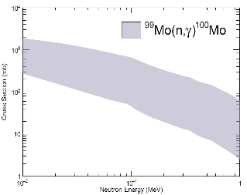




Systematic Study of Neutron-Capture Reactions on Peak Fission Products
OMP
NLD
γSF
Calculated cross sections
GOAL: Improve our understanding of trends in statistical nuclear properties through systematic study of Mo isotopes
TENT: Summer 2026
First experiments completed FY25
✅
✅
✅
✅
Use of multiple experimental techniques to determine and understand the systematic evolution of NLD and γSF. We will then apply modern analytical tools to predict the best parameters for a neutron-rich Mo-isotope.

Slide 10
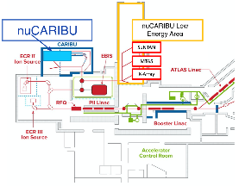
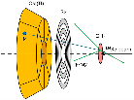
Constraining ¹³⁵Xe(n,γ) Through β-Oslo Measurements of ¹³⁶I Decay
The ¹³⁵Xe(n,γ) reaction at non-thermal energies is one of the most important, yet highly-uncertain cross sections for Gen IV reactor development.
As Gen IV reactors come online worldwide, the contribution of ¹³⁵Xe to atmospheric monitoring for non-proliferation will change in an unknown way if not measured.
This cross section of this short-lived (9 hour) fission fragment will be constrained through two separate, indirect experiments: β-Oslo (nuCARIBU @ ANL) in May 2026 and inverse-Oslo (DAPPER @ TAMU) in FY27.
Figure: The ¹³⁵Xe burnup probability at energies relevant to Gen IV reactors shows orders-of-magnitude discrepancies and discontinuities!
?
Upgrades
to the DAPPER array for inverse-Oslo at Texas A&M
β-Oslo at nuCARIBU with SuN (May ‘26)

Slide 11
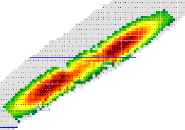
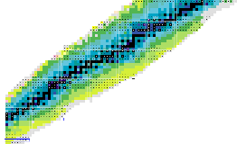
Realistic Reaction Evaluations for Fission Products Off Stability
Current nuclear data available for neutron-induced reactions on short-lived fission products are either non-existent or based on simplified assumptions, leading to unquantified impacts on predictions.
Why?
We will leverage machine-learning methods and predictive self-consistent approaches, combined with localized level-density experiments, to provide to more reliable parameter extrapolations, leading to nuclear data library files
²³⁵U Fission Yields
What?
Improved simulations for applications:
Reactor burnup (transient states and depletion)
Spent-fuel assay, waste management
nonproliferation, post-detonation forensics
Astrophysics
Impact?
Half-lives

Slide 12
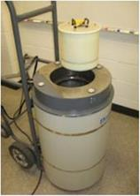
Measurements of spontaneous fission neutron outputs from even-even Pu isotopes
Why
A Well Coincidence Counter in passive operation is used to measure neutrons and infer the Pu mass of material
What
New neutron number and spectrum measurements on ^{240,242}Pu(sf)
Impact
Changing the ²⁴⁰Pu(sf) number distribution results in a 2-3% decrease in Pu mass
Neutrons are primarily from ²³⁸Pu, ²⁴⁰Pu & ²⁴²Pu spontaneous fission
²⁴²Pu(sf) PFNS

Slide 13
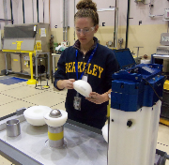

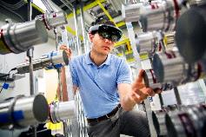

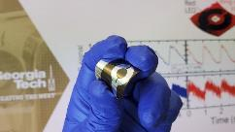


University Program –
Preparing for Future Challenges
Impactful research at lower Technology Readiness Levels
Bridges the academic and national laboratory knowledge bases
Supports a “pipeline” of talent for the next generation of national security technical experts
Builds broad support for nonproliferation

Slide 14
How to Engage
By the nature of the program, we encourage PIs and Co-PIs to work with their DOE laboratory points of contact or counterparts to vet and collaborate on nuclear data projects for DNN R&D.
National Laboratory | Point of Contact
Brookhaven | Donny Hornback
Argonne | Fredrik Tovesson / Candido Pereira
Oak Ridge | Andrew Nicholson
Idaho | David Chichester
Los Alamos | Sy Stange
Lawrence Berkeley | John Valentine / Shawn Tornga
Lawrence Livermore | Ali Dreyfuss
Pacific Northwest | Warnick Kernan
Sandia | Margot Hutchins
Savannah River | Nicholas Bridges

Slide 15
Questions?
DNN R&D is the primary U.S. Government sponsor of nuclear physics research for nonproliferation applications. The projects this office funds produce data that are used in numerous technologies, and they have considerable impact on a broad range of missions. DNN R&D is committed to working with the nuclear physics community to continue to advance this important area of research.

