Slide 1
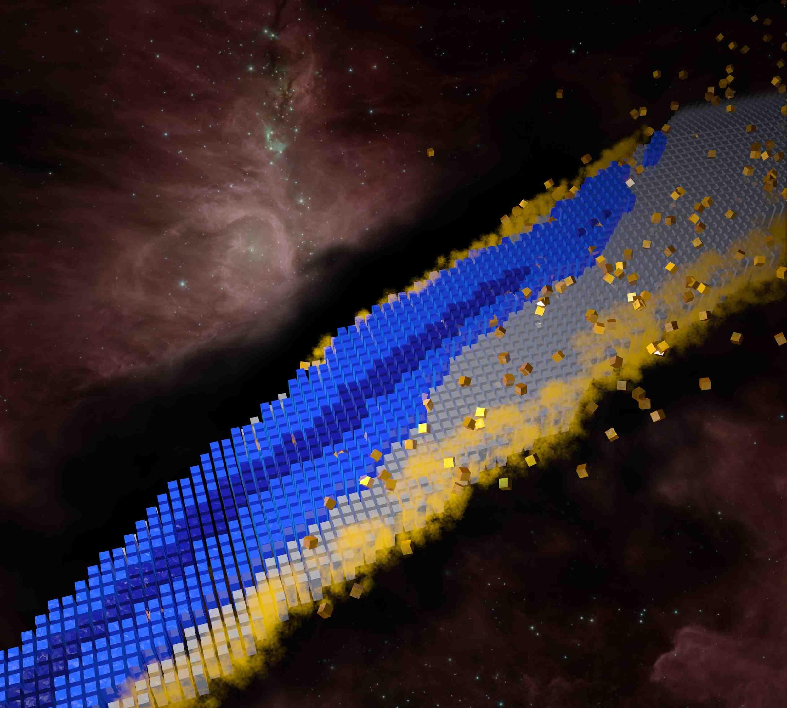
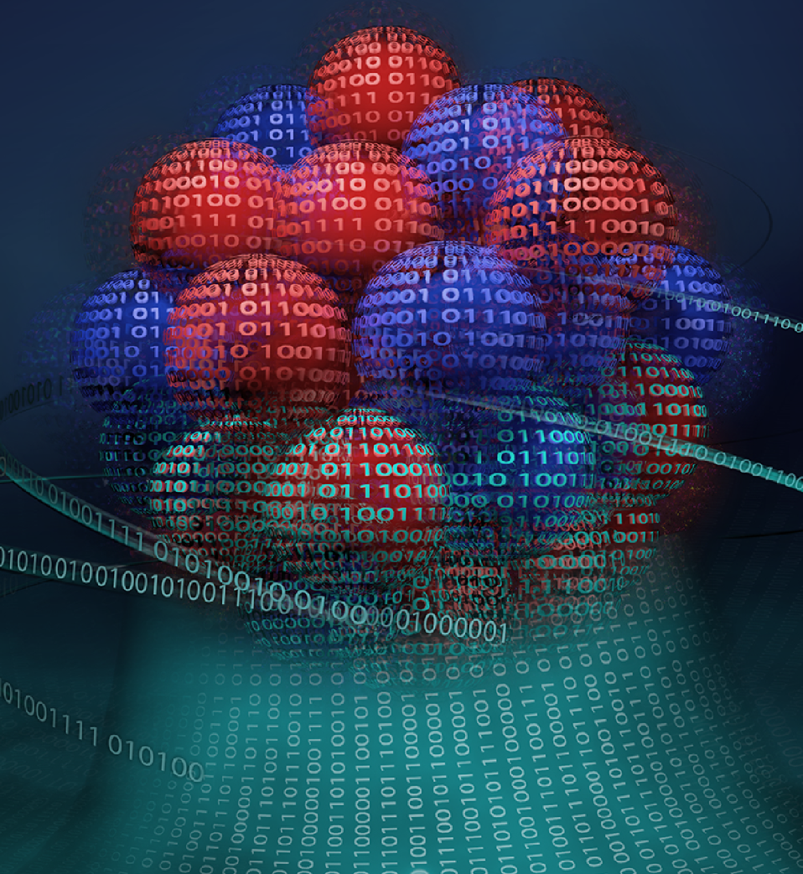


Bayesian Framework for Mining of Evaluated Nuclear Mass Data
Presented by: Kyle Godbey
This material is based upon work supported by the US Department of Energy, Office of Science, Office of Nuclear Physics under Grant No. DE-SC0023688
https://docs.google.com/presentation/d/1bvTcuPsnJpkC4tGojsT8V9GLRDGHceB_ECemQS6IMvY/edit
Notes:
Machine learning (automated processes that learn by example in order to classify, predict, discover, or generate new data)
Artificial intelligence (methods by which a computer makes decisions or discoveries that would usually require human intelligence)
https://towardsdatascience.com/no-machine-learning-is-not-just-glorified-statistics-26d3952234e3
https://towardsdatascience.com/the-actual-difference-between-statistics-and-machine-learning-64b49f07ea3
https://www.nature.com/articles/nmeth.4642
https://machinelearningmastery.com/relationship-between-applied-statistics-and-machine-learning/

Slide 2
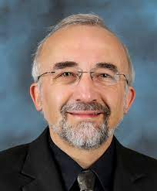

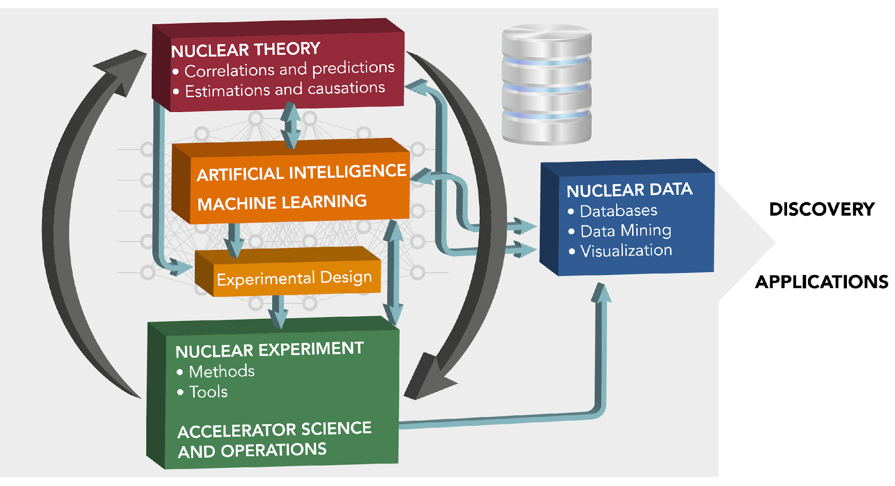


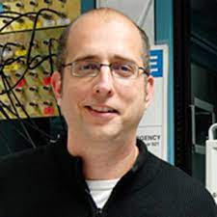


Our team: nuclear theory, nuclear experiment (nuclear data, nuclear astrophysics), statistics
Witek Nazarewicz (PI)
Kyle Godbey
Sudhanva Lalit (Postdoc)
Bailey Knight (PhD student)
Hendrik Schatz
Filip Kondev
Rikel Chakma (Postdoc)

Slide 3






Our collaborators

Slide 4
What, Why, How?
The main objective: to quantify the nuclear binding by employing state-of-the-art global nuclear models, the most current nuclear mass data, and Bayesian machine learning that enables us to make quantified predictions (⇒ extrapolations) by building on the most relevant theoretical and experimental information.
Why? Atomic Mass Evaluation recommends mass values and their uncertainties for all nuclei. AME also provides masses for nuclei that are not-yet observed and for nuclei where the experimental data are poorly known by extrapolating data from neighboring known nuclei. Improvements in the value of estimated masses and their uncertainties provided by us will benefit not only AME, but also other related nuclear data, such as nuclear cross sections, half-lives and delayed particle emission probabilities, which are essential input ingredients in nucleosynthesis simulations. Our extrapolated masses will guide experimental efforts in various areas of rare-isotope science and provide benchmarks for nuclear models.
Tools: use nuclear density functional theory (DFT) and statistical Bayesian machine learning (Bayesian Model Mixing) to provide quantified theoretical predictions.

Slide 5

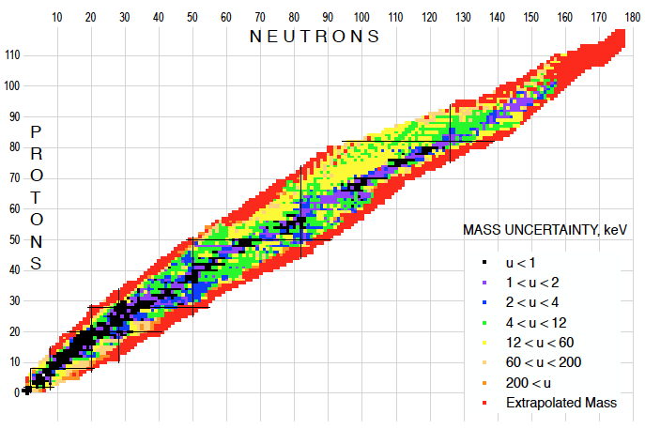
ANL component: provide Nuclear Data input
Atomic Mass Evaluation & NuBASE
Member of the US Nuclear Data Program - DOE/SC/NP
provide updated values for the atomic masses and other basic nuclear properties for all nuclei where experimental data exist
provide extrapolated mass values for a limited number of nuclei where experimental data are limited or do not exist
AME2020

Slide 6
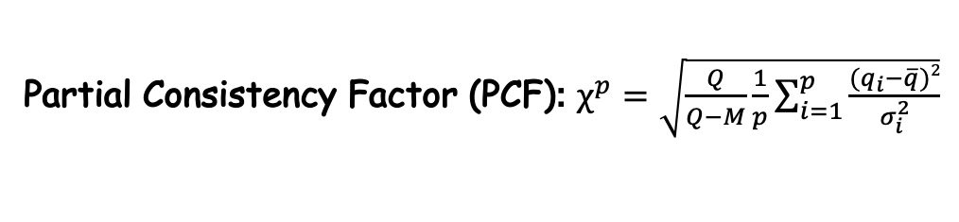
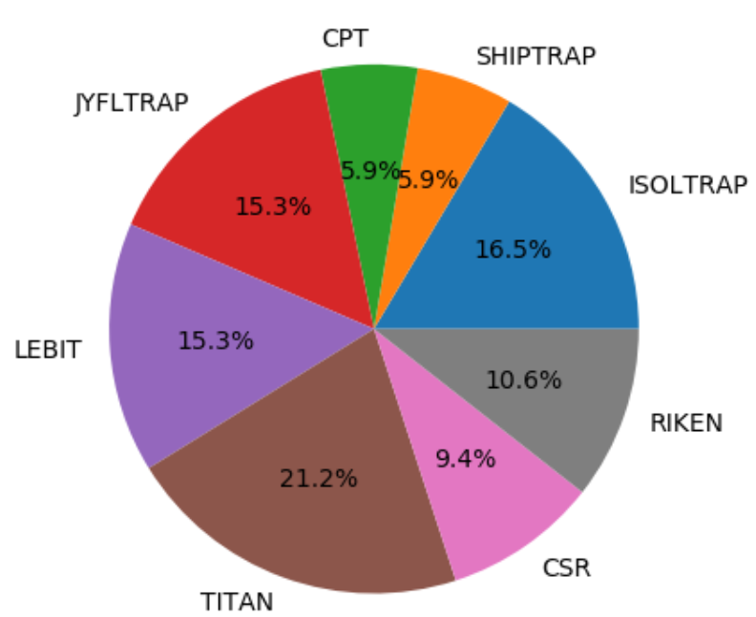
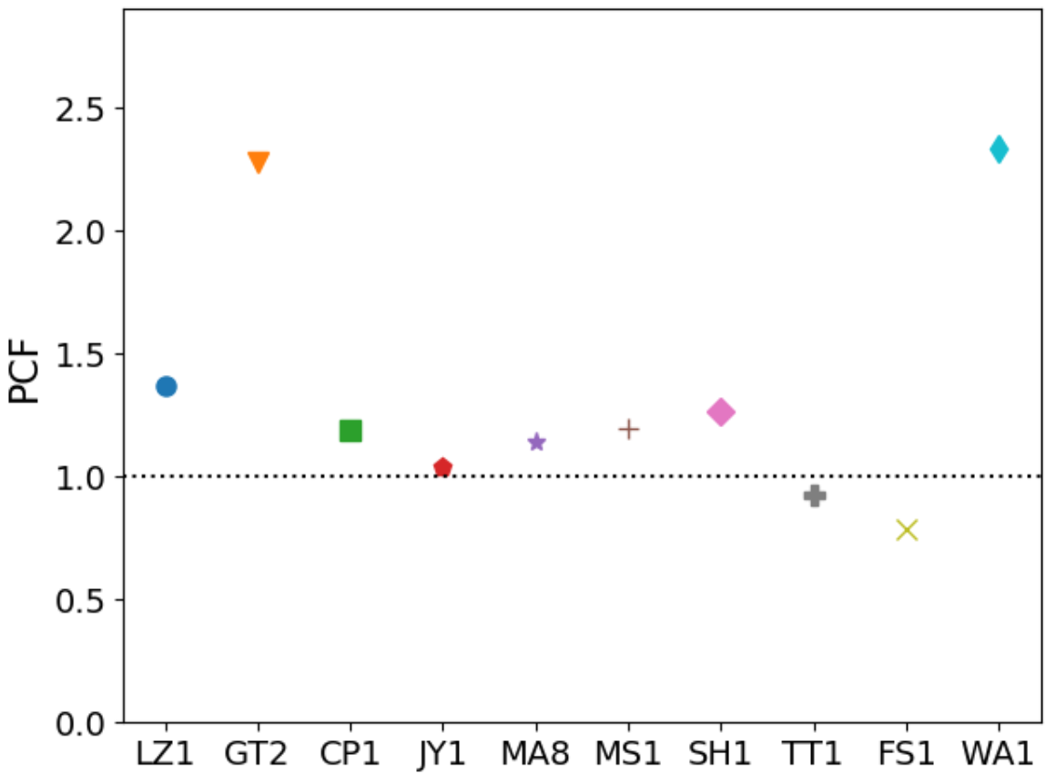
Which data are considered
Direct (mass spectrometry) and Indirect (reactions and decays) Data produced worldwide
      TOF & MR-TOF, Storage Rings & Penning Traps
      Decay Energies in β⁻, β⁺, α and p decays – far from stability
critically evaluate the experimental data & combine the accepted ones using the least-squares fit approach -> mass values & covariances for all known nuclei
ANL
ESR
WashingtonU
CSR
Shiptrap
CPT
Isoltrap
Titan
MSU
Lebit
Jyfltrap
FSU
published mass data since AME2016

Slide 7
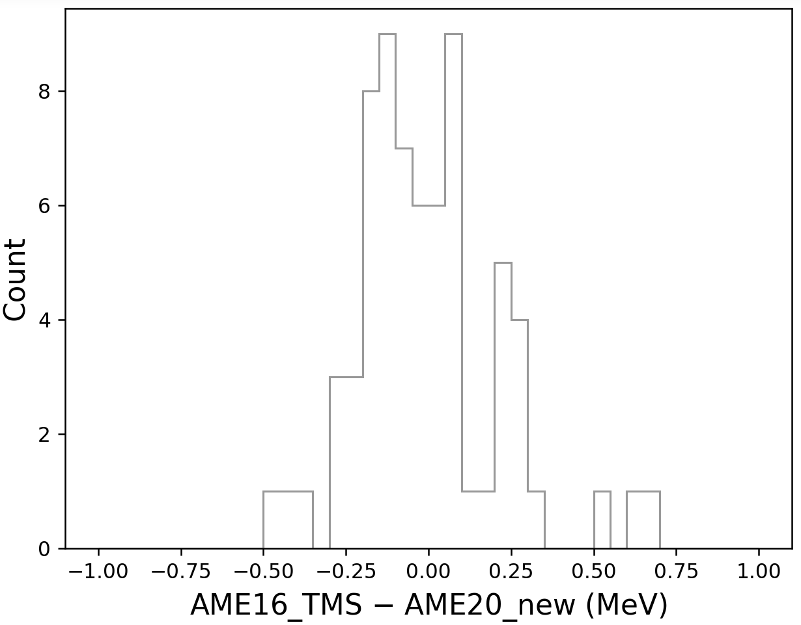
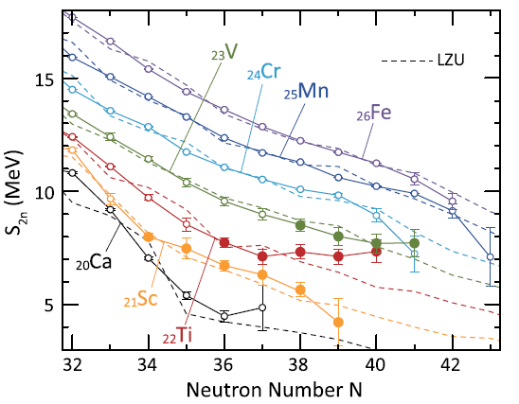
AME extrapolations
using an empirical approach by assuming that the Trend of the Mass Surface (TMS) is smooth
TMS extrapolated mass values for a limited number of unknown nuclei
replace “irregular” experimental masses by TMS extrapolated values – 77 cases in AME2020
accuracy of the AME extrapolation
not always justified … new physics?
S. Michimasa et al., PRL125 (2020) 122501
rms = 215 keV
TMS in AME2016, BUT exp in AME2020
build up of deformation around N=40

Slide 8
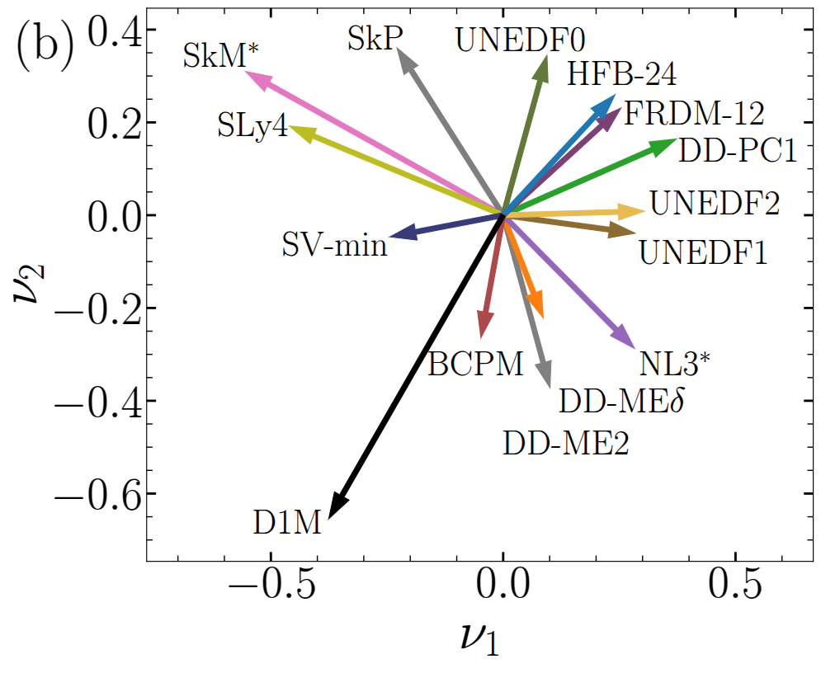
In many cases physics models may have a similar mathematical foundation but their parameters are calibrated using different methodologies. It is also possible that models are identical despite their different formulations. How to mix models and eliminate model redundancy?
Model orthogonalization and Bayesian mixing of nuclear mass models via Principal Component Analysis
P. Giuliani, K. Godbey, V. Kejzlar, W. Nazarewicz, Phys. Rev. Research 6, 033266 (2024)
The resulting scheme: the Bayesian Model Combination (BMC)
Projections of 15 realistic models of the nuclear binding energy into the first two principal components. This representation allows us to visualize inter-model relationships.

Slide 9
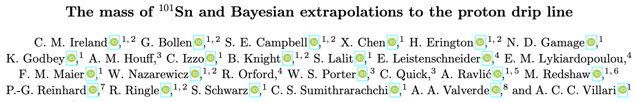
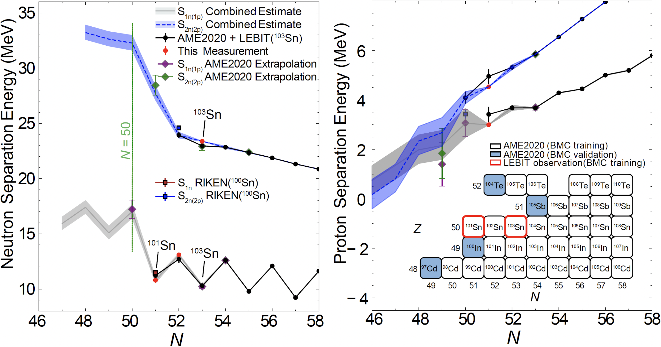

Slide 10
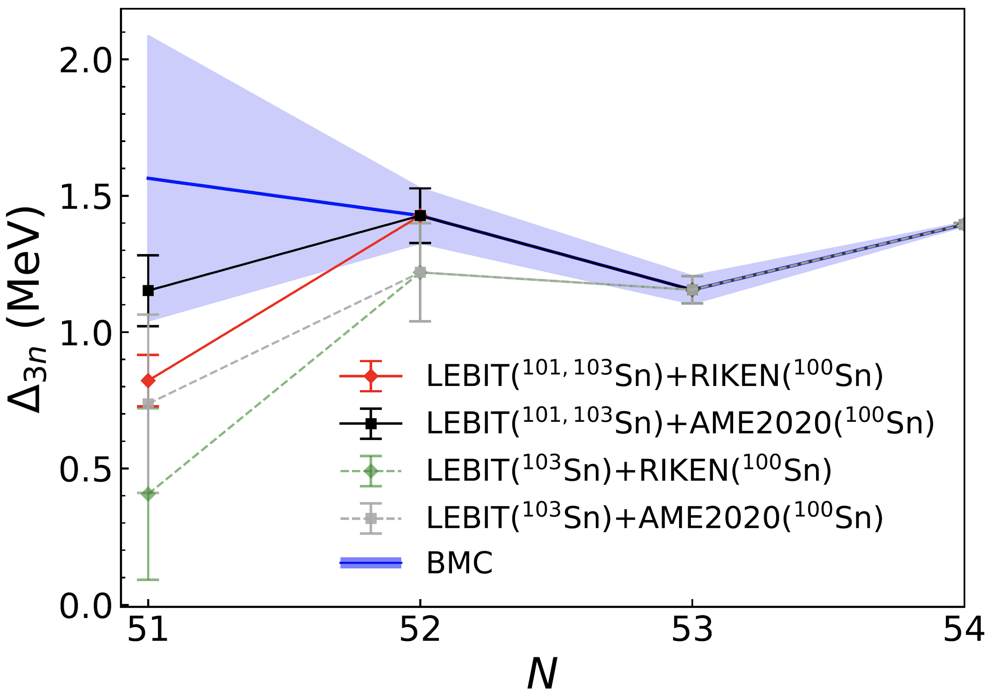

Slide 11
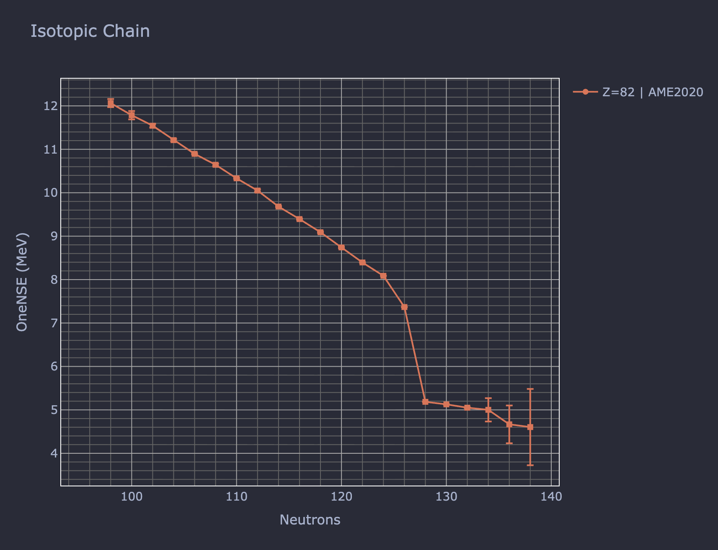
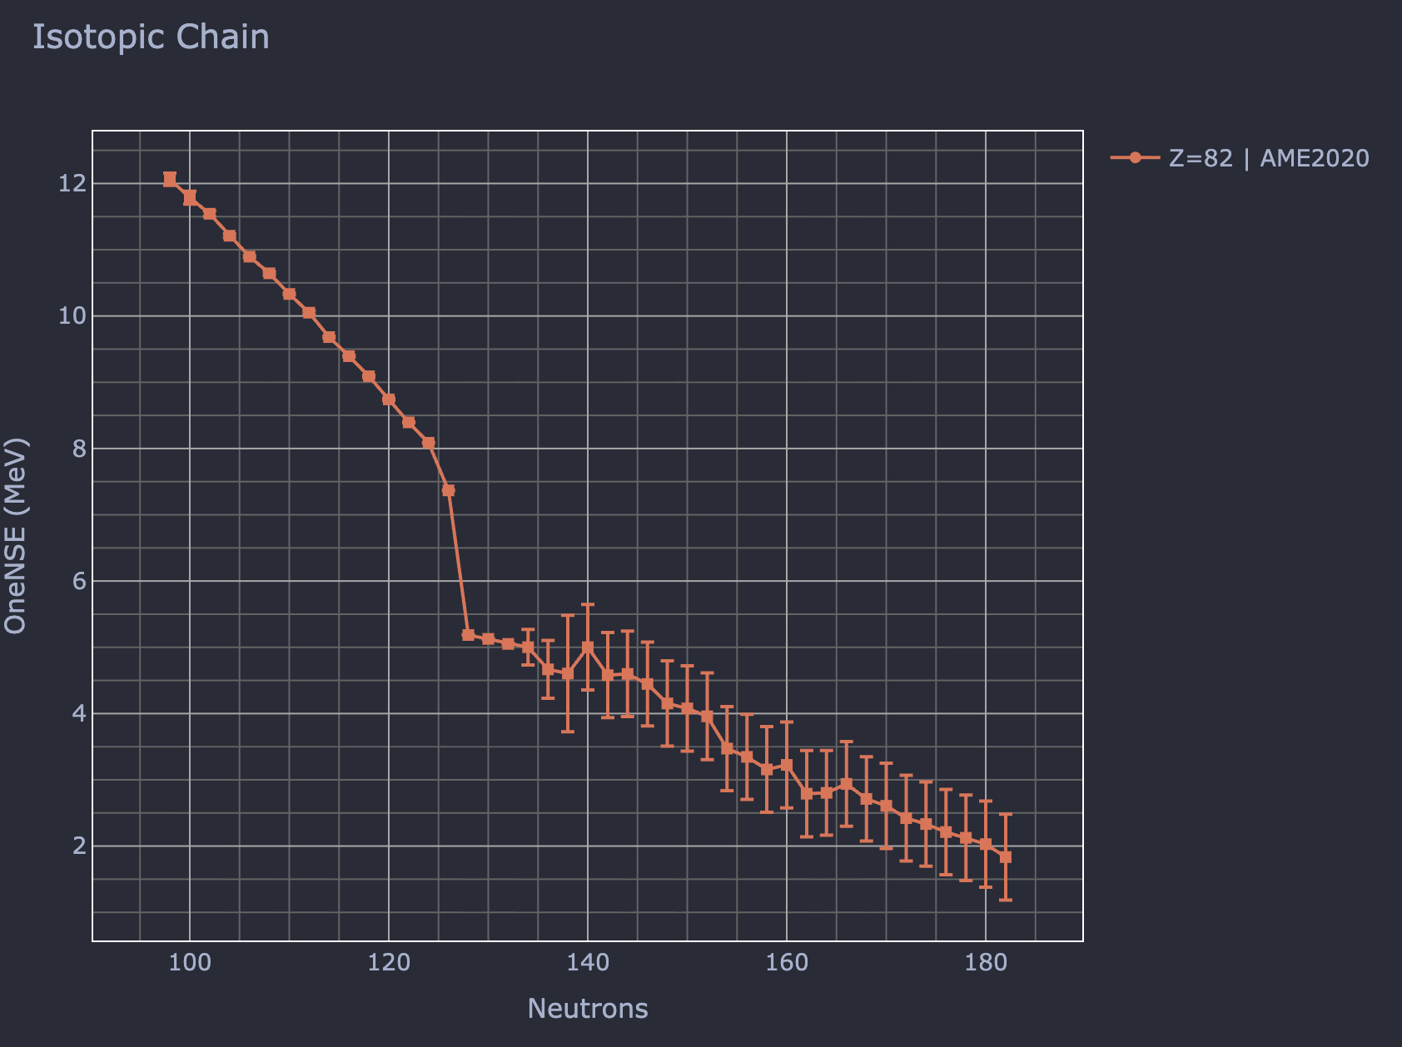

BMC model is now deployed on https://bmex.dev
Notes:
NLD database?

Slide 12
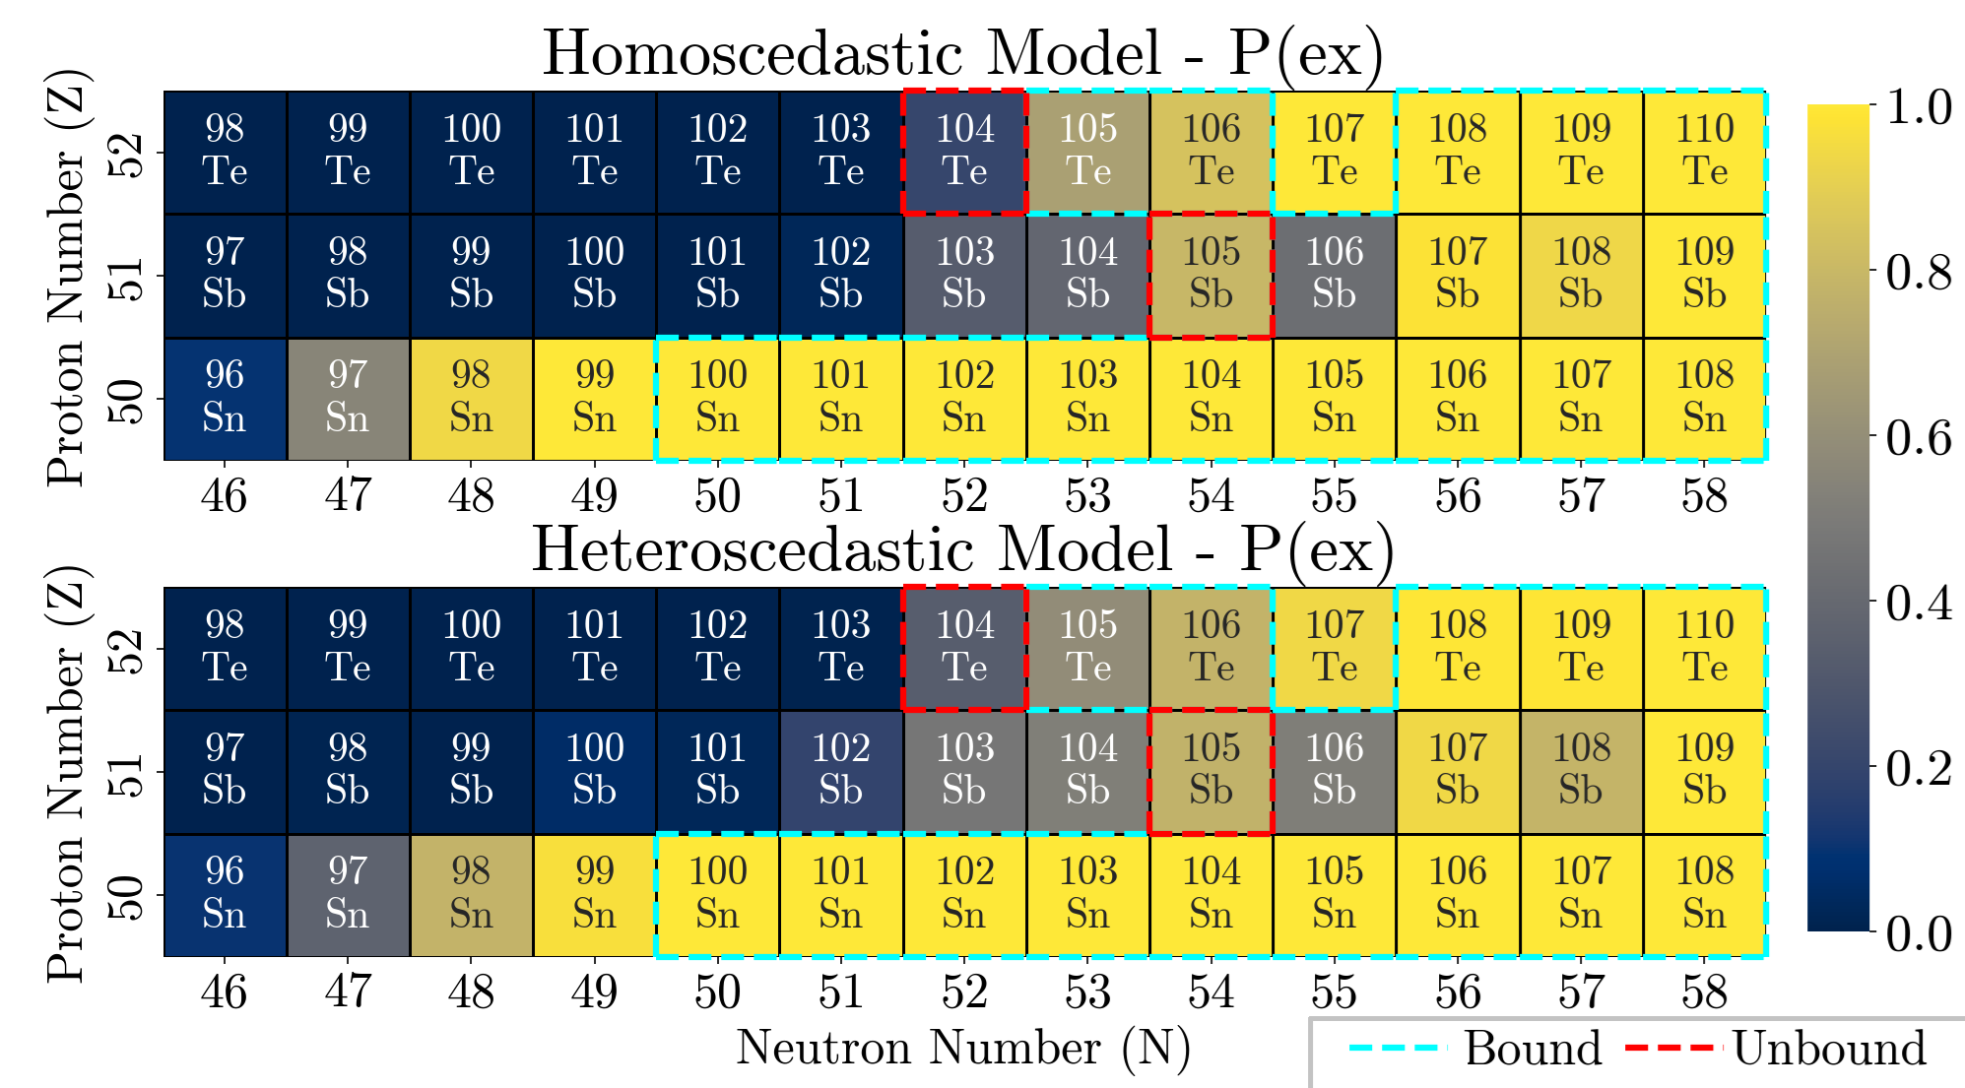
Physically-Motivated Heteroscedastic Uncertainties for Bayesian Nuclear Models Far from Stability
Bailey Knight, S. Lalit, P. Giuliani , K. Godbey , W. Nazarewicz , A. Ravlić and P. -G. Reinhard

Slide 13
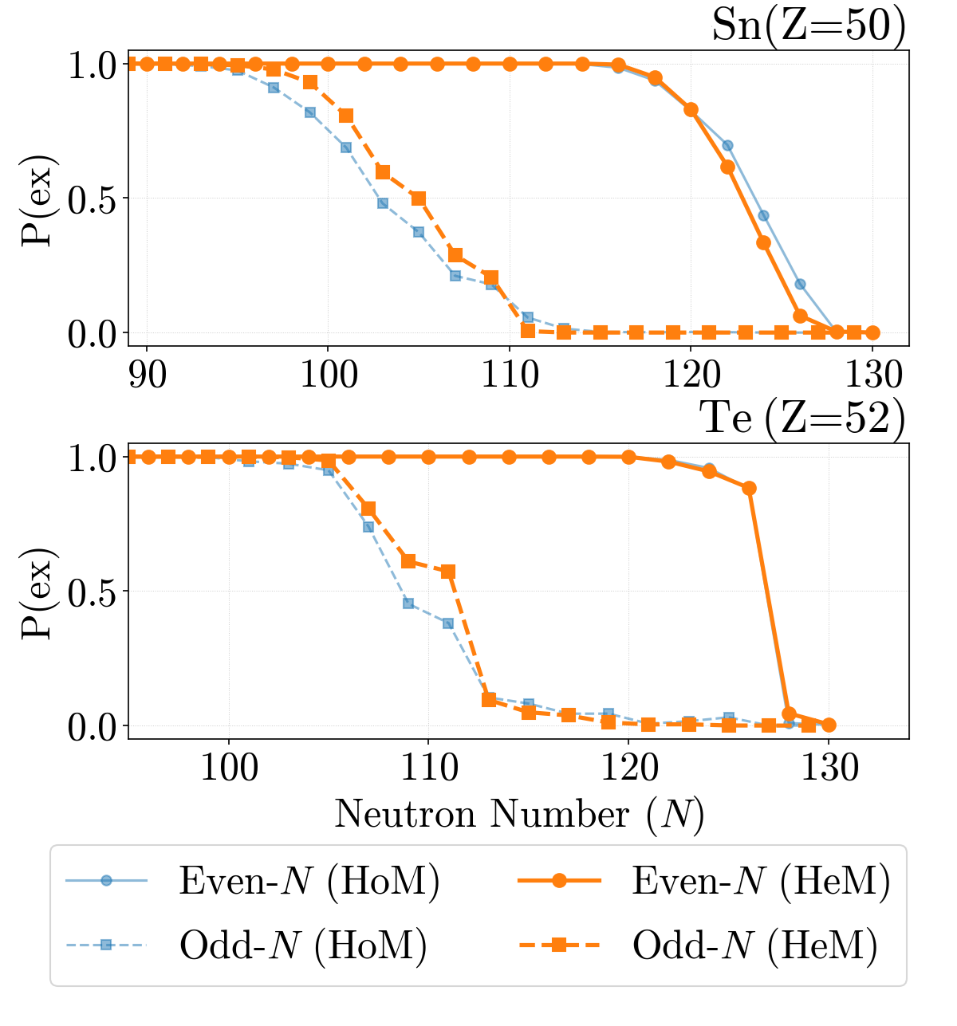
Physically-Motivated Heteroscedastic Uncertainties for Bayesian Nuclear Models Far from Stability
Bailey Knight, S. Lalit, P. Giuliani , K. Godbey , W. Nazarewicz , A. Ravlić and P. -G. Reinhard

Slide 14
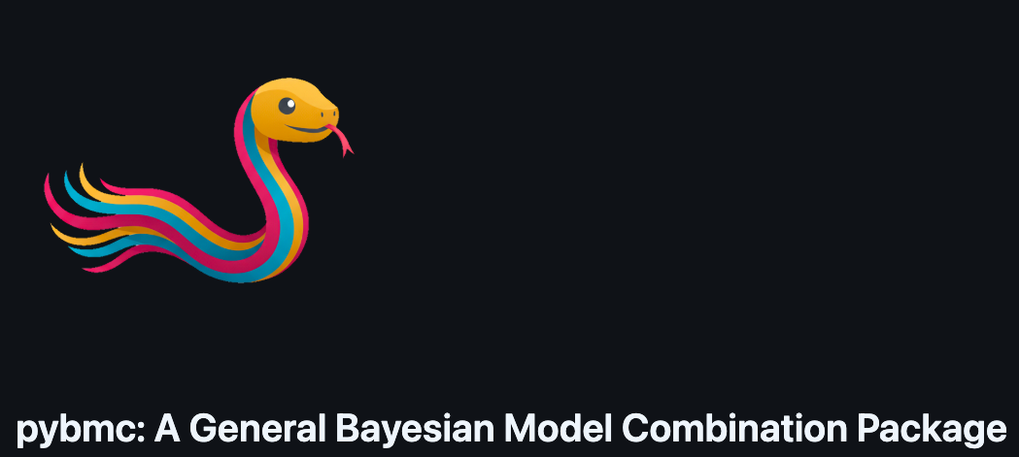
https://ascsn.github.io/pybmc/ https://github.com/ascsn/pybmc

Slide 15
https://ascsn.github.io/pybmc/ https://github.com/ascsn/pybmc
Led primarily by a team of three undergrads! A submission to the Journal of Open Source Software is currently being prepared.

Slide 16
Year-3 Summary
The paper on "The mass of 101Sn and Bayesian extrapolations to the proton drip line" has been accepted in Phys. Rev. C Lett.
Work continues on other BMC applications and applications using BMC datasets in astrophysical simulations.
pybmc was developed and incorporated into the https://bmex.dev tool.
A paper on new theoretical techniques for the nuclear physics simulations has been submitted for publication and new datasets incorporating those enhancements are forthcoming.
Along these lines, more work on fundamental research involving nuclear interactions is underway.
Work continues at ANL to finalize the next batch of AME recommended values.
A preliminary database was delivered to the MSU group during a visit in 2025 and investigations on the impact of the new data were started.

Slide 17
Thank you!

Slide 18
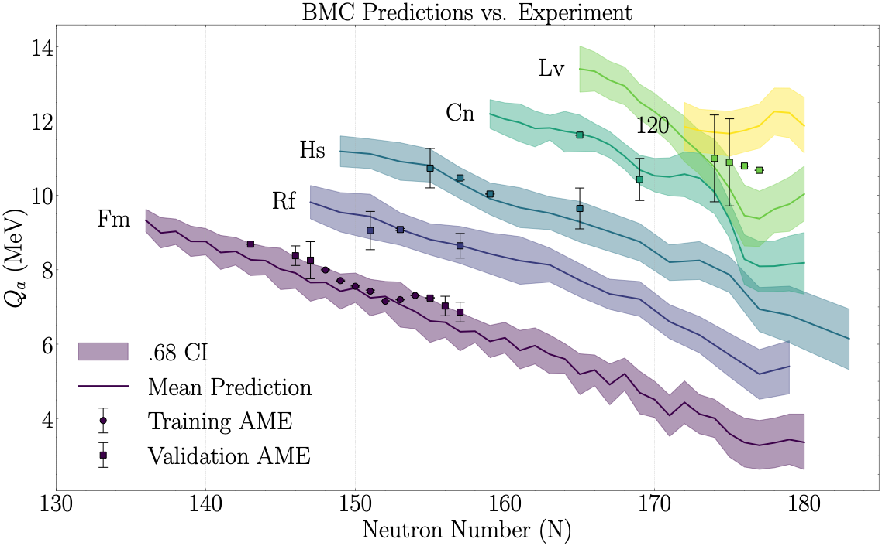

Slide 19
