Slide 1
NNSA’s Proliferation Resistance Optimization Program
Kyle J. Sallee, NA-231

Slide 2



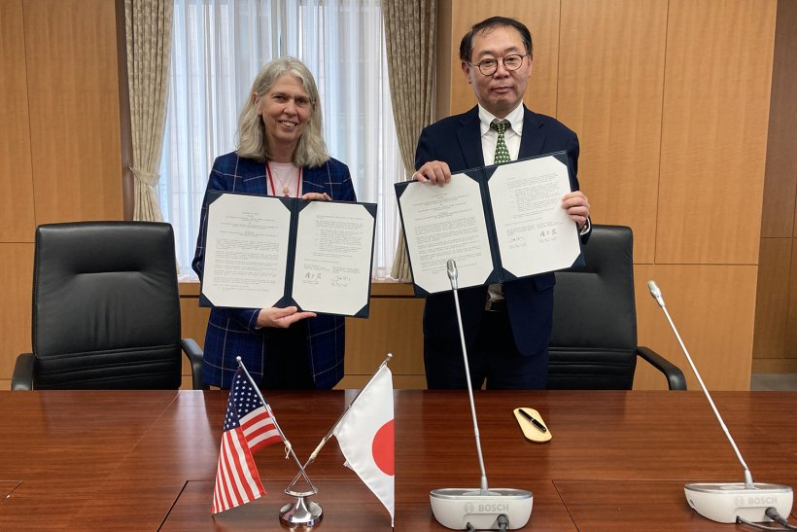
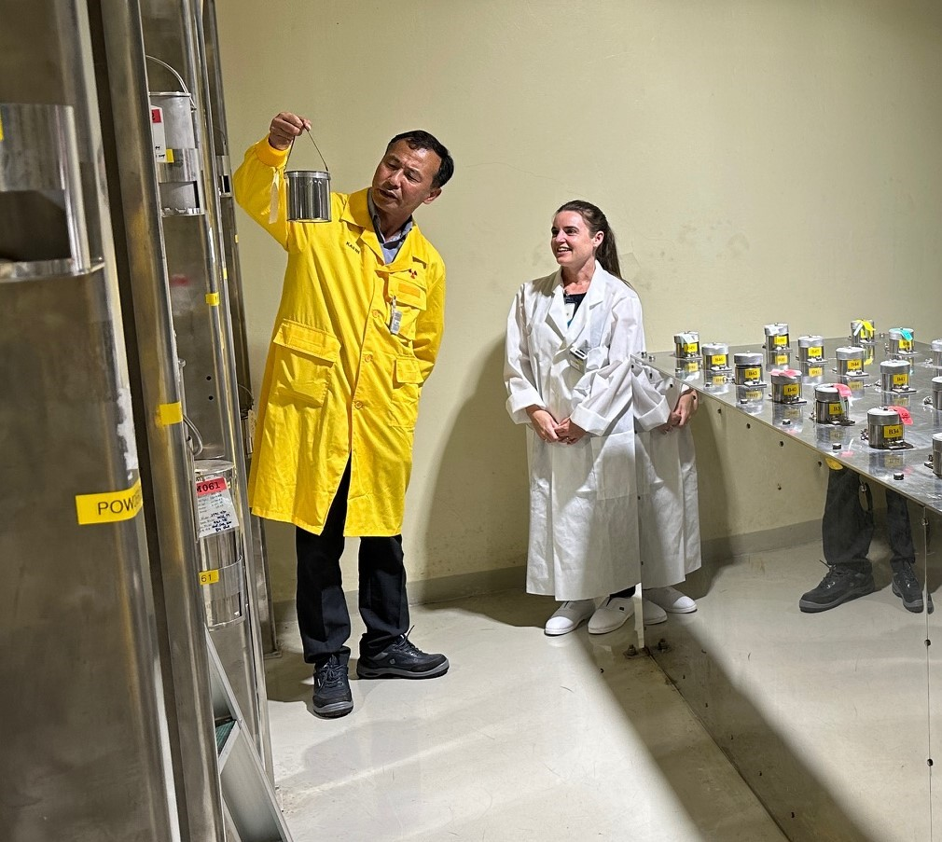
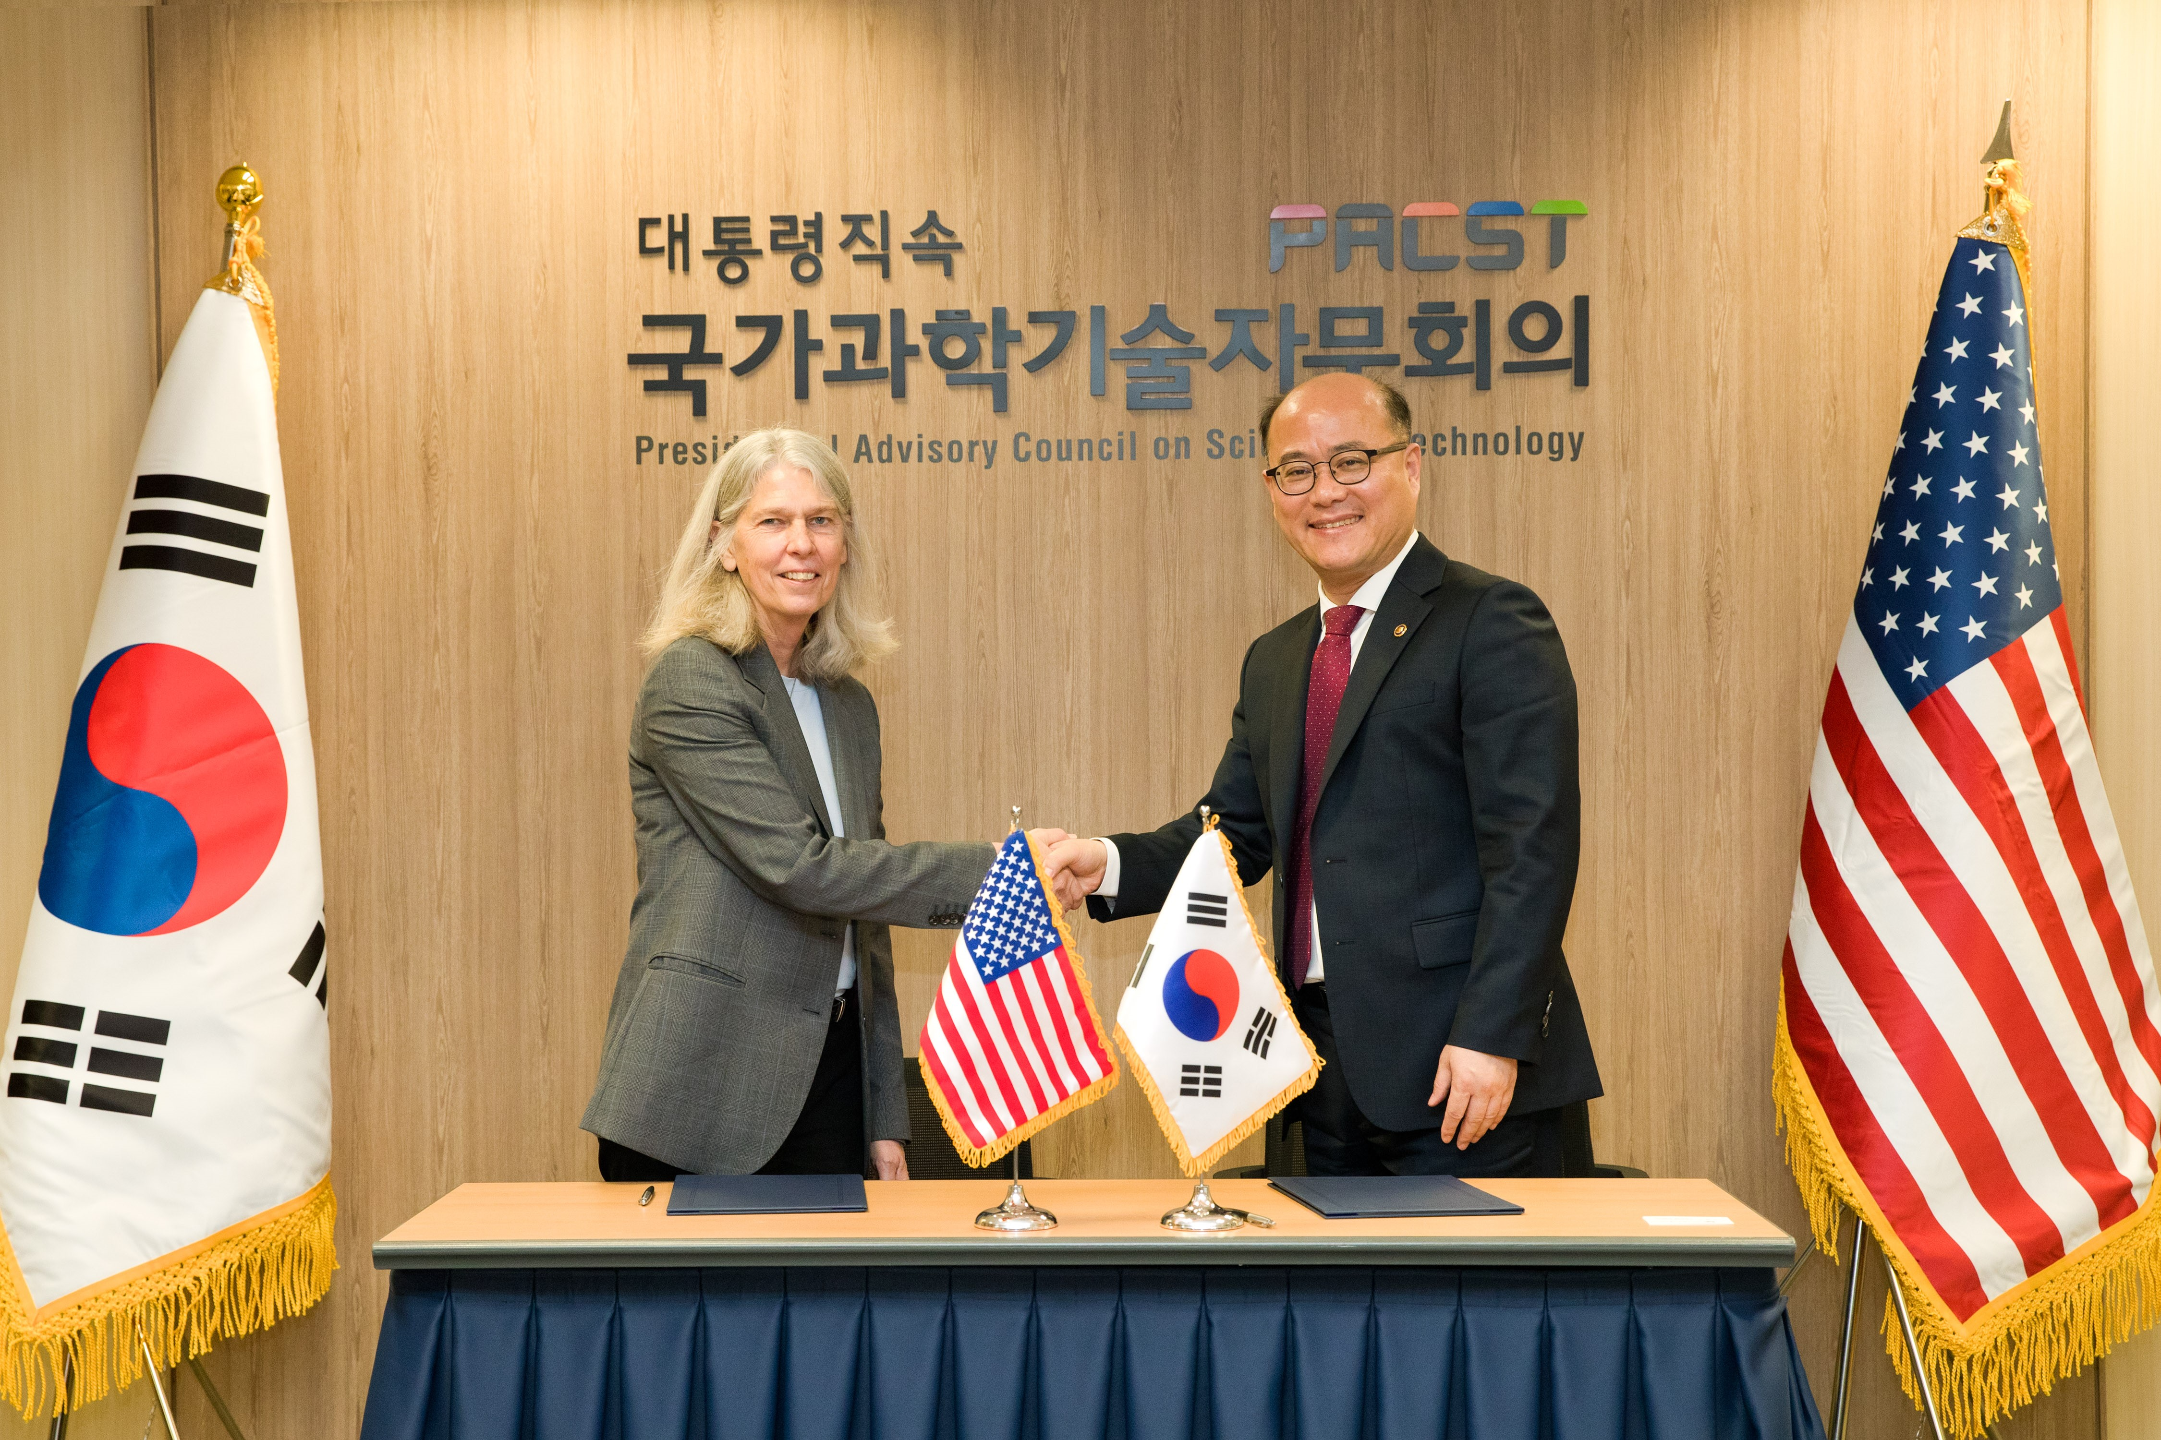



NNSA’s PRO-X Program
PRO-Research Reactors (PRO-RR)
PRO-Advanced Reactors and Fuel Cycles (PRO-AR&FC)
Est. in 2020
Technical teams at ANL and SRNL
Leverages over 40 years of reactor conversion experience
Focused on 3 technical areas of optimization: Core, Fuel, and Auxiliary
Partners in Asia, South America, Africa, and North America
Est. in 2024
Technical teams at ORNL and Y-12
Additional support from: INL, Sandia, LANL, SRNL, ANL, LLNL
Applying a novel approach, based on 40 years of reactor conversion experience
Focused on 3 technical areas: Assessments, engagements, and methodologies
Notes:
The NNSA’s Proliferation Resistance Optimization or “PRO-X” program is comprised of two elements: 1) Research Reactors; 2) Advanced Reactors & Fuel Cycles – the latter being the focus of today’s presentation
I would be remiss if I did not provide a brief primer on our program’s inception and how we are leveraging 40 years of reactor conversion experience to meet our mission and exemplify NNSA’s focus on “Peace through atomic strength”
PRO-X was established in 2020 to reduce the fissile material production potential and diversion pathways within new-build research reactors, while optimizing their performance for their stated peaceful uses missions.
Utilizing our experience in designing compact reactor cores, qualifying state-of-the-art research reactor fuels, and U.S. codes and methods, we have since expanded the research reactor element’s portfolio to span across Asia, South America, Africa, and North America.
In March of 2024, PRO-X established its Advanced Reactors and Fuel Cycles element, led by Oak Ridge and Y-12, and in collaboration with experts across INL, Sandia, LANL, SRNL, ANL, and LLNL.
I am excited to share our PRO-AR&FC element’s progress with you today and to detail how our new approach to assesses and enhancing proliferation resistance enables us to

Slide 3
Proliferation Resistance Optimization for Advanced Reactors & Fuel Cycles
Program comprised of (3) technical areas:
  Methodologies
  Assessments
  Engagements
Driver is reduction of “materials of weapons interest” in the facility
Objective, technical methodology that is technology agnostic
Notes:
The PRO-AR&FC program is comprised of three technical areas: Methodologies, Assessments, Engagements tasked with building a technical, objective, and repeatable methodology to both assess the intrinsic proliferation resistance of advanced reactors, considering their fuel cycles AND to develop a quantitative optimization methodology to improve proliferation resistance while maintaining reactor performance
Our proliferation resistance methodology development consisted of creating a list of attributes suitable to evaluate the intrinsic proliferation resistance of various types of advanced nuclear reactor facilities and their associated fuel cycle decisions.
Various proliferation resistance assessment methods, such as PR&PP (Proliferation Resistance and Physical Protection), PRAETOR (Proliferation Resistance Analysis and Evaluation Tool for Observed Risk), and INPRO (International Project on Innovative Nuclear Reactors and Fuel Cycles).
Upon assembling our initial list of attributes, our team assessed publicly available, nonproprietary advanced reactor designs through case studies to stress test the methodology and identify/address any oversights or vulnerabilities of the methodology
We completed five comprehensive case studies and generated multiple datasets consisting of a range of values for each attribute for the five categories of nonproprietary reactor designs, considering normal reactor operations and specific misuse cases.
Our case studies focused on four advanced reactor designs: : an integral pressurized water reactor, a sodium cooled fast reactor, a pebble bed reactor, and a liquid-fueled molten salt reactor. We also analyzed a conventional light water reactor.
Our assessment methodology has settled around three groupings of attributes: 1) Nuclear Reactor Features; 2) Fresh and Irradiated Nuclear Fuel; 3) Reactor Facility Features

Slide 4
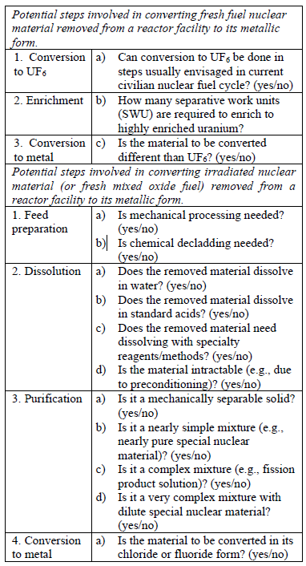
Key Nuclear Data & Modeling
Assessment methodology provides quantitative proliferation risk profile based on 12 attributes
Neutronics modeling & simulations used to quantify attributes (ex. BCM, MWth)
PRO-AR&FC envisions running hundreds of combinations of reactor design features, parameters, and operational parameters
Minimizing uncertainties in nuclear data is critical aspect of PRO-AR&FC process
Notes:
In my prior slide, I discussed our assessment methodology for proliferation resistance and I’d like to draw your attention to a sample of the assessment methodology on the right hand side of this slide.
The assessment methodology provides a quantitative proliferation risk profile for a given advanced nuclear reactor facility, based on 12 attributes. These attributes are applicable to a broad range of reactor design concepts, as tested by PRO-AR&FC through case studies. The assessment methodology is not intended to compare across reactor designs.
Neutronics modeling and simulations are used to quantify these attributes, for examples, to quantify the fissile material production capacity of the reactor facility (per year per MWth), the bare-sphere critical mass (BCM) of the converted nuclear material of weapons interest, and the corresponding spontaneous fission neutron rate and radiation dose rate (gamma and neutron) of a BCM.
The assessment provides a baseline for the intrinsic proliferation resistance of advanced reactors, as quantified by the 12 attributes. The optimization framework will analyze how modifications to the original reactor facility design, including changes to reactor design features and parameters, will impact the intrinsic proliferation resistance of the facility design. For example, do slight changes to the isotopic enrichment of the fuel have notable improvements on proliferation resistance attributes? Are there practical, but permanent, ways to modify the concentrations or isotopics of nuclear material in the fresh or irradiated fuel such that there are significant increases to the level of effort needed to misuse the facility, or to produce nuclear material of weapons interest at the facility?
PRO-AR&FC envisions running hundreds of combinations of reactor design features, parameters, and operational parameters (for various operational scenarios) to generate the input to the optimization framework. The 12 intrinsic proliferation resistance attributes, as well as various reactor performance (including safety) metrics will be calculated.
Relevant nuclear data for those calculations, across a broad suite of reactor concepts and designs (including sodium fast reactors, molten salt reactors, high-temperature gas-cooled reactors) is an important aspect of calculating these attributes. These calculations employ nuclear data; minimizing uncertainties in these nuclear data is important while quantifying the intrinsic proliferation resistance attributes. Some of the advanced reactors use new types of coolants, neutron moderators, and fuels and hence the nuclear data associated with it needs a close examination. (if needed, examples include nuclear data needs on isotopes of chlorine, beryllium, fluorine, thorium, 233U, etc.). Key data on gamma-ray energies and intensities, decay data, and mass attenuation coefficients will affect dose rate calculations. Similarly, nuclear data on spontaneous fission rates, neutron yield, reaction cross section of actinides, neutron multiplicities, affect accuracy of predicted quantities of fissile material production, BCM, and neutron dose rate. Uncertainties in these nuclear data impact the outcomes of the optimization process, as well as the recommendations we make to reactor designers.

Slide 5
A Partner to Industry, Safeguards, Security
PRO-AR&FC will assess and optimize A/SMR technologies
Focused on improving P.R. in a partner’s system NOT fundamentally changing their technology
Initial design and fuel cycle decision are a benchmark
Complimentary NOT competitive with other NNSA programs/efforts
Integrated into NNSA’s Nuclear NEXUS
Proliferation Resistance
Safety
Security
Safeguards
Notes:
As our program continues to develop the optimization methodology, it is important to stress that our aim is to be a partner to industry and our colleagues in safeguards, security, and safety and not a competitive line of effort.
Our focus is to enhance the proliferation resistance of a system, not to fundamentally change their technology – this is why we have structured the initial P.R. assessment to use the analyzed machine as the baseline and have not established a generic baseline facility.
Our program also recognizes that we must continue to be accessible to prospective industry partners which is why we are proud to be included in the NNSA’s Nuclear NEXUS site.

Slide 6


Optimized for Industry Engagement
PRO-AR&FC Team identifies opportunities to improve proliferation resistance while maintaining reactor performance using the optimization methodology
PRO-AR&FC Team conducts proliferation resistance assessment
Communicate optimization opportunities with industry partner
PRO-AR&FC Team reviews updated design
Formalize collaboration agreements, as needed
Industry partner revises design
Meet with industry partner
ASSESS
OPTIMIZE
Notes:
Last year, the PRO-AR&FC program developed its assessment methodology and performed initial tests of this methodology against a suite of publicly available advanced reactor designs and their material inputs. This work is being expanded upon this year to more fully test the assessment methodology against variations in the reactor designs considered last year.
Through development of a system optimization methodology, the PRO-AR&FC program will be building optimization tools to facilitate reactor and reactor facility design modification. These tools will rely heavily on the implementation of reliable nuclear data and will call on a wide assortment of data sources to ensure a useful outcome.

Slide 7
Thank you!

