Slide 1

Nuclear Data Requirements for Advanced Reactor Safeguards and Security
Workshop on Applied Nuclear Data Activities
February 2026
Ben Cipiti, National Technical Director

Slide 2
ARSS Program Goal and Objectives
The ARSS program is addressing near term challenges that advanced reactor vendors face in meeting material control and accounting (MC&A), physical protection system (PPS), and cybersecurity requirements for reactors built in the U.S.
Material Control & Accounting
Physical Protection Systems
Cybersecurity
Systems Level
Systems Level
Systems Level
PBR MC&A Approach
MSR MC&A Approach
Vendor Engagements
International Coordination
SMR PPS Design Approach
Microreactor PPS Design Approach
Vendor Engagements
Cyber-Informed Engineering
Defensive Cyber Architecture
Vendor Engagements
Technology Level
Technology Level
Technology Level
Measurement Technologies
Process Monitoring
Statistical Evaluations
Advanced Intrusion Detection
Advanced Delay Technologies
Advanced Response Tech/Tactics
Secure Elements/Tokens
Supply Chain
Control System Component Testing
Interface with Safety

Slide 3
Nuclear Data Needs
The vast majority of our nuclear data needs are related to MC&A:
  Use of burnup codes for MC&A declarations
  Burnup measurements for pebble bed reactors
  Support for on-line measurements for molten salt reactors
In the physical protection space, data needs are mostly related to performance testing of the technologies for detection, delay, and response.
In the cybersecurity space, the data needs are typically related to IT systems, processing speeds, and performance utilizing various approaches for anomaly detection.

Slide 4
Burnup Codes
From a domestic MC&A standpoint, most advanced reactors will follow the MC&A approach that existing large light water reactors follow: item accounting and use of burnup codes to declare inventories.
  This will be true for any reactor that uses solid fuel assemblies or fuel elements.
  But the codes may need to improve for some reactor types.
Pebble Bed Reactors will need to continue to improve burnup code predictions, but much work has already been done.
Last year at WANDA, improvement of burnup codes for liquid fueled molten salt reactors was discussed, and work is being done to improve the code predictions. Keep in mind that differences in fluoride, chloride, and flibe salts will have different needs.

Slide 5
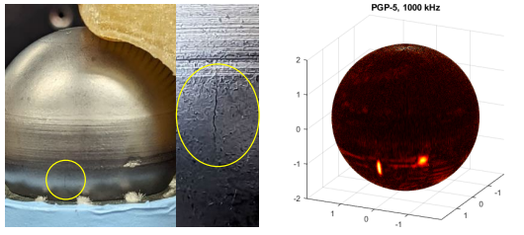
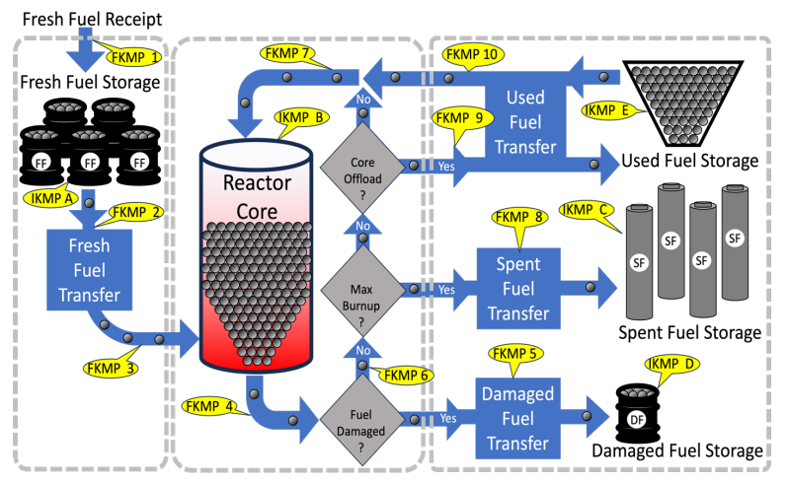
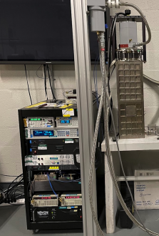
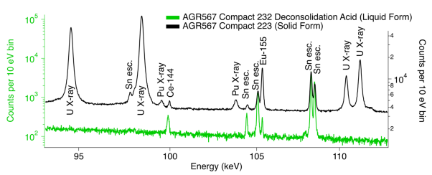
MC&A for Pebble Bed Reactors
Burnup Measurement (BUMS) for process control and actinide estimate
Pebble Integrity Measurement to look for damaged fuel
D. Kovacic et al. “Nuclear Material Control & Accounting for Pebble Bed Reactors,” Oak Ridge National Laboratory, ORNL/SPR-2023/2988 (December 2023).
C. Gariazzo et al. “Imaging Techniques for Pebble Accountancy in Pebble Bed Reactors,” Argonne National Laboratory, ANL/SS-24/1 (January 2024).
M. Croce et al. “Gamma Spectroscopy Performance for Irradiated Solid-Form TRISO Fuel,” Los Alamos National Laboratory, LA-UR-24-30542 (September 2024).
Notes:
The milestone report from last year was meant to outline the overall MC&A approach for a PBR. Hope it’s of use to inform the domestic approach.

Slide 6
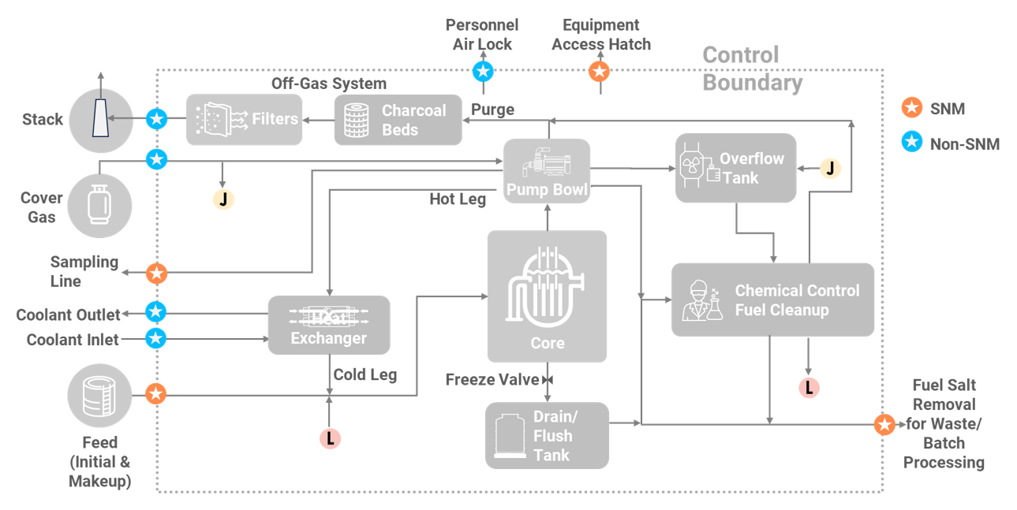
MC&A for Molten Salt Reactors
Molten Salt Reactors have challenges with MC&A due to the difficulties of getting low uncertainty actinide total measurements
  Even a 1% measurement uncertainty on 1000 kg of Pu leads to an SEID > 10 kg of Pu.
  Level measurements at low uncertainty will be extremely challenging
MSRs may rely additionally on a control boundary approach where monitoring is used for key penetrations and access points to the reactor loop.
S. Chirayath et al. “Control Boundary Analysis for Liquid-Fueled Molten Salt Reactors,” Oak Ridge National Laboratory, ORNL/SPR-2025/4221 (September 2025).
Notes:
The milestone report from last year was meant to outline the overall MC&A approach for a PBR. Hope it’s of use to inform the domestic approach.

Slide 7
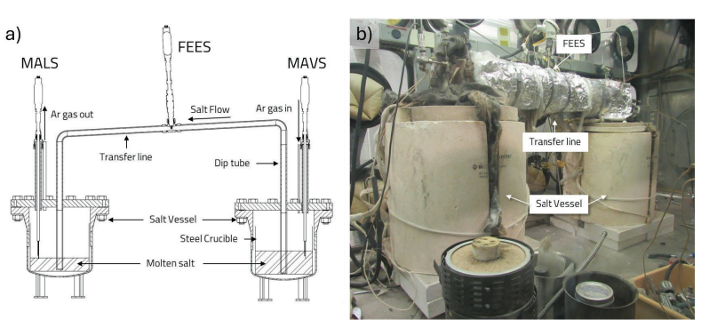
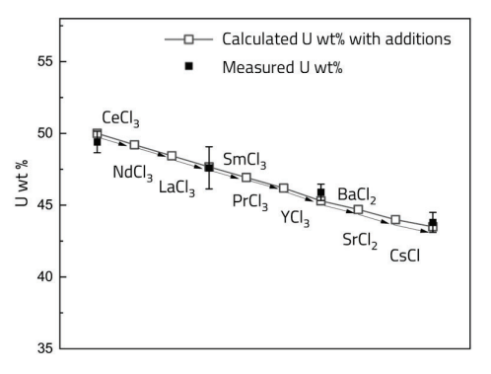
Voltammetry for Actinide Accountancy in MSRs
The Flow Enhanced Electrochemical Sensor (FEES) is designed to measure flowing molten salts in the conditions of an MSR.
Recent work has shown the ability to measure uranium in high concentration salts (up to 72.3 wt%) with fission product surrogates to mean absolute relative error of 0.8%.
Future work is evaluating a joint FEES-LIBS measurement to additionally determine Pu content to low uncertainty.
This sensor can be used for monitoring of other species and aspects of molten salts.
W. Doniger et al. “Flow Enhanced Electrochemical Sensor Performance in Complex Salt Systems,” Argonne National Laboratory, ANL/CFCT-25/27 (September 2025).

Slide 8
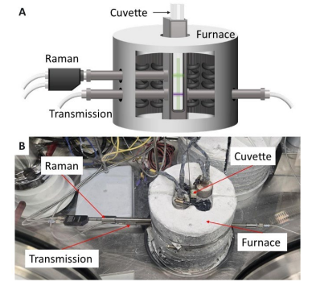
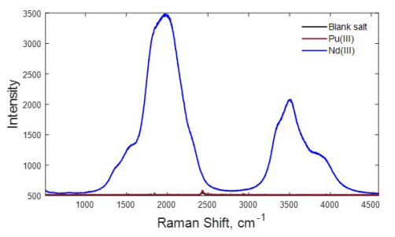
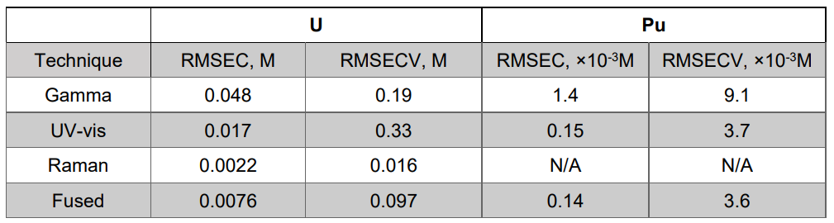
Spectroscopy for Actinide Accountancy in MSRs
Spectroscopy is another option for actinide measurements in molten salts.
The experimental work is moving toward more complex salt solutions to determine if there are interferences in mixed MSR solutions.
Current work is also evaluating a combined spectroscopy-gamma measurement to determine if there could be improved uncertainty on actinide measurements.
This sensor can be also used for monitoring of other species and aspects of molten salts.
S. Branch et al. “Optical Techniques for Advanced Salt Sytems,” Pacific Northwest National Laboratory, PNNL-38262 (September 2025).
S. Branch et al. “Data Fusion: Applying Chemometric Modeling to Gamma and Optical Spectroscopic Data,” Pacific Northwest National Laboratory, PNNL-37731 (May 2025).

Slide 9

Thank You!
Open reports are posted to the program website:
https://energy.sandia.gov/arss
For additional information:
  Ben Cipiti, National Technical Director (SNL) bbcipit@sandia.gov
  Dan Warner, Federal Program Manager daniel.warner@nuclear.energy.gov

