Slide 2
The Deimos Testbed
Peter Brain, T. Cutler, K. Stolte, A. Terricabras, N. Thompson
February 9 – 12 2026
WANDA 2026
Arlington, VA, USA
LA-UR-26-20890

Slide 3
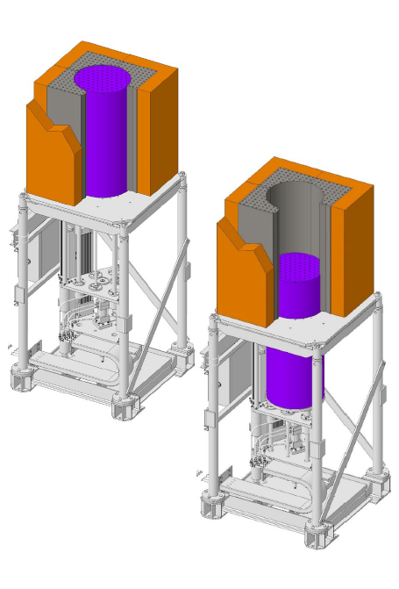
Deimos Experiment
Advanced Reactor Testbed
Los Alamos National Laboratory (LANL) Laboratory Directed Research and Development (LDRD) for advanced reactor testbed performed at National Criticality Experiments Research Center (NCERC) in 2024
Graphite-moderated, beryllium reflected, HALEU TRi-structural ISOtropic (TRISO) critical assembly
Utilizes fuel from the Compact Nuclear Power Source (CNPS) experiments from LANL circa 1990s
Notes:
Mention Holly Trullue and Theresa Cutler for timely experiment idea.

Slide 4
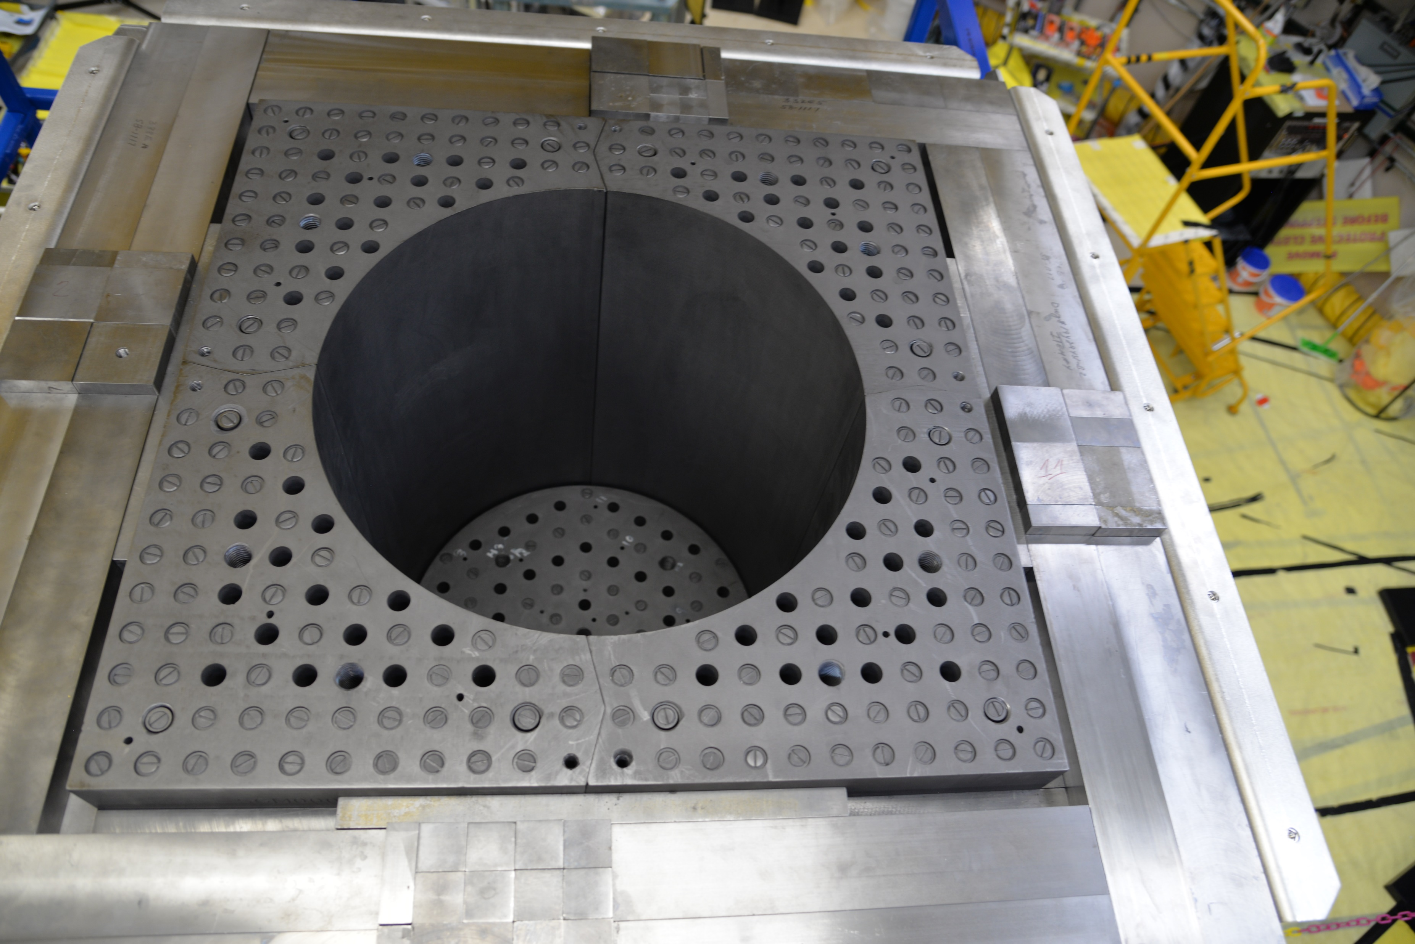
Deimos Experiment
Advanced Reactor Testbed Targeting Thermal Spectra
Deimos is a 3’ graphite cube, two-region core, the inner 21” cylinder controls remote criticality and outer core provides much of the fuel.
Reflected by 6”+ of Be metal, the reflector is made of 1,000+ pieces of Be.

Slide 5
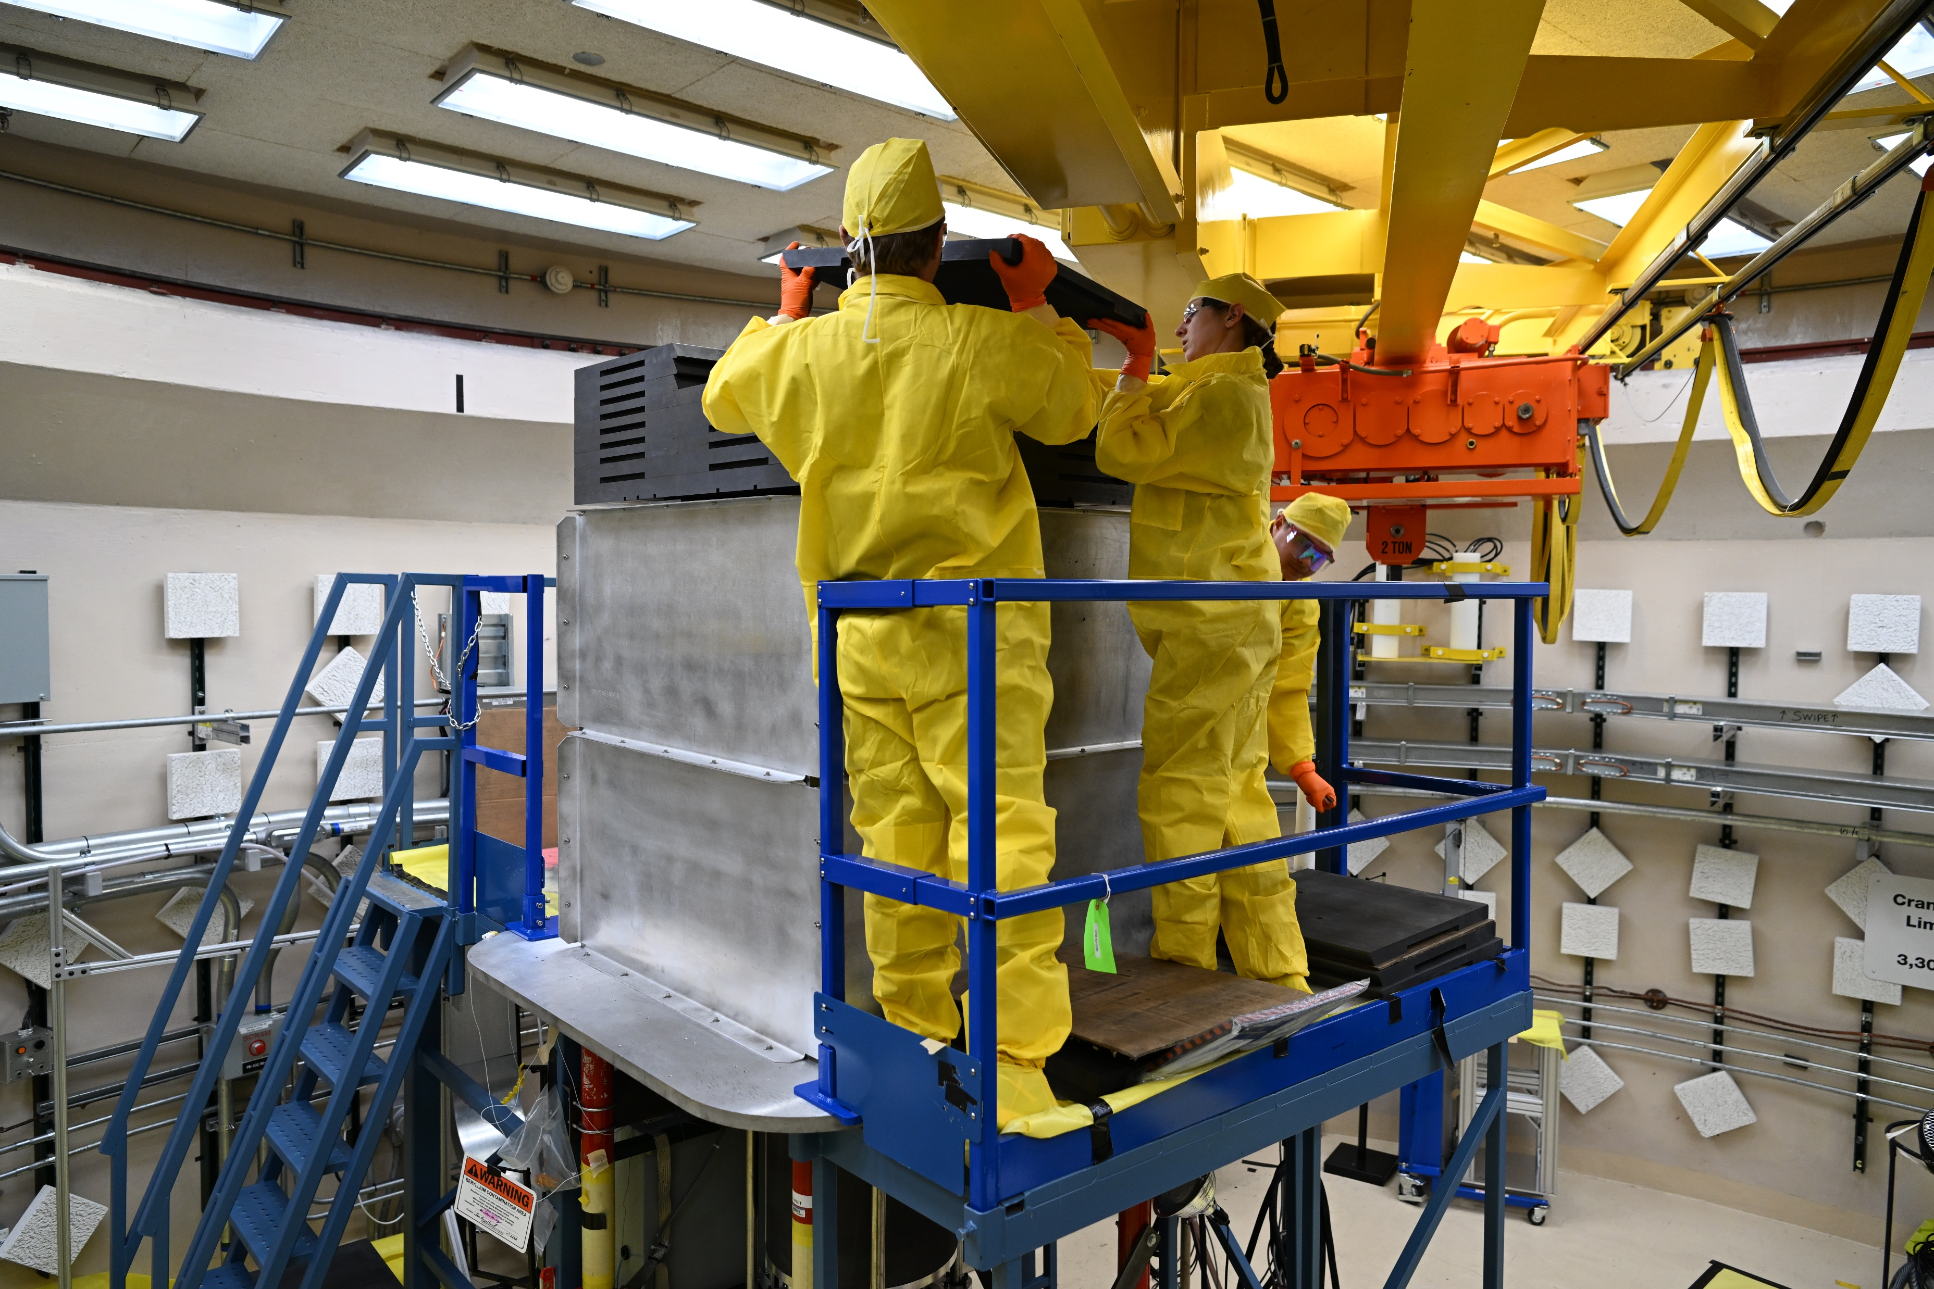

Slide 6
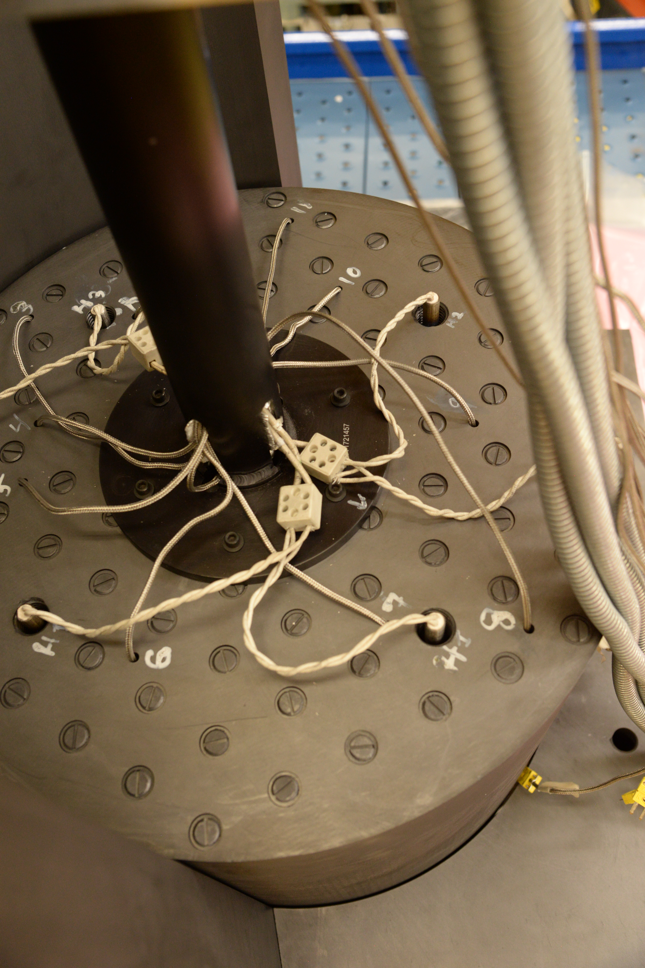
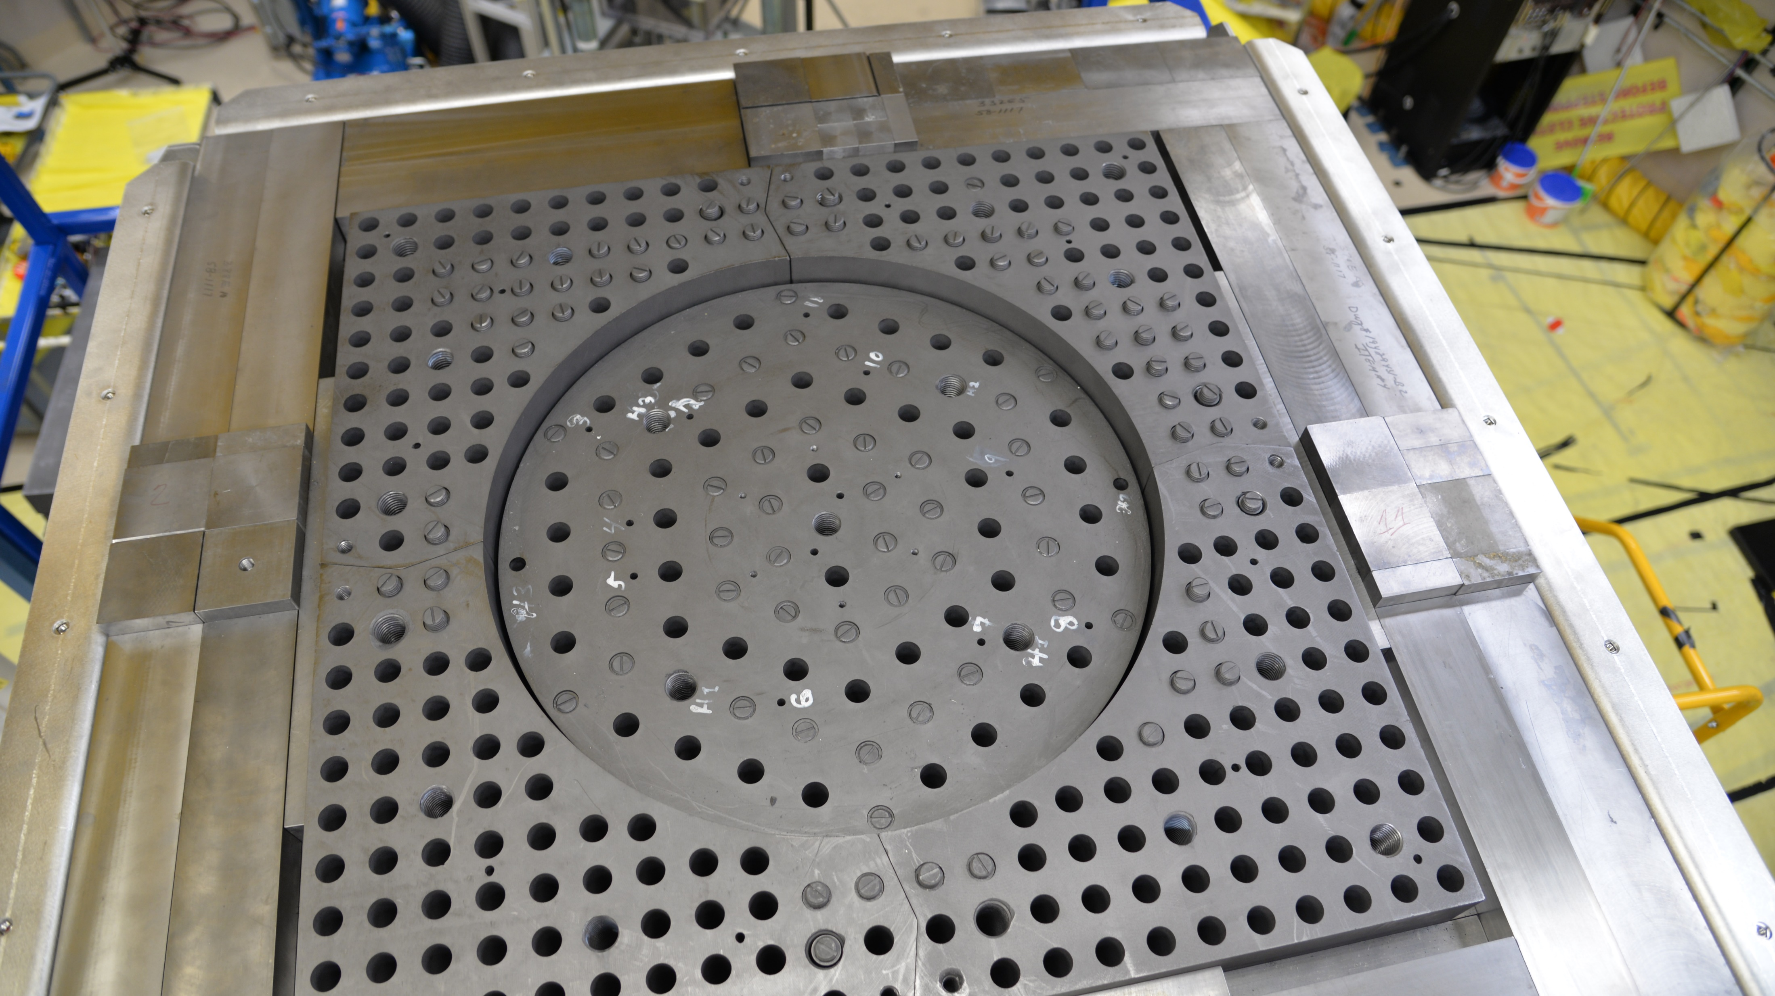
Deimos Experimental Setup
Hot and Cold Critical Capabilities
Both heated and unheated experiments performed (up to 110 ̊C)
DOE/NRC Collaboration for Criticality Safety Support for Commercial-Scale HALEU Fuel Cycles and Transportation (DNCSH) funded benchmarking of unheated core
5 critical configurations + 2 reproduction measurements (swap fuel cups) and 1 reconfiguration measurement (full core rebuild)

Slide 7
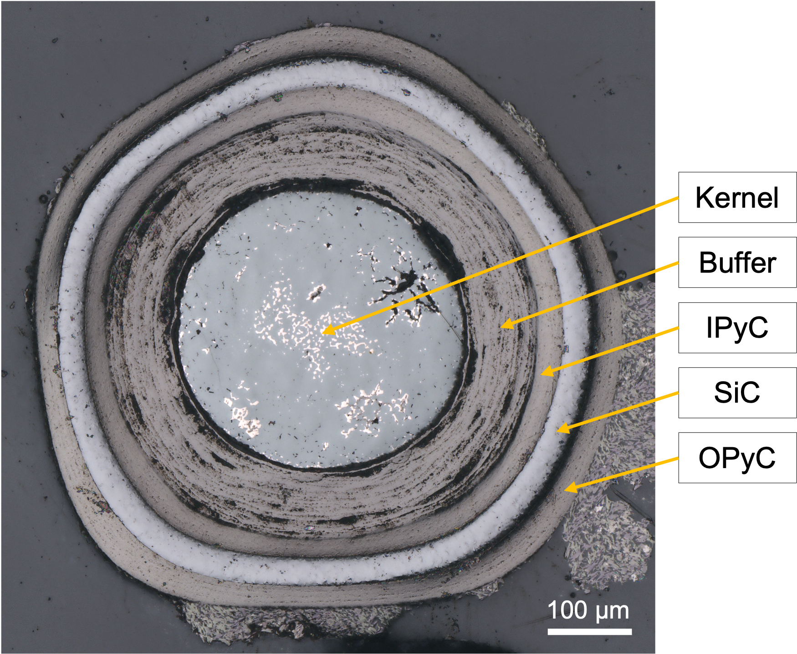
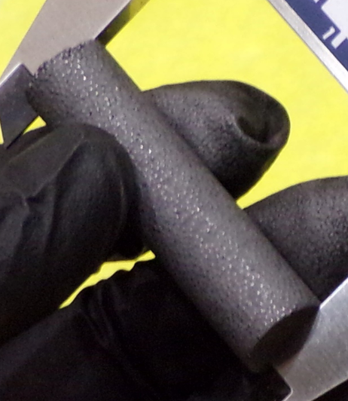
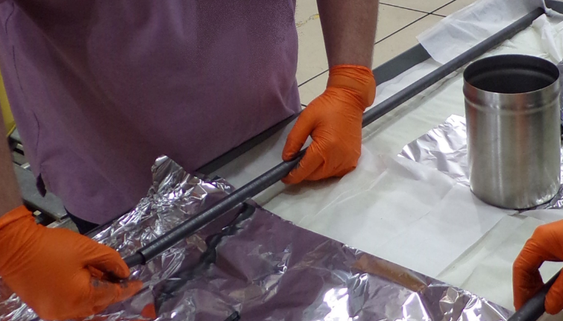
HALEU Fuel at NCERC
NCERC has HALEU material found nowhere else in the world
TRISO particles are comprised of
5 concentric layers
Innermost fuel kernel is 0.5 mm
in diameter
19 CNPS compacts are then stacked into a fuel
cup (fuel rod) made of graphite
These cups serve as the discrete fuel for Deimos
~11,500 TRISO particles are placed into a green graphite matrix and fired to form compact

Slide 8
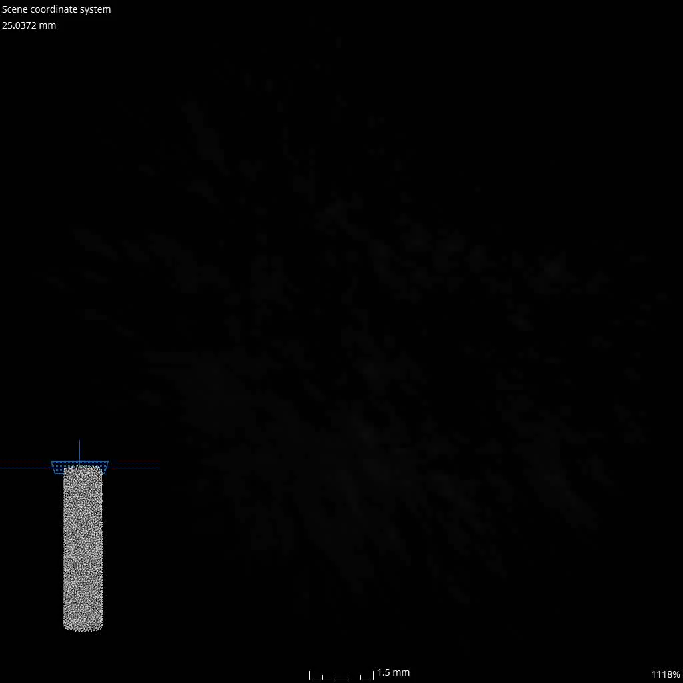
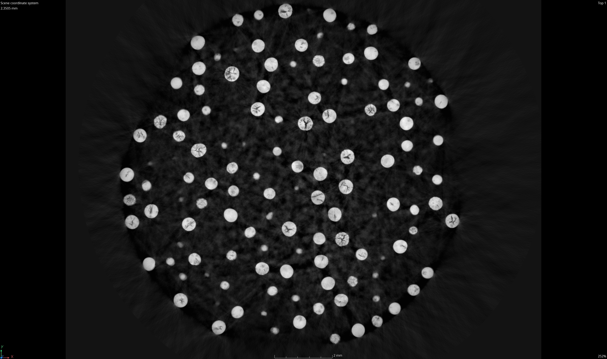
CNPS Fuel Required New Data for Benchmarking
Internal LANL collaboration with LEFFF
CT scans show that almost all particles
  Are not perfectly spherical
  Can give direct packing fraction measurement
Average dimensions fall within previous
literature (no major surprises)

Slide 9
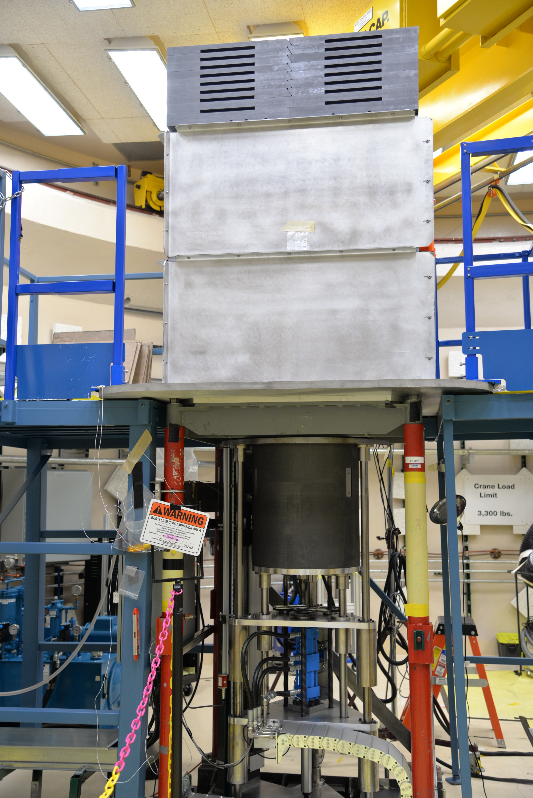
Beyond Deimos
Deimos was executed in FY24 and taken apart. However, it’s been rebuilt for several experiments, thereby achieving its testbed purpose
THETA
NOVA

Slide 10
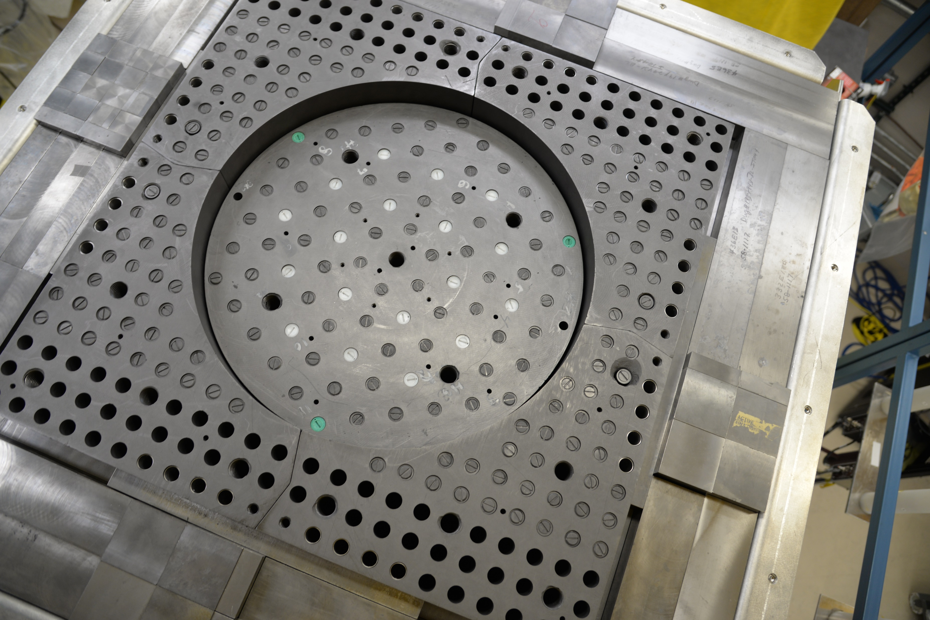
  Kairos Power collaboration to explore absorber worth and mixed moderator for TRISO shipments (poly, borated poly, stainless steel)
Beyond Deimos
THETA
NOVA

Slide 11
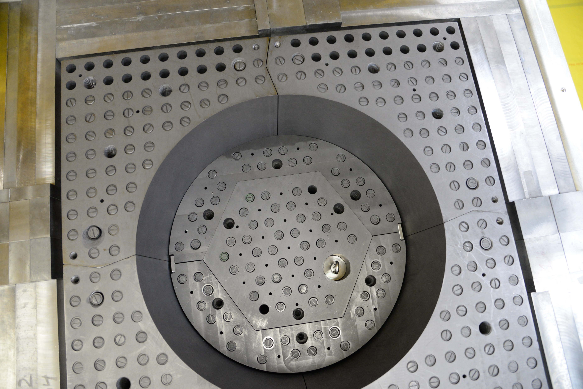
  Valar Atomics collaboration for reactor physics and control rod worth – first commercially provided inner core
Beyond Deimos
THETA
NOVA

Slide 12
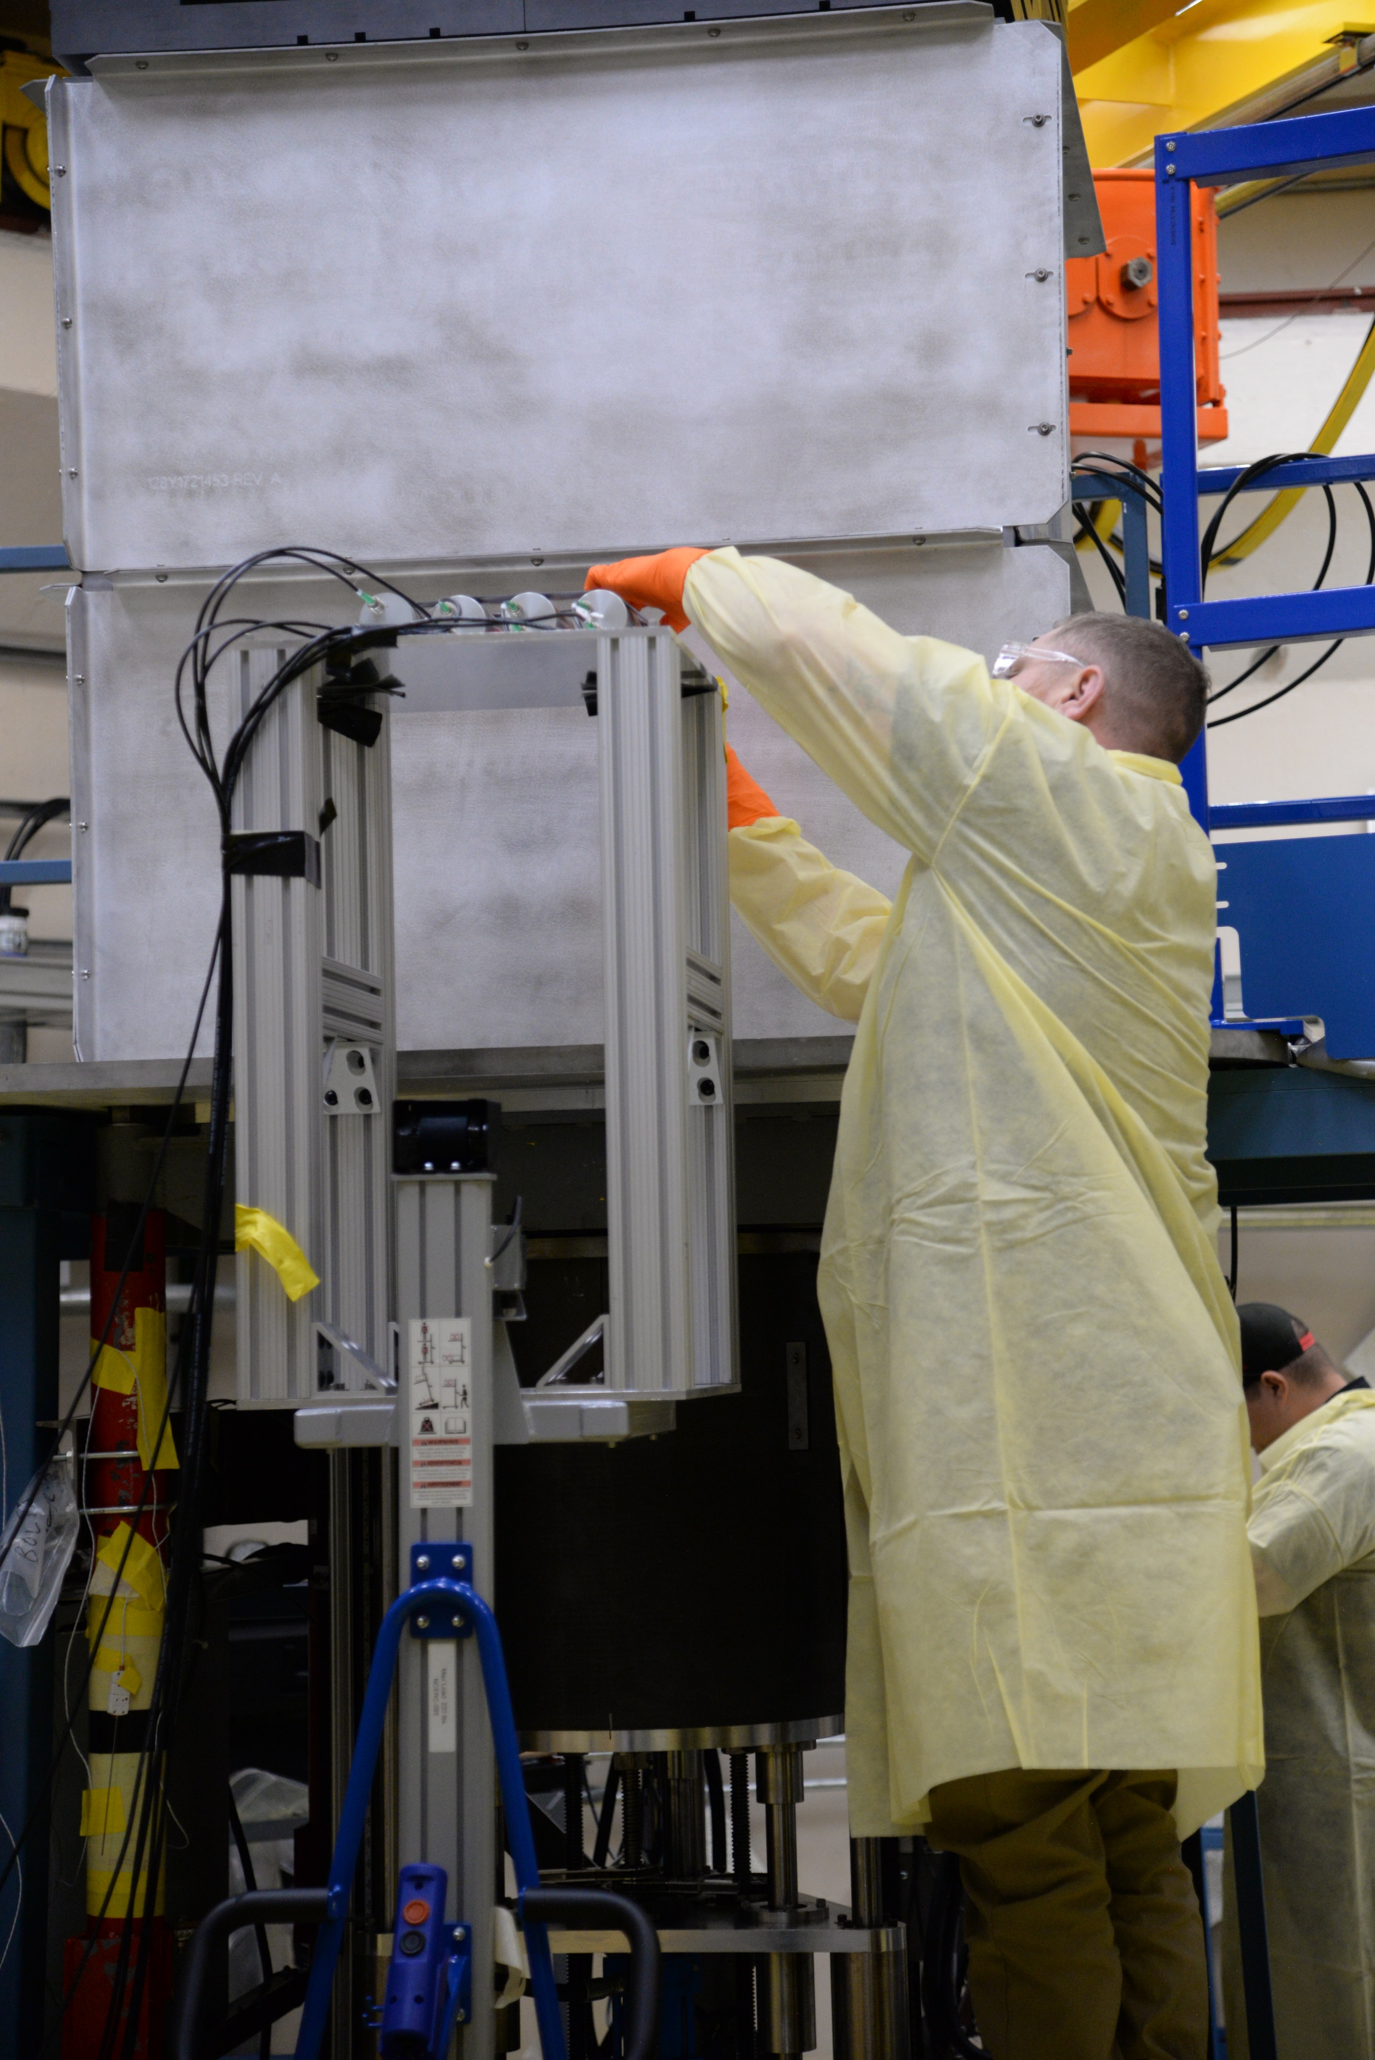
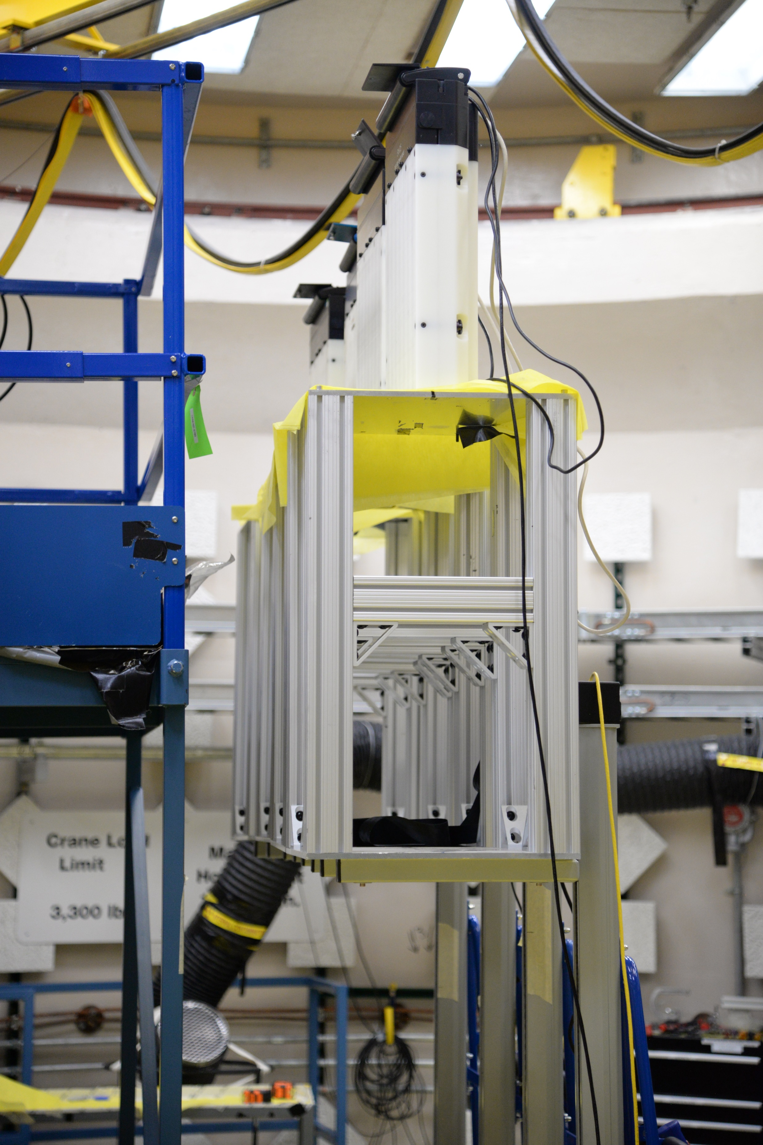
Safeguard Applications
Several avenues of research are ongoing with Deimos Testbed, measured gamma and neutron characteristics with in-core and ex-core detectors
Several projects for subcritical measurements to verifying fuel diversion in-progress of sponsor submission
  Advanced Reactor International Safeguards Engagement (ARISE) work for data analysis of previous measurements

Slide 13
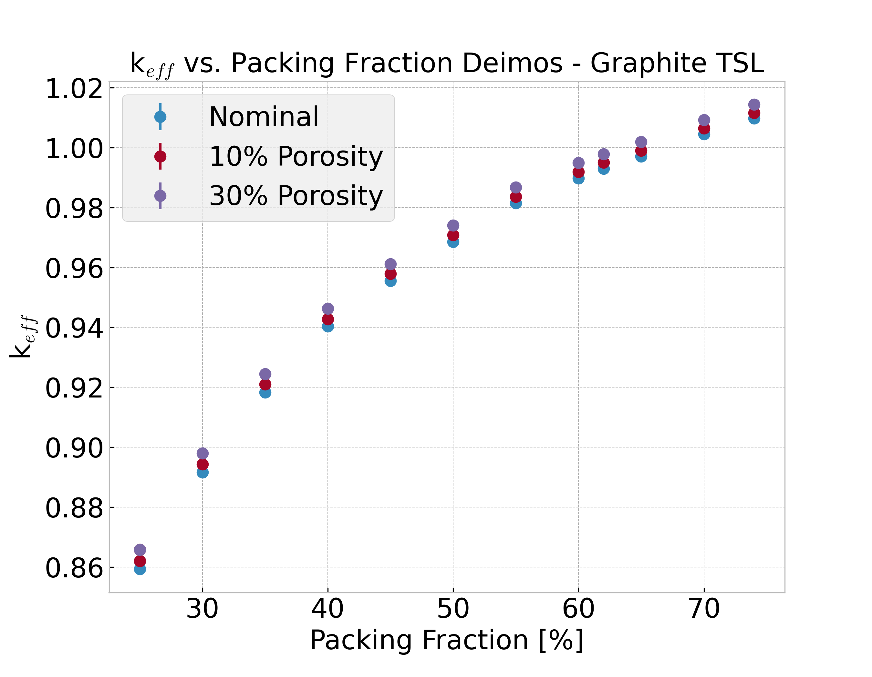
Nuclear Data Applications
Deimos is sensitive to graphite, beryllium, and uranium ND
Graphite TSLs show significant impact to calculations
  15-20 pcm/ % porosity for Deimos
Beryllium photo-neutrons are visible post shutdown

Slide 14
Conclusion
Deimos is Here to Meet Safeguard and Advanced Reactor Needs
Heated and room-temp experiments of HALEU TRISO in graphite moderator
Benchmark of original configurations enroute to ICSBEP
Interest from commercial companies for experiments on Deimos/alternate platforms
NCERC TRISO fuel and Deimos platform provide testbed for material diversion and nuclear data validation

Slide 15

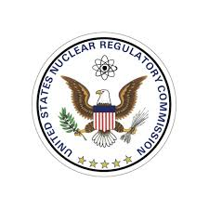


Acknowledgements
Thank you to all sponsors!
This work was supported by the DOE/NRC Criticality Safety for Commercial-Scale HALEU for Fuel Cycle and Transportation (DNCSH) project, a collaboration between United States Department of Energy (DOE) and the Nuclear Regulatory Commission (NRC), a component of the Office of Nuclear Energy’s HALEU Availability Program.
The Deimos experiment design was supported by the US Department of Energy through the Los Alamos National Laboratory and the Laboratory Directed Research & Development “Next Generation Small Nuclear Reactors”, 20220084DR.
NCERC is supported by the DOE Nuclear Criticality Safety Program, funded and managed by the National Nuclear Security Administration for the Department of Energy.

