Slide 1
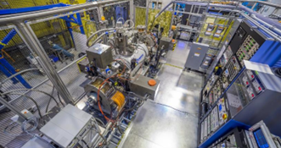
Applied Nuclear Data Capabilities at ATLAS/nuCARIBU
Workshop for Applied Nuclear Data Activities (WANDA) 2026
February 12, 2026
Guy Savard
ATLAS Scientific Director

Slide 2
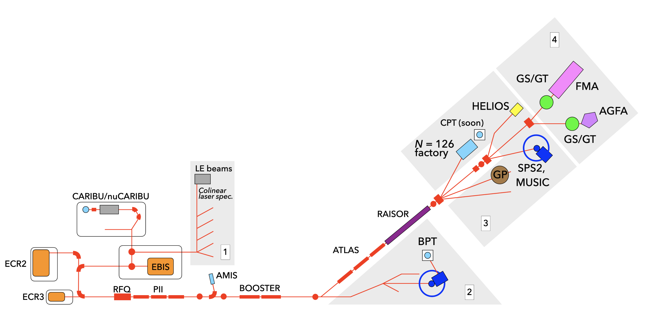
ATLAS/CARIBU facility
Stable beams at high intensity and energy up to 10-20 MeV/u
Light in-flight radioactive beams with RAISOR
  light beams, no chemical limitations, close to stability, acceptable beam properties
(nu)CARIBU beams
  heavy n-rich from Cf fission neutron-induced fission, no chemical limitations, low intensity, ATLAS beam quality, energies up to 15 MeV/u
State-of-the-art instrumentation for Coulomb barrier and low-energy experiments
Operating ~6000 hrs/yr (+ 2000 hrs/yr (nu)CARIBU stand alone) at > 90% efficiency
  Common PAC for ATLAS and (nu)CARIBU
  350-450 “single users” per year performing experiments at ATLAS
2

Slide 3
ATLAS stable and long-lived beams
Wide variety of “primary” beams
  Stable beams from protons to Uranium
  some long-lived beams (¹⁴C, ⁸⁵Kr, ²²³Ra, …)
Intensity up to a few pμA, limited by ion source performance and radiation safety
Excellent timing properties
  Pulse separation of 82 ns or n X 82 ns with n=1, 2, 3, …
  Pulse timing down to ~100 ps depending on beam and target location
Energy range from ~ 0.5 MeV/u up to 10-20 MeV/u depending on mass
Recent expansion of safety envelope with new SAD and ASE
  Maximum allowed proton beam energy raised to 25 MeV
  Deuterium and tritium beams now available
  Maximum allowed radiation potential increased

Slide 4
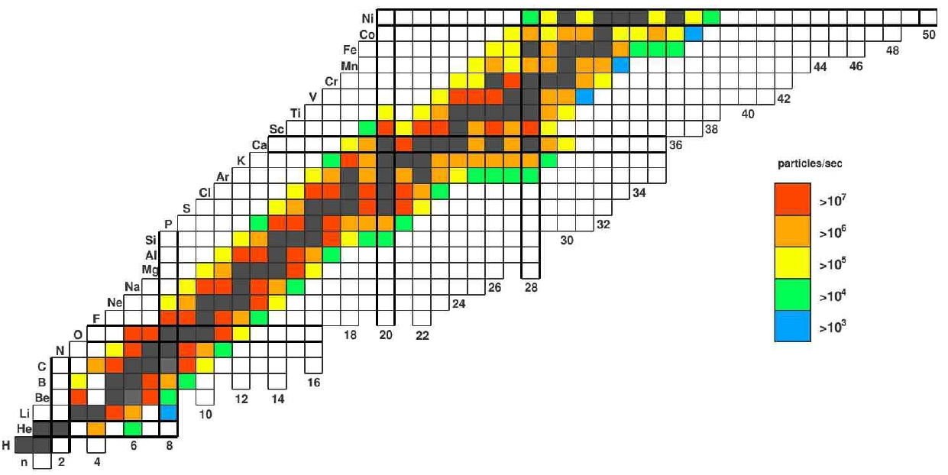
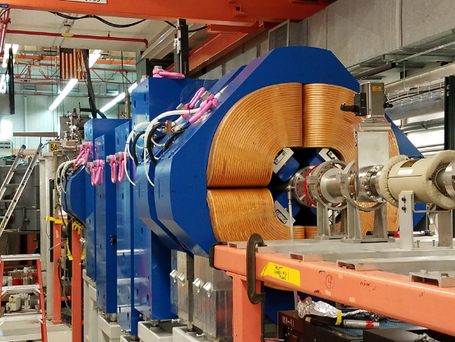
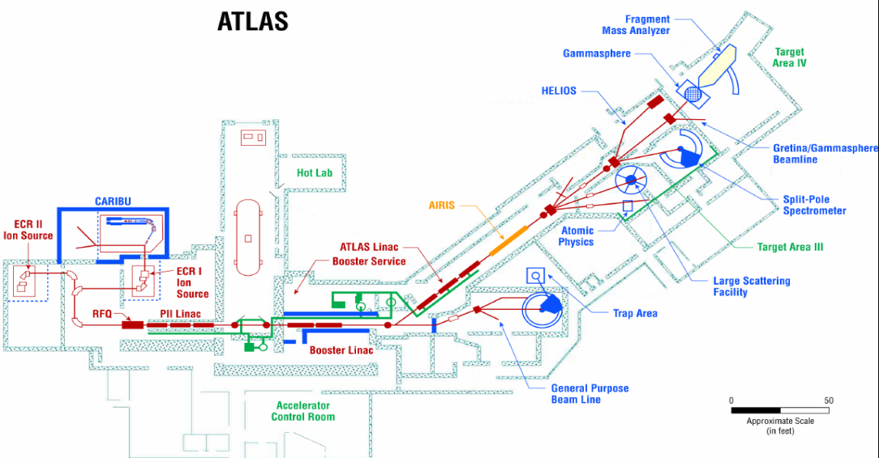

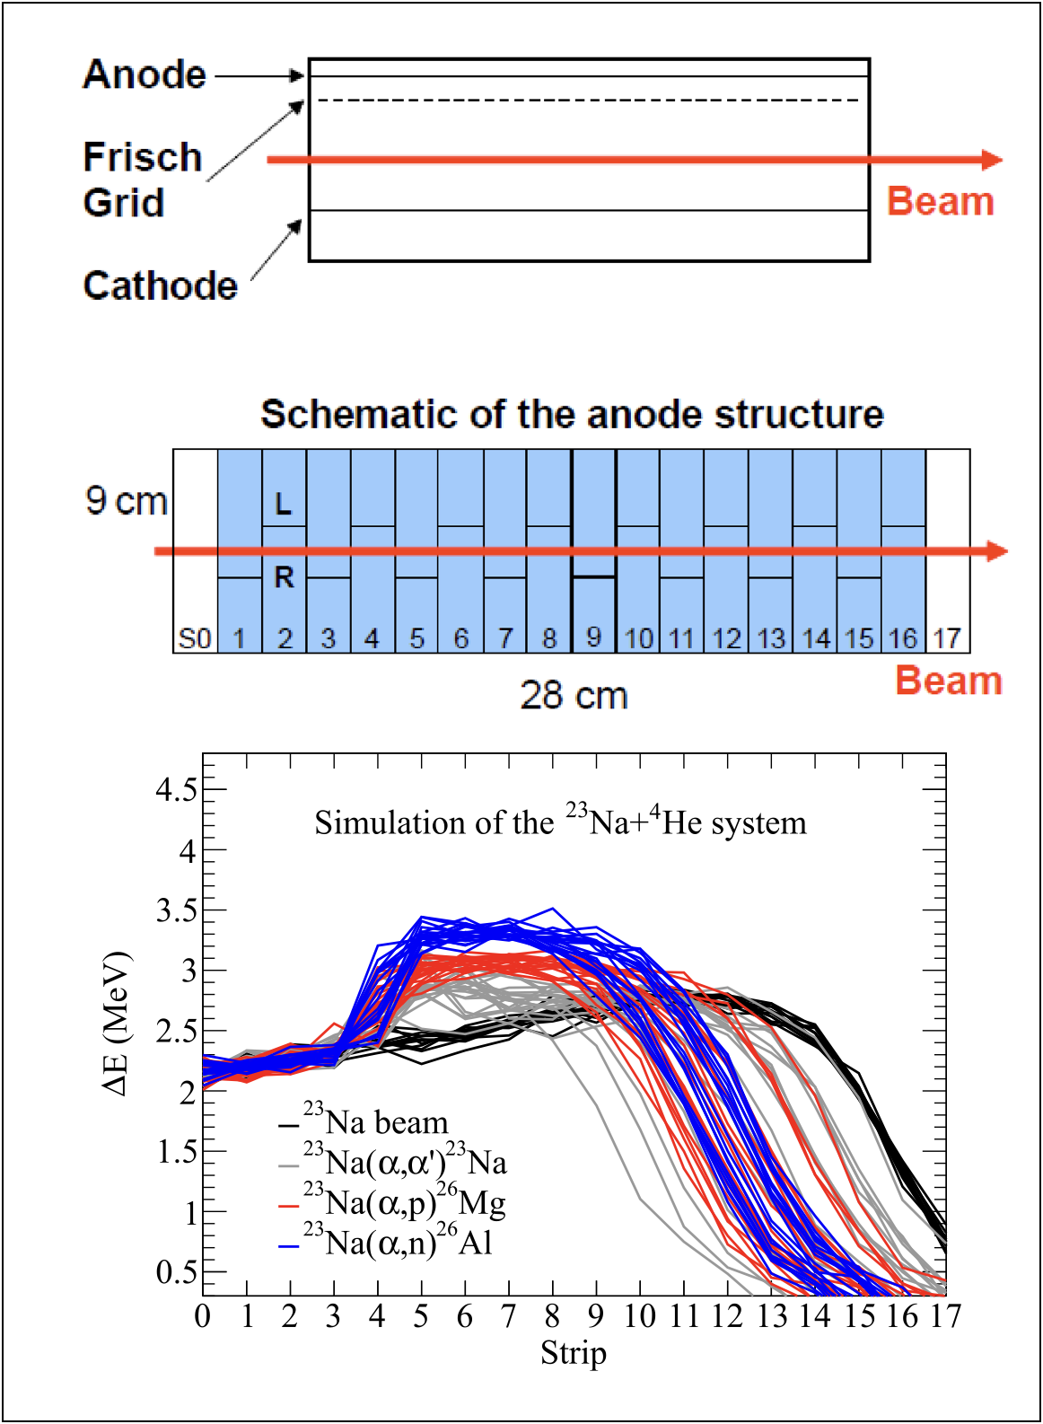
RAISOR: Light In-Flight Radioactive Beams
Multi-Purpose
RAISOR
Ideal energies for direct reaction studies (5-15 MeV/u), including negative Q-value reactions
RIB production is close to instrumentation making very short-lived beams (few 100 ns) available for reaction studies (including isomers).
Major programs are direct-reaction studies with HELIOS (inc. AT-TPC) and reactions relevant to nuclear astrophysics with MUSIC

Slide 5
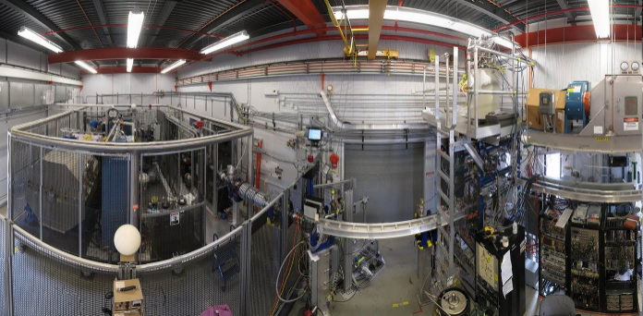
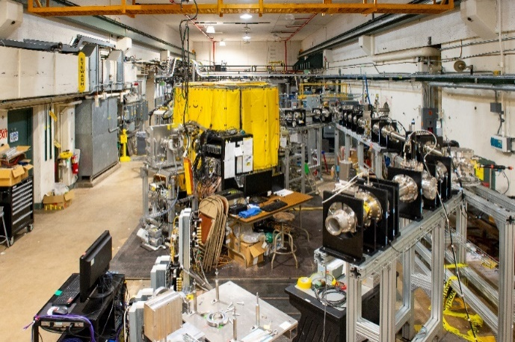
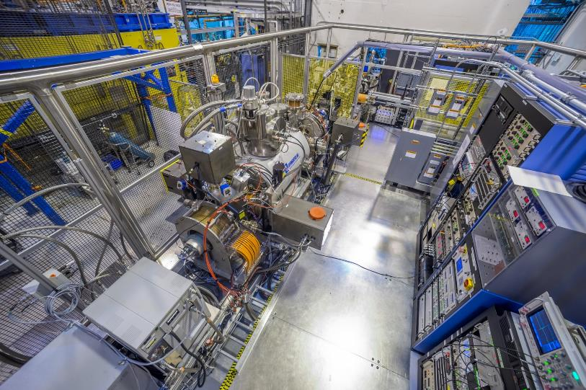
Neutron-rich beam source for ATLAS: nuCARIBU “front end” layout
n-induced fission of ²³⁵U
Main components of CARIBU
PRODUCTION: “ion source” is ²⁵²Cf source inside gas catcher
    Thermalizes fission fragments
    Extracts all species quickly
    Forms low emittance beam
SELECTION: Isobar separator and MR-TOF
    Purifies beam
DELIVERY: beamlines and preparation
    Low-energy buncher and beamlines
    Charge breeder to Increase charge state for post-acceleration
    Post-accelerator ATLAS and weak-beam diagnostics
Commissioned in 2012
Commissioned in 2020
Commissioned in 2017

Slide 6
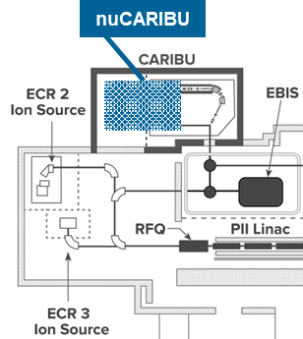
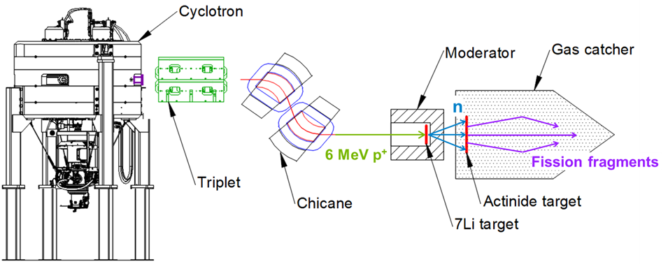
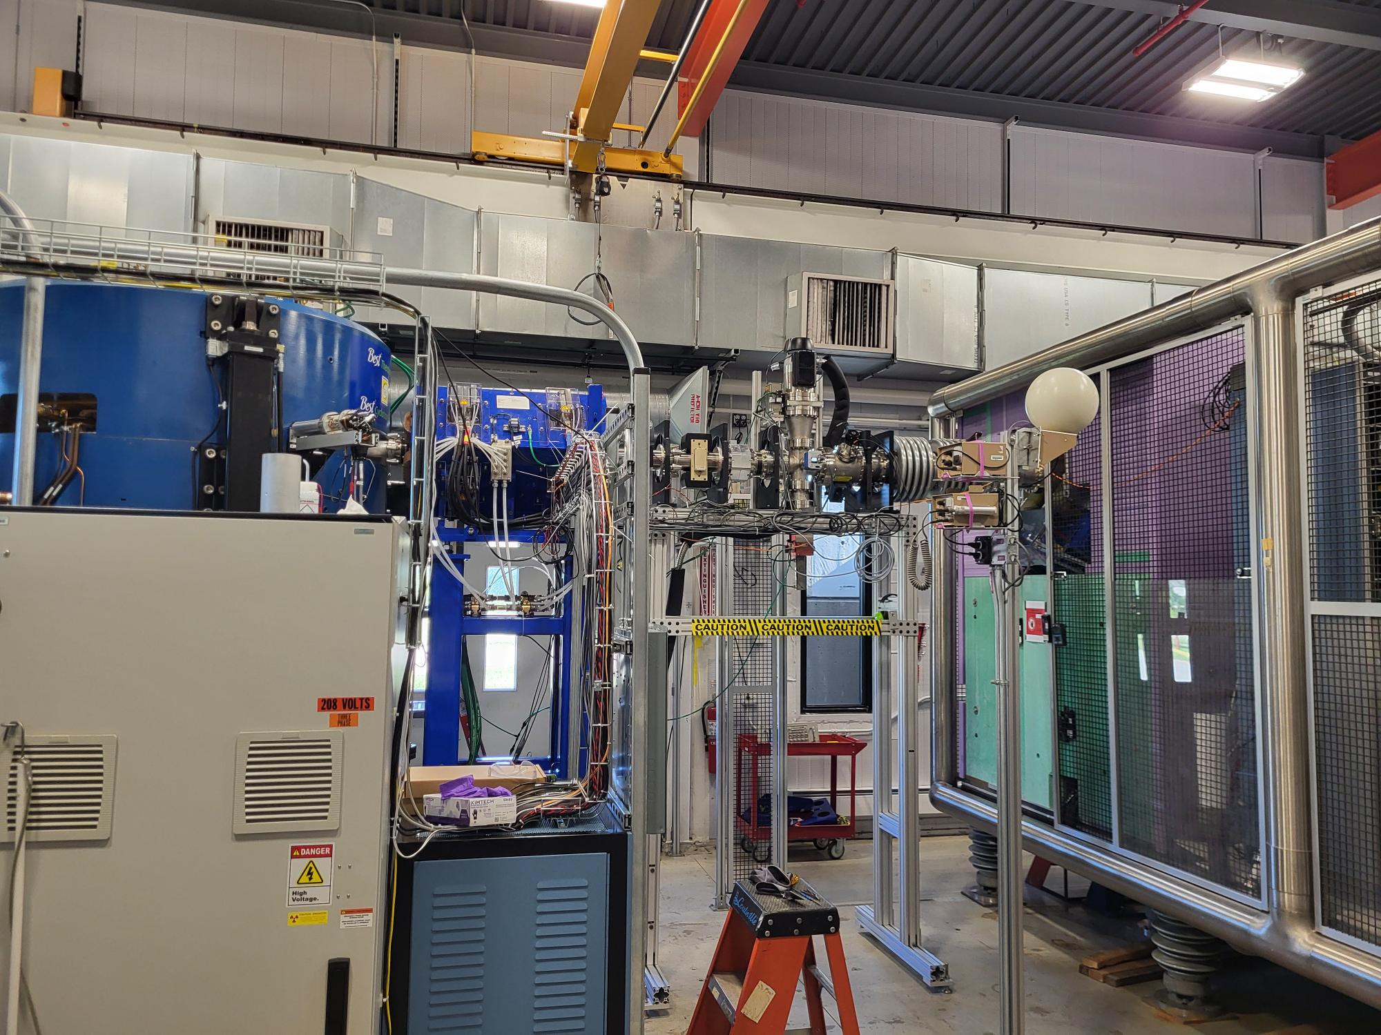
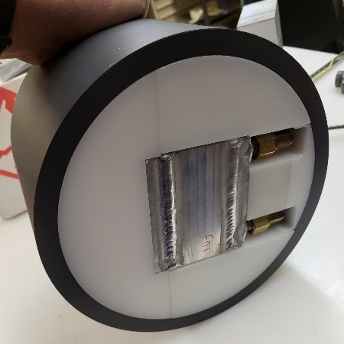
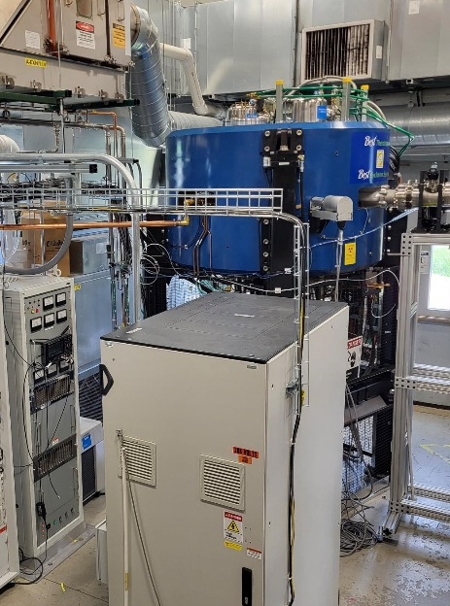
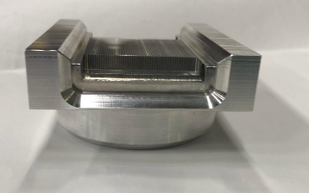
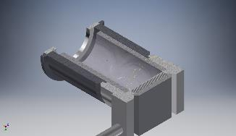
nuCARIBU (neutron-induced fission)
Move from spontaneous fission of ²⁵²Cf to neutron-induced fission of actinides (starting with ²³⁵U)
  Higher yield
  Easier to maintain and operate (neutron source based on p-⁷Li reaction)
Serving all areas of ATLAS
  seven low-energy beam lines in area 1
  ~6 MeV/u beams in area 2
  up to ~10 MeV/u beams in areas 3 & 4
Major programs for reaccelerated beams in Coulomb excitation (GS and GRETINA and in the future Clarion), with MUSIC for r/i-process, and with the AT-TPC and HELIOS for direct reaction studies and resonant elastic scattering
Major programs for low-energy beams in mass measurements, decay and laser spectroscopy

Slide 7
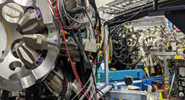

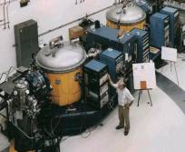
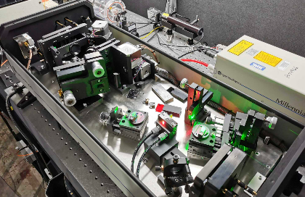
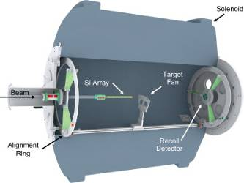
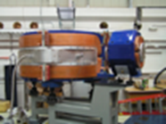
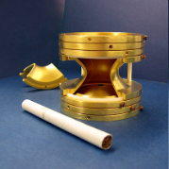
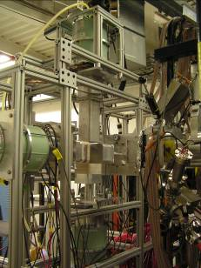
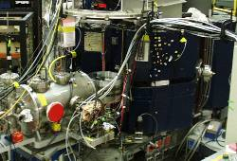
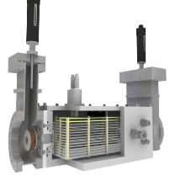
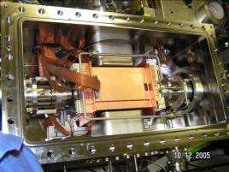
Distribution of experimental equipment
GAMMASPHERE/GRETINA
FMA
Laser spectroscopy
HELIOS spectrometer
CPT mass spectrometer
Laser Lab
X-array
Si-array (Ludwig) and Enge spectrometer
MUSIC
+ outside instruments playing an increasingly important role: GRETINA, CHICO-II, HERCULES, GODDESS, VANDLE, MTAS, SUN, AT-TPC ….
Beta decay Paul trap

Slide 8
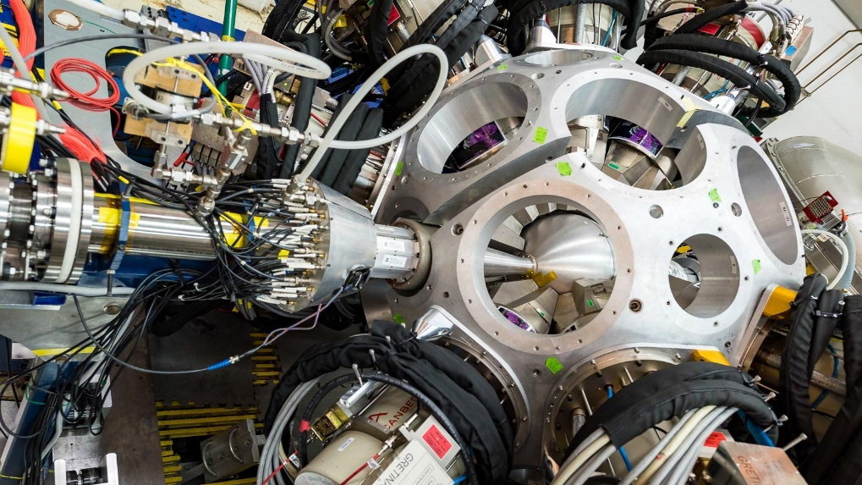
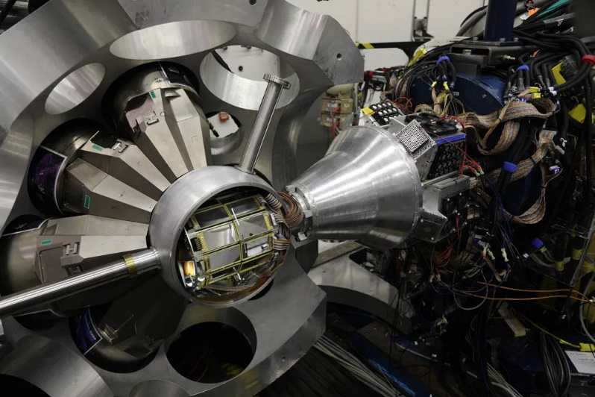
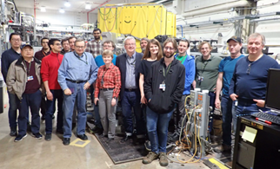
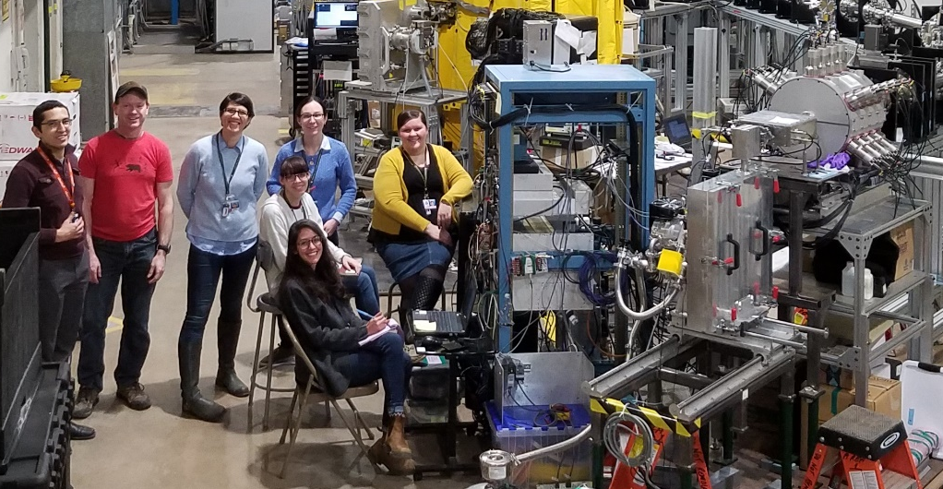
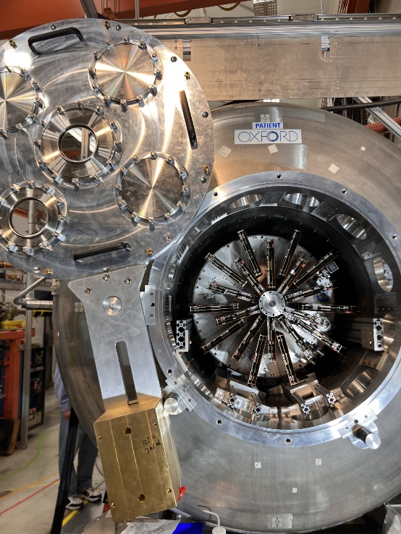
additional equipment capabilities
Significant impact of community devices
Local equipment continually improved for higher efficiency and rate capability
Extended stays by state-of-the-art community devices for focused physics campaigns
Versatile DAQ infrastructure to merge signals from visiting devices with local equipment
ORRUBA/GODDESS + GRETINA
CHICO2 + GRETINA
AT-TPC + HELIOS
SUN
MTAS

Slide 9
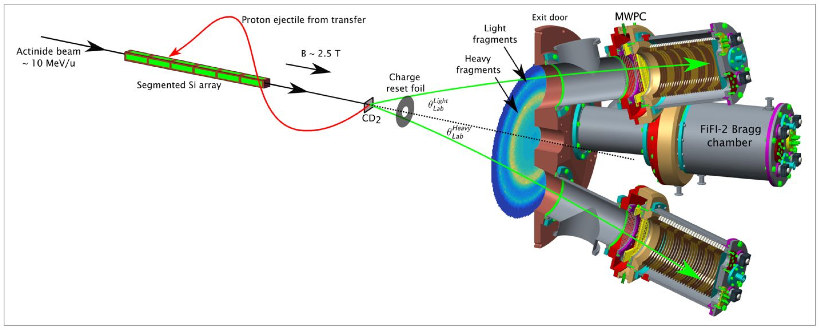

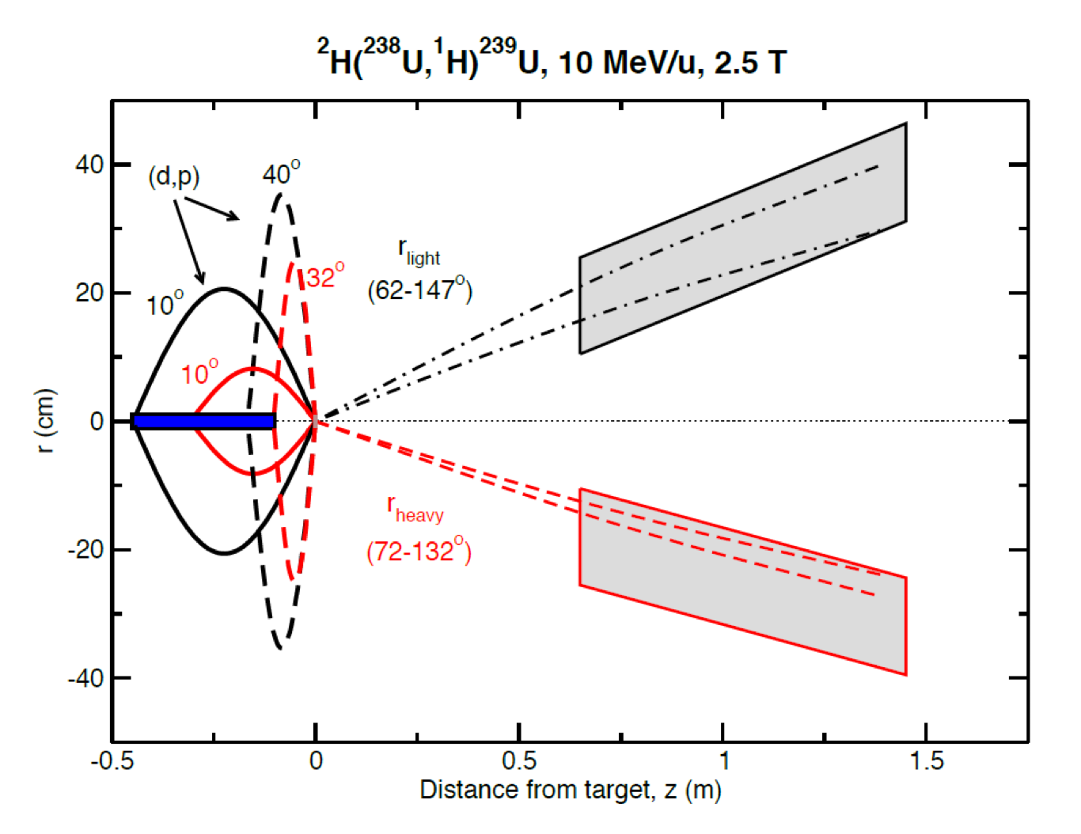
HELIOS @ ATLAS, nuclear fission
A new approach to fission studies, test case proves promising ... significant scope for upgrades
  ~100% intrinsic,
  ~10% fragment,
  ~1% heavy and light

Slide 10

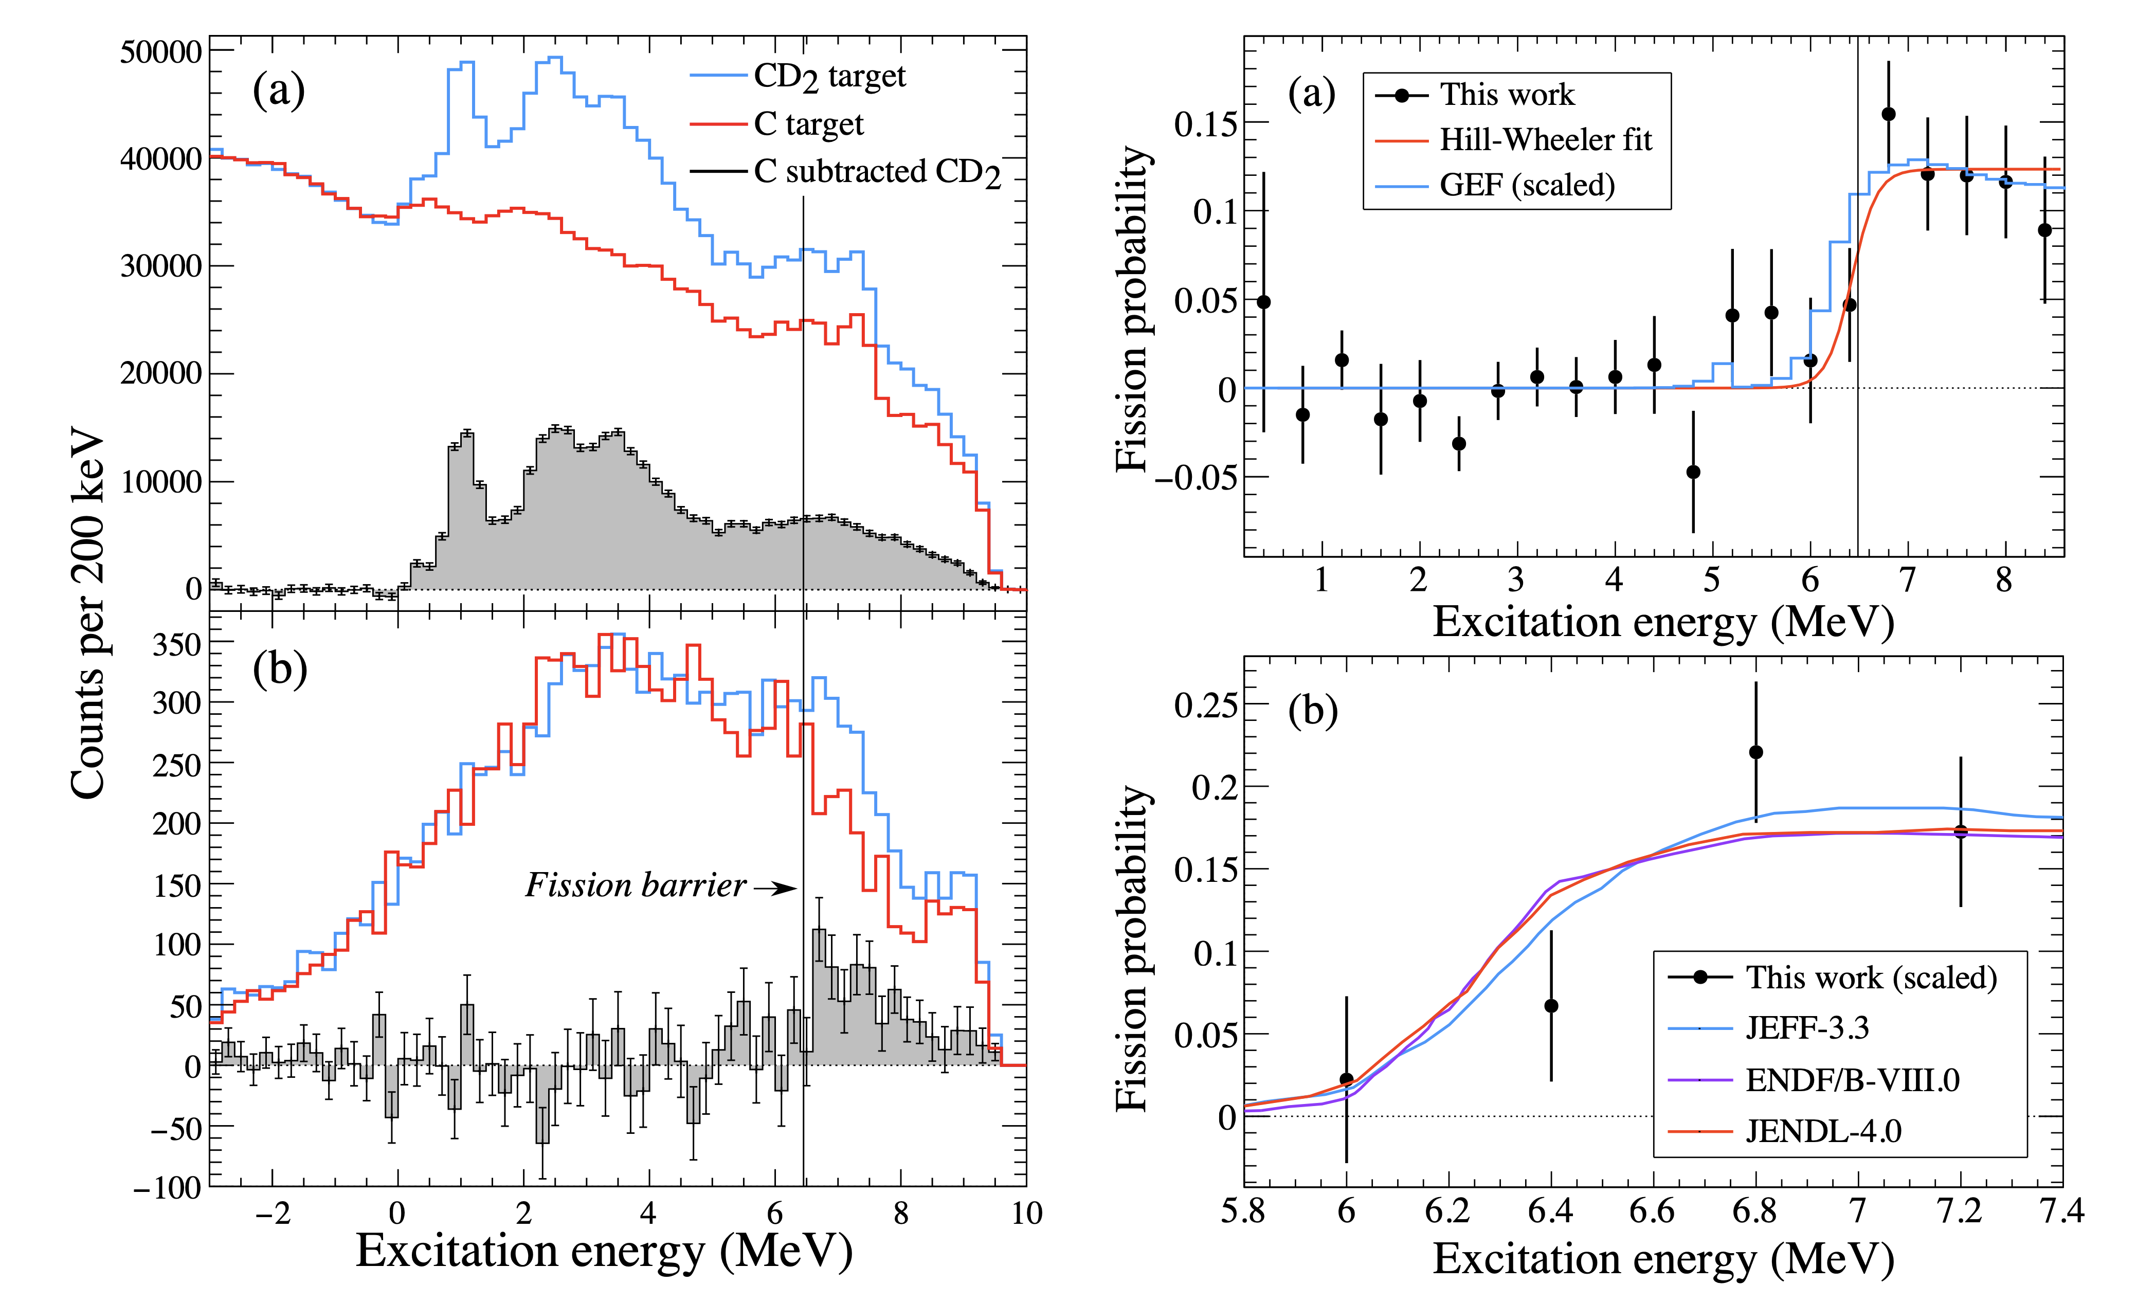
HELIOS @ ATLAS, nuclear fission
A new approach to fission studies, test case proves promising ... significant scope for upgrades
S. A. Bennett et al., Phys. Rev. Lett. 130, 202501 (2023)

Slide 11
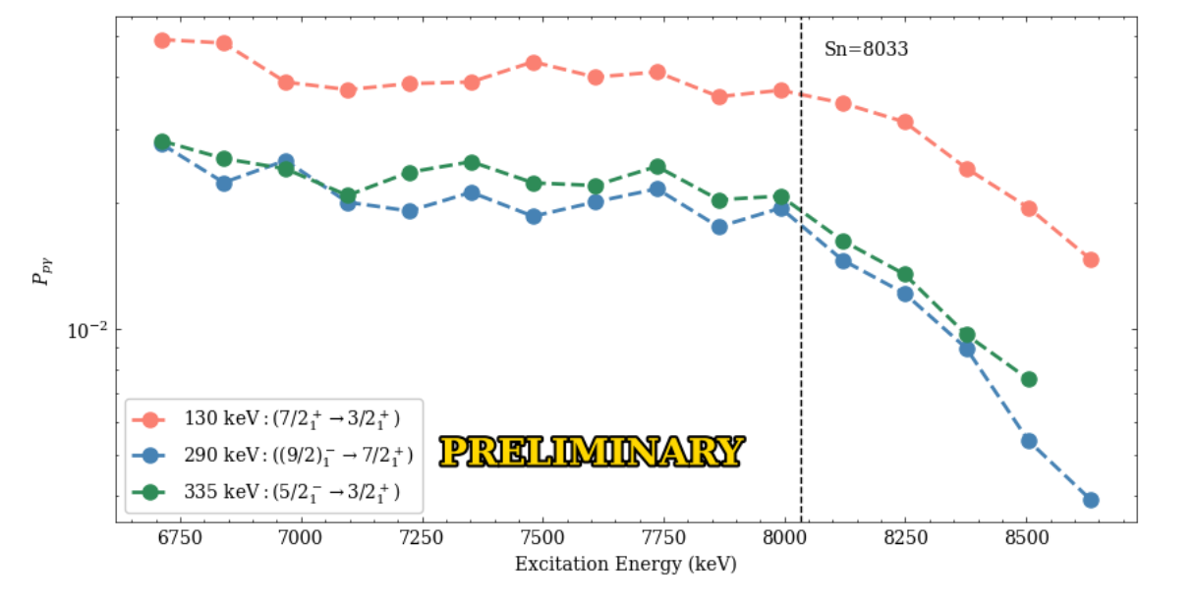
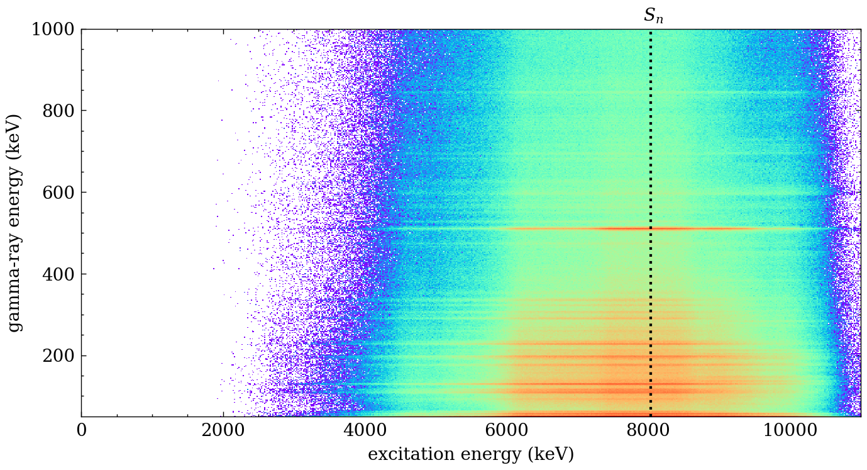
¹⁶⁹Tm(p,p`) for ¹⁶⁸Tm(n,γ) … with GRETINA-ORRUBA
Monoisotopic elements (such as ¹⁶⁹Tm) were sometimes used to assess the neutron environments in UGTs.
Constraining ¹⁶⁸Tm(n,γ), which was the goal of this experiment, will inform calculations of the thermal neutron spectrum.
Courtesy of R. Ghimire and A. Ratkiewicz

Slide 12
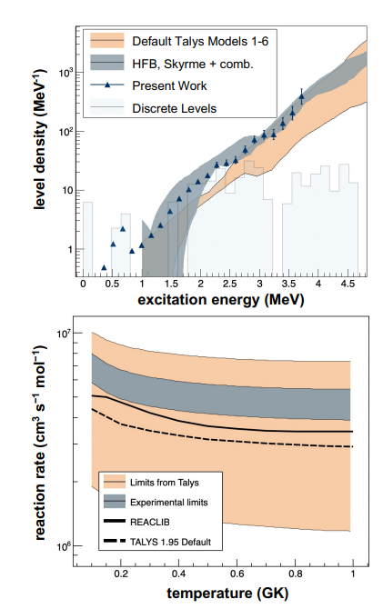
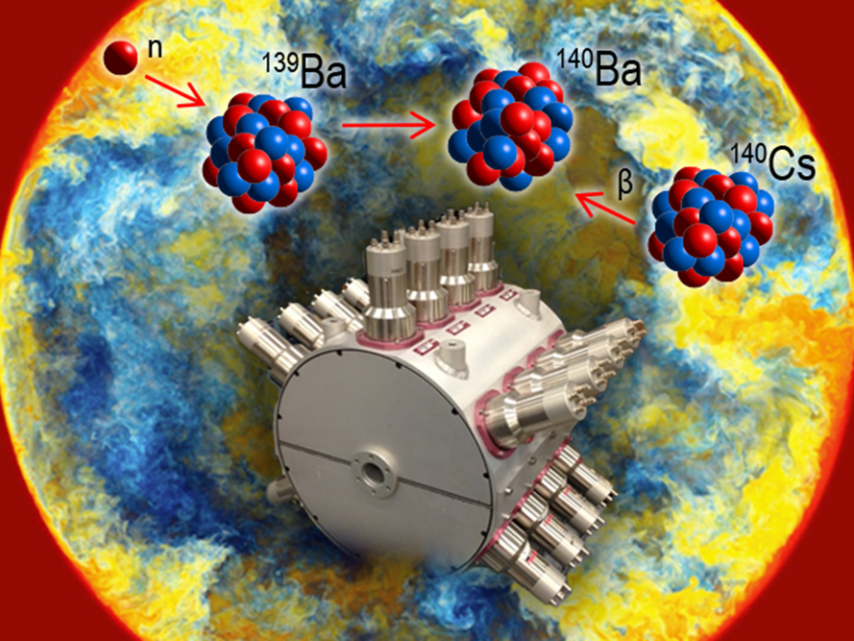
(n,γ) rate on n-rich isotopes constrained via beta-Oslo method using Sun at CARIBU
A. Spyrou et al. Phys. Rev. Lett. 132, 202701 (2024)

Slide 13
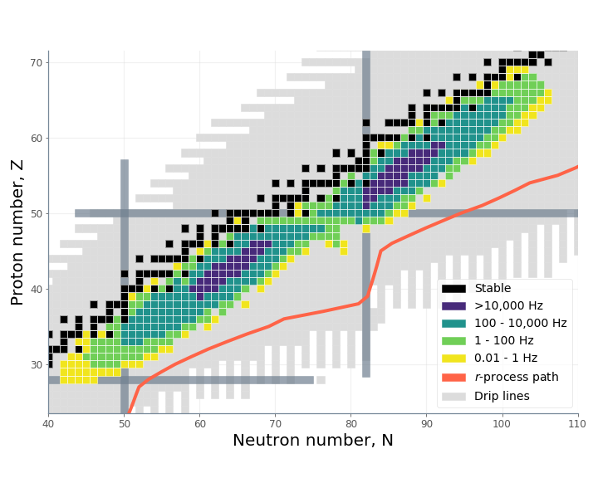
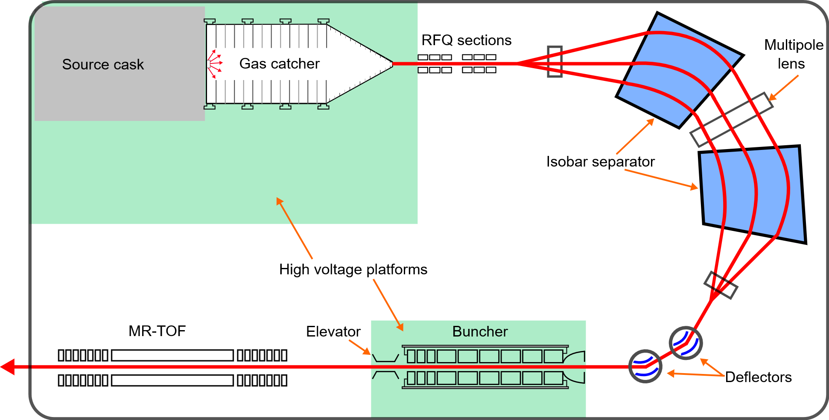

(nu)CARIBU mass/isotope/isomer selection
Californium rare isotope breeder upgrade
Position-sensitive MCP
R ~ 20,000,000
Penning
trap
²⁵²Cf
^{~0.5 Ci}
R = m/Δm ~ 10,000
RFQ prep trap
R ~ 100,000

Slide 14
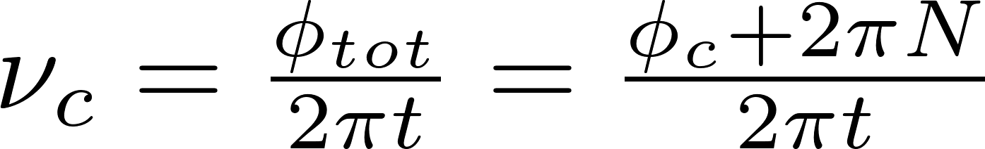
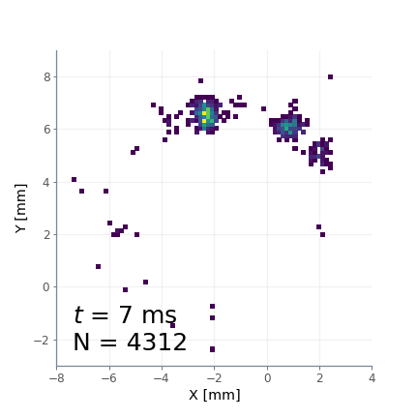
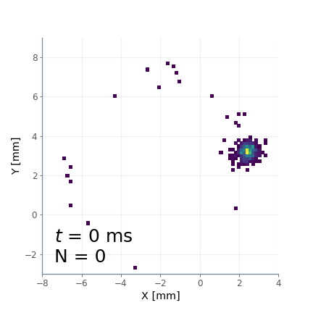
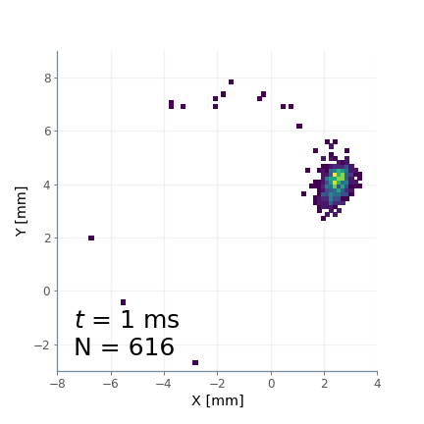
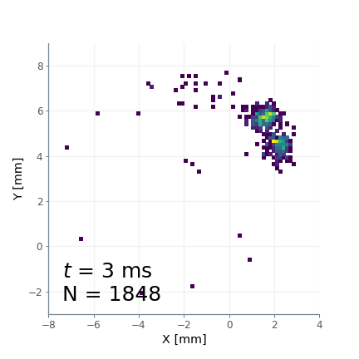
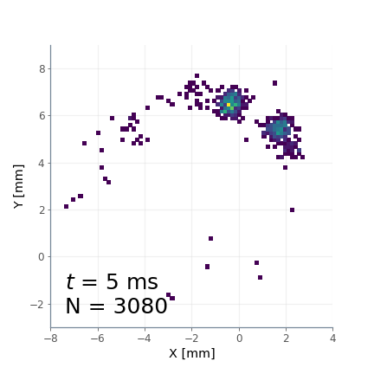
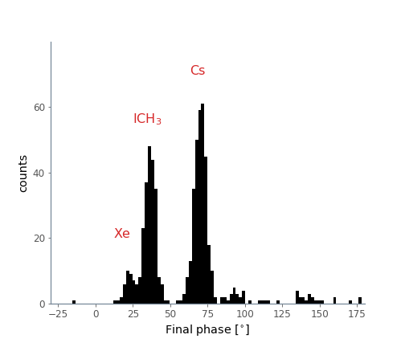
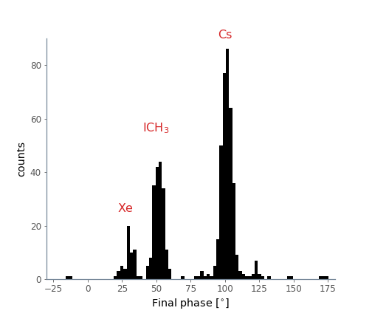
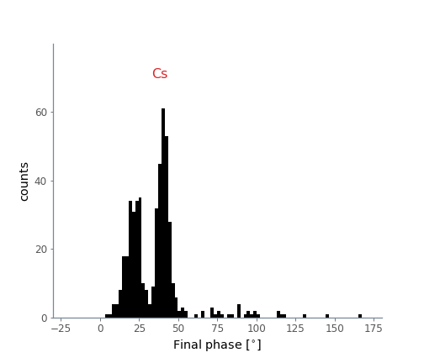
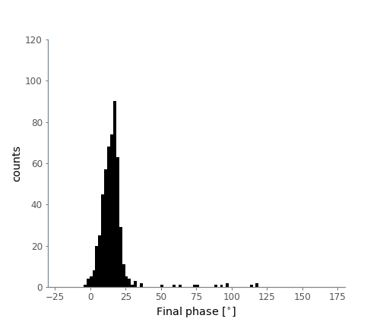

PI-ICR mass separation

Slide 15






Ion counting Isomer measurements: fission yield, excitation energy, ….
¹⁵⁶Pm , Tacc = 234.705 ms
¹⁶²Tb, Tacc = 125.241ms
¹⁶⁸Tb, Tacc = 234.247ms
A number of results related to the influence of these isomers on nuclear structure and astrophysics (astromers) have already been published … a big compilation of ²⁵²Cf fission isomeric yield is coming.

Slide 16





Ion counting for fission yield: use shorter excitation ( ~ 4 ms) and probe various angles
T_{acc} =4.212 ms
T_{acc} =4.232 ms
clustering algorithm
T_{acc} =4.242 ms
T_{acc} =4.252 ms

Slide 17



²⁵²Cf fission fragment distribution … heavy peak
Analysis of heavy peak completed for 1+ and 2+ ions
2+ ions measured with Penning trap and MR-TOF
Preparing for similar measurements on neutron-induced fission of ²³⁵U

Slide 18





Excited States in ¹⁰⁰Zr from β decay of ¹⁰⁰Y
Gammasphere
Area 4
¹⁰⁰Y isotopes from CARIBU transported to Gammasphere target position and implanted on moving tape.
γ-beta coincidences recorded during decay period ¹⁰⁰Y > ¹⁰⁰Zr.
Level structure determined from γ−γ coincidences
Spins of levels determined from angular correlation analysis.
¹⁰⁰Zr
Gammasphere configured for beta decay studies
Moving tape station (LSU)
Beta counter – HEART (Hexagonal Array for Triggering)
decay
growth
J. Wu et al., Phys. Rev. C 109, 024314 (2024)

Slide 19




Beta Decay Factory in Area 1
Gammasphere Decay Station
Saturn/X-Array Upgrades
Beta Decay Factory
β−γ coincidences for proper feeding intensities
γ−γ, γ−γ−γ for level structure determination and spin assignments from angular correlations
Reduced summing and crystal to crystal scattering (in contrast to X-Array)
Calorimetry provides information on excitation energy on event-by-event basis (Ge + BGO)
Gammasphere electronics upgrade provides 3 copies of Ge central contact @ 4, 8 and 20 MeV full range
Gammasphere upgrade project allows for relocation of device to Area 1.
Using nuCARIBU, we estimate 2 orders of magnitude increase in implanted ions.
Gammasphere gives multi-fold coincidences, total gamma-ray energy, angular correlations, for spin, parity, mixing rations.
X-Array – lifetimes (LaBr₃), low-energy gamma detections (BEGe), conversion electron measurement (LACES).
Campaign of six months to measure 30-50 parent decays
LaBr₃ to measure lifetimes – 2 rings, 15 1”x1” crystals each ring.
Conversion electron measurements utilizing Laces (LSU)
1-2 BEGe detectors for low-energy gamma-ray and x-ray detection
Si(Li) detector system to couple with
X-Array decay station
Area 1
γ ray angular correlations following
¹⁰⁰Y beta decay with Gammasphere
1 LaBr3 Ring @
X-Array
X-Array
GS

Slide 20
Growing application program at ATLAS
Enabled by
  Variety of clean mass separated beams: stable, long-lived isotopes, short-lived fission fragments … at required energies
  Broad suite of state-of-the-art equipment … both in-house (HELIOS, CPT, Gammasphere) and from the community (MTAS, SUN, GODDESS, GRETINA, …)
  Beamtime and PAC (with applied/data expertise)
Could only show some of the capabilities in the limited time but these programs can contributes significantly to the application field
    Decay properties of short-lived isotopes for safeguard, medical, energy, … applications
    Fission fragment distribution … now with n-induced fission
    Putting constraints on (n,γ) rates on short-lived isotopes
    Fission barrier determination
    …
We are finishing the analysis of the isomer ratio yield and independent fission product yield for spontaneous fission of ²⁵²Cf.
We have tested using only the MRTOF for next measurements and demonstrated that the two approaches agree.
Preparing to shift to nuCARIBU where we can use the same technique to look at FPY for thermal neutron induced fission on ²³⁵U and ²³⁹Pu. This will allow direct measurements on n-induced fission fragments with sub-second lifetime … those are critical for a number of applications and have only been determined indirectly so far.

