Slide 1
LBNL Nuclear Data Measurements
T.A. Laplace et al.
Department of Nuclear Engineering, University of California, Berkeley
Nuclear Science Division, Lawrence Berkeley National Laboratory
WANDA 2026

Slide 2
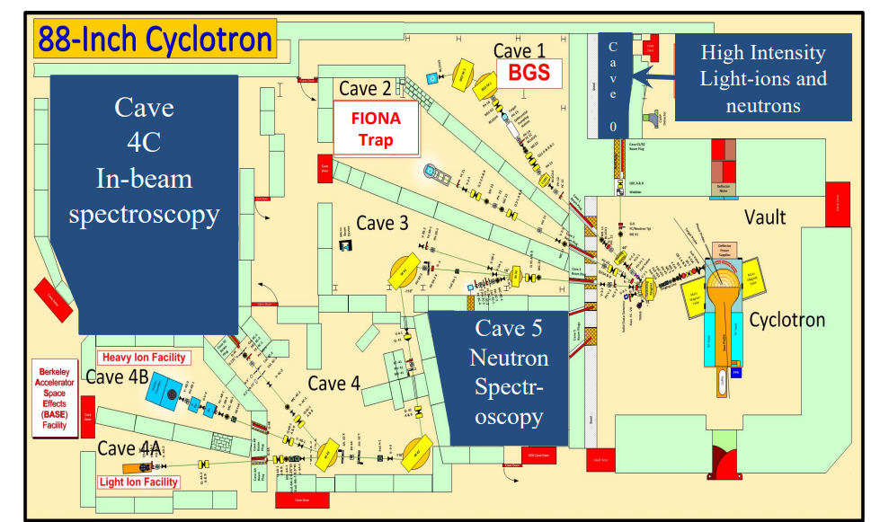
The 88-Inch Cyclotron at LBNL
K=140 sector focused cyclotron
Up to ~ 55 MeV protons/deuterons
Ion beams up to U
Neutron beams using thick target deuteron breakup

Slide 3
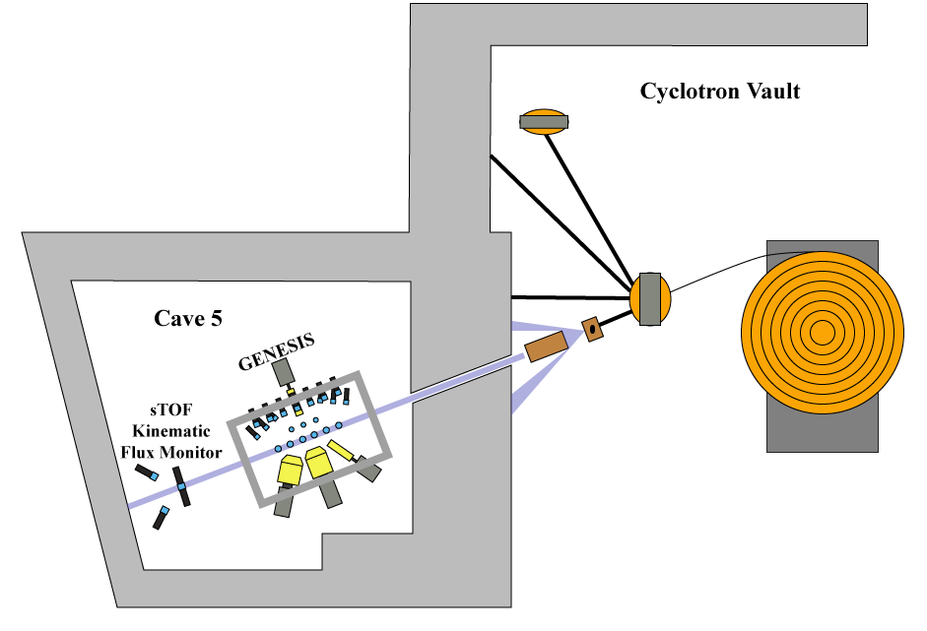
Cave 5 / GENESIS
Deuteron beams ranging from ~14-55 MeV used for neutron production
Pulse Period of 100~170 ns
Pulse widths of ~5 ns @ 25 MeV
10⁶ n/cm²/s at GENESIS target (~7 m downstream)

Slide 4
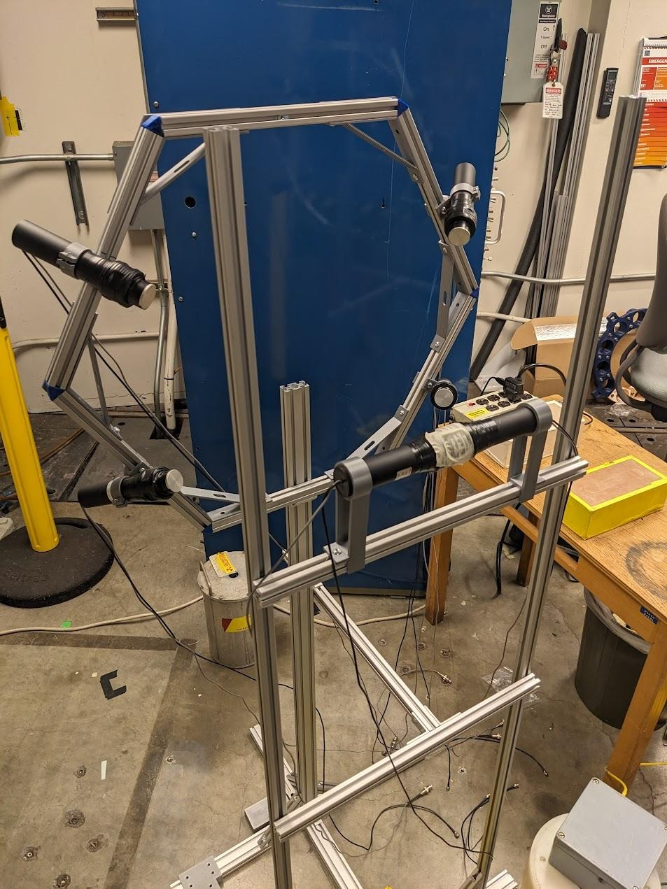
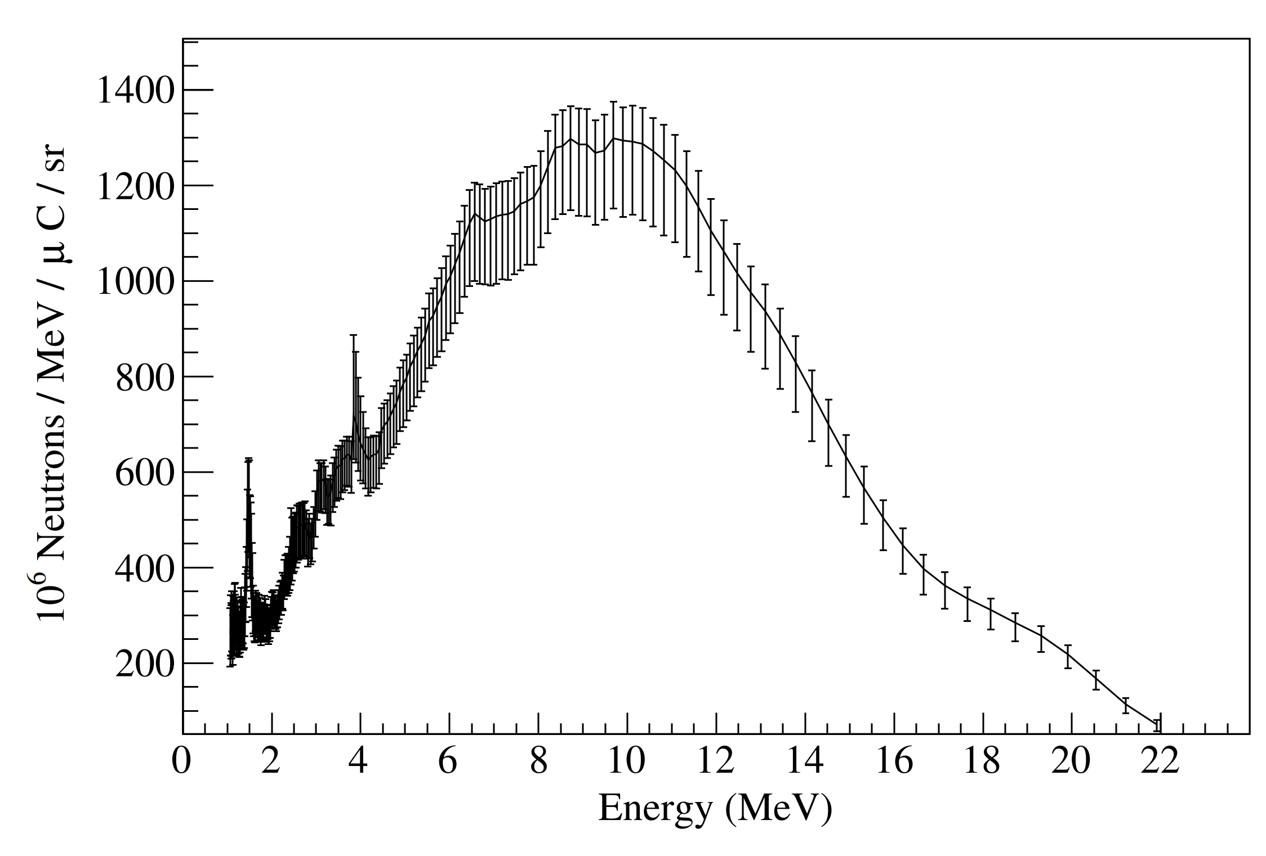
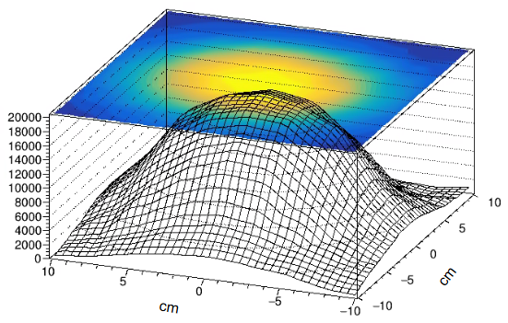
Neutron beam characterization
Flux and energy distribution using sTOF, validated using foil activation
Spatial distribution using scintillator on 2D stage
24 MeV deuterons on C

Slide 5
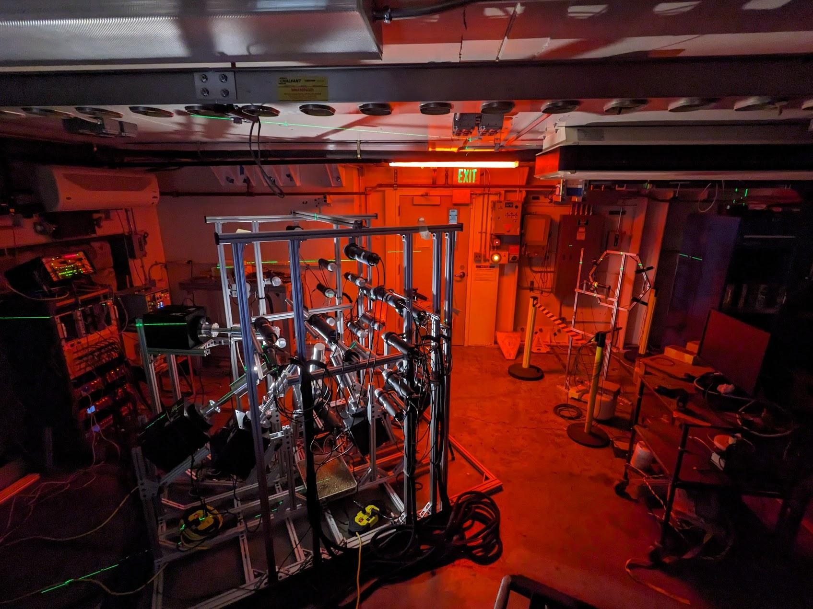
GENESIS measurements of (n,xγ) reactions
Modular array can be quickly re-configured
7 mechanically cooled HPGe (30% and 50%)
26 PSD-capable liquid scintillators grouped at specific angles (2-inch cylinders)
Full array modeled in Geant4.
Simulation validated with gamma-ray sources and Cf-252

Slide 6
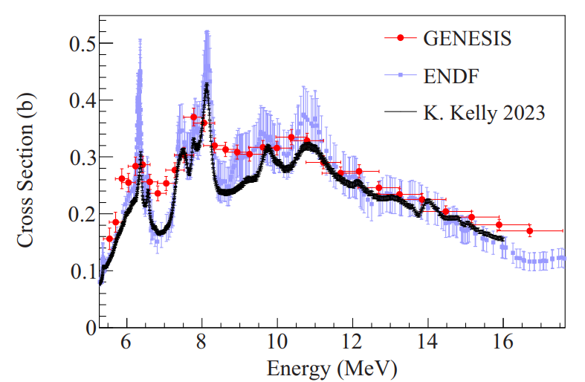
GENESIS results
Isotope | Status | Supported by
C-12 | Gordon, J. M., et al. Phys. Rev. C 111 (2025) | NA-22
Na-23 | Gordon, J. M., et al. to be submitted to Phys. Rev. C | NA-22
Si-28 | Beam time March 2026 | NA-22
Cl-35 | Nagel, T. S. PhD thesis (2024) | DOE-NEUP & NA-22
Fe-56 | Gordon, J. M., et al. accepted in Phys. Rev. C | DOE-NE, NA-113 & NA-22
Nb-93 | Analysis in progress | SSAA
Bi-207 | Analysis in progress | SSAA
U-238 | Analysis in progress | DOE-NE, SSAA
¹²C(n,n’₁γ) cross section
Gordon et al. PRC 111 (2025)

Slide 7
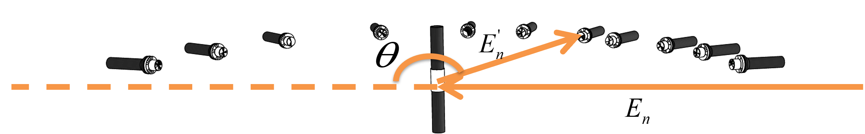
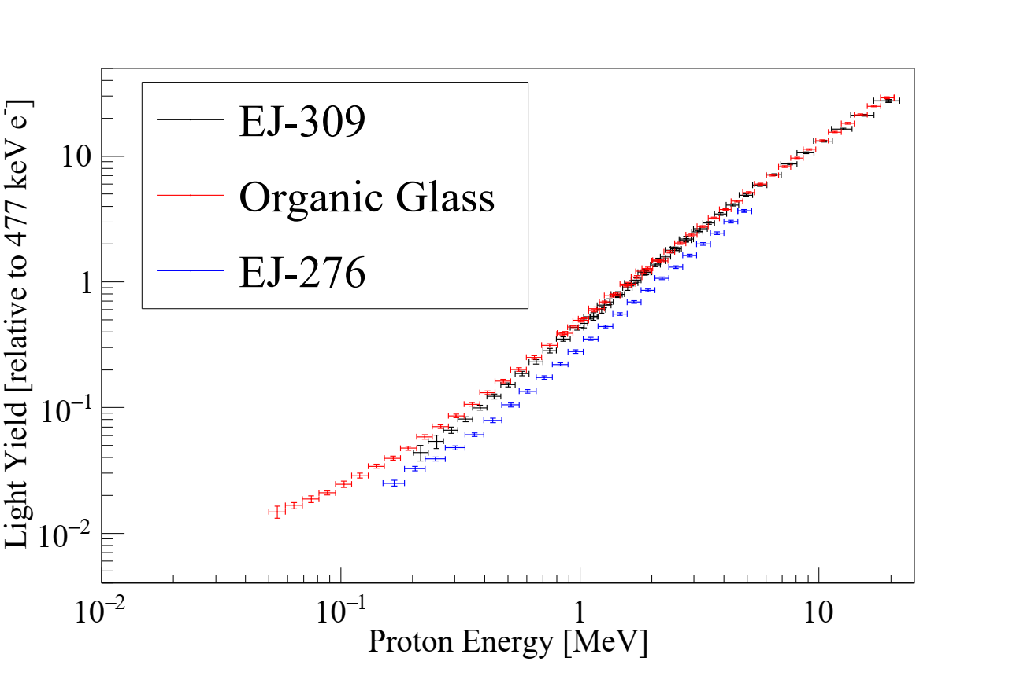
Neutron detector response
Double TOF method developed at LBNL to measure particle specific light output in organic materials (proton & carbon)
Model independent method, no bias from multiple scatters
Results are also available at scintillator.lbl.gov
J.A. Brown, PhD Thesis, UC Berkeley (2017)
J.A. Brown, B.L. Goldblum, et al. Journal of Applied Physics 124, (2018)
T.A. Laplace, B.L. Goldblum, et al., Phys. Rev. C 104, (2021)

Slide 8
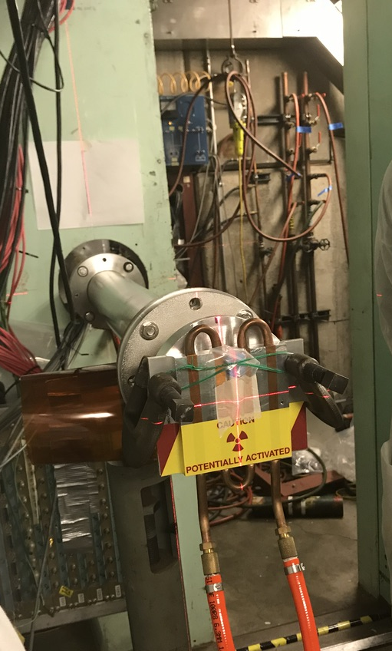
Cave 0: Intense Fast-Neutron Source
In addition to GENESIS, LBNL possesses a second fast-neutron source, capable of operating at high neutron fluxes
  Current capability: Φ ≲ 10¹² n/cm²/s, providing fluences relevant to fusion research with beam times on the order of hours
The source, located in Cave 0 of the 88-Inch Cyclotron, can be used thick-target activation, materials damage, and other integral measurements
  Recently employed for NIF-STARFIRE optics irradiation and neutron single-event effects testing of electronics
Existing TTDB target with cooling plate installed for continuous beam operation in Cave 0 shown at right →

Slide 9
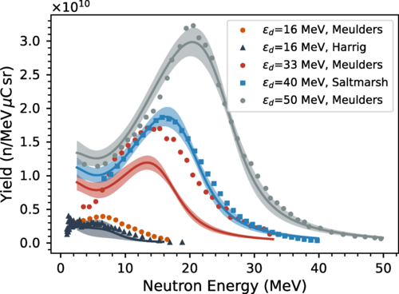
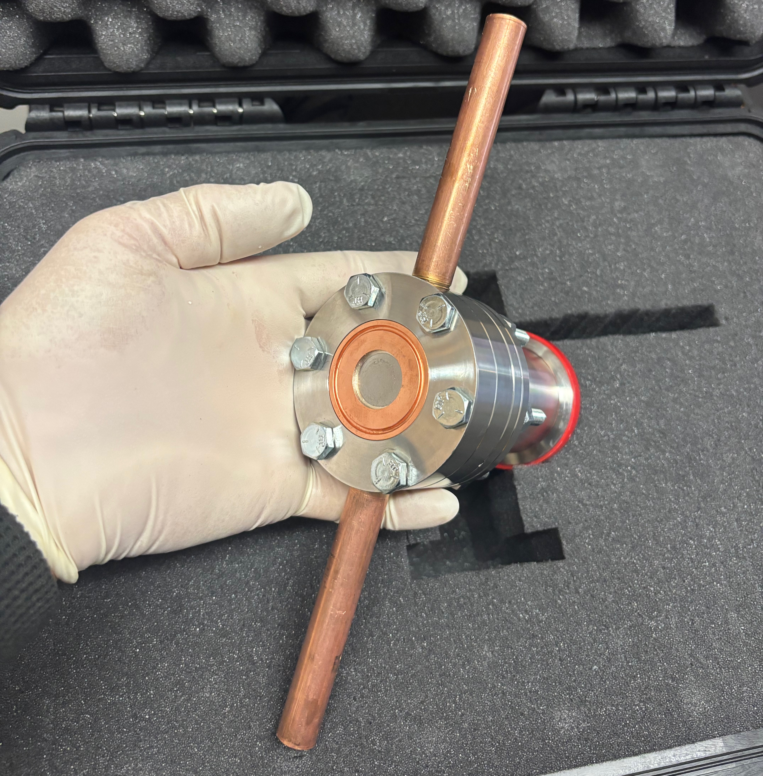
Cave 0: Intense Fast-Neutron Source
Thick-target deuteron breakup (TTDB) neutron spectra can be tailored based on the deuteron energy
  Neutron energies range from ~8 to 40 MeV, with spectra (shown in plot at right) dependent on the incident deuteron energy and angle relative to the beam¹
    ➔ E.g., E_{d} = 33 MeV produces a forward (0°) neutron spectrum at peaked at ~14 MeV
Neutron beam has been characterized using both time-of-flight and foil activation methods
A new beryllium target, which should provide the capability to increase flux to Φ ≈ 10¹⁴ n/cm²/s while reducing the γ-ray dose, is under development with funding from the Missile Defense Agency →
1. J. Morrell et al.,” Secondary neutron production from thick target deuteron breakup,” Phys. Rev. C 108, 024616 (2023). https://doi.org/10.1103/PhysRevC.108.024616

Slide 10
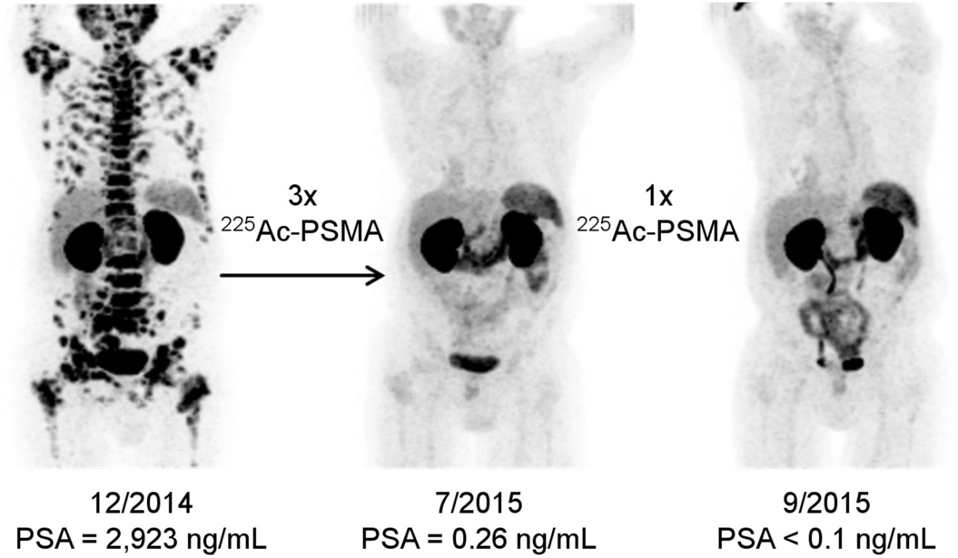
We’ve performed (p/d/n,x) isotope production cross section & decay measurements with LANL, BNL & Jülich
Monitor Foils
Al Degraders
Isotope | Lead | Isotope | Lead
²²⁵Ac | Morrell | ⁶⁸Ge/⁶⁸Ga | Fox
¹³⁴Ce | Morrell | ⁷²Se/⁷²As | Fox
Fe,Cu,Ti | Voyles | ^{193m}Pt | Ekeberg
¹⁶⁰Tb | Chapman | ²³⁶Np/²³⁶Pu | Fassbender
⁸⁶Y | Uddin, Martinsen | ^{117m}Sn/^{119m}Te | C. Apgar
^{82,83,84}Rb | Basunia, Uddin | ²⁰²Pb, ¹⁰³Pd | Y.H. Lee
γ-ray
detector
Beam
Foil of Interest
Prostate : Müller, Cristina et al., JNM 58. 91S-96xaS (2017)
Hundreds of excitation functions have been measured and used to tune reaction modeling with results published in PRC, NIM, EPJ, Rad. Acta…
Including both ²²⁵Ac for which produced these impressive results AND the ⁶⁸Ga used to produce these images!

Slide 11
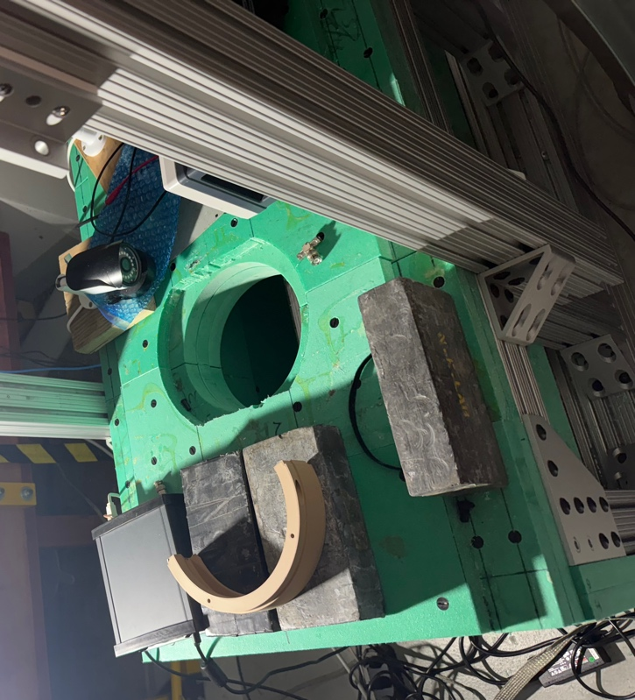
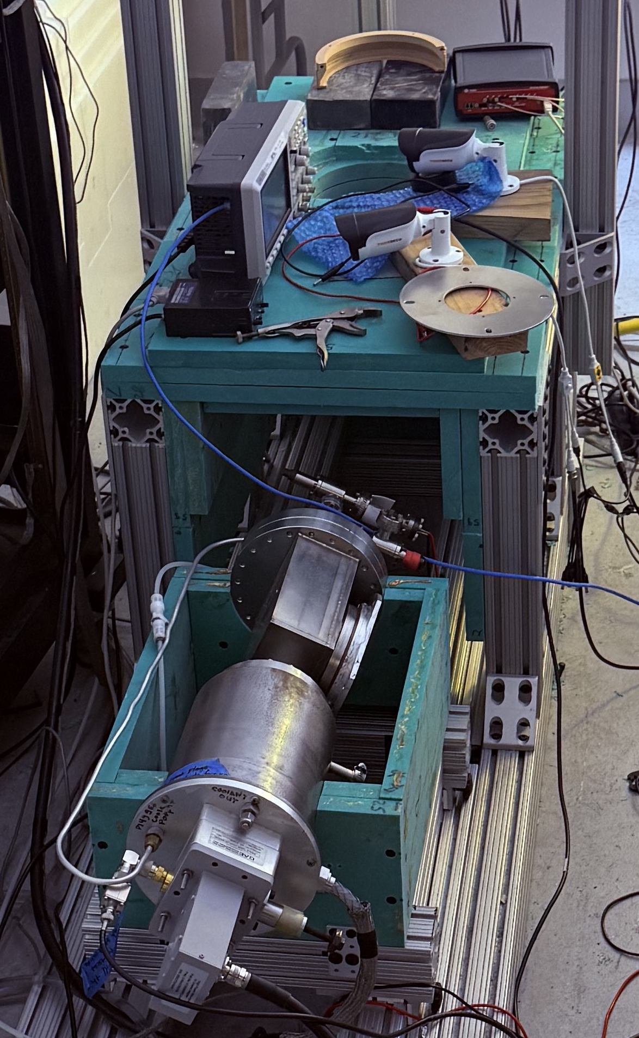
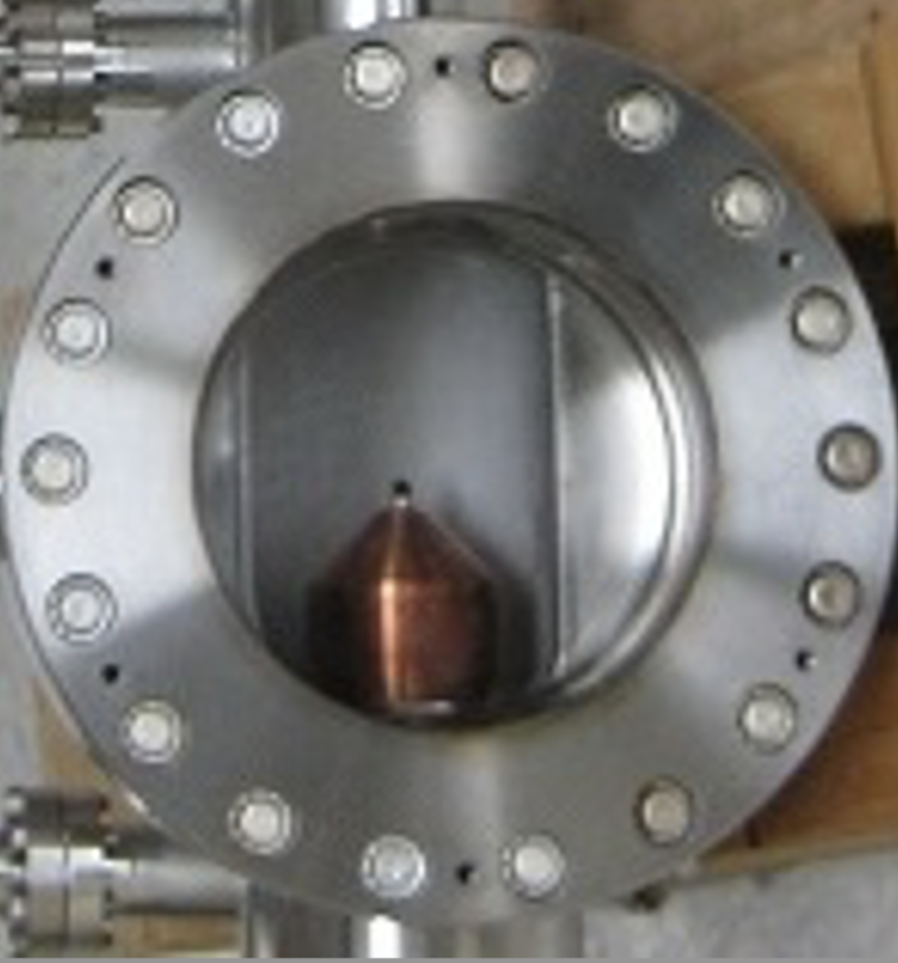
NEXUS (Neutron Experiments Under Soda)
Pursuing research and innovation in neutron interaction studies, medical isotopes, and nuclear data
Sample
γ-ray, neutron detectors
Sheilding
Tagged
Neutron
Cone
Tagged neutron port in borated poly “doghouse”
α
D beam
Scintillator/PMT
HPGe and scintillator detectors
API capability provides accurate flux determination
➔ Accurate mono-energetic measurement at 14.1 MeV, enabling independent normalization/comparison for other measurements like GENESIS
45°
45°
T Target
ZnO
scintillator
(α-detector)
Microwave
focusing
Nexus removed from doghouse and rotated 45°

Slide 12
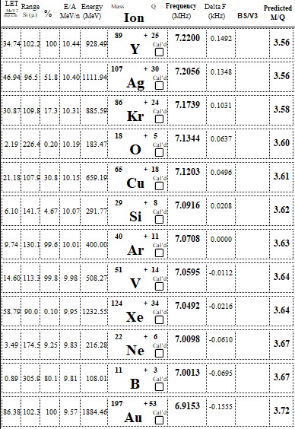
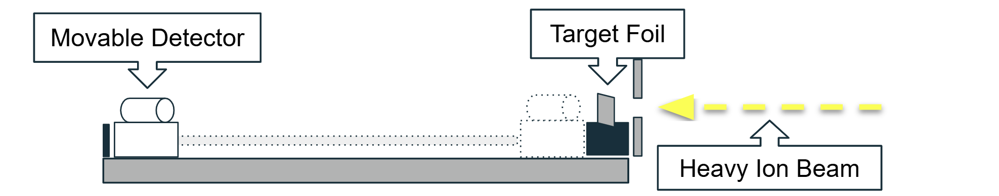
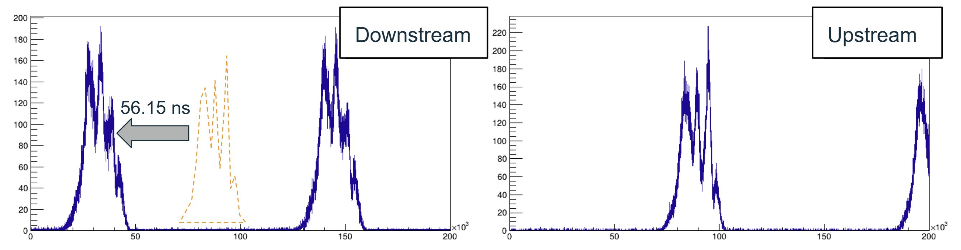
Stopping Power Measurements
88” Cyclotron cocktail beams - variety of heavy ions to switch between on demand.
10, 16, 20 MeV/u variants with degrader foils to lower energy → can efficiently gather stopping power data at many energies for many ions
Time-of-flight energy measurement w/ movable scintillator. Particle arrival time distributions measured at two locations. Distributions compared to find phase delay.
Energies measured w/ & w/o target foil to determine energy loss
Ions available in 10 MeV/u Cocktail beam

Slide 13


Thank you!
This work was performed under the auspices of the U.S. Department of Energy by Lawrence Berkeley National Laboratory under Contract No. DE-AC02-05CH11231 and Lawrence Livermore National Laboratory under Contract No. DE-AC52-07NA27344. This work was supported in part by the U.S. Department of Energy National Nuclear Security Administration through the Nuclear Science and Security Consortium under Awards No. DE-NA0003180 and No. DE-NA0003996, and by the NNSA Office of Defense Nuclear Nonproliferation R&D through the LB23-GammaProdXSwithGENESIS-PD3Ob project, the NNSA Stockpile Stewardship Academic Alliance.
The initial development of the GENESIS array was supported by DOE-NE under the NEAMS and NEUP programs. Beamtime was supported by DOE/SC-NP Through the U.S. Nuclear Data Program.
Development of a high flux fast neutron source is supported by the Missile Defense Agency.
Isotope production cross sections are supported by the Isotope Program within the U.S. Department of Energy’s Office of Science.
The development of the DT-API capability is supported by the University of California, Berkeley.

