Slide 1
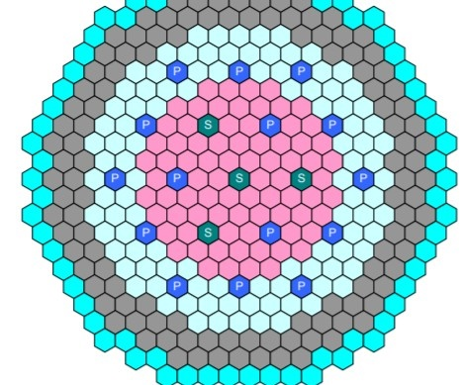
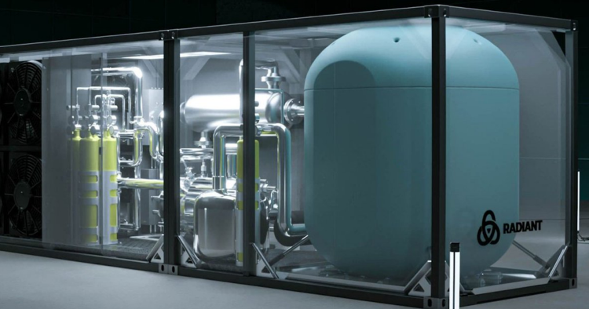
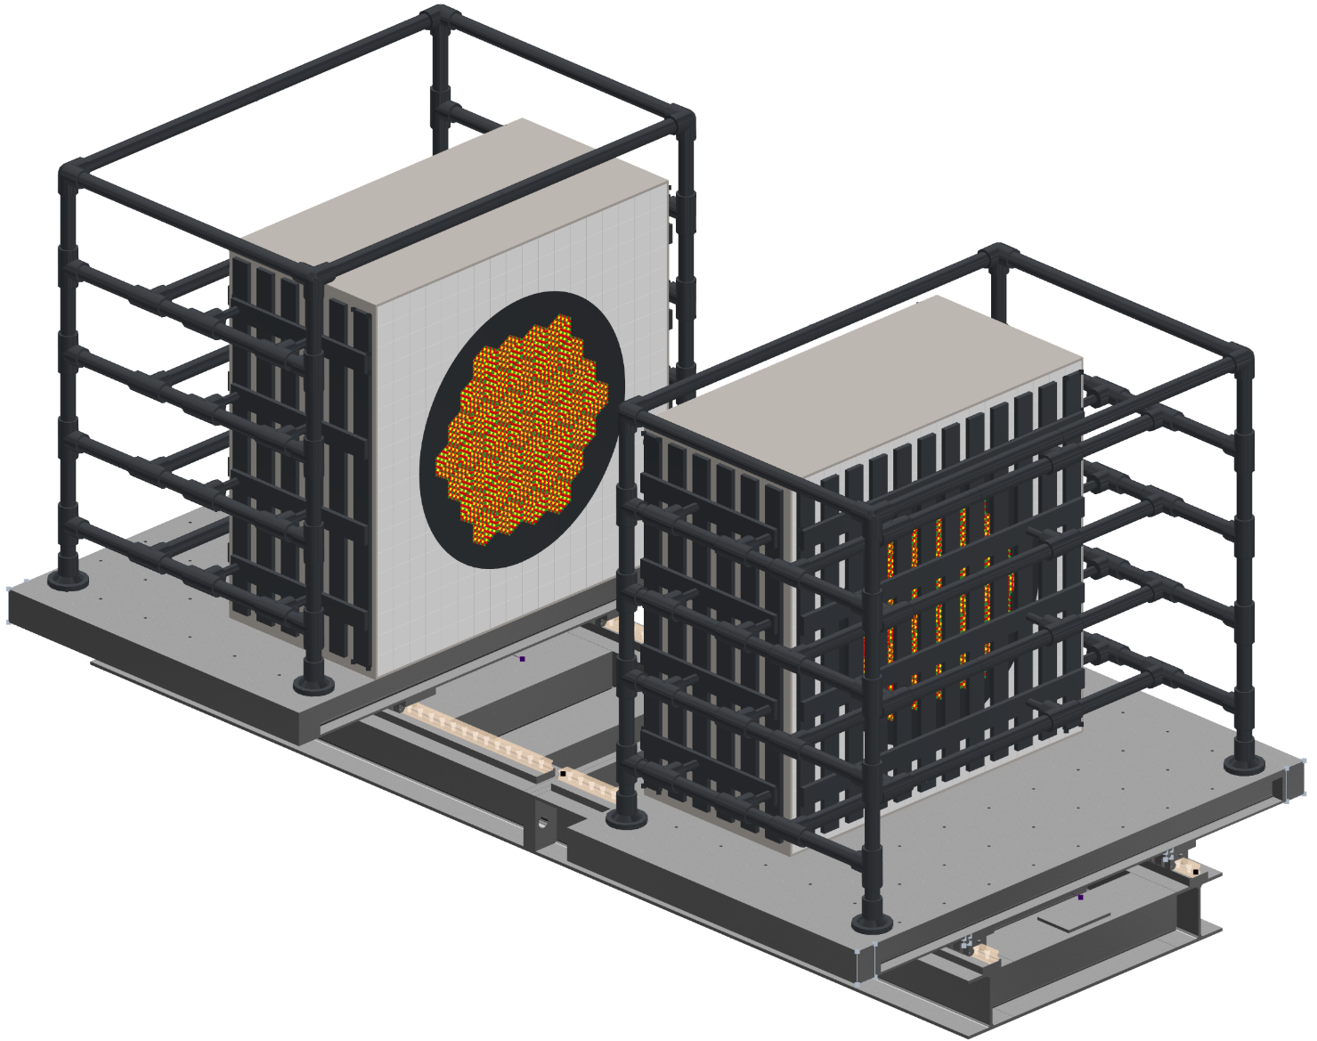
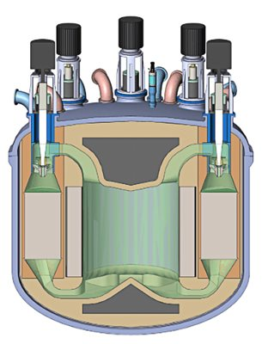

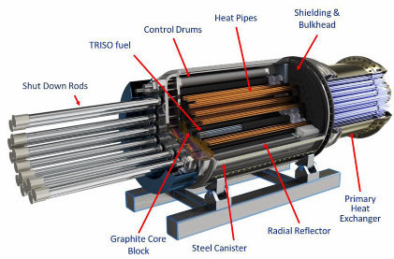
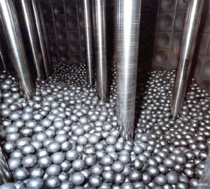

Nicolas Woolstenhulme¹, Margaret Marshall¹, Justin Johnson¹, JD Kelly¹, Troy Reiss¹, Brad Benefiel¹, Matt Lund¹, Paul Ferney¹, Catherine Percher², Theresa Cutler³, Mathieu Dupont⁴, Will Wieselquist⁴, Andrew Barto⁵, and Don Algama⁶
¹ Idaho National Laboratory
² Lawrence Livermore National Laboratory
³ Los Alamos National Laboratory
⁴ Oak Ridge National Laboratory
⁵ Nuclear Regulatory Commission
⁶Deparment of Energy
Integral Experiments for Criticality
An overview of the SPARC facility
Feb 2026

Slide 2
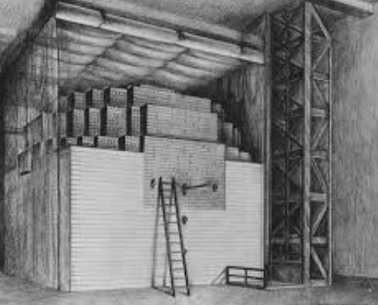
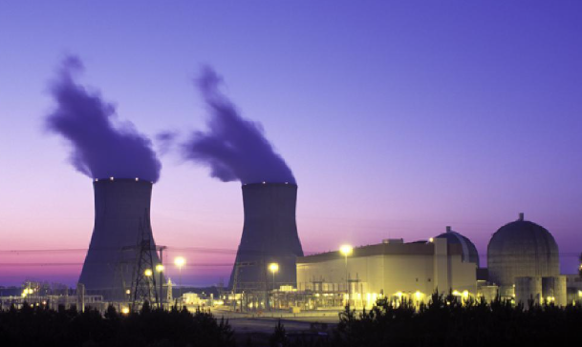

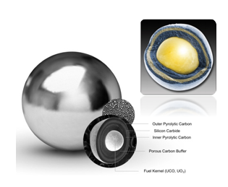
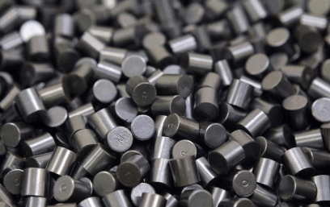
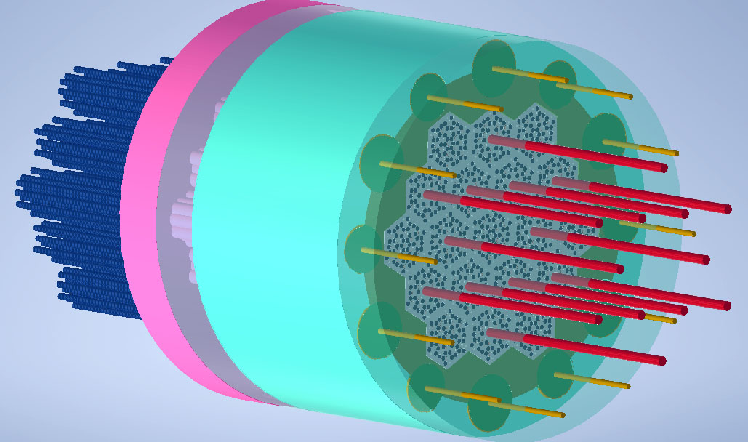
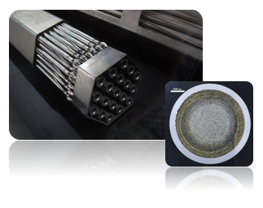
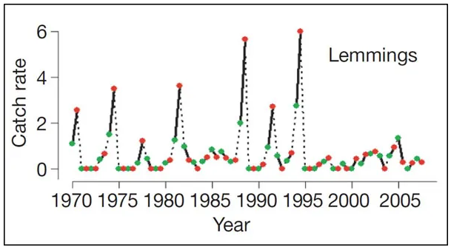
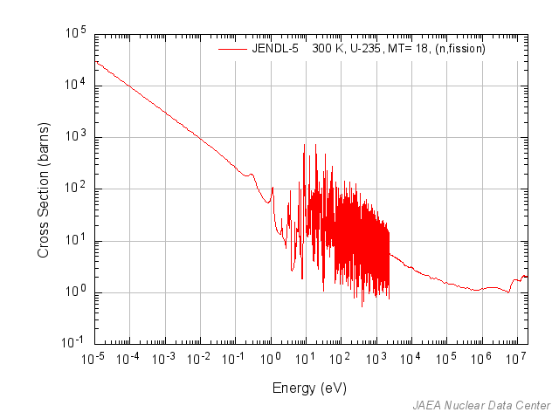
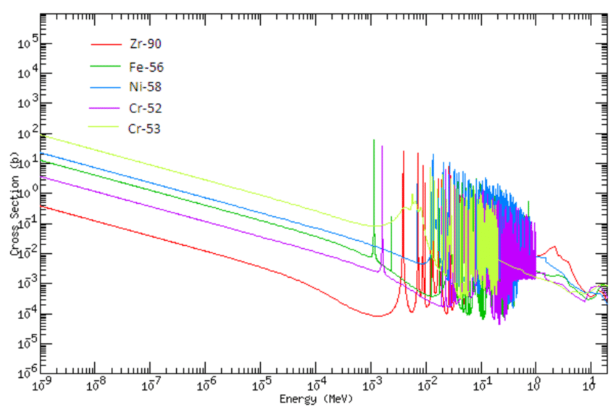
Lemmings, and Neutrons
Zero-power criticals have always been indispensable in getting the balance right
So, it is with reactors. Neutron birth and death rates must be balanced within a small fraction of the total (<1%) to operate at stable power
Lemmings: Chaotic population cycle due to complex interactions in birth rate, vegetation growth, and predation in the sparse arctic
And crucial in validating predictions to prevent “unintentional reactors” within economic fuel batch size (manufacturing, shipping, storage)
Modern transport codes are amazing, but unpinned by complex nuclear data for numerous reactions describing how nuclides & neutrons are born, bred, & lost
New fuels, materials, and cores: Advanced reactors further this enduring need

Slide 3
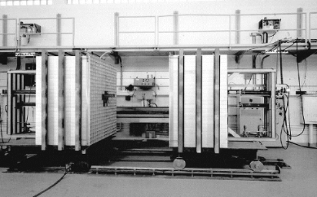
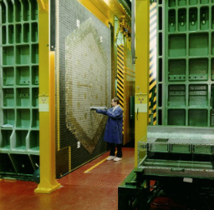
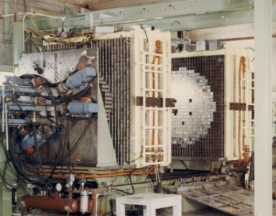
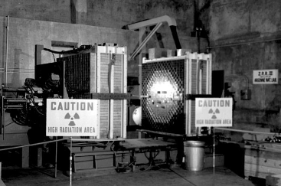
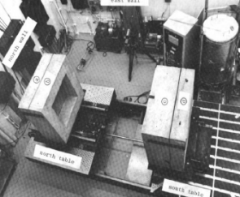
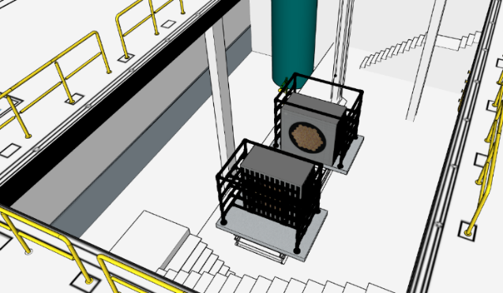
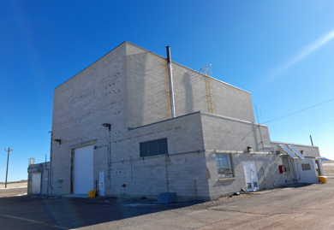
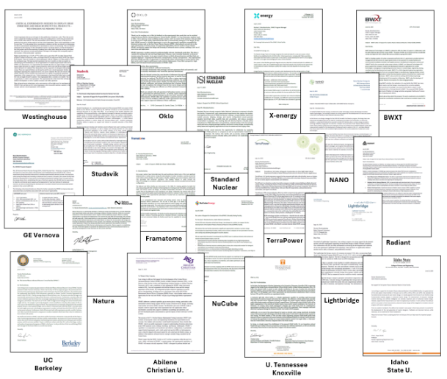
A SPARC of Hope
Historic HSTs in the U.S.
(all now decommissioned)
Large-scale critical experiments crucially needed, the U.S. (and western world) has lost this capability
  Best met by a Horizontal Split Table (HST): The Swiss army knife of zero-power reactors
  Support licensing & deployment of LEU+ and HALEU fuel cycle (factory, shipping, reactor operation, and storage)
PBF-613
Fuels, moderators, reflectors
Fuels, moderators, reflectors
Rendering of HST in PBF-613
DNCSH supporting INL to deploy a new HST for HALEU criticality safety research
  Strong industrial support, direct relevance to executive orders
  PBF-613 (former SPERT-IV building) selected
  System Physics Advanced Reactor Critical facility (SPARC)
External Letters of Support
HST Design
DOE/NRC Criticality Safety for Commercial-Scale HALEU Fuel Cycle and Transportation (DNCSH)

Slide 4
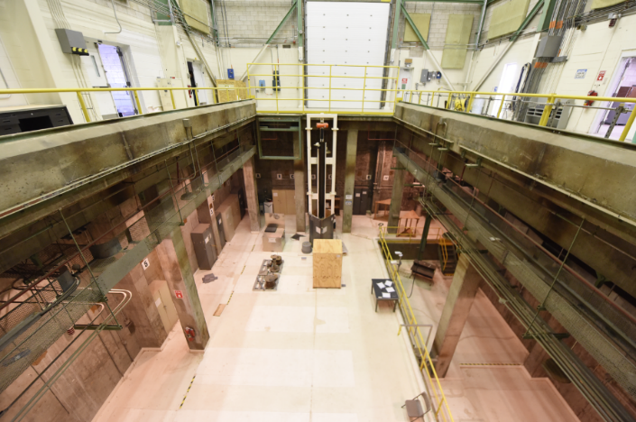
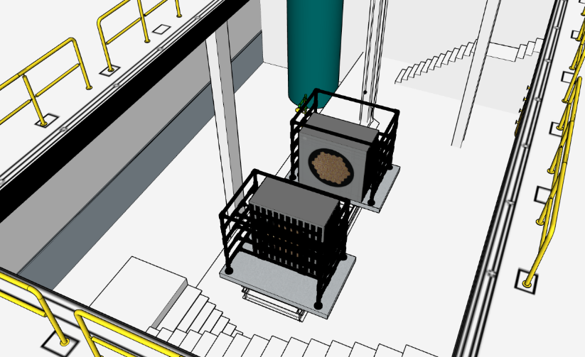
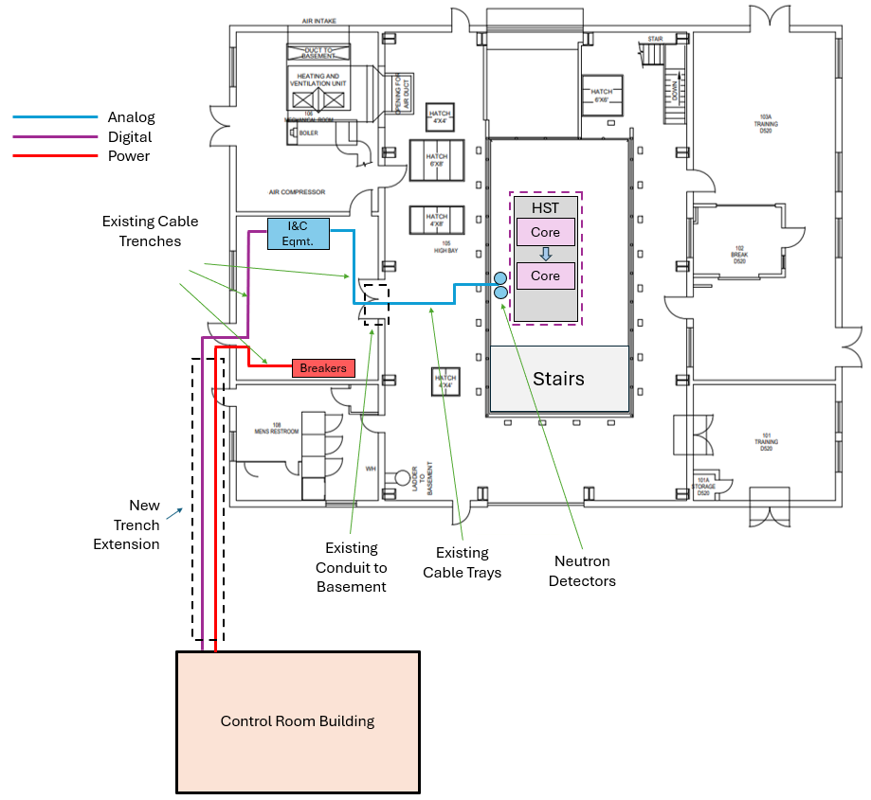
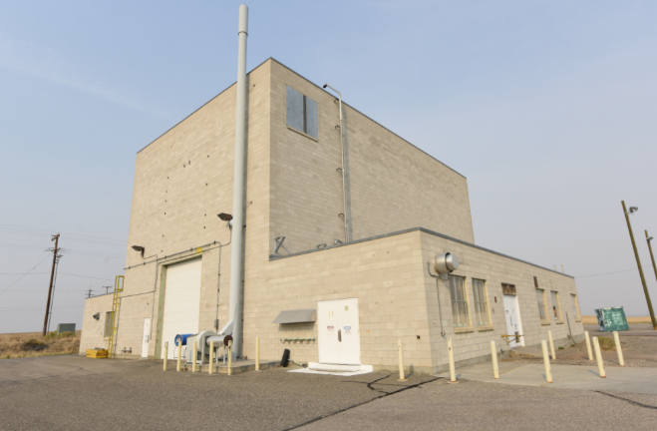
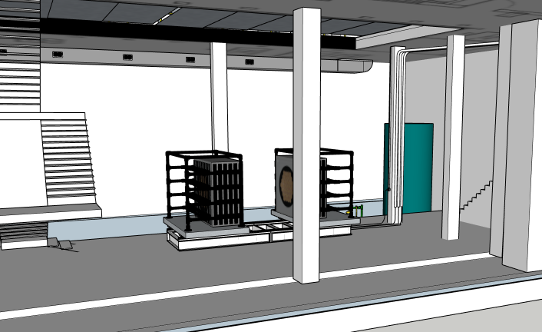
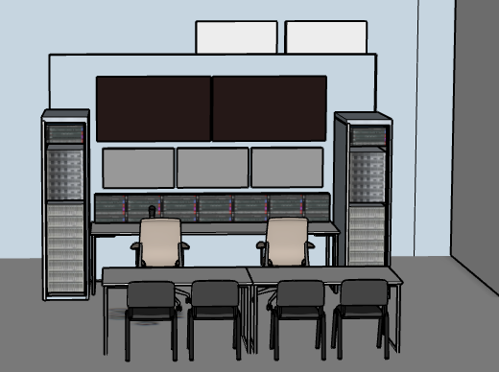
Facility Design
PBF-613 (former SPERT-IV reactor)
  Large “open basement”, low neutron room return
  Stout floors, overhead crane, radiologically clean
  Side wings for I&C, material storage
Basement of PBF-613
View from Main Floor
PBF-613
View from Basement
SPARC project scope includes:
  Safety basis creation for Hazard category 2 nuclear facility
  Install modular building with control console
  Install HST, I&C, and perform inaugural experiment

Slide 5
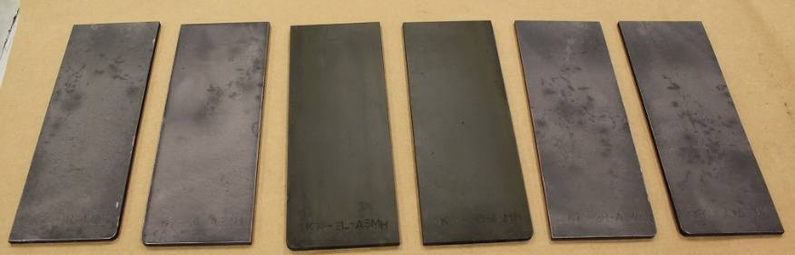
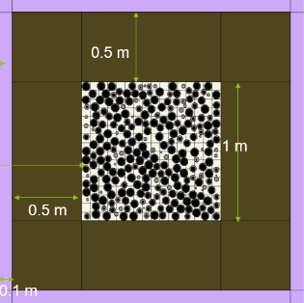
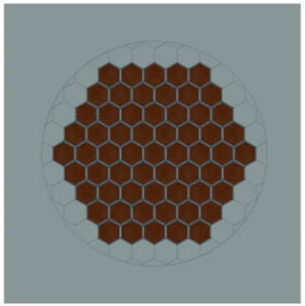
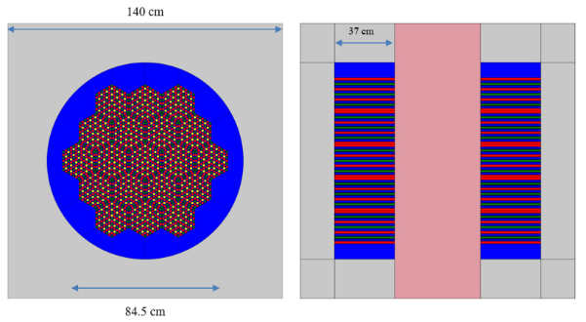
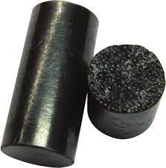
Capability Plan
Upgrades likely and/or feasible to come later
  Storage area suitable for beryllium
  Enhanced data and control system
    Data acquisition for heavily instrumented experiments
    Experiment electrical heating or chilling
    Remote controllable reactivity shims and/or oscillators
  Fuel storage racks for the full HALEU library
    TRISO compacts and/or pebbles
    UO₂-in-poly blocks
    U-Zr metallic fuel
    Fueled salts, “other” uranium ceramics
  On-site gamma spectroscopy
  Suspect exhaust system for bare uranium
  Mode-switchable protocols for experiments with elevated information security
Deploying as soon as possible with minimum viable capability package
  Facility security posture for HALEU fuels and unclassified experiments
  HST can support up to 2m cube, 24 MT core
  “Open-source” mechanical fixturing design (threaded holes grid on table)
  Fuel and hazardous materials clad or contained
  Straightforward data and controls system (HST gap control, external neutron detectors)
  Ample space for storing moderators & materials
  Fuel storage area for UO₂ RCF rods, U-Mo plates
TRISO Pebble Bed in Graphite Reflector
U-10Zr Metallic Fuel in SST Reflector, Fast Spectrum
Metal Hydride Heat Pipe Microreactor

Slide 6

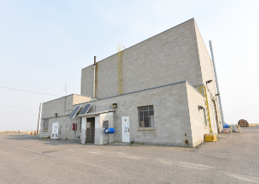

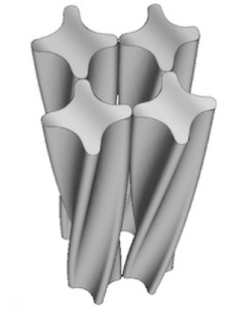
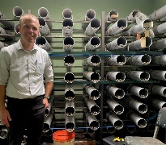
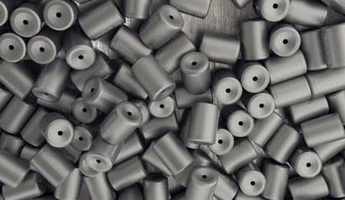

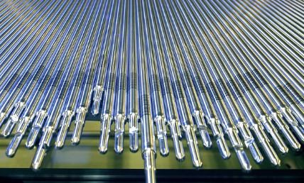
Project Vision
2028
2029
2030 →
2026
2027
Base operation and maintenance
Capability project funded by DNCSH
IFM program support
Establish SPARC
-Design & build HST
-Create haz cat 2 safety basis
-Install control room/console
-Procure and install I&C system
NE-relevant reactor physics and crit. safety tests
First tests w/ RCF rods
Industry CRADA/SPP, DOE reactor programs, NSUF, potential new NE reactor physics & crit safety program
NA-relevant crit. safety tests and training courses
PBF-613 maintenance
(repair roof, windows, lights, etc.)
NNSA-NCSP Program Support
Open for Business
INL-F&SS
Ship RCF rods to INL
University Fuel Services
Coordinate and facilitate advanced fuels for SPARC
AFC-NGF Program, industry partnerships
In an era of many reactor projects
  SPARC is unique as a DOE-funded reconfigurable test reactor facility
  Earnest-but-balanced schedule while setting the stage for a multidecadal critical experiments faciltiy

