Slide 1
Nuclear Security:
Fission Data Needs
B Pierson
Physicist
Notes:
Image: Abstract Data Visualization – Stock Photo

Slide 2
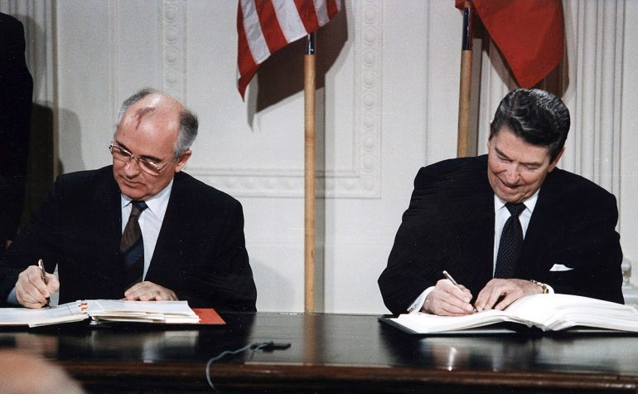
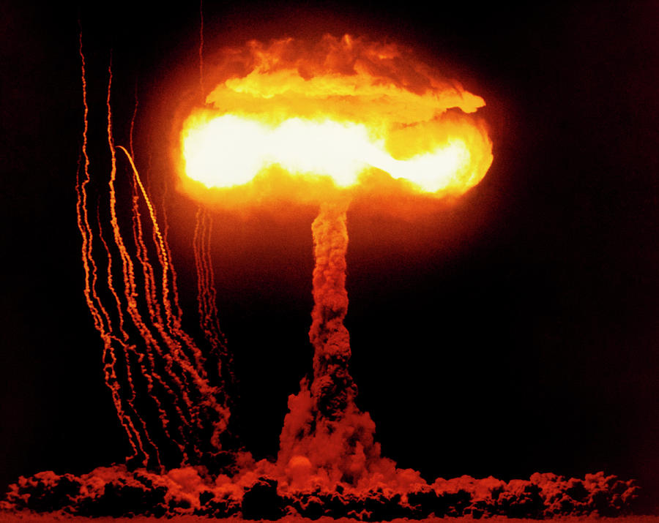
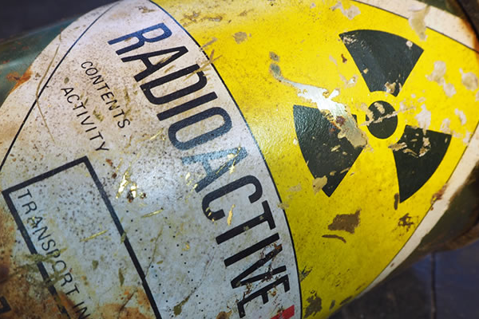
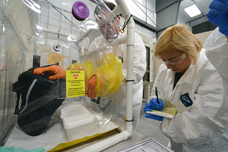
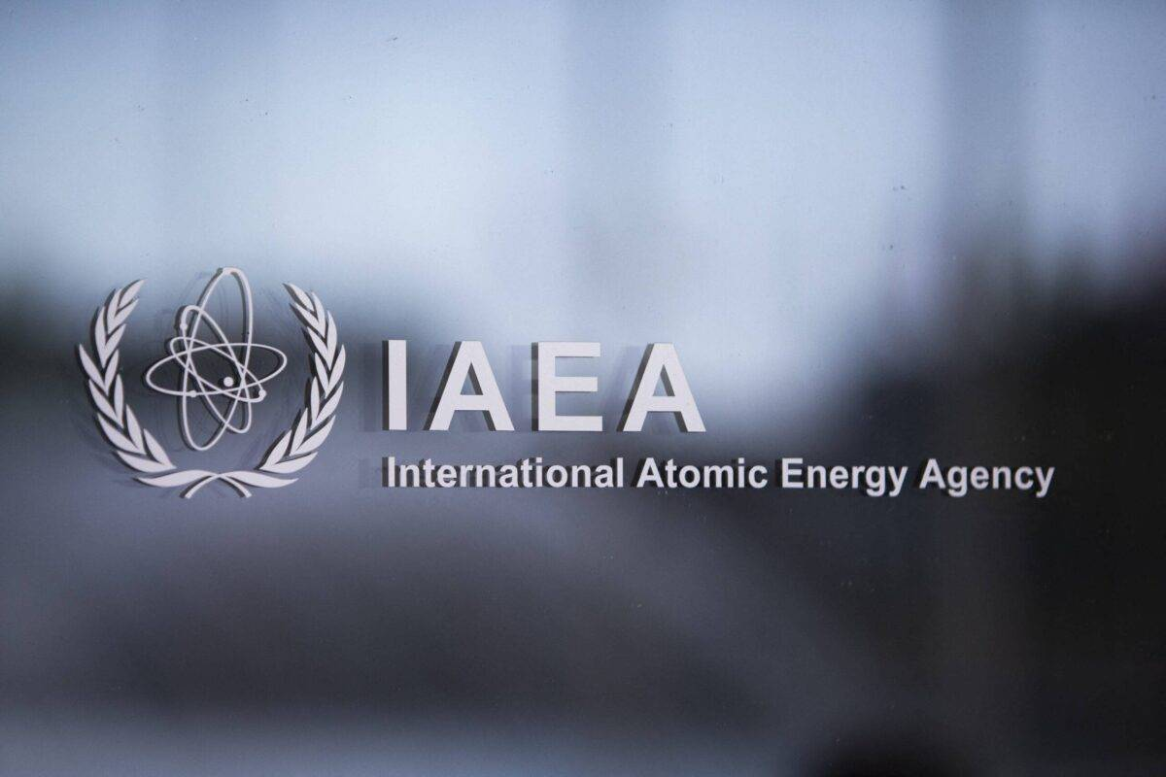
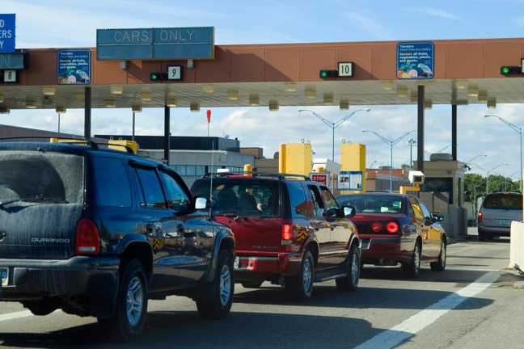
Nuclear Security Applications
Material Safeguards
Post-Det Nuclear Forensics
Waste Management
This Photo by Unknown Author is licensed under CC BY
This Photo by Unknown Author is licensed under CC BY-SA
This Photo by Unknown Author is licensed under CC BY-NC
Pre-det Nuclear Forensics
Monitoring
Border Security
This Photo by Unknown Author is licensed under CC BY-SA
This Photo by Unknown Author is licensed under CC BY-SA-NC

Slide 3
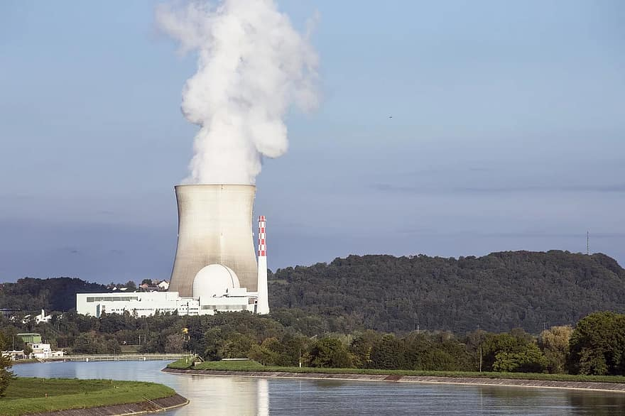
How is nuclear data traditionally used?
As a predictive tool
Ask yourself, is nuclear data used by commercial nuclear reactors today?
Of course, but operating history complements our understanding of that data
  Can lead to “application” bias
  Limited constraint on fission product yield data
The nuclear land-scape is rapidly changing…
Commercial applications in less hospitable, complex environments is expanding the the “operational” space
There’s a lot less complementary data for:
  Fast or fusion neutron fluence
  Alternative fuels/fuel mixtures
  Solar/galactic proton fluence

Slide 4
Where does my expertise lie?
Post-Det Nuclear Forensics
More & diverse fission product yield measurements at earlier times to understand chemical fractionation in debris
Many of these measurements are not as easily achieved using absolute measurement techniques (like β counting) so improved nuclear data related to the measurements (modern decay scheme evaluations) must coincide
England & Rider 1994 identified the need for improved isomer data, significant improvements since their evaluations release have been realized but isomer splitting and its effect on salient chains during debris formation is needed
Opportunities might include:
  Recovery of gas-jet or rapid chemical separation techniques to support improved accuracy and precision in measurement results (targeting wings and valleys)
  Recovering less common fission neutron sources like fission plate sources for a broader range of fissile isotopes (not just U235, U233, Pu239)
This Photo by Unknown Author is licensed under CC BY-SA

Slide 5

With a license to pontificate
Key stakeholders are aware of what’s needed…but more will help
Consortium for Nuclear Forensics research & development is performing related work
Stress testing recent model improvements:
  MCNP FREYA, CGMF
  GEANT4 Photofission
Active/Passive Neutron/Gamma Emission data from fission:
  Advanced Experimental Fuel Counter
    Modern validations of neutron multiplicity
  Passive Measurement/Active Interrogation
    Cross-cutting for almost all nuclear security applications
Example decks included as part of the test suite/examples in MCNP/Geant4 might be a good way to disseminate data
FORMATS MATTER! Leveraging existing ACE/G4NDL data formats and custom files could be a method to expand use of new data in parameter studies?
This Photo by Unknown Author is licensed under CC BY-NC

