Slide 1
Fission Data Needs for Criticality Safety
Presented at the Workshop for Applied Nuclear Data Activities
Arlington, VA
February 11, 2026
Catherine Percher

Slide 2
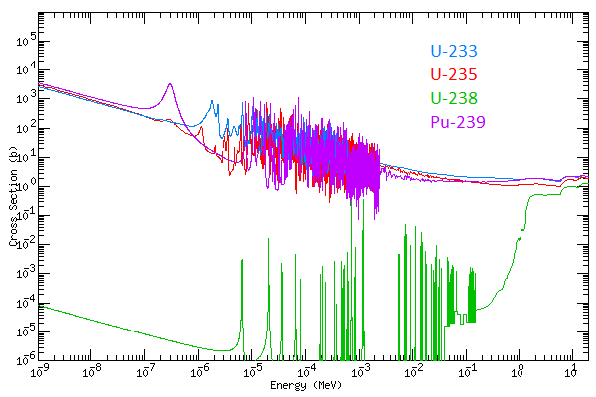
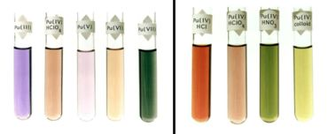
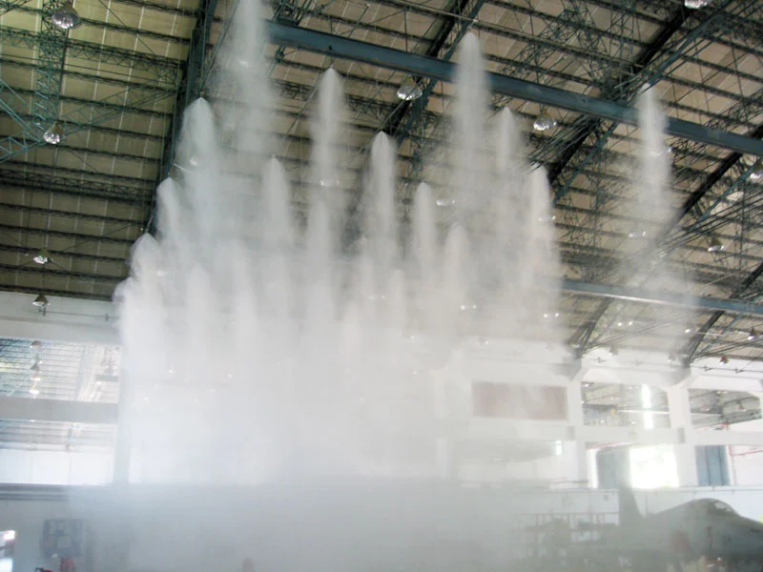
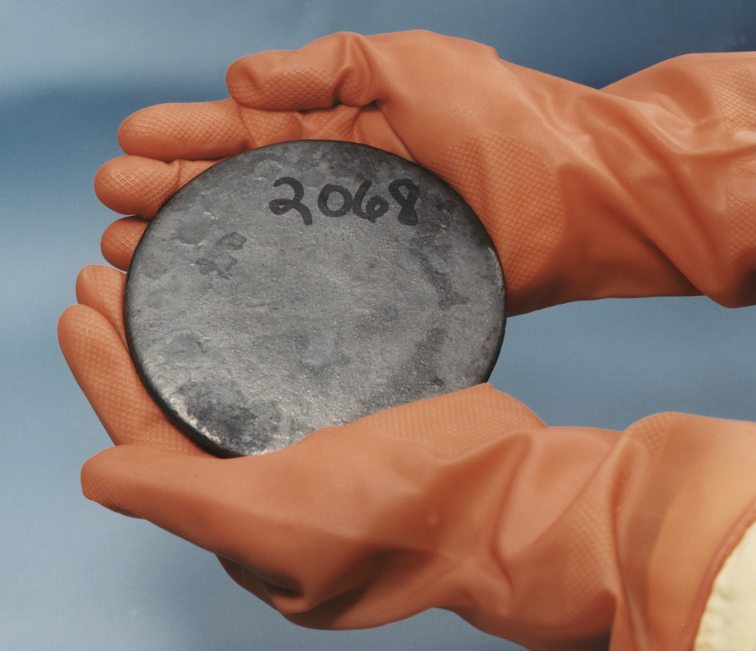
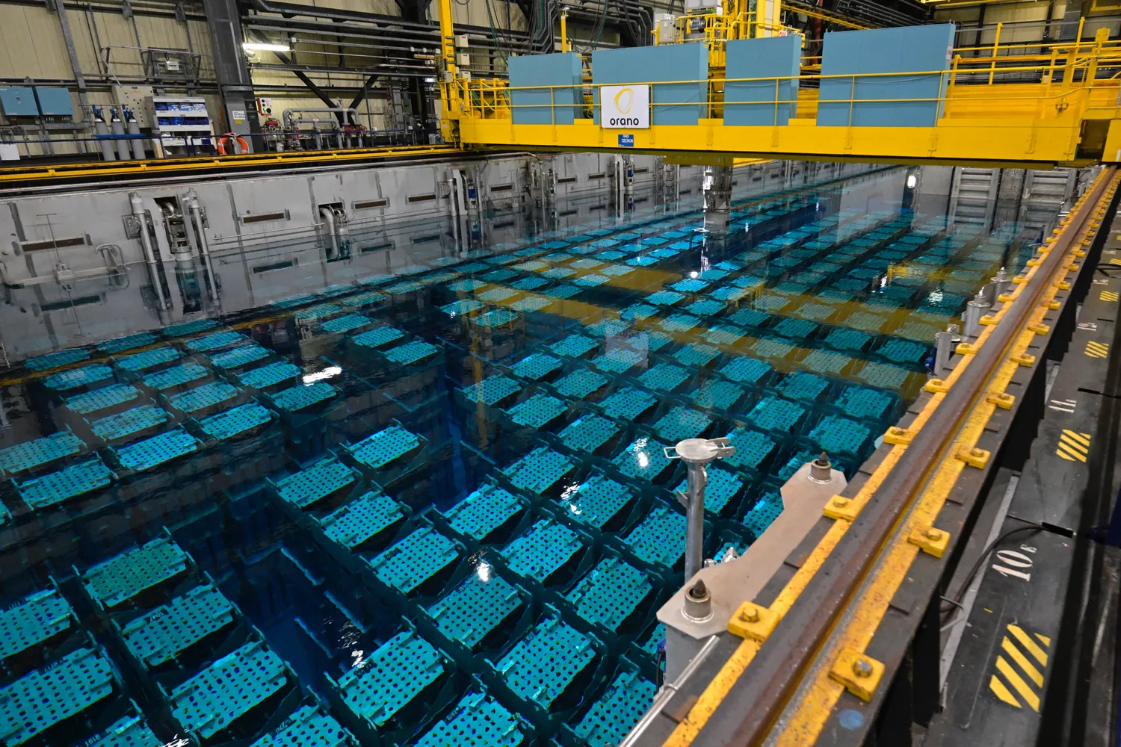
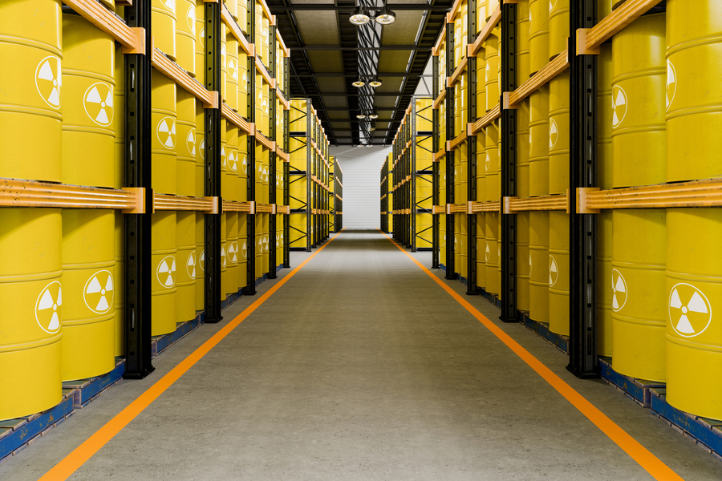
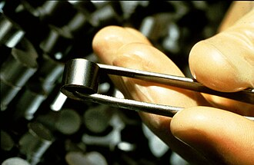

Nuclear Criticality Safety
Art and Science of Avoiding Fission Chain Reactions in Handling, Processing, and Storage

Slide 3
Fission Data Needs for Criticality Safety
Ensure k_{eff} calculates less than an upper subcritical limit determined by critical data
Most important: Fission cross section, nubar, and daughter neutron energy distributions for all incident neutron energies up to approximately 20 MeV
Burnup Credit- crediting spent fuel composition with reducing reactivity for back end of the fuel cycle operations (spent fuel pool, reprocessing, transportation, long-term storage)- 12 fissionable nuclides important to LWR fuel (see below)
  Fission product yields
Niche areas: neutron multiplicity distributions with neutron energy distribution (some subcritical simulations), prompt/delayed gamma data (accident doses)
Always need more validation benchmarks, particularly epithermal/intermediate. Colors in above table give relative benchmark coverage (darker the better)
²³⁴U | ²³⁵U | ²³⁶U | ²³⁸U | ²³⁷Np
²³⁸Pu | ²³⁹Pu | ²⁴⁰Pu | ²⁴¹Pu | ²⁴²Pu

