Slide 1
Fission Cross Section in the Resonance Region: Barrier effects in the R-matrix for fitting of fissile isotope
Luiz Leal
Oak Ridge National Laboratory
Nuclear Data Group
Nuclear Energy and Fuel Cycle Division
Workshop for Applied Nuclear Data Activities (WANDA)
Arlington, VA, February 9-12, 2026

Slide 2
Outlook: Toward More Physically Consistent Fission Modeling in the Resonance Region
Current Practice | Future Direction
Phenomenological fitting of fission cross sections | R-matrix formalism with physical barrier effects
Simplified single-barrier models | Multi-humped effects due to fission barrier
Limited use of spin/parity-resolved experimental data | Integration of spin-separated fission and resonance data
No treatment of class-II fluctuations | Explicit modeling of class-II contributions (especially for fertile isotopes)
Ad hoc treatment of missing channels | Coupling to inelastic and competing channels

Slide 3
Generalities on the Fission Cross Section Representation with the R-matrix approach
  Partial and total cross sections as a function of the collision matrix U_{cc’}
    with c’ is the exit channel (fission, γ, particle emission)
  Lane and Thomas (1958) with R_{cc’} one element of the R matrix
    R_{cc’} is defined in the channel space configuration and γ the basic parameter of the R matrix
γ_{λc} Entrance channel reduced width amplitude (for neutron here) ;
γ_{λc’} Exit channel reduced width amplitude (elastic, inelastic, radiative and fission)
E_{λ} Energy of the level λ

Slide 4
Reich-Moore approximation of R-matrix
Relation between the observed width Γ and the reduced width amplitude for entrance channel c and eigenstate (level) resonance λ
neutron channel
fission, capture channels
No approximation to the R-matrix: as many channels as needed (computing time and array size limitations)
Reich-Moore approximation:
Capture: average value (sum of interfering terms tends to zero)
Elastic channels: one or two elastic for s-waves
Fission: ≤ 4; following small degree of freedom in analysis of fission widths distribution
The RM formalism (reduce R-Matrix) works nicely for fissile isotopes. Interference effects in the fission channels can be represented. However, the unitarity of the collision matrix U_{cc’} is lost!!
Question: How many fission channels are needed? All the ENDF evaluations for fissile elements assume two fission channels!!

Slide 5

Goal: Physics for the fission channels. Are two fission channels good enough?
  Reich-Moore approximation (RM basics):
    Fission: ≤ 4; following small DoF (degree of freedom) in analysis of fission widths distribution
    ; Fitted parameter not related to any fission barrier
    Fissile nuclei: 2 channels needed for interference in fission cross section RM fit
    Fertile nuclei: 2 or 1 channels needed for the class-I resonances enhanced locally by a neighboring class-II state
    Standard RM fission cross section fit in the RRR : phenomenological fission channel parameters Γ_{λf1} , Γ_{λf2} for each ²³⁵U resonance of J^{π}= 3⁻ or 4⁻
    E_{λ} <Γ_{γ}> Γ_{n} Γ_{λf1} Γ_{λf2} ???? J^{π}
Γ_{λf1} , Γ_{λf2} are not uniquely defined as result of the non-unitarity of the collision matrix derived from the RM approach.

Slide 6
Research Activities
Attempt to find a unique set of Γ_{λf1} , Γ_{λf2}
See paper:
RESONANCE STRUCTURE IN THE FISSION OF (235U + n)
M. S. Moore
Los Alamos National Laboratory, Physics Division, P. 0. Box 1663, Los
Alamos, New Mexico 87545
L. C. Leal, G. de Saussure, R. B. Perez, and N. M. Larson
Oak Ridge National Laboratory, P. 0. Box X, Oak Ridge, TN 37830
Nuclear Physics A502 (1989) 443c-452c
North Holland, Amsterdam

Slide 7
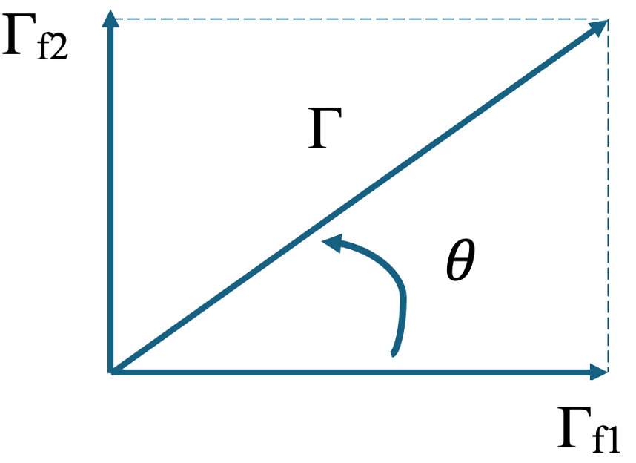
Research Activities
Attempt to find a unique set of Γ_{λf1} , Γ_{λf2}
Spin-separated data (Moore at al.) were used for assigning resonance spin J^{π} for s-wave resonances for J^{π} = 3- and 4-
Fission-vector orientations correspond to the correct K-quantum number distribution for each resonance.
No attempt to include fission penetrability into the
that is assumed to be one (P_{c}=1)

Slide 8
Research Activities
Attempt to find a unique set of Γ_{λf1} , Γ_{λf2} + ???
See paper:
Double-humped barrier effects in the R-matrix for fitting of fissile isotope
Luiz Leal¹, Olivier Bouland², and Gilles Noguère²
¹Insititut de Radioprotection et de Sûreté Nucléaire (IRSN), Fontenay-aux-Roses, France
² CEA, DES, IRESNE, DER, SPRC, Physics Studies Laboratory, Cadarache, F-13108 Saint-Paul-lez-Durance, France
EPJ Web of Conferences ND2022, 03015 (2023)

Slide 9

Extending Reich-Moore to treat fission for fissile nuclei
  Supplementing a fission barrier ‘penetrability’ in the observed fission width definition
  The fission barrier attenuation will be not represented by the
  common R-matrix penetrability factor but simulated by the
  transmission coefficient of a double-humped barrier (A=inner; B=outer)
  Aage Bohr transition states concept Γ_{λ}(K, J, π)
  Hill-Wheeler transmission
  Assumes statistical equilibrium (Hauser-Feshbach formalism valid when compound excitation energy is well above barrier height)
  Even-even fissioning nuclei carry only collective states below the 2 x n,p pairing (U ≤ 1.4 MeV)
Fission chan.

Slide 10
Transmission coefficients as a function of given barrier transition state (K, J, π)
  At low-neutron energy for J^{π}= 3⁻ or 4⁻ s-wave resonances, 4 collective transition states are involved for each. The corresponding fission widths are labeled by their K, J, π
T_{f} ^{K=0, J=3, π=-}=0.57
T_{f} ^{K=1, J=3, π=-}=0.54
T_{f} ^{K=1, J=4, π=-}=0.53
T_{f} ^{K=1, J=4, π=-}=0.42
T_{f} ^{K=2, J=3, π=-}=0.45
T_{f} ^{K=4, J=4, π=-}=0.42
T_{f} ^{K=1, J=4, π=-}=0.28
T_{f} ^{K=1, J=4, π=-}=0.31
  Minor energy variation in the RRR but
  different values
  Indication of 4 fission widths for J^{π}= 3⁻ namely, Γ_{λf1}, Γ_{λf2}, Γ_{λf3}, Γ_{λf4}
  and 3 fission widths for J^{π}= 4⁻ Γ_{λf1} , Γ_{λf2} , Γ_{λf3}

Slide 11
Testing the approach
Modified version of the SAMMY code was developed
Fitting of Spin-separated data of Moore et al. for ²³⁵U (J^{π} = 3- and J^{π} = 4-)
Fitting of total fission cross section of C. Paradela et al. for ²³⁵U
Resonance levels for J^{π} = 3-
E_{λ} <Γ_{γ}> Γ_{n} Γ_{λf1} Γ_{λf2} Γ_{λf3} Γ_{λf4}
Resonance levels for J^{π} = 4-
E_{λ} <Γ_{γ}> Γ_{n} Γ_{λf1} Γ_{λf2} Γ_{λf3}

Slide 12
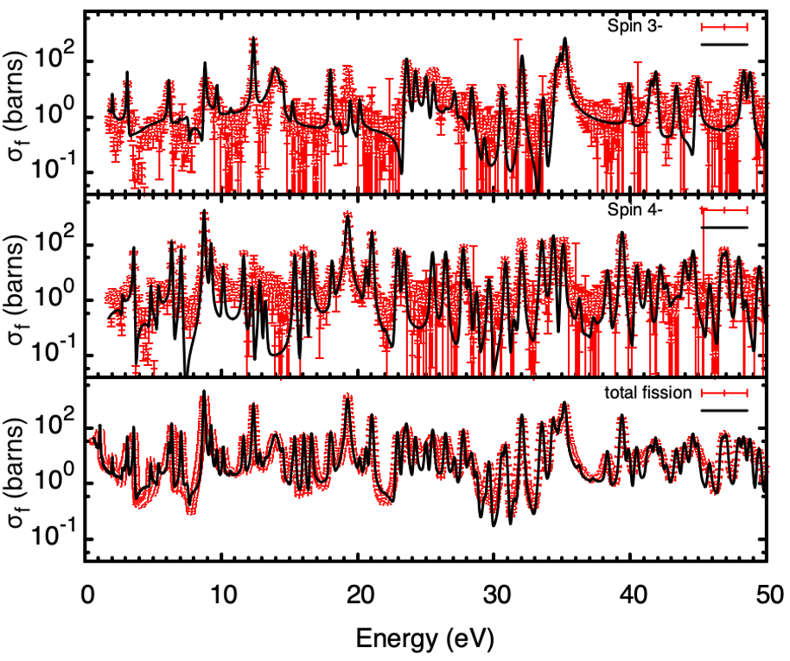
Results:
Preliminary results using the modified Reich-Moore formalism in SAMMY.
The top two plots correspond to the spin-separated fission cross section data from Moore et al. The bottom plot shows the total fission cross section from Paradela et al.
All results are shown for the energy range from 0 to 50 eV.

Slide 13
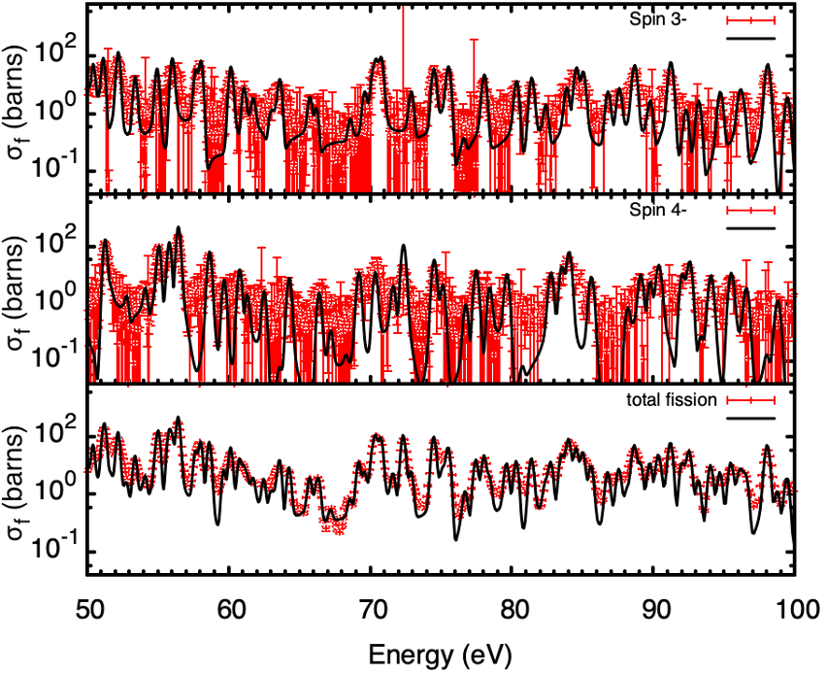
Results:
Preliminary results using the modified Reich-Moore formalism in SAMMY.
The top two plots correspond to the spin-separated fission cross section data from Moore et al. The bottom plot shows the total fission cross section from Paradela et al.
All results are shown for the energy range from 50 to 100 eV.

Slide 14
Key Takeaways and Future Directions
A more accurate theoretical description of the fission process may help explain other observables, such as fluctuations in radiative widths.
Transitioning away from phenomenological fitting toward more physical R-matrix representations requires more complex (but meaningful) fission parameterizations — especially when starting from raw data.
Inclusion of long-range class-II fluctuations is critical, particularly for fertile isotopes, due to the influence of the second potential well.
The treatment of missing or unmodeled inelastic neutron channels above ~77 eV remains an open question — further investigation is needed to understand their role in resonance-region behavior.

Slide 15
Implementation Considerations and Support Needs
The use of LRF = 7 (extended Reich-Moore formalism) appears sufficient to support the proposed developments — no changes to the ENDF or GNDS format are required.
Existing processing codes (e.g., AMPX, NJOY) may require minor updates or none at all to accommodate this format extension.
Continued support from program sponsors is essential to:
Extend and maintain R-matrix capabilities for multi-channel fission analysis.
Validate the modified formalism against modern experimental datasets (e.g., spin-separated fission, high-resolution time of flight).
Integrate enhanced fitting tools into the broader nuclear data infrastructure.

Slide 16
Long-Term Goal
Advance a more physical representation of fission resonance behavior within the R-matrix formalism.
Bridge theoretical modeling with high-resolution fission data, including multichannel interference and barrier penetration effects.
Enable next-generation evaluations of fissile and fertile isotopes based on improved physics models, not just parameter fits.

