Slide 1
The Importance of Correlations in Fission Modeling
Ramona Vogt (LLNL and UC Davis)
LLNL-PRES-2015516

Slide 2
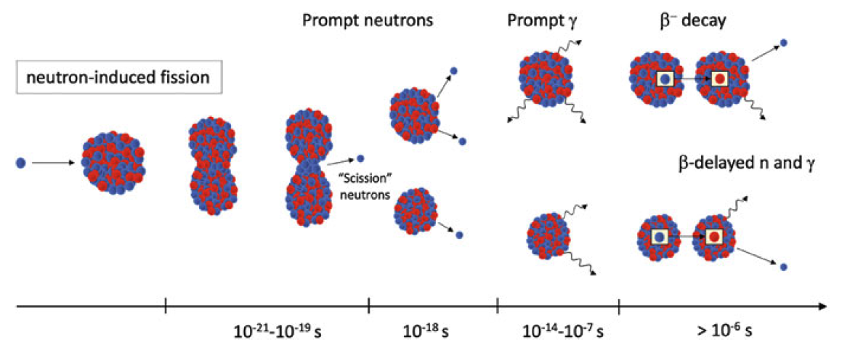
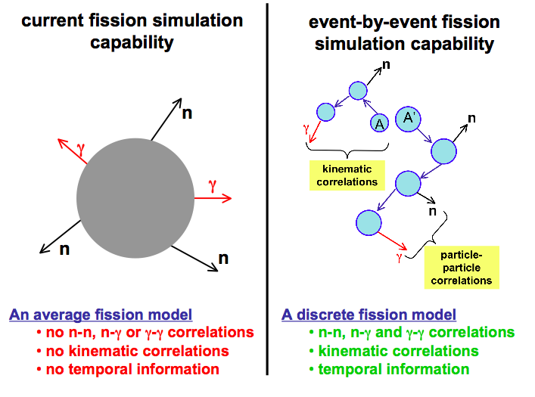
Continuous evolution of fission evaluations requires modeling, including correlations between observables
NSAC 2022-23 Subcommittee on Nuclear Data recommended formation of a technical nuclear data collaboration (TNDC) to establish methods for continuous fission evaluation

Slide 3
Everything in a fission event is correlated
Complete fission models can provide the detailed modeling that is required to better understand fission
Models depend on the initial properties of the fission fragments: mass, charge, spin, and TKE
Mass yields, along with charge yields, contribute most to independent and cumulative yields that make up fission product yield evaluations – TKE is overlooked but it is extremely important for modeling

Slide 4
Correlations between neutron multiplicity and TKE
Average TKE and its dispersion are far larger than are compatible with uncertainties on average neutron multiplicity
PRC 99 (2019) 054619

Slide 5
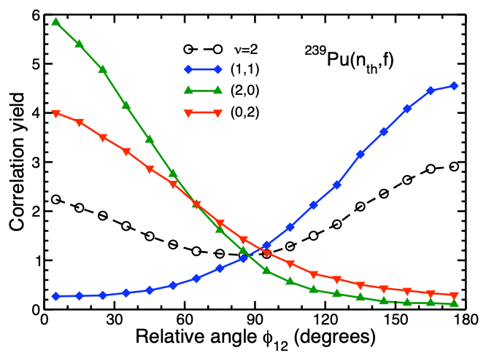
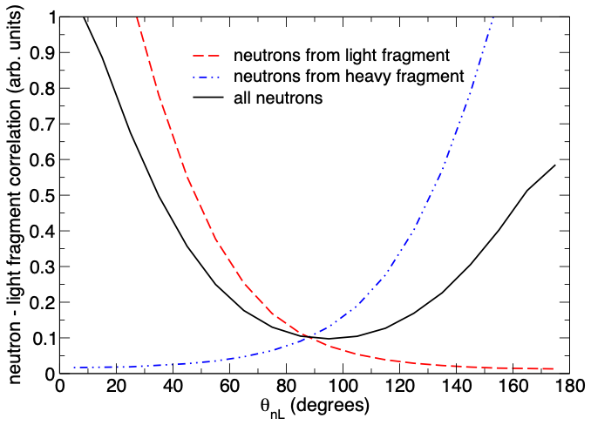
Correlations between neutrons and/or fragments
X=n: Correlations between neutrons when exactly
2 neutrons with E_{n} > 1 MeV are emitted:
One n from each fragment (blue) back-to-back;
both from single fragment emitted in same
direction, tighter correlation when both from
light fragment (green) than from heavy (red);
open circles show sum of all possibilities
X = L: Neutron emission can also be correlated
with individual fragments
Neutrons emitted by either fragment (H or L) with respect to the direction of L: neutrons from L emitted preferentially toward θ_{nL} = 0°; neutrons from H are at θ_{nL} = 180°; correlation becomes more tightly peaked for
higher neutron kinetic energies
X

Slide 6
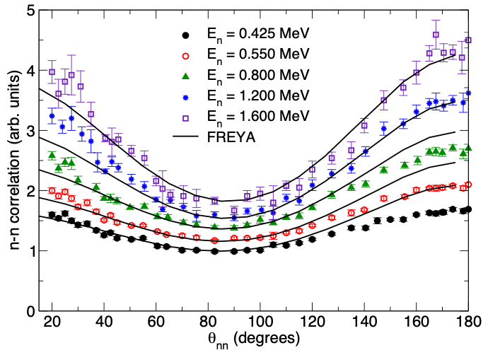
Measured correlations depend on neutron energy (n-n) and A_{L} (n-A_{L})
PRC 97 (2017) 044601
Gagarski et al ²⁵²Cf(sf), 2008
EPJA 54 (2018) 9
These correlations can constrain energy sharing among fragments, even when the
fragments are not measured, as in –n correlations

Slide 7
Neutron-gamma correlations
NIMA 968 (2020) 163907
Not yet well understood, more work is needed
PRC 107 (2023) 014612
Wilson et al., Nature (2021))
Notes:
Left: approximate sawtooth in data for

Slide 8
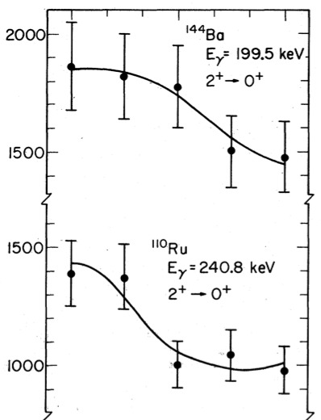
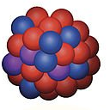
Correlations between photons and fragment spin
Orientation of fragment spins relative to fragment motion
J.B. Wilhelmy et al.,
PRC 5, 2041 (1972):
Look only at E2 emissions in even-even product nuclei
4⁺
Pioneering
experiments:
J.B. Wilhelmy et al., Phys. Rev. C 5, 2041 (1972)
A. Wolf & E. Cheifetz, Phys. Rev. C 13, 1952 (1976)
2⁺
0⁺
Two reference scenarios:
oblate
The fragment spin is parallel
to the direction of motion:
Fragment spin is perpendicular
to the direction of motion:
prolate
sideways peaked
0º
90º
γ
Angle θ
oblate
prolate
θ _{γ,f}
forward-backward
f
90º
PRC 106 (2022) 014609

Slide 9
Everything in a fission event is correlated
Complete fission models can provide the detailed modeling that is required to better understand fission
Models depend on the initial properties of the fission fragments: mass, charge, spin, and TKE
Mass yields, along with charge yields, contribute most to independent and cumulative yields that make up fission product yield evaluations – TKE is overlooked but it is extremely important for modeling

