Slide 1
Improving Nuclear Data with Advanced Computational Capabilities
Office of Advanced Simulation and Computing and Institutional Research and Development

Slide 2
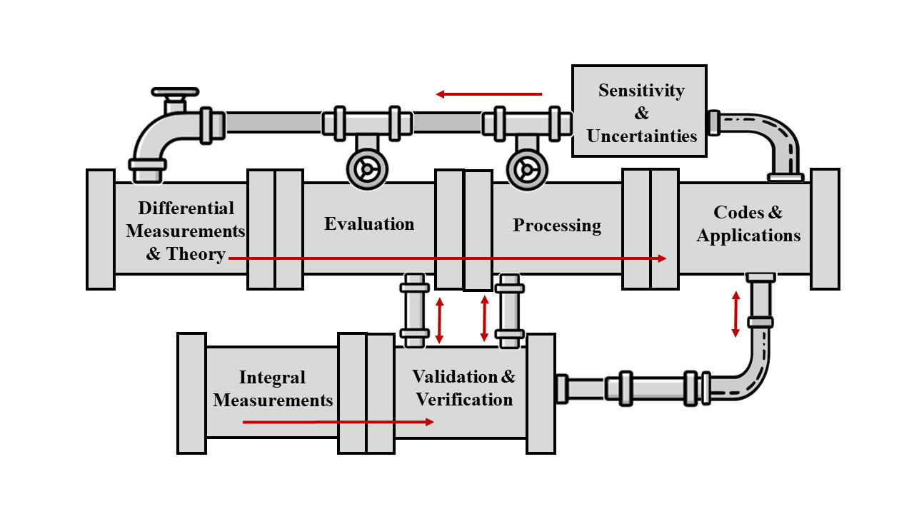
Nuclear Data Pipeline (NA-114 perspective)
NA-114 has demonstrated strong support for efforts across the nuclear data pipeline: critical activities supporting the nuclear deterrent mission
Modern methods and platforms increase data fidelity
Machine Learning/Artificial Intelligence (ML/AI) provides new opportunities for improved accuracy and reduced timelines
Both LLNL and LANL maintain a complete and integrated nuclear data pipeline to achieve Defense Program goals – NA-114 directly funds multiple technical activities

Slide 3
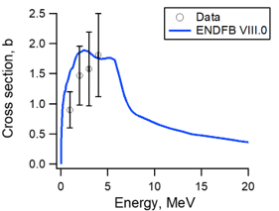
Evaluations remain a significant activity
Use nuclear theory reaction codes, constrained by measured differential data and validated against integral data, to determine accurate mean values and uncertainties
Identify priorities based on sensitivity and uncertainty studies, specific requests, and available capabilities (both experiment and theory)
Need for capabilities to
  Improve workflow, reproducibility, and timeline
  Provide robust covariances (including model form)
  Predict challenging reaction cross sections
²³⁹Pu(n,n’)
Neutron inelastic scatter measurements (points with error bars) and evaluated cross section from ENDF/B-VIII.0
Partnership with the US Nuclear Data Program is key
Notes:
The plot on the right is for Pu-239 inelastic scatter and demonstrates an area where theory is filling in large gaps.
Uncertainty studies is bold here because that is an area that nuclear data leads over other scientific communities – and we see prioritization moving away from expert judgement and toward quantifiable needs.

Slide 4
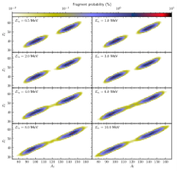
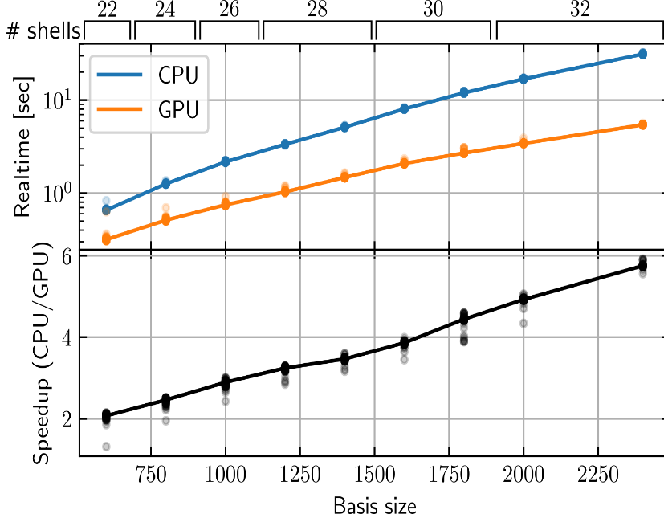
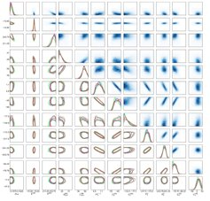
Predictive theory of fission with uncertainties is on the horizon
Calculating fission is a challenge, involving many-body quantum systems, deformation, and a distribution of reaction products
Advanced theories predict a range of fission properties
Calculations require next-generation HPC machines
Bayesian techniques and AI/ML emulators enable uncertainty quantification
Notes:
Fission is one of the most challenging nuclear data to calculate, where both the reaction cross section and the products (neutron, gamma, fission fragments) are important.
Advanced theory work, new computational platforms, and AI/ML capabilities are expanding our reach for predicting this complex process in a predictive way.
These activities require coupling reaction and structure nuclear theories and require large computational resources.
Emulators are being used to reduce computation while retaining high-fidelity results, allowing correlations and uncertainties to be calculated.
This work also connects to experiments, where measured data are needed are needed to constrain theory and reduce uncertainties.

Slide 5
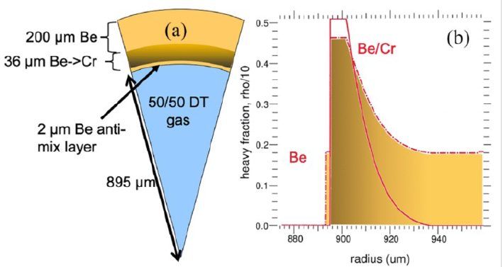
Activation library activities are growing
Radchem diagnostics at the NIF:
Radiochemical tracers used in historical and modern experiments
Networks can involve reactions on radioactive isotopes and metstable states – often no data, theory only
Expanding networks, advancing theory, and implementing uncertainties
Ablator: blows off and drives capsule inward
Cr
(p,n), (d,2n); short range
⁵²Mn (5.6 d)
Ratio:
fuel-ablator mix
⁵²Cr (stable)
doped in
ablator
⁵¹Cr (528 d)
(n,2n); long range
S. A. MacLaren et al, Demonstration of a Novel Radiochemical Mix Diagnostic for Fusion Implosions at the National Ignition Facility, Phys. Rev. Lett. 085101 (2025)
Notes:
We use an activation/inventory library that is not part of ENDF to describe reaction networks used in historical and modern experiments.
Experiments in OES are measuring the reactions where possible, either directly or indirectly, but many gaps remain.
These networks can be complex and involve reactions with unstable isotopes and reactions on excited states where only theoretical predictions are possible.
Data compilation and libraries are supported under ASC, connecting to users such as those modeling experiments at the NIF.
Shown is one example for measuring mix between capsule ablator and DT gas, where mix reduces the output.
Charged particle reactions show short range interactions
Neutron reactions show long range reactions
And their ratio is proportional to the amount of mix
Modeling this activation was an important aspect of identifying and using this new diagnostic

Slide 6
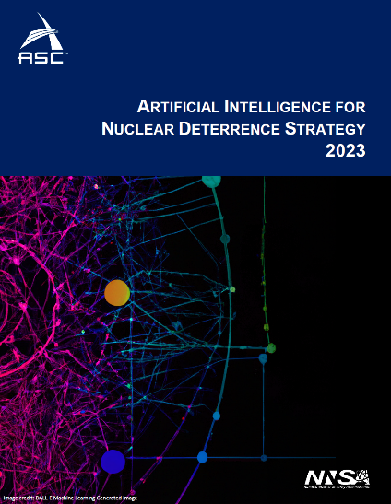





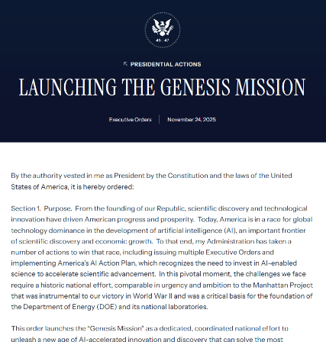




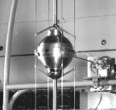
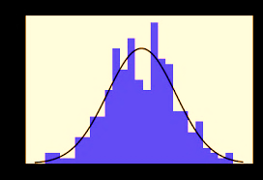
Nuclear data are well suited for ML/AI, and there are many examples of current use
Nuclear data production is an excellent candidate for agentic orchestration
= communication
protocols
theory
Fission
theory
Fission
events
Library
AI/ML
(GMA)
Neutron Standards
Evaluation
V&V
Tool integration
Processing
Existing
data
Reaction
Models
Orchestration
Specialized agents
UQ
Adjustment
Specialized agents
Notes:
Machine learning and AI methods are used in nuclear data production to reduce turnaround time and improve efficiency.
We are invested in expanding current capabilities and finding new opportunities where advanced methods can be applied.
We are shifting from data-driven science to AI-driven science.
For example, in the future independent activities can be coordinated and driven by the evaluation so that they operate in a unified, complementary way.
Specialized agents, or AI components, can focus on specific roles such as data inputs and outputs to the evaluation.
Forward looking capabilities are part of the NA-114 strategy outlined in 2023 and the broader Genesis Mission from the White House earlier this year.

Slide 7
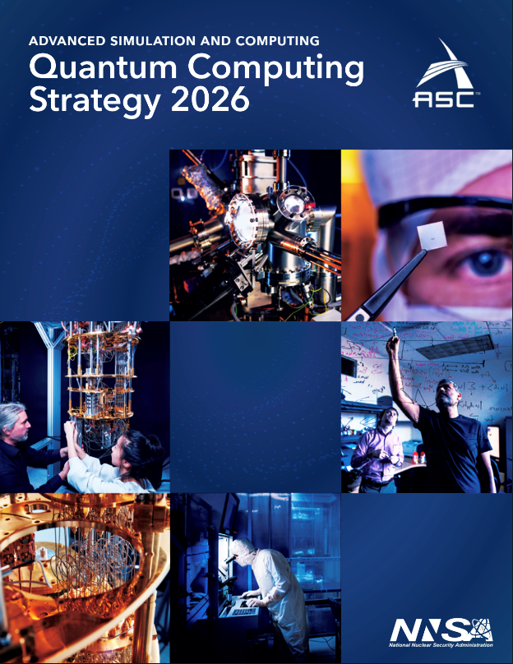
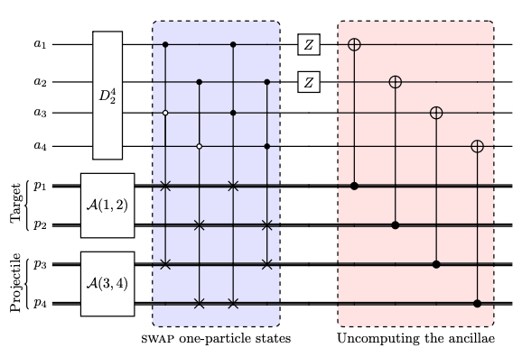
Quantum computing is poised to enable the next frontier in predictive theory capabilities
Nuclear dynamics is a strong candidate for quantum acceleration, with the potential to radically enhance
nuclear data modeling and prediction
Quantum-classical co-processing of
two-nucleon reaction
Quantum complexity for
two-particle reaction dynamics
Variational calculation of scattering phase shifts
Quantum circuit for antisymmetrizing target-projectile states
Continued development of quantum algorithms for nuclear dynamics is essential to fully leverage quantum platforms for predictive simulations
Notes:
Quantum computing shows promise for NNSA’s future predictive science mission.
Quantum Information Science, or QIS, is poised to give us a path to tackle problems that are extremely challenging, and in some cases intractable, on classical computers alone.
One especially promising area is nuclear dynamics, which deals with how nuclei interact and react with each other.
Improvements here directly impact nuclear data, cross sections, and reaction modeling that feed into many of our mission applications.
Nuclear dynamics is a natural fit for quantum computing because the underlying physics is fully quantum mechanical. In principle, a quantum computer can represent and evolve these systems more efficiently than any classical machine.
the leftmost figure shows a study of the complexity of the quantum mechanical scattering problem for a two particle system
In this example, simple reaction dynamics start from a classically prepared state and then evolve, as shown in the purple insets, generating significant quantum entanglement. In the middle of the trajectory, where the particles collide and react, the complexity peaks
In full nuclear simulations, such jumps in complexity demand exponentially large classical resources, but are naturally captured by quantum simulations on quantum platforms.
The second figure is an example of a quantum simulation of two-neutron dynamics carried out with the Advanced Quantum Testbed at Lawrence Berkeley Natl. Lab.
The third figure shows how we use variational quantum algorithms in combination with time evolution algorithms to simulate scattering phase shifts, which tell us how particles scatter off each other
We have also developed quantum circuits toward describing a nuclear reaction (fourth figure)
The science community is making promising advances in quantum algorithms for nuclear reactions.
These are still relatively simple systems, but they are essential stepping stones to more complex, mission relevant problems.

Slide 8
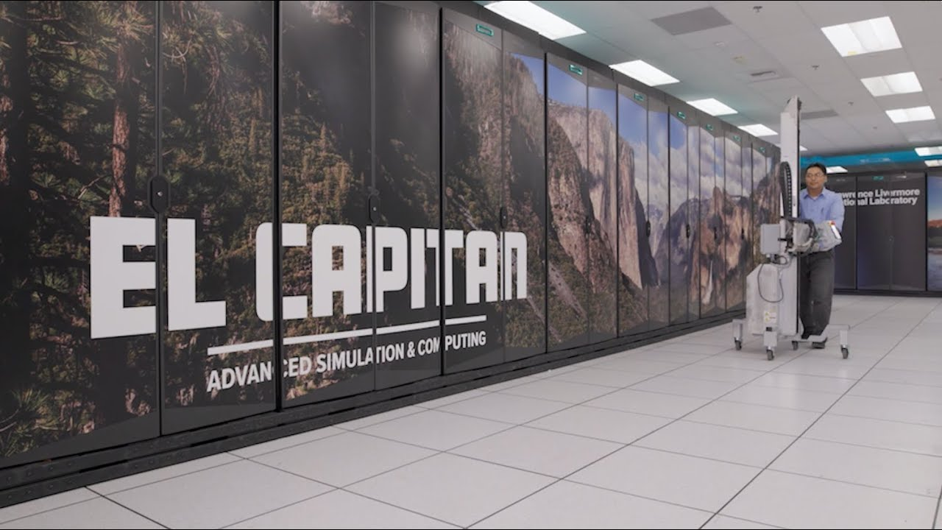
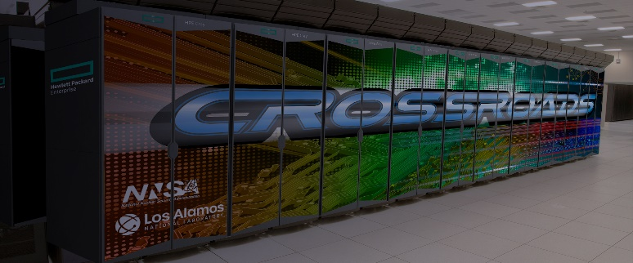
Work under ASC strives for cutting edge capabilities
Machine learning and AI use is growing
  Supports acceleration of theory and data production
  Challenge: High accuracies often needed
Advanced computation platforms (e.g. GPU-based systems) allow larger and more accurate calculations
  Requires refactoring and modernizing codes
  Challenge: Valuable legacy Fortan codes
Examining uncertainties beyond measured data for covariances
  Large scale and complex calculations
  Challenge: May increase current uncertainties

