Slide 1
Nuclear Data Toward Predictive Capabilities
Office of Experimental Science

Slide 2
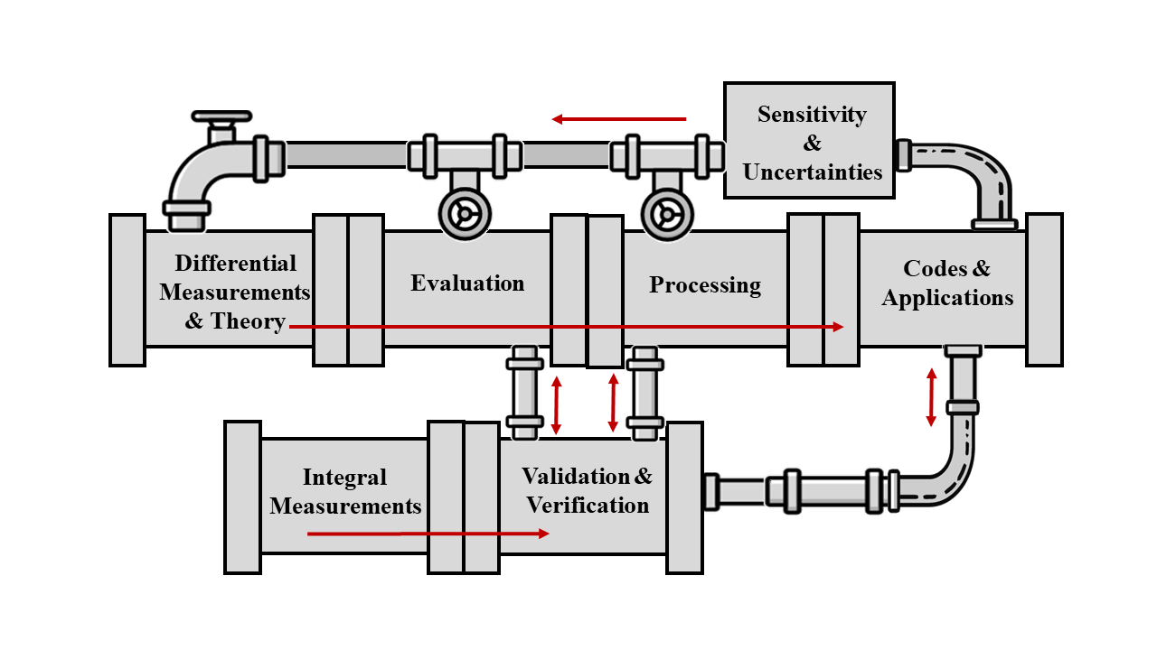
Nuclear Data Pipeline (NA-113 perspective)
NA-113 oversees critical activities in the nuclear data pipeline supporting the deterrent mission
Collaboration is key for maintaining and strengthening our capabilities
Uncertainty Quantification studies identify sensitivities and priorities
Machine Learning/Artificial Intelligence (ML/AI) is providing new methods for experimental data reduction/analysis and applications studies
Both LLNL and LANL maintain a complete and integrated nuclear data pipeline to achieve Defense Program goals – NA-113 directly supports foundational and applied activities
Notes:
Repeat slide from previous years

Slide 3
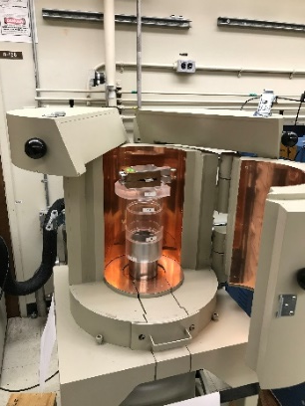
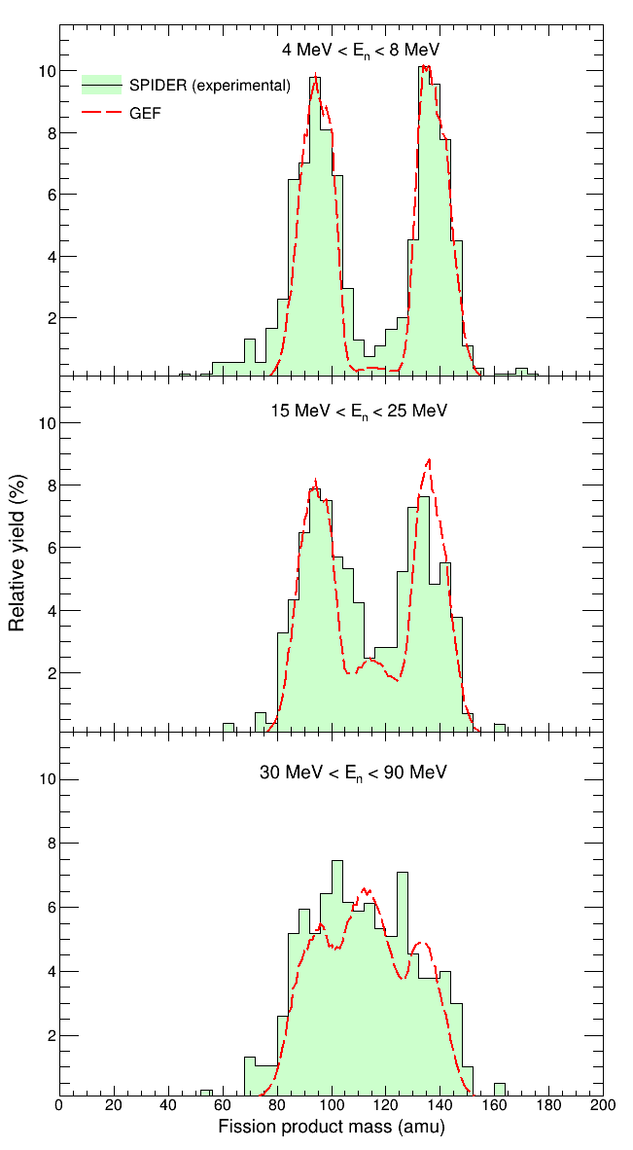
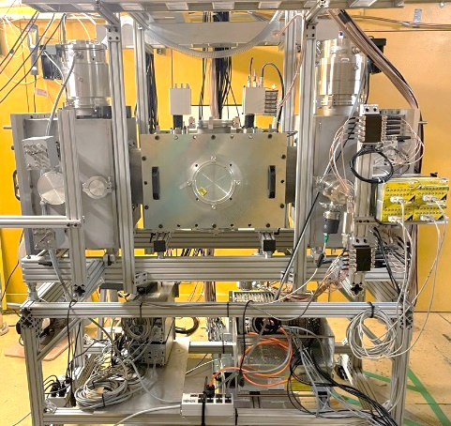
Neutron fission measurements have been a focus
Accurate nuclear data needed for predictive capabilities
  Previous campaigns on the “Big 3” (²³⁵U, ²³⁸U, and ²³⁹Pu) for precision cross sections and prompt neutron emission energies
  Improvements to minor actinides may also be needed
Fission product yields continue to improved
  Successful completion of energy-dependent neutron-induced cumulative yields for the Big 3
  Refining decay branching ratios used in analysis at LLNL
  Ready to measure correlations & independent yields at megaSPIDER at LANL
LLNL decay counting system
LANL megaSPIDER and fission yield data
Efforts are long-term investments that provide excellent data and are achieved through a collaboration between national labs and universities
Notes:
Fission is an important reaction in stockpile science
Precision cross sections and neutron emission spectra for priority isotopes U-235, U-238, and Pu-239 have been delivered
Improvements data for minor actinides may also be needed
Campaigns for energy-dependent cumulative yields successfully completed for U-235, U-238, and Pu-239
Precision measurements for fission product decay branching ratios continue reduce uncertainties in the fission yields
In addition, new campaigns for independent fission yields and correlations are starting at LANL following the successful commissioning of megaSPIDER

Slide 4
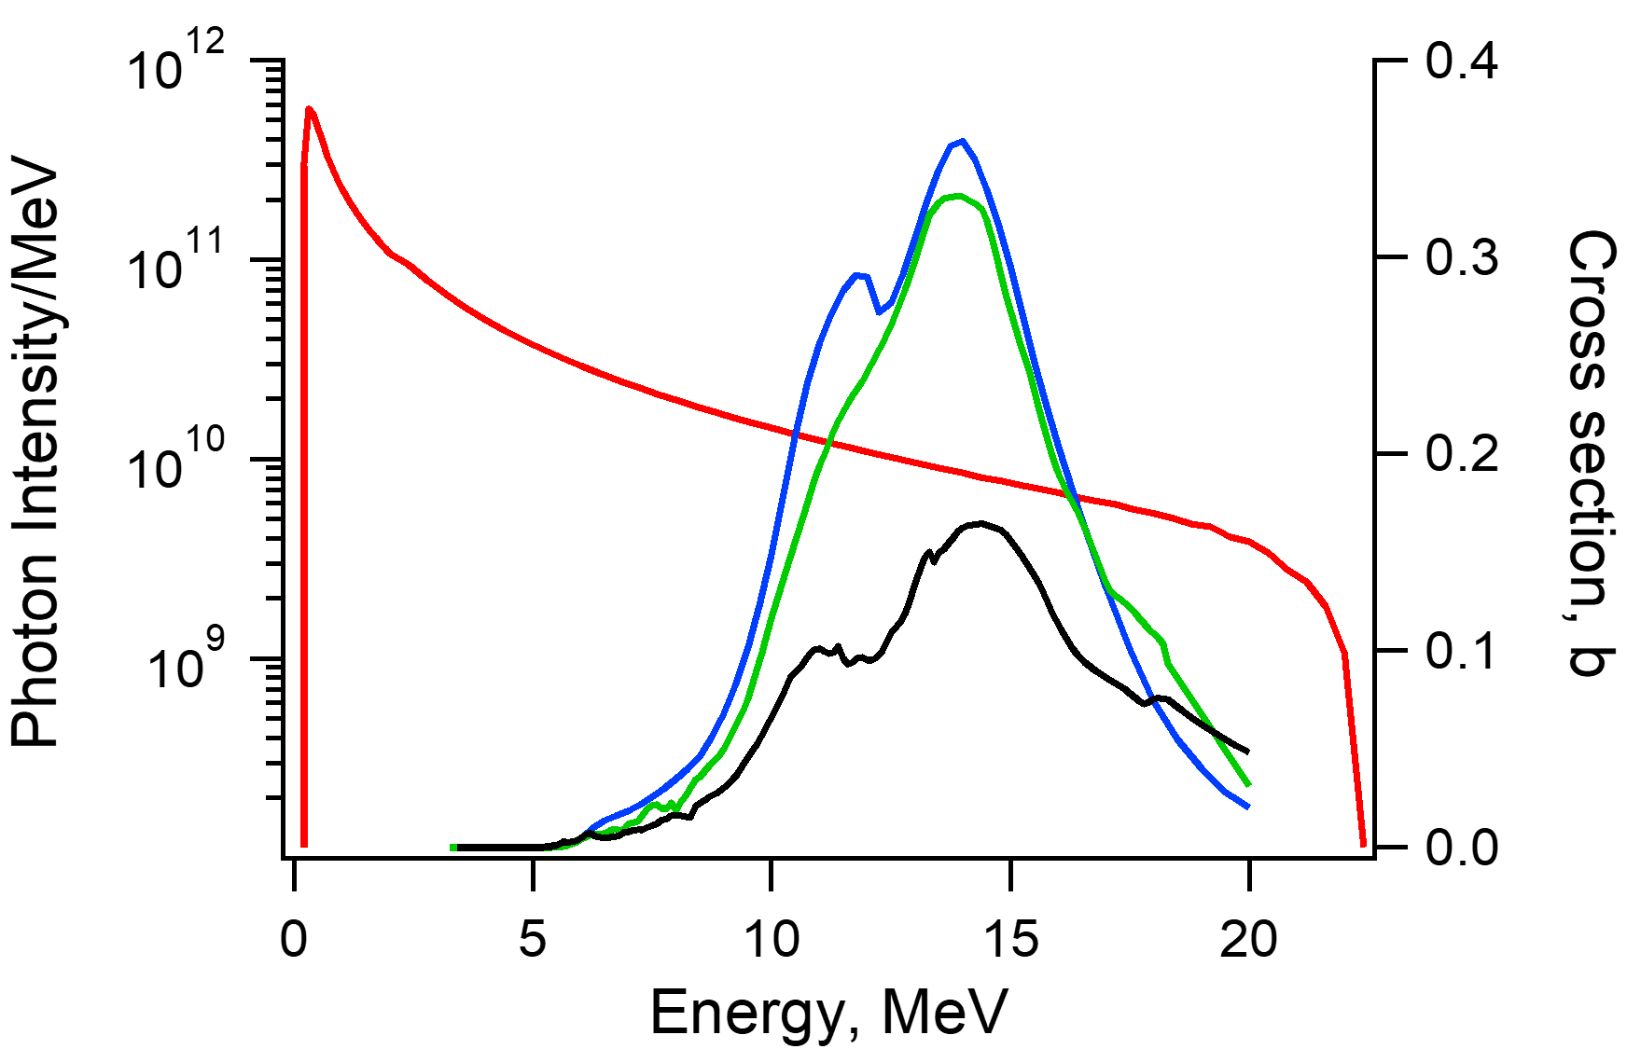
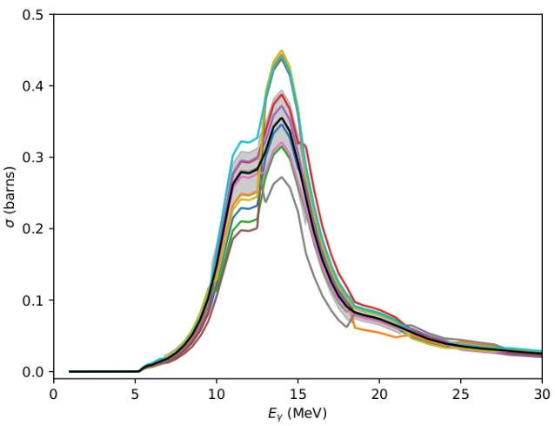
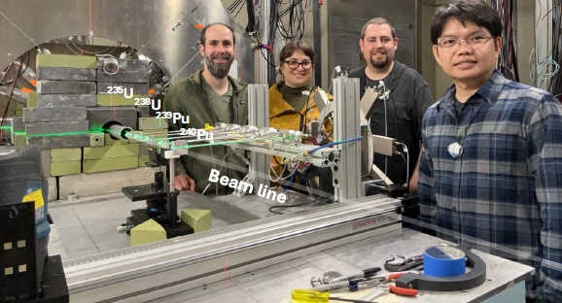
Photonuclear data are a newer emphasis
Radiography beam profile
²³⁹Pu(n,f), ²³⁵U(n,f), ²³⁸U(n,f)
Need high-intensity penetrating radiography for examining dense materials and challenging experimental conditions (e.g. smoke)
Photonuclear reactions need to be considered for photon energies > ~ 7 MeV
Neutrons and gammas produced
  reduce image quality
  affect shielding requirements
  damage other diagnostics
Neutron scatter also plays a role
²³⁹Pu(n,f)
New measurements, new evaluations, and covariance data being delivered
Notes:
Scorpius is a high-energy radiography system planned for PULSE at NNSS
Photon energies above approximately 7 or 8 MeV (typical) will cause photonuclear reactions, emitting neutrons and gammas
This radiation will
Reduce image quality
Affect shielding requirements
And damage other diagnostics
Reactions, particularly scatter, with the neutrons will also play a role
Predicting the neutron dose is important for experimental design and analysis
We have efforts for new data measurements (photofission), integral measurements, and evaluation to quickly deliver these data to modeling and simulation activities used in experiment planning

Slide 5
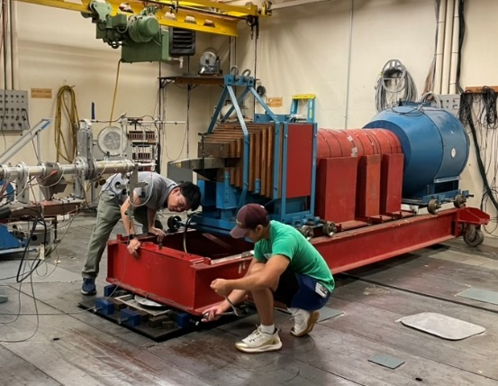
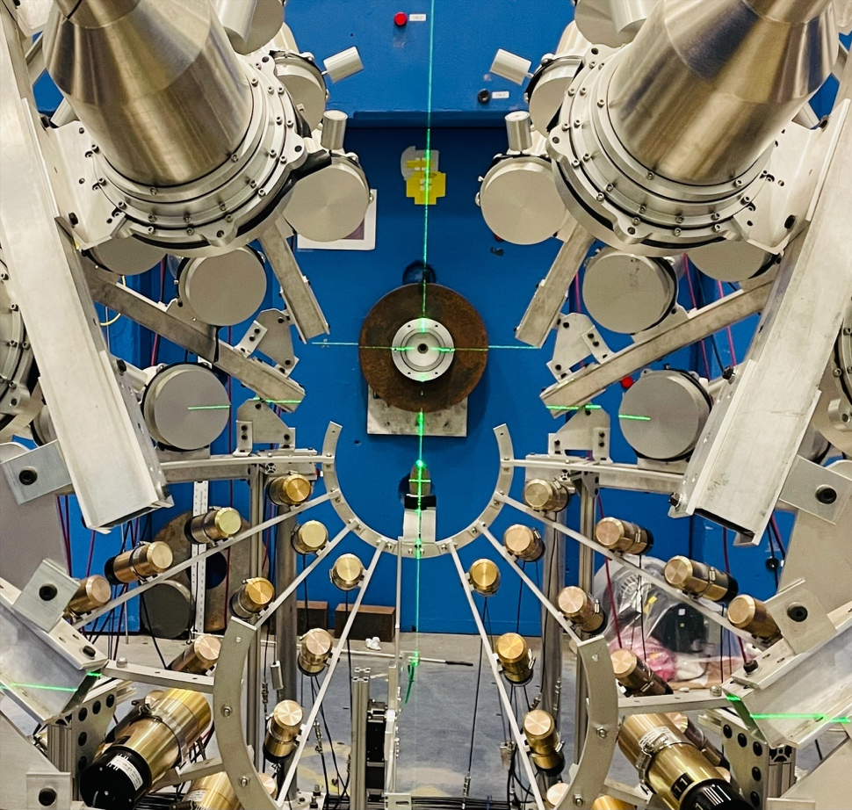
Neutron scatter measurements have been identified as a priority
Scattering is a difficult neutron reaction channel to measure and poorly constrained
  Limited reaction observables: neutrons, γ rays
  Neutrons are very hard (but necessary) to measure, generally rely on time-of-flight for energy measurement (>>10 ns flightpath)
Actinides present more obstacles:
  Significant neutron background from fission
  Low γ−ray energies/intensities in actinides make neutrons the only reliable probe
  Actinide material difficult to work with
Active efforts underway to collect these important data – need evaluation support to get data into library
Monoenergetic neutron source: LLNL with TUNL (actinides, ²³⁸U) and with Mississippi State, UKAL (non-fissionable; ⁵¹V, Ti)
Broad-energy neutron source: LANL at LANSCE with Correlated Gamma-Neutron Array CoGNAC
Complete: ⁹Be,¹²C,¹⁶O,²⁸Si Ongoing: ⁵⁶Fe,²³⁸U,¹⁹⁷Au
Planned: ²³⁹Pu, ²³⁵U

Slide 6
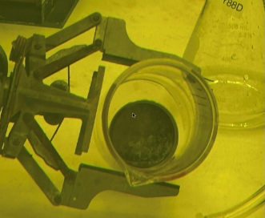
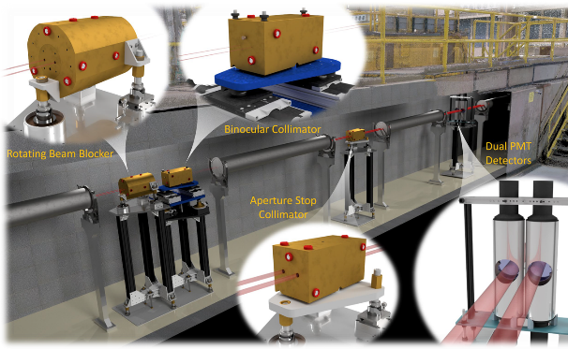
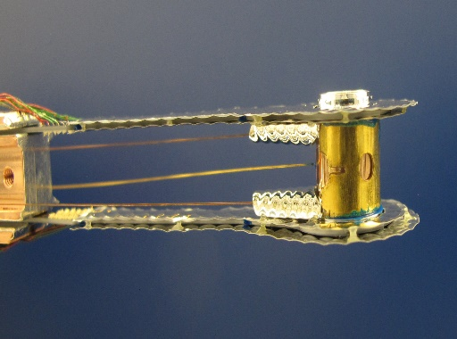
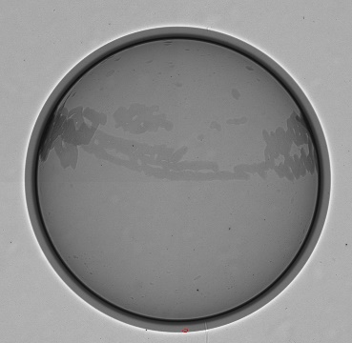
Improved reaction cross sections with unstable isotopes requires new measurements and theory
Radiochemical diagnostics
Reactions on fission products, “burn-up”
Challenging measurements
  Indirect techniques with LLNL at ANL, FRIB, TAMU
    Complex detector arrays, challenging analysis
    Need theory development for unstable nuclei
  Direct techniques at NIF and LANSCE
    Need isotope production capabilities (radioactive targets)
    Requires optimized detection capabilities
⁸⁸Y irradiation at IPF in 2025 and DICER prepares for cross section measurements with radioactive Y-88
(2 Ci, 150 ug) at LANSCE
87
(n,2n)
88
(n,2n)
89
80 h
107 d
100%
High neutron flux and low numbers of radioactive target atoms needed at NIF: Successful demonstration for (n,2n) cross sections on ⁸⁹Y and ⁸⁸Y
(n,γ)
(n,γ)
Example: simplified Y reaction network, where many reactions are on unstable nuclei (few to no measurements)
Notes:
Repeat slide from previous years – updated photos

Slide 7
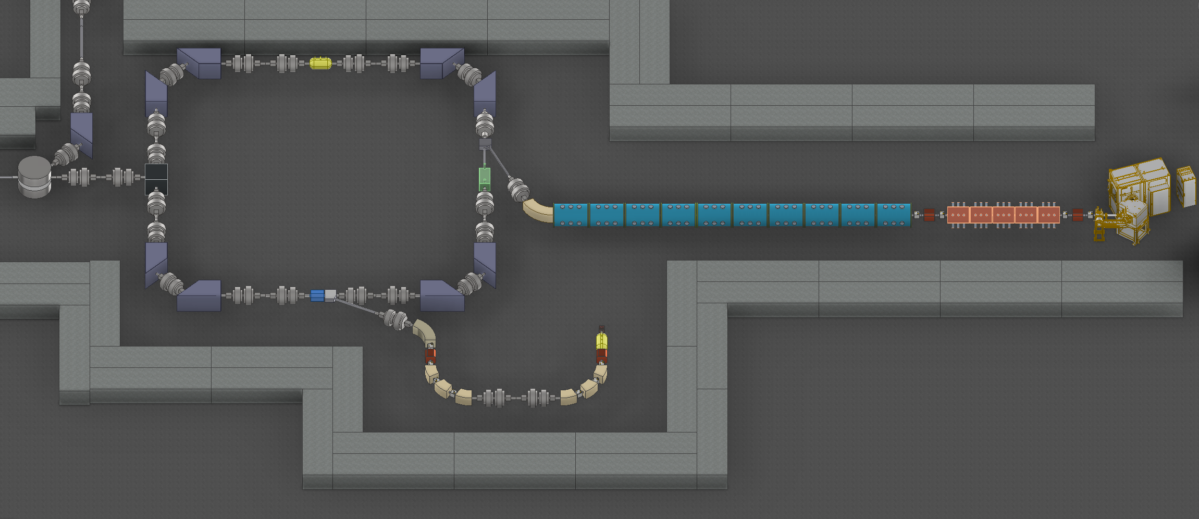
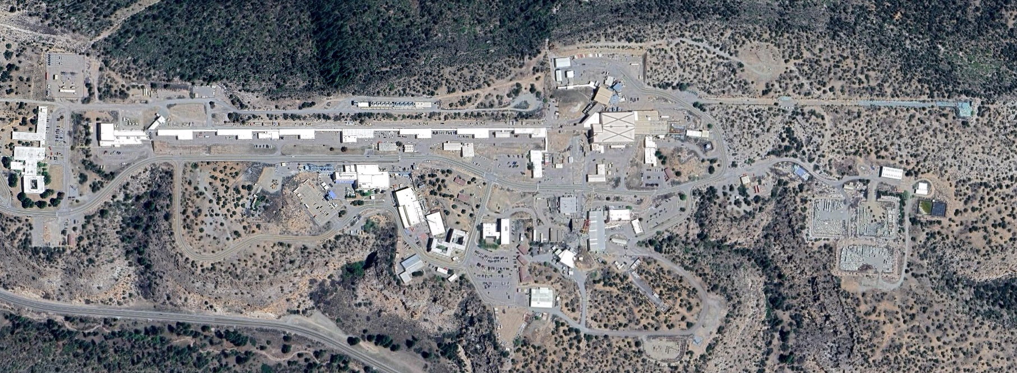
LANSCE Enhancements (LANE) revolutionize nuclear physics capabilities to meet NNSA mission needs
LANE is part of the NNSA Enterprise Blueprint and a top priority of the LANL Laboratory Agenda
Modernizing the LANSCE accelerator and end stations is critical for delivering high precision data for NNSA missions
PSR modernization and WNR Enhancements will augment world-unique nuclear experiment capabilities
Heavy ion beam
H⁺
Reactants
LAMP: LANSCE Modernization LANE: LANSCE Enhancements
Neutron Target Facility
(NTF)
pRad-HE
Area A
pRad-II
ARMAG
Rad Target Fab
Line A
NTF
NTF enables first-time, direct measurements of cross sections on short-lived nuclei with neutrons
NTF measurements improve uncertainties and bring new physics understanding that directly benefit Assessment Science, nonproliferation, forensics, and astrophysics
Burst Facility
LAMP
PSR Modernization
SMARTS 2.0/GRAACE
WNR Enhancements

Slide 8
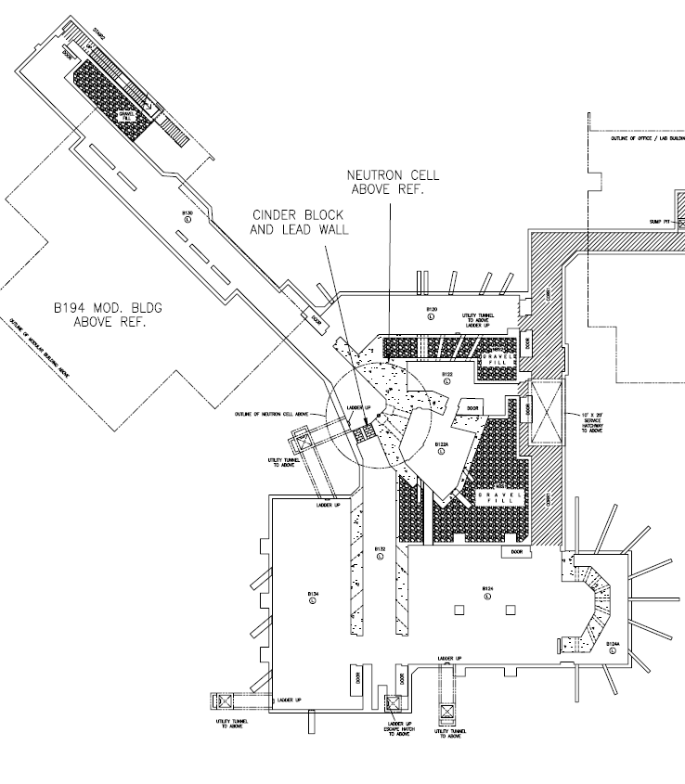
Livermore Nuclear Science (LiNuS) Center will expand experimental capabilities
LiNuS Center
(Proposed upgrade to B194)
LiNuS will provide high-flux, pulsed, monoenergetic neutrons at a range of energies
Complementary to LANSCE broad energy spectrum
Facility will provide high-priority Defense Program needs identified in multiple L1 Milestones:
  ²³⁹Pu(n,n’) – nToF provides outgoing neutron spectrum
  ²³⁹Pu(n,2n) – High-flux activation with mass spectrometry
Facility can also be used for integrated measurements such as pulsed spheres providing nuclear data constraints for reduced uncertainties
LLNL has made LDRD investments to reduce risk on the accelerator and target technology
Accelerator
Buncher
Radioactive Target
Activation
Scattering Target
Integral
Experiments

Slide 9

OES supports multiple experimental efforts driven by applications needs
Data needs identified through sensitivity studies and connections across NNSA offices
Challenging measurements taken on by diverse teams
  Data are shared with the broader community – improves foundational science understanding
  Expanding capabilities for challenging reaction measurements
Evaluation is a pinch point: need more evaluators
ML/AI may accelerate data delivery from experiment to application
  Detector channel calibrations, data fitting
  Identification/removal of contaminants
  … and more
Applications
Delivery
Needs
Nuclear Data
Library
Foundational Data
Experiment/Theory
Evaluation
Reaction Theory
Notes:
Repeat slide from previous years

