Slide 1
Nuclear Data Needs for Safeguards

Slide 2
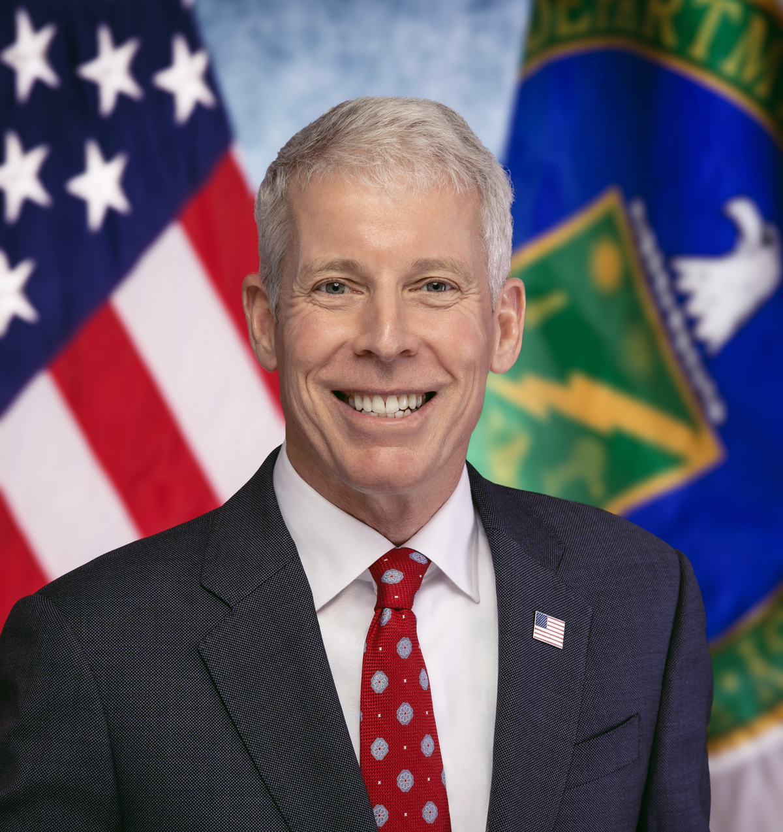
Drivers for nuclear data
“As global energy demand continues to grow, America must lead the commercialization of affordable and abundant nuclear energy. As such, the Department will work diligently and creatively to enable the rapid deployment and export of next-generation nuclear technology.”
– U.S. Secretary of Energy, Chris Wright

Slide 3

International Nuclear Safeguards
Detect and deter proliferation and undeclared nuclear activities
Strategic Goal – Provide American leadership at the International Atomic Energy Agency (IAEA) to ensure that partner states implement and meet international safeguards obligations.
Strategic Objectives
Engage with American advanced reactor designers and other stakeholders to provide expert support in promoting the timely incorporation of safeguards by design, through programmatic and technical initiatives
Implement AUKUS agreement
Develop, test, and transfer more efficient and cost-effective safeguard tools, technologies, and methods
Develop partner country capacity to implement safeguards effectively and efficiently
Implement U.S. safeguards obligations, manage U.S. Support Program to IAEA Safeguards, and assess the security of U.S.-obligated material in foreign facilities
3

Slide 4




Advanced Reactor
International Safeguards Engagement (ARISE)
Prepare advanced nuclear technology stakeholders to meet the highest nonproliferation/safeguards standards
Engage with Advanced
Nuclear Industry
Build Safeguards Knowledge
Base and Capacity for
Advanced Nuclear
Prepare Stakeholders for
New Technologies and Deployment Models

Slide 5
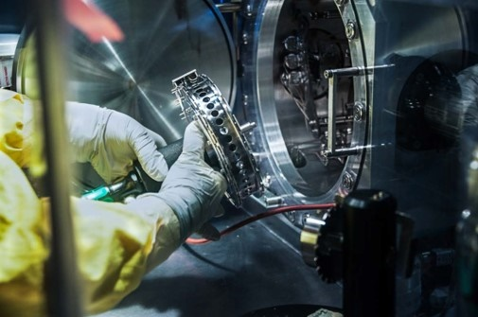
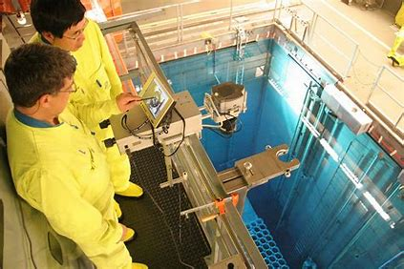
Safeguards Technology Development
  MISSION
To strengthen international safeguards through the development and application of tools, technologies, and methods that improve the effectiveness and efficiency of international safeguards for the International Atomic Energy Agency (IAEA) at both the facility and state levels.
“To be the trusted, international leader in the development of innovative tools and techniques to verify the peaceful use of nuclear technologies”
- SGTech Team June 2024
  Vision

Slide 6
SGs Nuclear Data and Modeling Needs
Validation and Benchmarking
Passive neutron source terms for non‑traditional fuel forms
Fission yield + decay data for burn up and spent-fuel verification
Gamma emission data for complex actinide mixtures
Nuclear data for salt and coolant activation
Peace Through Atomic Strength

