Slide 1
Advanced Reactor Safeguards Modeling and Simulation
February 2026
2026 Workshop for Applied Nuclear Data Activities (WANDA), Washington, DC
Jin Whan Bae
Oak Ridge National Laboratory

Slide 2
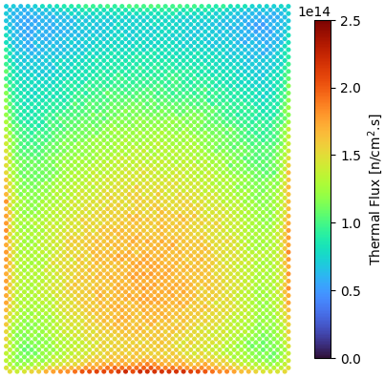
Accurate modeling of advanced reactors has an array of challenges compared with modeling of LWRs
Different neutron spectrum
  Fast, epithermal
New material
  Nuclear data
  Unknown material impurities -> uncertainties in modeling
Dynamic irradiation environment
  Flowing fuel (molten salt reactors [MSRs], pebble bed reactors (PBRs))

Slide 3
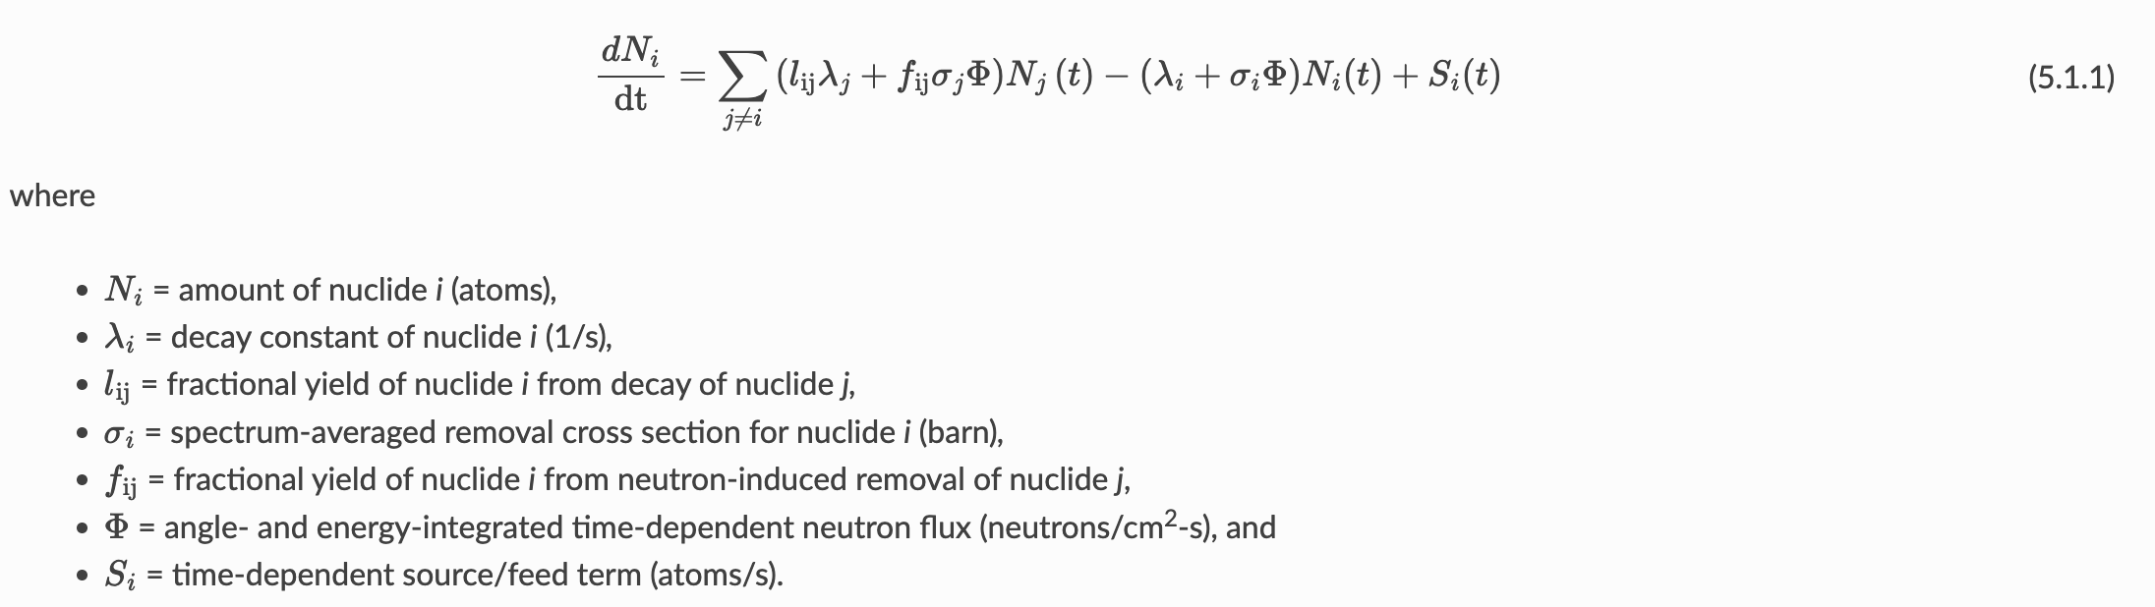
Accurate inventory prediction requires accurate flux calculations
Resolutions of:
  Space: How do we bin each volume (cell)?
  Energy: What should the energy resolution be? Best to use continuous energy reaction rate.
  Time: Does the flux change dramatically over time (nonlinear)?

Slide 4
Advanced reactors are more complicated and have more “dimensions” to consider
Pebble-bed reactors (PBRs):
  Fuel is solid (no mixing) but is moving
    Different flux environment
    Heterogeneous geometry
  Various pebble management strategies
    Flow rate, reinsertion strategies
MSRs:
  Fuel is liquid (mixing) and is moving
    Different flux but also composition (advection)
    How to define “control volume” inventory
  Various molten salt flow strategies
    Flow rate, processing and separation systems
-Need for a tightly coupled multiphysics simulation (more than particle transport + depletion) for accurate inventory simulation

Slide 5
Previous work on PBRs
Increased accuracy of flux and inventory modeling
  Yves Robert, Jianwei Hu
2. Data framework for pebble bed safeguards
  Jin Whan Bae, Donny Hartanto, Jianwei Hu
3. SCALE development team
  Steve Skutnik, Rabab Elzohery, Will Wieselquist, Tarek Ghaddar, Tara Pandya, Matt Jessee, Rike Bostelmann

Slide 6


Pebble bed operation is complex and unique
Matrix
Core
Shell
Continuous online refueling
Approximately 10⁴–10⁵ pebbles circulating (gravity/buoyancy)
Pebbles discharged based after multiple passes based on burnup assessment
Criticality control with pebble flow
Focused on Kairos Power’s generic fluoride-salt-cooled high-temperature reactor (gFHR) design in this talk, but can be customized to other PBR designs
Note: Motion is inverted for HTGRs
Defueling chute
4 cm
Discharged
pebble
Typical FHR pebble.
Nondestructive assessment (burnup, integrity)
Shell
Matrix
Pebble bed
(~10⁴–10⁵ pebbles)
Disposal
Discarded
pebble
6 cm
Typical HTGR pebble.
Fueling chute
~1 mm
SiC
Buffer
Fresh pebble
Reinserted
pebble
Fuel kernel
Fresh pebbles
PyC
TRISO particle.
Schematic view of multipass PBR operation.
Higher burnup, continuous operation, low excess reactivity
Notes:
I will get into the specifics of the method later, but I want to provide you with a basic idea of what we want to replicate when simulating the operation of PBRs.
So, we have double heterogeneous (so fuel spheres into bigger spheres) stacked into the vessel, which circulate continuously, driven by gravity for gas-cooled reactors or drag for molten-salt-cooled reactors.
Disclaimer: I will show a lot of applied cases to the MSRs (or FHRs), but the method is agnostic to what the coolant is and which direction the pebbles are going.
Pebbles are discharged from one end of the core. They then go through a nondestructive assessment of their burnup and mechanical integrity. If they are suitable for another pass through the core, then they are reinserted. Otherwise, they are discarded.
To maintain criticality, fresh pebbles are also continuously reinserted in the core. After running for a long time with a steady state, the core consumes and discards roughly as much as what is inserted, so it reaches an equilibrium state.

Slide 7
Hyper-fidelity (HxF) depletion: leveraging GPU-based discrete element method (DEM) to explicitly track individual pebbles
Staying in core
Pebble bed
Monte Carlo transport
Thermal hydraulics
Individual depletion
Pebble
motion
Until converged
Fresh fuel
Reinserted
Discarded?
Decay time
Discharged
Discharged?
Discarded
Reprocessing

Slide 8
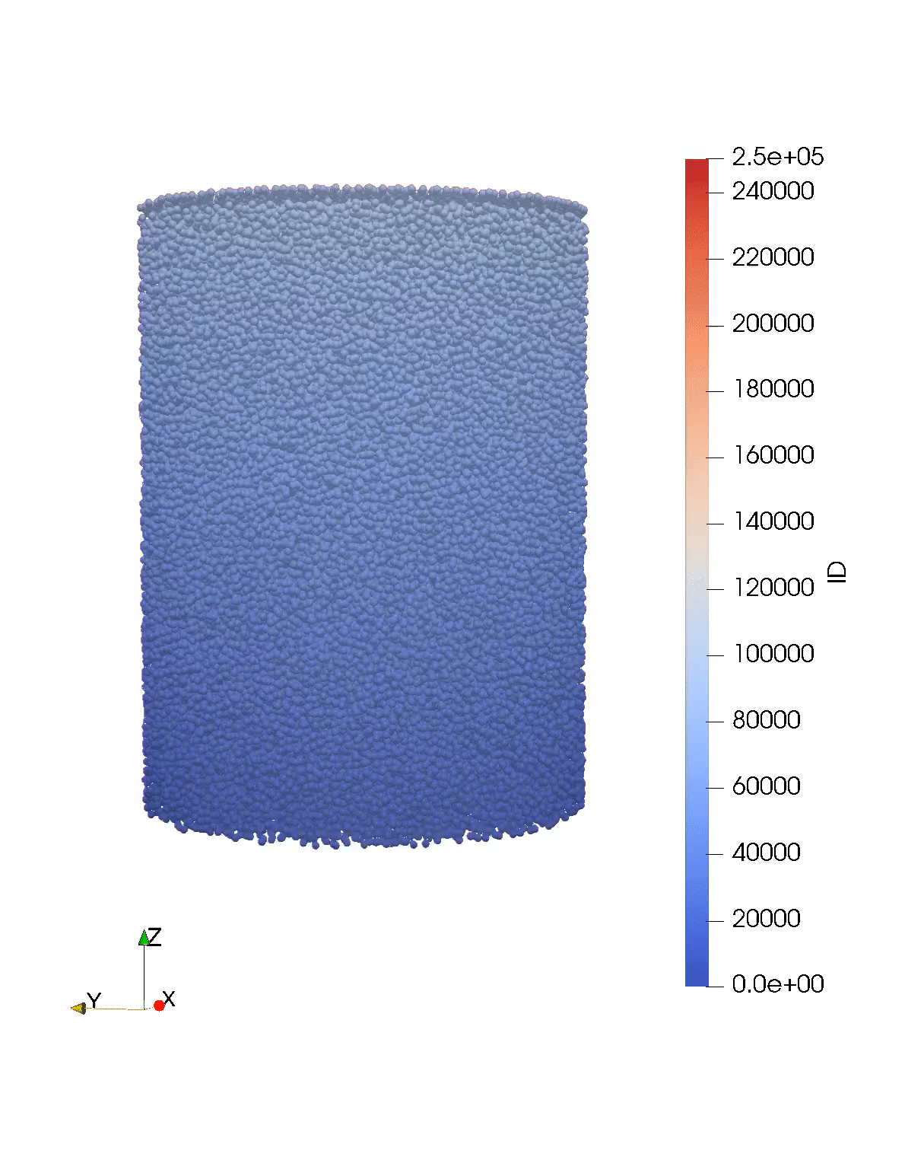
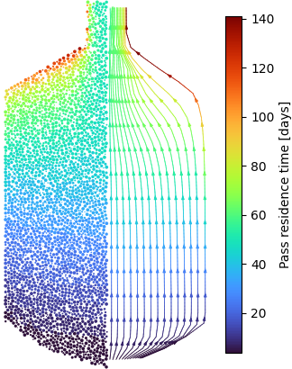
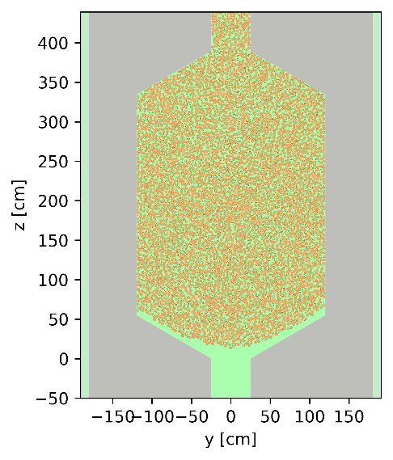
PBR-DEME can feed Serpent (HxF) or lower-fidelity methods
DEM results for gFHR-like model with defueling chute (250,190 pebbles,
60% PF).
Average trajectories and pass residence times
(representative slice).
Serpent model at a given time step
(representative slice).
Notes:
Applying this to an FHR model with 250,000 pebbles, we obtain trajectories and positions evolutions.
This is very valuable, both for HxF and lower-fidelity methods.
The plot you see on the right is the Serpent model with the positions obtained from the DEM fed into it at a given time step.

Slide 9
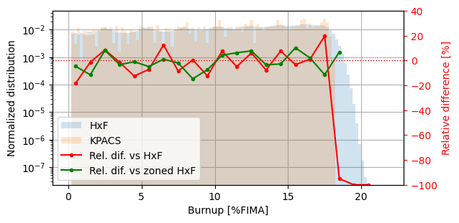
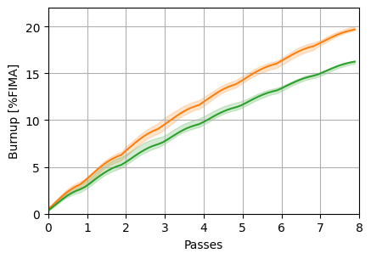
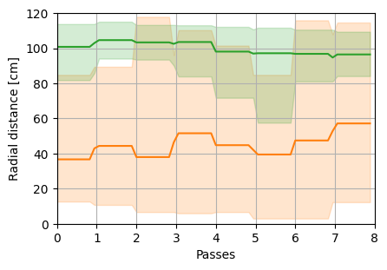
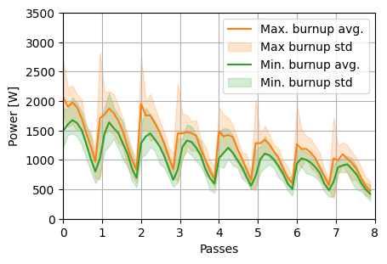
HxF generates high-fidelity equilibrium data
Reaching equilibrium: approximately 3–7 days on a large cluster
Once equilibrium is found: continue running to obtain data (burnup, flux distribution, isotopics)
Equilibrium compositions:
Different from simplified methods
Highly dependent
on trajectories
Comparison between lower-fidelity (KPACS)
and HxF.
Equilibrium thermal flux for gFHR model.
Trajectory-dependent burnup and powers.
Notes:
HxF was used in the past for the gFHR, which is a purely cylindrical core.
First, we reach the equilibrium, which is the most time-consuming part of the simulation. We wait for the core’s k_{eff}, global inventory, and flux and power distributions to converge.
So, we simulate transport, deplete nuclides, move the pebbles, proceed to monitoring, discard old fuel and insert fresh fuel, and do it again many times for multiple passes.
Once the equilibrium is reached, this simulation keeps going, and we can record each equilibrium snapshot and aggregate the data.
One valuable insight from the results is that if we compare with simplified methods in terms of burnup distributions, we see that these lower-fidelity methods fail to capture outliers well.
The plot you see here shows the comparison between HxF and KPACS, developed by Kairos Power, which is considered on the higher end of accuracy.
I did not include it here, but differences in compositions and power distributions are also observed in core.
The beauty of having very granular data is that we can follow pebble histories individually.
Here, I take an average of the pebbles with the highest (> 19.5 %FIMA) and lowest (< 16.5 %FIMA) discharge burnup and see their power history and the trajectories they had in the core.
We see that the higher powers giving higher discharge burnups are due to a more central radial position, whereas the lowest powers are found for pebbles in the intermediate radial regions.

Slide 10
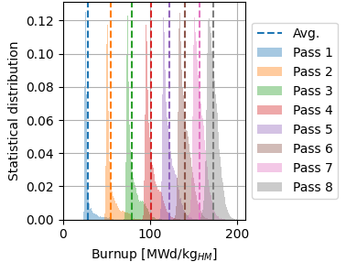
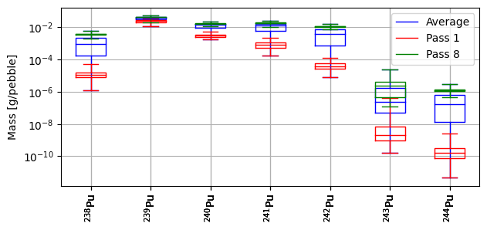
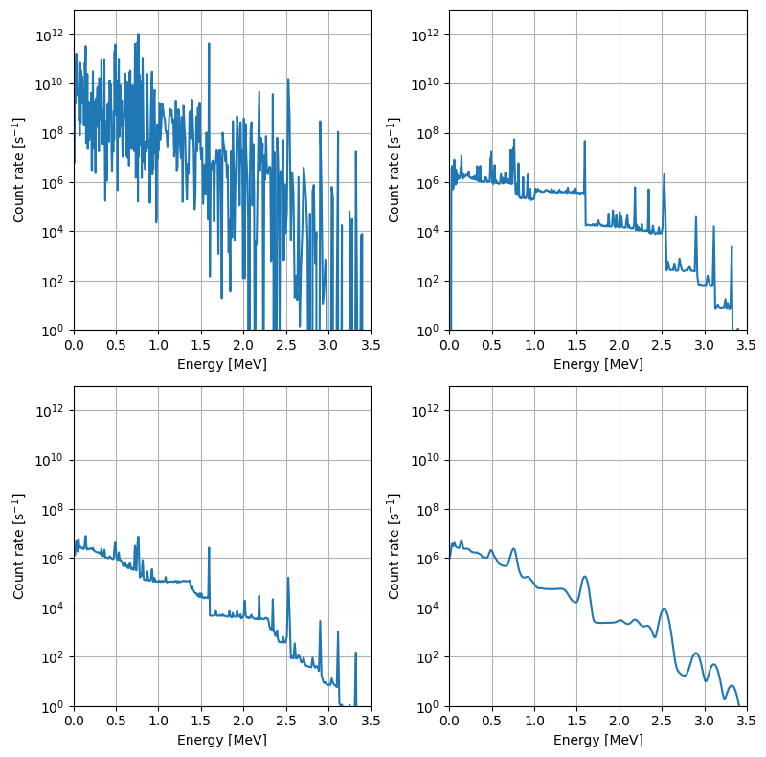
Pebble-wise discharge inventory can be extracted/analyzed
Discharged fuel analysis:
Cumulative burnup, fluence
Nuclide inventory
History: trajectory, power, flux, etc.
Potential for safeguards:
Plutonium vector
Gamma emission spectrum
→ detector
Enhance monitoring without extra physical measurements (ML)
Other applications:
Fuel performance
Waste management
ML for operation and
inventory projections
Equilibrium plutonium vector for gFHR
discharged pebbles.
Discharge burnup distributions per pass at equilibrium.
Pebble inventory
burnup history
Gamma spectra (emission/detection) in average HTR-10 discharged pebble (NaI detector, 3 days decay before measurement).
Notes:
We can also record the content of the pebbles that were discharged or discarded, such as burnup, fluence, their nuclide inventory or history, similar to what I showed in the last slide.
This gives us very important insights for design, operation, and safety as well as for safeguards.
For instance, because we have access to the nuclide inventory here, you can see the plutonium vector for the core that I showed you earlier, depending on the pass number.
This plot is simple but contains the data from millions of discharged pebbles at once, with unique sets of trajectories.
Another application, very relevant here, is that we can generate accurate gamma emission spectra from the discharged nuclide inventory.
Here, for example, we generated the gamma spectra from Serpent directly for an HTR-10 equilibrium core and simulated the measured response of a sodium iodine detector.
Of course, I pointed out the potential use for safeguards, but many other applications are possible, including fuel performance, waste management, or machine learning for projecting inventory during operation.

Slide 11
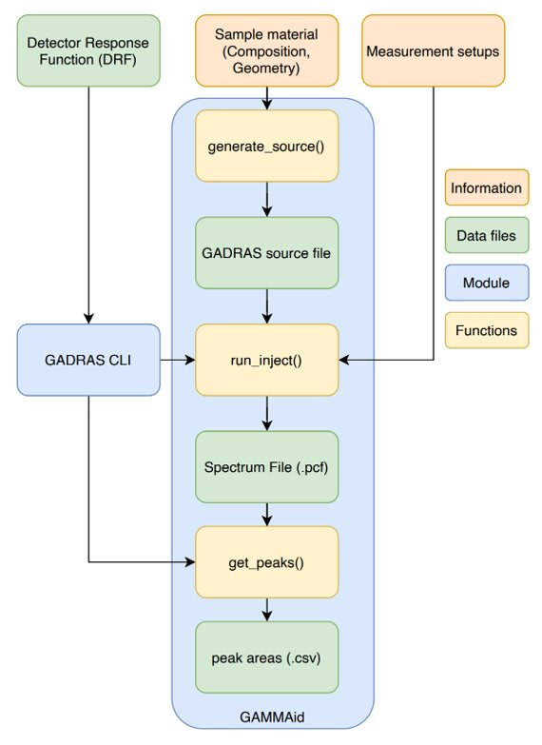
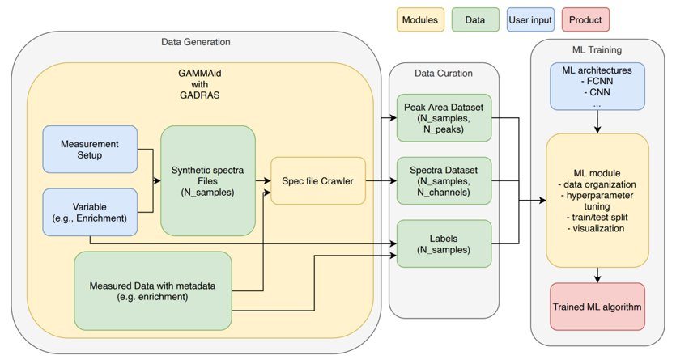
GammaID: Data framework for gamma spectra generation and training

Slide 12
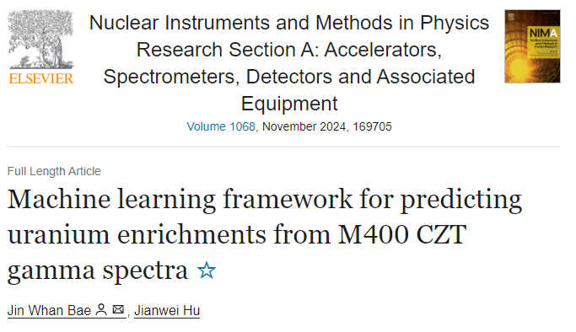
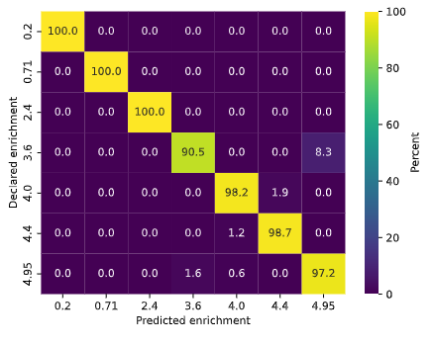
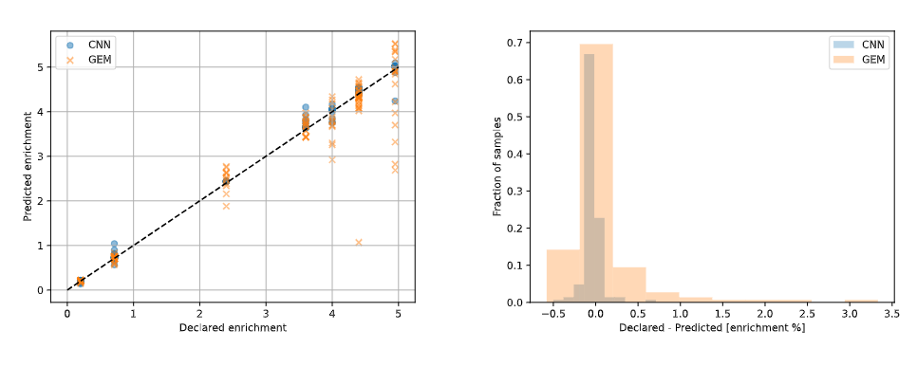
GammaID Demonstrated on a campaign of UF₆ measurements to use gamma spectra to predict enrichment
Can classify measured UF₆ sample enrichments with 98.3% accuracy
Outperforms GEM code in predictions of ²³⁵U enrichment in UF₆ cylinders

Slide 13
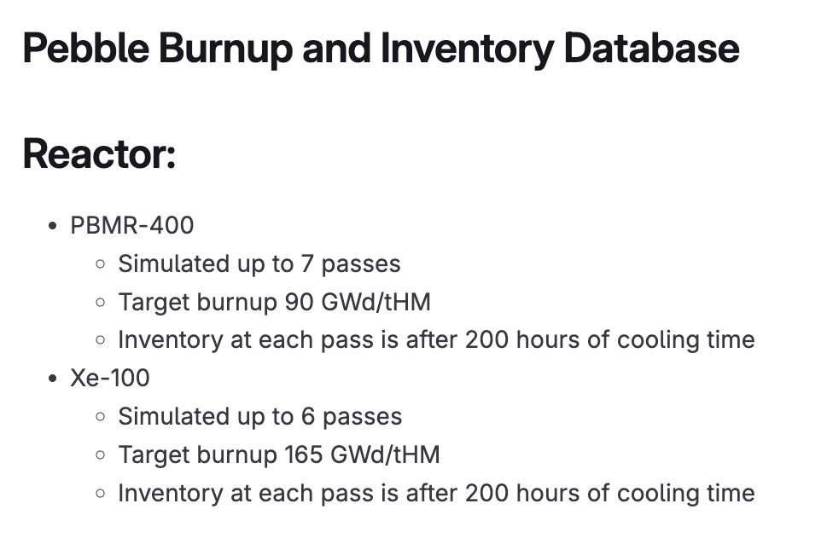
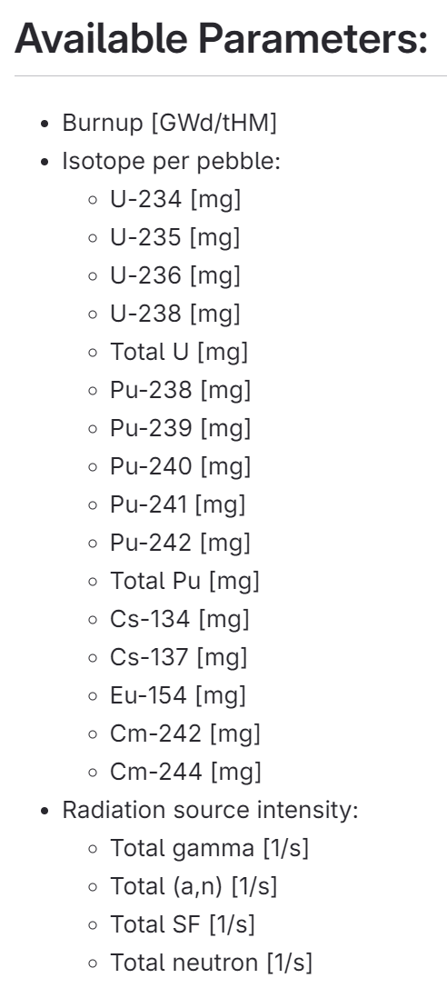
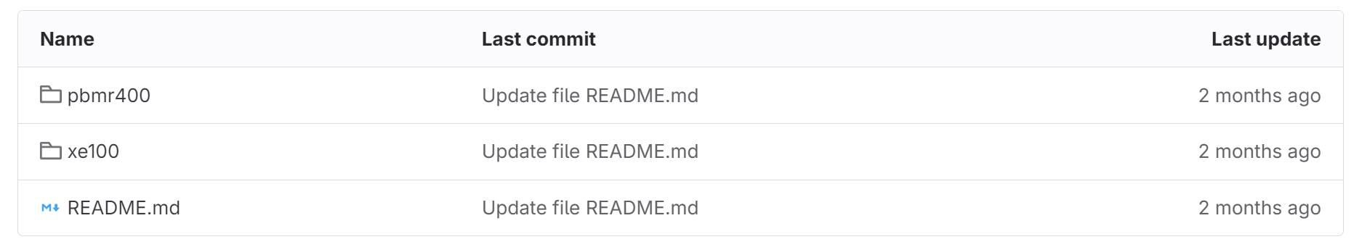
Leveraging the database generated from previous presentation

Slide 14
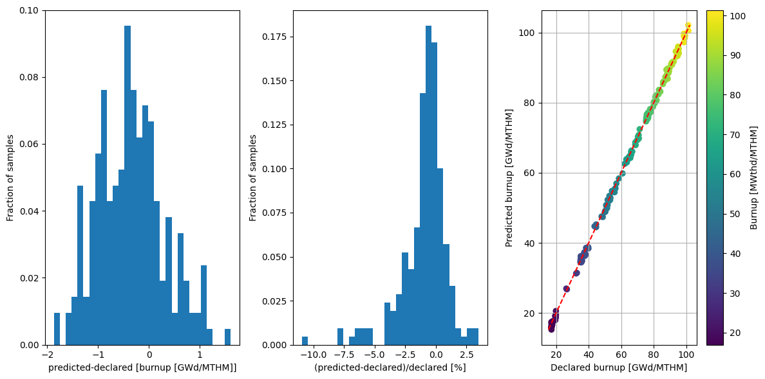
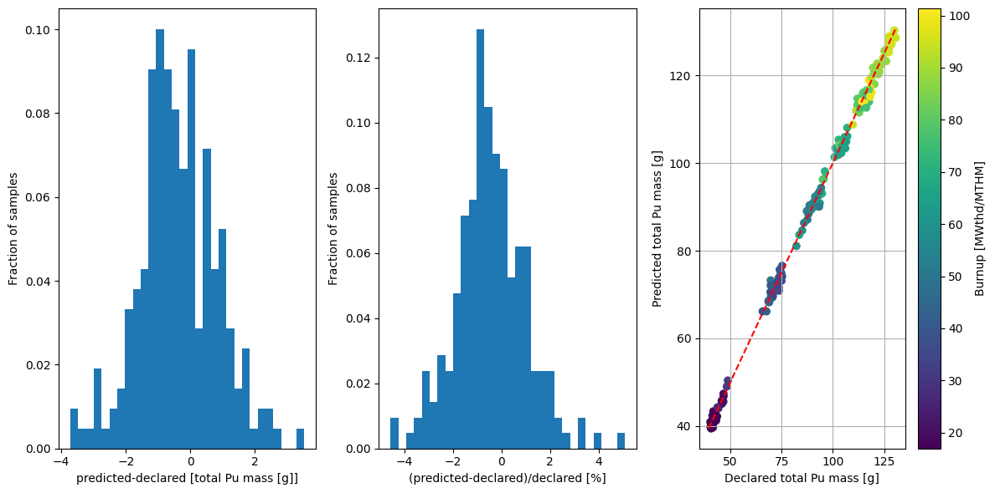
Using whole-spectrum convolutional neural network (CNN): burnup and Pu mass predictions

Slide 15
Using CNNs
 |  | Cs peak ratio linear regression | Whole-spectra CNN (only test data)
Avg. absolute relative error [%] | Burnup | 5.81 (± 9.55) | 1.38 (± 1.58)
 | U mass | 0.29 (± 0.24) | 0.08 (± 0.06)
 | Pu mass | 6.10 (± 5.81) | 1.17 (± 0.095)
 | Fissile mass | 10.00 (± 7.81) | 1.53 (± 1.59)
Avg. absolute error | Burnup | 2.20 (± 1.94) | 0.60 (± 0.42)
 | U mass | 21.25 (± 18.52) | 6.31 (± 4.57)
 | Pu mass | 4.78 (± 3.63) | 1.00 (± 0.75)
 | Fissile mass | 25.90 (± 18.96) | 3.73 (± 3.15)
Train on the entire spectra
  2,300 channels
  1,400 samples
Outperforms Cs peak ratio method

Slide 16
Previous work on MSRs
Salt processing modeling
  Discrete processing
  Continuous processing
Salt advection modeling
  Time-dependent flux exposure impact

Slide 17
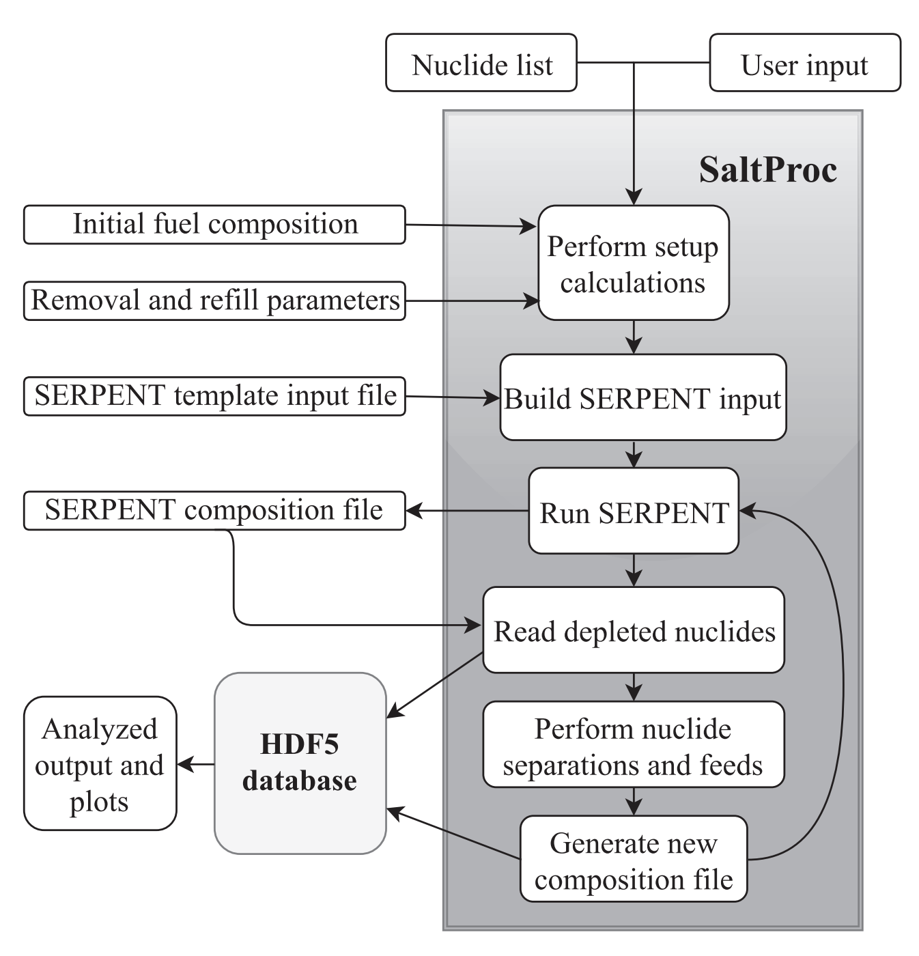
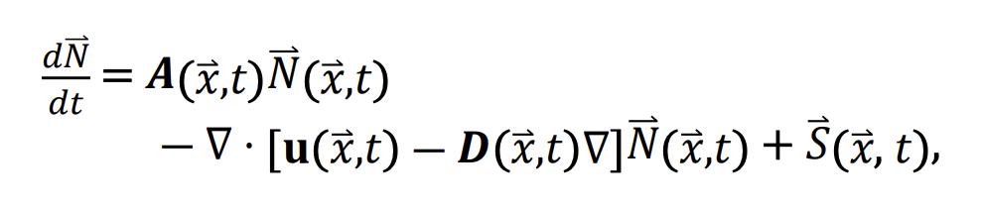
Discrete and continuous salt processing modeling
Salt processing (removal of fission products, addition of fertile/fissile) can be modeled by:
  Discrete: step by step (flux calculation → depletion → processing of composition → repeat)—Andrei Rykhlevskii, Jin Whan Bae, Katy Huff
  Continuous: embedding removal/source term into Bateman equation—Benjamin Betzler, Jin Whan Bae

Slide 18
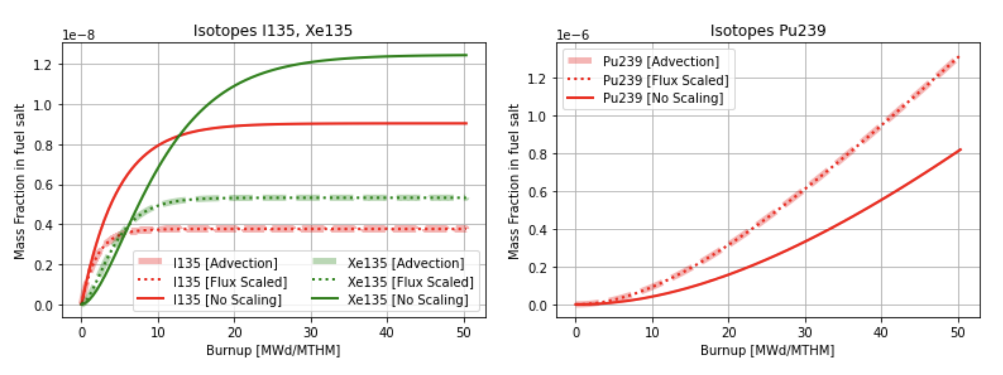
Advection modeling—considering fuel salt flowing in and out of core is highly impactful for inventory calculations
Approximations can be made by scaling (reducing) the flux magnitude by:
  In core residence time / (in core + out core residence time)
Flow rate can control fission product equilibrium inventory oscillation, delayed neutron precursor, etc.

Slide 19
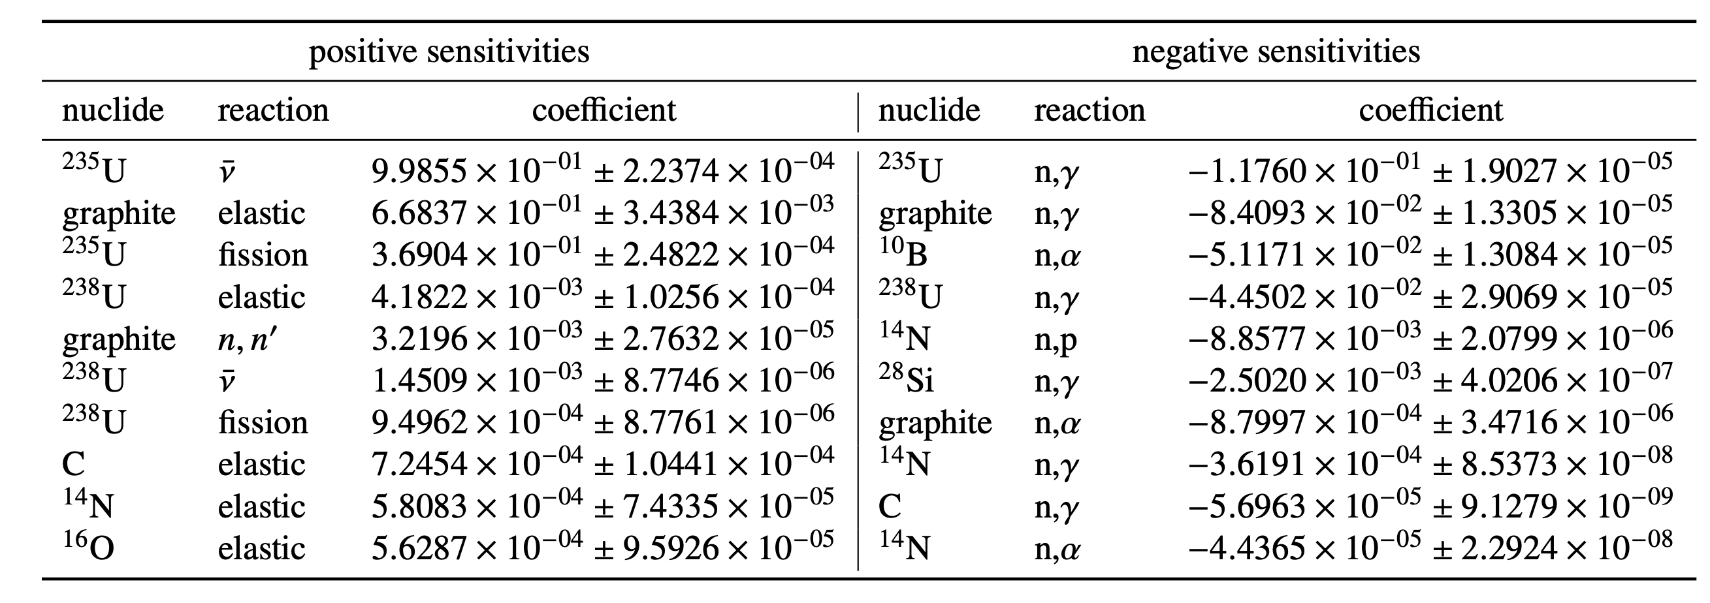
Nuclear data uncertainty propagation
Using SCALE/Sampler for nuclear data sensitivity + uncertainty propagation
Friederike Bostelmann, Germina Procop, Rabab Elzohery
Calculating sensitivity coefficient and using nuclear data covariance matrix
Can identify important and impactful data:
  Important: high sensitivity
  Impactful: high/low sensitivity, high covariance → stronger impact to total uncertainty

Slide 20
Advanced reactor inventory modeling is difficult and requires a coupled multiphysics simulation for accuracy
Some advanced reactors have a lot more than just burnup and initial enrichment to consider
A lot more variables (e.g., flow rate, number of passes) can impact composition
Focusing on uncertainty reduction and propagation
  Addressing most impactful parameters and understanding impact
    e.g., modeling TRISO particles explicitly or modeling pebble locations explicitly
    How impactful is mixing of fuel inventory in MSR to inventory calculations?
  Nuclear data uncertainty propagation
Developing reference solutions and testing approximations/accelerations for practical use
  Multiphysics coupling

Slide 22
LWR fuel depletion is batched, static
Get power curve, assembly location
Get flux on assembly location, scale by power
2-step approach of lattice model → core model
  Get pin-wise power distributions for more accurate burnup calculation
Small complications with burnable poisons, integral fuel burnable absorbers (IFBAs), wet annular burnable absorbers (WABAs)
Most isotopic nuclear data well known, small uncertainty

