Slide 1
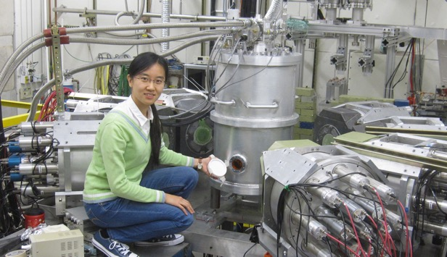
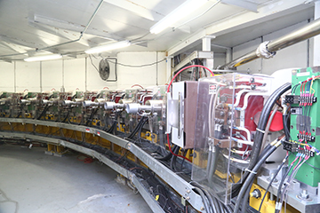
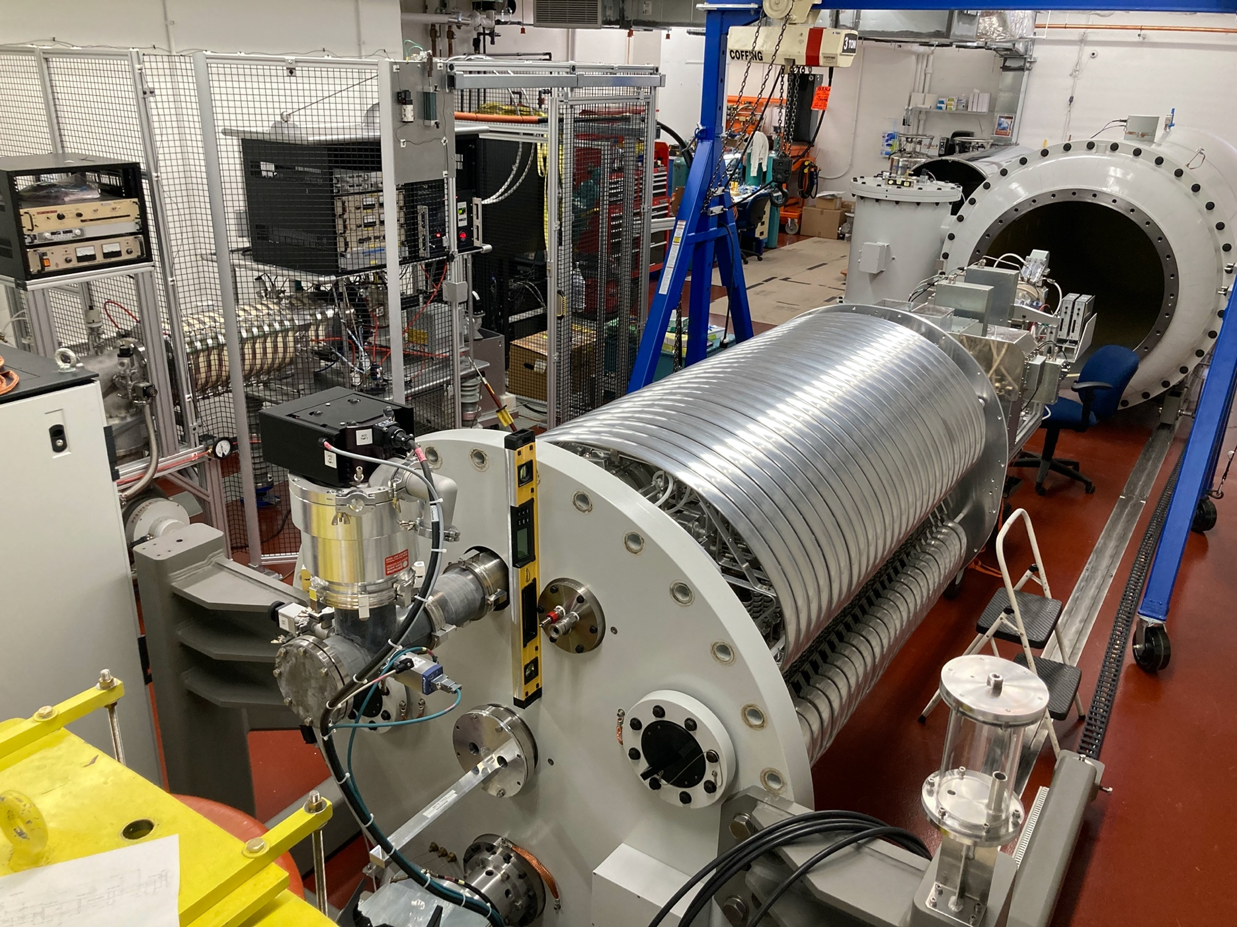
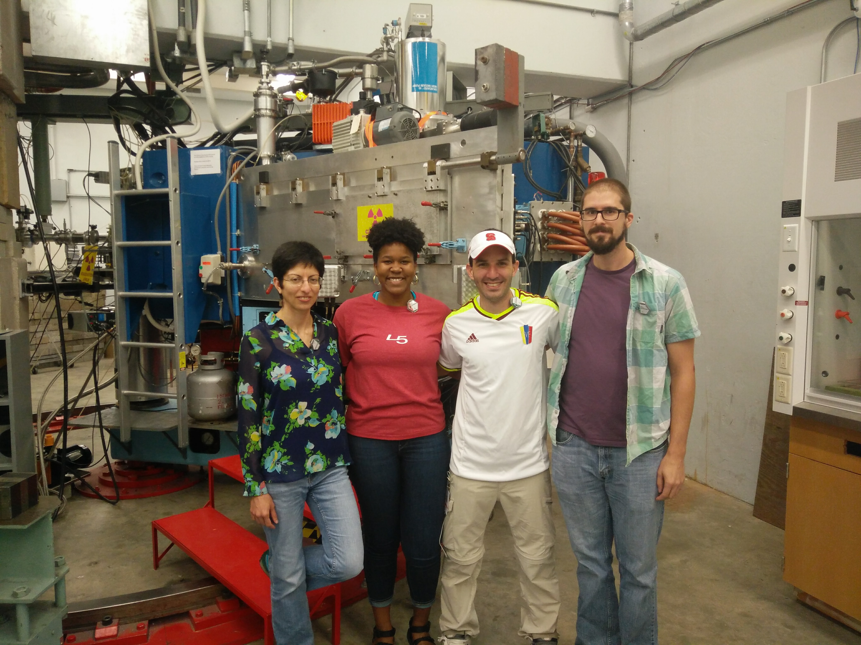
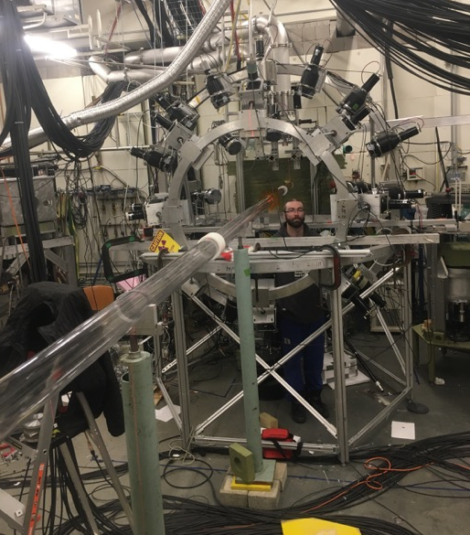
Gamma-ray and Neutron Beam Research Infrastructures at TUNL
Triangle Universities Nuclear Laboratory
Duke University, NC Central University, NC State University, and the University of NC at Chapel Hill
DOE Center of Excellence
Educates ~8% of the nation’s PhDs in experimental nuclear physics
Accelerator Facilities
High Intensity Gamma-ray Source (HIGS)
Laboratory for Experimental Nuclear Astrophysics (LENA)
Tandem Accelerator Laboratory
Research Areas:
Nuclear Structure and Fission
Nuclear Astrophysics
Low-Energy QCD
        Nucleon Structure
        Few-Nucleon Systems
By: Calvin R. Howell
Duke University/TUNL

Slide 2
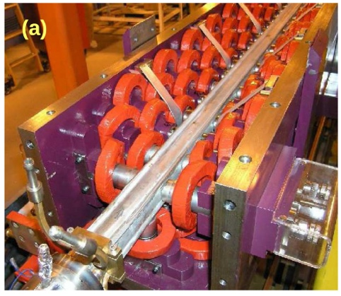
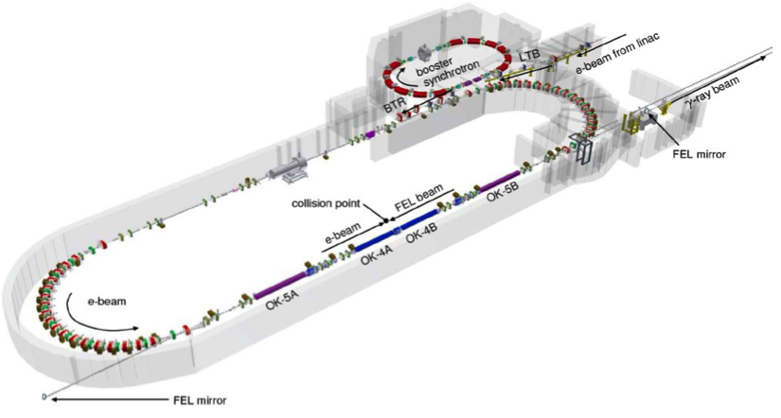
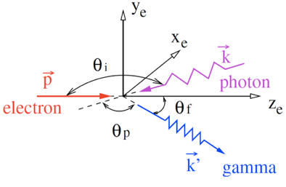
High Intensity Gamma-ray Source (HIγS)
Features that enable basic and applied research
Wide beam energy range: 2 to 110 MeV
Selectable beam energy spread (by collimation)
High beam intensity on target (>10⁷ γ/s @ ΔE/E = 5%)
>95% beam polarization (linear and circular)
1.2 GeV Storage Ring FEL
Beam time structure:
T = 180 ns and Δt = 300 ps
Energy resolution by collimation
mirror
γ-ray flux → I_{e} * P_{oc}
(2γ)²
53 m
Example:
E_{e} = 800 MeV ➔ γ = 1566
λ_{FEL} = 193 nm
E_{FEL} = 6.43 eV
E_{γ} = 63.1 MeV
Enhancements underway
Upgrade of Linac RF system
FEL cavity mirror R&D

Slide 3
HIGS: Beam Flux Performance and Requesting Beam Time
Requesting Beam Time
Nuclear Physics Research
  Proposals for beam time are reviewed by the HIGS Program Advisory Committee (PAC)
  PAC meetings are held about every 18 months
  PAC approved experiments are offered to scheduled for beam time within two years of approval
  An example of proposal solicitation is given at https://tunl.duke.edu/higs-pac-2025
Non-NP Projects
  Contact the TUNL Director

Slide 4
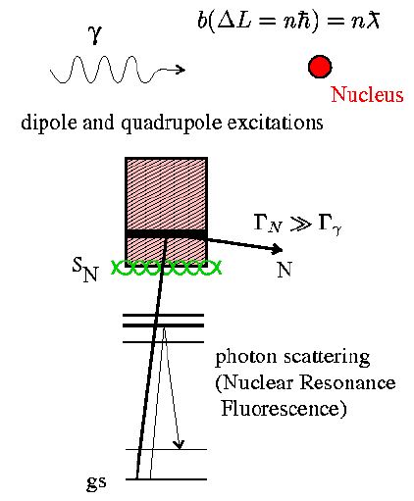
Overview of Research at HIγS
HIγS operates about 1500 hours/year for nuclear physics research
Low-Energy QCD:
Compton Scattering
nucleon electric and magnetic polarizabilities
nucleon spin polarizabilities
Few-nucleon Systems
photodisintegration of ²H, ³He and ³H (cross sections, target-beam helicity dependent cross sections, polarization transfer)
60 MeV ≤ E_{γ} < 110 MeV
E_{γ} ≤ 30 MeV
Many-body Strongly Interacting Systems:
Nuclear Structure and Nuclear Astrophysics
NRF, (γ,γ’)
(γ,n), (γ,p), (γ,α) and (γ, fission) reactions
Applied Research:
Nuclear Security
Medical Isotope R&D
γ-ray Detector R&D
Figure from 2007 USA Nuclear Science LRP

Slide 5
HIGS: Layout of Target Rooms
γ-ray beam
Beam flux monitors

Slide 6
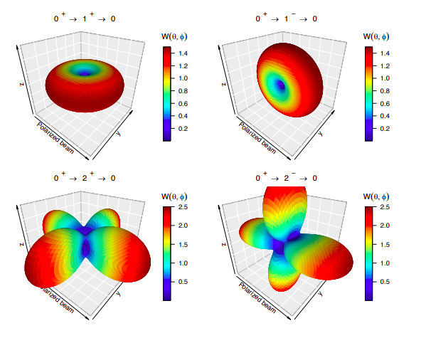

HIGS: Nuclear Resonance Florescence (NRF)
For a nucleus with a 0⁺ ground state, mainly spin-1 states are excited.
Elastic decays occur via gamma emission following well-defined angular distributions depending on the spin/parity of the state
Linearly polarized beam enables measurement of the parity, as well
1^{+/-}
2⁺
0⁺
Inelastic
Elastic
Examples of angular correlations $W\left(θ,φ\right)$ for elastic transitions
C. Iliadis and U. Friman-Gayer, EPJ A 57, 190 (2021).

Slide 7
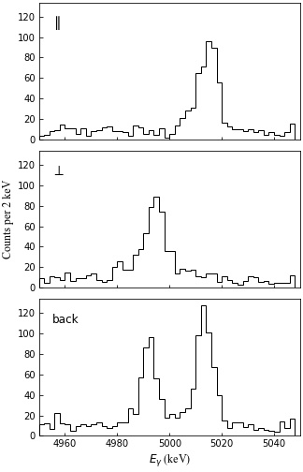
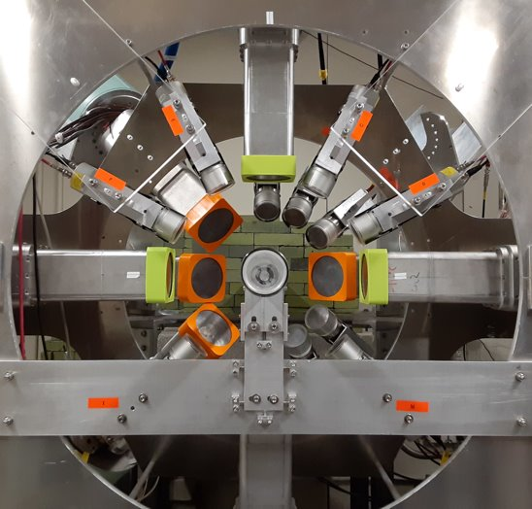
Clover Array at HIGS
Clover Array​
Beam direction: into page
8 clover-type HPGe
12 CeBr₃ scintillators
Notes:
Detectors in strategic positions to distinguish these patterns

Slide 8



HIGS: Example of gamma-ray cascade measurement
J. Isaak and N. Pietralla, Probing Nuclear Structure with Photon Beams, Handbook of Nuclear Physics, doi:10.1007/978-981-15-8818-1_2-1 (2022)
Photon Strength Function
¹²⁸Te
$$2_{1}^{+}→0_{1}^{+}$$
¹²⁸Te
²²⁸Ac
$$4_{1}^{+}→2_{1}^{+}$$
$$2_{2}^{+}→2_{1}^{+}$$

Slide 9
HIGS: NRF with radioactive targets
²⁴⁰Pu target (~4.7g)

Slide 10
HIGS: Cumulative Fission Project Yield (FPY) Measurements via activation
Cumulative FPYs:
Monitor reactor operation
Post-event forensics
Calculation of ν energy spectrum from reactors
¹⁴⁵Ce
²³⁹Pu*
¹⁴⁴Ce
γ
34.8%
γ
Isotopes with medium length half-lives
Short-lived isotopes

Slide 11
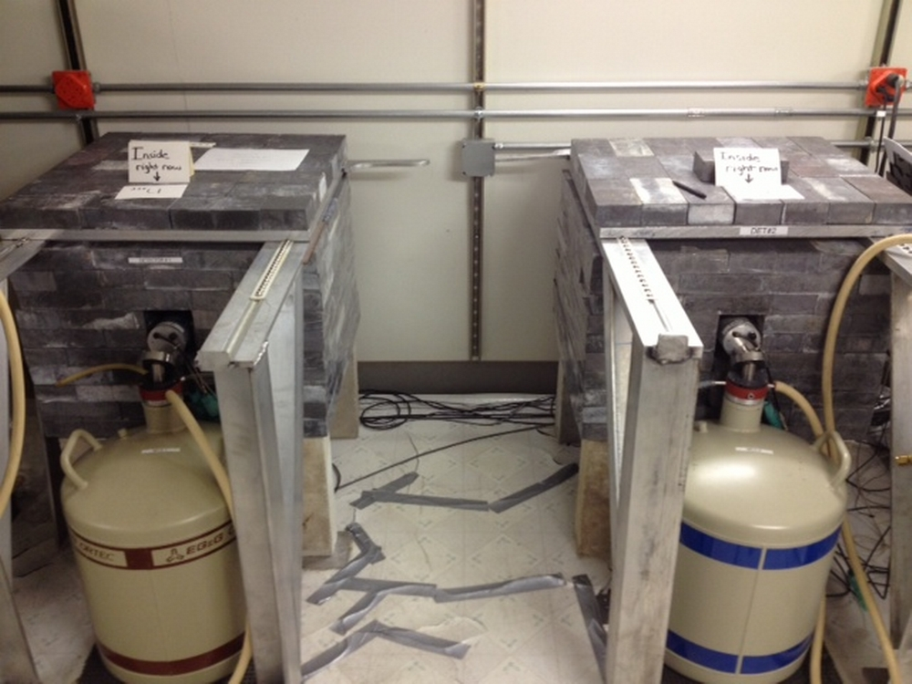

HIGS: Cross-section Measurements Using Sample Activation Technique
TUNL: Low-Background Counting Facility
Sub-basement of Duke Physics building
TUNL: RApid Belt-driven Irradiated Target Transfer System (RABITTS)
T_{1/2} > 20 minutes
1 second < T_{1/2} < 20 minutes
Kollmorgen/Automations
Max linear speed = 10 m/s
Positioning precision = 33 μm

Slide 12
HIGS: Facility and Research References
Facility:
C. Sun et al., Energy and energy spread measurements of an electron beam by Compton scattering method, https://doi.org/10.1103/PhysRevSTAB.12.062801
H.R. Weller et al., Research opportunities at the upgraded HIS facility, https://doi.org/10.1016/j.ppnp.2008.07.001
NRF:
W. Tornow et al., Measurement of magnetic dipole strength in 40 Ar between 9.3 and 10.3 MeV excitation energy and impact on neutral current neutrino interaction, Phys.Rev. C 112 (2025) 5, 054320, https://doi.org/10.1103/55xh-b4f7
O.Papst, Deviations from the Porter-Thomas Distribution due to Nonstatistical 𝛾 Decay below the ¹⁵⁰Nd Neutron Separation Threshold, Phys.Rev.Lett. 135 (2025) 5, 052501, https://doi.org/10.1103/n6zw-zhz2
D. Savran et al., Transition width of the 𝐽^{𝜋} =1− two-phonon state of ⁸⁸Sr, https://doi.org/10.1103/PhysRevC.110.024312
J. Kleemann et al., Gamma Decay of the ¹⁵⁴Sm Isovector Giant Dipole Resonance: Smekal-Raman Scattering as a Novel Probe of Nuclear Ground-State Deformation, 10.1103/PhysRevLett.134.022503
Activation:
I. Tsorxe et al., Measurements of short-lived fission product yields from photofission of ²³⁸U using 13.0 MeV monoenergetic photons, Phys. Rev. C 113, 024603, https://doi.org/10.1103/57zl-ks5z
J. Song et al., Photonuclear cross sections for ¹⁹⁷Au: An update on the gold standard, https://doi.org/10.1103/PhysRevC.110.064604
Krishichayan et al., Fission product yield measurements using monoenergetic photon beams, 10.1103/PhysRevC.100.014608
S.W. Finch et al., Development of a rapid-transit system for precision nuclear physics measurements, 10.1016/j.nima.2021.166127

Slide 13
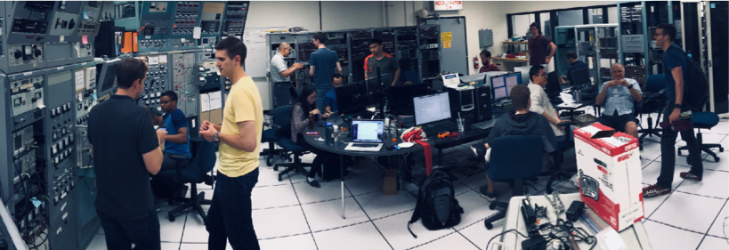
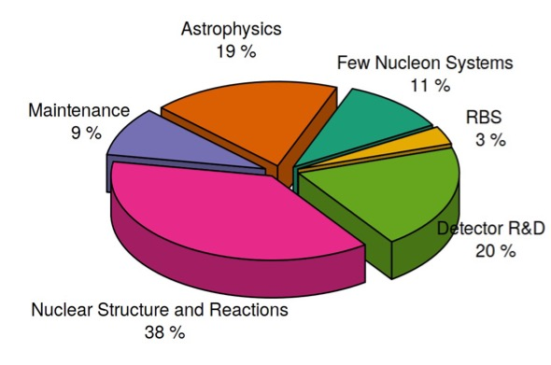
Tandem Accelerator Laboratory: Shared resource
Maintained by technical staff
Operated by researchers
Scheduled quarterly
Offers students hands-on holistic research experience: experimental nuclear physics + beam deliver optimization
Period: July 2017 – March 2020
Days scheduled = 698 (71% scheduled)
Total hours run = 8,873

Slide 14
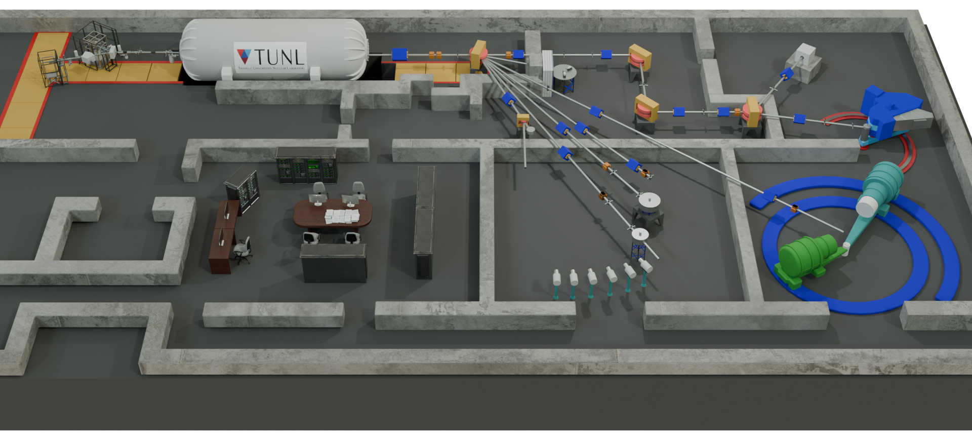
Tandem Accelerator Laboratory
Beam Injector Upgrade
(1) TORVIS: Toroidal Volume Ion
Source by the NEC
100 μA of H⁻
40 μA of ⁴He⁻ and ³He⁻
Pulsed or DC
(2) SNICS II: Source of Negative Ions by Cesium Sputtering
TORVIS
Light-ion beams: p, d, ³He, ⁴He
Medium-mass ions: from SNIC
Secondary beams: n
Injector Line
SNICS II
Target Implanter
Station

Slide 15
Tandem Accelerator Laboratory: Neutron Beam Areas
Shielded Neutron Source: collimated beam
Open Neutron Source
Neutron Source Reactions
E_{n} = 60 keV, 500 – 600 keV; ⁷Li(p, n)
E_{n} = 1 – 4 MeV; ³H(p, n)
E_{n} = 5 – 16 MeV; ²H(d, n)
Pulsed and DC beams available
Δt_{cp} < 2.0 ns FWHM

Slide 16
Tandem Lab: Example of n-n coincidence measurement
E_{n} = 15.6 MeV
θ₁ = θ₂ = 40∘

Slide 17
Tandem Lab: Research Examples
Few-Nucleon:
R.C. Malone et al., Measurement of the ¹S₀ neutron-neutron effective range in neutron-deuteron breakup, 10.1016/j.physletb.2022.137557
R.C. Malone et al., Neutron-neutron quasifree scattering in neutron-deuteron breakup at 10 MeV, 10.1103/PhysRevC.101.034002
Neutron-induced Fission:
M.E. Gooden et al., Energy dependence of fission product yields in the second-chance fission region, 10.1103/PhysRevC.109.044604
A.P.D Ram et al. Fission product yields from the ²³⁸U(n,f) reaction at En=4.6 MeV, 10.1103/PhysRevC.107.054608
Neutron Scattering:
D. Cintas et al., Measurement of the sodium and iodine scintillation quenching factors across multiple NaI(Tl) detectors to identify systematics, 10.1103/PhysRevC.110.014613
W. Tornow, S.W. Finch and M.F. Kidd, Potential neutron-induced γ -ray background on natural tellurium relevant to
¹³⁰Te 0νββ decay searches at the CUORE and SNO+ detectors, 10.1103/PhysRevC.103.044612
S. MacMullin et al., Measurement of the elastic scattering cross section of neutrons from argon and neon, 10.1103/PhysRevC.87.054613

Slide 18
Support Acknowledgement
Department of Energy, Office of Nuclear Physics
Grant #: DE-FG02-97ER41033
Thank you

