Slide 2
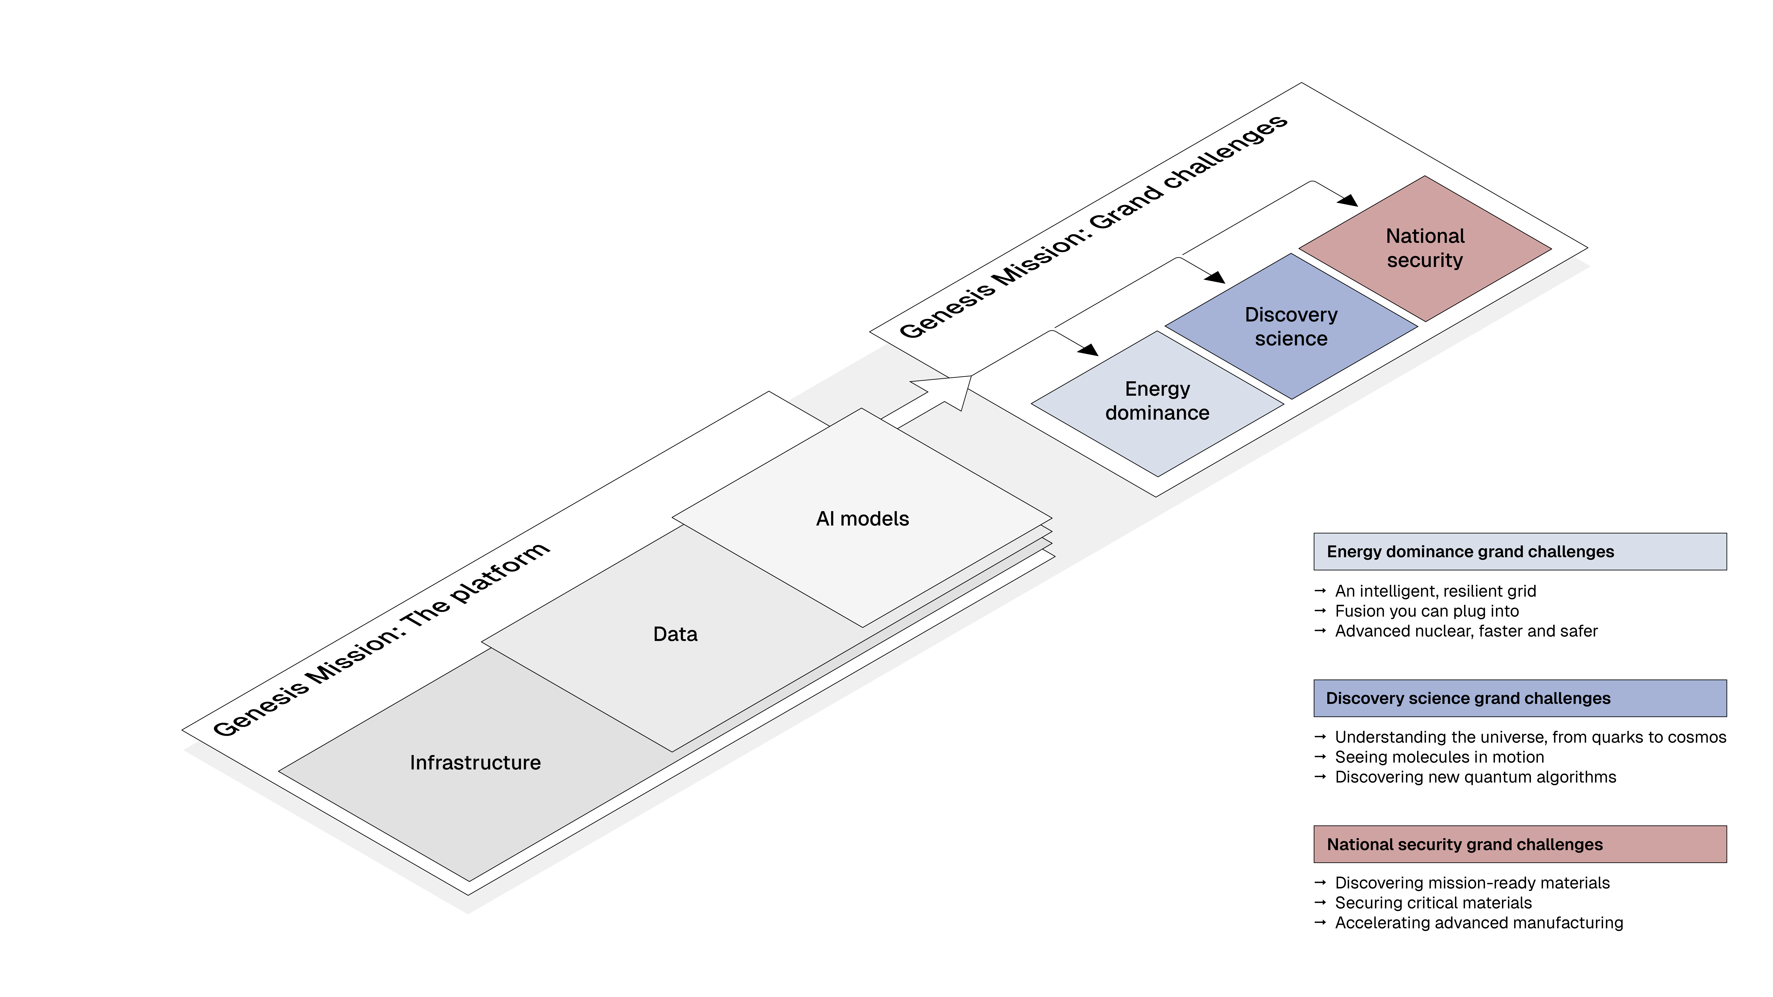
Genesis Mission Overview

Slide 3
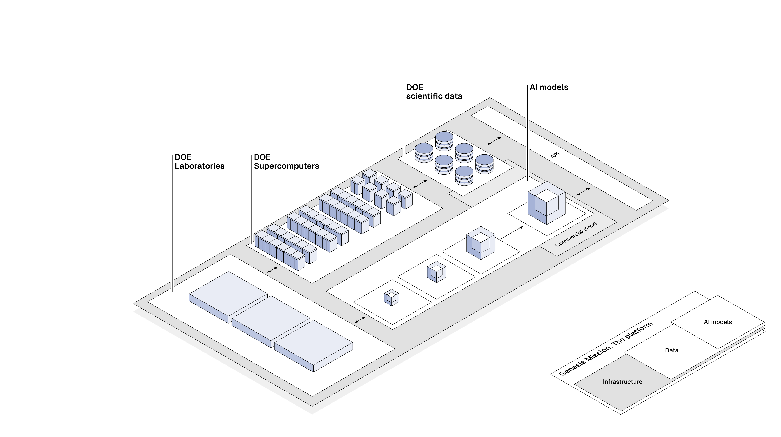
Platform Infrastructure

Slide 4
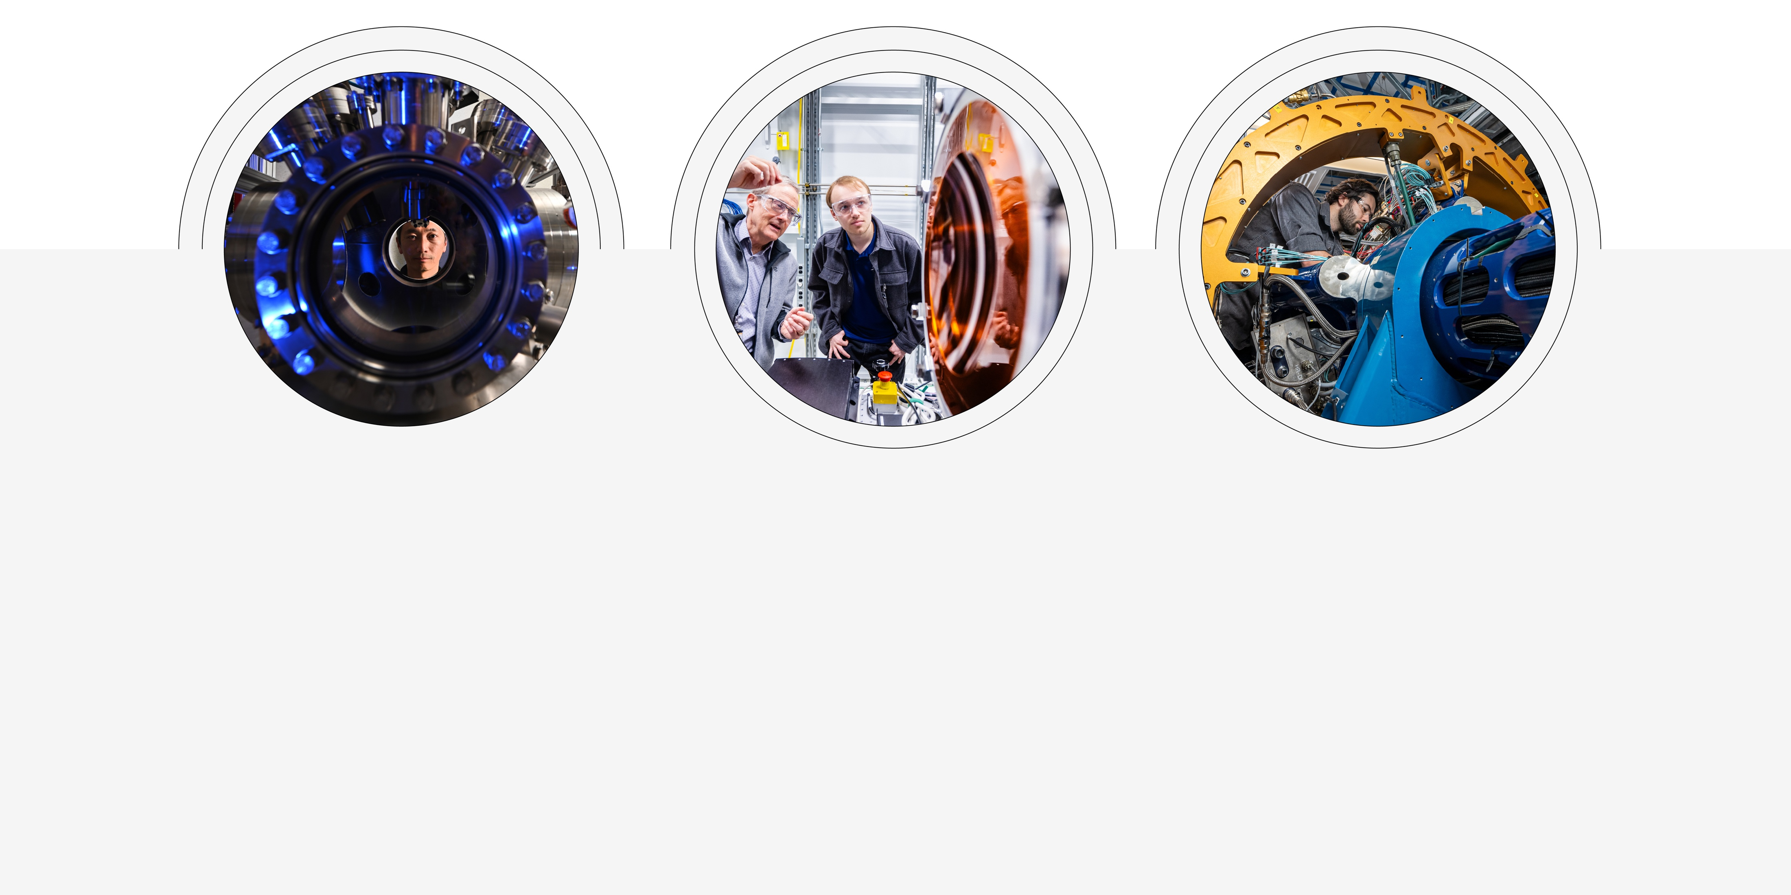
Grand Challenges
Energy
AI will be used to accelerate sustainable fusion power, optimize advanced nuclear reactor design and operation, and enable a more intelligent and resilient electrical grid.
Discovery Science
AI will be used to illuminate molecular dynamics, unify data to understand the universe from quarks to cosmos, and generate new quantum algorithms.
National Security
AI will be used to secure critical materials, accelerate advanced manufacturing, and discover mission-ready materials for defense and industry.

Slide 5

Addressing a Portfolio of Key National Challenges
Accelerating scientific
discovery through AI-driven
code development
AI driven co-design for microelectronics
AI for efficient quantum
algorithms
AI for planning and operation
of the U.S. power grid
AI for transforming combustion science and technology for energy applications
AI for nuclear security and non-proliferation
Q2C Science at Scale: From Quarks to Cosmos
The Autonomous Microelectronics Consortium
R Accelerating Microelectronics Codesign (MTv2-Microelectronics)
R MOAT: Multi-Office Accelerator Operations & Controls
PROMETHEUS: Autonomous Power Plant Design (APPD)
SYNAPS-I: Light and Neutron Imaging FM
GRID-UNI: Agentic AI Foundation for the U.S. Power Grid
R MAIQMag: Multimodal AI for Quantum Magnets
OPAL-OMAHA: Bio/Autonomous Labs
Fusion-FM: Foundational Model for Magnetic Confinement Fusion

Slide 6
