Slide 1
DOE Public Access and Data Management Requirements
February 2026
Michael Cooke
Senior Technical Advisor
Office of the Deputy Director for Science Programs

Slide 2
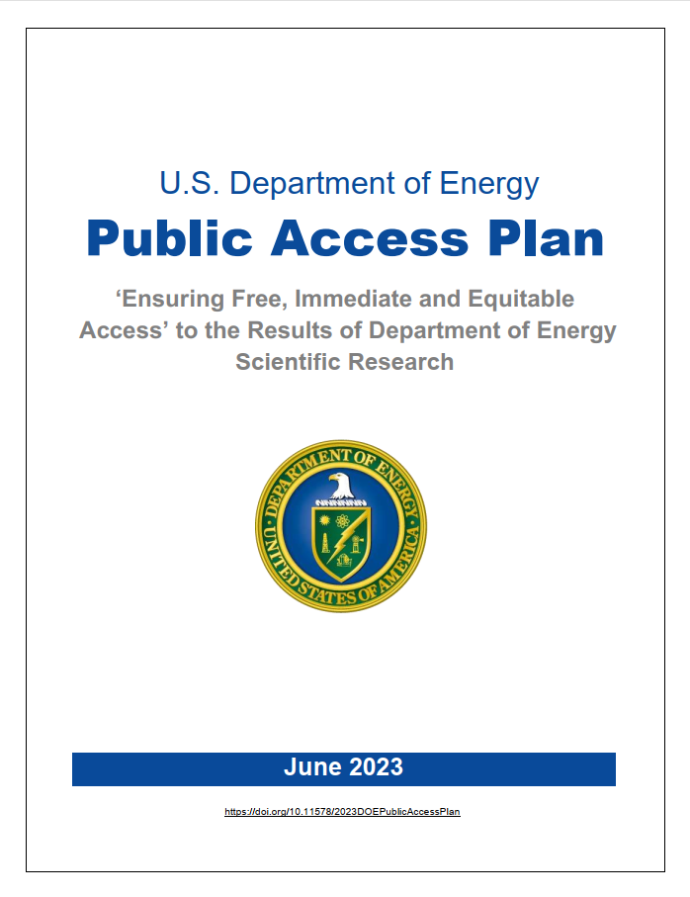
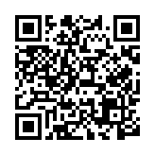
DOE Digital Data Management
2014 DOE Public Access Plan established Data Management Plan (DMP) requirements for sharing digital research data
  DMP requirements included in DOE solicitations and invitations for research funding since 2014
2023 DOE Public Access Plan introduces enhanced Data Management and Sharing Plan (DMSP) requirements for sharing digital scientific data
  New DMSP requirements became effective for DOE-supported R&D efforts beginning October 1, 2025
  All new solicitations and invitations for research funding will include DMSP requirements
Full plan and FAQ available at:
https://www.energy.gov/doe-public-access-plan
https://doi.org/10.11578/2023DOEPublicAccessPlan

Slide 3
2023 DOE Public Access Plan
Publications
Move from 12-month embargo to immediate access upon publication
Continue to submit accepted manuscripts via E-Link, but earlier in reporting process
Provide access through DOE’s designated repository, DOE PAGES®
Emphasize author deposits of accepted manuscripts (green OA) – DOE
Details in following slides…
Data
Now Data Management and Sharing Plans (DMSPs)
“Scientific Data” to validate and replicate research findings
Data underlying publications should be made available at time of publication
Timeline for sharing other scientific data
Repository selection should align with NSTC Desirable Characteristics of Data Repositories guidance
Persistent Identifiers
Collect metadata associated with publications and data
Metadata to include authors, affiliations and funding with associated PIDs, publication date, and PID for output
Instruct researchers to obtain a PID for themselves and use when publishing and reporting R&D outputs
Researcher PIDs must meet common/core standards
PIDs for awards
2023 DOE Public Access Plan: https://www.energy.gov/doe-public-access-plan

Slide 4
DOE Requirements for Digital Research Data Management
Increase pace of
scientific discovery
Protect integrity, enhance value of science
Scientific Data Management Principles
Maximize appropriate
data sharing
Data Management and Sharing Plan (DMSP) Requirements
Validation and replication of results
Timely and fair access
Data repository selection
Data management and sharing resources
Data sharing limitations
Full text of available on DOE Requirements and Guidance for Digital Research Data Management website
All DOE-funded R&D awards/contracts subject to a DOE-approved DMSP, require reporting of data
Implementation supported through commensurate budget for approved scope
Publicly shared data shared must be reported to the Office of Scientific and Technical Information (OSTI)
If needed, DMSP updates must be provided to DOE for review and approval

Slide 5
Data Management Requirements Updates
Highlighted changes from previous data management strategy
  Updated DOE principles emphasize aim to “maximize appropriate data sharing”
  “Data Management Plans” changed to “Data Management and Sharing Plans” to highlight sharing
  Reporting requirements aim to enhance compliance monitoring and evaluation metrics
Data Management Plan (previous) |  | Data Management and Sharing Plan (FY 26)
Scope is “Research Data” to validate research findings |  | Scope is “Scientific Data” to validate and replicate research findings
Data underlying publications should be made as accessible as possible |  | Data underlying publications should be made available at time of publication
No explicit requirement regarding other research data |  | Timeline for sharing other scientific data is required
No explicit requirement regarding repository selection |  | Repository selection should align with NSTC Desirable Characteristics guidance (next slide)

Slide 6
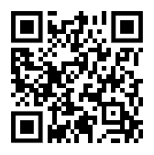
Desirable Characteristics of Data Repositories
Guidance by the National Science and Technology Council (NSTC)
Subcommittee on Open Science for federally funded research
  Improves consistency in instructions to researchers about selecting data repositories
  Helps ensure research data are findable, accessible, interoperable, and reusable (FAIR) to the greatest extent possible, while integrating privacy, security, and other protections
Organizational Infrastructure
Free and Easy Access
Clear Use Guidance
Digital Object Management
Unique Persistent Identifiers
Broad and Measured Reuse
Technology
Authentication
Long-term Technical Sustainability
Risk Management
Retention Policy
Long-term Organizational Sustainability
Metadata
Curation and Quality Assurance
Common Format
Provenance
Security and Integrity
Additional Considerations for Human Data
Fidelity to Consent
Security
Limited Use Compliant
Download Control
Request Review
Plan for Breach
Accountability
Desirable Characteristics of Data Repositories for Federally Funded Research, guidance by the NSTC Subcommittee on Open Science, published May 2022
6

Slide 7
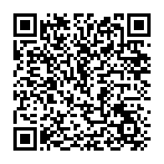
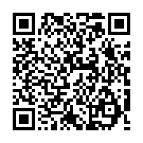
Guidance for Applicants
DOE DMSP Guidance
SC DMSP Guidance
DOE Req. and Guidance for Digital
Research Data Management
  Principles
  Data Management and Sharing Plan Requirements
  Reporting of Data Products
  Best Practices for Data Sharing
Writing a Data Management and Sharing Plan
  Suggested Elements of a DMSP
  Resources to aid developing a DMSP
Frequently Asked Questions
  Applicability of requirements
  What to include in a DMSP
  Data sharing and preservation
  Evaluation
Glossary
Links to DOE guidance
  Requirements
  Writing a DMSP
  Glossary
Guidance for Reviewers on Digital Data Management
  Sample questions for review
  Guidance for reviewer feedback
Additional Requirements and Guidance from SC Programs
Data Management Resources at Office of Science User Facilities
Frequently Asked Questions

Slide 8
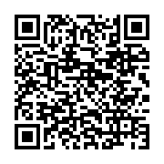
Suggested Elements of a DMSP
Data types, sources, and standards
Data security, preservation, and sharing
For each type of scientific data that will be used or generated, provide:
A general description of the nature and scope of the data
The amount of data processing and data standards/formats used
Anticipated amount or size of the data and timeline for production
Key metadata and documentation that will facilitate data interpretation
Provide plans and timelines for data security, preservation, and appropriate sharing, which may include:
Measures to ensure data security and integrity
A description of the shared subset(s) or reduced elements of the total data for each data type
Data repositories that will be used, including brief description of how each aligns with the NSTC "Desirable Characteristics”
How PIDs will be used to make the data findable and reusable
Timelines for sharing data not associated with a publication
Related tools, software, and code
Describe any code, software, or special tools needed to make use of the data, including to support validation and replication of results
Oversight of data management and sharing
Data access and reuse considerations
Describe how the implementation of the DMSP will be monitored and managed
Describe factors that limit public sharing of the scientific data. Consider ways to maximize appropriate sharing. Factors may include:
Targeted reuse cases for the scientific community or broader public
Protection of confidentiality, privacy, business info., and/or security
Negative impacts on IP, innovation, and U.S. competitiveness
Value of sharing and the associated cost and burden
Applicable laws, regulations, and DOE orders/policies
Full Suggested Elements plus
Resources to Aid Developing a DMSP available on Writing a Data Management and Sharing Plan website

Slide 9

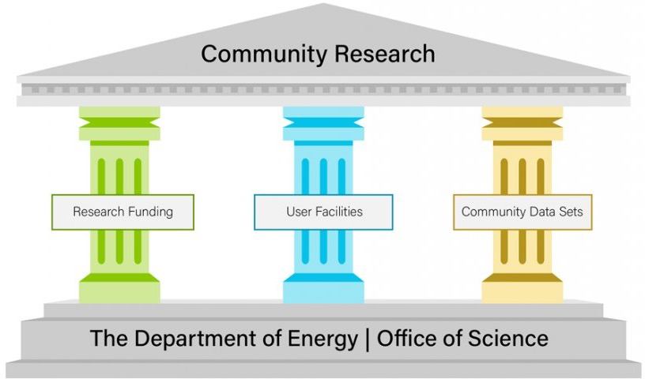
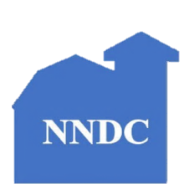






DOE PuRe Data Resources
Public Reusable Research (PuRe) Data Resources aim to make data publicly available in order to advance scientific or technical knowledge
https://science.osti.gov/Initiatives/PuRe-Data

Slide 10

Thank you!

