Slide 1
OpenAI Content Generation for the Nuclear Science References (NSR) Database
Boris Pritychenko
National Nuclear Data Center, Brookhaven National Laboratory, Upton, NY 11973-5000, USA
February 9, 2026
WANDA

Slide 2

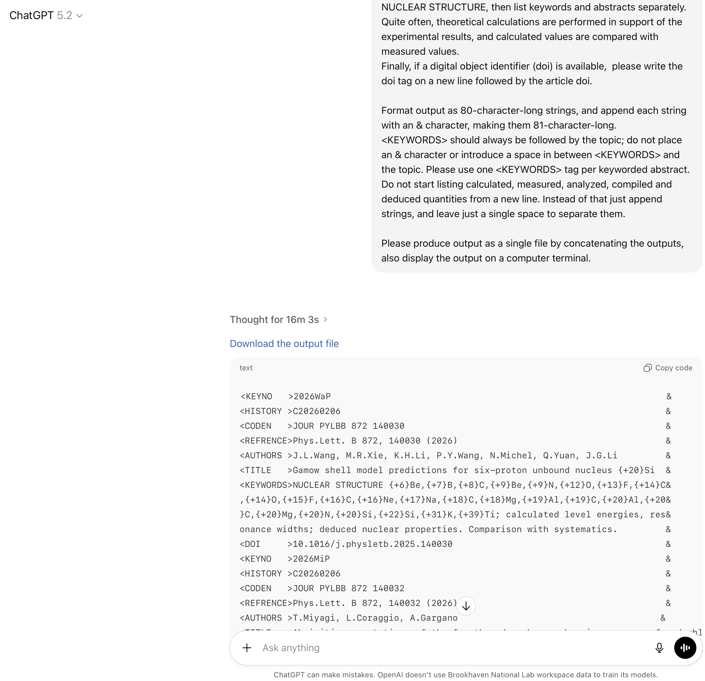
OpenAI Content Generation for the Nuclear Science References (NSR) Database: NNDC, Brookhaven National Laboratory
Low- and intermediate-energy nuclear bibliography database.
253,137 bibliographic records, including 205,183 keyworded abstracts as of February 6, 2026.
Essential for Evaluated Nuclear Structure Data File (ENSDF) and nuclear research.
Current workflow: articles are manually picked, BibTex/RIS files are used to produce NSR entries.
Ph.D. scientists read PDFs and write keyworded abstracts.
Future workflow: OpenAI analyzes nuclear physics journals and downloads PDFs.
Zipped PDFs are uploaded into OpenAI interface.
ChatGPT executes NSR prompt and generates NSR DB entries with keyworded abstracts.
Ph.D. scientist visual inspection
Later, journal Web articles could be processed directly, without PDFs.

