Slide 1
How to Run Inclusive Meetings
Nuclear Science Division Staff Meeting – DEI Talk
Tuesday, October 22, 2019

Slide 3
New inclusive meeting style!
New you!
New (fiscal) year!

Slide 4
Prepare for Inclusive Meetings
New (Fiscal) Year Resolution #1

Slide 5
Lay the groundwork for an inclusive experience.
Create and send out an agenda at least 24 hours in advance
Pro tip #1: Include or update the meeting event on the calendar with the agenda.
Pro tip #2: Attach a GoogleDoc to the calendar event with the agenda in it to encourage collaborative note taking.
Pro tip #3: Assign attendees to action items, as appropriate, so people can prepare and the roles are clear.
2. Budget enough time to cover the agenda items.
Pro tip: If there are certain agenda items that are only relevant to a subset of the meeting attendees, shift those agenda items to a follow-on meeting.
3. Start the meeting by laying the groundwork for an inclusive experience
Pro tip: Have everyone introduce themselves, including their gender pronouns.

Slide 6
Run/Participate in Inclusive Meetings
New (Fiscal) Year Resolution #2

Slide 7
Everyone has the power to make meetings inclusive.
Engage everyone in the discussion.
Inclusive action: Call on people who have not yet had a chance to share or contribute yet.
Don’t forget: on remote calls, check in on participants to ensure they follow the conversation and contribute.
Inclusive action: When providing feedback or disagreeing with someone, be aware of your tone and the words you use.
2. Mitigate interruptions and discussion domination.
Pro tip #1: Come equipped with phrases like “Wait a minute or hang on, I’d like to hear the rest of Loretta’s thought”
Pro tip #2: If someone is a repeat offender, talk to them after the meeting about the impact of interruptions/dominating on discussions.
3. Write down and assign action items before ending a meeting.
Pro tip: When assigning or confirming who is responsible for each action item, this is a great time to provide positive feedback for people’s contributions.

Slide 8
New (Fiscal) Year Resolutions for Inclusive Meetings
In FY20, let’s
Organize, lead, and participate in inclusive meetings by
Communicating discussion items (agenda)
Starting off each meeting with an overview of the agenda, goals of the meeting, and reminders of the rules of engagement
Be proactive about creating an inclusive environment by
Ensuring that everyone feels comfortable about sharing their thoughts
Mitigating interruptions and discussion dominating
Highlighting good ideas and inclusive actions

Slide 9
If you want to recognize a positive action in support of Inclusion, Diversity, Equity, and Accountability (like creating an inclusive meeting environment) pick up a Luminary Card in the NSD Office and fill out the form for the NSD newsletter!

Slide 10
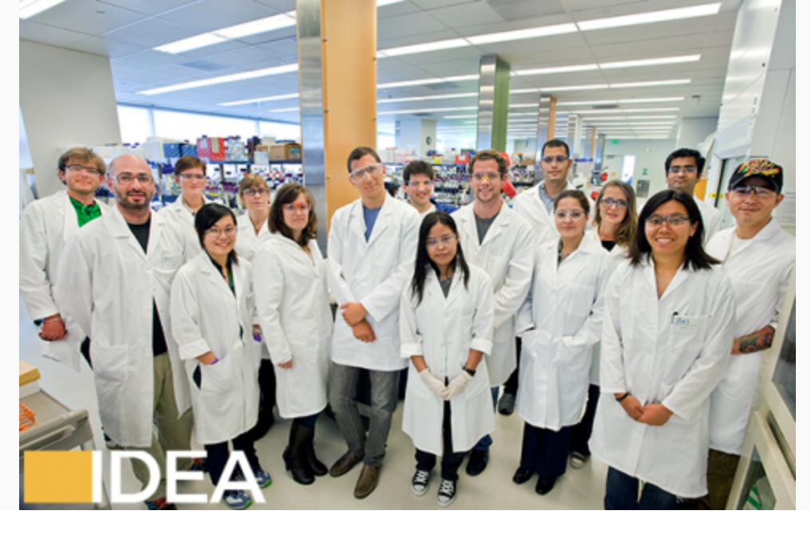
Upcoming IDEAS Seminar:
How to Build a Team of Inclusive Leaders
Date: Thursday, Oct. 24
Time: 12pm
Location: 50A-5132 and on Zoom
See Elements announcement from Mon. Oct. 21 for more info

