Slide 1
COR Resins from Polyspectra for Ultra tough Cryo and Rad compatible resin printed parts
S. Krave
24 July 2025

Slide 2
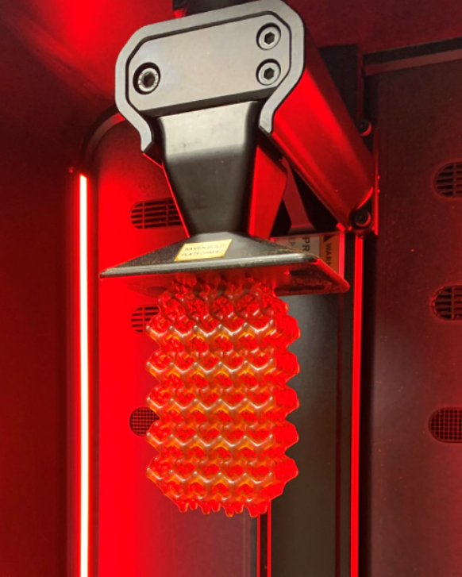
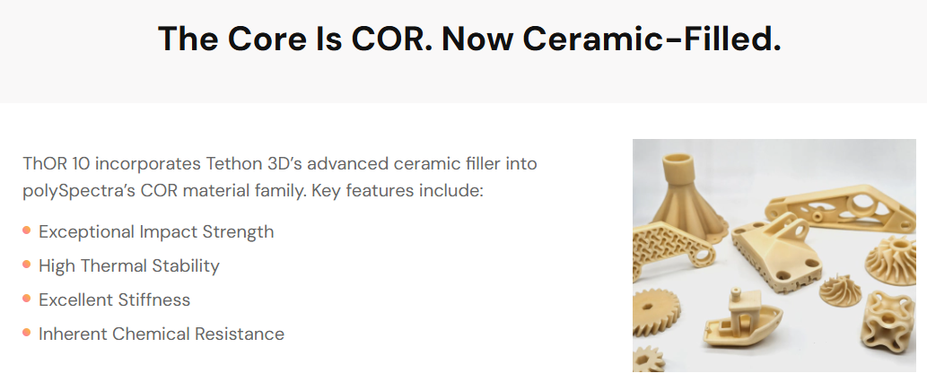
COR Resin from Polyspectra
COR resins are a cyclic olefin resin system that has been sensitized to UV light for 3d printing applications
  Seem Familiar???
  pDCPD based
    Similar chemistry as CTD 701 and TELENE

Slide 3

Plans
Honestly I’m not entirely sure what to do with it, but it checks a ton of boxes.
  Use to replace PEEK/ULTEM/G-10 magnet former parts
  Fixturing
  Covers
  Connectors
  Etc
I will order a few sample pieces (a few tens of $) for cryogenic CTE, tensile and flexural tests in both filled and unfilled versions
There are Probably a couple of good SBIR topics here if anyone has some ideas.

Slide 4
Potential off label uses
Probably a lot I will not list there here but think about it.

Slide 5
References
https://polyspectra.com/
https://en.wikipedia.org/wiki/Polydicyclopentadiene
https://www.additivemanufacturing.media/products/glass-filled-composite-photopolymer-for-industrial-am
Redacted report from SBIR (in files)

