Slide 1
SVT Services Status and Next Steps
Nick Payne
npayne@lbl.gov
7/22/2025
EIC Weekly Meeting

Slide 2
Tasks Completed and In Progress
SVT Discs
  Air cooling requirements ✓
  Power requirements ✓
  Air service design ⌛
  Electrical service design ⌛
Barrel Detectors
  Air/water cooling requirements ⌛
  Power requirements ✓
  Air service design □
  Electrical service design □
PST/Integration
  Air exhaust design □
  Air/Electrical Patch Panel □
  Disc Supports ⌛
Administrative
  CAD Model synchronization ⌛
Key:
✓ Completed
⌛ In Progress
□ Not Started

Slide 3
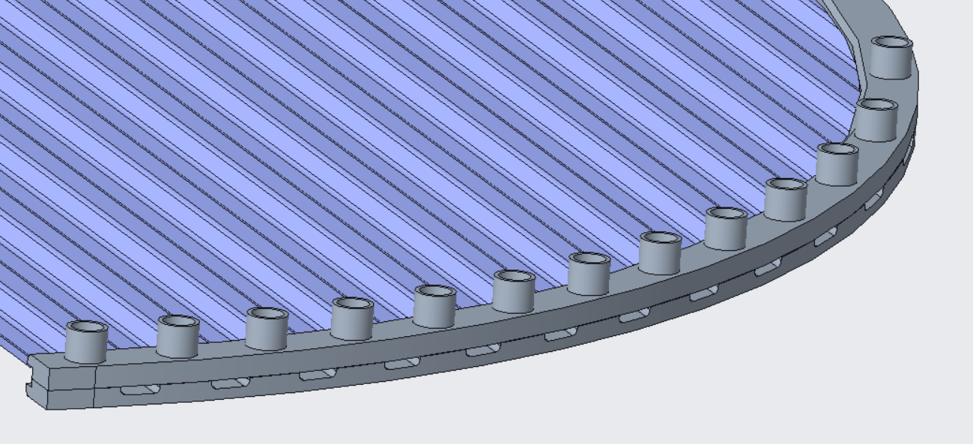

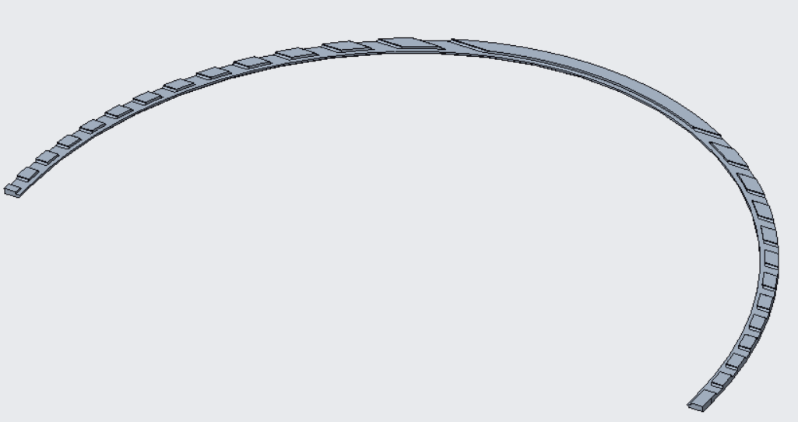
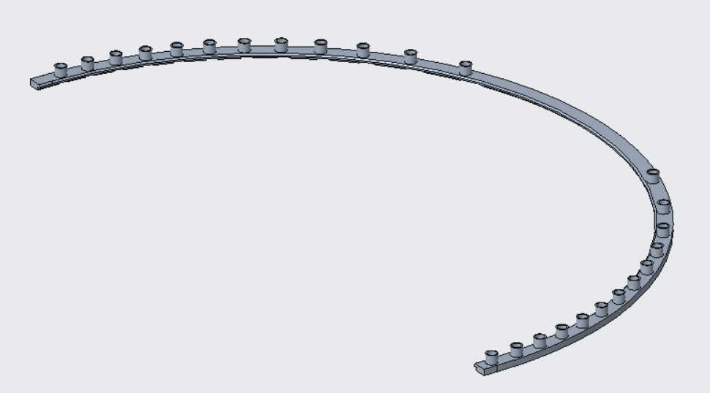
Rim Assembly Design Details
U-turn features for first 4 channels.
Front rim contains nozzles.
Back rim contains exhaust channels.

Slide 4
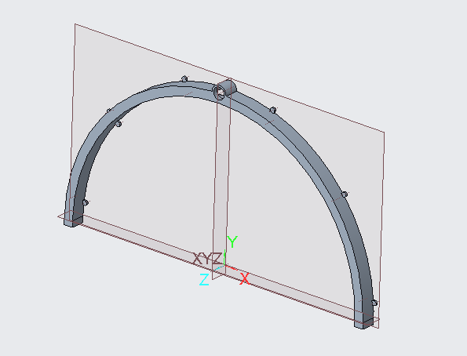


Plenum Design

Slide 5
General Sequence of Tasks
Disc assembly air service design (Hose quick connects, plenums, hose supports, junctions)
Disc mounting (hardware selection, mounting points, tool access checks)
Disc assembly electrical service design (FPCs, wire bundles, wire clips)
Barrel detectors air/water service design
Air exhaust (needs to be studied further)
Barrel electrical service design (wire bundles, wire clips)
PST patch panel service connection

