Slide 1

U.S. Higgs Factory Coordination Consortium for Accelerator
Magnet Systems Proposals
July 30, 2025

Slide 2
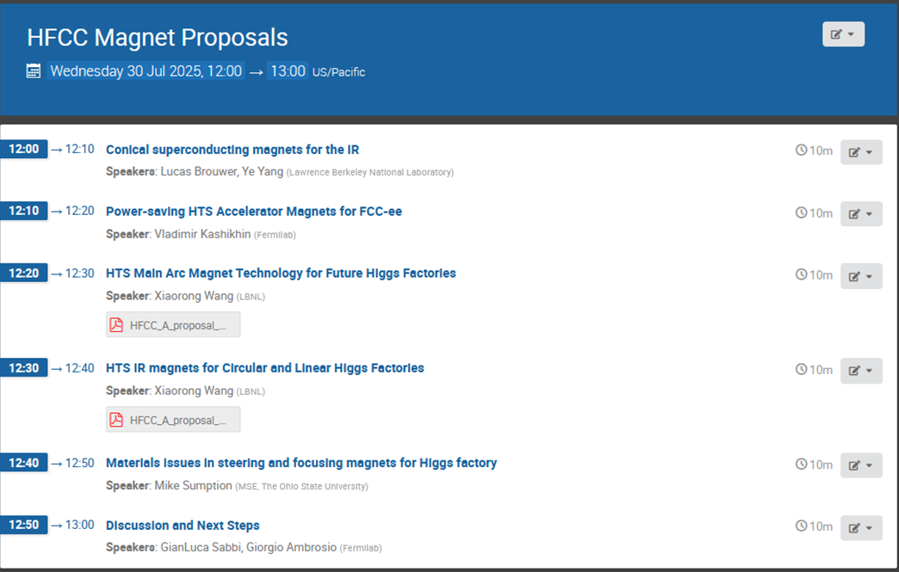
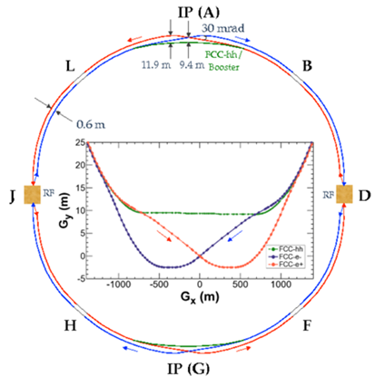
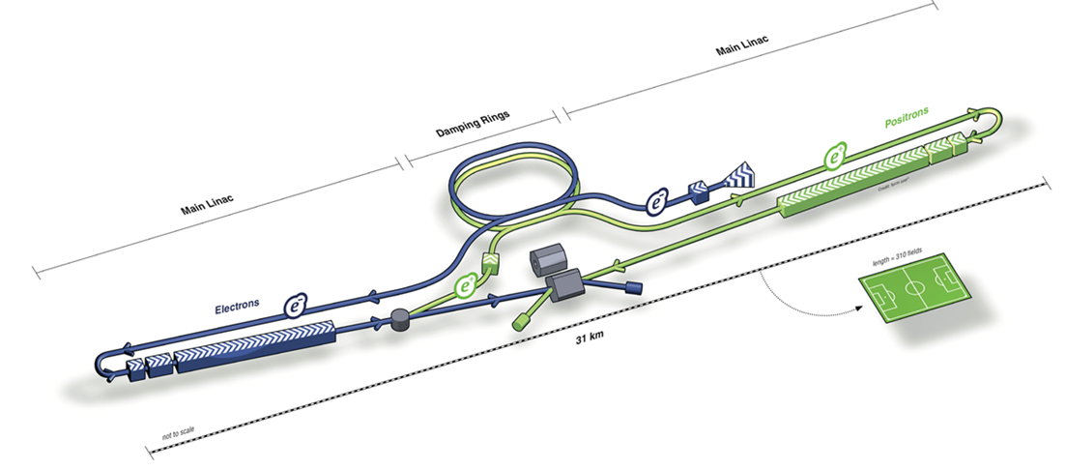
Meeting Agenda

Slide 3
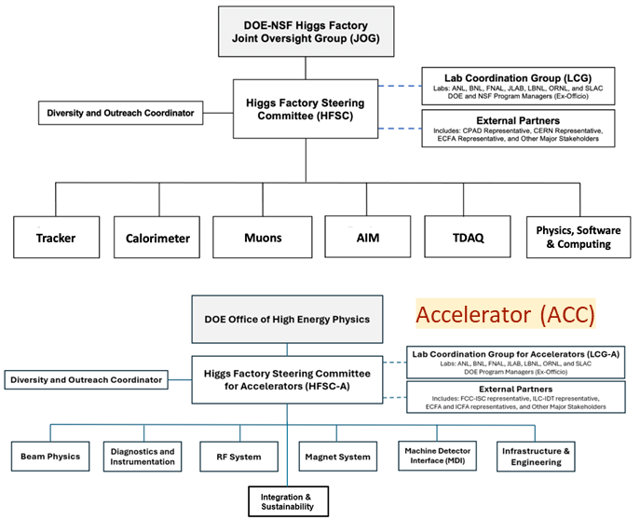
US Higgs Factory Coordination Consortium
Created by DOE and NSF to provide strategic direction and leadership for the U.S. community to engage, shape, and thereby advance the development of the PED and Accelerator program for a potential future Higgs factory; and to ensure cooperation with our partners in the international program.
Led by Higgs Factory Steering Group (HFSC-PED & HFSC-ACC)
Accelerator (ACC)

Slide 4
Steering Committee Guidance on R&D Plans
Select a set of R&D topics that will contribute to the Higgs Factory designs, augment core capabilities in the US and potentially lead to a significant role in a future construction project
Encourage the development of proposals from US participants for collaboration on the FCC-ee, LCF, or ILC within the L2 subject area
  Based on US expertise, capabilities and historical achievements
  Think about interplay with other L2s and PED and where joint projects can benefit both
  Work with project management to ensure our input is relevant and desired
  Contribute to FCC Feasibility Study and ILC Cost update
Start to develop a list of possible tasks with rough funding levels

Slide 5
Current Status
Established POCs with US magnet programs to help us reach out to the community
  Labs/Universities: BNL, FNAL, LBNL, TAMU, OSU, PPPL, FRIB/MSU, JLAB, ANL, ORNL, SLAC
  Projects/Collaborations: MDP, HL-LHC AUP, USLUA, EIC, MC
Established magnet POCs with FCC-ee and LC projects
Solicited proposals in April with a deadline of June 13
  No established budget yet: goal was to support discussions with DOE on R&D plans and funding levels
Recent information is that there might be some end of year funding available in FY25
Committee chairs requested that each L2 ranks their proposals based on the primary criteria:
  Relevance to a future HF
  Benefit to the US program
  Interest from the HF projects
Several proposals are at the boundary between L2s. Today we review proposals that were formally submitted under magnets, but we plan to interact with other L2s (e.g. beam physics, MDI and sustainability) to help establish consistent processes and uniform evaluations
Participated in similar meeting to review MDI proposals on 7/15

Slide 6
Thank you

