Slide 1

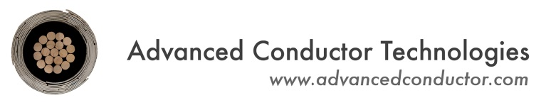



Development of high-field dipole magnets using the latest generation of CORC® cables and wires
Danko van der Laan
Advanced Conductor Technologies & University of Colorado, Boulder, Colorado, USA
Sven Dönges Kyle Radcliff & Daniel Kwiatkowski
Advanced Conductor Technologies, Boulder, Colorado, USA
Dima Abraimov
Applied Superconductivity Center, National High Magnetic Field Laboratory, Tallahassee, Florida, U.S.A.
Xiaorong Wang, Yufan Yan, Lukas Brouwer, Hugh Higley & Soren Prestemon
Lawrence Berkeley National Laboratory, Berkeley, California, U.S.A.
Vadim Kashikhin & Vito Lombardo
Fermi National Accelerator Laboratory, Batavia, Illinois, U.S.A.
Zack Johnson
Type One Energy Group, Woburn, Massachusetts, U.S.A.
US-MDP 2025, July 30th, 2025

Slide 2
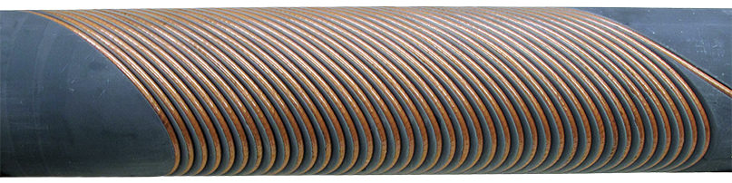
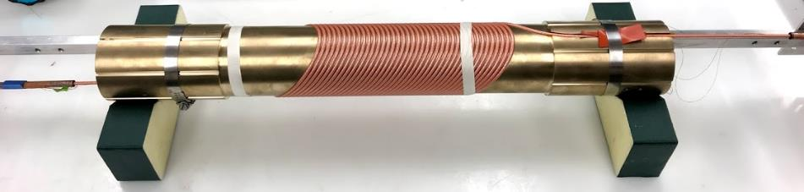
Canted-cosine-theta dipole magnet development based on CORC® wires
Development of low-inductance 20 T dipole CCT magnet by
Developing and demonstrating the CORC®-based CCT magnet technology
Improve the in-field and bending performance of CORC® wires
2017: Demonstration of 1.2 T (CCT-C1)
2-Layer coil, 40 turns per layer
Low-J_{e}, 16-tape CORC® wire
Generated 1.2 T at 4.5 kA
2020: Demonstration of 2.9 T (CCT-C2)
4-Layer coil, 40 turns per layer
30 mm bend radius
Medium-J_{e}, 30-tape CORC® wire
Generated 2.9 T at 6.5 kA
CORC® CCT-C1
CORC® CCT-C2
A 1.2-T canted cos θ dipole magnet using high-temperature superconducting CORC® wires, X. Wang, et al., Supercond. Sci. Technol. 32, 075002 (2019)
Development and performance of a 2.9 Tesla dipole magnet using high-temperature superconducting CORC® wires, X. Wang, et al., Supercond. Sci. Technol. 34, 015012 (2021)
2

Slide 3
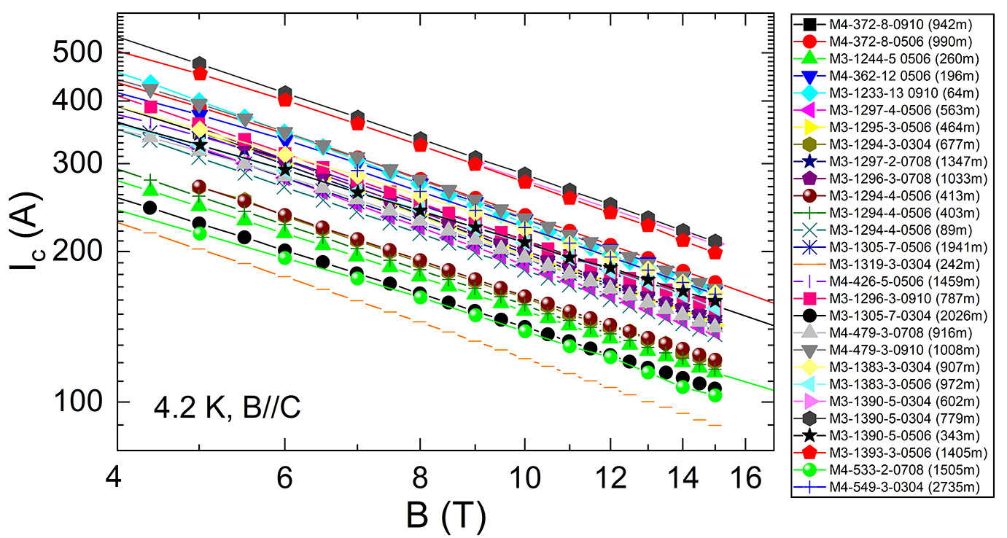
Development for magnet CCT-C3 with 5 T dipole field
How to reach 5 T in CCT-C3?
Magnet containing 6 layers with 40 turns each, requiring 145 meters of CORC® wire
Maintaining the same 30 mm bending radius at poles as CCT-C2
Develop high-J_{e} CORC® wire from 30 tapes using SuperPower’s ”HM” formulation
Performance of SuperPower SCS2030-AP tape 2016 - 2020
Performance of SuperPower SCS2030-HM tape 2021 - 2022
3

Slide 4
Improvement of CORC® wire bending flexibility
Improve bending flexibility of standard 30-tape CORC® wire
Reduce bending degradation for 30 mm bending radius from 20 – 30 % as seen in CCT-C2
Allow future CCT magnets to be based on 20 mm bending radius
CCT-C2 (AP based) CORC® wire
70 – 80 % I_{c} retention at 30 mm radius
CORC® wire (SuperPower HM)
91.8 % I_{c} retention at 25 mm radius
80.3 % I_{c} retention at 17.5 mm radius
CORC® wire (Shanghai Superconductor)
~100 % I_{c} retention at 30 mm radius
97 % I_{c} retention at 20 mm radius
83.5 % I_{c} retention at 15 mm radius
Extensive optimization followed
Danko van der Laan, Jeremy Weiss, Kyle Radcliff and Dmytro Abraimov, Supercond. Sci. Technol. 37 115007 (2024)
4

Slide 5
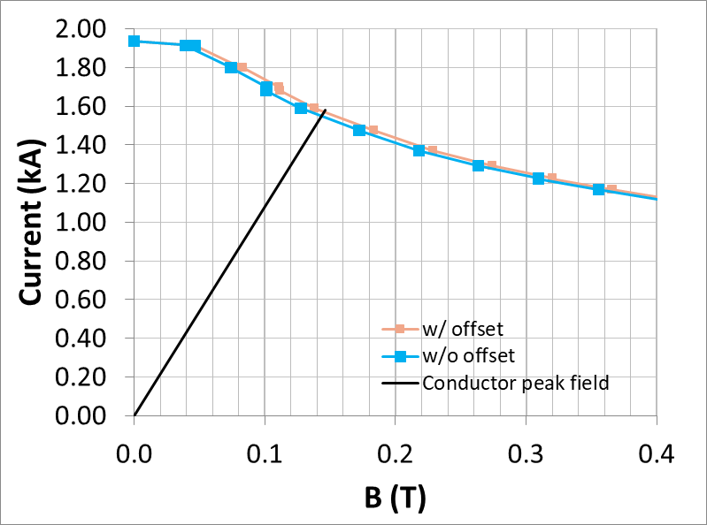
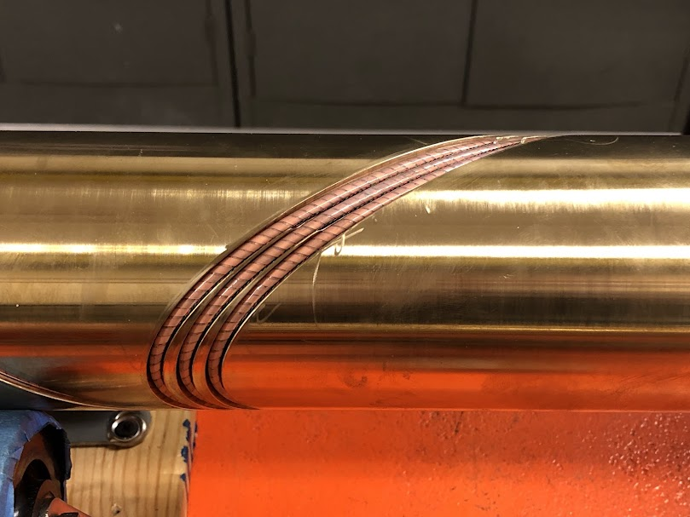
CORC® wire performance when wound into CCT structures
Optimized CORC® wire wound into CCT structure
CCT structure with 20 mm bending radius
Load line suggests close to 1.6 kA at a peak field of 145 mT
CORC® wire I_{c} in CCT structure was indeed 1,514 A
Close to 100 % I_{c} retention
5

Slide 6
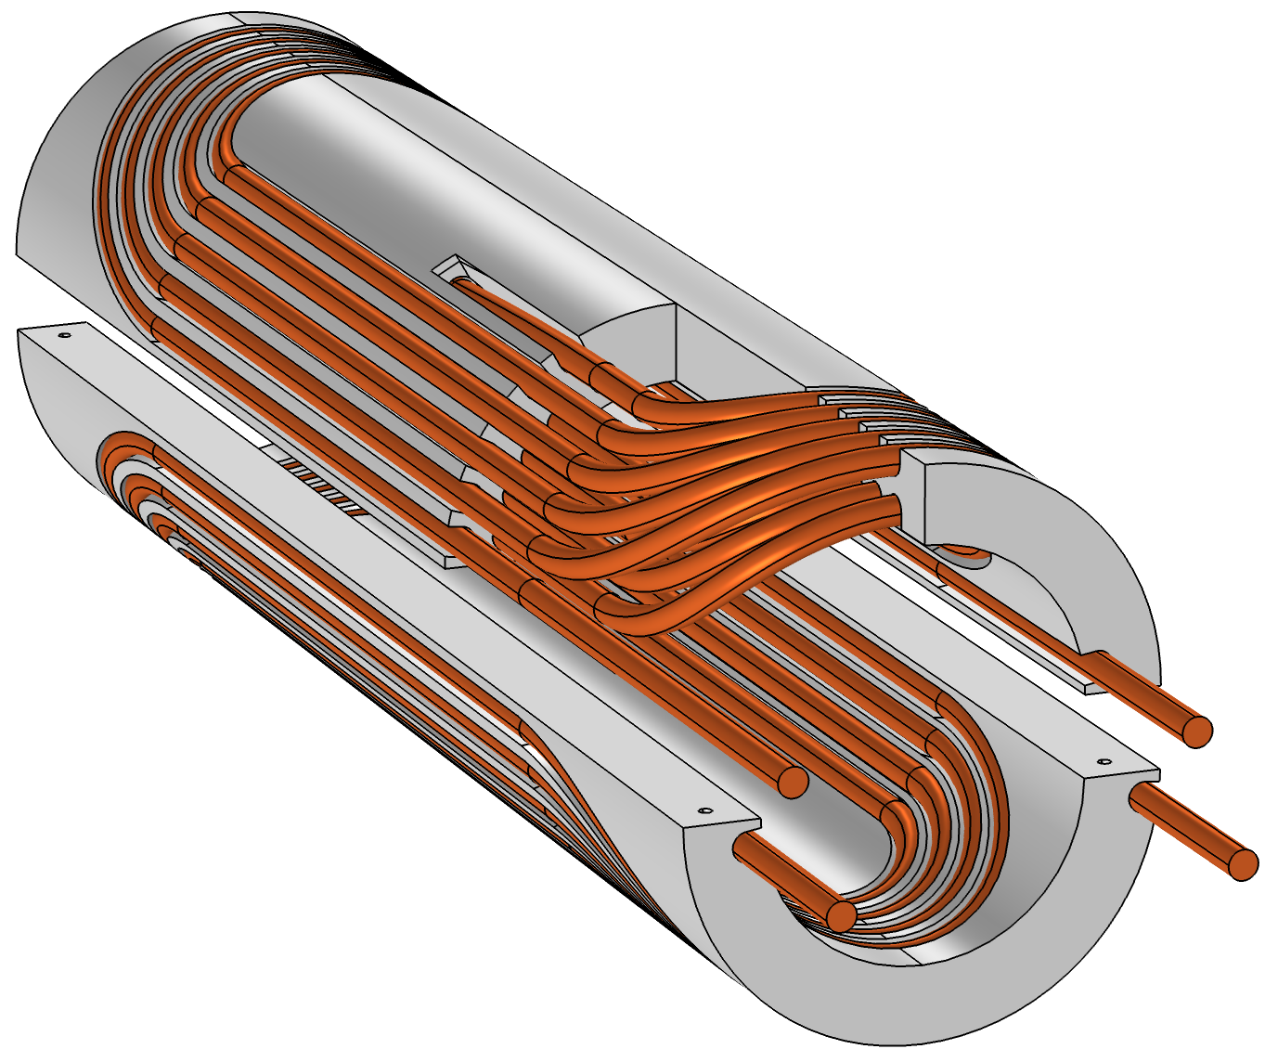
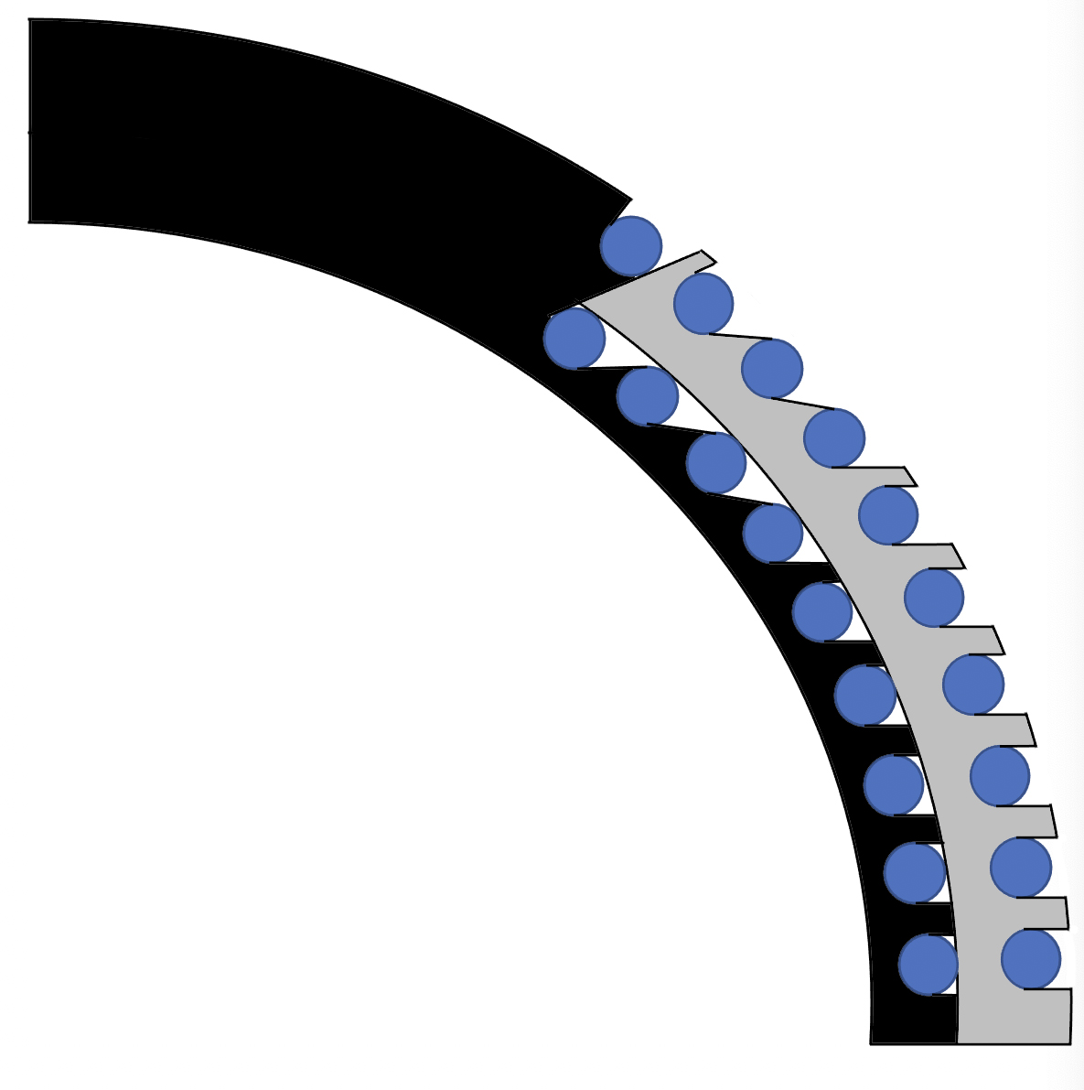
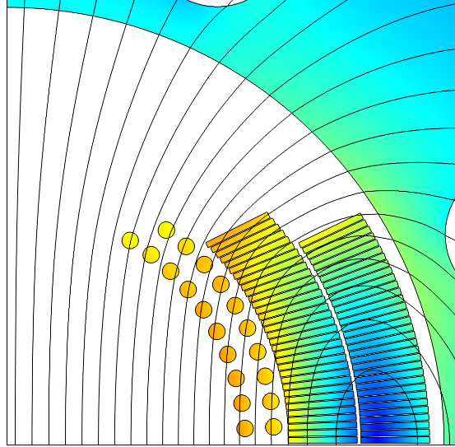

CORC®-COMB insert development
COMB magnet development goal
Develop a high-field insert COMB magnet based on CORC® wires that would ultimately deliver a 20 T dipole field within a 15 T LTS outsert. The goal would be achieved by developing several sub-scale coils to identify any problems with winding the CORC® wire into the COMB structure, followed by potential coil form optimization steps and winding of longer length CORC® wires into multi-layer COMB coils.
High-J_{e} CORC® wires that are now highly flexible allow for a more expedited development of COMB magnets
6

Slide 7
CORC® wire performance when wound into COMB structures
COMB structures apply compound bends to CORC® wires
Current designs based on 30 mm radius at poles
Effective radius is around 25 mm
Earlier CORC® wires showed degradation
Optimized CORC® wires
COMB structure with conventional groove
Groove with constant radius of curvature
Performance of latest generation of CORC® wires
Much higher bending flexibility no longer results in degradation
COMB structures are now optimized to have constant curvature
7

Slide 8
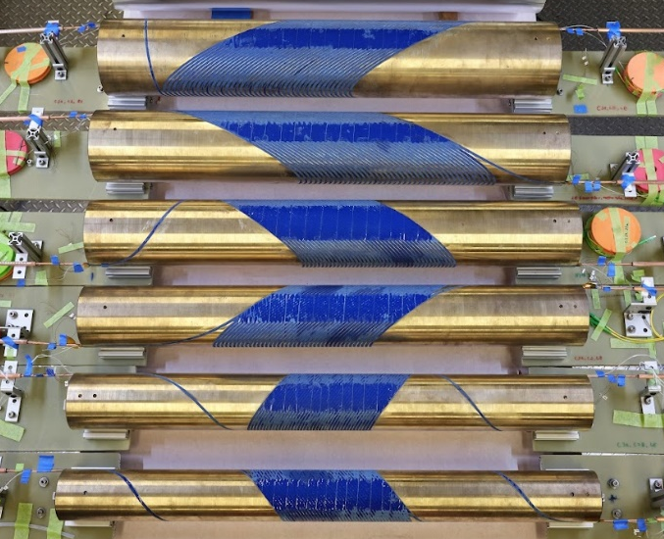
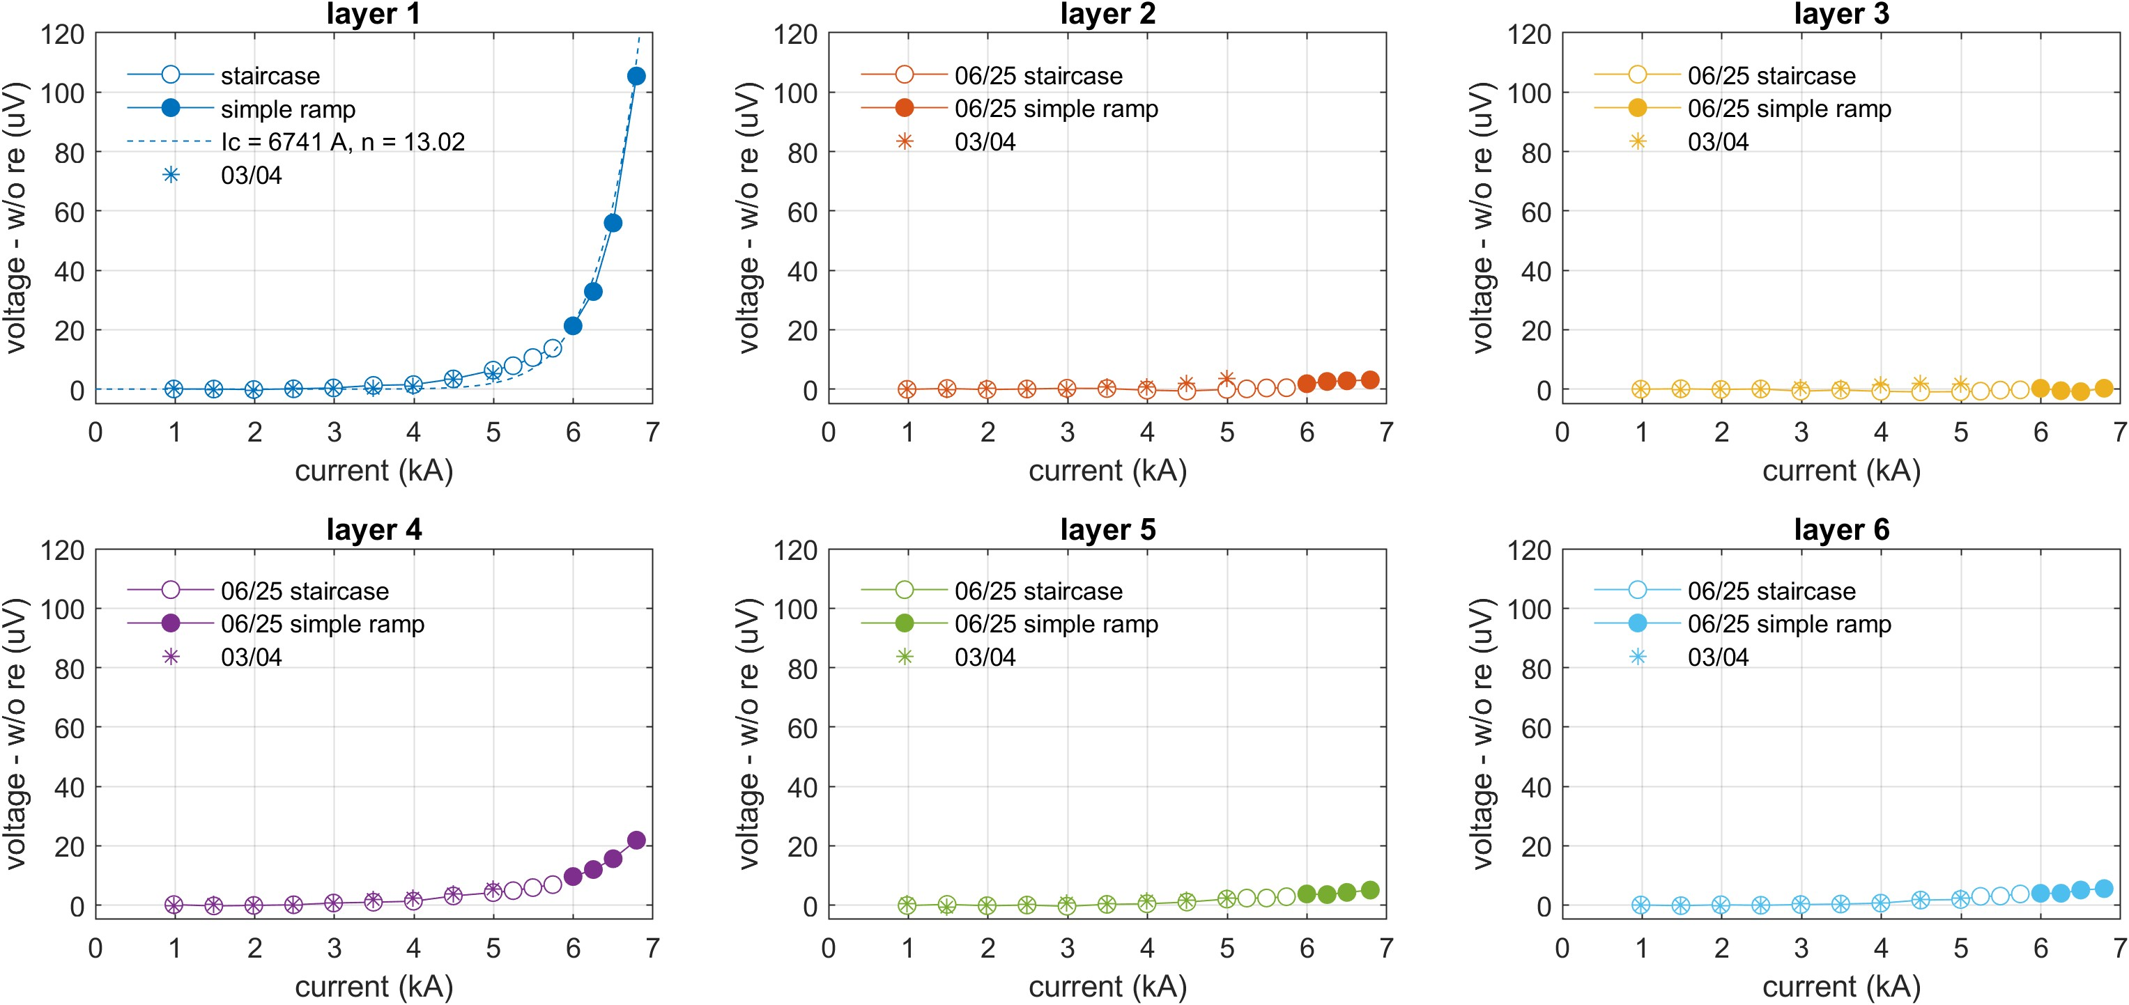
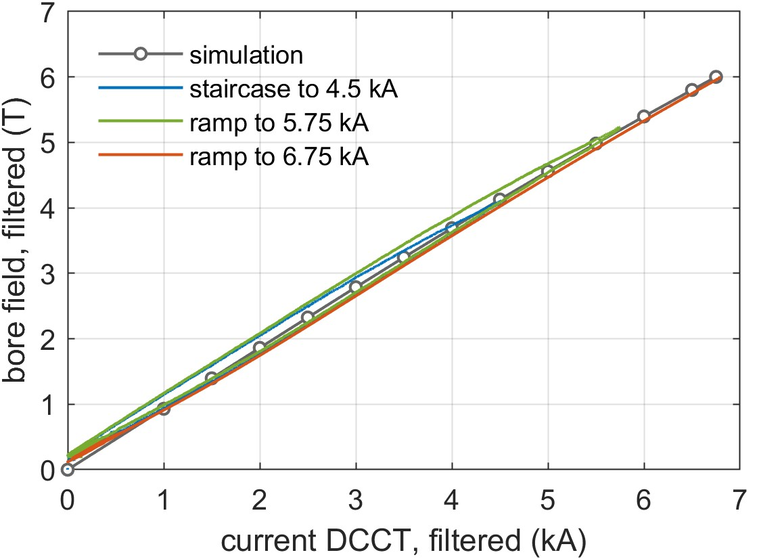
Initial results of dipole magnet CCT-C3: 6 T!
2025: Magnet CCT-C3 exceeded its target of 5 T dipole field!
Dipole field of 6 T achieved at 6.75 kA
Much lower CORC® wire bending degradation than 30 % as assumed in the original magnet design
Inner layer (Layer 1) transition started and reached about 0.1 μV/cm but may have room to reach a dipole field of 6.2 – 6.3 T!
6.0 T
8

Slide 9
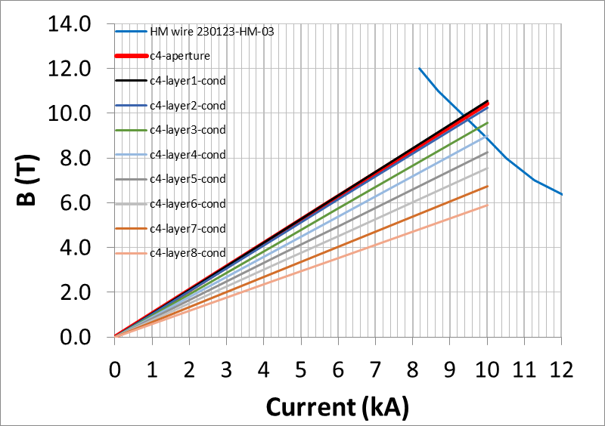
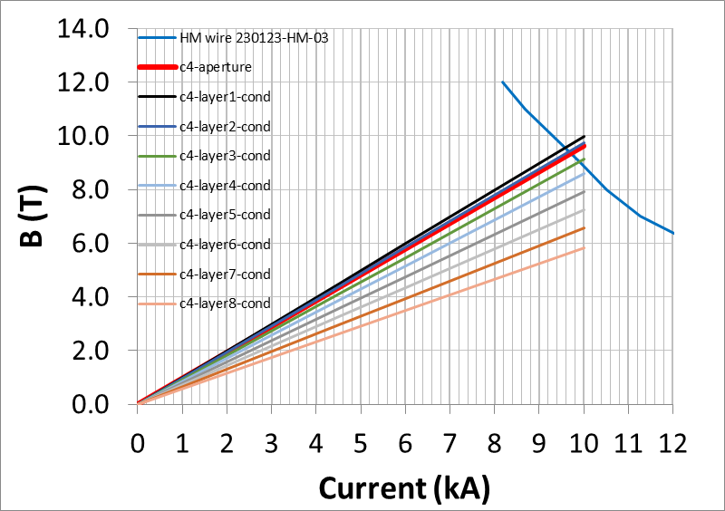
How to get to 10 T dipole field in CCT-C4 (in less than 2 years)?
Two initial designs from Xiaorong
Both based on 8 layers
Both based on 65 mm aperture
Both having an OD of 205 mm
Both could reach 10 T when using iron
One designed around 20 mm bending radius
The other designed around a 30 mm bending radius
Option 2
30 mm bending radius
9.2 T dipole at 9.6 kA
9.6 T peak conductor field
TF 0.964 T/kA
Higher bending margin
Lower I_{c} requirements
Option 1
20 mm bending radius
9.8 T dipole at 9.4 kA
9.9 T peak conductor field
TF 1.045 T/kA
Lower bending margin
Higher I_{c} requirements
9

Slide 10
Performance of 30-tape CORC® wires at 4.2 K
SuperPower HM tape
Shanghai Superconductor tape
SuperOx tape
CORC® wire (SuperPower HM tapes)
Tested at 31.5 mm radius hairpin
New record J_{e}(20 T) of 530 A/mm²
87 % of tape performance at 12 T
CORC® wire (SST tapes)
Tested at 20 mm radius hairpin
J_{e}(20 T) of 465 A/mm²
90 % of tape performance at 11 T
CORC® wire (SuperOx tapes)
Tested at 31.5 mm radius hairpin
J_{e}(20 T) of 388 A/mm²
79.6 % of tape performance at 11 T
Danko van der Laan, Jeremy Weiss, Kyle Radcliff and Dmytro Abraimov, Supercond. Sci. Technol. 37 115007 (2024)
10

Slide 11
What conductor can be used for 10 T CCT-C4 Option 2?
SuperPower HM tape
Shanghai Superconductor tape
CORC® wire (SuperPower HM tapes)
30-tape CORC® wire requires 20-30 % improvement of I_{c}
CORC® wire (SST tapes)
30-tape CORC® wire requires 100 % improvement of I_{c}
How much tape I_{c} improvement can we expect?
Would a 42-tape CORC® wire be possible?
Would a 42-tape CORC® wire be possible?
11

Slide 12
Potential development of high tape count CORC® wires
Conductor grading
Inner layer may need to contain 42 tapes (4.2 mm thick CORC® wire)
Outer layers based on standard 30-tape CORC® wire
Bending flexibility 42-tape CORC® wire
30-tape CORC® wire maintains 97 % of I_{c} at 20 mm bend radius
Could we engineer a 42-tape CORC® wire with > 95 % I_{c} retention at 30 mm bend radius? (I’m confident we can)
30-tape CORC® wire wound from SST tape
12

Slide 13
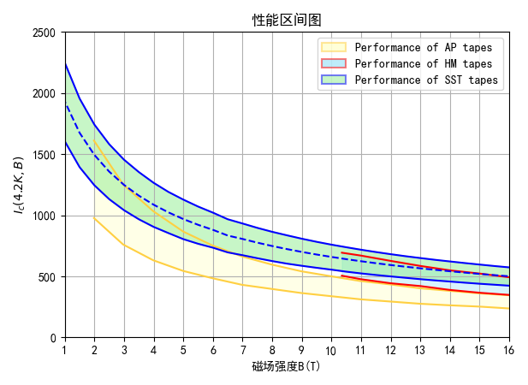
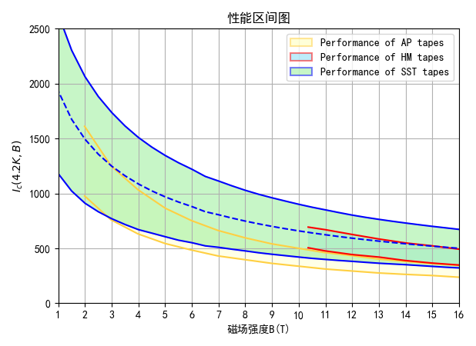
Latest tapes from Shanghai Superconductor
Exploring high-performance SST tapes
Higher layer quality in combination with a thicker REBCO layer allows the SST tape performance to match SuperPower HM tape performance
Winding trials of high-performance SST tapes are expected in September-October
95 % of mass production at SST
Total of 1493 samples
60 % of mass production at SST
13

Slide 14
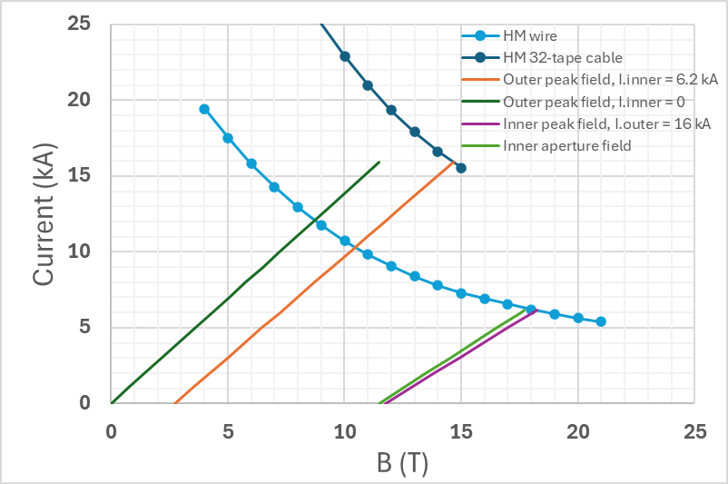
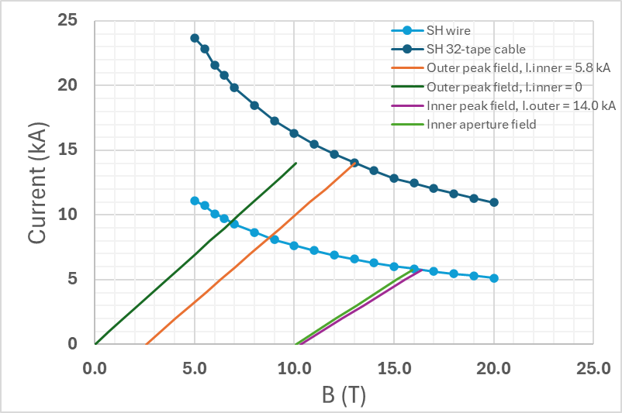
Stand-alone CORC® CCT magnets approaching 20 T
Combining a CORC® CCT outsert with a CORC® CCT insert
CORC® CCT outsert aperture 155 mm, 8 layers of 32-tape CORC® cable with 45 mm bend radius
CORC® CCT insert aperture 50 mm, 8 layers of standard 30-tape CORC® wire with 20 mm bend radius
SuperPower HM
CORC® cable and wire based on SuperPower HM tape
Insert: dipole field 6.2 T at 6.2 kA
Outsert: dipole field 11.5 T at 15.9 kA
Combined field of 17.7 T
CORC® cable and wire based on SST tape
Insert: dipole field 5.8 T at 5.7 kA
Outsert: dipole field 10.1 T at 13.3 kA
Combined field of 15.9 T
Possible more than 17 T with their high-J_{c} tape
Shanghai Superconductor

