Slide 1
MDP Materials FNAL Updates
S. Krave, C. English
7 August 2025

Slide 2
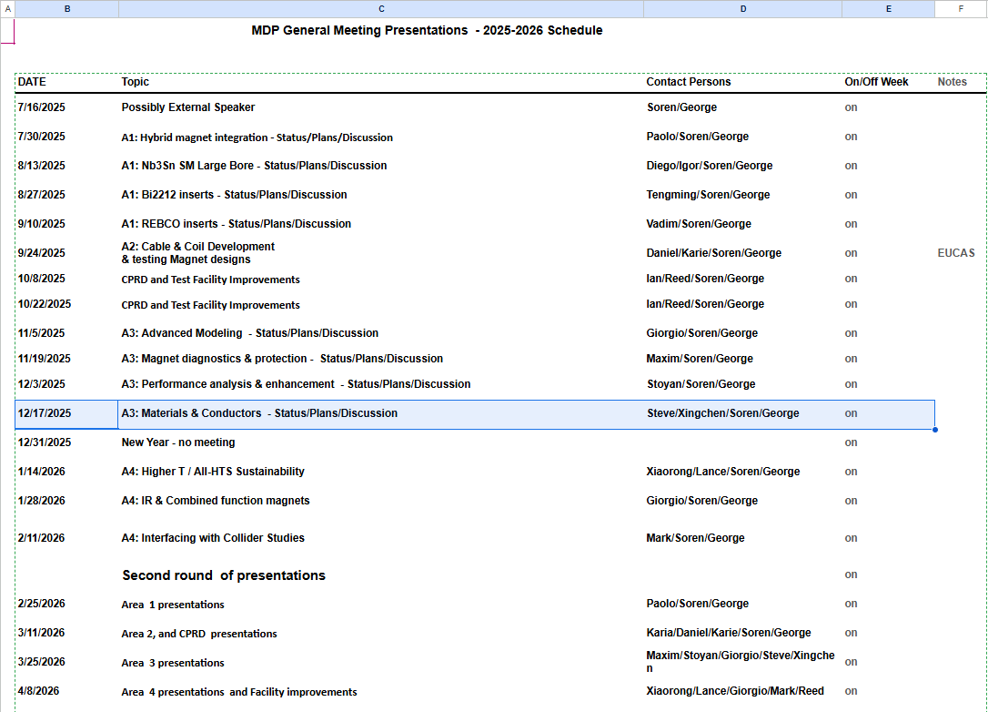
Update Presentation at MDP Meeting
December 17: It’s not that far away

Slide 3
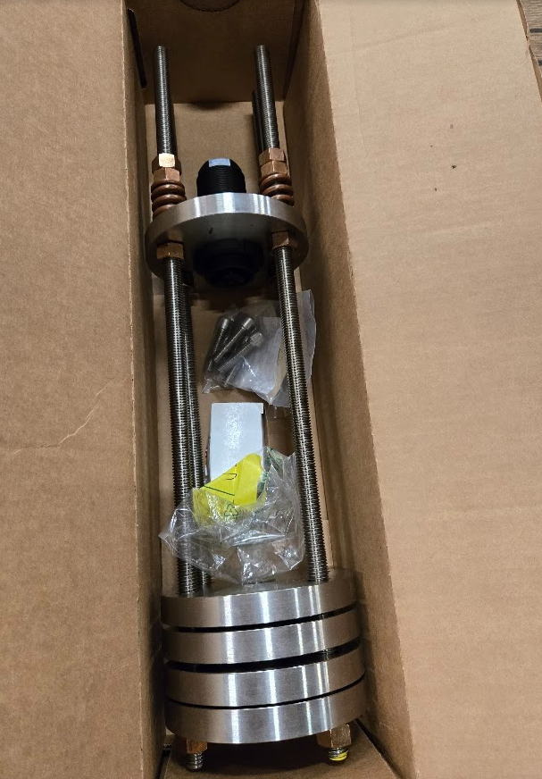
Baby multifunction load probe
Parts are arriving
Waiting on pushrod
Loading to 6000 lbs in LN2

Slide 4
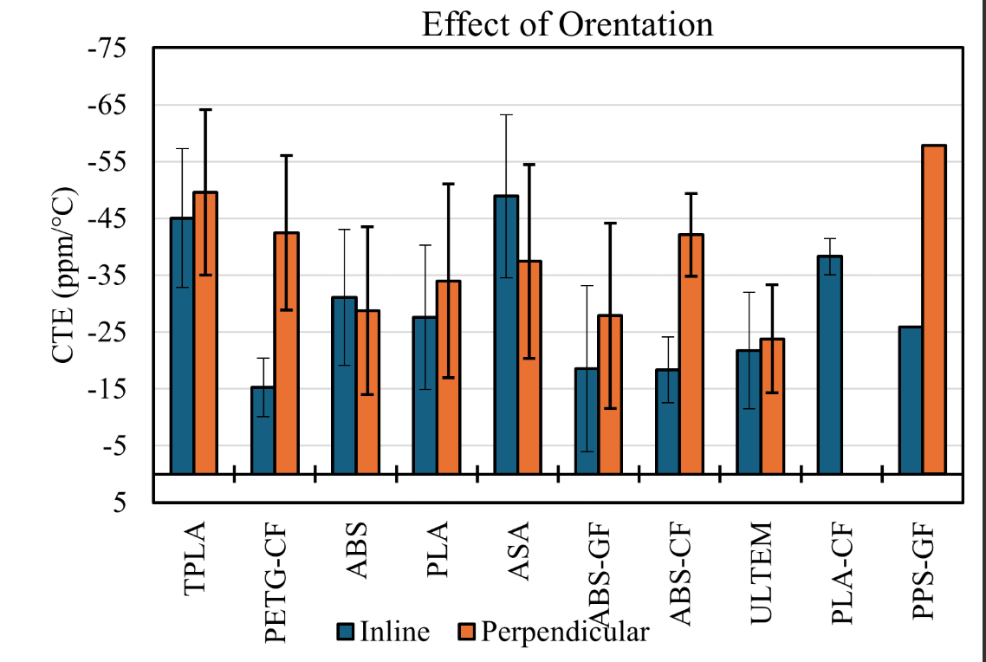
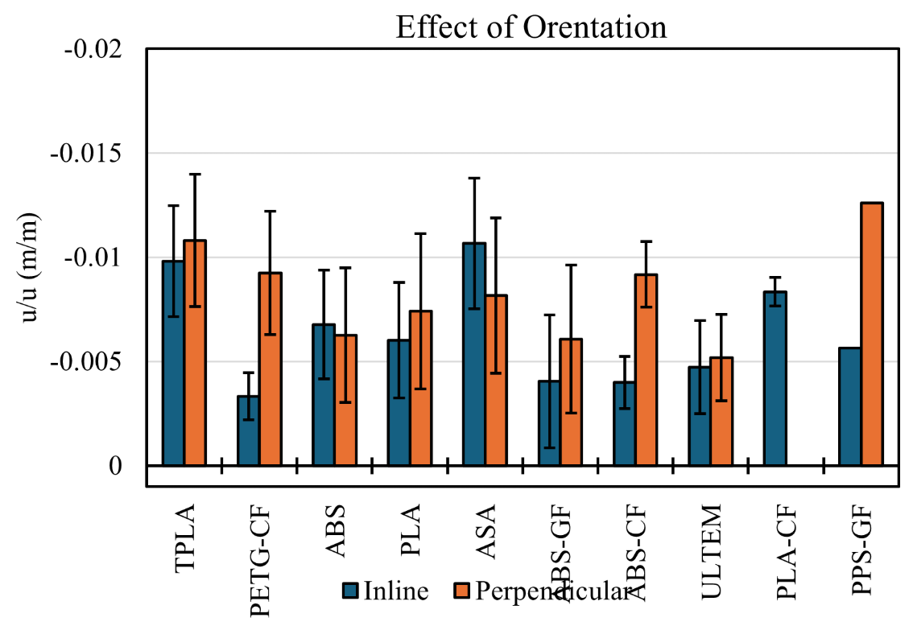
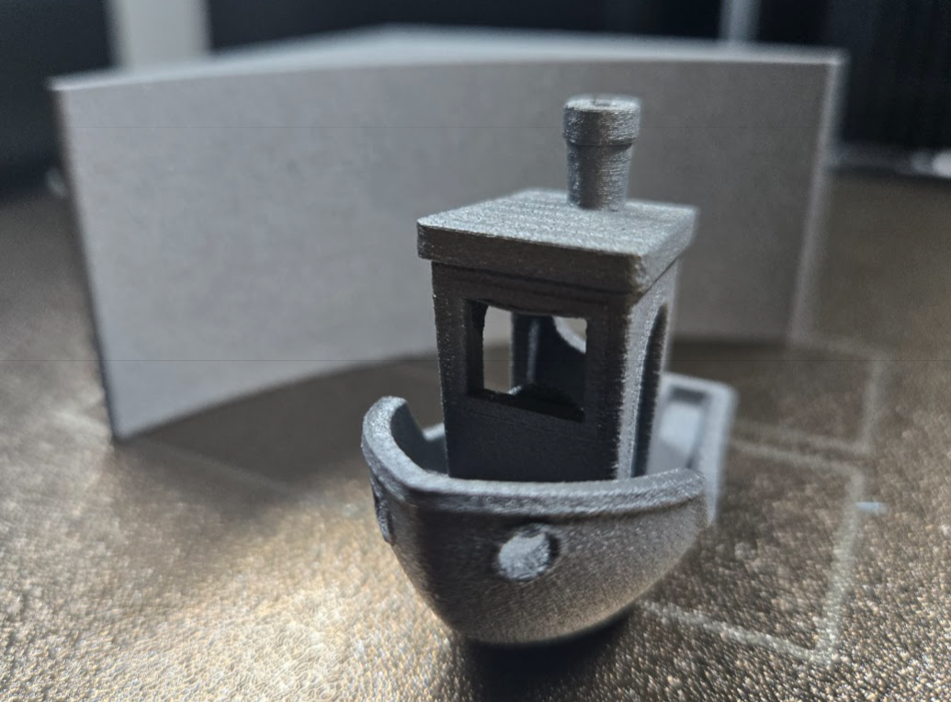
Updates on 3d printed materials
Added Polymaker PPS-GF
Soon to test bending strength at RT and 77K and refine CTE Measurements.
Aluminum
Stainless Steel

